Slide 1
User Interface

Slide 2
User interface
The app’s user interface is everything that the user can see and interact with
Android provides a variety of pre-built UI components, such as structured layout objects and UI controls that allow you to build your apps GUI
Android also provides other UI modules for special interfaces such as dialogues, notifications, and menus
https://developer.android.com/guide/topics/ui/declaring-layout.html

Slide 3
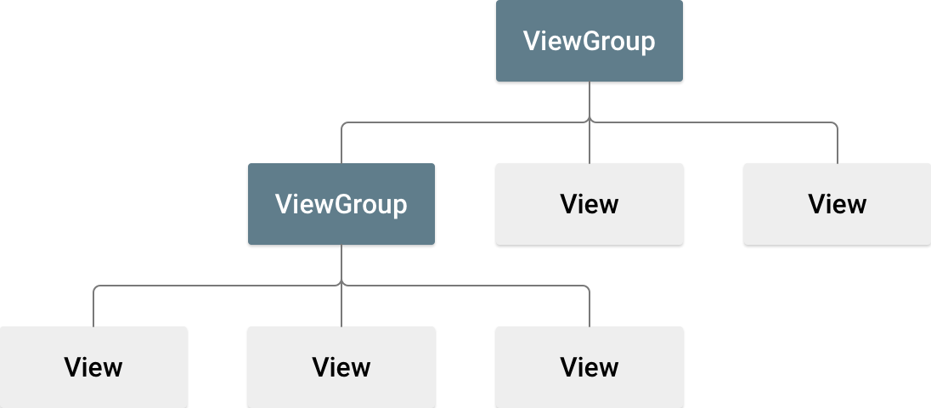
Layouts
A layout defines the structure for a user interface in your app
All elements in the layout are built using a hierarchy of View and ViewGroup objects
A View usually draws something the user can view and interact with
A ViewGroup is an invisible container that defines the layout structure for View and other ViewGroup objects
https://developer.android.com/guide/topics/ui/declaring-layout.html

Slide 4
Declaring a layout
You can declare a layout in one of two ways:
1) Declare UI elements in XML – Android provides a straightforward XML vocabulary that corresponds to view classes and subclasses, such as those for widgets and layouts. Can also use Android Studio’s Layout Editor to build XML layout using a drag and drop interface
2) instantiate layout elements at runtime – your app can create view and viewgroup objects and manipulate their properties programmatically
Declaring UI in XML allows you to isolate the layout from the code controlling its behavior, making your app design more modular, and easily providing different layouts for different screen sizes and orientations
You can also declare the default layout using XML and then modify it programmatically at runtime.
https://developer.android.com/guide/topics/ui/declaring-layout.html

Slide 5
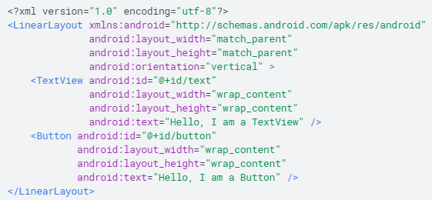
Writing the XML
Quickly design UI layouts and screen elements they contain with a series of nested elements
Each layout file must contain exactly one root element which must be a View or ViewGroup object. Additional layout objects and widgets can be added to the root as children to build a view hierarchy that defines your layout.
https://developer.android.com/guide/topics/ui/declaring-layout.html

Slide 6

Loading the XML resource
When the app is compiled, each XML layout file is compiled into a View resource
Load the View from onCreate(), by passing setContentView() a reference to your layout resource in the form R.layout.layout_file_name
https://developer.android.com/guide/topics/ui/declaring-layout.html

Slide 7

XML Attributes
Every View and ViewGroup object supports their own variety of XML attributes, some are specific to a View object (TextView supports textSize attribute, for example) and the attributes are inherited by any View objects that extend the class
Some attributes (such as id) are common to all View classes, because they are inherited from the root View class
ID: any View object may have an integer ID associated to it as a unique identifier. The id is assigned as a string in the layout file which is converted to an integer by the compiler.
Syntax for declaring ID inside XML - android:id=“@+id/my_button”
@ symbol indicates to the XML parser to expand the rest of the ID string and identify it as an ID resource
+ symbol indicates this is a new resource name that must be created and added to resources (in the R.java file)
Example: the simplest way to create a view and reference it from the app:
(java)
(xml)
https://developer.android.com/guide/topics/ui/declaring-layout.html

Slide 8
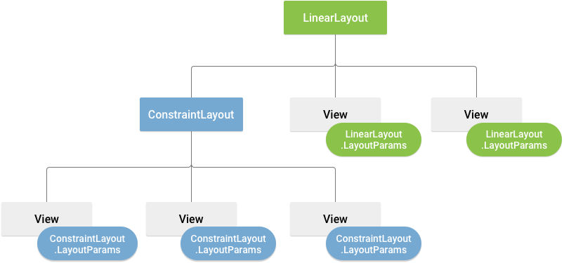
Layout parameters
XML layout attributes named layout_X (where X is a layout type) define layout parameters for the View that are appropriate for the ViewGroup in which it resides
Every ViewGroup class implements a nested class that extends ViewGroup.LayoutParams, this subclass contains property types defining the size and position for each child view, as appropriate for the ViewGroup
Each child element must define LayoutParams appropriate to the parent.
All view groups include a width and height, and each view is required to define them. Width and height are typically defined using either wrap_content or match_parent
Use relative measures such as density independent pixel units (dp)
Visualization of a view hierarchy with layout parameters associated with each view. The parent ViewGroup (LinearLayout) defines layout parameters for each child view, including the child ViewGroup (ConstraintLayout)
https://developer.android.com/guide/topics/ui/declaring-layout.html

Slide 9
Layout Position
Views are rectangles. The view location is hence specified according to the rectangle’s top left corner, specified in pixels.
getLeft() and getTop() return, in pixel units, the x and y coordinate of the View relative to its parents. For example if calling getLeft() on a View returns 20, we know that the View is 20 pixels to the right of the left edge of its direct parent.
getRight() and getBottom() are similar but they compute the width and height offset respectively, ie, getRight = getLeft() + getWidth()
https://developer.android.com/guide/topics/ui/declaring-layout.html

Slide 10
Size, padding, and margins
View size is expressed with a width and a height. A view actually possess two pairs of width and height values:
1) measured width and height – these dimensions define how big a View wants to be within its parent, can be obtained with getMeasuredWidth(), getMeasuredHeight()
2) drawing width and height – these dimensions define the actual size of the View on screen at time of drawing, and may be different from measured values. Obtain using getWidth() and getHeight()
https://stackoverflow.com/questions/8657540/what-is-the-difference-between-getwidth-height-and-getmeasuredwidth-height-i
Padding is expressed in pixels for the left, top, right, and bottom parts of a view, and is used to offset the content of a View by a certain number of pixels.
https://developer.android.com/guide/topics/ui/declaring-layout.html

Slide 11
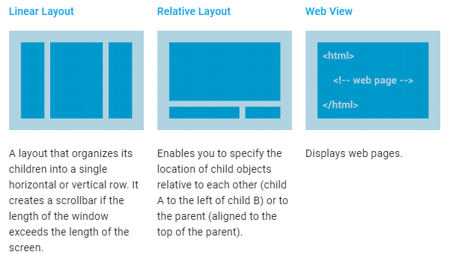
Common layouts
Each subclass of the ViewGroup class provides a unique way to display the views you nest within it.
Some common examples:
LinearLayout
RelativeLayout
WebView
https://developer.android.com/guide/topics/ui/declaring-layout.html

Slide 12
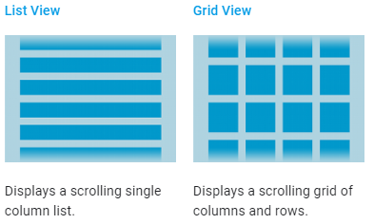
Building layouts with an adapter
What if the content for your layout is not determined at runtime? In this case, you can use a layout that subclasses AdapterView to populate the layout with views at runtime.
Subclasses of AdapterView use an Adapter to bind data to their layout.
Adapter behaves as a middleman between the data source and AdapterView layout – retrieving the from an array or database, and converting it into a view that can be added into the AdapterView layout
ArrayAdapter – creates a view for each array item by calling toString() on each item and placing contents in a TextView – customize by extending ArrayAdapter and overriding getView()
SimpleCursorAdapter – use this when your data comes from a cursor (SQL)
https://developer.android.com/guide/topics/ui/declaring-layout.html

Slide 13
https://developer.android.com/guide/topics/ui/declaring-layout.html

Slide 14
https://developer.android.com/guide/topics/ui/declaring-layout.html

