Slide 1
CS230 Developing Mobile Apps
Lecture 15

Slide 2
Overview
Firebase Authentication
Monetization
App store optimization
Android Dev summit 2019:
https://www.youtube.com/watch?v=5jJ-e278BFY&list=PLWz5rJ2EKKc_xXXubDti2eRnIKU0p7wHd

Slide 3
Firebase Authentication
Most apps need to know the identity of the user:
Save user data in the cloud
Provide same personalized experience across all user’s devices
Firebase Authentication provides:
Backend services
Easy to use SDKs
Ready-made UI libraries
Supports authentication using passwords, phone numbers, Google, Facebook, Twitter, and more
https://firebase.google.com/docs/auth/

Slide 4
Firebase Authentication key capabilities
Can use FirebaseUI as a complete solution, or use Firebase Authentication SDK to manually integrate one of several sign-in methods
FirebaseUI is the recommended way to add complete sign-in system to app
Handles UI flow for signing in users with email, phone #, facebook, google, etc.
Implements best practices for authentication on mobile devices
Maximizes sign-in and sign-up conversion for your app
Handles error-prone, security sensitive cases like account-recovery, account linking
Can easily be customized to fit your app’s visual style
Open source
https://firebase.google.com/docs/auth/

Slide 5
How does Firebase Authentication work?
To sign user into app, first get authentication credentials from user
Can be email/pwd, or an OAuth token from federated identity provider
Federated identity providers: facebook, google, twitter, etc.
Credentials passed to Firebase Authentication SDK
Firebase’s backend services verify credentials and return response
Following successful sign-in, you have access to user’s basic profile info
Can control user’s access to data stored in Firebase database
Authenticated users can read/write to Realtime Database and Cloud Storage by default
https://firebase.google.com/docs/auth/

Slide 6
Federated Identity and OAuth 2.0
Federated identity is a way to use an account from one website/device to create account/login to another site/device
Two main players in federated identity system:
1) Identity provider (you)
2) Service provider (Facebook, Google, Twitter, etc.)
OAuth 2.0 is a delegated authorization framework ideal for APIs
Enables apps to obtain limited access to user’s data, without giving password
OAuth is like a hotel key card, but for apps
Follow link below to read more about OAuth:
https://developer.okta.com/books/api-security/authn/federated/#authn-federated

Slide 7
Facebook login with Firebase Authentication
Can let users authenticate with Firebase using their Facebook account
Step 1: https://firebase.google.com/docs/auth/android/facebook-login
Integrate facebook login to your app
After a user signs in for the first time, a new account is created and linked to their credentials
This account is stored as part of Firebase project, and can be used to identify a user across every app in your project

Slide 8
Monetization $$$
Subscriptions – all the most profitable apps are subscription based ☹
Spotify, Netflix, Tinder, HBO, Hulu, Pandora Radio, etc.
In-app purchases – GAMES
Pokemon GO, Lineage, Clash Royale, Mobile Strike, etc.
Download for free and make basic purchases
Advertising – messaging/social media, GAMES
Video ads, banner ads, interstitial ads, native ads
Pay up-front to download

Slide 9
Google play billing library
Google Play Billing: a service that lets you sell digital content on Android
Product types:
One-time products: in-app product, single, non-recurring charge (additional levels, loot box, media, etc.)
Rewarded products: an in-app product requiring user to watch video ad. (Extra lives, in-game currency, etc.)
Subscriptions: in-app product requiring a recurring charge. (Online magazines, music streaming services, etc.)
https://developer.android.com/google/play/billing/billing_overview

Slide 10
Purchase tokens and order IDs
Google Play Billing tracks products/transactions with purchase tokens and order IDs
Purchase token: a string representing a buyer’s entitlement to a product, indicates a Google user has paid for a specific product
Order ID: string representing a financial transaction on Google Play. Included in a receipt emailed to buyer, used to manage refunds.
for one-time products and rewards, every purchase creates new token/ID
For subscriptions, initial purchases creates token/ID, and a new order ID is issued at every recurring charge
https://developer.android.com/google/play/billing/billing_overview

Slide 11
In-app product configuration
Within Google play console:
Title – short description of in-app product (“loot box”)
Description – longer description of product
Product ID – unique, human readable ID for your product
Price/Default price – amount user will pay for the product
For subscriptions, can also set Billing period, free trial period, introductory price, grace period, account hold
https://developer.android.com/google/play/billing/billing_overview

Slide 12
Using Google Play Billing Library
Adding Google Play Billing functionality common to all in-app products
Step 1: add the billing dependency
Step 2: connect to Google Play – before you can make Google Play Billing requests, must first connect to Google Play
dependencies { ... implementation 'com.android.billingclient:billing:2.0.3' }
https://developer.android.com/google/play/billing/billing_library_overview

Slide 13
Google play billing library
1) call newBuilder() to create instance of BillingClient, must also call setListener() to receive updates on purchases initiated by your app
2) establish connection to Google Play. Setup is asynchronous, must implement BillingClientStateListener to receive callback once setup is complete
3) override onBillingServiceDisconnected() callback to implement your own retry policy on lost connection
private BillingClient billingClient; billingClient = BillingClient.newBuilder(activity).setListener(this).build(); billingClient.startConnection(new BillingClientStateListener() { @Override public void onBillingSetupFinished(BillingResult billingResult) { if (billingResult.getResponseCode() == BillingResponse.OK) { // The BillingClient is ready. You can query purchases here. } } @Override public void onBillingServiceDisconnected() { // Try to restart the connection on the next request to // Google Play by calling the startConnection() method. } });
https://developer.android.com/google/play/billing/billing_library_overview

Slide 14
Query for in-app product details
Unique product IDs you create used to asynchronously query Google Play for in-app product details
Call querySkuDetailsAsync(), passing instance of SkuDetailsParam that specifies list of product ID strings and SkuType
Implement listener SkuDetailsResponseListener, and override onSkuDetailsResponse(), which is called when query finishes
List<String> skuList = new ArrayList<> (); skuList.add("premium_upgrade"); skuList.add("gas"); SkuDetailsParams.Builder params = SkuDetailsParams.newBuilder(); params.setSkusList(skuList).setType(SkuType.INAPP); billingClient.querySkuDetailsAsync(params.build(), new SkuDetailsResponseListener() { @Override public void onSkuDetailsResponse(BillingResult billingResult, List<SkuDetails> skuDetailsList) { // Process the result. } });
https://developer.android.com/google/play/billing/billing_library_overview

Slide 15
Retrieve prices for in-app products:
Your app should maintain its own product ID list
Call getResponseCode() to retrieve response could, should be BillingResponse.OK
Query results stored in a List of SkuDetails objects
Can then call a variety of methods on each object, to view relevant information about the in-app product
if (result.getResponseCode() == BillingResponse.OK && skuDetailsList != null) { for (SkuDetails skuDetails : skuDetailsList) { String sku = skuDetails.getSku(); String price = skuDetails.getPrice(); if ("premium_upgrade".equals(sku)) { premiumUpgradePrice = price; } else if ("gas".equals(sku)) { gasPrice = price; } } }
https://developer.android.com/google/play/billing/billing_library_overview

Slide 16
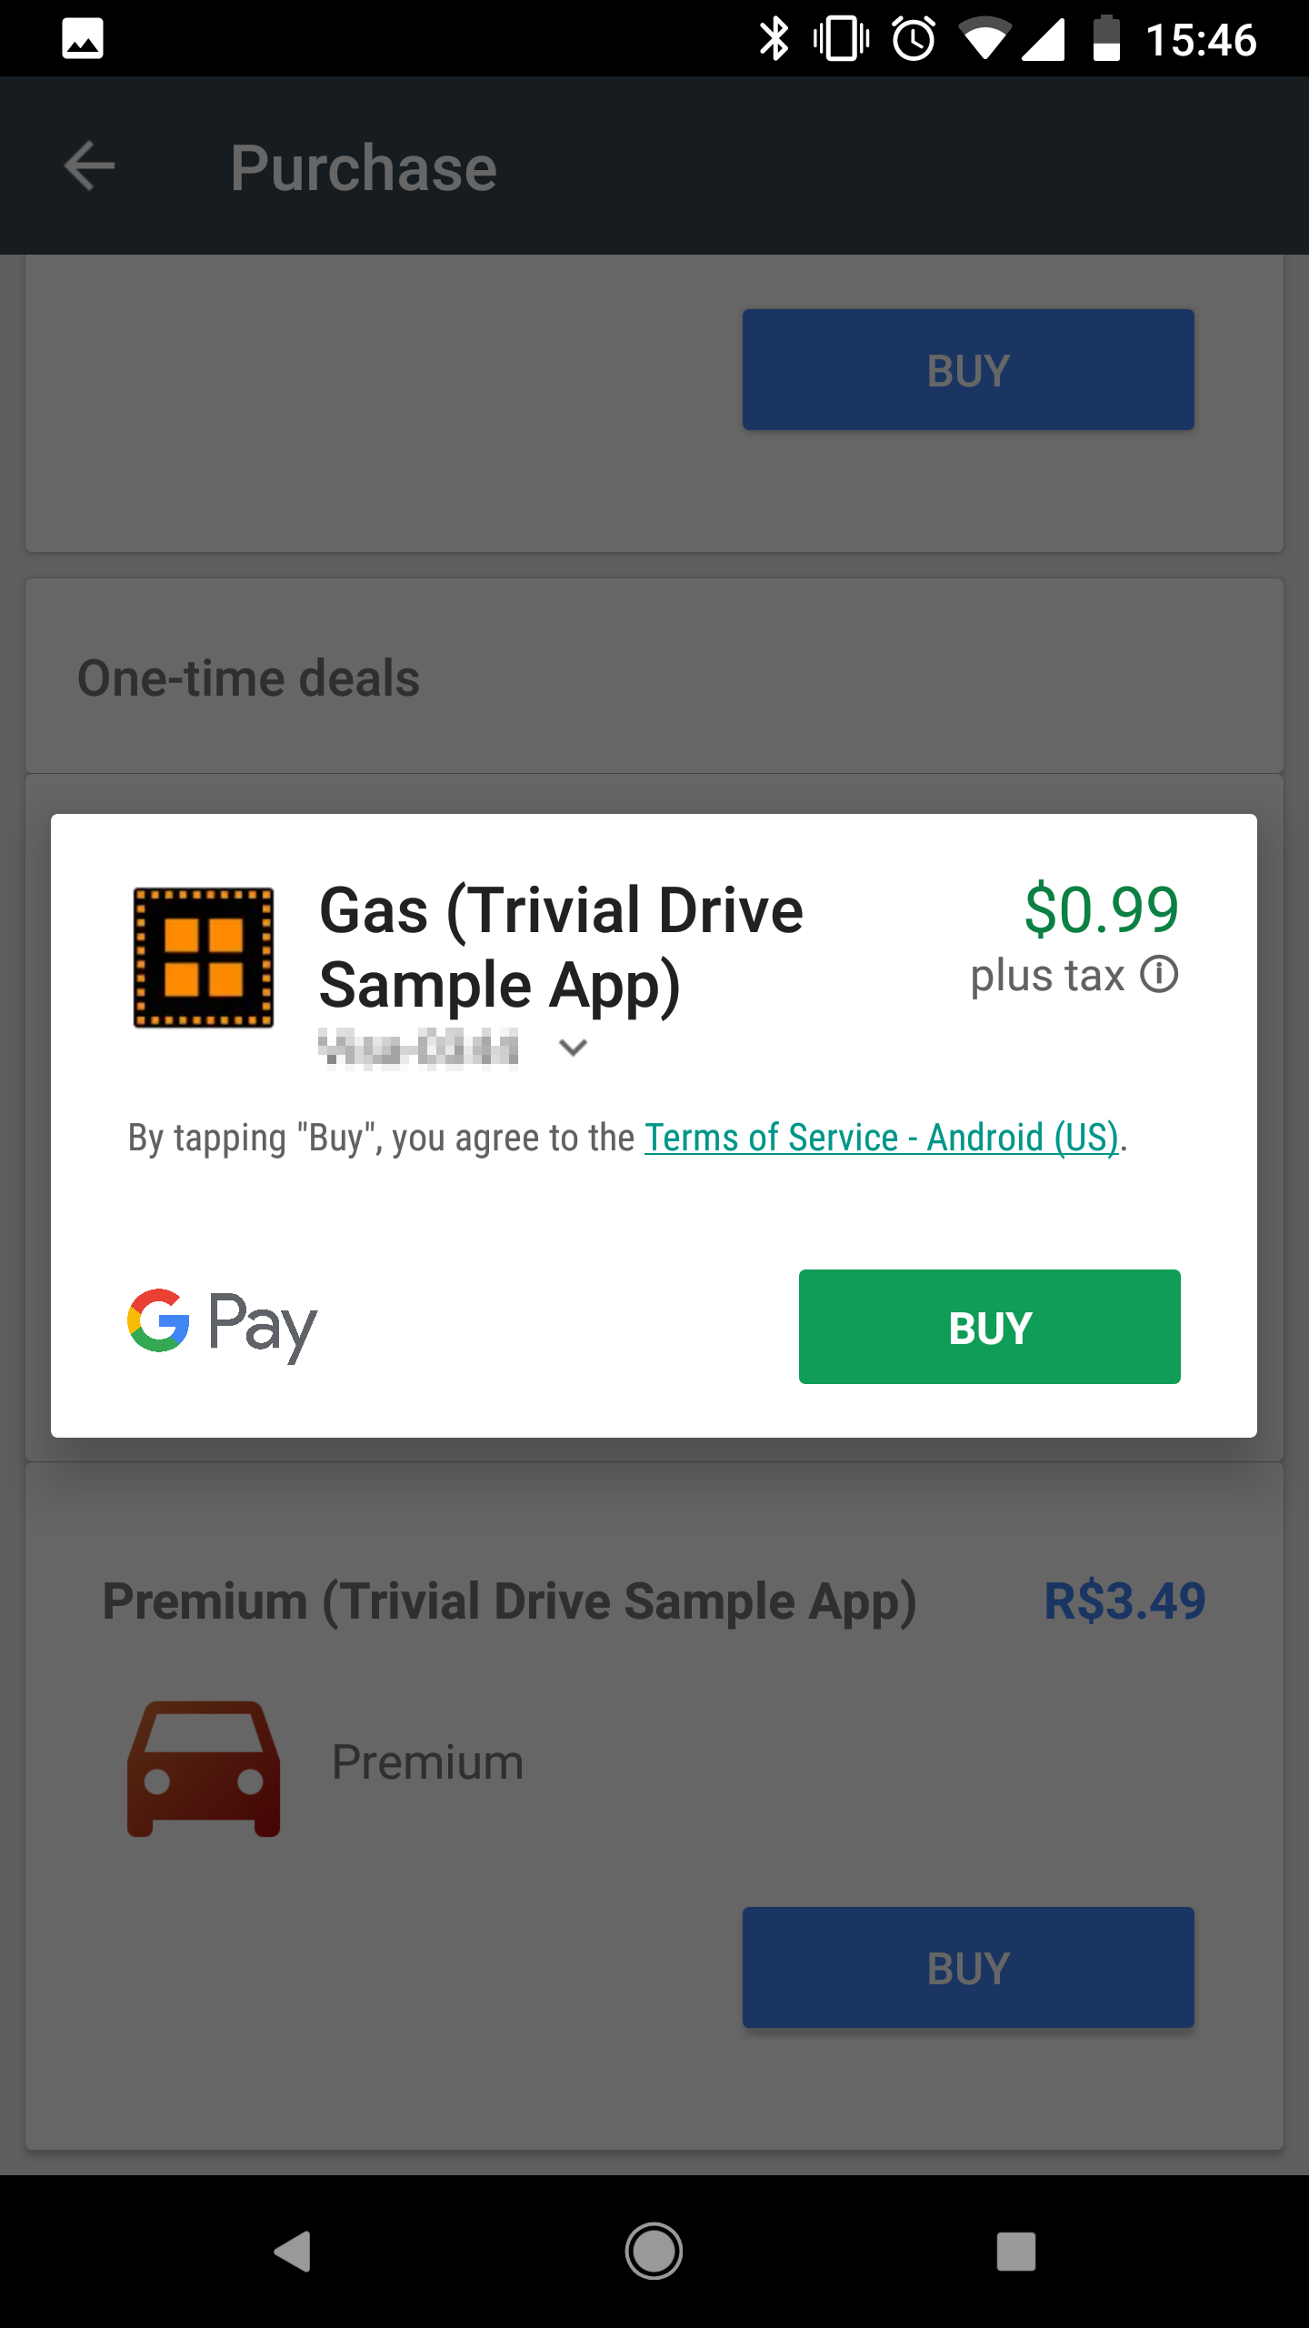
Enable purchase of in-app product
To start purchase request from your app, call launchBillingFlow() method from UI thread
Pass a reference to BillingFlowParams object containing relevant data to complete the purchase, such as product ID and type
When you call launchBillingFlow(), system displays Google Play purchase screen:
// Retrieve a value for "skuDetails" by calling querySkuDetailsAsync(). BillingFlowParams flowParams = BillingFlowParams.newBuilder() .setSkuDetails(skuDetails) .build(); int responseCode = billingClient.launchBillingFlow(flowParams);
https://developer.android.com/google/play/billing/billing_library_overview

Slide 17
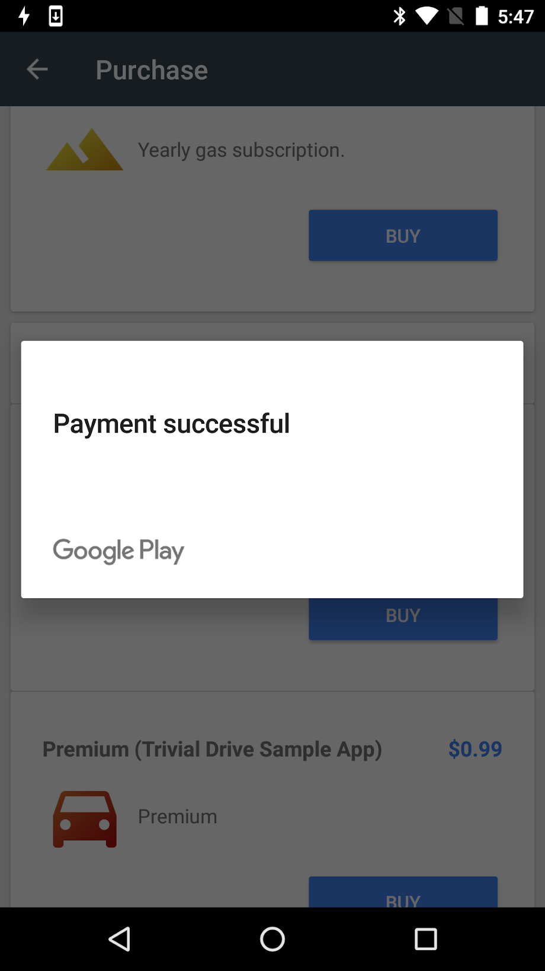
Handle result of purchase operation
launchBillingFlow() method returns one of several response codes
GooglePlay calls onPurchaseUpdated() method to deliver the result of the purchase operation to a listener implementing PurchasesUpdatedListener interface
Must implement onPurchasesUpdated() method to handle possible response codes
@Override void onPurchasesUpdated(BillingResult billingResult, List<Purchase> purchases) { if (billingResult.getResponseCode() == BillingResponse.OK && purchases != null) { for (Purchase purchase : purchases) { handlePurchase(purchase); } } else if (billingResult.getResponseCode() == BillingResponse.USER_CANCELED) { // Handle an error caused by a user cancelling the purchase flow. } else { // Handle any other error codes. } }
Successful purchase also generate a purchase token, a unique identifier representing the user and product ID for in-app purchase. Can store the purchase token locally, or ideally pass it to a backend server where it can be used to verify the purchase and protect against fraud.
https://developer.android.com/google/play/billing/billing_library_overview

Slide 18
Acknowledge a purchase
If you use Google Play Billing Library 2.0 or later, must acknowledge all purchases within 3 days or the purchase is refunded
Can easily acknowledge a purchase using one of 3 methods:
1) for consumables, use consumeAsynch() found in client API
2) for non-consumables, use acknowledgePurchase() in client API
3) a new acknowledge() method also available in server API
https://developer.android.com/google/play/billing/billing_library_overview

Slide 19
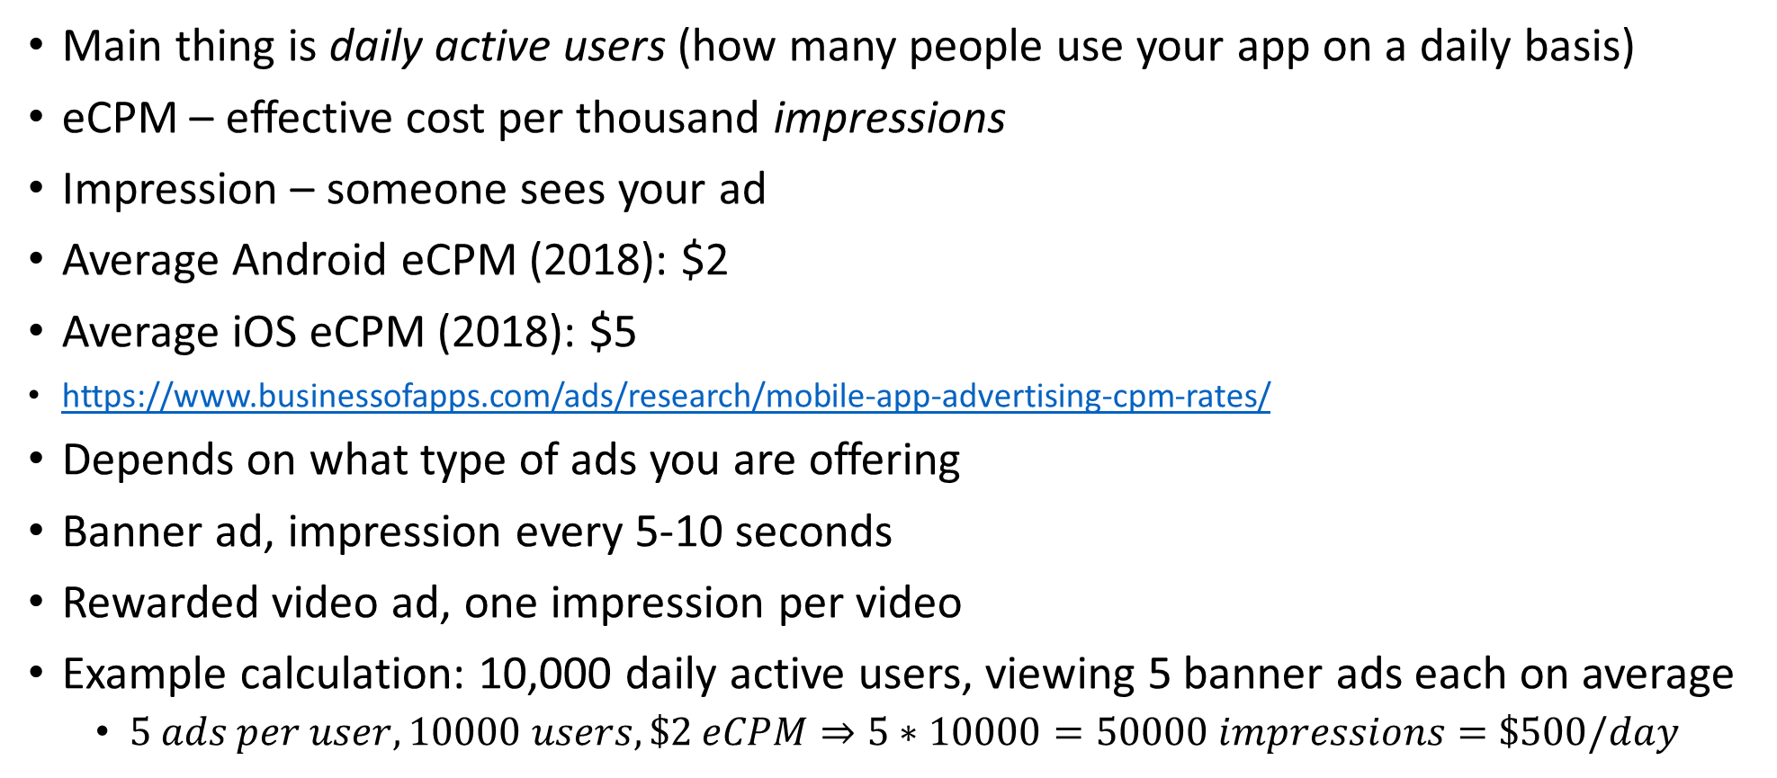
Monetize through ads
Main thing is daily active users (how many people use your app on a daily basis)
eCPM – effective cost per thousand impressions
Impression – someone sees your ad
Average Android eCPM (2018): $2
Average iOS eCPM (2018): $5
https://www.businessofapps.com/ads/research/mobile-app-advertising-cpm-rates/
Depends on what type of ads you are offering
Banner ad, impression every 5-10 seconds
Rewarded video ad, one impression per video
Example calculation: 10,000 daily active users, viewing 5 banner ads each on average
$5 ads per user, 10000 users, \$2 eCPM⇒5∗10000=50000 impressions=\$500/day$
https://admob.google.com/home/resources/how-much-revenue-can-you-earn-from-admob/

Slide 20
Monetize Android app using AdMob with Firebase
Google AdMob is an easy way to monetize mobile apps with targeted, in-app mobile advertising
Key capabilities:
Earn more – show ads from millions of Google advertisers in real time
Improve user experience – native and video ads create a positive user experience as you monetize by matching look and feel of your app
Scale fast – show ads to users in more than 200 markets, and if you have more than one app, cross-promote your app
Access monetization reports – make smarter decisions about product strategy
https://firebase.google.com/docs/admob/android/quick-start

Slide 21
How does AdMob work?
Google AdMob allows to monetize app through in-app advertising
Ads can be banner ads, video ads, interstitial ads, or native ads
Can also display in-app purchase ads
Need to create AdMob account, and activate Ad Unit IDs, a unique identifier for places within your app where ads are displayed
AdMob uses Google Mobile Ads SDK, which helps app developers gain insights about users, drive more purchase, maximize ad revenue
Why use AdMob with Firebase? Take advantage of Firebase’s free and unlimited analytics solution to monetize more intelligently – sessions, user demographics, revenue from in-app products, and more.
Firebase is recommended (use AdMob with Firebase)
https://firebase.google.com/docs/admob/android/quick-start

Slide 22
Getting started AdMob with Firebase
Import and initialize the Mobile Ads SDK:
Update the manifest:
Initialize the SDK: (only done once, ideally at app launch)
implementation 'com.google.firebase:firebase-ads:18.3.0'
<!-- Sample AdMob App ID: ca-app-pub-3940256099942544~3347511713 --> <meta-data android:name="com.google.android.gms.ads.APPLICATION_ID" android:value="[ADMOB_APP_ID]"/>
@Override protected void onCreate(Bundle savedInstanceState) { super.onCreate(savedInstanceState); // ... // Sample AdMob app ID: ca-app-pub-3940256099942544~3347511713 MobileAds.initialize(this, "YOUR_ADMOB_APP_ID"); }
https://firebase.google.com/docs/admob/android/quick-start

Slide 23




Choose an ad format
Banner ad – rectangular image or text that occupy a spot within the ad’s layout. Remains on screen while user interacts with app, can refresh automatically
Interstitial ad – full screen ads that cover the UI until closed by user, best used at natural pauses in the app’s flow
Native ad – component-based ad format giving you freedom to customize the way assets like headlines and calls to action are implemented, matches your app theme
Rewarded video ad – interstitial ads that the user has the option of watching in full, in exchange for in-app rewards
https://firebase.google.com/docs/admob/android/quick-start

Slide 24
Implement a Banner ad in AdMob with Firebase
Step 1: add AdView to app’s layout
First step towards displaying a banner is to place AdView in layout of Activity or Fragment where you would like to display the ad:
Note: ads:adSize (to set custom size), ads:adUnitId (unique identifier for the location in the ap where you display the ad, different for other fragments/activity)
# main_activity.xml ... <com.google.android.gms.ads.AdView xmlns:ads="http://schemas.android.com/apk/res-auto" android:id="@+id/adView" android:layout_width="wrap_content" android:layout_height="wrap_content" android:layout_centerHorizontal="true" android:layout_alignParentBottom="true" ads:adSize="BANNER" ads:adUnitId="ca-app-pub-3940256099942544/6300978111"> </com.google.android.gms.ads.AdView> ...
Can also create an AdView programmatically through source code
https://developers.google.com/admob/android/banner

Slide 25
Load an ad
once AdView is in place, next step is to load the ad
Use loadAd method from AdView class
your app is now ready to display banner ads
Warning – always test with test ads rather than live, production ads (follow link below for more details)
https://developers.google.com/admob/android/test-ads
protected void onCreate(Bundle savedInstanceState) { super.onCreate(savedInstanceState); setContentView(R.layout.activity_main); MobileAds.initialize(this, new OnInitializationCompleteListener() { @Override public void onInitializationComplete(InitializationStatus initializationStatus) { } }); mAdView = findViewById(R.id.adView); AdRequest adRequest = new AdRequest.Builder().build(); mAdView.loadAd(adRequest); }
https://developers.google.com/admob/android/banner

Slide 26
App store optimization
Info in these slides taken from AppAnnie’s “App Store optimization, the Definitive Playbook” (link at bottom)
What is app store optimization (ASO)?
Currently over 4 million apps on Google Play store
We want our app to be listed first when someone searches for it
ASO – the ongoing process of testing and measuring updates to app store marketing assets, with the goal of increasing visibility and driving downloads
ASO comprises two distinct goals
1) discoverability – increasing search traffic to your app
2) conversion – convincing users to download your app
https://drive.google.com/open?id=1Zx4PRjYi7OGpX_bX5QKrUl7sudZf4Xj2

Slide 27
Which factors influence Google Play the most?
High impact:
App name - keywords
Total downloads
Download velocity – rate of downloads in recent past
Click-through rate – proportion of people who visit listing, and also click install
Medium impact:
App description - keywords
Average rating
Price
Low impact:
Ratings count
Time since release
Update frequency

Slide 28
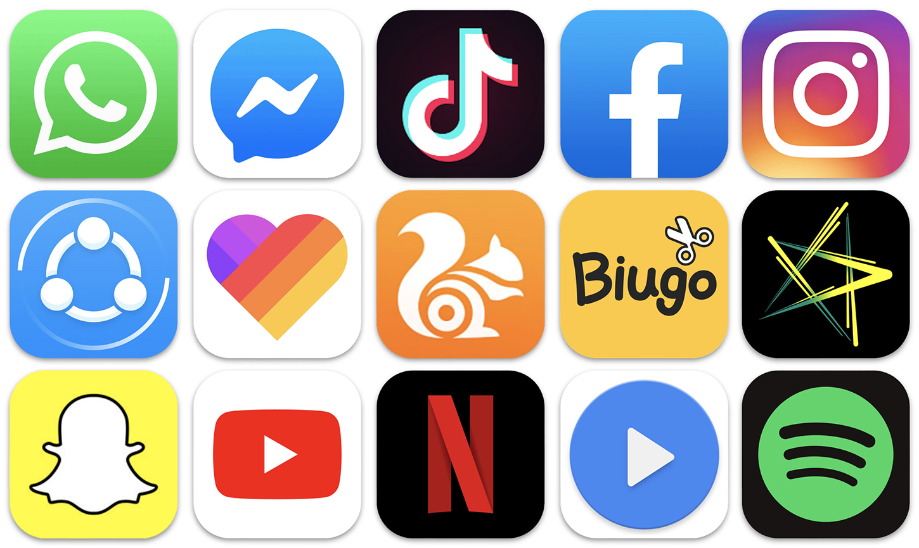
Making a first impression – app icons and more
The way you present your app in the app store – words, images, and videos – makes the differences when convincing users to download
App icon: probably the most important factor in deciding whether a user will download your app or not
the first visual element users see when they view an app in the store listing
Should represent what your app is about in the simplest manner possible
App icon tips:
Keep it simple – complex icons can be difficult to view on smaller devices
Design for scalability – icon will be shown in multiple places at multiple sizes, icon should maintain its legibility and uniqueness
Be recognizable – be novel, and try out several variations on your design, to see what works best
Check the competition – don’t make your icon too similar
Stand out from the crowd
Test, test, test – sequential A/B testing – try two different icons, keep the one that performs best, repeat
https://drive.google.com/open?id=1Zx4PRjYi7OGpX_bX5QKrUl7sudZf4Xj2

Slide 29
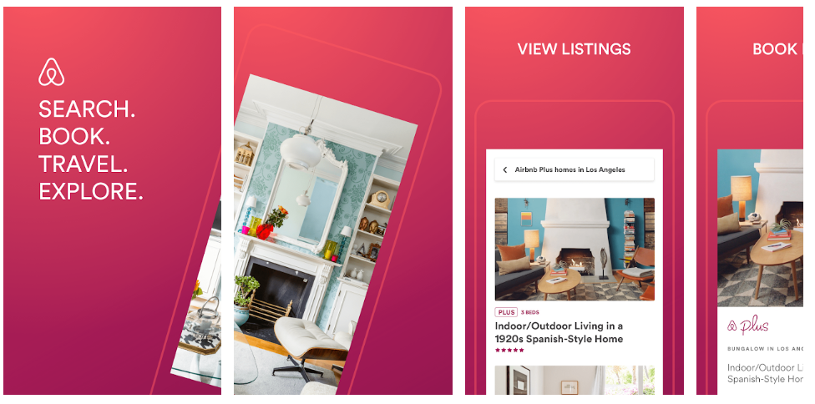
Screenshots
Can use eight screenshots in Google play store, use them all to maximize visibility and sell app’s value
Prioritize key messages – first 3 screenshots are most visible, make sure your selling points are featured in these
Tell a story – make sure your screenshots address the user’s needs
Airbnb:
Airbnb uses compelling visuals and text to succinctly communicate core features of app to prospective users
First two screenshots stand alone to entice prospective users to install with key verbs that relate to actions a user in the mindset for travel would be undertaking
Next four screenshots illustrate key value propositions that communicate why Airbnb is a strategic companion for on-the-go travel
https://drive.google.com/open?id=1Zx4PRjYi7OGpX_bX5QKrUl7sudZf4Xj2

Slide 30
Video
Can create short video to highlight key features of app
Give user sneak peak into key features of your app
Pacing and structure:
First 5 seconds are critical, need to capture attention immediately
15-25 seconds is industry standard
Focus on best features first
Tell viewers what to do next (call to action, ie, INSTALL NOW!)
Check out ‘Harry Potter, Wizards Unite’ for example of a good video
https://drive.google.com/open?id=1Zx4PRjYi7OGpX_bX5QKrUl7sudZf4Xj2

Slide 31
The power of search
Most common way app is found/downloaded is through search
Choosing keywords: how can we select keywords maximizing discoverability?
1) categorize yourself for discoverability – take into account where you’ll be most competitive, and where you can organically attract the most users
2) pay attention to competitors – take keywords from top competitors.
3) leverage user reviews – take keywords from reviews, they may resonate better with future customers
4) diversify branded vs generic keywords strategically – need both generic “shopping” and branded “Walmart” keywords. You can list competitor brand names in your description, but shouldn’t in app title
5) stay on top of rankings using KPIs – continuously evaluate how modifying keywords affects downloads
6) Keyword “goodness” – volume and difficulty – higher volume = more users are searching this term, higher difficulty means many other apps also list this term. Want high Volume/difficulty ratio keyword
Include keywords in title and app description
App Annie has tools to support volume/difficulty and other metrics for keyword finding
https://drive.google.com/open?id=1Zx4PRjYi7OGpX_bX5QKrUl7sudZf4Xj2

Slide 32
Categorizing your app
Two ways to be ranked in app store:
1) by category
2) overall
Every app publisher is responsible for choosing how to categorize app
Choose category relevant to your app, but also where you stand out best relative to competition
Choosing category:
1) where you believe your app best fits naturally
2) how target users will search for your app
3) how similar apps (competitors) are categorizing themselves
Can move your app into a less relevant, but less crowded category
Example: twitter moved from social networking to news, becoming #1 in news category
https://drive.google.com/open?id=1Zx4PRjYi7OGpX_bX5QKrUl7sudZf4Xj2

Slide 33
Influence of ratings and reviews
Positive ratings and reviews improve your app’s performance in app store
You have more control over ratings and reviews than you think
Encourage optimal reviews and ratings
Dating app example – prompt user for review after a successful match
Game example – prompt user for review after obtaining new power
Prompt users for direct feedback during the app, to find when they are enjoying the app most (then use those moments to ask for review)
If user leaves bad review, respond to them, fix the issue, and then ask them to update their review
Gain honest and trusted reviews at launch – basically ask your friends for 5 stars
https://drive.google.com/open?id=1Zx4PRjYi7OGpX_bX5QKrUl7sudZf4Xj2

Slide 34
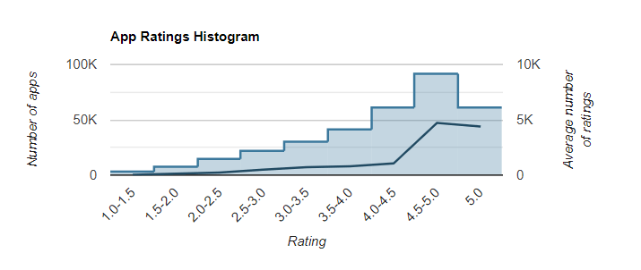
Review statistics
82% of apps have no reviews (junk apps)
Apps with more reviews have higher average rating
Expect <1% of your users to leave reviews without being prompted
My most popular app – 60k downloads, 220 reviews
220/60000 = 0.3% (and I have a ‘leave review’ option on my main menu) ☹
https://drive.google.com/open?id=1Zx4PRjYi7OGpX_bX5QKrUl7sudZf4Xj2

Slide 35
ASO Cheat sheet
Making a strong first impression:
App icon – simple, scalable, and unique, keep testing until you find most effective variation
Screenshots – maximize visibility (use all available screenshots), engaging narrative, best screenshots first, relevant to user’s interests
Video – short, sweet, and punchy, simplicity over flash, engage within 5 seconds
Testing – continuously test new designs to optimize for highest performing creative assets
Discoverability:
Selecting category – consider app’s most natural fit and the competition
Keywords – place in app title/description, keep tabs on competitors and take their keywords, recycle keywords from user reviews, monitor how different keywords affect daily downloads
Reviews – pay attention to your users, react to their comments, be responsive
Prompting reviews - improve likelihood of positive review by asking for feedback when user has a good moment with your app. Approach trusted reviewers for initial boost

Slide 36
More tips
Publisher name – should match your app’s theme
Generic keywords ‘best, top, free’ to rank for phrase combinations
Localize keyword description to each market
Repeat Tier 1 keywords 2 or 3 times in the description
Reduce length of description to make keywords more prominent

Slide 37
Summary

