Slide 1
CS230 Mobile App Programming
Instructor: Russell Butler, Ph.D.
Fall 2019

Slide 2
Administrative slide
3 credit course (lab/lecture hybrid)
1.5 hours of lecture, 1.5 hours of lab (per week) (will vary)
4-8 hours of personal time per week
Evaluation:
Labs 10% (10 labs)
Assignments 60% (3 assignments)
Final Project 30% (1 project)
No textbook, will teach directly from documentation
https://developer.android.com/

Slide 3
Course prerequisites and goals
Familiarity with at least one object-oriented programming language (preferably java or C++)
Should recognize the following terms: class, constructor, interface, getter, setter, generic types
Goal: learn how to program mobile apps for Android
Anyone can make an app, however, we want to learn strong fundamentals and shorten the learning curve
Final project: release an app on Google Play or Apple App Store

Slide 4
Today’s outline
Mobile landscape
My apps
We will start developing in Android studio next week

Slide 5
Mobile landscape (2019)
Macro trends
Gaming
Retail
Restaurant and food delivery
Banking and finance
Video streaming
Social networking and messaging
Travel
All statistics taken from App Annie’s “The state of Mobile” annual report https://www.appannie.com/en/insights/market-data/the-state-of-mobile-2019/

Slide 6
Summary
194 billion downloads worldwide (2018)
$101 billion worldwide app store consumer spend (2018)
3 hours per day spent in mobile by average user (2018)
360% higher average IPO for companies with mobile focus
Snapchat, line, candy crush, tinder, uber, etc..
30% higher engagement in non-gaming apps for gen Z vs older demographics

Slide 7
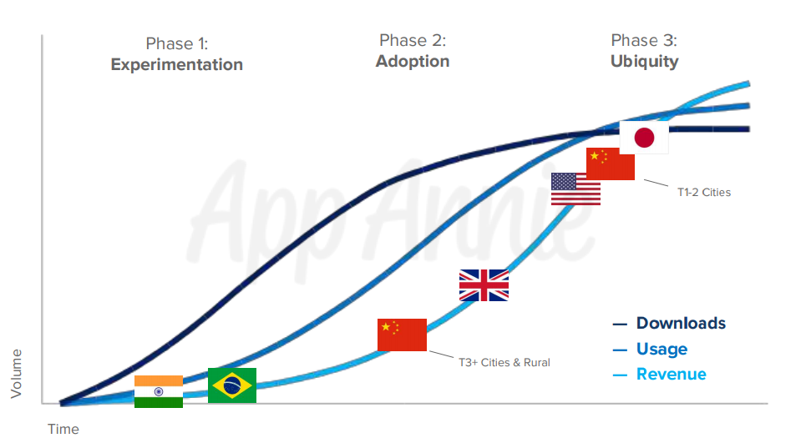
Macro trends
1) Experimentation: strong download numbers driven by new mobile device owners discovering and experimenting with new apps
2) Adoption: engagement climbs as mobile habits begin to form and users settle in to their go-to apps
3) Ubiquity: increased engagement and consumer spend as mobile takes over consumer mindshare

Slide 8
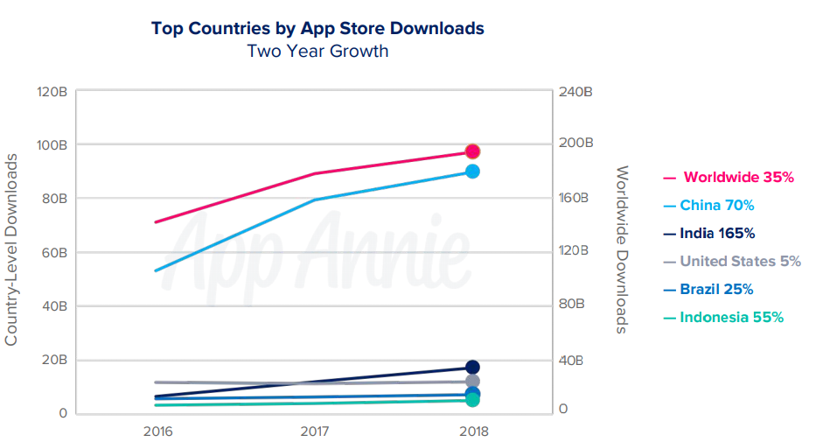
Download trends
Downloads up 35% from 2016 to 2018 (exceeded 194,000,000,000 in 2018)
China accounted for nearly 50% of downloads across iOS and Android
Emerging markets continue to fuel download growth
Mature markets (US) continue to see strong download numbers but growth has slowed
Mature markets growing strongly in other metrics (engagement and spend)
Games account for 35% of all downloads

Slide 9
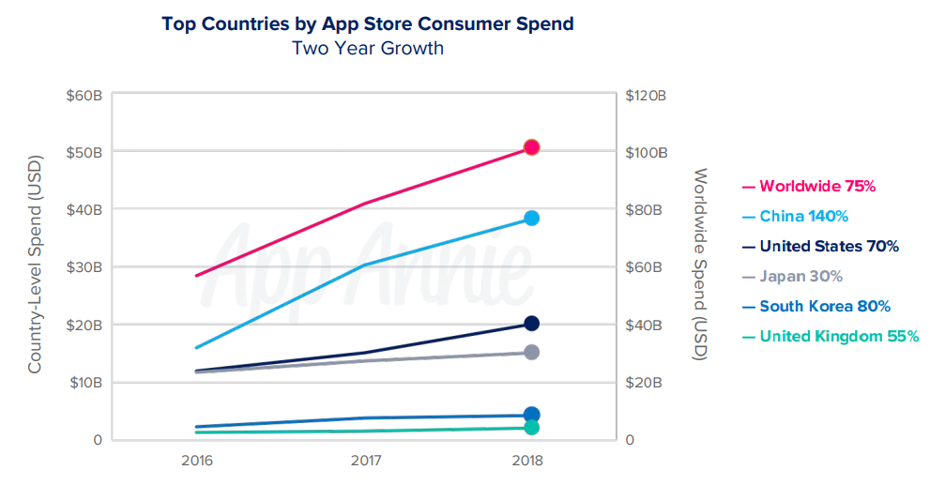
Spending trends
Consumer spend up 75% from 2016, to 101,000,000,000
Paid downloads, in-app purchases, in-app subscriptions
Does NOT include payments outside app store (Uber, Amazon, etc) or revenue from in-app advertising
China accounted for 40% of consumer spend in 2018
Games accounted for 74% of consumer spend in 2018
Non-gaming apps accounted for 26% of consumer spend in 2018, up from 18% in 2016 due to growth in in-app subscriptions

Slide 10
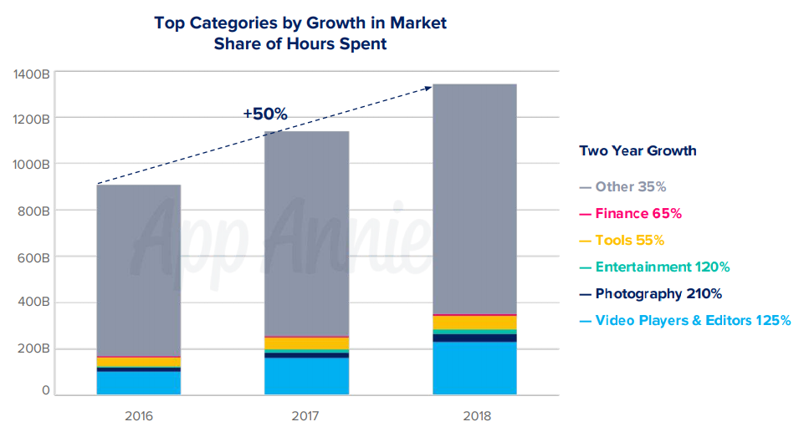
Engagement trends
Time spent in apps grew 50% from 2016 to 2018
Led by: (110% growth)
Video players/editors
Entertainment
Photography
Tools and finance
50% of time spent on mobile devices is in social and communications apps
15% in video players/editors, 10% in games

Slide 11
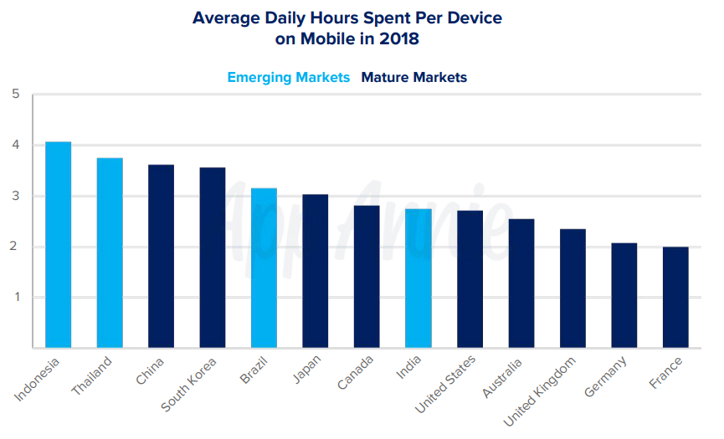
Daily use trends
Mobile users spent over 4 hours a day on their devices in Indonesia
3 hours per day in mature markets (US/Canada)
Time spent mostly performing micro-movements (checking email/bank, browsing news, etc) as well as gaming, social media, and streaming

Slide 12
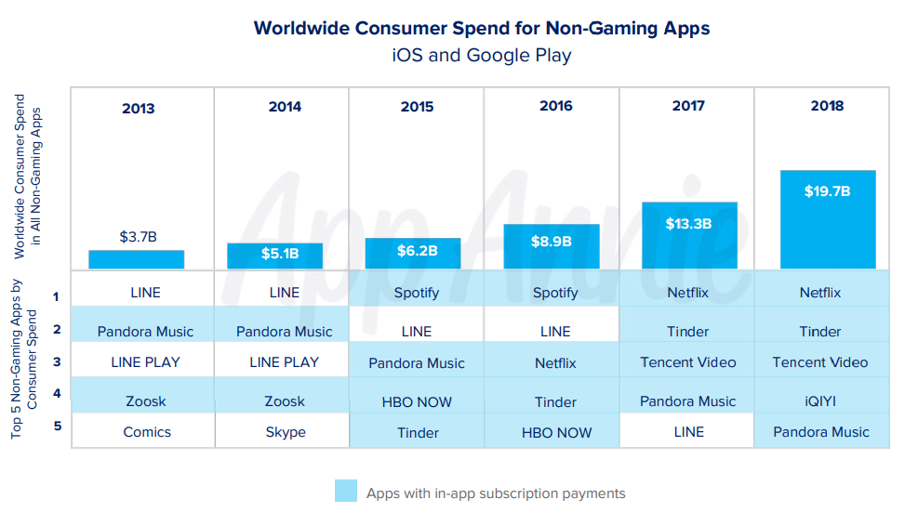
Subscription boom
Global consumer spend in non-gaming apps grew 120% from 2016
Top 5 most lucrative non-gaming apps of 2018 were all subscription based
Forecasted to increase to 75 billion by 2022
Netflix has stopped offering subscriptions through app store

Slide 13
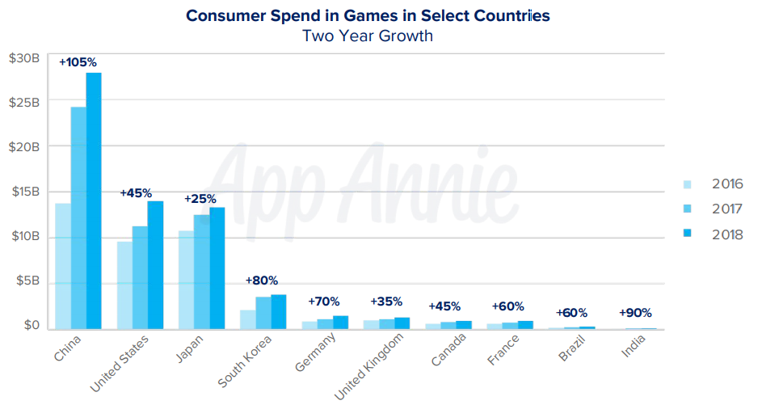
Gaming trends
Games accounted for 74% of consumer spend in 2018
Mobile gaming is fastest growing sector of gaming market, beating consoles, PC, and handhelds
Mobile gaming will reach 60% of gaming market share by 2019, up 35% from 2013
China, US, Japan account for 75% of gaming spend

Slide 14
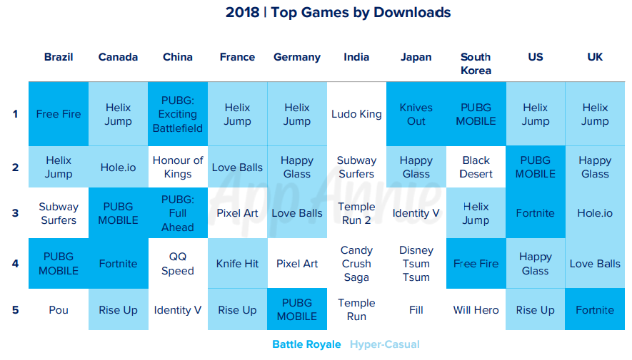
Gaming trends
Battle royale and hyper-casual games dominated 2018
PUBG Mobile, fortnite, rules of survival, free fire
Mobile devices are powerful!
Competitive online gaming culture
Hyper-casual games (simple gameplay mechanics)
Voodoo, Helix Jump, Hole.io
Candy crush, pokemon go, still popular

Slide 15
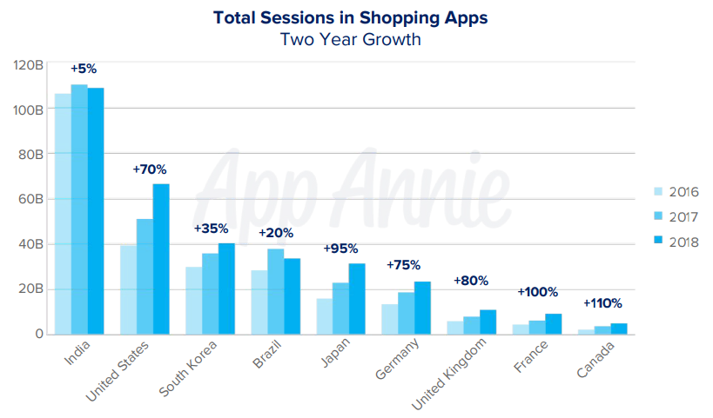
Retail trends
Time spent in shopping apps up 45% from 2016-2018
70% growth in US, 475% growth in Thailand
Time spend in shopping apps correlates with e-commerce sales
Mobile projected to comprise 75% of e-commerce sales by 2021

Slide 16
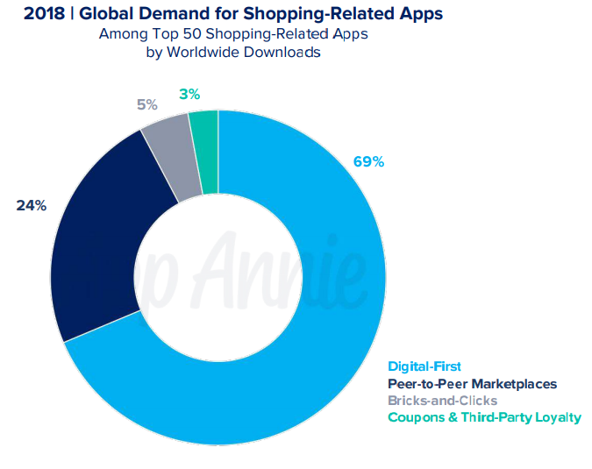
Peer to peer marketplaces
p2p markets were the 2nd most popular way to shop mobile in 2018
Shopee, ebay, Mercadolibre, letgo, OLX the top 5 p2p marketplace apps by download in 2018

Slide 17
Restaurant and food delivery
Globally, mobile purchases of food and drink up 130% from 2016 to 2018
325% growth in France, 230% growth in South Korea
Growth in fast food apps (quick service restaurants QSRs) and delivery services
Traditional brick and mortar food/drink industry with strong presence in mobile space
Top 5 food delivery app downloads up 115% from 2016 to 2018
Particularly in established markets (Canada, US, UK)
Starbucks and UberEats partnering in China and now US to streamline delivery and morning routine, transforming our daily rituals
QSRs such as Mcdonalds/Burger King leveraging loyalty programs through their apps (flash deals through push notifications)
Burger King leveraging location based offers (1 cent whopper) to hit #1 daily downloads on iphone in December 2018

Slide 18
Banking and finance
3.4 billion downloads of finance apps in 2018, up 75% from 2016
Brazil, India, Indonesia saw strongest growth
Banking and Fintech
Democratization of fintech services
Investing (Acorns, robinhood, wealthsimple)
Money transfer (Revolut)
Consumer loans (kredivo)
Microloans (afterpay) (Credit card alternatives)
Average user checks bank account 1x per day (up 35% from 2016)
Retail banking apps topped average monthly active users (MAU) chart
Revolut secured European banking license in 2018
Plans to open chequing/saving accounts and retail/business lending options
Paying by phone QR code becoming common, (PayPay in japan) (convenient and frictionless)

Slide 19
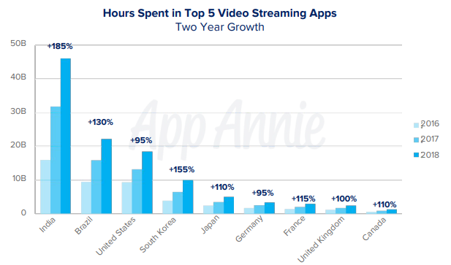
Video streaming
>100% growth in 8 major countries for time spent in top 5 video streaming apps
Consumption switching from desktop/tv to mobile
Youtube dominates video streaming apps (9 of every 10 minutes streamed was from youtube)
Youtube kids, Twitch
Youtube comes pre-installed
Consumer spend in video streaming apps exploded (285% worldwide increase 2018 vs 2016)
Youtube’s premium features
Disney+ launch in 2019
2.2 billion spent on top 5 streaming services in 2018 (Netflix #1 worldwide)
Live streaming apps (BIGO LIVE, Nonolive)
Sport streaming

Slide 20
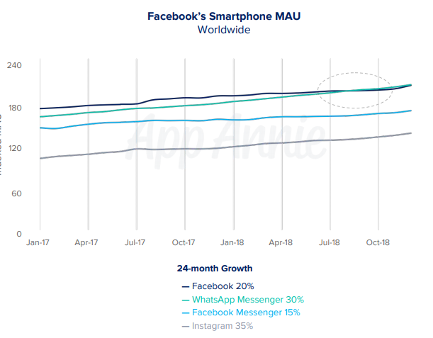
Social networking and messaging
685 billion hours spent globally in social/messaging apps in 2018, up 35% from 2016
Half of time spent on mobile globally is in social/messaging
Video is an expected feature for many social/messaging apps
Live streaming, video calling, viewing short-form video clips
Instagram, snapchat, tik tok foster deep engagement for generation z
Whatsapp was top social/messaging app for user engagement
demand for free calls and messages
Simple UI, ease of use for adding contacts
Encrypted messaging
higher MAU than Facebook
Snapchat 2nd place for user engagement
Photos/videos important for modern communication
Instagram users up 35% from 2017 to 2018
Users don’t seem to care about privacy (facebook scandals)

Slide 21
Travel
Number of sessions in travel/navigation apps up 50% 2016 to 2018
Google Maps, Uber, Airbnb
Car sharing apps up 25% year over year in 2018
Bike and scooter sharing apps breakout (up 530%) in 2018 vs 2017
Still in early phases (Bird and Lime)
Top 5 airline apps grew 55% from 2016 to 2018
Apps allow airlines to establish direct relationship with customers, this connection has been undermined by travel aggregators in recent years

Slide 22
Other industries
Dating apps – $400million to $1.4 billion or 190% increase in consumer spend (Subscriptions) from 2016 to 2018, led by Tinder
Unique dating apps (Bumble, women initiate first message)
Global spend in health/fitness apps up 300% from 2016 to 2018
Myfitnesspal
Meditation apps, culture shift towards wellness
Video calling doctors

Slide 23
2019 predictions
App store consumer spend will surpass $120 billion in 2019
double the global box office market
growing 5x rate of global economy
Gaming: mobile will grow to 60% of global gaming market share
Fortnite/PUBG combined with powerful devices
Hypercasual games with simple gameplay
Pokemon Go (first game past $1 billion, at ~$3 billion today)
10 minutes of every hour spent consuming media in 2019 will be streaming video on mobile
60% more apps will monetize through in-app ads
Mobile dominates digital advertising market (155 billion, or 62% of 250 billion)

Slide 24
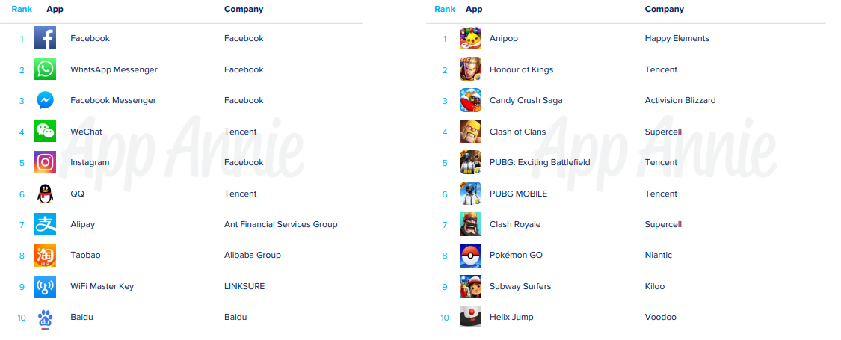
Top 10 apps by monthly active users worldwide

Slide 25
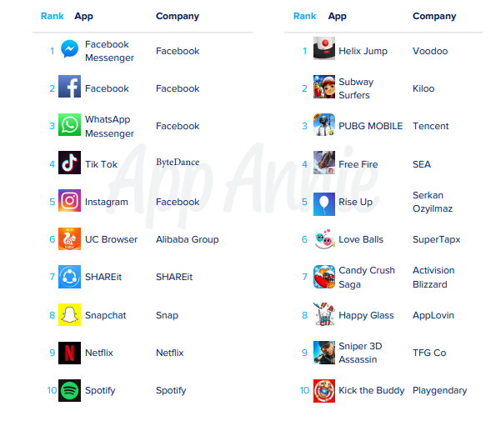
Top 10 apps by download worldwide

Slide 26
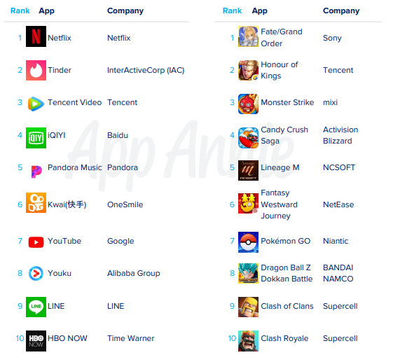
Top 10 apps by consumer spend worldwide

Slide 27

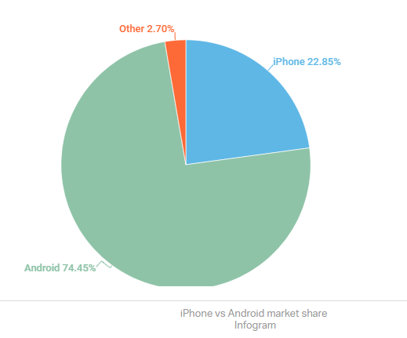
Android vs iOS (#devices)
Iphone 22.8%
Android 74.4%
Android sells more phones because of China and India
Android sells wider range of devices (and price)

Slide 28
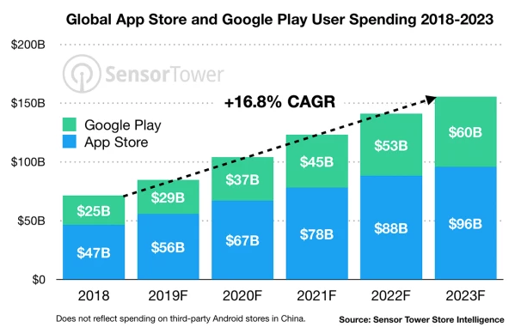
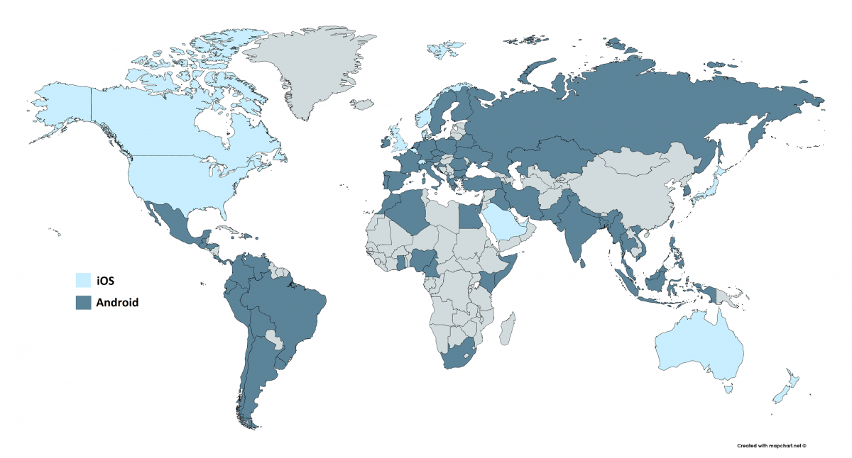
Google play and Apple App Store
Google Play has 2x the number of users as Apple App store
Apple app store generates 2x the revenue of Google Play

Slide 29
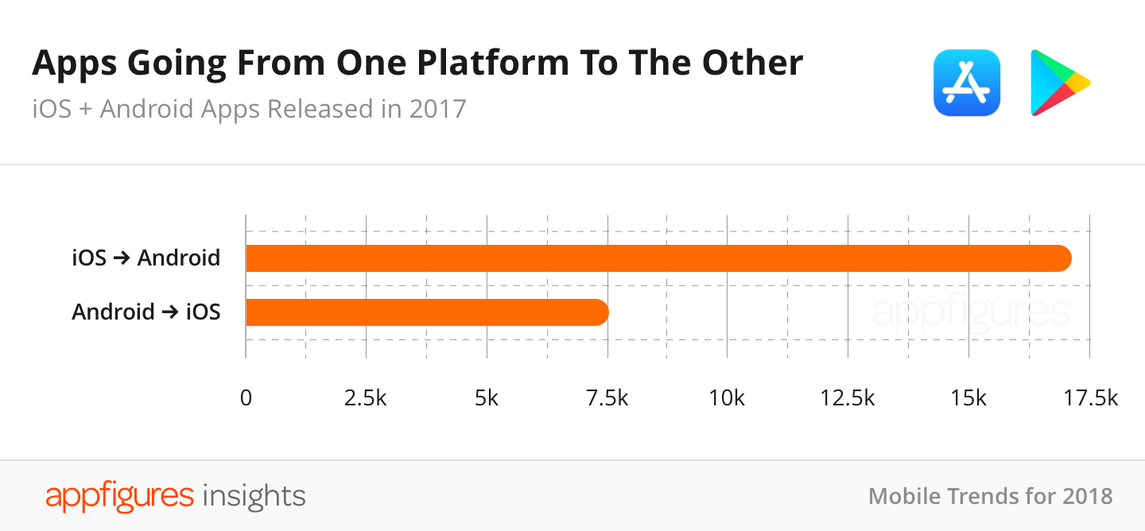
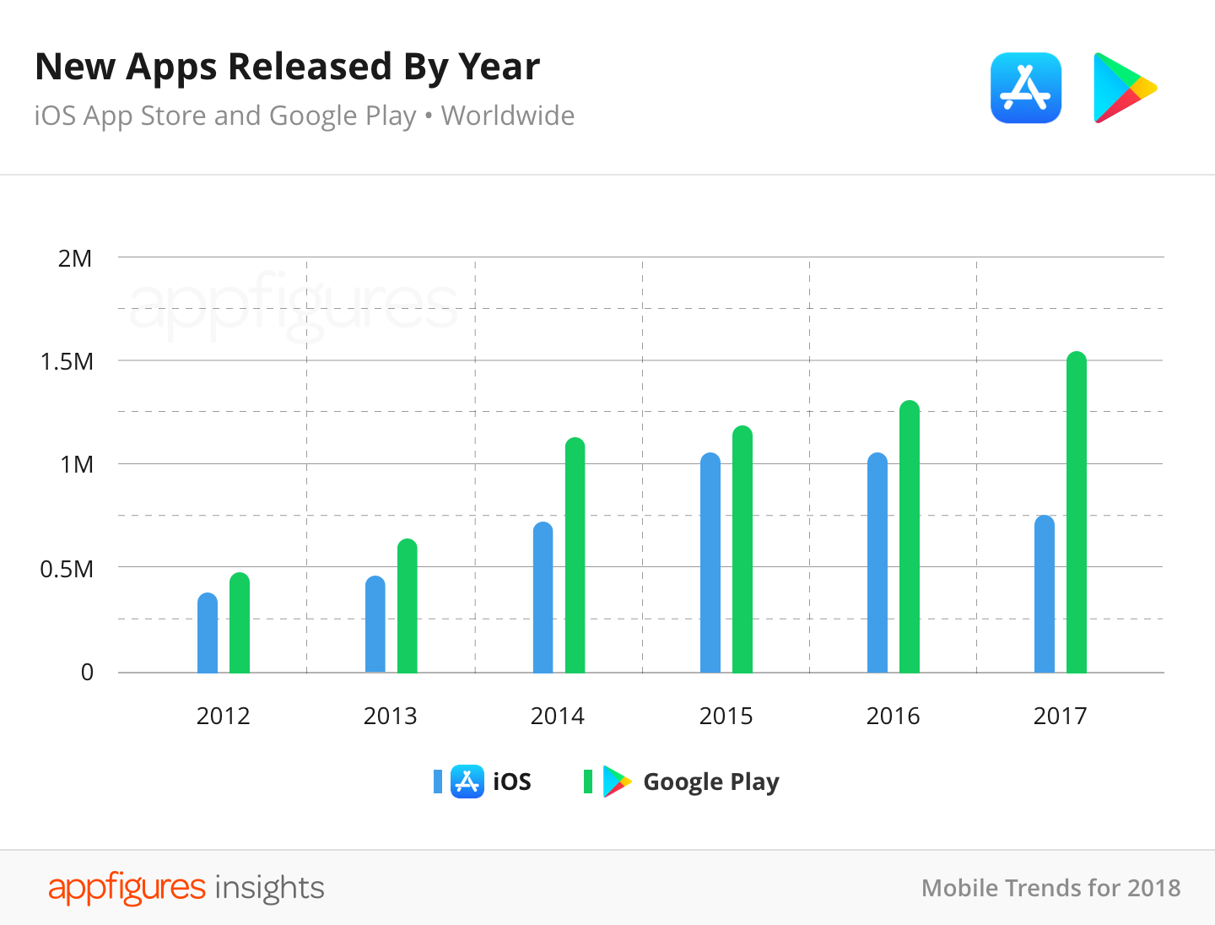
More Google vs Apple trends
More apps are created first for iOS and then later released on Android
Number of apps released:
Google Play is accelerating, Apple App Store is decelerating
This may change

Slide 30
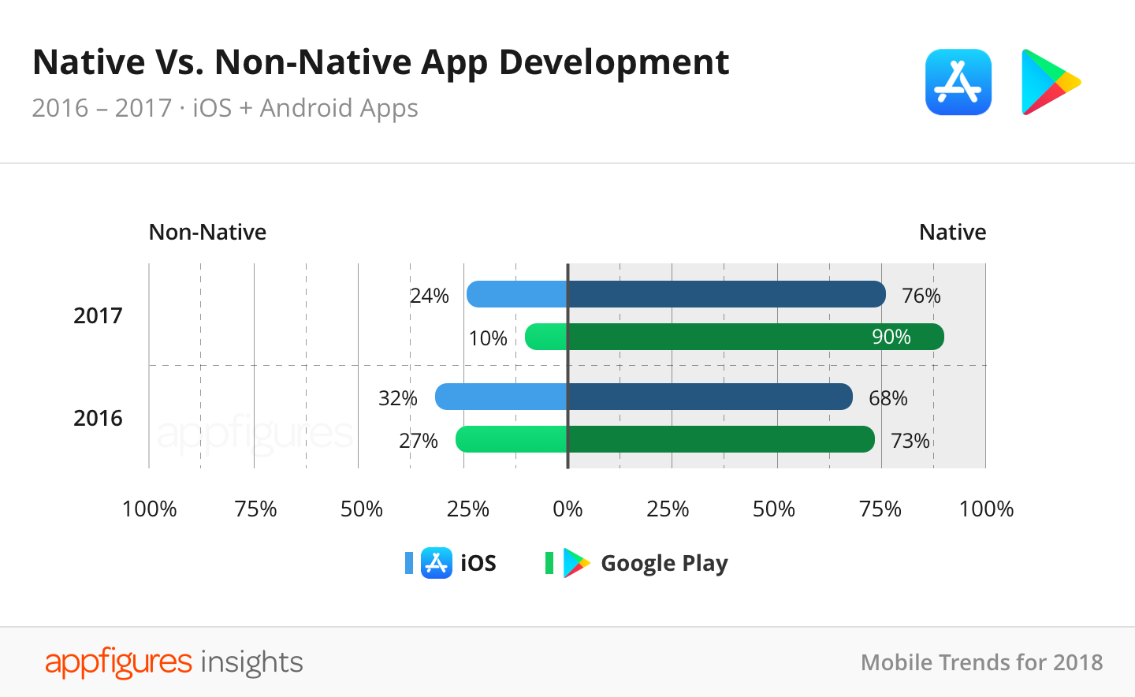
Native vs non-native apps
Proportion of non-native apps is actually decreasing

Slide 31
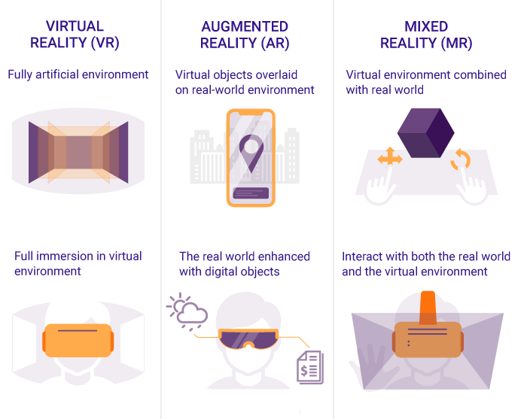
AR and VR
More mobile apps will implement AR and VR in 2019, most successful example to date is Pokemon Go
According to reports, Pokemon Go has generated a revenue of $3 billion and was downloaded approx. 752 million times.
Around 5 million active users playing Pokemon Go across the globe.
Huge success for gaming, more companies will try to replicate this

Slide 32
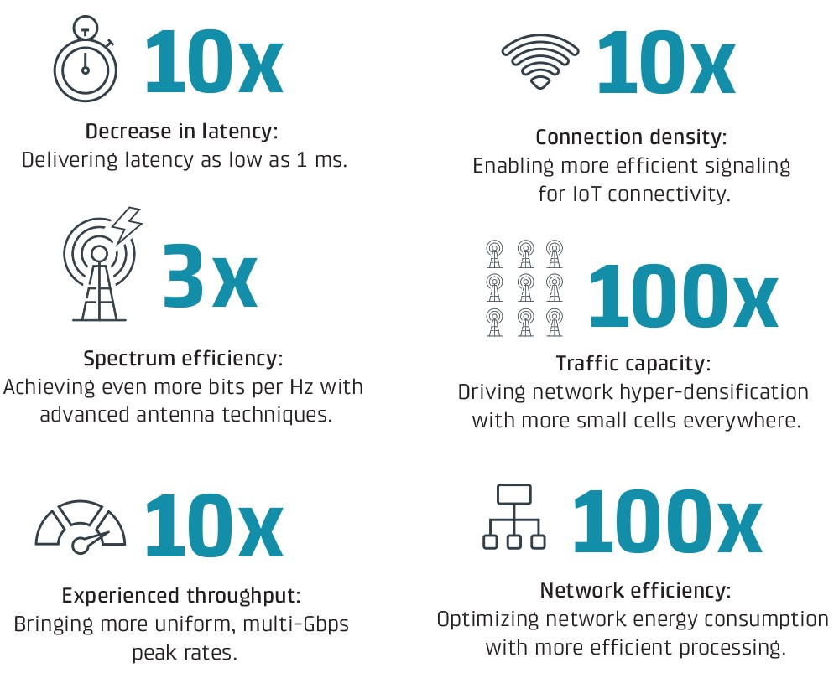
5G
5G technology is going to be the most popular app development trend for the year 2019.
Take this into consideration when designing your app
Custom made network slices
Ultra-low network latency

Slide 33
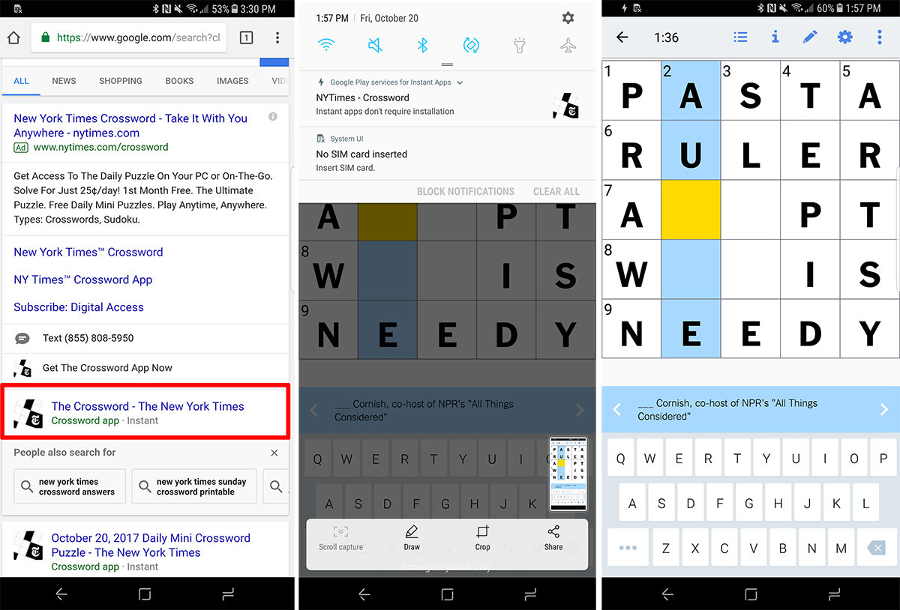
Instant apps
The next step in app evolution
Speed and power of a native app with ease and immediacy of a web app
Look and operate just like apps installed on your phone, but you don’t need to download anything
helps iOS and Android developers achieve a better conversion rate in comparison to a regular mobile app.
For example, apps like Hollar and NYTimes have increased their conversion rate by 20% and 27% respectively by using the instant mobile application.

Slide 34
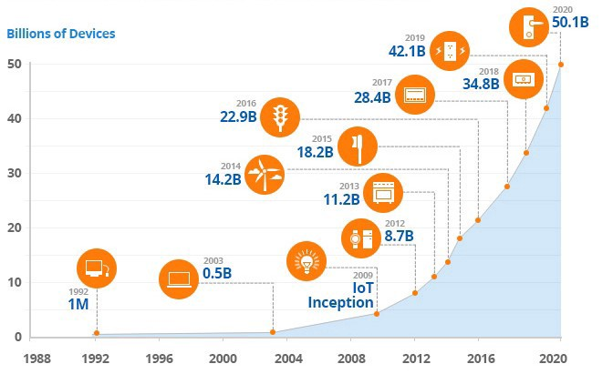
Internet of things
The Internet of Things for mobile app development has become a big industry that is evolving with time. Using this technology, mobile application developers can create intuitive platforms to control different non-IT equipment via apps.
Almost all tech giants have started developing IoT friendly apps. It is expected that the IoT investment will reach $120 billion by 2020.

Slide 35

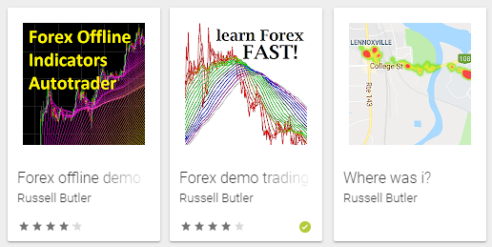



My apps
Steam
Google Play Store
Release Sep 2019
1 download
$4 revenue
Release Aug 2017
58,000 downloads
$1,500 revenue
Release July 2019
12 downloads
$0 revenue
Release Feb 2019
220 downloads
$0 revenue
Overall:
~60,000 downloads
~5,000 MAU
~$1,900 revenue
I’m expecting a large revenue jump soon due to recent releases on Apple/Steam
Release April 2018
5,000 downloads
$300 revenue
Apple App Store
Release Aug 2019, 500 downloads, $0 revenue
Release Feb 2019, ? downloads, $0 revenue

Slide 36
Unity, VR, Wearables
Problem: app stores are saturated (over 2.7 million apps on Google Play)
Emerging devices (smartwatches, virtual reality)
Galaxy Watch, Apple Watch, Oculus Quest, Oculus Go, etc
Unity – build once, deploy anywhere
Mobile (ios, android)
VR/AR (Oculus, Gear, HTC)
Desktop (windows, mac, linux)
Console (PS4, xbox, Nintendo)
Web (webGL)

Slide 37
Resources:
Android developer conference (this October)
https://developer.android.com/dev-summit
Android developer guide:
https://developer.android.com/guide
Android developer documentation
https://developer.android.com/docs

