Slide 1
CS230 Developing Mobile Apps
Lecture 3

Slide 2
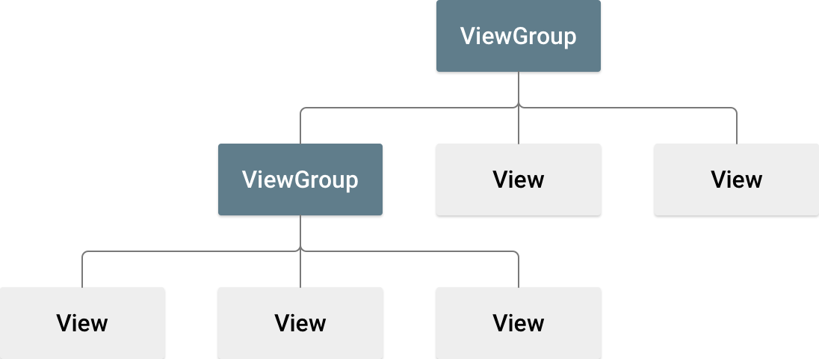
Layouts
A layout defines the structure for the user interface in your app
All elements in your layout are built using a Hierarchy of View and ViewGroup objects
A View draws something the user can see and interact with
A ViewGroup is an invisible container that defines the layout structure for View and other ViewGroup objects
Widgets and Layouts
https://developer.android.com/guide/topics/ui/declaring-layout

Slide 3
Declaring Layouts
You can declare Layouts in two ways:
1) Declare UI elements in XML – use Android’s straightforward XML vocabulary, or use the drag-and-drop interface in the Layout Editor
2) Instantiate layout elements at runtime – your app can create and manipulate View/ViewGroup objects programmatically
Declaring your UI in XML allows for separation of concerns (a theme we will come back to in this course), separating the presentation of your app from the code that controls its behavior
Using XML also allows you to predefine different layouts for different screen sizes and orientations
https://developer.android.com/guide/topics/ui/declaring-layout

Slide 4
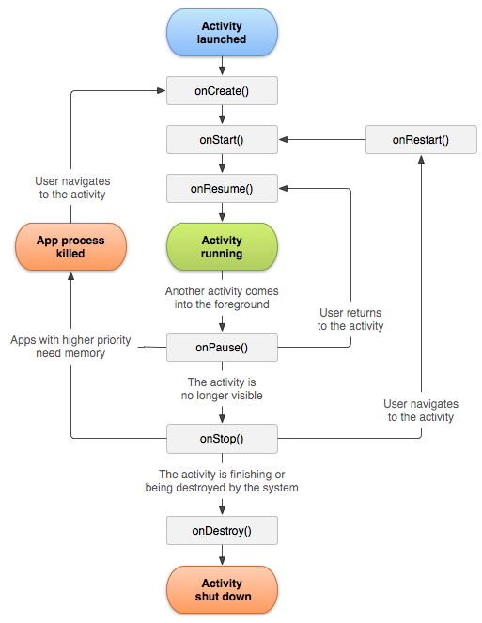
Activity Lifecycle
As the user navigates through, out of, and back to your app, the Activity instances in your app transition through different stages of their lifecycle
Lifecycle callbacks
onCreate()
fires when the system first creates the activity
Basic application startup logic (bind data to lists, instantiate variables, inflate layout, etc.)
Receives parameter savedInstanceState, a Bundle object containing saved state
https://developer.android.com/guide/components/activities/activity-lifecycle

Slide 5
Today:
Download project from Moodle
Work on TODOs
First assignment (full description next Monday)
Use an ArrayAdapter to display a list of objects

Slide 6
If you finish all the TODOs
Add an options menu:
https://developer.android.com/guide/topics/ui/menus

