Slide 1
CS230 Developing Mobile Apps
Lecture 5

Slide 2
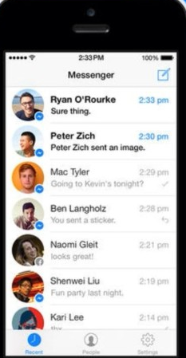
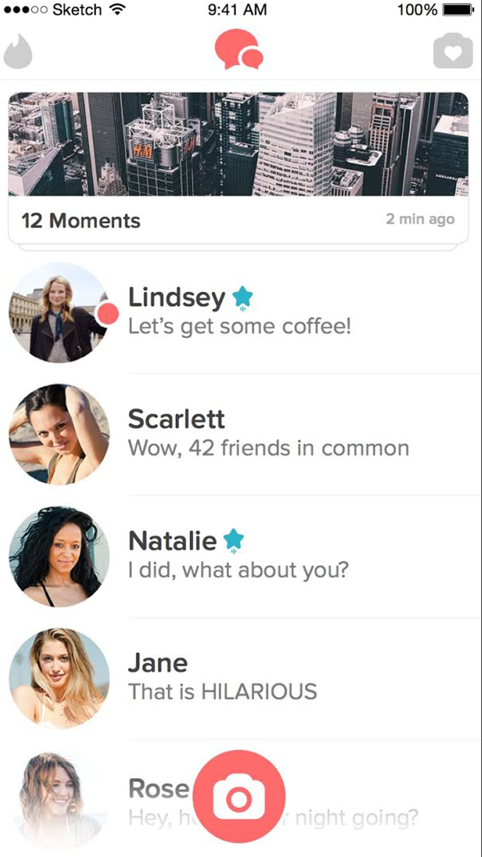
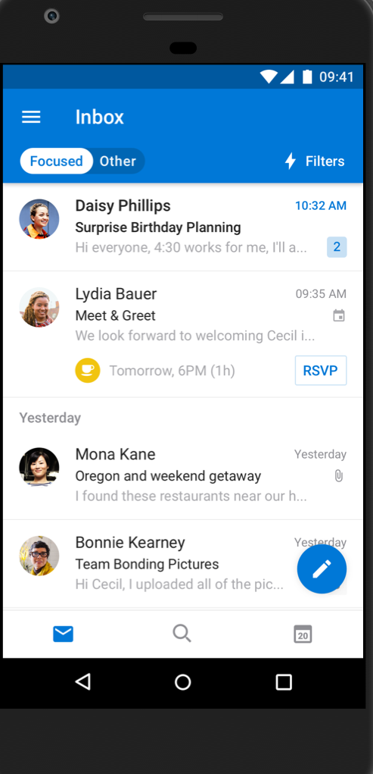
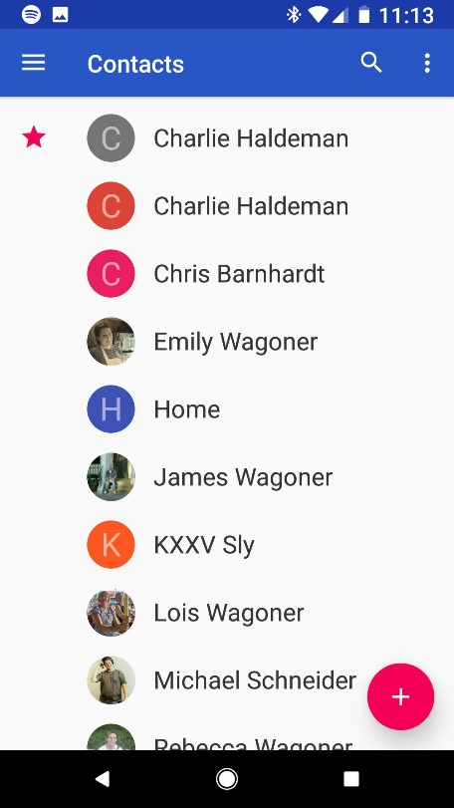
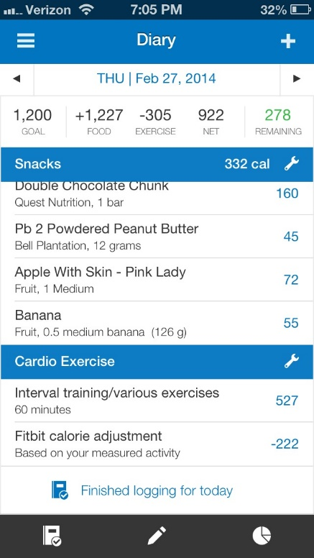
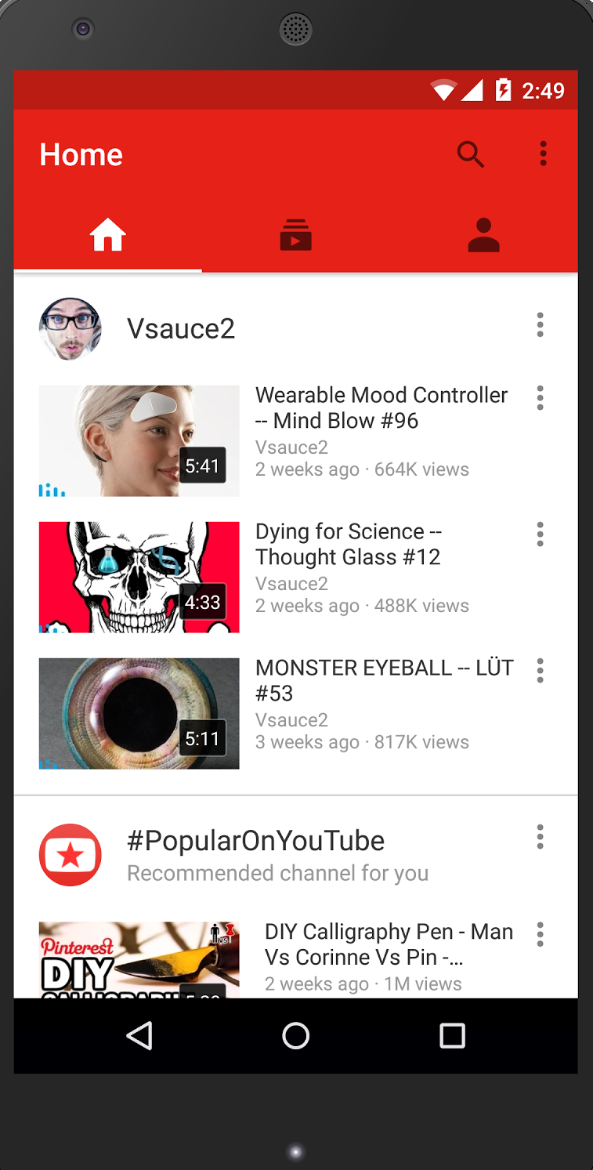
Assignment 1
Displaying a list of expandable items is probably the most common pattern in app design
contacts
myfitnesspal
youtube
tinder
outlook
messenger
…just to name a few

Slide 3
Create a list with RecyclerView
RecyclerView is a more advanced and flexible version of ListView
ListView displays a vertically scrollable collection of views, where each view is positioned immediately below the previous view in the list
ListView is an adapter view that doesn’t know the details of the items it displays, but instead requests views on demand from a listAdapter as needed
RecyclerView requires you to define a ViewHolder (static) class, enforcing the ViewHolder pattern. (means you don’t have to instantiate a view for every item in your adapter, an expensive process). Reduces number of findViewById() calls.
findViewById() expensive because it does does DOM parsing (parses XML from string to DOM Document) DOM=Document Object Model
RecyclerView supports 3 types of predefined layout managers: LinearLayoutManager, StaggeredGridLayoutManager, GridLayoutManager
Handles item animations (item addition, deletion, etc.)
https://developer.android.com/guide/topics/ui/layout/recyclerview
https://developer.android.com/reference/android/widget/ListView.html

Slide 4
Setting up RecyclerView (in MainActivity)
Get the recyclerView xml layout
Set layout manager – defines how items are presented in the recyclerView
Initialize and set the adapter
public class MyActivity extends Activity { private RecyclerView recyclerView; private RecyclerView.Adapter mAdapter; private RecyclerView.LayoutManager layoutManager; @Override protected void onCreate(Bundle savedInstanceState) { super.onCreate(savedInstanceState); setContentView(R.layout.my_activity); recyclerView = (RecyclerView) findViewById(R.id.my_recycler_view); // use this setting to improve performance if you know that changes // in content do not change the layout size of the RecyclerView recyclerView.setHasFixedSize(true); // use a linear layout manager layoutManager = new LinearLayoutManager(this); recyclerView.setLayoutManager(layoutManager); // specify an adapter (see also next example) mAdapter = new MyAdapter(myDataset); recyclerView.setAdapter(mAdapter); } // ... }

Slide 5
RecyclerView Adapter
public class MyAdapter extends RecyclerView.Adapter<MyAdapter.MyViewHolder> { private String[] mDataset; // Provide a reference to the views for each data item // Complex data items may need more than one view per item, and // you provide access to all the views for a data item in a view holder public static class MyViewHolder extends RecyclerView.ViewHolder { // each data item is just a string in this case public TextView textView; public MyViewHolder(TextView v) { super(v); textView = v; } } // Provide a suitable constructor (depends on the kind of dataset) public MyAdapter(String[] myDataset) { mDataset = myDataset; } // Create new views (invoked by the layout manager) @Override public MyAdapter.MyViewHolder onCreateViewHolder(ViewGroup parent,int viewType) { // create a new view TextView v = (TextView) LayoutInflater.from(parent.getContext()) .inflate(R.layout.my_text_view, parent, false); ... MyViewHolder vh = new MyViewHolder(v); return vh; } // Replace the contents of a view (invoked by the layout manager) @Override public void onBindViewHolder(MyViewHolder holder, int position) { // - get element from your dataset at this position // - replace the contents of the view with that element holder.textView.setText(mDataset[position]); } // Return the size of your dataset (invoked by the layout manager) @Override public int getItemCount() {return mDataset.length;} }
The adapter object creates views for items, and replaces the content of some of the views with new data items when the original item is no longer visible
The ViewHolder describes an item and metadata about its place in recyclerView
onCreateViewHolder() is called by the layout manager, sets up the view to display an items contents
onBindViewHolder binds data to the view

Slide 6
Intents
An Intent is a messaging object you can use to request an action from another app component. There are 3 fundamental use cases:
Starting an Activity – pass an Intent to startActivity(), the Intent describes the activity to start and carries any necessary data, example: opening a settings screen.
Starting a Service – a Service is a component that performs background operations without any UI, example: downloading data, querying location, music player, etc.
Delivering a Broadcast – a Broadcast is a message any app can receive. The system delivers various broadcasts for system events, example: boot up, airplane mode, low battery, etc.
There are two types of Intent:
1) Explicit intents – specify which application/component will satisfy the intent by supplying either the target app’s package name, or a fully-qualified component class name. Typically used to start a component in your own app.
2) Implicit intents – do not name specific component, but instead declare a general action to perform, which allows a component from another app to handle it. Often results in app chooser popping up.

Slide 7
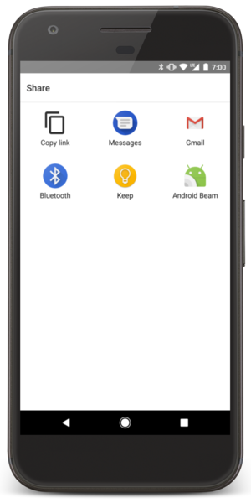
App chooser:
Started with implicit intent to send some text data

Slide 8
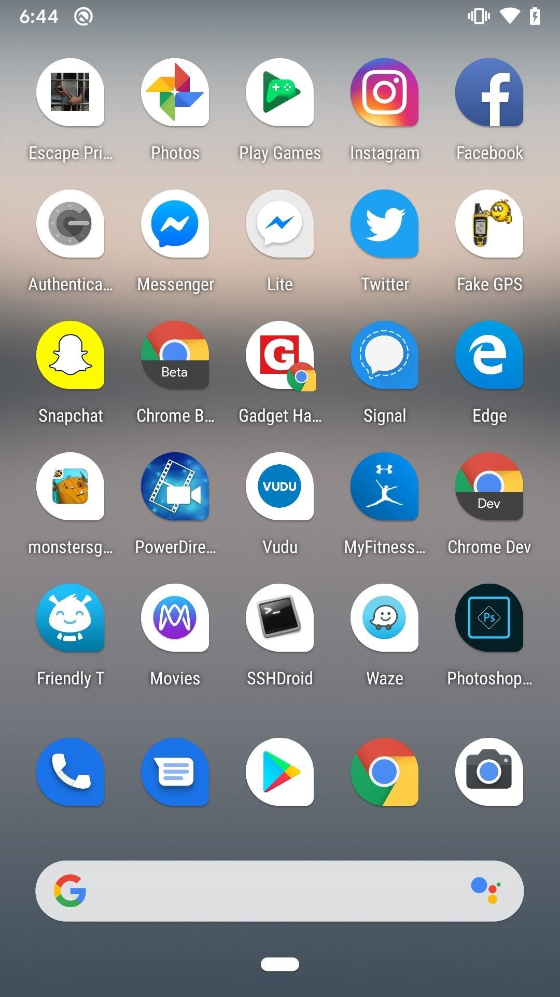
Launcher Intent filter
In the manifest:
<activity android:name=".MainActivity"> <intent-filter> <action android:name="android.intent.action.MAIN" /> <category android:name="android.intent.category.LAUNCHER" /> </intent-filter> </activity>
Home app populates the app launcher by finding all activities with intent filters that specify the ACTION_MAIN action and CATEGORY_LAUNCHER category. A match is only successful if the actions and categories in the intent match against the filter.
If your app does not define this intent filter in the manifest, it will not show up in launcher menu, and it will not be searchable from the Google Play Store.

Slide 9
What goes into an intent
Component name
The name of the component to start (optional), makes intent explicit if used
Action
Specifies the generic action to perform (view, pick, etc.)
Example: ACTION_VIEW with startActivity() if you want to launch a gallery app to display a photo
Data
URI (uniform resources identifier) + MIME type (multipurpose internet mail extension) helps android system find the best component to serve your intent
Category
Most intents do not require this, but it is a string containing additional information about the kind of component that should handle the intent
Extras
Key-value pairs carrying additional information required to complete the requested action, example, the email address of a recipient if you are creating an intent to open an email app
https://developer.android.com/guide/components/intents-filters

Slide 10
Lab 3: sending data between apps using Intents
Create 2 separate projects:
Project 1: ImplicitIntent
Project 2: ReceiveIntent
Project 1 will have a Plain Text widget to write message via keypad
Project 2 will have a TextView to display message from Project 1
Outline: The user will write a message in the Plain Text widget in Project 1 and press ‘Enter’. Project 1 will then create an Implicit Intent containing the message, which will open the app chooser. Project 2 will be visible in the app chooser because it will define the appropriate <intent-filter> component in its manifest. Project 2 will handle the incoming message, displaying it in a TextView
Bonus: use startActivityForResult() instead of startActivity() in Project 1 to receive back an edited version of the original message from Project 2.
https://developer.android.com/training/basics/intents/sending
https://developer.android.com/guide/components/intents-filters
https://developer.android.com/training/sharing/receive

