Slide 1
CS230 Developing Mobile Apps
Lecture 12

Slide 2

Content Providers
Content providers:
Help an app manage its stored data
Provide a way to share data with other apps
Encapsulate data
Provide mechanisms for defining data security
Content providers are the standard interface connecting data in one process with code running in another process
content provider
broadcast
service
activity
https://developer.android.com/guide/topics/providers/content-providers

Slide 3
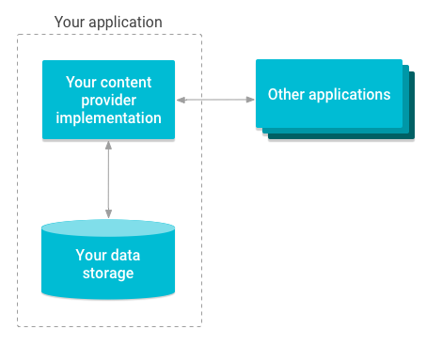
Content providers manage access to storage
Implementing a content provider has many advantages
Can configure a content provider to allow other apps to securely access and modify your app’s data
Use content providers if you plan to share data
May still use if you don’t plan to share, because they provide a nice abstraction
https://developer.android.com/guide/topics/providers/content-providers

Slide 4
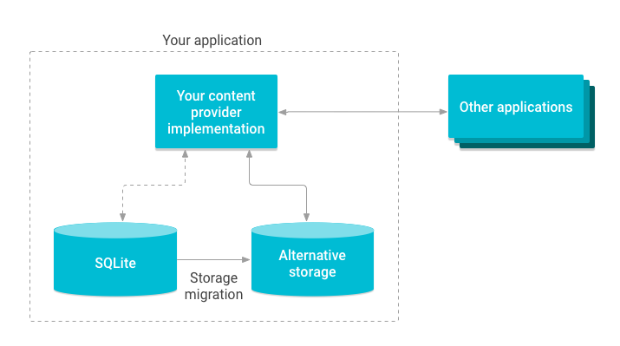
Illustration of migrating content provider storage:
Abstraction provided by content providers allows you to make modifications to your app data storage implementation without affecting other existing apps that rely on access to your data
Example: swap out an SQLite database for external storage
https://developer.android.com/guide/topics/providers/content-providers

Slide 5
Classes that rely on ContentProvider
AbstractThreadedSyncAdapter
CursorAdapter
CursorLoader
If you make use of any of these classes, need to implement content provider
Also need content provider in the following cases:
1) want to implement custom search suggestions in app
2) need to expose your application data to widgets
3) want to copy/paste complex data/files from your app to other apps
Android framework includes content providers managing data such as audio, video, images, and contact information. These are accessible to any Android app
Use content provider to access a variety of data storage sources, including:
Structured data (SQLite relational database)
Unstructured data (image files)
https://developer.android.com/guide/topics/providers/content-providers

Slide 6
Cursor
http://www.informit.com/articles/article.aspx?p=2731932&seqNum=4
Cursors contain the result set of a query made against a database in Android
Cursor class has an API that allows an app to read (in a type safe manner) the columns returned from the query, and iterate over rows of result set
Reading cursor data:
Once a cursor has been returned from database query, app needs to iterate over the result set and read column data from the cursor
Internally, the cursor stores the rows of data returned by query along with a position that points to current row of data in result set
Cursor class provides methods to manipulate its internal position:
Cursor.move(int offset)
Cursor.moveToFirst()
Cursor.moveToLast()
Cursor.moveToNext()
Cursor.moveToPosition(int position)
Cursor.moveToPrevious()

Slide 7
Advantages of content provider
Content providers offer granular control over permissions for accessing data
Can choose to restrict access to content provider to your app only
Can grant blanket permission to access data from other apps
Can configure different permissions for reading/writing data
Use content provider to abstract away details for accessing different data sources
Example: your app stores structured records in SQLite database, as well as video and audio files. Use a content provider to access all of this data in the same way
We will cover:
Content provider basics – access/update data using existing content provider
Creating a content provider – design and implement your own content provider
Calendar provider – access calendar provider (part of Android platform)
Contacts provider – access contacts provider (part of Android platform)
https://developer.android.com/guide/topics/providers/content-providers

Slide 8
Content provider basics
A content provider manages access to a central repository of data
Primarily intended to be used by other apps, which access the provider using a provider client object
Together, providers and provider clients offer a consistent, standard interface to data that also handles inter-process communication and secure data access
Work with content providers in one of two scenarios:
1) you want to implement code to access existing provider in another app
2) you want to create new provider in your own app to share data with other app
We will now cover the basics of working with existing content providers:
How content providers work
The API used to retrieve data from content provider
The API used to insert, update, or delete data in a content provider
Other API features that facilitate working with providers
https://developer.android.com/guide/topics/providers/content-provider-basics

Slide 9
Working with existing content provider (Overview)
Content provider presents data to external apps as one or more tables, similar to tables found in relational database
Row represents an instance for some type of data the provider collects
Each column represents an individual piece of data collected for an instance
Content provider coordinates data storage access for multiple APIs/components:
1) sharing access to your app data with other apps
2) sending data to a widget
3) returning custom search suggestions for your app through search framework using SearchRecentSuggestionsProvider
4) Synchronizing application data with your server using AbstractThreadedSyncAdapter
5) loading data in your UI using CursorLoader
https://developer.android.com/guide/topics/providers/content-provider-basics

Slide 10
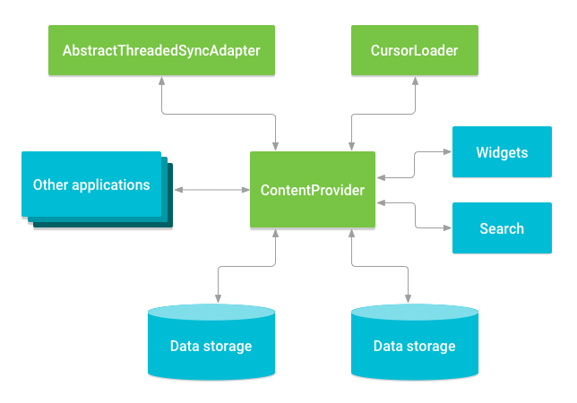
Relationship between content provider and other components
https://developer.android.com/guide/topics/providers/content-provider-basics

Slide 11
Accessing a provider
Use ContentResolver object in your app’s Context to access data as a client from a content provider
ContentResolver object communicates with ContentProvider class object
Provider object receives requests from client, performs action, returns result
ContentResolver object has methods that call identically-named methods in ContentProvider object
ContentResolver methods provide basic CRUD (create, retrieve, update, delete) functions of persistent storage
https://developer.android.com/guide/topics/providers/content-provider-basics

Slide 12
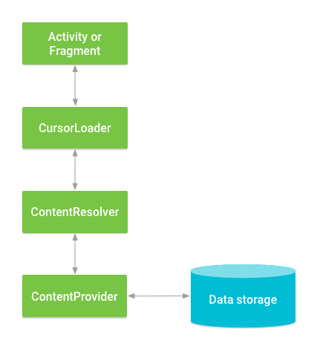
Interaction between ContentProvider, other classes, and storage
Common pattern for accessing a ContentProvider from your UI:
1) use a CursorLoader to run asynchronous query in background of Activity
2) query gets the ContentProvider using the ContentResolver
UI continues to be available to user while query is running
Note – to access a provider, your app has to request specific permissions in manifest (Content Provider permissions, later)
https://developer.android.com/guide/topics/providers/content-provider-basics

Slide 13
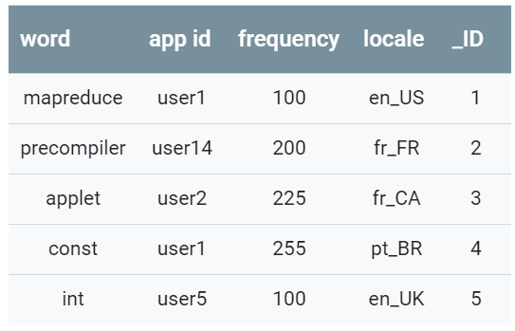
User Dictionary
One of the built-in providers in Android is the user dictionary, which stores spellings of non-standard words the user wants to keep
Each row represents an instance of a word that might not be found in a standard dictionary
Each column represents some data for that word, such as where it was first encountered (locale)
Example of what user dictionary data might look like in content provider’s table
// Queries the user dictionary and returns results cursor = getContentResolver().query( UserDictionary.Words.CONTENT_URI, // The content URI of the words table projection, // The columns to return for each row selectionClause, // Selection criteria selectionArgs, // Selection criteria sortOrder); // The sort order for the returned rows
https://developer.android.com/guide/topics/providers/content-provider-basics

Slide 14
Content URI
A content URI is a URI that identifies data in a provider
Content URIs include the symbolic name of the entire provider (its authority) and a name that points to a table (path)
When you call a client method to access a table in a provider, the content URI for the table is one of the arguments
In previous slide, constant CONTENT_URI contains the content URI of the user dictionary ‘words’ table.
ContentResolver parses URIs authority, and uses it to resolve the provider by comparing the authority to a system table of known providers
ContentResolver can then dispatch query arguments to correct provider
ContentProvider uses the path part of content URI to choose table to access
In previous example, full URI for ‘words’ table is: content://user_dictionary/words
Where user_dictionary string is provider’s authority, word string is table’s path
String content:// (scheme) is always present, and identifies it as a content URI
Many providers allow access to a single row in table by appending an ID to the URI
Example: retrieve a row whose _ID is 4:
Uri singleUri = ContentUris.withAppendedId(UserDictionary.Words.CONTENT_URI,4);
https://developer.android.com/guide/topics/providers/content-provider-basics

Slide 15
Retrieving data from a provider
To retrieve data from provider, follow these basic steps:
1) Request read access permission from provider
2) define the code that sends a query to the provider
Requesting read access permission:
App needs “read access permission” to request data from a provider
Request in manifest <uses-permission>, using exact permission name defined by provider
Request is implicitly granted by the user when they install your app
Look in provider’s documentation to find exact name of read access permission
Example: android.permission.READ_USER_DICTIONARY must be requested in your app’s manifest to read the device’s dictionary
https://developer.android.com/guide/topics/providers/content-provider-basics

Slide 16
Constructing a query
Define some variables for accessing the dictionary provider:
// A "projection" defines the columns that will be returned for each row String[] mProjection = { UserDictionary.Words._ID, // Contract class constant for the _ID column name UserDictionary.Words.WORD, // Contract class constant for the word column name UserDictionary.Words.LOCALE // Contract class constant for the locale column name }; // Defines a string to contain the selection clause String selectionClause = null; // Initializes an array to contain selection arguments String[] selectionArgs = {""};
https://developer.android.com/guide/topics/providers/content-provider-basics

Slide 17
Constructing a query
Code showing how to use ContentResolver.query(), with User Dictionary Provider as an example
Provider client query is similar to an SQL query, contains a set of columns to return, a set of selection criteria, and sort order
Set of columns that query should return is called a projection
Expression specifying rows to retrieve is split into a selection clause and selection arguments.
Selection clause is a combination of logical and Boolean expressions, column names, and values (mSelectionClause)
If you specify a replaceable parameter ‘?’ instead of a value, query method will retrieve the value from the selection arguments array (mSelectionArgs)
If the user doesn’t enter a word, selection clause is set to null, and query returns all words in the provider.
If user enters a word, selection clause is set to UserDictionary.Words.WORD + “=?” and the first argument of selection arguments array is set to the word the user enters
/* * This defines a one-element String array to contain the selection argument. */ String[] selectionArgs = {""}; // Gets a word from the UI searchString = searchWord.getText().toString(); // Remember to insert code here to check for invalid or malicious input. // If the word is the empty string, gets everything if (TextUtils.isEmpty(searchString)) { // Setting the selection clause to null will return all words selectionClause = null; selectionArgs[0] = ""; } else { // Constructs a selection clause that matches the word that the user entered. selectionClause = UserDictionary.Words.WORD + " = ?"; // Moves the user's input string to the selection arguments. selectionArgs[0] = searchString; } // Does a query against the table and returns a Cursor object mCursor = getContentResolver().query( UserDictionary.Words.CONTENT_URI, // The content URI of the words table projection, // The columns to return for each row selectionClause, // Either null, or the word the user entered selectionArgs, // Either empty, or the string the user entered sortOrder); // The sort order for the returned rows // Some providers return null if an error occurs, others throw an exception if (null == mCursor) { /* * Insert code here to handle the error. Be sure not to use the cursor! You may want to * call android.util.Log.e() to log this error. * */ // If the Cursor is empty, the provider found no matches } else if (mCursor.getCount() < 1) { /* * Insert code here to notify the user that the search was unsuccessful. This isn't necessarily * an error. You may want to offer the user the option to insert a new row, or re-type the * search term. */ } else { // Insert code here to do something with the results }
https://developer.android.com/guide/topics/providers/content-provider-basics

Slide 18
Displaying query results
ContentResolver.query() client method always returns a Cursor containing columns specified by query’s projection for rows that match query’s selection criteria
Cursor object provides random read access to the rows and columns it contains
Using Cursor methods, you can iterate over the rows in results, determine data type of each column, get the data from a column, and examine other properties
Some cursor implementations automatically update the object when the provider’s data changes, or trigger methods in observer object when Cursor changes, or both
If no rows match the selection criteria, the provider returns a Cursor object for which Cursor.getCount() is 0 (empty cursor)
If internal error occurs, results of query depend on particular provider.
May choose to return null, or may throw an exception
Since a Cursor is a “list” of rows, a good way to display the contents of a Cursor is to link it to a ListView via a SimpleCursorAdapter
https://developer.android.com/guide/topics/providers/content-provider-basics

Slide 19
This snippet continues the previous snippet
Creates a SimpleCursorAdapter object containing Cursor retrieved by the query, and sets this object to be the adapter for a ListView
// Defines a list of columns to retrieve from the Cursor and load into an output row String[] wordListColumns = { UserDictionary.Words.WORD, // Contract class constant containing the word column name UserDictionary.Words.LOCALE // Contract class constant containing the locale column name }; // Defines a list of View IDs that will receive the Cursor columns for each row int[] wordListItems = { R.id.dictWord, R.id.locale}; // Creates a new SimpleCursorAdapter cursorAdapter = new SimpleCursorAdapter( getApplicationContext(), // The application's Context object R.layout.wordlistrow, // A layout in XML for one row in the ListView mCursor, // The result from the query wordListColumns, // A string array of column names in the cursor wordListItems, // An integer array of view IDs in the row layout 0); // Flags (usually none are needed) // Sets the adapter for the ListView wordList.setAdapter(cursorAdapter);
https://developer.android.com/guide/topics/providers/content-provider-basics

Slide 20
Content provider permissions
Provider’s app can specify permissions other apps must have to access its data
This ensures user knows what data another app will try to access
Based on provider’s requirements, other apps request necessary permissions
End users see the requested permissions when they install the app
If provider’s app specifies no permissions, other apps cannot access its data
Components in provider’s app always have full read/write access, regardless of the specified permissions
User Dictionary Provider requires android.permission.READ_USER_DICTIONARY to retrieve data from it. The provider itself has the separate WRITE_USER_DICTIONARY permission for inserting, updating, or deleting data
Request permissions using <uses-permission> element in manifest
<uses-permission android:name="android.permission.READ_USER_DICTIONARY">
https://developer.android.com/guide/topics/providers/content-provider-basics

Slide 21
Inserting, updating, and deleting data
In the same way that you retrieve data, also use ContentResolver to modify data
Call a method of ContentResolver with arguments that are passed to corresponding method of ContentProvider
Provider and client automatically handle security and IPC
Inserting data:
Call ContentResolver.insert() to insert data into a provider
insert() inserts a new row into provider and returns content URI for that row
https://developer.android.com/guide/topics/providers/content-provider-basics

Slide 22
Inserting data
// Defines a new Uri object that receives the result of the insertion Uri newUri; ... // Defines an object to contain the new values to insert ContentValues newValues = new ContentValues(); /* * Sets the values of each column and inserts the word. The arguments to the "put" * method are "column name" and "value" */ newValues.put(UserDictionary.Words.APP_ID, "example.user"); newValues.put(UserDictionary.Words.LOCALE, "en_US"); newValues.put(UserDictionary.Words.WORD, "insert"); newValues.put(UserDictionary.Words.FREQUENCY, "100"); newUri = getContentResolver().insert( UserDictionary.Words.CONTENT_URI, // the user dictionary content URI newValues // the values to insert );
Inserting a new word into the User Dictionary Provider
Data for new row goes into a single ContentValues object, which is similar in form to a one-row cursor
Columns in this object need not have same data type, and can be null
This snippet doesn’t add the _ID column, because provider assigns this automatically
Content URI returned in newUri identifies newly added row: content://user_dictionary/words/<id_value>
where id_value is the contents of _ID for the new row, get this using ContentUris.parseId()
https://developer.android.com/guide/topics/providers/content-provider-basics

Slide 23
Updating data
This snippet changes all rows whose locale has a value of “en” to null
To update a row, use a ContentValues object with updated values just as with insertion, and selection criteria just as with a query
The client method you use is ContentResolver.update()
You only need to add values to the ContentValues object for columns you’re updating
To clear a column, set value to null
Return value is number of updated rows
// Defines an object to contain the updated values ContentValues updateValues = new ContentValues(); // Defines selection criteria for the rows you want to update String selectionClause = UserDictionary.Words.LOCALE + " LIKE ?"; String[] selectionArgs = {"en_%"}; // Defines a variable to contain the number of updated rows int rowsUpdated = 0; ... /* * Sets the updated value and updates the selected words. */ updateValues.putNull(UserDictionary.Words.LOCALE); rowsUpdated = getContentResolver().update( UserDictionary.Words.CONTENT_URI, // the user dictionary content URI updateValues, // the columns to update selectionClause, // the column to select on selectionArgs // the value to compare to );
https://developer.android.com/guide/topics/providers/content-provider-basics

Slide 24
Deleting data
Deleting rows is similar to retrieving row data:
Specify selection criteria for the rows you want to delete, and client method returns number of deleted rows
This code deletes rows whose appid matches ‘user’
// Defines selection criteria for the rows you want to delete String selectionClause = UserDictionary.Words.APP_ID + " LIKE ?"; String[] selectionArgs = {"user"}; // Defines a variable to contain the number of rows deleted int rowsDeleted = 0; ... // Deletes the words that match the selection criteria rowsDeleted = getContentResolver().delete( UserDictionary.Words.CONTENT_URI, // the user dictionary content URI selectionClause, // the column to select on selectionArgs // the value to compare to );
https://developer.android.com/guide/topics/providers/content-provider-basics

Slide 25
Provider data types
Content providers can offer many different data types
User Dictionary Provider seen in preceding examples offers only text, but providers can also offer following formats:
integer
long integer (long)
floating point
long floating point (double)
Another data type providers often use is Binary Large OBject (BLOB), implemented as 64KB byte array.
Check available data types by looking at Cursor class’s “get” methods
Data type for each column in a provider is usually provided in its documentation
Example for User Dictionary: https://developer.android.com/reference/android/provider/UserDictionary.Words.html
https://developer.android.com/guide/topics/providers/content-provider-basics

Slide 26
Contract classes
Contract class defines constants that help apps work with content URIs, column names, intent actions, and other features of a content provider
Not included automatically with provider, provider’s developer has to define them and make them available to other developers
Check android.provider package for Android’s contract classes:
https://developer.android.com/reference/android/provider/package-summary.html
Example: User Dictionary Provider has contract class UserDictionary containing content URI and column name constants
Content URI for “words” table is defined in constant UserDictionary.Words.CONTENT_URI
UserDictionary.Words class also contains column name constants, used throughout the code snippets in this guide
Example: query projection can be defined:
String[] projection = { UserDictionary.Words._ID, UserDictionary.Words.WORD, UserDictionary.Words.LOCALE };
https://developer.android.com/guide/topics/providers/content-provider-basics

Slide 27
MIME type reference
Content providers can return standard MIME media types, or custom MIME type strings, or both
MIME types have the format: type/subtype
Example: well-known MIME type text/html has text type and html subtype
If provider returns this type for a URI, it means a query using that URI will return text containing HTML tags
Custom MIME type strings or “vendor-specific” MIME types are more complex:
Type value is always vnd.android.cursor.dir (for multiple rows)
Or vnd.android.cursor.item (for a single row)
The subtype is provider specific, Android built-in providers usually have a simple subtype
Example: when Contacts app creates a row for new phone number, it sets following MIME type in the row: vnd.android.cursor.item/phone_v2
Most content providers define contract class constants for MIME types they use:
For contacts https://developer.android.com/reference/android/provider/ContactsContract.RawContacts.html
https://developer.android.com/guide/topics/providers/content-provider-basics

Slide 28
Lab 7 Contacts provider
Retrieve list of contacts using ContactsContract class
Display the results using a ListView
Bonus (0.5%) retrieve and display contacts details when user clicks ListView item

Slide 29
Contacts provider
Contacts provider manages devices central repository of data about people
Source of data you see in device’s contacts app
You can access its data in your own app
Contact provider is complex and its API include an extensive set of contract classes and interfaces facilitating data retrieval/modification
We will look at:
Basic contacts provider structure
How to retrieve data from contacts provider
How to modify data in the provider
How to write sync adapter for synchronizing data from your server to provider
https://developer.android.com/guide/topics/providers/contacts-provider

Slide 30
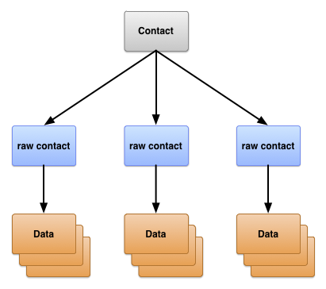
Contacts provide organization
Contact provider maintains three types of data about a person, each corresponding to a table offered by the provider
1) ContactsContract.Contacts table
Row representing different people based on aggregation of raw contact rows
2) ContactsContract.RawContacts table
Rows containing summary of a person’s data specific to a user account and type
3) ConctactsContract.Data table
Rows containing details for a raw contact, such as email addresses and phone numbers
https://developer.android.com/guide/topics/providers/contacts-provider

Slide 31
Raw contacts
Represents a person’s data coming from single account type and account name
Can have multiple raw contacts for the same person
To understand how raw contacts work, consider user ‘Emily Dickenson’ who has following three user accounts defined on her device:
1) Emily.dickinson@gmail.com
2) emilyd@gmail.com
3) twitter account “belle_of_amherst”
The user has enabled sync contacts for all three accounts in Accounts settings
Suppose Emily opens browser and logs into gmail as (1), opens contacts, and adds “Thomas Higginson”. Later, she logs into gmail as (2), and sends an email to “Thomas Higginson”, which automatically adds him as a contact. She also follows “colonel_tom” (Thomas Higgonson’s twitter ID) on Twitter
Contacts Provider creates three raw contacts as a result of this work:
A) raw contact for Thomas Higginson associated to Emily.dickinson@gmail.com
B) a second raw contact for Thomas Higginson associated to emilyd@gmail.com
C) a third contact for Thomas Higgonson associated with belle_of_amherst
https://developer.android.com/guide/topics/providers/contacts-provider

Slide 32
Data
Data for raw contact is stored in ContactsContract.Data row, that is linked to raw contact’s _ID value
This allows single raw contacts to have multiple instances of the same type of data such as emails or phone numbers
Different types of data are stored in this single table:
Display name, phone number, email, postal address, photo, website details, etc.
To help manage this, ContactsContract.Data table has some columns with descriptive names and others with generic names
Descriptive column name examples:
RAW_CONTACT_ID – the value of _ID column of raw contact for this data
MIMETYPE – type of data stored in this row expressed as custom MIME type
IS_PRIMARY – if this type of data row can occur more than once for raw contact, flags the data row that contains primary data for the type
https://developer.android.com/guide/topics/providers/contacts-provider

Slide 33
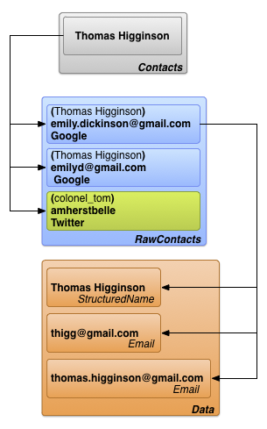
Contacts
Contacts provider combines raw contact rows across all account types and account names to form a contact
This facilitates displaying and modifying all data a user has collected for a person
Contacts provider manages creation of new contact rows, and aggregation of raw contacts with an existing contact row
Apps are not allowed to add contacts, some columns in contact row are read-only
Contacts provider creates new contact upon addition of new raw contact that doesn’t match any existing contacts
Contacts provider links a contact row to its raw contact rows with the contact row’s _ID column in the Contacts table
https://developer.android.com/guide/topics/providers/contacts-provider

Slide 34
Retrieving a list of contacts
We will retrieve a list of contacts whose data matches all or part of a search string
Multiple techniques:
1) match contact names
2) match a specific type of data such as a phone number
3) match any type of data
To do any type of search of the Contacts Provider, your app must have the READ_CONTACTS permission:
We will now see how to match a contact by name and list the results (lab 7)
<uses-permission android:name="android.permission.READ_CONTACTS" />
https://developer.android.com/training/contacts-provider/retrieve-names

Slide 35
Match a contact by name and list the results
This technique tries to match a search string to the name of a contact or contacts in the Contact Provider’s ContactsContract.Contacts table
Display the results in a ListView, to allow user to choose among matched contacts
Can also use recyclerView or any type of display you want
Android provides a contracts class called ContactsContract, which defines useful contacts and methods for accessing the provider
When you use ContactsContract, you don’t have to define your own constants for content URIs, table names, or columns
import android.provider.ContactsContract;
https://developer.android.com/training/contacts-provider/retrieve-names

Slide 36
Define a projection
Define a constant that contains the columns you want to return from your query
Each item in your ListView displays the contact’s display name, containing the main form of the contact’s name
In Android 11 and later, this is DISPLAY_NAME_PRIMARY
Column Contacts._ID is used together with LOOKUP_KEY to construct a content URI for the contact the user selects
@SuppressLint("InlinedApi") private static final String[] PROJECTION = { Contacts._ID, Contacts.LOOKUP_KEY, Build.VERSION.SDK_INT >= Build.VERSION_CODES.HONEYCOMB ? ContactsContract.Contacts.DISPLAY_NAME_PRIMARY : ContactsContract.Contacts.DISPLAY_NAME };
https://developer.android.com/training/contacts-provider/retrieve-names

Slide 37
Specify the selection criteria
To specify the data you want, create a combination of text expressions and variables that tell the provider which columns to search and values to find
For the text expression, define a constant that lists the search columns
Preferred practice is to represent the values with a “?” placeholder
During retrieval, the placeholder is replaced with values from an array
// Defines the text expression @SuppressLint("InlinedApi") private static final String SELECTION = Build.VERSION.SDK_INT >= Build.VERSION_CODES.HONEYCOMB ? Contacts.DISPLAY_NAME_PRIMARY + " LIKE ?" : Contacts.DISPLAY_NAME + " LIKE ?"; // Defines a variable for the search string private String searchString; // Defines the array to hold values that replace the ? private String[] selectionArgs = { searchString };
https://developer.android.com/training/contacts-provider/retrieve-names

Slide 38
Implement onCreateLoader()
In onCreateLoader(), set up the search string pattern
To make a string into a pattern, insert “%” characters to represent a sequence of zero or more characters, or “_” to represent a single character
Example: %Jefferson% would match both “Thomas Jefferson”, “Jefferson Davis”
@Override public Loader<Cursor> onCreateLoader(int loaderId, Bundle args) { /* * Makes search string into pattern and * stores it in the selection array */ selectionArgs[0] = "%" + searchString + "%"; // Starts the query return new CursorLoader( getActivity(), ContactsContract.Contacts.CONTENT_URI, PROJECTION, SELECTION, selectionArgs, null ); }
https://developer.android.com/training/contacts-provider/retrieve-names

Slide 39
Recap
Contact provider helps app manage stored data and share data with other apps
Allows for granular control over data access permissions
Allows for abstraction of app’s data
Fourth component of 4 main components in Android development
Lab 7 – retrieve list of contacts using ContactsContract and display
https://developer.android.com/training/contacts-provider/retrieve-names

