Slide 1
Activities

Slide 2
Concept of an Activity
Activity class is a crucial component of an Android app
Unlike programming paradigms with the main() method, Android system initiates code in an Activity instance by invoking specific callback methods corresponding to specific lifecycle stages
Mobile app experience differs from desktop – user interaction with the app doesn’t always begin in the same place (email app – launched from home, or launched from a social media app)
Apps are composed of different activities – when one app invokes another, it calls a specific activity, rather than the app as a whole.
Activity class serves as entry point for app’s interaction with user
activity (noun) – “the condition in which things are happening or being done.” (Merriam Webster dictionary)

Slide 3
One Activity = one screen
An activity provides the window in which the app draws its user interface (UI), can fill screen or float on top of other windows
Example: photo app has gallery and preferences screen, each a separate Activity
Most apps contain multiple activities (and multiple screens)
The main activity is the first screen to appear when the app is launched, from there the user can launch other activities
Activities are only loosely bound to one another within an app, and can be launched independently
To use activities, they must be registered in the app’s manifest

Slide 4
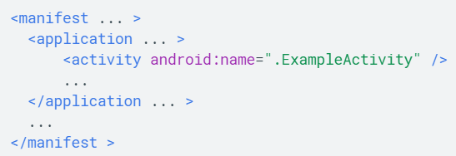
Declare an Activity
Add an <activity> element as a child of the <application> element in the manifest
Requires android:name
Other attributes (label, icon UI theme, etc) can be added

Slide 5
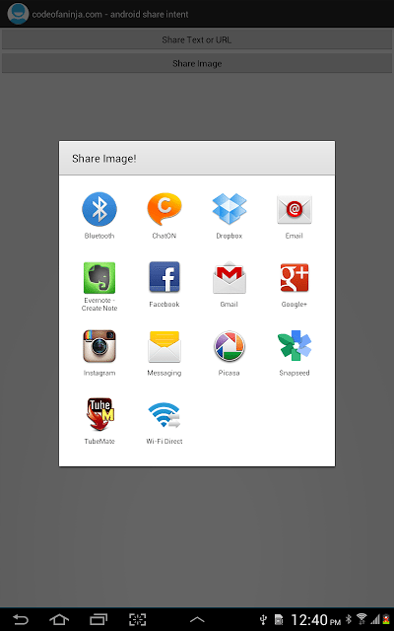
Intent filters
Another fundamental feature of Android, Intent filters provide the ability to launch an activity based on explicit and implicit requests
Example of explicit request: “start send email activity from Outlook”
Example of implicit request: “start send email activity from any app capable of sending emails”
When the system UI prompts the user to select a specific app for a task, that’s an intent filter at work

Slide 6
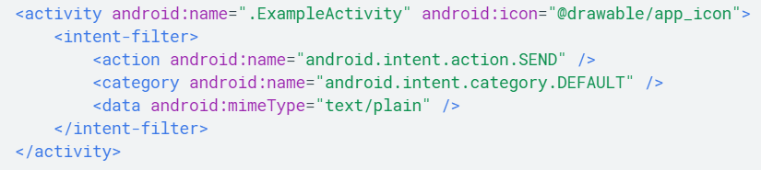
Declaring an intent filter
Declare the <intent-filter> attribute within the <activity> element
Requires an <action> element, optionally <category> and/or <data>
Together, these elements specify which intents your activity can respond to
Example: an activity that sends text data, and receives requests from other activities to send text data

Slide 7
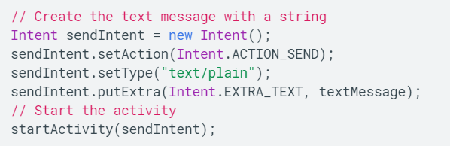
Calling the send text data Activity:
Java
XML
Note – intent filters are not necessary if you want your app to be self-contained/disallow other apps from activating its activities.

Slide 8
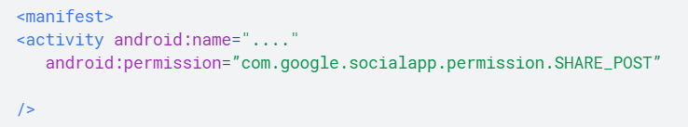
Permissions
Use the manifest’s <activity> tag to control which apps can start a specific activity
A parent activity cannot launch a child activity unless they both declare the same permission in the manifest
Example: if your app wants to use ‘SocialApp’ to share a post on social media, SocialApp must define the permission that an app calling it must have:
Then, to be allowed to call SocialApp, your app must match the permission set in SocialApp’s manifest:

Slide 9
Activity lifecycle callback summary
Activity goes through a number of states over the course of its life, a series of callback functions are used to handle the transitions between an activity’s states:
onCreate () – fires when system creates activity. Initializes essential activity components. Example: create views, bind data to lists. Must call setContentView() to define layout for activity’s UI
onStart() – called directly after onCreate(), final preparations for coming to foreground and becoming interactive
onResume() – last callback before activity can interact with user. Activity is now at top of activity stack, capturing all user input. Called after onRestoreInstanceState(Bundle). Always followed by onPause()
onPause() – called when activity loses focus, entering paused state (back button press or menu button press). May continue to update UI. Always followed by onResume() or onStop()
onStop() – called when activity is no longer visible to user (activity was destroyed, another activity was started/resumed). Always followed by onRestart() or onDestroy()
onRestart() – called when activity in stopped state is about to restart, restores state of activity from the time it was stopped
onDestroy() – called before an activity is destroyed. Implemented to ensure that all of an activities resources are released when the activity is destroyed.

Slide 10
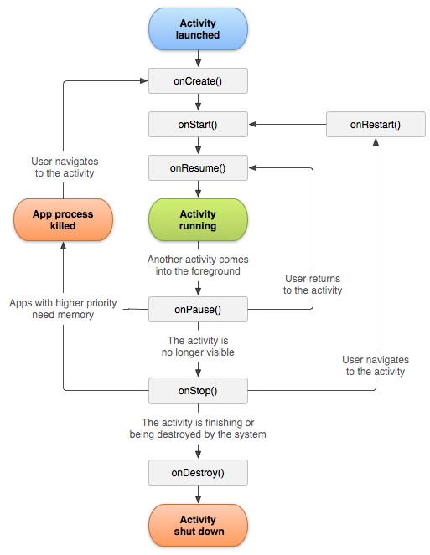
Activity lifecycle diagram:
https://developer.android.com/guide/components/activities/activity-lifecycle

Slide 11
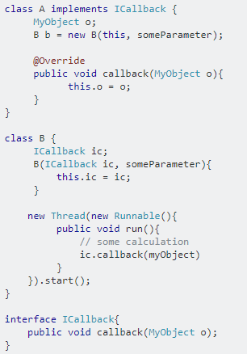
Callback functions
In Java/Android, callback functions are implemented through interfaces
Example: class A implements the ICallback interface with its callback() method.
Class A then calls class B to do some work.
When class B finishes its work, it can notify class A through the callback function
https://stackoverflow.com/questions/18054720/what-is-callback-in-android

Slide 12
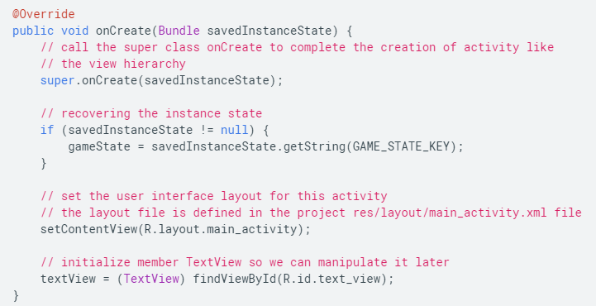
onCreate() callback
Fires when system first creates the activity
Perform all the logic that happens only once per Activity lifetime
Bind data to lists
Associate activity with a ViewModel
Instantiate class-scope variables
Receives parameter savedInstanceState, a Bundle object containing the activity’s previously save state (screen orientation changes, etc)
Lifecycle aware components hooked up to lifecycle of your activity will receive ON_CREATE event
Activity quickly moves from onCreate() to onStart()
https://developer.android.com/guide/components/activities/activity-lifecycle

Slide 13
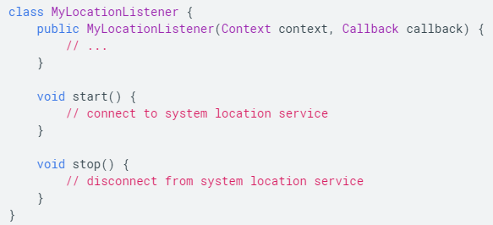
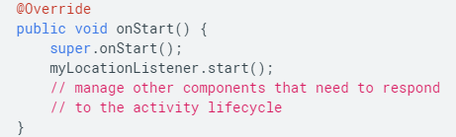
Lifecycle-aware components
BAD EXAMPLE:
A location listener for your app:
Lifecycle-aware components perform actions in response to a change in the lifestyle status of another component such as activities or fragments
Helps produce better organized, lighter weight code that is easier to maintain
Allows you to move code out of the lifecycle callbacks (onCreate(), onStart(), etc) and into the components themselves
android.arch.lifecycle package provides classes and interfaces that let you build lifecycle-aware components
And in your mainActivity’s onStart() :
Instead, add a lifecycle observer to the MyLocationListener
https://developer.android.com/topic/libraries/architecture/lifecycle

Slide 14
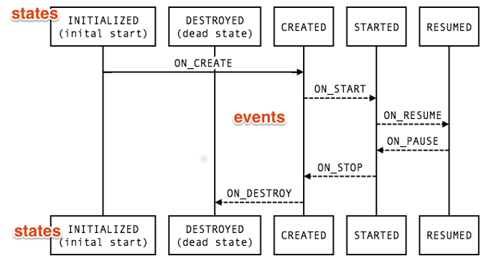
Lifecycle class
Lifecycle is a class holding information about the lifecycle of your activity, allowing other objects to observe the activity’s state
Lifecycle uses two main enumerations to track lifecycle status for its associated component
Event: the lifecycle events that are dispatched from the framework and Lifecycle class, these events map to callback methods in Activity
State: the current state of the component tracked by Lifecycle object
Think of the states as nodes of a graph, and events as edges between the nodes
https://developer.android.com/topic/libraries/architecture/lifecycle

Slide 15
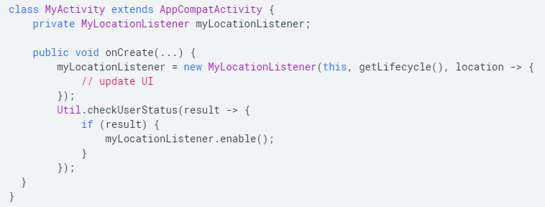
Using LifecycleObserver example
Have MyLocationObserver class implement LifecycleObserver, and then initialize it with the activity’s Lifecycle in onCreate()
This allows MyLocationObserver to implement its own logic to react to changes in the activity’s lifecycle, rather than relying on the activity to call its lifecycle change methods
https://developer.android.com/topic/libraries/architecture/lifecycle

Slide 16
onStart() callback
Fires as the activity enters the started state
Makes the activity visible to the user as it enters the foreground and becomes interactive
This is where the app initializes the code that maintains the UI
When activity moves to started state, any lifecycle-aware component tied to the activity’s lifecycle receives the ON_START event
Finishes quickly, followed by onResume()
https://developer.android.com/guide/components/activities/activity-lifecycle

Slide 17
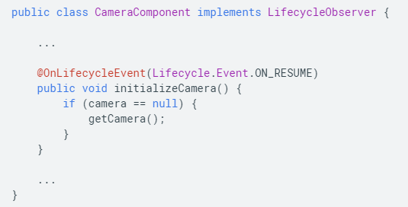
onResume()
Called when the activity comes to the foreground. This is the state in which the app interacts with the user.
Lifecycle-aware components will receive ON_RESUME event, so they can enable any functionality that needs to run while the component is visible and in the foreground (example: showing camera preview)
Activity cycles between onPause() and onResume() when something happens to interrupt the app briefly (phone call, screen off)
Therefore, onResume() should initialize any components released during onPause()
Example of a lifecycle aware component accessing the camera when it receives an ON_RESUME event
https://developer.android.com/guide/components/activities/activity-lifecycle

Slide 18
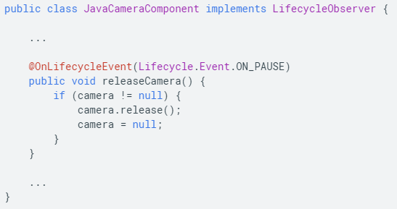
onPause()
Called on first indication user is leaving the activity, indicates the activity is no longer in the foreground (though may still be visible if multi-window mode enabled)
Use onPause() to pause or adjust operations that you expect to resume shortly
As long as the activity is partially visible but not in focus, it remains paused.
Any lifecycle aware components tied to the activity will receive the ON_PAUSE event when the activity is paused
Do not use onPause() to perform long-running operations (saving data, network calls, database transactions) as onPause() is very brief and the work may not complete before the method ends.
Example of LifecycleObserver reacting to ON_PAUSE, releasing the camera that was initialized in ON_RESUME earlier
https://developer.android.com/guide/components/activities/activity-lifecycle

Slide 19
onStop()
Invoked when the activity is no longer visible to the user (newly launched activity covers the screen or activity finishes running)
Lifecycle-aware components receive the ON_STOP event
Use onStop() to release or adjust resources not needed while the app is not visible to user (animations, or fine-grained map updates)
Use onStop() to perform CPU intensive shutdown operations like saving information to a database
The Activity object is kept in memory after onStop(), maintaining all state and member information, so there is no need to re-initialize components created during onCreate() or onStart().
https://developer.android.com/guide/components/activities/activity-lifecycle

Slide 20
onDestroy()
Called before the activity is destroyed, for one of two reasons
1) activity is finishing due to user shutdown or finish() being called
2) system temporarily destroys activity due to configuration change (device rotation)
Lifecycle-aware components will receive the ON_DESTROY event
Use the isFinishing() method to distinguish between 1 & 2 (shutdown, or configuration change)
onDestroy() should release all resources not yet released by earlier callbacks (onStop(), onPause())
https://developer.android.com/guide/components/activities/activity-lifecycle

Slide 21
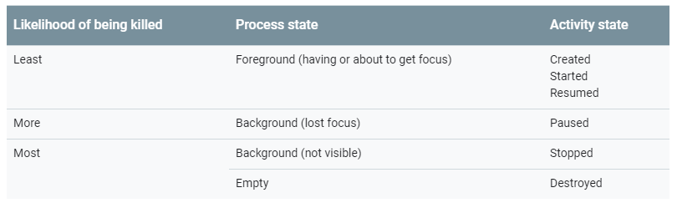
Activity state and ejection from memory
The system kills processes when it needs to free up RAM. The likelihood of a process being killed depends on its Activity’s state:
The system will kill the process the activity is running in, destroying the activity and everything else running in the process
https://developer.android.com/guide/components/activities/activity-lifecycle

Slide 22
Instance state
When the activity is destroyed through system constraints (memory, device orientation change) the system remembers the activity’s existence, and will be able to create a new instance of the activity using a set of saved data describing the state of the activity
This saved data is called the Instance state, a collection of key-value pairs stored in a Bundle object
By default, the Bundle saves information about each View object in your activity, layout (ex: text field of EditText widget), however your activity might have other state information you’d like to restore (member variables)
Due to the fact that Bundle is only appropriate for saving a trivial amount of data (requires serialization on the main thread, consuming system-process memory), we use a combined approach to preserving data: persistent local storage, onSavedInstanceState(), and ViewModel class
https://developer.android.com/guide/components/activities/activity-lifecycle

Slide 23
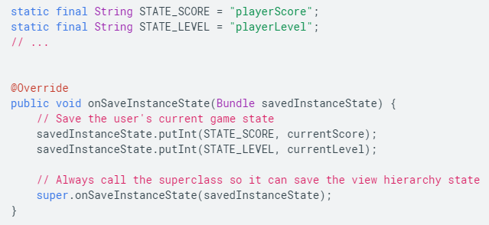
onSaveInstanceState() callback
Called as the activity begins to stop, so your activity can save state information to an instance state bundle. By default, only saves transient information about the view hierarchy’s state
To save additional information, override onSaveInstanceState() and add key-value pairs to the Bundle object
To retrieve these values, just call savedInstanceState.get in onCreate()
Example: overriding onSaveInstanceState() to save the player’s score and level
https://developer.android.com/guide/components/activities/activity-lifecycle

Slide 24
Configuration change occurs
Change from portrait to landscape (phone rotated)
Activity is destroyed and recreated (onPause->onStop->onDestroy are all triggered), new activity is created (onCreate->onStart->onResume are all triggered)
Use a combination of ViewModels, onSaveInstanceState(), and/or persistent and local storage to preserve activity’s UI state
When an app switches from single-window to multi-window mode, a configuration change occurs, however, when switching between two apps in multi-window mode, only onPause() or onResume() is called
https://developer.android.com/guide/components/activities/state-changes

Slide 25
Activity of dialogue appears in foreground
If a new activity or dialogue appears in the foreground taking focus and partially covering the activity in progress (facebook messenger), onPause() is called
If the new activity/dialogue completely covers the activity in progress, onPause() and onStop() are called.
When the covered activity comes back to the foreground, onRestart()->onStart()->onResume() are called
https://developer.android.com/guide/components/activities/state-changes

Slide 26
User taps back button
When the user taps the back button on a device, activity is destroyed (onPause->onStop->onDestroy), and the activity is also removed from the back stack
onSaveInstanceState is not called in the case of a back button press, because it is assumed that the user tapped back with no intention of returning
You can override onBackPressed(), to implement a confirmation dialogue box, or some other behavior
https://developer.android.com/guide/components/activities/state-changes

Slide 27
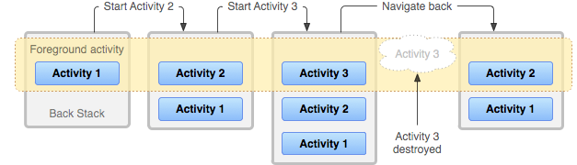
Tasks and the back stack
A task is a collection of activities that users interact with when performing a certain job, the activities are arranged in a stack called the back stack, in the order in which each activity is opened
Example: email app, user opens email from inbox, the message is displayed using a new activity which is added to the back stack, if the user presses back the message activity is popped off the back stack
https://developer.android.com/guide/components/activities/tasks-and-back-stack

Slide 28
Exercise: testing your app’s activities
https://developer.android.com/guide/components/activities/testing
Test how your app behaves in certain instances, such as:
Another app such as the phone interrupts your activity
The system destroys and recreates your activity
The user places your activity in a new windowing environment (multi-window or picture in picture)
Exercise using ActivityScenario, a cross-platform API to place your activity in states simulating device-level events just described

