Slide 1
Background tasks

Slide 2
Background tasks
We will learn how to efficiently run apps in the background while your app’s UI may not be visible, while minimizing battery usage
https://developer.android.com/guide/background
https://developer.android.com/guide/background

Slide 3
Guide to background processing
Every app has a main thread that handles the UI, measures and draws Views, coordinates user action and receives/acts on lifecycle events
If too much is happening in the main thread (UI thread), the app appears to freeze or slow down, creating undesirable user experience
Long running operations (disk access, bitmap decoding, network requests) should be done on a separate background thread (anything that takes more than a few milliseconds)
Some tasks can be performed in another thread while the user continues to interact with the app, but some apps may run tasks even when the user has left the app (synching periodically with background server, fetching new content within the app, etc)
This presentation will teach you how to most effectively handle these cases where the user has left the app, but the app continues to run in the background (background processing)
https://developer.android.com/guide/background

Slide 4
Challenges in background processing
Background tasks consume CPU, RAM, and battery, which can affect the device’s overall function if not handled correctly
Android restricts background work when the app is not visible to the user:
Doze mode (Android 6.0) – restricts app behavior when the screen is off, and device is stationary.
Standby (Android 6.0) – puts unused applications into a special state restricting their network access, jobs, and syncs
Limited implicit broadcasts (Android 7.0) and doze-on-the-go
Android 8.0 further limits background behavior (reduced location access from background, releasing cached wakelocks)
Android 9.0 introduced App Standby Buckets, which dynamically prioritizes app requests for resources based on app usage patterns
https://developer.android.com/guide/background

Slide 5
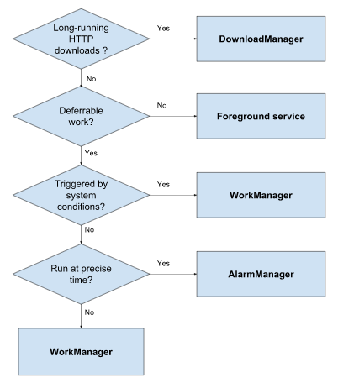
Choosing the right solution for your work:
Can the work be deferred, or does it need to happen now? Example: user clicks a button to fetch data from server – this must be done now. Updating a log, however, can be done anytime.
Is the work dependent on system conditions? For example, are your background tasks better suited to running while the device is plugged in and idle, such as when you need to compress some data or deliver updates?
Does the work need to happen at a precise time? Calendar notifications need to be precise, other jobs not so much.
https://developer.android.com/guide/background

Slide 6
Different approaches to background work:
WorkManager – for work that is deferrable (doesn’t need to run now) and expected to run even if your device/application restarts, use WorkManager. WorkManager is an Android library that gracefully runs deferrable background work when the work’s conditions (such as network availability and power) are satisfied
Foreground services – for user-initiated work that needs to run to completion and must execute immediately, use a foreground service. Foreground services are visible to users via a non-dismissible notification in the notification tray.
AlarmManager – use when you need to run a job at a precise time. AlarmManager will launch your app if necessary to do the job at the time you specify. However, WorkManager is better at balancing system resources, so if you don’t need precise timing, use WorkManager instead.
DownloadManager – use when your app is performing long-running HTTP downloads. DownloadManager conducts the download in the background, taking care of HTTP interactions and retrying downloads after connectivity failures/system reboots.
https://developer.android.com/guide/background

Slide 7
Sending operations to multiple threads:
Speed and efficiency of long-running, data-intensive operations often improves if you split it into smaller operations running on multiple threads
If a device has a CPU with multiple processors, threads can run in parallel, example: decode multiple image files to display on a thumbnail screen runs substantially faster if you decode each image on a separate thread
We will learn how to set up and use multiple threads in an Android app using a thread pool object, and how to define code that runs inside a thread and communicates with the main UI thread
https://developer.android.com/training/multiple-threads

Slide 8
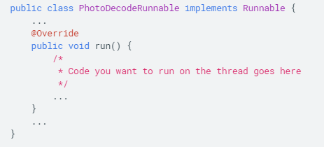
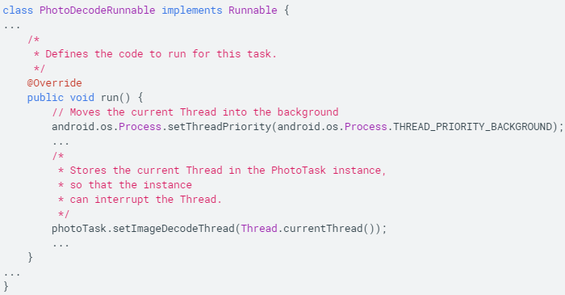
Specifying the code to run on thread
Implement a Runnable class, which runs code on a separate thread in Runnable.run(). Can also pass a Runnable to another object, then attach it to a thread and run it. One or more Runnables performing a specific operation are called a task.
Thread and Runnable are the building blocks for more powerful Android classes such as HandlerThread, AsyncTask, and IntentService.
1) Define a class that implements Runnable
2) Implement the run() method, and set thread priority to background to reduce resource competition between your new thread and the UI thread. Also store a reference to Runnable object’s thread
1)
2)
https://developer.android.com/training/multiple-threads/define-runnable

Slide 9
Create a manager for multiple threads
Previous slide showed how to specify the code that runs on a thread, if you only want to run the task once, this is all you need.
Use an IntentService to run a task repeatedly on different sets of data on a single thread
Use a ThreadPoolExecutor, which uses a queue to manage a collection of threads, so you can automatically run tasks as resources become available, or to allow multiple tasks to run simultaneously.
Adhere to thread-safe practices when using ThreadPoolExecutor (enclose variables accessed by 2 or more threads in ‘synchronized’ block)
https://developer.android.com/training/multiple-threads/create-threadpool

Slide 10
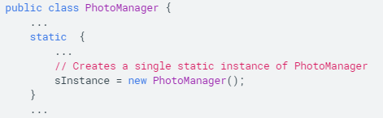
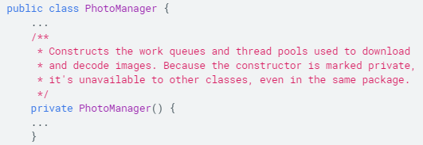
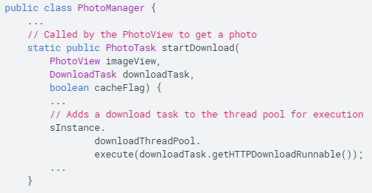
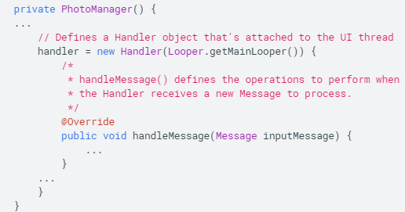
Define thread pool class
Instantiate ThreadPoolExecutor in its own class, and within this class do the following:
Use static variables for thread pools – this will ensure you only have a single instance of a thread pool in your app, providing a single control point for restricted CPU or network resources.
Use a private constructor – this ensures your class is a singleton, and you don’t need to enclose class accesses in a synchronized block
Start your tasks by calling methods in the thread pool class – define a method in the thread pool class that adds a task to thread pool’s queue
Instantiate a Handler in the constructor and attach it to your app’s UI thread – a Handler allows your app to safely call the methods of UI objects such as Views, which may only be safely altered from the UI thread.
https://developer.android.com/training/multiple-threads/create-threadpool

Slide 11
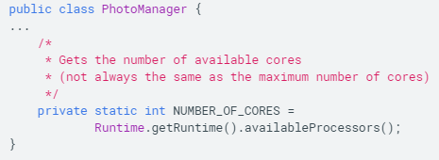
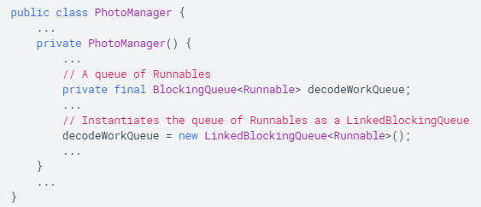
Determine thread pool parameters
Once you have the overall class structure, start defining the thread pool. To instantiate ThreadPoolExecutor, you need to following values:
Initial pool size and maximum pool size – the number of threads you can have in a pool depends primarily on the number of available cores on device, obtainable from system environment
Keep alive time and time unit – the duration that a thread will remain idle before it shuts down, set with TimeUnit
A queue of tasks – the incoming queue from which ThreadPoolExecutor takes Runnable objects. To start code on a thread, ThreadPoolManager takes a Runnable object from a FIFO queue and attaches it to the thread. Use any queue class that implements BlockingQueue interface,
https://developer.android.com/training/multiple-threads/create-threadpool

Slide 12
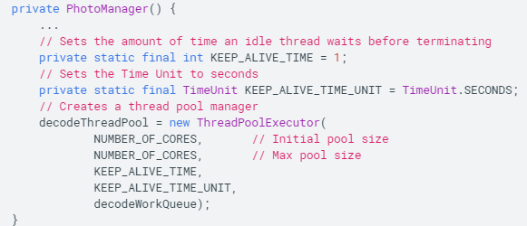
Create a thread pool
To create a pool of threads, instantiate a thread pool manager by calling ThreadPoolExecutor(), which creates and manages a constrained group of threads. Because initial pool size and maximum pool size are the same, ThreadPoolExecutor creates all the thread objects when it is instantiated.
Alternatively, use the Executors factory methods if you don’t want to manage the details of thread pool sizing
https://developer.android.com/training/multiple-threads/create-threadpool

Slide 13
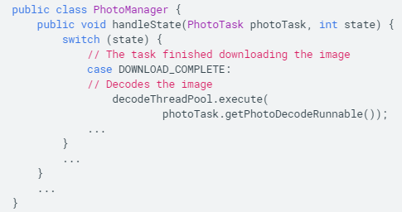
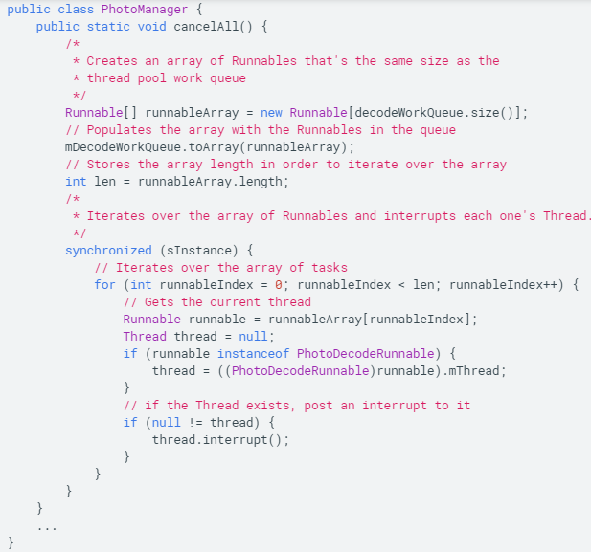
Run code on a thread pool
Previously, we learned how to define a class that manages thread pools and the tasks that run on them. Now, we will actually run a task on a thread pool.
Run a task on a thread in the thread pool: to start a task object on a thread in a particular thread pool, pass the Runnable to ThreadPoolExecutor.execute(), this adds the task to the thread pool’s work queue.
When ThreadPoolExecutor starts a Runnable on a thread, it automatically calls the object’s run() method.
Interrupt running code: to stop a task, you need to interrupt it’s thread, calling Thread.interrupt() on the handle to the task’s thread that you stored earlier
https://developer.android.com/training/multiple-threads/run-code

Slide 14
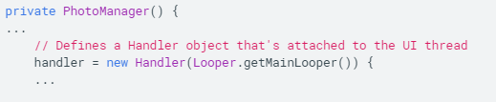
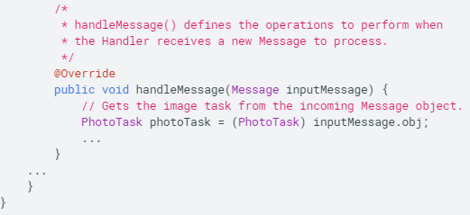
Communicate with the UI thread
We may want to send data from our tasks to objects running on the main UI thread, so we can get and display the results of our background work
We use a Handler running on the UI thread to transfer data from other threads. Handler is part of Android system’s framework for managing threads, a Handler object receives messages and runs code to handle the messages. You can create a Handler for a new or existing thread and connect it to your UI thread.
Define a Handler on the UI thread: instantiate the Handler object during construction of the class that creates your thread pools and store it in a global variable. Connect it to the UI thread by instantiating it with the Handler(Looper) constructor.
When you instantiate a Handler based on a particular Looper instance, the Handler runs on the same thread as the Looper
Override handleMessage() inside the Handler, this method is invoked when the Handler receives a new message for a thread it is managing. All of the Handler objects for a particular thread receive the same message
https://developer.android.com/training/multiple-threads/communicate-ui

Slide 15
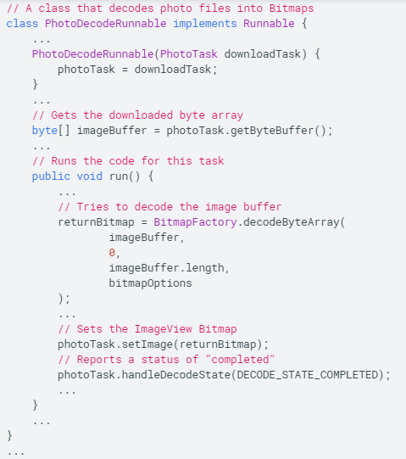
Move data from a task to the UI thread
To move data from a task object running on a background thread to an object on the UI thread, start by storing references to the data and the UI object in the task object
Next, pass the task object and a status code to the object that instantiated the handler, in this object send a Message containing the status and the task object to the Handler. Because Handler is running on UI thread, it can move the data to the UI object.
Store data in the task object: example, a Runnable running on a background thread that decodes a bitmap and stores it in its parent object PhotoTask. Runnable also stores status code DECODE_STATUS_COMPLETED
PhotoTask also contains a handle to the ImageView that displays the bitmap. You can’t assign the bitmap to the ImageView, however, because not currently running on UI thread
Instead, the next step is to send this status to PhotoTask object (next slide)
https://developer.android.com/training/multiple-threads/communicate-ui

Slide 16
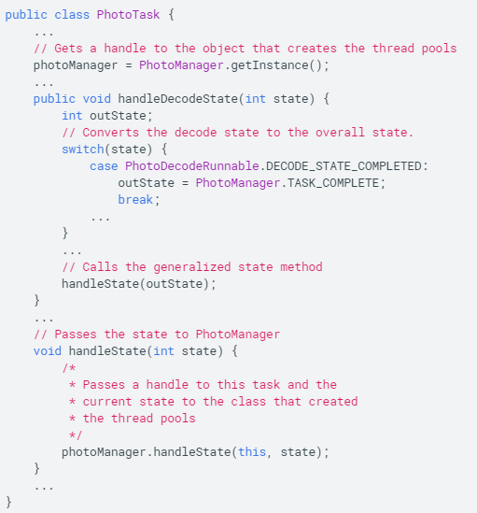
Sending status up the object hierarchy
PhotoTask is the next higher object in the hierarchy, maintaining references to the decoded data and the View object that will show the data. PhotoTask receives a status code from PhotoDecodeRunnable and passes it along to the object that maintains thread pools and instantiates a Handler
https://developer.android.com/training/multiple-threads/communicate-ui

Slide 17
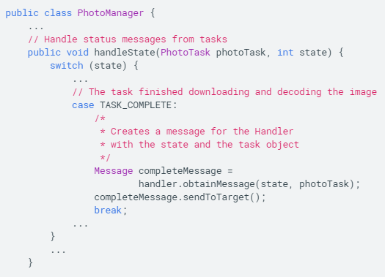
Move data to the UI
From the PhotoTask object, the PhotoManager object receives a status code and handle to PhotoTask object. Because the status is TASK_COMPLETE, PhotoManager creates a Message containing the state and task object, and sends it to the Handler
https://developer.android.com/training/multiple-threads/communicate-ui

Slide 18
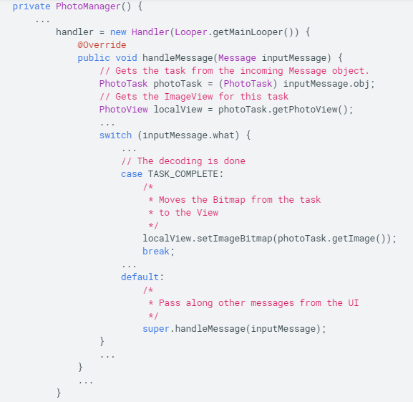
Handling the message
Handler.handleMessage() checks the status code for each incoming message. If TASK_COMPLETE, the task is finished, and PhotoTask object in Message contains both a bitmap and an ImageView. Because Handler.handleMessage() is running on the UI thread, it can safely move the Bitmap to the ImageView
https://developer.android.com/training/multiple-threads/communicate-ui

Slide 19
Sample app
To try out the concepts download ThreadSample:
https://developer.android.com/shareables/training/ThreadSample.zip
Creating an unkillable service? (to annoy users)

Slide 20
Background optimizations
Background processes can be memory and battery intensive, example: implicit broadcast may start multiple background processes registered as to listen for it, even if they don’t do much work. This can substantially affect device performance and user experience
To alleviate this, Android 7.0 applies the following restrictions:
Apps do not receive CONNECTIVITY_ACTION broadcasts if they declare their broadcast receiver in the manifest, instead, they will receive CONNECTIVITY_ACTION broadcasts if they register their BroadcastReceiver with Context.RegisterReceiver() and the context is still valid
Apps cannot send or receive ACTION_NEW_PICTURE or ACTION_NEW_VIDEO broadcasts
Instead of using these implicit broadcasts, JobScheduler and WorkManager provide robust mechanisms to schedule network operations when specific conditions, such as connection to an unmetered network are met.
https://developer.android.com/topic/performance/background-optimization

Slide 21
User-initiated restrictions
Beginning in Android 9, if an app exhibits bad behaviors described in Android vitals (consuming excessive resources), the system prompts the user to restrict app’s access to system resources
Some bad behaviors include:
Excessive wake locks – 1 partial wake lock held for an hour when screen is off
Excessive background services
Restrictions depend on the device, example: AOSP builds cannot run jobs, trigger alarms, or use the network except when app is in foreground
https://developer.android.com/topic/performance/background-optimization

Slide 22
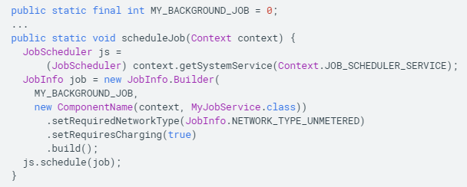
Restrictions on receiving network broadcasts
Apps targeting Android 7.0 do not receive CONNECTIVITY_ACTION broadcasts if they register to receive them in their manifest, and processes that depend on this broadcast will not start.
This is a problem for apps that want to listen for network changes or perform bulk network activity when device connects to an unmetered network.
To get around this, schedule network jobs on unmetered connections:
Build JobInfo object using JobInfo.Builder, apply setRequired NetworkType() method, and pass JobInfo.NETWORK_TYPE_UNMETERED as a parameter.
When the conditions for the job are met, the app receives a callback to run the onStartJob() method in the specified JobService.class
An alternative to JobScheduler is WorkManager, an API that allows you to schedule background tasks that need guaranteed completion
Example: schedule a service to run when the device connects to an unmetered connection and is charging
https://developer.android.com/topic/performance/background-optimization

Slide 23
Monitor network activity while app is running
Running apps can still listen for a CONNECTIVITY_CHANGE with a registered BroadcastReceiver, but the ConnectivityManager API provides a more direct method to request a callback only when specified network conditions are met.
NetworkRequest objects define the parameters of the network callback in terms of NetworkCapabilities.
Create the NetworkRequest objects with the NetworkRequest.builder class. registerNetworkCallback() then passes NetworkRequestObject to the system.
When the network conditions are met, the app receives a callback to execute onAvailable() method defined in ConnectivityManager.NetworkCallback class
The app continues to receive callbacks until it exits or calls unregisterNetworkCallback
https://developer.android.com/topic/performance/background-optimization

Slide 24
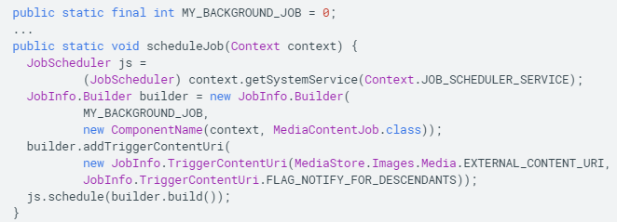
Restrictions on receiving image/video broadcasts
In Android 7.0, apps are not able to send or receive ACTION_NEW_PICTURE or ACTION_NEW_VIDEO broadcasts, this restriction helps alleviate performance issues when several apps wake up simultaneously to process new image or video
Instead we use JobInfo and JobParameters as an alternate solution
Trigger Jobs on Content URI changes:
To trigger jobs on content URI changes, Android 7.0 extends JobInfo API with following methods
JobInfo.TriggerContentUri() – encapsulate parameters required to trigger a job on content URI changes
JobInfo.Builder.addTriggerContentUri() – passes a TriggerContentUri object to JobInfo. A ContentObserver monitors the encapsulated content URI.
Example: schedule a job to trigger when the system reports a change to content URI ‘MEDIA_URI’. When the system reports a change in the specified content URI, the app receives a callback and JobParameters object is passed to onStartJob() method in MediaContentJob.class
https://developer.android.com/topic/performance/background-optimization

Slide 25
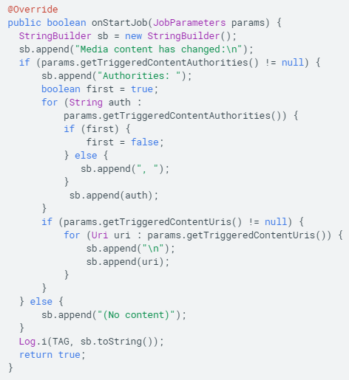
Determine which content authorities triggered a job
JobParameters allows your app to receive useful information about what content authorities and URIs triggered the job:
Uri[] getTriggeredContentUris() – return an array of URIs that have triggered the job, will be null if no URIs have triggered the job (this occurs if job was triggered due to deadline or some other reason)
String[] getTriggeredContentAuthorities() – return a string array of content authorities that have triggered the job.
Example: override JobService.onStartJob() and record content authorities and URIs that have triggered the job
https://developer.android.com/topic/performance/background-optimization

Slide 26
Further optimizations:
Optimizing your app to run on low memory devices and conditions can improve performance and user experience.
Remove dependencies on background services and manifest-registered implicit broadcast receivers, if possible, optimize your app to run without background processes entirely
Can simulate conditions where implicit broadcasts and background services are unavailable in the android debug bridge (ADB):
Disable implicit broadcasts/background services
Re-enable
https://developer.android.com/topic/performance/background-optimization

