Slide 1
Fragments

Slide 2
Fragments
fragment (noun) - “a small part broken or separated off something.” Merriam Webster Dictionary
A fragment is a modular section of an activity with its own lifecycle, receives its own input events, and can be added/removed while the activity is running (think of it as a modular sub-activity)
You can combine multiple fragments in a single activity to build a multi-pane UI
Must always be hosted within an activity, and fragment’s lifestyle is directly affected by host activity’s lifestyle (destroying activity destroys all fragments etc), however fragments can be manipulated independently while activity is running (in onResume() state)
Each activity has its own back stack that keeps track of fragment transactions, and can be used to reverse fragment transactions using the back button
Fragments live inside the ViewGroup inside the activity’s view hierarchy, you can insert a fragment into an activity either through xml <fragment> elements or through application code by adding it to an existing ViewGroup
https://developer.android.com/guide/components/fragments

Slide 3
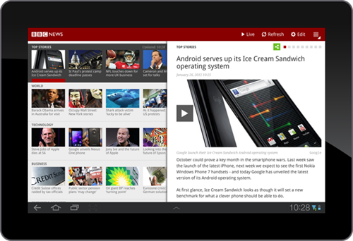
Fragment design philosophy
Introduced in Android 3.0 (API level 11, February 2011) to support more dynamic and flexible UI designs on large screens such as tablets
Fragments allow you to divide the layout activity and modify the activity’s appearance at runtime, preserving changes in a back stack managed by the activity
Example: news app can list articles in one fragment (left side of screen), and display a full article in another fragment (right side of screen)
Each fragment has its own set of lifecycle callback methods to handle user inputs, allowing you to select and read an article within the same activity
https://developer.android.com/guide/components/fragments

Slide 4
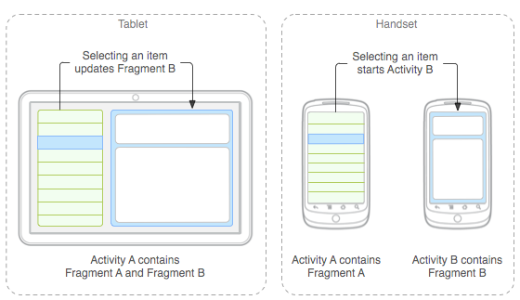
Fragments enable modular design
You should design each fragment as a modular and reusable activity component (fragments should avoid calling other fragments)
Example: if you want your app to support both tablets and phones, you can reuse fragments in different layout configurations to optimize user experience based on available screen space
Embed two fragments in a single Activity when running on tablet, and use two separate activities, each with their own fragment, when running on phone
https://developer.android.com/guide/components/fragments

Slide 5
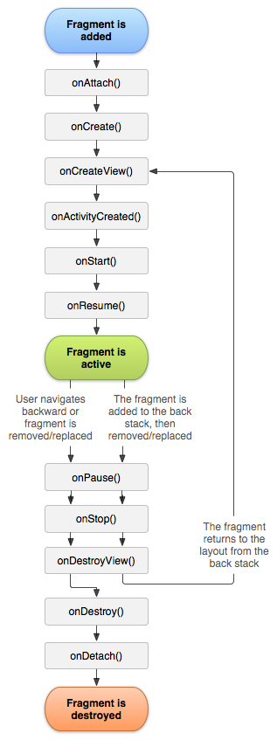
Creating a fragment
Fragment class has code very similar to Activity, containing callbacks such as onCreate, onStart, onPause, onStop, as well as callbacks unique to fragments
At minimum, your fragment class should implement the following lifecycle methods:
onCreate() – called when fragment gets created, use to initialize essential components you want to retain when the fragment is paused/stopped
onCreateView() – called when fragment draws UI for the first time, must return the View at root of fragment’s layout, can return null if fragment has no UI
onPause() – called when user leaves the fragment, use to effect any changes that should persist beyond current user’s session
https://developer.android.com/guide/components/fragments

Slide 6
Some useful Fragment subclasses
DialogFragment – displays floating dialogue, use as an alternative to Activity’s dialogue helper methods because it is added to Activity’s fragment back stack, allowing you to return to previous fragments using back
ListFragment – displays list of items managed by an adapter (such as SimpleCursorAdapter), provides methods for handling a list view (ex: onListItemClick(), which handles clicks on a list)
PreferenceFragmentCompat – displays hierarchy of Preference objects as a list (used to create settings screen for your application)
https://developer.android.com/guide/components/fragments

Slide 7
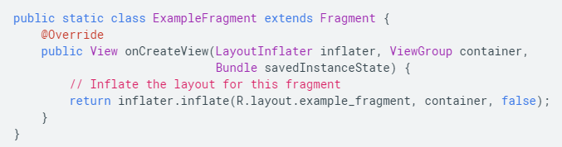
Using fragment to add a user interface
Fragments are typically part of an activity’s UI and contribute their own layout to the activity
Use the onCreateView() callback, which provides a LayoutInflater object, to inflate a layout resource defined in xml:
Example: a subclass of fragment that loads a layout from xml
container: the parent ViewGroup in which the fragment’s layout is inserted
savedInstanceState: bundle providing data about the previous instance of the fragment
inflater: class to instantiate layout XML file into its corresponding view objects
https://developer.android.com/guide/components/fragments

Slide 8
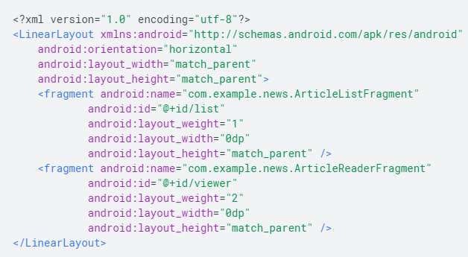
Adding a fragment to an activity
Fragments typically contribute a portion of UI to the host activity, and are embedded as a part of the activity’s overall view hierarchy. There are two ways you can add a fragment to the activity layout
1) declare the fragment inside the activity’s layout file – example: a layout file for an activity with two fragments.
android:name attribute in <fragment> specifies the Fragment class to instantiate within the layout
The system will instantiate each fragment specified in the layout and call the onCreateView() method for each one, to retrieve each fragment’s layout
https://developer.android.com/guide/components/fragments

Slide 9

Adding a fragment to an activity
2) programmatically add the fragment to an existing ViewGroup
You can add fragments to your activity layout whenever the activity is running, by specifying a ViewGroup in which to place the fragment
Get an instance of FragmentTransaction from your FragmentActivity, and then use add(), specifying the fragment to add and the view to insert it into
https://developer.android.com/guide/components/fragments

Slide 10
Managing fragments
Use the FragmentManager to manage fragments in your activity, get it by calling getSupportFragmentManager() from your activity
FragmentManager allows you to:
Get fragments that exist in the activity with findFragmentById() for fragments that provide a UI in the activity layout XML, or findFragmentByTag() for fragments that are not defined in XML
Pop fragments off the back stack with popBackStack(), simulating a back button press by the user
Register a listener for changes to activity’s fragment back stack using addOnBackStackChangedListener()
https://developer.android.com/guide/components/fragments

Slide 11
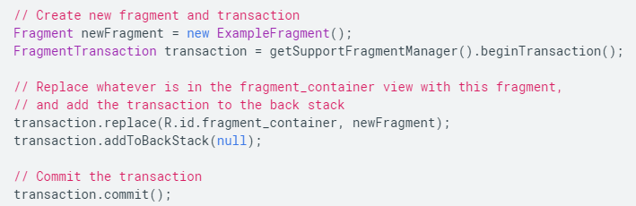
Performing fragment transactions
One of the best things about fragments is the ability to add, remove, replace, and perform other actions with them in response to user interaction, otherwise called fragment transactions
Each transaction is a set of changes that you want to perform at the same time, set up the changes using add(), remove(), replace(), etc and then apply the changes using commit()
You should also call addToBackStack() to allow the user to reverse the changes if they want using the back button. commit() must be called last
Example:
Replace one fragment with another, and preserve the previous state in the back stack. newFragment replaces whatever fragment is in the layout container R.id.fragment_container
https://developer.android.com/guide/components/fragments

Slide 12
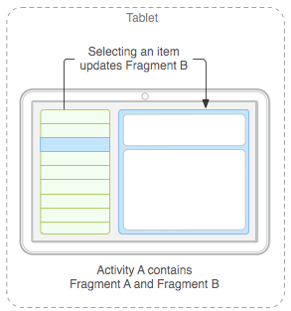
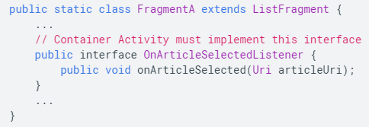
Communicating with the activity
A given instance of a fragment is directly tied to the activity that hosts it.
Your fragment can communicate with other components of the activity by first calling using getActivity(), and the activity can call methods in a fragment using FragmentManager’s findFragmentById or findFragmentByTag
Creating event callbacks to activity: you may need to share events or data with the host activity, or other fragments hosted by the activity. Typically, data can be shared using a ViewModel.
If you need to propagate events that ViewModel cannot handle, instead define a callback interface within the fragment, and implement it in the host activity class. Then, when the activity receives a callback through the interface, it can share information with other fragments in the layout
Example: the news article activity wants to update the article display (fragment B) when an article is selected in the menu (fragment A). The host activity will implement OnArticleSelectedListener, an interface defined in fragment A
https://developer.android.com/guide/components/fragments

Slide 13
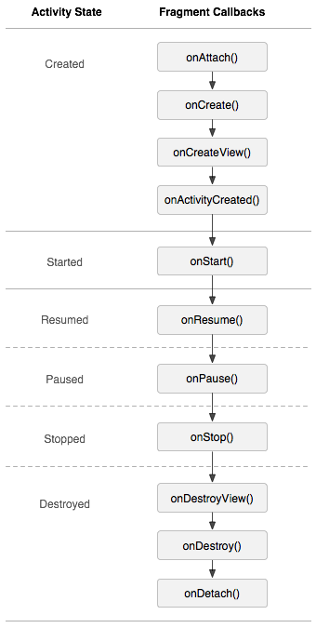
Handling the fragment lifecycle
Similar to managing activity lifecycle; the fragment can exist in one of three states:
1) resumed – fragment is visible in the running activity
2) paused – another activity partially covers or has focus over the fragment’s host activity
3) stopped – the fragment is not visible, the host activity has either stopped or removed the fragment and added it to the back stack
The UI state of a fragment is preserved across configuration changes in the same way as for an activity (using onSaveInstanceState(), ViewModel, and persisten local storate).
The main difference between fragment and activity lifecycles is that activities are always automatically added to the system’s back stack when the user navigates away using back button, whereas fragments need to be explicitly added to their host activity’s back stack using addToBackStack() during a transaction that removes the fragment
The only time a fragment’s lifecycle is independent from that of its host activity is after the host activity reaches onResume() state, in this state you can freely add or remove fragments to to/from the activity
https://developer.android.com/guide/components/fragments

Slide 14
Example: two-pane layout
An activity containing two fragments, one to show a list of Shakespeare play titles, another to show a summary of the play when selected from the list
Code in android studio
https://developer.android.com/guide/components/fragments

Slide 15
Create a fragment
https://developer.android.com/guide/components/fragments

Slide 16
Test your fragment
https://developer.android.com/guide/components/fragments

Slide 17
Build a flexible UI
https://developer.android.com/guide/components/fragments

Slide 18
Communicate with other fragments
https://developer.android.com/guide/components/fragments

