Slide 1
Intents and Intent Filters

Slide 2
Intents and intent filters
An Intent is a messaging object you can use to request an action from another app component. There are three fundamental use cases:
1) starting an activity: an Activity represents a single screen in an app, you can start a new activity by passing an intent to startActivity(), the intent describes the activity to start and carries any necessary data. You can call startActivityForResult() if you want a result from the activity you start, in the form of a separate intent object through your own activity’s onActivityResult() callback
2) starting a service: a Service is a component that performs operations in the background without a user interface. Use JobScheduler to start services.
3) Delivering a broadcast: a broadcast is a message that any app can receive. The system delivers various broadcasts for system events, such as when the system boots or the charger is connected. Deliver a broadcast to other apps by passing an intent to sendBroadcast() or sendOrderedBroadcast()
https://developer.android.com/guide/components/intents-filters

Slide 3
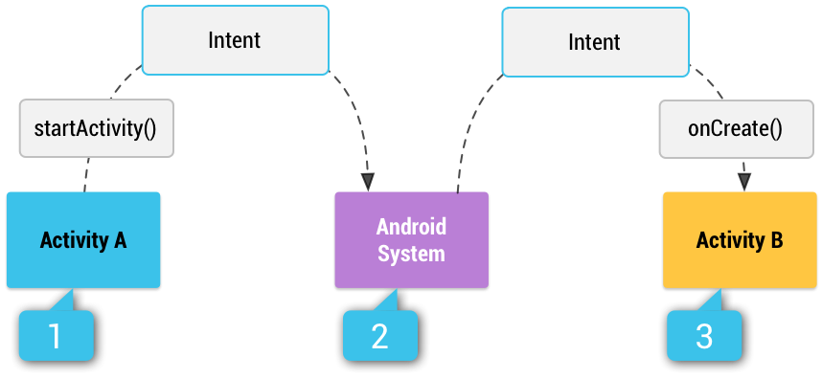
Intent types
There are two types of intent:
1) explicit intents specify which application will satisfy the intent through the target app’s package name or a fully qualified component class name. typically used to start an activity within your own app, because you know the class name of the activity or service you wish to start. Example: start a service to download in background.
2) implicit intents declare a general action to perform, allowing a component from another app to handle it. Example: you have a coordinate you want to show on the map, use an implicit intent to request an app capable of drawing maps show the coordinate.
If you do not provide any intent filters within your activity’s manifest, the activity will only be started from explicit intents
How an intent is delivered through the system to start an activity. 1) Activity A defines an intent and uses it to call startActivity(). 2) the OS receives the intent, and searches all apps for an intent filter that matches the intent. 3) the OS starts the matching activity (Activity B) by invoking its onCreate() method and passing it the intent.
https://developer.android.com/guide/components/intents-filters

Slide 4
Building an intent
The intent object carries information that Android OS uses to determine which component to start (component name/category) as well as information the component will need to perform the action.
Primary information contained within an intent:
Component name – name of component to start, optional, this is what makes an intent an explicit intent. Without a component name, the intent is implicit and system describes what component should receive the intent based on other information (action, data, category). Set ComponentName with a fully qualified class name (com.example.ExampleActivity), using setComponent(), setClass(), setClassName(), or in the intent’s constructor.
Action – a string specifying the generic action to perform (such as view or pick). Common actions for starting an activity:
ACTION_VIEW: use when you have some information an activity can show the user, such as a photo to view in a gallery app.
ACTION_SEND: also known as a share intent, use when you have some information the user can share with another app, such as email or social media.
Data – the URI that references the data to be acted upon, data type generally dictated by intent’s action, for example an ACTION_EDIT intent should contain URI of a document to edit. You can use setData() and setType() to set the URI/MIME type respectively, or setDataAndType() to set both
Category – a string with additional info about what kind of components can handle the intent, not required by most intents.
Extras – key-value pair with additional info required to accomplish the requested action, example: building an intent to send email with ACTION_SEND, use putExtra() to specify recipient with EXTRA_EMAIL key
Flags – instruct Android OS how to launch an activity, example: which task activity should belong to
https://developer.android.com/guide/components/intents-filters

Slide 5

Example explicit intent
Explicit intents are used to launch a specific app component such as an activity or service within your own app.
To create an explicit intent, only component name is required, all other intent properties are optional
Example: your app contains a service DownloadService to download file from web, start it with the following code, which specifies the context and class in the Intent(this, DownloadService.class) call:
https://developer.android.com/guide/components/intents-filters

Slide 6
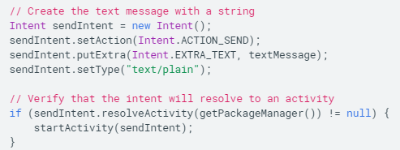
Example implicit intent
Implicit intents specify actions that can invoke any app on the device able to perform the action. Used when your app cannot perform the action, but other apps exist that can.
Example: your app has content the user wants to share, create an implicit intent using ACTION_SEND action with extras specifying the content to share, then call startActivity() with your implicit intent and the user will pick from a list of apps that can share the content.
Use resolveActivity() on your implicit intent before calling startActivity(), to avoid cases where the device has no apps that can perform the action (causing your app to crash):
https://developer.android.com/guide/components/intents-filters

Slide 7
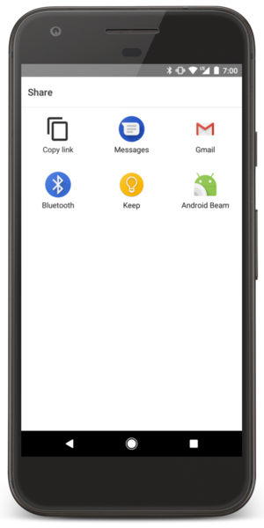
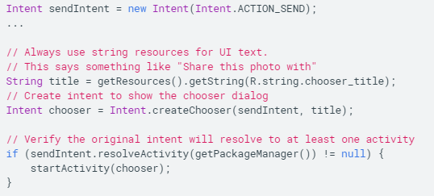
Forcing an app chooser
User will often choose a default app to receive implicit intents (for example opening a web page, user usually prefers chrome)
However, the user may also want to use a different app each time, in which case, you can explicitly show the app chooser using createChooser() and sending the chooser to startActivity(), rather than the intent itself:
https://developer.android.com/guide/components/intents-filters

Slide 8

Receiving an implicit intent
Declare intent filters under each of your app’s components in the manifest to indicate which implicit intents your app can receive.
Each <intent-filter> specifies the type of intent it accepts based on the intent’s action, data, and category.
Each component should define separate filters for each unique job it can do, for example, an image gallery app should define a filter for viewing, and a filter for editing, and decide how to behave based on information in the intent (show/don’t show controls)
Define the type of intent your component responds to through: <action> , <data> , <category> filters
https://developer.android.com/guide/components/intents-filters

Slide 9
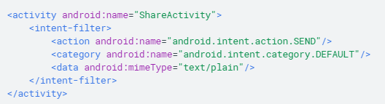
Example activity declaration with intent filter
This activity has an intent filter that receives ACTION_SEND intents with text data type:
An implicit intent is tested against a filter by comparing the intent to each of the three elements. To be delivered to the component, the intent must pass all three tests, if it fails to match any of them, the intent will not be delivered to the component by the Android OS.
https://developer.android.com/guide/components/intents-filters

Slide 10
Security concerns and dynamic filters
Another app can potentially start one of your app’s components using an explicit intent, if the developer is able to determine your component names (even if your app has implicit intent filters).
If you want to restrict access to your components, do not declare intent filters in the manifest, instead, set that component’s exported attribute to false.
Filters for Broadcast receiver components can be registered dynamically by calling registerReceiver() and unregisterReceiver(), this allows your app to listen for broadcasts during only a specified time during which the app is running.
https://developer.android.com/guide/components/intents-filters

Slide 11
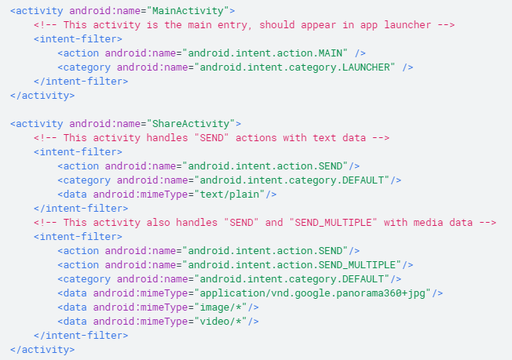
Example filters:
An example manifest file from a social sharing app:
MainActivity is the app’s main entry point, opens by the user tapping the app’s icon
ACTION_MAIN – indicates this activity is the main entry point and does not expect any intent data
CATEGORY_LAUNCHER – activity’s icon should be placed in system’s app launcher
ShareActivity – facilitates sharing text and media content, can enter by navigating from MainActivity, and also from another app using an implicit intent that matches either of the two intent filters.
https://developer.android.com/guide/components/intents-filters

Slide 12
Pending intent
PendingIntent is a wrapper around the intent object. Its primary purpose is to grant permission to a foreign application to use the contained intent as if it were executed from your app’s own process.
Use pending intents when:
Declaring an intent to be executed when the user performs an action with your Notification (Android’s NotificationManager executes the intent)
Declaring an intent to be executed when the user performs an action with your App Widget (Home screen app executes the intent)
Declaring an intent to be executed at a specified future time (Android’s AlarmManager executes the Intent)
Pending intents are not executed using startActivity(), rather, you declare the intended component type during creation by calling creator method:
PendingIntent.getActivity() for an intent that starts an activity
PendingIntent.getService() for an intent that starts a service
PendingIntent.getBroadcast() for an intent that starts a BroadcastReceiver
Each method takes the current context, the intent you want to wrap, and one or more flags specifying how the intent should be used.
https://developer.android.com/guide/components/intents-filters

Slide 13
Intent resolution
When Android OS receives an implicit intent to start an activity, it searches for the right activity by comparing the received intent to intent filters based on three aspects: Action, Data, and Category.
Action test: intent filters declare zero or more <action> elements, and the action specified in the intent must match one of the actions listed in the filter. If the filter declares no actions, no intent can pass it. However, if the intent does not specify an action, it passes all filters with at least one action.
Category test: intent filters can specify zero or more <category> elements. Every category in the intent must match a category in the filter. If the intent has no categories, it automatically passes.
Data test: intent filters can specify zero or more <data> elements (next slide)
https://developer.android.com/guide/components/intents-filters

Slide 14
Intent resolution: data test
Each <data> element can specify a URI structure and MIME type. The URI has four separate attributes: scheme, host, port, and path:
<scheme://<host>:<port>/<path>
Example: content://com.example.project:200/folder/subfolder/etc
Here, scheme=content, host=com.example.project, port=200, path=folder/subfolder/etc
Each of these attributes is optional in a <data> element, but there are dependencies between them:
If a scheme is not specified, host is ignored. If a host is not specified, port is ignored. If both scheme and host are not specified, path is ignored.
When URI in an intent is compared to URI in filter, only the parts included in the filter are compared. Example: filter specifies only the URI’s scheme, any intent with matching scheme will pass filter, regardless of other attributes.
Data test compares intents URI and MIME type to filter’s URI and MIME type using the following rules:
1) if intent does not specify either URI or MIME type, it can only pass filters that also fail to specify URI/MIME type
2) if intent specifies URI but not MIME type, it can only pass filters with a matching URI and no MIME type
3) if intent specifies MIME type but not URI, it can only pass filters with matching MIME type and no URI
4) if intent specifies both URI and MIME type, it passes MIME type test only if it matches filter’s MIME type. It passes URI part of test either if a) its URI matches filter’s URI or b) it has a content: or file: URI and filter does not specify a URI. A component is presumed to support content: and file: data if its filter lists only a MIME type.
The filter in (4), specifying a MIME type but no URI, are common because most available data is dispensed by content providers.
https://developer.android.com/guide/components/intents-filters

Slide 15
Intent matching
Intents are matched with filters not only to start a component, but also to discover things about the components of all the apps on a device.
For example, the Home app populate the app launcher by finding all activities with intent filters specifying ACTION_MAIN action and CATEGORY_LAUNCHER category.
Note – play store will not list apps without these actions/categories (why?)
Your app can use intent matching in a similar way to the Home app. PackageManager has a set of query…() methods that return all components which can accept a particular intent and a similar series of resolve…() methods that determine the best component to respond to an intent.
Example: queryIntentActivities() returns a list of all activities that can perform the intent passed as an argument, and queryIntentServices() does the same but for services.
https://developer.android.com/guide/components/intents-filters

Slide 16
Common intents
We will cover several implicit intents that you can use to perform common actions, organized by the type of app that handles the intent
Each section will also show how to create an intent filter to advertise the app’s ability to perform the same action
https://developer.android.com/guide/components/intents-common

Slide 17
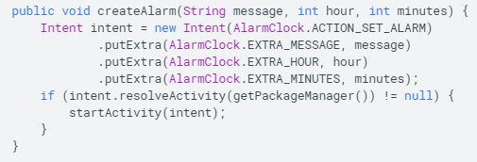
Alarm clock
Action: ACTION_SET_ALARM
Data URI: None
MIME type: None
Extras: EXTRA_HOUR, EXTRA_MINUTES, EXTRA_MESSAGE, EXTRA_DAYS, EXTRA_RINGTON, EXTRA_VIBRATE, EXTRA_SKIP_UI
https://developer.android.com/guide/components/intents-common

Slide 18
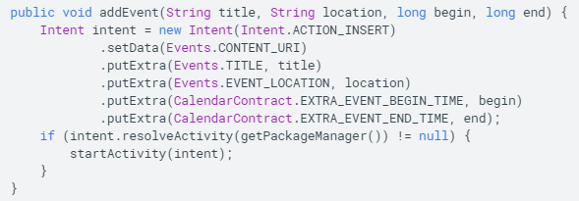
Calendar
Action: ACTION_INSERT
Data URI: Events.CONTENT_URI
MIME type: "vnd.android.cursor.dir/event"
Extras: EXTRA_EVENT_ALL_DAY, EXTRA_EVENT_BEGIN_TIME, EXTRA_EVENT_END_TIME, TITLE, DESCRIPTION, EVENT_LOCATION, EXTRA_EMAIL
https://developer.android.com/guide/components/intents-common

Slide 19
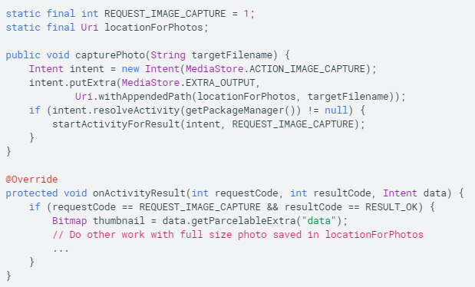
Camera
Action: ACTION_IMAGE_CAPTURE or ACTION_VIDEO_CAPTURE
Data URI: None
MIME type: None
Extras: EXTRA_OUTPUT (URI location where camera should save)
https://developer.android.com/guide/components/intents-common

Slide 20
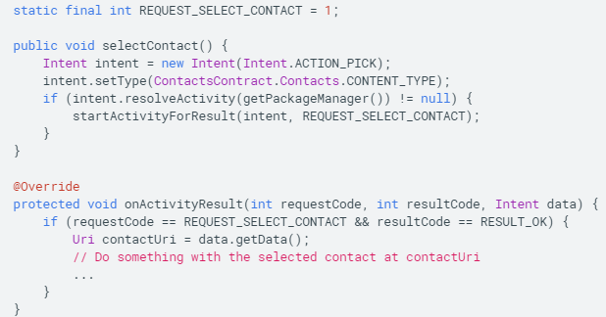
Contacts/People app (select a contact)
Action: ACTION_PICK
Data URI: None
MIME type: Contacts.CONTACT_TYPE
Extras:
https://developer.android.com/guide/components/intents-common

Slide 21
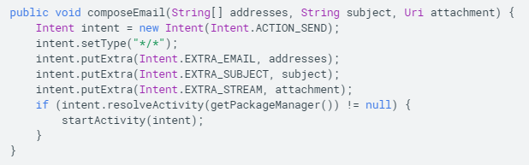
Email
Action: ACTION_SENDTO (no attachment), ACTION_SEND (one attachment), ACTION_SEND_MULTIPLE (multiple attachments)
Data URI: None
MIME type: “text/plain”, “*/*”
Extras: EXTRA_EMAIL, EXTRA_CC, EXTRA_BCC, EXTRA_SUBJECT, EXTRA_TEXT, EXTRA_STREAM
https://developer.android.com/guide/components/intents-common

Slide 22
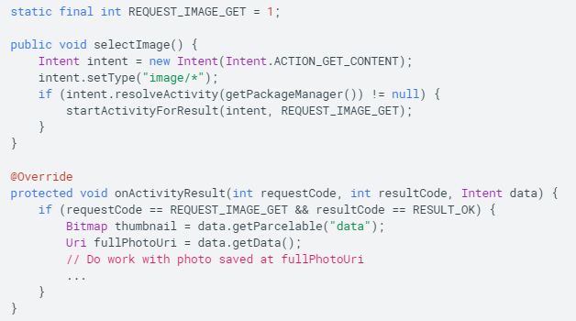
File storage/retrieval
Action: ACTION_GET_CONTENT
Data URI: None
MIME type: MIME type corresponding to file type user should select
Extras: EXTRA_ALLOW_MULTIPLE, EXTRA_LOCAL_ONLY
https://developer.android.com/guide/components/intents-common

Slide 23
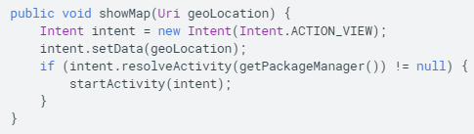
Maps
Action: ACTION_VIEW
Data URI: geo: latitude, longitude
MIME type: None
Extras:
https://developer.android.com/guide/components/intents-common

Slide 24
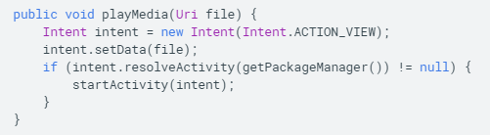
Music or Video
Action: ACTION_VIEW
Data URI: file: <URI>, content: <URI>, http: <URL>
MIME type: “audio/*”, “application/ogg”, “application/itunes”
Extras:
https://developer.android.com/guide/components/intents-common

Slide 25
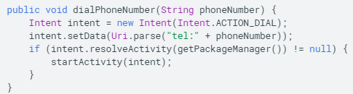
Phone
Action: ACTION_DIAL, ACTION_CALL
Data URI: tel:<phone-number>, voicemail:<phone-number>
MIME type: None
Extras:
https://developer.android.com/guide/components/intents-common

Slide 26
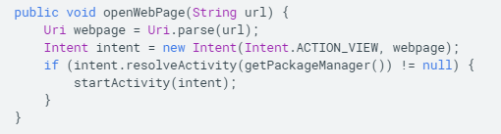
Web browser
Action: ACTION_VIEW
Data URI: http:<URL>, https:<URL>
MIME type: “text/plain”, “text/html”, “application/xhtml+xml”
Extras:
https://developer.android.com/guide/components/intents-common

Slide 27
Others common intents
Text messaging
Settings
Web search
etc

