Slide 1
Interacting with other apps

Slide 2
Interacting with other apps
Each android app typically has several activities, each activity displaying a UI that allows the user to perform a certain function (view map, use camera, etc).
To take the user from one activity to another, your app must use an Intent to define your app’s “intent” to do something
Passing the Intent to the system with a method such as startActivity() allows the system to use the Intent to identify and start the appropriate app component, or separate app
Intents can be either explicit or implicity
Explicit intent: start a specific component (such as another activity within your app)
Implicit intent: start any component that can handle the requested task (take photo, share photo, etc)
Will learn about how to use intents to perform basic interactions with other apps (start, receive result) and respond to intent
https://developer.android.com/training/basics/intents

Slide 3
Sending the user to another app
An important feature of Android OS – send a user to another app based on an ‘action’ they would like to perform
Example: your app has a business address you would like to view on a map, but no activity to display maps. You can create a request in your app to view the map, and Android will find and start the appropriate app to view your address on a map
Explicit intents define the exact class name of the component you want to start, used to navigate between activities within your own app
When you need to have another app perform an action (map example), an implicit intent is used
https://developer.android.com/training/basics/intents/sending

Slide 4
Building an implicit intent
Implicit intents do not declare the class name of the component to start, instead, they declare an action to perform
The action specifies the thing you want to do – view, edit, get, or send
Intents often include data associated with the action – ex: a photo to send, or an address you want to view. Data can be a Uniform Resource Identifier (URI), or another data type
Example: creating an intent to initiate a phone call using URI data to specify phone number
Example: create an intent to open a specific web page using URI data to specify a link:
https://developer.android.com/training/basics/intents/sending

Slide 5
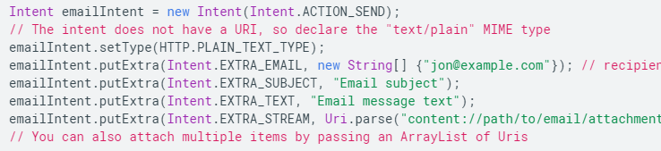
Adding extra data to implicit intent
You can add one or more pieces of extra data to your intent using putExtra() methods
By default, system determines the appropriate MIME type required by an intent based on included URI data. If URI is not used, you should specify the MIME type using setType(). This further specifies what type of activity should receive the intent
An example adding extra data to send email with attachment:
A media type (also known as a Multipurpose Internet Mail Extensions or MIME type) is a standard that indicates the nature and format of a document, file, or assortment of bytes.
https://developer.android.com/training/basics/intents/sending

Slide 6
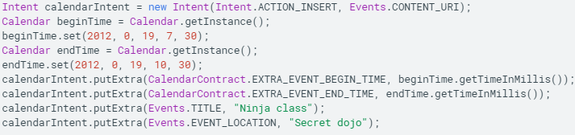
Extra data example 2: creating a calendar event
https://developer.android.com/training/basics/intents/sending

Slide 7

Verify that an app can receive your intent
Android guarantees that certain intents will resolve to one of the build in apps (Phone, email, calendar etc), but you should always include a verification step before invoking an intent
Use queryIntentActivities() to get a list of activities capable of handling your intent, and check if the list is not empty
https://developer.android.com/training/basics/intents/sending

Slide 8
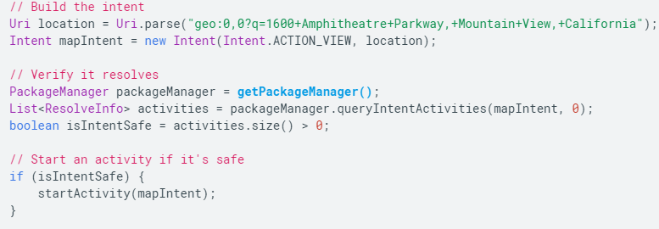
Start an activity with the intent
Use startActivity(intent) to start an activity with an intent
Complete example: create an intent to view a map, verify the app exists to handle the intent, and then start it
https://developer.android.com/training/basics/intents/sending

Slide 9
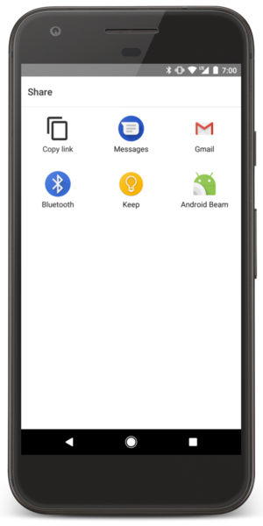
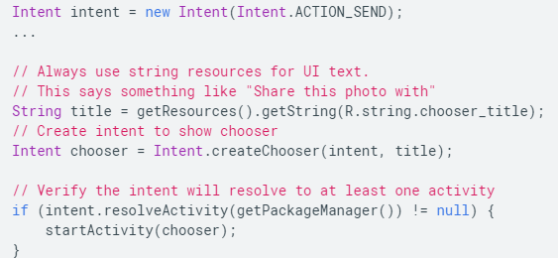
Showing an app chooser
When you pass your intent to startActivity(), if there is more than one app capable of serving the intent, the user will be prompted with a selection screen (app chooser).
The app chooser will allow the user to select a default option to perform the action using the same app every time (and not be prompted by the app chooser on subsequent intent firings)
However, you can also force the chooser to start up on every call to startActivity, if you want to remove the option of selecting a default app
https://developer.android.com/training/basics/intents/sending

Slide 10
Getting a result from an activity
You can also start another activity and receive a result in return using startActivityForResult() (instead of startActivity())
Example: start the camera app, receive photo as result. Or, start your contacts app, receive contact details as result.
The activity responding to startActivityForResult() must be designed to return a result, and will send the result as another Intent object. Your activity will receive this result in the onActivityResult() callback
https://developer.android.com/training/basics/intents/result

Slide 11
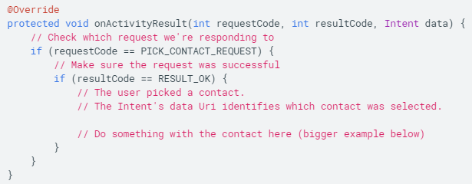
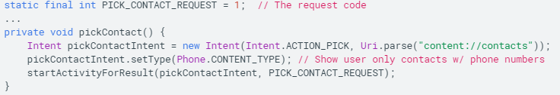
Starting the activity (for result)
Similar to startActivity, but need to also pass an additional integer which serves as a request code, so your app can properly identify the result in the onActivityResult() callback and handle it appropriately
The system will call your activity’s onActivityResult() when the activity you called with startActivityForResult() terminates
onActivityResult() takes 3 arguments: requestCode, resultCode, and data
Handling the format of the Intent result: easy if sent from another activity within your own app (you know what the result will be), and apps included with Android provide an API to understand the result of the callback, for example, camera app returns a Bitmap, people app returns a content URI with contact info, etc
Handling the result:
Example: starting an activity allowing a user to pick a contact:
https://developer.android.com/training/basics/intents/result

Slide 12
Allowing other apps to start your activity
If your app performs actions that might be useful to other apps, it should be prepared to respond to action requests by specifying the appropriate intent filter in your activity
Example: you created a social app to share message/photos, your app should support the ACTION_SEND intent, which will allow your app to show up in the app chooser when the user initiates a share action
To allow other apps to start your activity, need to add an <intent-filter> element in the activity element of your app’s manifest file
The <intent-filter> element is picked up by the system when your app is installed, and added to an internal catalogue of intents
https://developer.android.com/training/basics/intents/filters

Slide 13
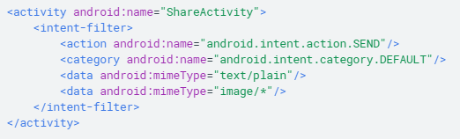
Adding an intent filter
Your intent filter should be as specific as possible in terms of the type of action and data your activity will accept
Your intent filter should fulfill the following criteria:
Action: a string naming the action to perform, usually a platform-defined value such as ACTION_SEND or ACTION_VIEW, specify in manifest with <action> element
Data: a description of the data associated with the intent, specify using <data> element, you can specify MIME type, URI prefix, or a combination of the two, to indicate the data type specified
Category: provides an additional way to characterize the activity handling the intent, related to user gesture, or location from where it was sent, implicit intents use CATEGORY_DEFAULT by default, specify with <category> element
Example: defining an intent filter that handles the ACTION_SEND event when the data type is either text or image:
https://developer.android.com/training/basics/intents/filters

Slide 14
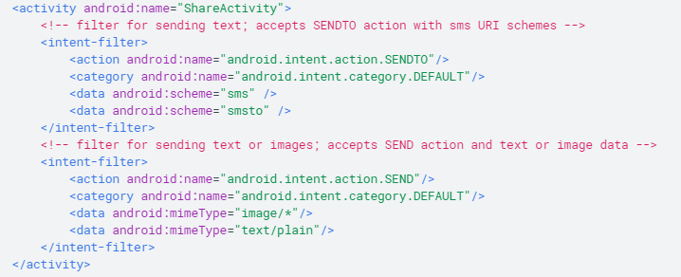
Mutually exclusive actions
Each incoming intent specifies a single action and data type, but a single intent filter can declare multiple instances of <action>, <data>, and <category>
However, if any two pairs of action and data are mutually exclusive in their behavior, you should create separate intent filters to specify which actions are acceptable when paired with which data types
Example: your activity handles both text and images for the ACTION_SEND and ACTION_SENDTO intents, in this case, you must define two separate intent filters for the two actions because a ACTION_SENDTO intent must use the data URI to specify the recipients address using the send or sendto URI scheme
https://developer.android.com/training/basics/intents/filters

Slide 15
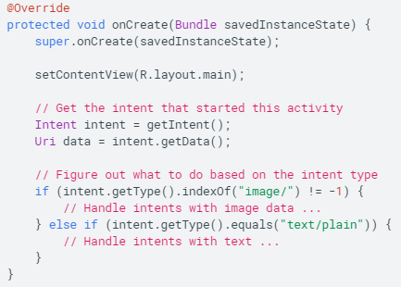

Handling the intent in your activity
Read the Intent that started your activity in order to decide what action to take.
Call getIntent() in one of the early callbacks (onCreate, onStart) to retrieve the Intent that started your activity
Returning the result: to return a result to the activity that invoked yours, create a new intent with the result, and then call setResult(), followed by finish() to destroy your activity:
https://developer.android.com/training/basics/intents/filters

