Slide 2
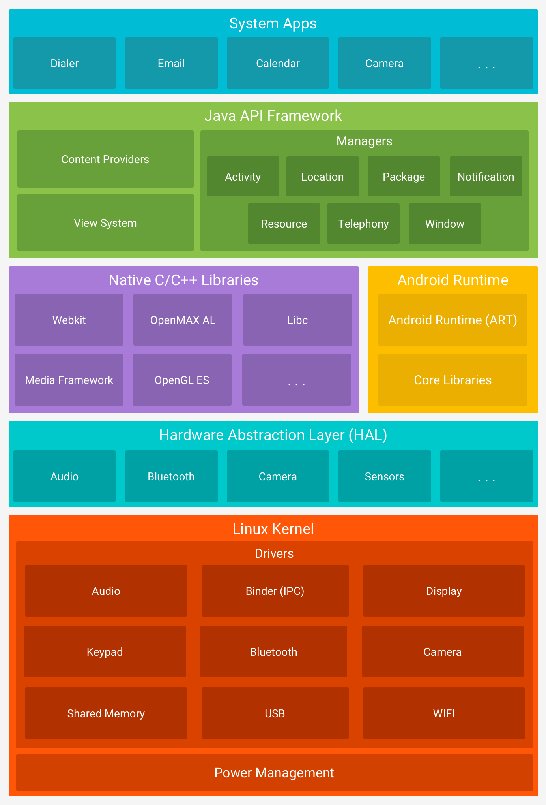
Platform architecture
Android is an open source, linux based software stack created for a wide array of devices and form factors.
Linux kernel
Hardware abstraction layer (HAL)
Android runtime, Native C/C++ libs
Java API framework
System apps

Slide 3
Linux kernel
Foundation of the Android platform
Android Runtime (ART) relies on Linux kernel for underlying functionalities such as threading and low-level memory management
Allows Android to take advantage of key security features
Linux is a stable and secure kernel trusted by corporations and security pros
Secure inter-process communication (IPC) enables secure communication between applications running in different processes
Linux kernel provides:
User-based permissions model
Process isolation
Extensible mechanism for secure IPC
The ability to remove unnecessary and potentially insecure parts of kernel
Allows manufacturers to develop hardware drivers for a well-known kernel
https://source.android.com/security/overview/kernel-security.html

Slide 4
Linux kernel is a multi-user operating system
Fundamental security objective of Linux kernel is to isolate user resources from each other
The Linux security philosophy is to protect user resources from one another:
Prevent user A from reading user B’s files
Ensure user A does not exhaust user B’s memory or CPU resources
Ensure user A does not monopolize user B’s devices (GPS, phone, etc)
Enforced by the Application Sandbox

Slide 5
Android’s Application Sandbox
Each Android app is assigned a unique user ID (UID) and runs in its own process
The UID is used by Android to set up a kernel-level Application Sandbox.
Linux Kernel enforces security between apps and the system at the process level through standard Linux facilities (user and group IDs)
By default, apps cannot interact with each other and have limited access to the operating system
Example: user A tries to do something malicious, like read user B’s data, or dial the phone (which is a separate app), the Linux Kernel protects against this behavior because user A does not have the appropriate priviledges
Application Sandbox is based on decades-old UNIX-style user separate of processes and file permissions
Generally, to break out of the Application Sandbox in a properly configured device, one must compromise the security of the Linux Kernel
Don’t make app data world accessible, if you need to share files use a content provider or a common location on external storage
https://source.android.com/security/app-sandbox

Slide 6
Other security features:
System partition: set to read-only, the System Partition contains Android’s kernel as well as the OS libraries, application runtime, application framework, and applications.
safe mode: loads the core system partition but not user applications, although these can be started manually
Filesystem permissions: in UNIX-style environment, ensures that one user cannot read or alter another user’s files. In Android, each app runs as its own user, and unless the developer explicitly shares the apps files, they cannot be read or altered by another application.
Security-enhanced Linux: android uses security-enhanced Linux (SELinux) to apply access control policies and establish mandatory access control on processes

Slide 7
Security-Enhanced Linux in Android
Android uses Security-Enhanced Linux (SELinux) to enforce mandatory access control (MAC) over all processes, even those running with root/superuser privileges
With SELinux, Android can:
Better protect and confine system services
Control access to application data and system logs
Reduce the effects of malicious software
Protect users from potential flaws in code on mobile devices
SELinux operates on the principle of default denial: Anything not explicitly allowed is denied
SELinux operates in two global modes:
Permissive mode – permission denials are logged but not enforced
Enforcing mode – permission denials are logged and enforced (Android uses this)
All attempted disallowed actions are prevented and attempted violations logged (Logcat)
SELinux also supports per-domain permissive mode in which specific sets of processes (domains) can be made permissive while placing the rest of the system in global enforcing mode
More info on SELinux: http://freecomputerbooks.com/books/The_SELinux_Notebook-4th_Edition.pdf
https://source.android.com/security/selinux/index.html

Slide 8
Android developer security tools
Core security features:
Android Application Sandbox isolates app data and execution from other apps
Application framework with robust implementations of common security functionality (cryptography, permissions, secure IPC)
Technology to mitigate risk associated to common memory management errors: ASLR, NX, ProPolice, safe_iop, OpenBSD dlmalloc, OpenBSD calloc, Linux mmap_min_addr
An encrypted file system that can be enabled to protect data on lost or stolen devices
User-granted permissions to restrict access to system features and user data
Application-defined permissions to control application data on a per-app basis
https://developer.android.com/training/articles/security-tips

Slide 9
Android developer security tips: storing data
Most common security concern for app developers: is the data you save on the device accessible to other apps?
There are three ways to save data on the device:
Internal storage – accessible only to your app (protection implemented by Android), sufficient for most apps. To share internally stored data, do not use MODE_WORLD_WRITEABLE or MODE_WORLD_READABLE, because they provide no control over data format, or the ability to limit access to certain apps. Instead, use a content provider.
External storage – SD cards. Globally readable and writeable. Don’t store sensitive information here. Perform input validation when handling data from external storage (as you would for any untrusted source).
Content providers – offers a structured storage mechanism that can be limited to your own app, or exported to allow access by other apps.
If you don’t want to share any data, mark your ContentProvider as android:exported=false in the manifest.
ContentProvider exported for use by other applications can specify distinct read/write permissions, or a single permission for both operations. Limit your permissions to those required for the task.
To limit data sharing to apps only you (the dev) create, use android:protectionLevel set to signature
When accessing ContentProvider, use parameterized query methods such as query(), update(), and delete() to avoid potential SQL injections from untrusted sources

Slide 10
Android developer security tips: permissions
Due to Android Application Sandbox resources and data can only be shared between apps by explicit permission declaration (including access to devices such as the camera)
Requesting permissions: minimize the number of permissions your app requires. This reduces the risk of inadvertent misuse, increases user adoption, and makes your app less vulnerable. Declare necessary features with <uses-feature> element in the manifest
If possible, don’t request any permission (use internal vs external storage, etc)
Use access controls rather than user-confirmed permissions, because user-confirmation is confusing and reduces user adoption
Do not leak permission-protected data. This occurs when your app exposes data over IPC that is available because only your app has permission to access that data, and the clients of your app’s IPC interface may not have the same data-access permissions. (see link below for details on frequency and effects of these attacks)
Permission re-delegation: https://www.usenix.org/legacy/event/sec11/tech/full_papers/Felt.pdf

Slide 11
Android developer security tips: networking
Network transactions inherently risky because they involve transmitting data private to the user
Use IP networking: HTTPS over HTTP whenever it is supported on the server, because mobile devices are often connected to unsecured wifi hotspots. Use SSLSocket class implements authenticated, encrypted socket-level communication.
Do not use localhost network ports for handling sensitive IPC, as these interfaces are accessible by other apps on the device

Slide 12
Android developer security tips: input validation
Insufficient input validation is one of the most common security problems affecting applications, regardless of platform. Android has platform-level countermeasures that reduce exposure of applications to input validation issues.

