Slide 1
Services

Slide 2
Services overview
A service is an application component that can perform long-running operations in the background, and doesn’t provide any UI
Services continue to run in the background even if the user switches to another app
Components can bind to services, interacting and performing inter-process communication (IPC), example: services can handle network transactions, play music, file IO, or talk to a content provider, all from the background
https://developer.android.com/guide/components/services

Slide 3
Three types of service
Foreground service: performs an operation noticeable to user, for example audio player playing audio (audio is audible to user). Must display a notification, and continue running even when user is not interacting with app.
Background service: performs an operation not directly noticed by the user, example: an app uses a service to compress its storage, this type of work usually done in background
Bound service: a service is bound when an application component binds to it by calling bindService(). Bound services offer client-server interface allowing components to interact with the service, send requests, receive results, within and across processes using IPC. Bound services run only when they have at least one component bound.
Services can be started to run indefinitely onStartCommand() and also allow binding onBind(), just be sure to implement these methods
Services are started using Intents, but you can declare your service private in the manifest file to block access from other apps
Services run in the main thread of hosting process by default, if your service performs CPU intensive work or blocking operations, create a new thread for it
https://developer.android.com/guide/components/services

Slide 4
Choosing between service and thread
Services are specific components that run in the background even when the user has left your app, only create a service if this is what you need
If you want to perform work outside your UI thread while your app is in the foreground, use a thread instead of a service
https://developer.android.com/guide/components/services

Slide 5
Service basics
Subclass Service, or use one of its existing subclasses, and override callback methods handling key components of the service lifestyle and providing mechanism that allows the component to bind to the service, if appropriate.
Most important callbacks to override:
onStartCommand() – invoked when system calls startService() or another component (activity) requests the service. Service is started and runs indefinitely in the background. If implemented, need to also call stopSelf() or stopService() when work completes
onBind() – invoked when system calls bindService() or when another component wants to bind to the service. Must return an IBinder, that clients will use to communicate with the service, return null if you don’t want to allow binding
onCreate() – called before onStartCommand(), system invokes this method to perform one-time setup procedures when the service is initially created, not called if service already running
onDestroy() – invoked by system when service is no longer used and about to be destroyed. Clean up resources here (threads, listeners, receivers).
https://developer.android.com/guide/components/services

Slide 6
How Android handles services
If service is started using startService(), it continues to run until it stops itself with stopSelf() or another component calls stopService()
If started using bindService(), service runs only as long as component is bound to it, and is destroyed after clients unbind
Android stops a service when resources are low and it needs to recover memory/RAM for the foreground app
Services are less likely to be killed when bound to foreground activity
If service is started using startService() and is long-running, its priority is lowered over time, and becomes susceptible to being killed
https://developer.android.com/guide/components/services

Slide 7
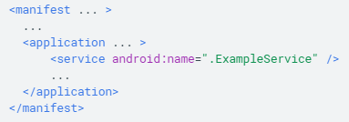
Declaring a service
Must declare all services in your application’s manifest file, as you do for activities and other components
Add a <service> element as child of <application>
android:name is the only required attribute, but you can add other attributes such as permissions required to start the service, and the processes in which the service can run
Do not declare intent filters for your service, and always start your services using explicit intents (you cannot be sure which service will respond to the intent and often the user cannot see which services was started)
android:exported to false stops other apps from accessing your service
Declaring a service in the manifest
https://developer.android.com/guide/components/services

Slide 8
Creating a started service
A started service is one that another component starts by calling startService(), resulting in onStartCommand() method being called
The started service’s lifecycle is independent of the component that started it, and can run indefinitely in the background, even if the component that started it gets destroyed.
The started service should stop itself by calling stopSelf(), or can be stopped by another component calling stopService()
An activity can start a service by calling startService() and passing an Intent that specifies the service and includes any data for it to use, which is received in hte onStartCommand() method
Example: an activity needs to save some data to an online database. The activity can start a companion service and deliver it the data by passing an intent to startService(), the service receives the intent in onStartCommand(), connects to the internet, performs the transaction, and then stops/destroys itself.
Two classes can be extended to create a started service:
Service – the base class for all services, when extending this class its important to create a new thread in which the service can do its work, as Service uses the application’s main thread by default
IntentService – a subclass of Service that uses a worker thread to handle all of the start requests, one at a time. Override onHandleIntent, which receives the intent for each start request so you can complete the background work
https://developer.android.com/guide/components/services

Slide 9
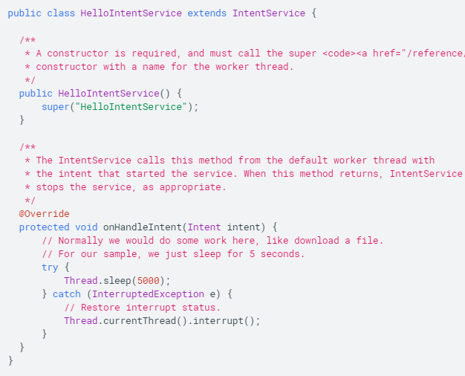
Extending IntentService
IntentService class does the following:
Creates a default worker thread that executes all the intents delivered to onStartCommand() separately from application’s main thread
Creates a work queue that passes one intent at a time to your onHandleIntent() implementation, so you don’t have to worry about multi-threading issues
Stops the service after all start requests are handled, so you don’t have to call stopSelf()
Provides a default implementation of onBind() that returns null
Provides a default implementation of onStartCommand() that sends the intent to the work queue and then to onHandleIntent() implementation
To complete the work provided by client, implement onHandleIntent
https://developer.android.com/guide/components/services

Slide 10
Extending Service
If you require your service to perform multi-threading, (instead of processing start requests through a queue as with IntentService), extend Service
onStartCommand() must return an integer, a value that describes how the system should continue the service in the event that it is killed. Must be one of the following constants:
START_NOT_STICKY – if system kills service after onStartCommand() returns, no not recreate the service unless there are pending intents to deliver. The safest option that avoids running service when unnecessary
START_STICKY – if the system kills service after onStartCommand() returns, recreate the service and call onStartCommand(), but do not redeliver the last intent. Suitable for media players or similar services that run indefinitely waiting for jobs
START_REDELIVER_INTENT – similar to START_STICKY, but also call onStartCommand() with the last intent delivered to the service, suitable for Download services or any service actively performing a job that should be immediately resumed.
https://developer.android.com/guide/components/services

Slide 11

Starting a service
Start a service from an activity by passing an Intent to startService() or startForegroundService(). Android will call the onStartCommand() method and pass the intent
startService() returns immediately, and allows Android to call the service’s onStartCommand(), if the service isn’t already running the system calls onCreate() first
If the service doesn’t provide binding, the intent delivered with startService() is the only mode off communication between the app and the service
To send a result back, the client starting the service can create a PendingIntent for a broadcast using getBroadcast() and deliver it to the service in the Intent that starts the service, the service can then use the broadcast to deliver the result
Example using explicit intent:
https://developer.android.com/guide/components/services

Slide 12
Stopping a service
Started services must manage their own lifecycle, the system will not stop them unless it needs to reclaim resources. The service must stop itself by calling stopSelf() or another component can stop it through stopService()
Once requested top stop with stopSelf() or stopService(), the system destroys the service as quickly as possible
If the service handles multiple requests to onStartCommand() concurrently, don’t stop the service when you finish processing the start request, because the service may have received an additional start request
Instead, use stopSelf(int), to ensure that your request to stop the service is always based on the most recent start request
https://developer.android.com/guide/components/services

Slide 13
Creating a bound service
A bound service allows application components to bind to it using bindService(), to create a long-running connection
Use a bound service when you want to interact with the service from activities and other components in your application, or expose your application’s functionality through IPC
To create a bound service, implement onBind() callback method to return an Ibinder that defines the interface for communication with the service. This allows other components to call bindService() to retrieve the interface and begin calling methods on the service
When there are no components bound to the service, the system destroys it, it does not need to be stopped explicitly like started services
Multiple clients can bind to the same service simultaneously, when a client is done interacting it calls unbindService() to unbind
https://developer.android.com/guide/components/services

Slide 14
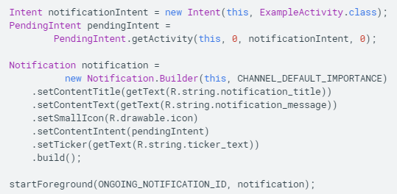
Running a service in the foreground
A foreground service is a service the user is actively aware of and is not a candidate for the system to kill to reclaim resources
Must provide a notification for the status bar, placed under Ongoing heading, and the notification cannot be dismissed unless the service is stopped or removed from foreground
Limit your app’s use of foreground services – only use foreground services when the service is noticeable to the user (music, location)
Start a foreground service using startForeground()
https://developer.android.com/guide/components/services

Slide 15
Managing service lifecycle
Service lifecycle is simpler than activity lifecycle, but more important to track because services can run in the background indefinitely
The service lifecycle can follow one of two paths:
1) started service – created when another component calls startService(), runs indefinitely and must stop itself using stopSelf(), or another component calls stopService(), system then destroys
2) bound service – created when another component (client) calls bindService(), client then communicates with service through Ibinder interface, and can close the connection calling unbindService(), when all clients have unbound, system destroys the service
These two pathways are not separate – can bind to started service, in which case, calling stopService() will not destroy unless all clients have unbound
https://developer.android.com/guide/components/services

Slide 16
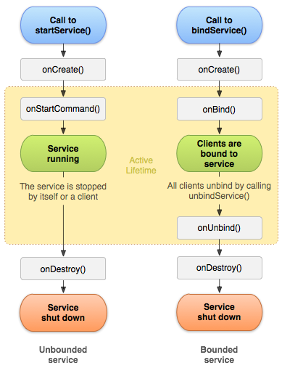
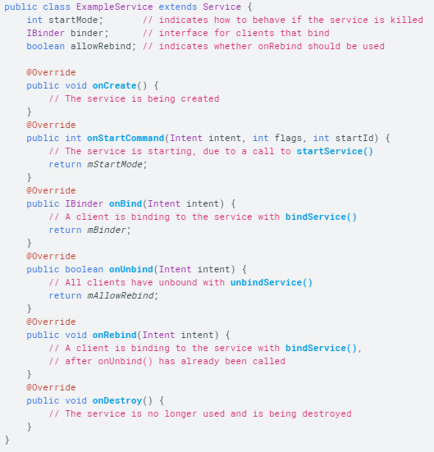
Implementing lifecycle callbacks
The lifetime of a service occurs between onCreate() and onDestroy()
The active lifetime of a service begins with either onStartCommand() or onBind(), each method handles the intent used to start the service
https://developer.android.com/guide/components/services

Slide 17
Create a background service
Use the IntentService class for a straightforward operation running on a single background thread.
IntentService is unaffected by most user lifecycle events, so it continues to run in circumstances that would shut down an AsyncTask
Limitations of IntentService:
Can’t interact directly with UI, must send results to an Activity
Work requests run sequentially (single background thread)
Operations running on IntentService cannot be interrupted
https://developer.android.com/training/run-background-service/create-service

Slide 18
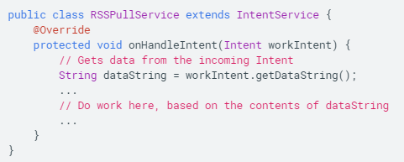
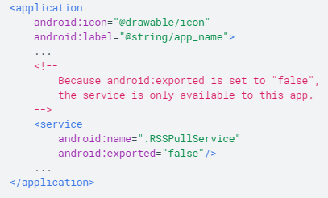
Handle incoming intents
Define a class extending IntentService, and override onHandleIntent()
Define your IntentService in the manifest with a <service> element child of <application>
No intent filter is needed, the service is started using an explicit intent. This also means that only components in the same app, or other apps with the same user ID can access the service
https://developer.android.com/training/run-background-service/create-service

Slide 19
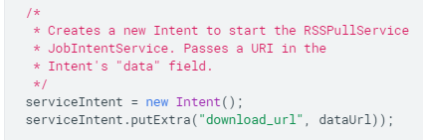
Send work requests to background service
Create an intent and queue it up by calling enqueueWork()
You can send the work request from anywhere in the activity or fragment, including callbacks that respond to button presses or taps
Once enqueueWork() is called, IntentService does the work defined in onHandleWork() and then stops itself
The next step is to report the results of the work back using a BroadcastReceiver
https://developer.android.com/training/run-background-service/send-request

Slide 20
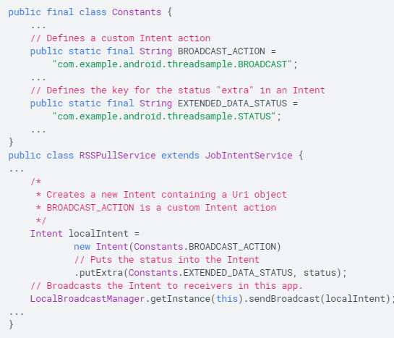
Report work status
We often want to report the status of a background service to the component that started the service
Receive status updates from background services using LocalBroadcastManager, which limits broadcast Intent objects to components in your own app
To send status of a work request from JobIntentService to other components, first create an Intent containing the status in its extended data, can also add action and data URI to the intent
Next, send Intent by calling LocalBroadcastManager.sendBroadcast(), which sends the intent to any component in your application registered to receive it
https://developer.android.com/training/run-background-service/report-status

Slide 21
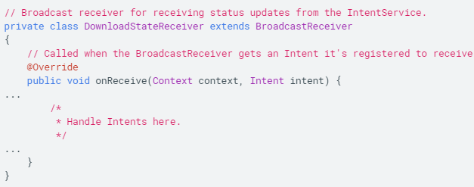
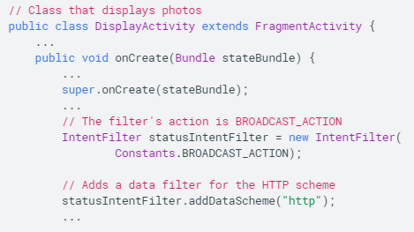
Receive status broadcasts from JobIntentService
Use subclass of BroadcastReceiver, in subclass, implement onReceive() callback, which will be invoked by LocalBroadcastManager when it receives an intent.
LocalBroadcastManager passes incoming intent to onReceive()
Create an IntentFilter to define filters matching specific actions, categories, and data.
https://developer.android.com/training/run-background-service/report-status

Slide 22
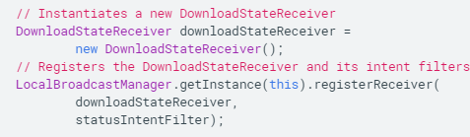
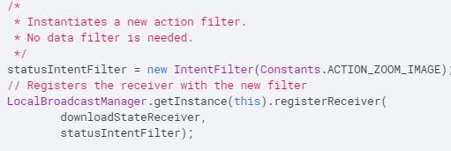
Receive status broadcasts from JobIntentService
To register BroadcastReceiver and IntentFilter with the system, get an instance of LocalBroadcastManager and call its registerReceiver() method
A single BroadcastReceiver can handle more than one type of Intent, allowing you to run different code for each intent action. Simply define another IntentFilter for the same BroadcastReceiver, create the IntentFilter, and repeat the call to registerReceiver()
Sending a broadcast intent does not start or resume an Activity, rather, BroadcastReceiver receives and processes Intent objects even when your app is in the background. You can use a notification to notify the user about received broadcasts, but never start an activity in response to an incoming broadcast Intent.
https://developer.android.com/training/run-background-service/report-status

Slide 23
Bound services
Overview: a bound service is the server in a client-server interface.
Allows components (Activities) to bind to the service, send requests, receive responses, and perform inter-process communication (IPC)
Typically only lives while it serves another component and does not run indefinitely
https://developer.android.com/guide/components/bound-services

Slide 24
Binding to a started service
You can create a service that is both started and bound (start using startService(), and then bind using bindService())
In the above case, service will persist as long as either 1) clients remain bound or 2) stopSelf() or stopService() have not been called
Must implement onBind() AND onStartCommand() for a bound, started service.
Example: music player will start a service to run indefinitely when the user exits the Activity, but also allow binding, so when the user returns to the music player Activity, it can re-bind to the started service and regain control of the playback
Client binds to service by calling bindService(). Client must provide implementation of ServiceConnection, which monitors the connection with the service. Once the client is bound, the system calls onServiceConnected is called in ServiceConnection, providing an IBinder argument allowing the client to communicate with the bound service
The same IBinder is delivered to all subsequent clients that connect to the service
https://developer.android.com/guide/components/bound-services

Slide 25
Creating a bound service:
When creating a service that provides binding, you must provide an IBinder that provides the programming interface clients can use to interact with the service, this can be done in 3 ways:
1) Extend the Binder class – if the service is private to the client and runs in the same process, you should create your interface by extending Binder and returning an instance of it from onBind(). The client receives the Binder and can use it to directly access public methods in Binder implementation or Service. This is the preferred method, the only reason you wouldn’t use it is because your service is used by other applications or across processes.
2) Using a messenger – when you need your interface to work across different processes, you can use a Messenger. The service will define a Handler that responds to different types of Message objects. This Handler is the basis for a Messenger that can then share an IBinder with the client, allowing the client to send commands to the service using Message objects. This is the simplest way to do IPC because Messenger queues all requests into a single thread.
3) Using AIDL – Android Interface Definition Language (AIDL) decomposes objects into primitives that the OS can understand and marshals them across processes to perform IPC. The Messenger technique is based on AIDL as its underlying structure. To use AIDL directly, however, must create a .aidl file defining the programming interface, the Android SDK tools uses this file to generate an abstract class that implements the interface and handles IPC, which you can then extend within your service. Most apps shouldn’t use AIDL to create bound service (complicated, multithreading)
https://developer.android.com/guide/components/bound-services

Slide 26
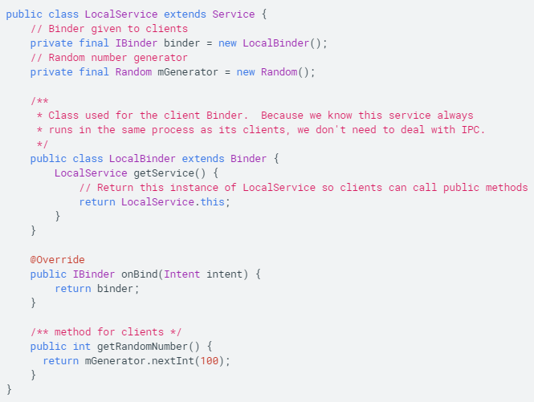
Extending Binder class (intra-process)
If your service doesn’t communicate across processes, you can implement your own Binder to provide direct access to public Service methods
1) in your service, create an instance of Binder that does one of the following:
A) contains public methods the client can call
B) returns the current Service instance, which has public methods the client can call
C) returns an instance of another class hosted by the service with public methods the client can call
2) return this instance of Binder from onBind() callback
3) in the client, receive the Binder from onServiceConnected() and make calls to the bound service using methods provided
Example: service that provides clients with access to methods in the service through a Binder implementation
https://developer.android.com/guide/components/bound-services

Slide 27
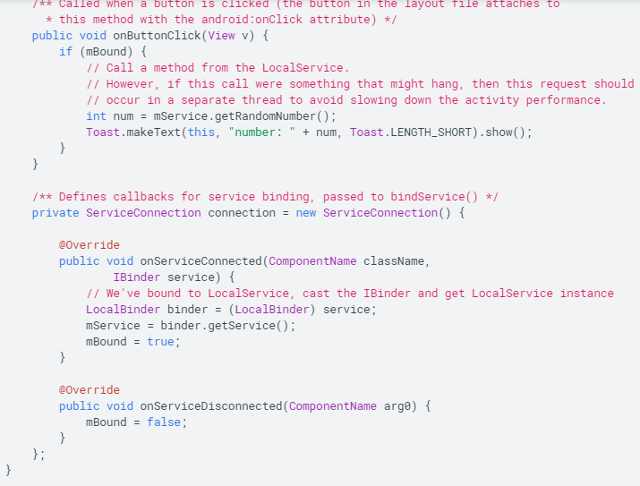
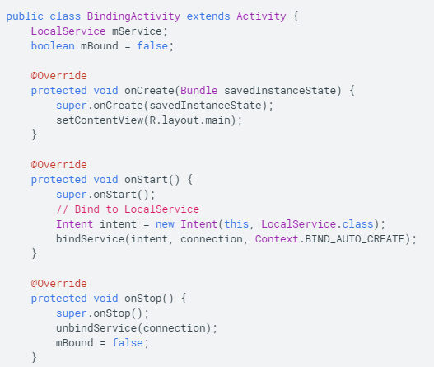
Example activity
This activity binds to LocalService and calls getRandomNumber() when a button is clicked. Shows how the client binds to the service using an implementation of ServiceConnection and the onServiceConnected callback
https://developer.android.com/guide/components/bound-services

Slide 28
Using a messenger for IPC
You can use a Messenger if you need your service to communicate with other processes, allowing you to do IPC without AIDL
Most applications don’t need explicit multi-threading using AIDL.
How to use Messenger:
1) implement a Handler in your service that receives a callback for each call from a client
2) The service uses Handler to create Messenger object (which is a reference to the Handler
3) The Messenger creates an IBinder that the service returns to clients from onBind()
4) Clients use the IBinder to instantiate Messenger (referencing service’s Handler), which the client uses to send Message objects to the service
5) the service receives each Message in its Handler’s handleMessage() method
In this way, the client does not directly call methods on the service, instead, the client delivers Message objects that the service receives in its Handler
https://developer.android.com/guide/components/bound-services

Slide 29
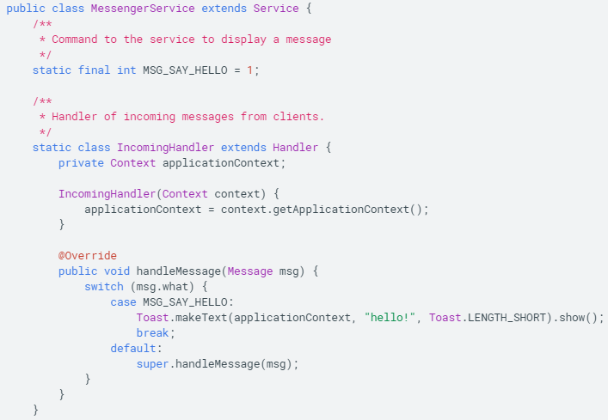
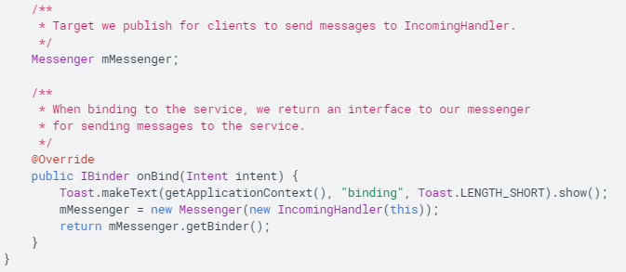
Example Service using Messenger interface
Service receives incoming message in the handleMessage() method of the Handler, and then decides what to do based on msg.what
https://developer.android.com/guide/components/bound-services

Slide 30
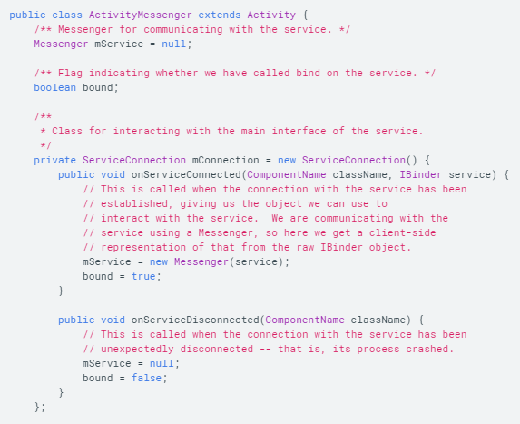
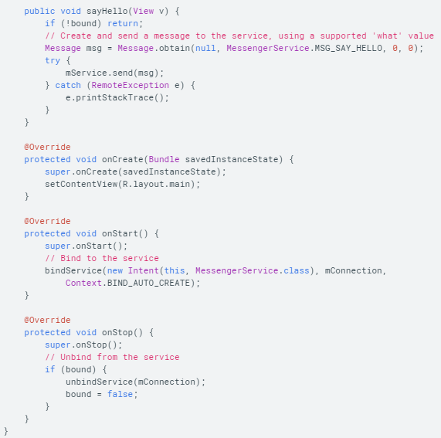
Creating a messenger in the client
Client creates a Messenger based on the IBinder returned by the service, and send messages using send().
https://developer.android.com/guide/components/bound-services

Slide 31
Binding to a service
Application components (clients) can bind to a service by calling bindService(). Android will then call service’s onBind() method, returning an IBinder for interacting with the service
Binding is asynchronous, and bindService() returns immediately without returning the IBinder to the client.
To bind a service from your client:
1) implement ServiceConnection, and override onServiceConnected() and onServiceDisconnected().
2) call bindService(), passing the ServiceConnection implementation
3) when the system triggers onServiceConnected() callback, you can begin making calls to the service, using the methods defined by the interface
4) call unbindService() to disconnect from the service
https://developer.android.com/guide/components/bound-services

Slide 32
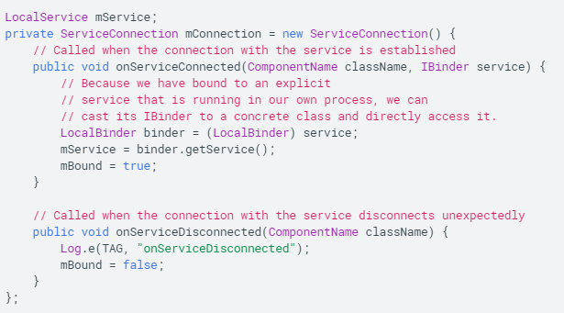

Connecting client to service example
Cast the returned IBinder to the LocalService class and request the LocalService instance
The client can bind to a service by passing ServiceConnection to bindService
If you need to interact with service only while activity is visible, bind during activity’s onStart() and unbind during onStop()
Caution: make sure to use explicit intent to bind to a service, otherwise an exception will be thrown
https://developer.android.com/guide/components/bound-services

Slide 33
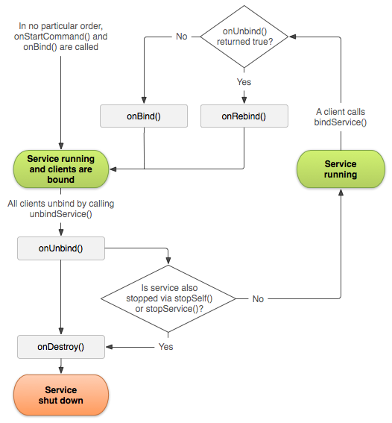
Managing bound service lifecycle
Android system destroys any service that is unbound from all clients (unless it was started using onStartCommand), therefore, purely bound services’ lifecyle is managed entirely by Android OS
However, if you implemented onStartCommand() callback, the service is considered started and must be explicitly stopped using stopSelf() or stopService()
If you service is started and accepts binding, when the system calls onUnbind(), you can optionally return true if you would like to receive a call to onRebind() the next time a client binds to the service. onRebind() returns void, but the client still receives the IBinder in its onServiceConnected callback. (figure)
https://developer.android.com/guide/components/bound-services

