Slide 1
ideas

Slide 2
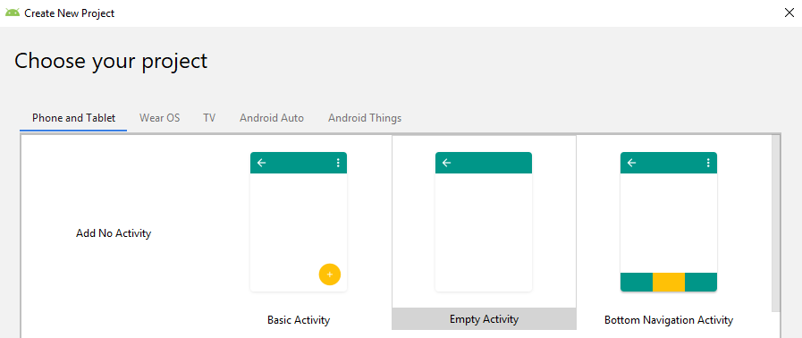
Support library action bar
Action bars
Action bar is a primary toolbar within the activity that may display activity title, navigation, and other interactive items
Android support library is a set of code libraries that provide backward-compatible versions of Android framework APIs as well as features that are only available through the library APIs

Slide 3
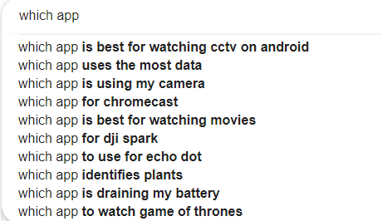
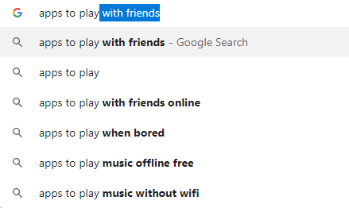
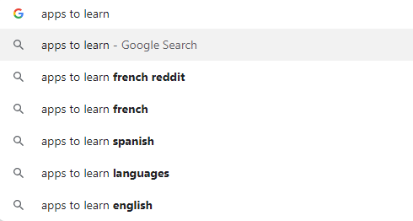
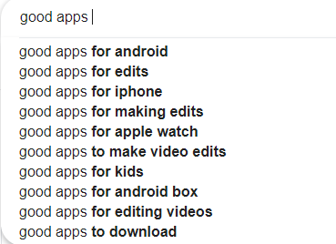
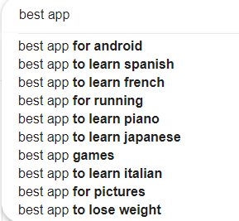
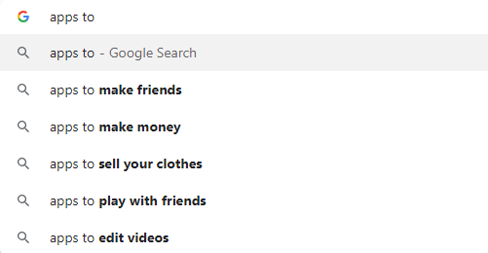
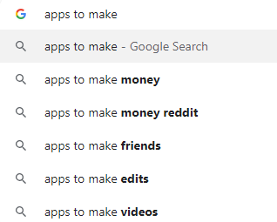
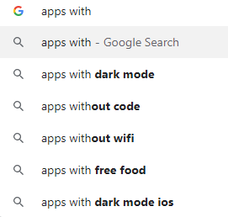
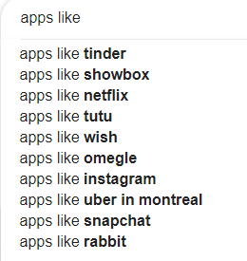
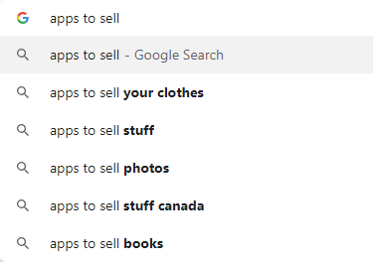
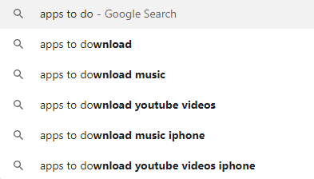
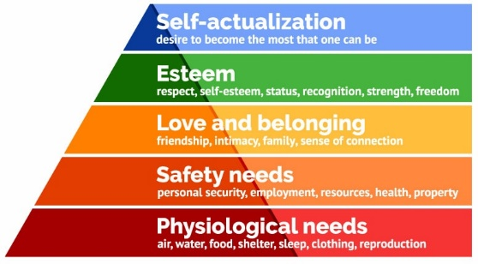
Mobile apps

Slide 4
Learning app through examples:
The location tracker app
The system scanning app
The multimedia streaming app
The messenger/communication app
The game app
Unity, graphics2D, openGL
The social media/sharing app
The selfie editing app
What do all these apps have in common? UI,

Slide 5
Reverse engineer popular apps
Reverse engineer popular apps, and replicate their basic functionality

Slide 6
An imaginary real estate agent / realtor app. Give them a test web service with a few endpoints:
List of properties
Property details
Maybe tokenized user login (bonus points)
Maybe add favourites (bonus points)
Making this work would cover a good amount of basic Android development: fragments, layouts, lists, async image loading, infinite scroll, adapters, web service interaction, navigation, Google Maps display etc.

Slide 7
The majority of android development is making an api call and displaying a list of data from that. You'll probably want to cover that. And something to include custom views/viewgroups and what role those play

Slide 8
A note taking app. This is what I build for new frameworks that I wanna learn. It covers a lot thing like:
Persistent data storage
Making adapters and using them in recycler view
Dealing with observables and updating when their value chnages
Android Navigation
There are many features that you can add to it to make it more complex like remote syncing, password protection, labels for notes, etc. From my experience, it is a great place to start

