Slide 1
CS230 Developing Mobile Apps
Lecture 5

Slide 2
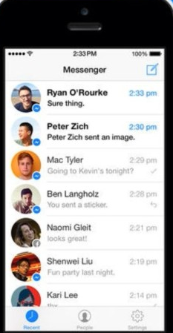
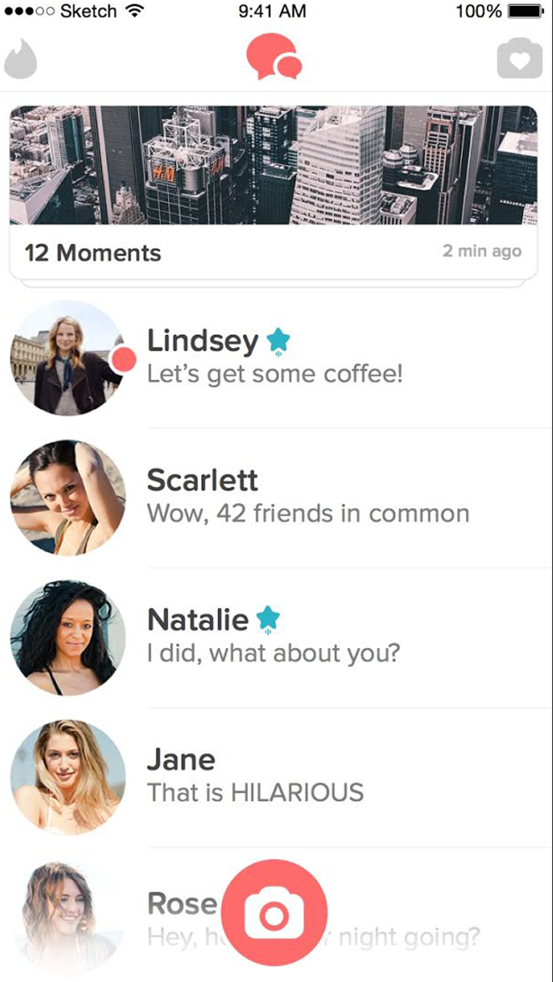
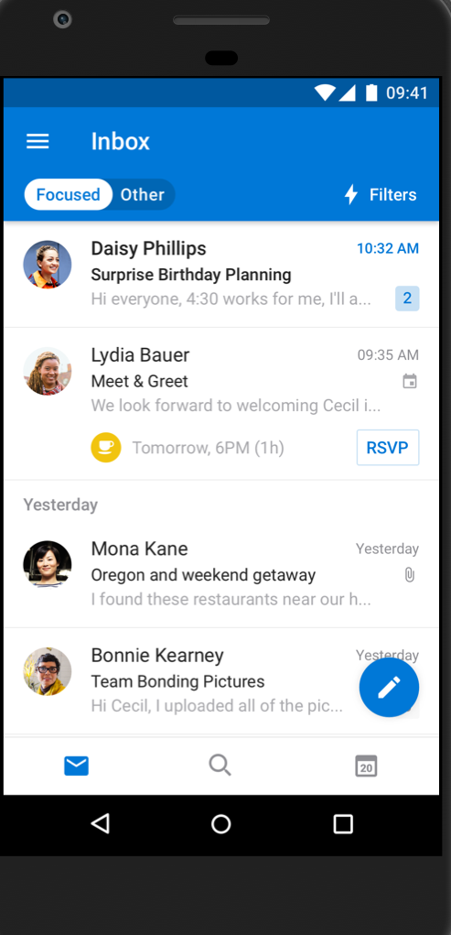
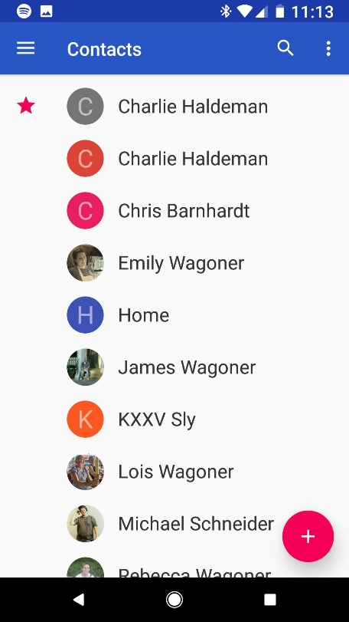
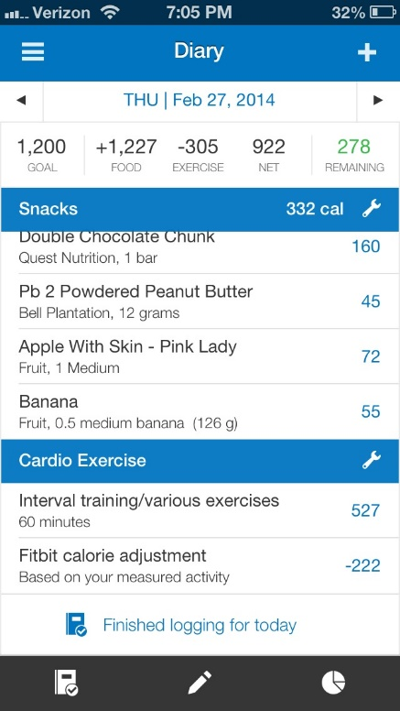
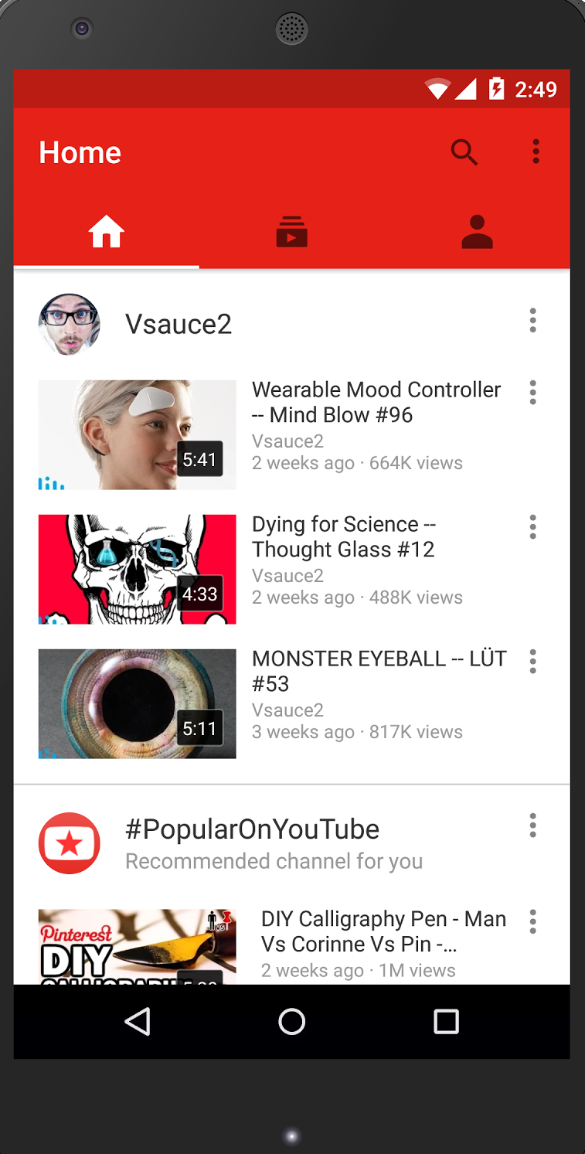
Assignment 1
Displaying a list of expandable items is probably the most common pattern in app design
contacts
myfitnesspal
youtube
tinder
outlook
messenger
…just to name a few

Slide 3
Create a list with RecyclerView
RecyclerView is a more advanced and flexible version of ListView
ListView displays a vertically scrollable collection of views, where each view is positioned immediately below the previous view in the list
ListView is an adapter view that doesn’t know the details of the items it displays, but instead requests views on demand from a listAdapter as needed
https://developer.android.com/guide/topics/ui/layout/recyclerview
https://developer.android.com/reference/android/widget/ListView.html

