Slide 1
CS230 Programming Mobile Apps
Today:
Intro - What is a mobile app?
First project - Hello World

Slide 2
What is a mobile app?
A mobile application (mobile app) is a piece of software running on a mobile device that adds value to the user’s life
An Android app is a mobile app running on the Android operating system

Slide 3
Android Studio
Android Studio is the official integrated development environment (IDE) for Google’s Android operating system, built on JetBrains’ IntelliJ IDEA software and designed specifically for Android development
IntelliJ IDEA

Slide 4
Create project
Choose activity type (Basic, maps, full screen, etc.)
Name
Package name
Save location
Language
Minimum API level
Support instant apps
Use androidx.* artifacts

Slide 5
Hello world
4 main files
MainActivity.java
activity_main.xml
AndroidManifest.xml
build.gradle

Slide 6
MainActivity.java
import androidx…
import base class for activities that use the support library action bar features
import android…
import a mapping from String keys to various Parcelable values
public class MainActivity
default Activity to run app in (more on activities later)
extends AppCompatActivity
base class for activities that use the support library action bar features
onCreate()
called when activity is first created
Bundle savedInstanceState
contains data saved earlier if activity is being re-initialized
super.onCreate();
assign Context to Activity, avoid SuperNotCalledException
setContentView();
assign visual design of activity through xml layout file
R.layout.activity_main
MainActivity.java is the application file which ultimately gets converted into an executable and runs your code
import androidx.appcompat.app.AppCompatActivity; import android.os.Bundle; public class MainActivity extends AppCompatActivity { @Override protected void onCreate(Bundle savedInstanceState) { super.onCreate(savedInstanceState); setContentView(R.layout.activity_main); } }
What is the support library? What is the action bar?

Slide 7
activity_main.xml
encoding
character encoding for xml document
Constraintlayout
constraintLayout is a ViewGroup which allows you to flexibly position and size widgets
xmlns:android
defines android:xxx elements
xmlns:app
defines app:xxx attributes
xmlns:tools
defines additional namespace to help design UI, discarded at build time.
android:layout_width
Set to wrap_content or match_parent or a number in dpi
tools:context
Tells which activity the layout is associated, helps guess a default layout theme at design time (since themes are defined in manifest, and associated to activities not layouts)
TextView
A user interface element that displays text to the user
A typical android app is comprised of one or more screens. You define what each screen looks like using an XML layout.
<?xml version="1.0" encoding="utf-8"?> <androidx.constraintlayout.widget.ConstraintLayout
xmlns:android="http://schemas.android.com/apk/res/android" xmlns:app="http://schemas.android.com/apk/res-auto" xmlns:tools="http://schemas.android.com/tools" android:layout_width="match_parent" android:layout_height="match_parent" tools:context=".MainActivity"> <TextView android:layout_width="wrap_content" android:layout_height="wrap_content" android:text="Hello World!" app:layout_constraintBottom_toBottomOf="parent" app:layout_constraintLeft_toLeftOf="parent" app:layout_constraintRight_toRightOf="parent" app:layout_constraintTop_toTopOf="parent" /> </androidx.constraintlayout.widget.ConstraintLayout>
Why does http:.//schemas.* not exist? “URIs as schema identifiers are not required to point to documents that exist. There is no schema for the android xml files since the elements or attributes are completely dependent on what classes and attributes your application defines.” -joe

Slide 8
AndroidManifest.xml
package
App’s package name, used by build tools to determine location of code entities when building project
application
Declaration of the app. This element contains sub-elements that declare each of the application’s components and has attributes that affect all components
android:allowBackup=
Allow application data to be backed up during adb backup
icon, label, roundIcon
Specify icon, label, and round icon
android:supportsRtl
Suports right to left layouts (Arabic, Urdu, Hebrew, etc.)
android:theme
A theme is a type of style that’s applied to an entire app, not just an individual view
activity android:name
Activity component, every app component you create must be declared in manifest
intent-filter
Intent filter declaration, when an app issues an intent to the system, the system locates the appropriate app based on the intent filter
The manifest file describes the fundamental characteristics of the app and defines each of its components
<?xml version="1.0" encoding="utf-8"?> <manifest xmlns:android="http://schemas.android.com/apk/res/android" package="com.russ.helloworld"> <application android:allowBackup="true" android:icon="@mipmap/ic_launcher" android:label="@string/app_name" android:roundIcon="@mipmap/ic_launcher_round" android:supportsRtl="true" android:theme="@style/AppTheme"> <activity android:name=".MainActivity"> <intent-filter> <action android:name="android.intent.action.MAIN" /> <category android:name="android.intent.category.LAUNCHER" /> </intent-filter> </activity> </application> </manifest>
https://developer.android.com/guide/topics/manifest/manifest-intro

Slide 9
build.gradle
apply plugin: 'com.android.application'
Indicate that you are building an application, not a library
compileSdkVersion 29
Version of the API the app is compiled against
buildToolsVersion "29.0.1"
Version of compiler to use
defaultConfig {}
Block to define manifest properties
applicationId "com.russ.helloworld"
Every android app has a unique application ID that looks like a java package name
minSdkVersion 15
Determine which of a user’s devices app can be installed on
targetSdkVersion 29
Indicate to Android OS your app is tested up to this version
versionCode 1
Positive integer used as internal version number, higher=more recent
versionName "1.0"
User-friendly version name
testInstrumentationRunner
Instrumentation runner, entry point into running your test suite.
minifyEnabled
Detect and remove unused classes, fields, methods, and attributes from packaged app
proguardFiles
Java class file shrinker, optimizer, obfuscator, and preverifier. Optimizes bytecode and removes unused instructions.
dependencies {}
Modern software projects rarely build code in isolation. Projects reference modules for the purpose of reusing existing, proven functionality.
apply plugin: 'com.android.application' android { compileSdkVersion 29 buildToolsVersion "29.0.1" defaultConfig { applicationId "com.russ.helloworld" minSdkVersion 15 targetSdkVersion 29 versionCode 1 versionName "1.0" testInstrumentationRunner "androidx.test.runner.AndroidJUnitRunner" } buildTypes { release { minifyEnabled false proguardFiles getDefaultProguardFile('proguard-android-optimize.txt'), 'proguard-rules.pro' } } } dependencies { implementation fileTree(dir: 'libs', include: ['*.jar']) implementation 'androidx.appcompat:appcompat:1.0.2' implementation 'androidx.constraintlayout:constraintlayout:1.1.3' testImplementation 'junit:junit:4.12' androidTestImplementation 'androidx.test:runner:1.2.0' androidTestImplementation 'androidx.test.espresso:espresso-core:3.2.0' }

Slide 10
App resources

Slide 11
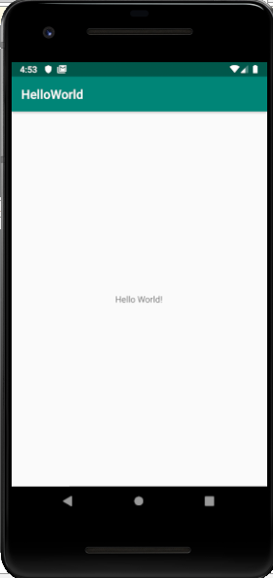
Hello world (so many questions)
protected void onCreate(Bundle savedInstanceState)
Protected?
When is it called?
Who calls it?
Where did savedInstanceState come from?
setContentView(R.layout.activity_main);
How does the layout get inflated?

Slide 12
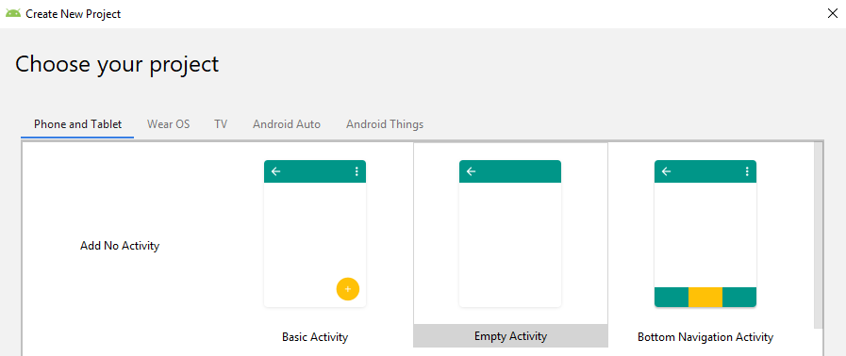
Support library action bar
Action bars
Action bar is a primary toolbar within the activity that may display activity title, navigation, and other interactive items
Android support library is a set of code libraries that provide backward-compatible versions of Android framework APIs as well as features that are only available through the library APIs

Slide 13
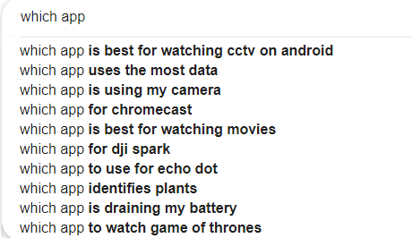
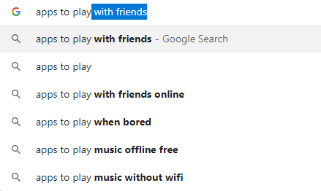
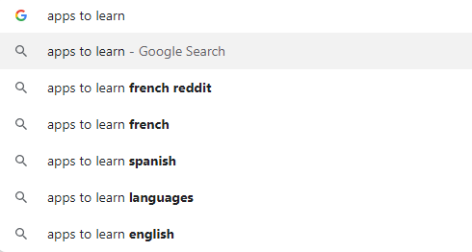
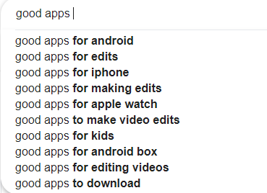
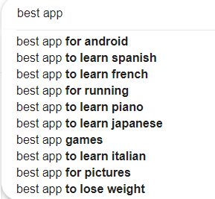
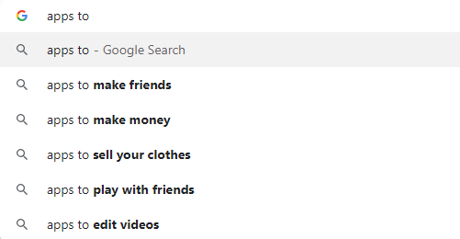
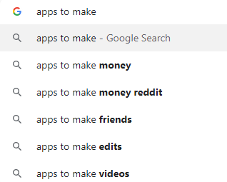
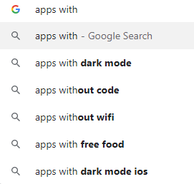
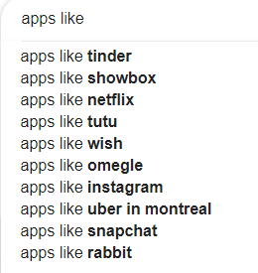
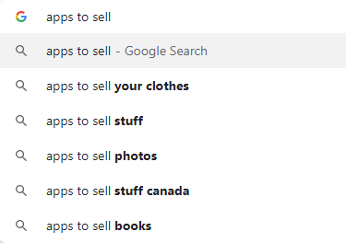
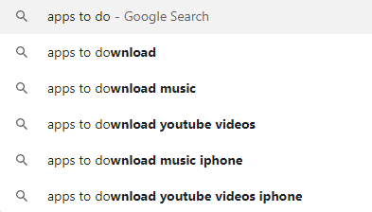
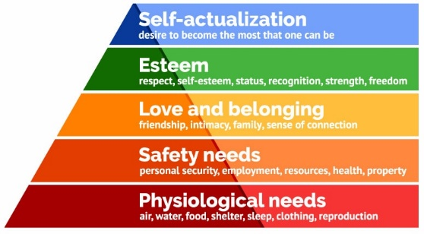
Mobile apps

Slide 14
Learning app through examples:
The location tracker app
The system scanning app
The multimedia streaming app
The messenger/communication app
The game app
Unity, graphics2D, openGL
The social media/sharing app
The selfie editing app
What do all these apps have in common? UI,

Slide 15
Reverse engineer popular apps
Reverse engineer popular apps, and replicate their basic functionality

Slide 16
An imaginary real estate agent / realtor app. Give them a test web service with a few endpoints:
List of properties
Property details
Maybe tokenized user login (bonus points)
Maybe add favourites (bonus points)
Making this work would cover a good amount of basic Android development: fragments, layouts, lists, async image loading, infinite scroll, adapters, web service interaction, navigation, Google Maps display etc.

Slide 17
The majority of android development is making an api call and displaying a list of data from that. You'll probably want to cover that. And something to include custom views/viewgroups and what role those play

Slide 18
A note taking app. This is what I build for new frameworks that I wanna learn. It covers a lot thing like:
Persistent data storage
Making adapters and using them in recycler view
Dealing with observables and updating when their value chnages
Android Navigation
There are many features that you can add to it to make it more complex like remote syncing, password protection, labels for notes, etc. From my experience, it is a great place to start

