Slide 1
Broadcasts

Slide 2
Broadcasts overview
Similar to the publish-subscribe design pattern, Android apps can send or receive messages from the Android system and other apps using broadcasts
These broadcasts are sent when an event of interest occurs
Example: system boots up, or devices starts charging (system broadcast). Or, an app can send a broadcast telling other apps it has downloaded new content
Apps can register to receive specific broadcasts. When a broadcast is sent, the system automatically routes broadcasts to apps that have been subscribed to receive that particular type of broadcast.
Do not abuse broadcasts – example of NETWORK_CONNECTIVITY intent filter, this has been eliminated in Android 7.0 for performance reasons
https://developer.android.com/guide/components/broadcasts

Slide 3
System broadcasts
The system automatically sends system broadcasts when certain events occur, such as switching in and out of ‘airplane mode’
System broadcasts are sent to all apps subscribed to receive the event
The broadcast message itself is wrapped in an Intent object, whose string identifies the event that occurred, example: android.intent.action.AIRPLANE_MODE, the intent may also include extras with additional information, example: true/false for AIRPLANE_MODE
See BROADCAST_ACTIONS.txt in the Android SDK for a complete list of system broadcasts
https://developer.android.com/guide/components/broadcasts

Slide 4
Changes to system broadcasts
System broadcast behavior has changed as Android evolves:
Android 9.0 – NETWORK_STATE_CHANGED_ACTION broadcast no longer receives information about user’s location or personally identifiable data. Also, system broadcasts from wifi no longer contain SSIDs, BSSIDs, connection information, or scan results
Android 8.0 – system imposes additional restrictions on manifest-declared broadcast receivers. Can no longer use the manifest to declare a receiver for most implicit broadcasts, however you can still use a context-registered receiver when user is using your app
Android 7.0 – ACTION_NEW_PICTURE and ACTION_NEW_VIDEO are no longer sent as system broadcasts. Also, apps listening for CONNECTIVITY_ACTION broadcast must register using registerReceiver(BroadcastReceiver, IntentFilter), simply declaring the receiver in the manifest no longer works
https://developer.android.com/guide/components/broadcasts

Slide 5
Receiving broadcasts
Apps can receive broadcasts in two ways
1) manifest-declared receivers and
2) context-registered receivers
https://developer.android.com/guide/components/broadcasts

Slide 6
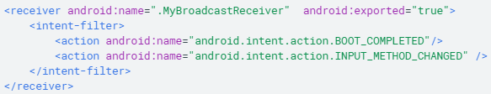
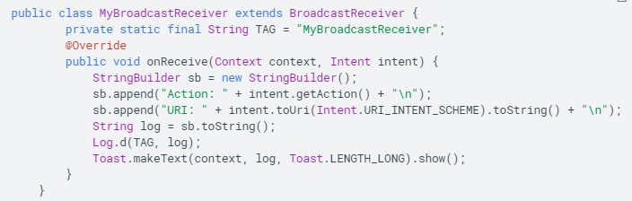
Receiving broadcasts through manifest-declared receivers
If you declare a broadcast receiver in your manifest, the system launches your app (if not already running) when broadcast is sent
Note –as of API 26, cannot use manifest to declare receiver for implicit broadcasts, with a few exceptions. Use scheduled jobs instead.
Declaring a broadcast receiver in the manifest:
1) specify <receiver> element in your app’s manifest
2) subclass BroadcastReceiver and implement onReceive(Context, Intent)
The system package manager will register the receiver when the app is installed. The receiver becomes a separate entry point to your app, meaning the system can start the app and deliver the broadcast
The system creates a new BroadcastReceiver component object to handle each broadcast it receives, which is valid only during the call to onReceive()
1) Specify <receiver> in manifest
2) Subclass BroadcastReciever and implement onReceive()
https://developer.android.com/guide/components/broadcasts

Slide 7

Receive broadcasts through context-registered receivers
Context-registered receivers receive broadcasts as long as their registering context is valid, example: you register to receive within an Activity, as long as the activity is not destroyed, you can continue to receive broadcasts. If you register within the Application context, can receive broadcasts as long as the app continues to run
Perform the following steps to register a receiver with a context:
1) create instance of BroadcastReceiver
2) create an IntentFilter and register the receiver by calling registerReceiver(BroadcastReceiver, IntentFilter)
3) to stop receiving broadcasts, call unregisterReceiver(android.content.BroadcastReceiver)
1) create instance of BroadcastReceiver
2) create IntentFilter and register receiver
https://developer.android.com/guide/components/broadcasts

Slide 8
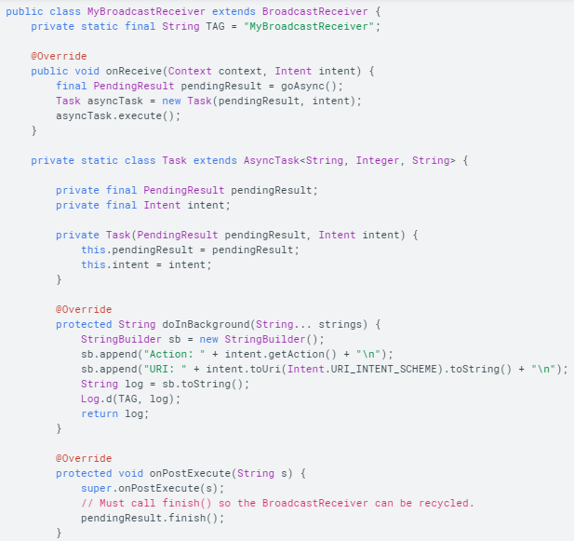
Effects of BroadcastReceiver on process state
The state of BroadcastReceiver (running or not) affects the state of its containing processes, which in turn affects the likelihood of being killed by the system, example: when onReceive() is in progress, process is considered foreground by the system and unlikely to be killed.
However, once onReceive() returns, BroadcastReceiver is no longer active, and its host process loses importance to the system, especially in cases where the app is not used often, the system then considers the process low priority and kills it
For this reason, should not start long-running background threads from a broadcast receiver, because the system can kill it at any time after onReceive() returns. Instead, either use goAsync() or schedule a JobService from the receiver using JobScheduler, so the system knows the process continues to perform active work.
Example of BroadcastReceiver using goAsync() to indicate to the system it needs more time to finish after onReceive() completes.
https://developer.android.com/guide/components/broadcasts

Slide 9

Sending broadcasts
Android provides three ways for apps to send broadcasts:
1) sendOrderedBroadcast(Intent, String) method sends broadcasts to one receiver at a time. Each receiver executes in turn, and propagates the result to the next receiver (or aborts the broadcast). The order is controlled by android:priority attribute of the receiver`s intent filter
2) sendBroadcast(Intent) – send broadcast to all receivers in undefined order, otherwise known as a normal broadcast. More efficient than sendOrderedBroadcast(), but also means receivers cannot read results from other receivers or abort the broadcast
3) LocalBroadcastManager.sendBroadcast – send broadcasts to receivers that are in the same app as the sender. Use if you don’t need to send broadcasts to other apps, as it is more efficient (no IPC needed) and no security issues with other apps sending/receiving your broadcasts.
Example: sending a broadcast by creating an intent and calling sendBroadcast(Intent). The broadcast message is wrapped in an intent object, whose action string must provide the app’s java package name syntax and uniquely identify the broadcast event.
https://developer.android.com/guide/components/broadcasts

Slide 10

Restricting broadcasts with permissions
Permissions allow you to restrict broadcasts to the set of apps that hold certain permissions, you can enforce permissions on the sender or the receiver of the broadcast
Sending with permissions: you can specify permission parameters when sending broadcasts, and only receivers who have been granted that permission through their manifest can receive the broadcast.
Send broadcast with permission specification
Receiving app must request permission in manifest
https://developer.android.com/guide/components/broadcasts

Slide 11
https://developer.android.com/guide/components/broadcasts

Slide 12
Security considerations and best practices
Use LocalBroadcastManager whenever possible (if you don’t need to send broadcasts outside your app). Local broadcasts can be used as a general purpose publisher/subscriber event bus without the overhead of system-wide broadcasts
Use context registration over manifest declaration, to avoid having the system launch your app when it is closed due to a system-wide broadcast (this saves system resources and device performance)
Do not broadcast sensitive information using implicit intents
https://developer.android.com/guide/components/broadcasts

