Slide 1
Data and Files

Slide 2
App data and files
Learn how to preserve app and user data as:
Files on the device
Key-value pairs
In a database
With other data types
Share data between other apps and devices
Add a backup server to let users:
Store information in the cloud
Sync across devices
Recover data in a new device

Slide 3
Data and file storage overview
Android provides several data saving options, depending on specific needs (space, data type, private/public)
Different data storage options available on Android:
Internal file storage – store app-private items on device file system
External file storage – store files on shared external file system, usually for shared files such as photos
Shared preferences – store private primate data in key-value pairs
Databases – store structured data in a private database
Except for external storage, these are all intended for app-private data, the data is not accessible to other apps
Use FileProvider API to share files with other apps
Use ContentProvider to expose your app’s data to other apps, ContentProviders give full control of what read/write access is available to other apps
https://developer.android.com/guide/topics/data/data-storage

Slide 4
Internal storage
Files saved to internal storage are private to your app by default, other apps cannot access them (nor can the user without root access)
System creates a private directory on the file system for each app where you can organize any files your app needs
Files saved on internal storage are deleted when the user uninstalls your app
Internal cache files – used for temporary internal storage, each app has a private cache directory specifically for temporary files
https://developer.android.com/guide/topics/data/data-storage

Slide 5
External storage
Every Android device supports a shared ‘external storage’ space that you can use to save files. Files saved to external storage are world-readable, and can be modified by the user when they enable USB mass storage to transfer files
Use external storage for files that should be accessible to other apps and saved even if the user uninstalls your app, such as photos or downloaded files.
The system provides public directories for most type of files (photos, music, ringtones, etc)
Can also create an app-specific external directory that the system deletes when your app is uninstalled.
https://developer.android.com/guide/topics/data/data-storage

Slide 6
Shared preferences
Used SharedPreferences if you don’t need to store a lot of data and it doesn’t require a specific structure. SharedPreferences API allows you to read and write persistent key-value pairs of primitive data types: Booleans, floats, ints, longs, and strings
Key-value pairs are written to XML files that persist across user sessions, even if app is killed. Can specify this XML’s name, or use per-activity files to save your data
SharedPreferences is not strictly for saving preferences, you can save any type of primitive data (such as a high score). In fact, to save user preferences use Androidx’s preference library to build a settings screen
https://developer.android.com/guide/topics/data/data-storage

Slide 7
Databases
Android provides full support for SQLite databases
Any database you create is accessible only by your app
Instead of using SQLite API directly, use the Room persistence library to create and interact with databases
Room library provides object-mapping abstraction layer allowing fluent database access
Room persistence library takes care of low-level concerns, reducing time and effort that would be spent working directly with SQLite
https://developer.android.com/guide/topics/data/data-storage

Slide 8
Save files on device storage
Android file system is similar to disk-based file system on other platforms
File object good for reading or writing large amounts of data in start-finish order, example: images or anything exchanged over network
Choose internal or external storage:
Internal storage:
Always available
Accessible only by your app
Removed when user uninstalls your app
Internal storage best when you want to ensure the user and other apps cannot access the data directly
External storage:
Not always available, can be removed by user (SD card)
World-readable, files may be read outside your control
When user uninstalls, externally stored files only removed if you use getExternalFilesDir() to save
External storage best for files that don’t require access restriction, files to share with other apps, or allow the user to access from computer/other devices
https://developer.android.com/training/data-storage/files

Slide 9
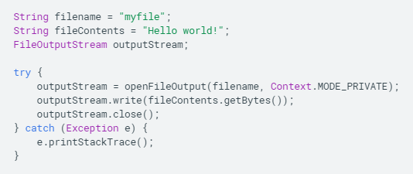
Save file to internal storage
App’s internal storage directory is specified by app’s package name in a special location of Android file system
Write a file: acquire the appropriate directory as a File by calling one of two methods:
getFilesDir() – returns a File representing an internal directory for your app
getCacheDir() – returns a File representing internal directory for app’s temporary cache files
To create a new file in one of these directories, pass the File provided by getFilesDir() or getCacheDir() to File() constructor
Example: write some text to a file - call openFileOutput() to get a FileOutputStream that writes to a file in your internal directory. openFileOutput() requires file mode parameter, passing MODE_PRIVATE makes it private to your app. Use a FileProvider to share private files with other apps
https://developer.android.com/training/data-storage/files

Slide 10
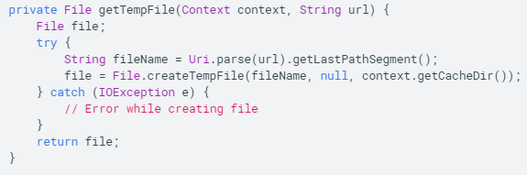
Write a cache file
Use createTempFile() to cache files
Files created with createTempFile() are placed in a cache directory private to your app
You should regularly delete the cache files you no longer need
Caution – if system runs low on storage, may delete cache files without warning, so be sure to check for existence of files before reading them
Example: extract a file name from a URL and create a file with that name in your app’s internal cache
https://developer.android.com/training/data-storage/files

Slide 11

Open an existing file or directory
Call openFileInput(name) to read an existing file
Get an array of all your app’s file names by calling fileList()
Open a directory with one of the following methods:
getFilesDir() – returns a File representing the directory on the file system that’s uniquely associated with your app
getDir(name,mode) – create new or open existing directory within your app’s unique file system directory, the new directory appears inside the directory provided by getFilesDir()
getCacheDir() – returns a File representing cache directory on the file system uniquely associated to your app
To create a new file in one of the above directories, use File() constructor and pass the File object provided by one of the above methods, example:
https://developer.android.com/training/data-storage/files

Slide 12
Save a file on external storage
Save files on external storage when you want the data to be accessible to other apps or a computer
Request storage permissions and verify storage is available
Can save two different types of files:
Public files – files freely available to other apps and user. Public files remain when user uninstalls app, example: photos, downloaded files
Private files – files belonging only to your app, deleted when user uninstalls your app. Technically available to other apps/user because they exist on external storage, but serve no purpose beyond your app
https://developer.android.com/training/data-storage/files

Slide 13

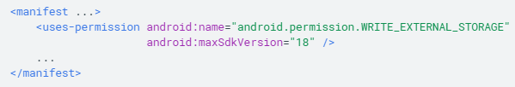
External storage permissions
Request external storage permissions – request to WRITE_EXTERNAL_STORAGE permission in manifest (this implicitly gives READ_EXTERNAL_STORAGE as well, however, the inverse is not true)
If writing to private external storage (specific to your app, accessed using getExternalFilesDir()), you don’t need to request permissions after API 18
https://developer.android.com/training/data-storage/files

Slide 14
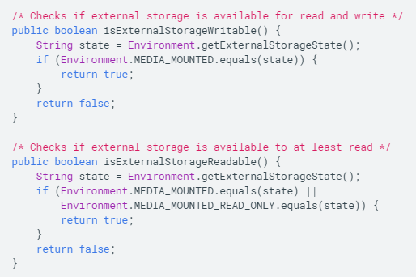
Verify external storage is available
In some cases external storage will be unavailable (user has mounted device to PC, or removed SD card), so you should always verify the volume is available before accessing
Query external storage using getExternalStorageState(), if return is MEDIA_MOUNTED, can read and write files. If returns MEDIA_MOUNTED_READ_ONLY, can only read files
https://developer.android.com/training/data-storage/files

Slide 15
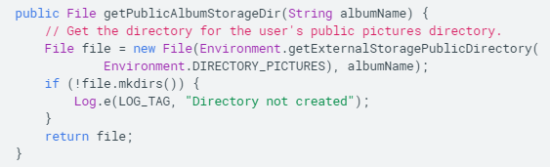
Save to public external directory
To save public files (photos, downloads etc) on external storage, use getExternalStoragePublicDirectory() method to get a File representing the appropriate directory on external storage
getExternalStoragePublicDirectory() takes argument specifying file type you wish to save, so it can be placed with other public files (DIRECTORY_MUSIC, DIRECTORY_PICTURES, etc)
To hide files from Android’s media scanner, include an empty file named .nomedia in external file directory, this prevents media scanner from reading your media files and providing them to other apps through MediaStore content provider
https://developer.android.com/training/data-storage/files

Slide 16
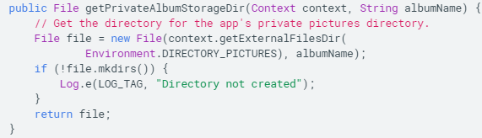
Save to private external directory
To save files private to your app and not accessible by MediaStore content provider, use getExternalFilesDir() and pass it a name indicating type of directory you want to save
Each directory added this way is added to a parent directory containing all your app’s external storage files, which is deleted when the system uninstalls your app
Passing null to getExternalFilesDir() returns the root of your app’s private external storage
Do not store files critical to your app’s function on external storage, as it can be removed at any time
Some devices contain two external storage partitions (one on SD, one allocated on internal memory), in this case call getExternalFilesDirs() which returns File array with files for each storage location, first entry is primary external storage
https://developer.android.com/training/data-storage/files

Slide 17
Query and delete
Use getFreeSpace() or getTotalSpace() to find out how much storage space is available ahead of time (assuming you know the size of the file you are saving)
getFreeSpace() – current available space in storage volume
getTotalSpace() – size of storage volume
You can also just write the data and catch the IOException if it occurs due to lack of space
Deleting a file – call delete on the File object: myFile.delete();
If the file is located on internal storage, context can locate and delete file for you: myContext.deleteFile(filename)
https://developer.android.com/training/data-storage/files

Slide 18
Save key-value data using shared preferences
The SharedPreferences API is used if you have a relatively small collection of key-values you would like to save
SharedPreference object points to a file containing key-value pairs, and provides simple methods to read and write the pairs
Each SharedPreference file is managed by the framework and can be private or shared
Note – SharedPreferences APIs are for reading and writing key-value pairs, do not confuse with Preferences API, which helps build a UI for your app’s settings
https://developer.android.com/training/data-storage/shared-preferences

Slide 19

Get a handle to shared preferences
Create a new shared preference file or access an existing one by calling one of these methods:
getSharedPreferences() – use to get multiple shared preference files by name, specify names with first parameter, call from any Context
getPreferences() – use from Activity if you want only one shared preference file for the activity, retrieves default sharedPreference file belonging to activity so does not require name argument
Name shared preference files in a way uniquely identifiable to your app, for example, prefix file name with your application ID “com.example.myapp.PREF”
getDefaultSharedPreferences() gets the shared preference file for entire app
Example: access the shared preference file identified by R.string.preference_file_key and open in private mode so its only accessible to your app
https://developer.android.com/training/data-storage/shared-preferences

Slide 20


Writing/Reading shared preferences
Once you’ve acquired a handle to SharedPreferences, create a SharedPreferences.Editor by calling edit() on your SharedPreferences
Pass your key-value pairs using methods such as putInt(), putString(), then call apply() or commit() to save the changes
apply() – writes changes asynchronously
commit() – writes changes on current thread (avoid using on UI thread)
To read from shared preferences file, call getInt(), getString() etc providing the key of the value you want, and optionally a default value to return if the item is not present
writing to shared preferences
reading from shared preferences
https://developer.android.com/training/data-storage/shared-preferences

Slide 21
Sharing simple data
Android applications have the ability to communicate and integrate with one another, allowing you to re-use functionality that already exists in another app
We will learn common ways to send and receive simple data between apps using Intents and ActionProviders

Slide 22
Sending simple data to other apps
When constructing intent, must specify action you want the intent to trigger. ACTION_SEND indicates the intent is sending data from one activity to another, even across process boundaries.
To send data to another activity, simply specify the data and its type, and the system will display compatible receiving activities for the user to choose from
Sending and receiving data between apps is mostly used for sharing social content, Intents allow users to do this quickly and easily using their favorite apps
https://developer.android.com/training/sharing/send

Slide 23
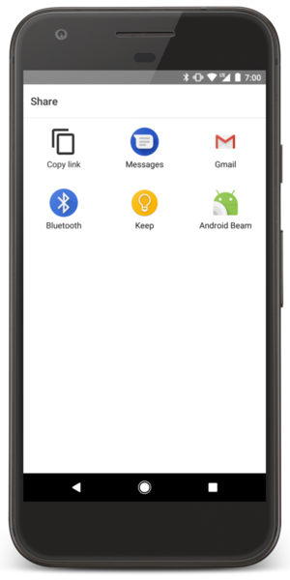
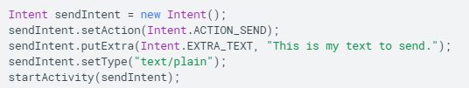
Sending text content
Most straightforward and common use of ACTION_SEND is sending text content from one activity to another, example: browser app can share URL of current webpage with any app, useful for sharing websites with friends
https://developer.android.com/training/sharing/send

Slide 24

Sending binary content
Binary content is shared using ACTION_SEND action combined with setting appropriate MIME type and placing URI to data in an extra named EXTRA_STREAM. Commonly used for sharing images, but can be used for sharing any type of content
Can use MIME type of */*, but this will only match activities able to handle generic data streams
Receiving application needs permission to access the data the URI points to, this can be done in two ways:
1 - Storing the data in your own ContentProvider and making sure other apps have permission to access your provider, this can be done by using per-URI permissions which are temporary and only grant access to receiving application.
2 – using the system MediaStore. MediaStore is primarily aimed at video, audio, and image MIME types, but can also store non-media types. Once added to MediaStore, content is accessible to any app on the device
Sharing binary data (image) with an intent
https://developer.android.com/training/sharing/send

Slide 25
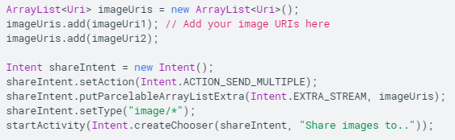
Send multiple pieces of content
To send multiple pieces of content, use ACTION_SEND_MULTIPLE together with a list of URIs pointing to the content
MIME type varies according to the mix of content you are sharing, example: want to share 3 jpegs? Type is “image/jpeg”. Want to share mixture of image types? Type is “image/*”, which matches activities that can handle any type of image.
Use */* MIME type if you’re sharing a wide variety of types
Make sure the provided URIs point to data that the receiving application can access
Example of sharing multiple image types.
https://developer.android.com/training/sharing/send

Slide 26
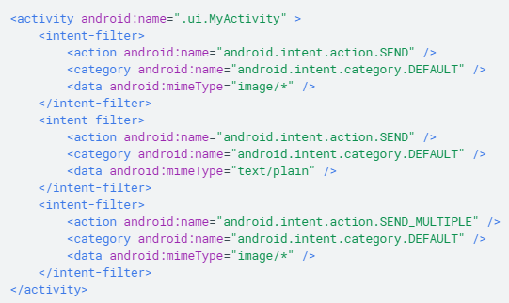
Receiving simple data from other apps
Your app can receive as well as send data.
Think about how users interact with your app, and what data types you might want to receive, example: social networking app would probably want to receive both text and image data
Inform the system what intents your app can receive in your app’s manifest
Define intent filter using <intent-filter> element in manifest
Example manifest of an application that handles text content, single image of any type, or multiple images of any type. This app will be listed in the intent chooser if another app tries to share any of these data types, and .ui.MyActivity will start if the user selects this app
https://developer.android.com/training/sharing/receive

Slide 27
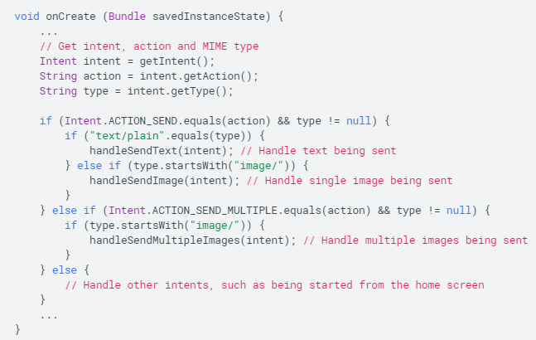
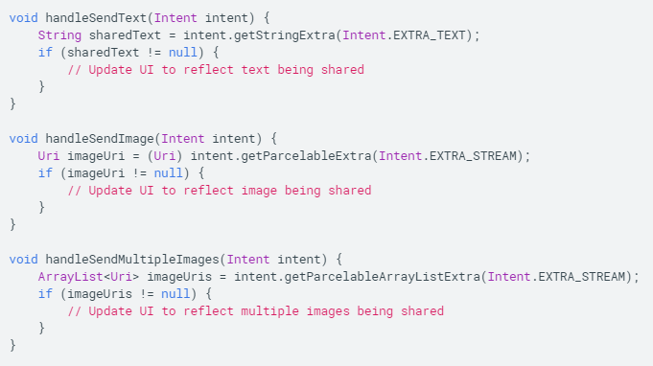
Handle incoming content
To handle incoming content, start by calling getIntent() to get the intent object
Once you have the Intent object, examine its contents to decide what to do next
You can then perform actions like update a view (EditText), or more complicated actions like apply a filter to a photo
Remember to process binary data in a separate thread, as it can be quite heavy
https://developer.android.com/training/sharing/receive

Slide 28
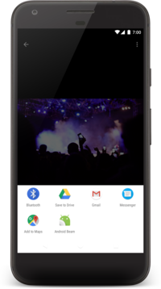
Adding an easy share action
Android 4.0 introduced ActionProvider, extended by ShareActionProvider, which provides an effective and user-friendly share action to your ActionBar
https://developer.android.com/training/sharing/shareaction

Slide 29
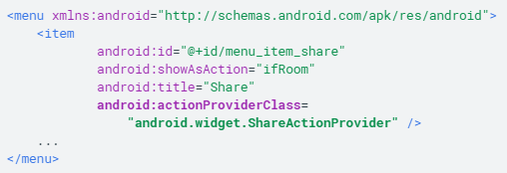
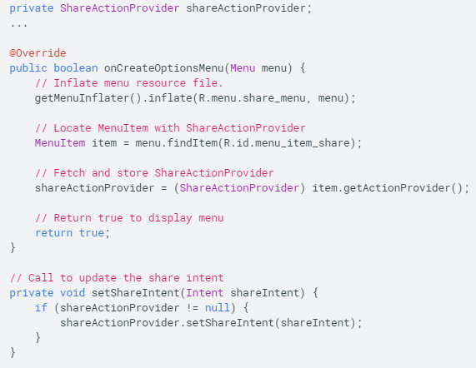
Easy share action
To get started with ShareActionProviders, define android:actionProviderClass attribute for corresponding <item> in your menu resources file
This delegates responsibility for your item’s appearance and function to ShareActionProvider, however you will need to tell the provider what you would like to share
Set the share intent – must provide ShareActionProvider with a share intent. Share intent should use ACTION_SEND, and additional data in extras.
To assign a share intent, first find the corresponding MenuItem when you inflate the menu resources in the Activity/Fragment, then call MenuItem.getActionProvider() to retrieve the ShareActionProvider. You can then use setShareIntent() to update the share intent associated with that action
https://developer.android.com/training/sharing/shareaction

Slide 30
Sharing files
The only secure way to offer a file from your app to another app is to send the receiving app the file’s content URI and grant temporary access permissions to that URI
Content URIs with temporary URI access permissions are secure because they apply only to the app that receives the URI, and expire automatically
Android’s FileProvider component provides the method getUriForFile() for generating a file’s content URI
To share small amounts of text/binary data between apps, use an intent as previously discussed. This lesson will discuss how to securely share files from your app to another app using content URIs generated by the Android FileProvider component and temporary permissions granted to the receiving app
https://developer.android.com/training/secure-file-sharing

Slide 31
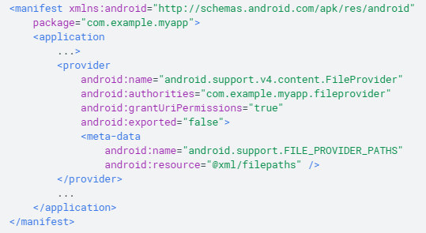
Setting up file sharing: specify FileProvider
Defining a FileProvider for your app requires an entry in the manifest. This entry specifies the authority to use in generating content URIs, as well as the name of an XML that specifies the directories your app can share
android:authorities attribute specifies URI authority that you want to use for content URIs generated by FileProvider. Use an authority consisting of the app’s android:package value with string ‘fileprovider’ appended
The <meta-data> child element of <provider> points to an XML file specifying the directories you want to share
android:resource attribute is the path and name of the file, without the .xml extension.
Contents of file described on next slide
Example: adding the <provider> element that specifies the FileProvider class, authority, and XML file name
https://developer.android.com/training/secure-file-sharing/setup-sharing

Slide 32

Setting up file sharing: specify shareable directories
Once you have added FileProvider to manifest, next step is to specify directories containing the files you want to share
Start by creating filepaths.xml in the res/xml/ subdirectory of project. Here, specify the directories by adding an XML element for each directory
In this example, <files-path> tag shares directories within the files/ directory of your app’s internal storage.
Path attribute shares images/ subdirectory of files/
Name attribute tells FileProvider to add the path segment myimages to content URIs for files in the files/images/ subdirectory
<paths> element can have multiple children, each specifying a different directory to share. Can also use <external-path> element to share directories in external storage, and <cache-path> to share cache directories
You cannot programmatically add a directory to share, only possible through XML
Example of contents of res/xml/filepaths.xml, also demonstrates how to share a subdirectory of files/ directory in your internal storage area
According to snippets from this lesson, if you request a content URI for the file default_image.jpg, FileProvider returns the following URI:
https://developer.android.com/training/secure-file-sharing/setup-sharing

Slide 33
https://developer.android.com/training/secure-file-sharing/share-file

Slide 34
https://developer.android.com/training/secure-file-sharing/share-file

Slide 35
https://developer.android.com/training/secure-file-sharing/share-file

Slide 36
https://developer.android.com/training/secure-file-sharing/share-file

Slide 37
https://developer.android.com/training/secure-file-sharing/share-file

