Slide 1
CS230 Developing Mobile Apps
Lecture 13

Slide 2
Firebase
Firebase is a mobile and web application development platform
Used to develop web, Android, and iOS applications
Firebase consists of several integrated tools for development, maintenance, and analysis of mobile apps
Firebase advantages:
Easy to use, well documented (many tutorials online)
High integration capabilities
High performance – has access to Google’s infrastructure, owned by Google
Can scale to millions of concurrent connections
Suitable for realtime applications
Wide functionality
Highly scalable
Can replace any piece of backend software
Firebase disadvantages:
Limited free plan (however, small apps with <15k daily active users will fit into free tier)
Successful app with >200k daily active users will cost ~$200/month
Learning curve requires time
Difficult execution of complex data queries
https://dzone.com/articles/firebase-platform-overview

Slide 3
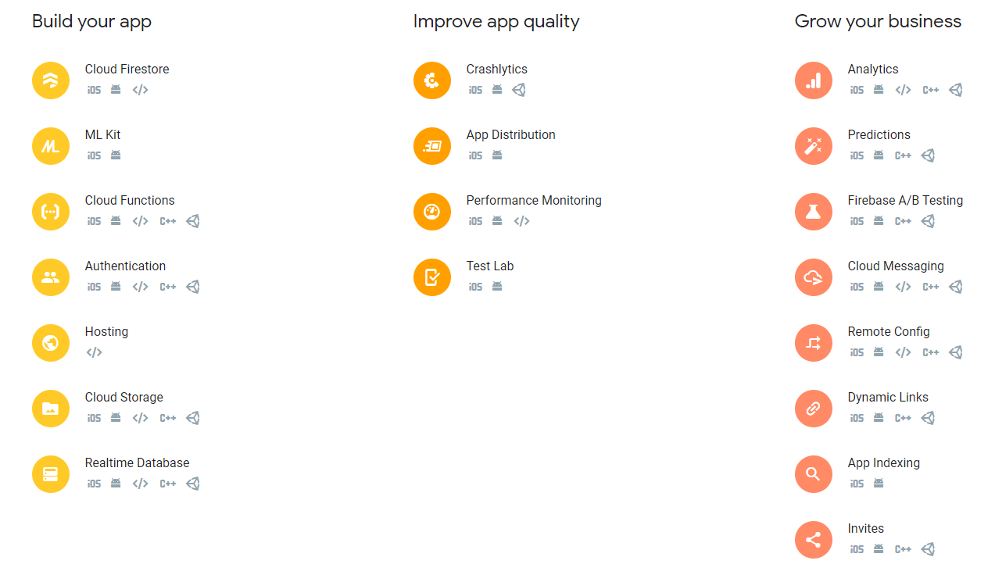
Firebase overview
Who uses Firebase?
Shazam (120 million MAUs)
Skyscanner (50 million MAUs)
New York times
Many more:
https://firebase.google.com/use-cases
https://firebase.google.com/docs

Slide 4
Firebase Realtime Database
Firebase Realtime Database is a cloud-hosted database
Data stored as JSON and synchronized in real time to every connected client
Key capabilities:
Realtime – instead of typical HTTP requests, Firebase Realtime Database uses data synchronization – every time data changes, any connected device receives that update within ms.
Provides collaborative and immersive experiences without thinking about network code
Offline – Firebase apps remain responsive even when offline, because Firebase Realtime Database SDK persists your data to disk. Once connectivity is reestablished, client device receives any changes it missed, resynchronizing with current server state.
Accessible from Client devices – Firebase Realtime Database accessible directly from mobile device or web browser, no need for an application server.
Scale across multiple devices – support your app’s data needs at scale by splitting your data across multiple database instances in the same Firebase project.
https://firebase.google.com/docs/database

Slide 5
How does Firebase realtime database work?
Realtime database provides a flexible, expression-based rules language called Firebase Realtime Database Security Rules, to define how your data should be structured and when data can be read from/written to
When integrated with Firebase Authentication, developers can define who has access to what data, and how they access it
Realtime Database is a NoSQL database, has different optimizations and functionality compared to a relational database
Realtime Database API designed to only allow operations that can be executed quickly
Enables great realtime experience serving millions without compromising responsivity
Can be used to backend MMORPG built in Unity: https://forum.unity.com/threads/can-firebase-be-used-to-backend-unity-mmos.173675/
https://firebase.google.com/docs/database

Slide 6
Firebase realtime database implementation path
1) Integrate the Firebase Realtime database SDKs
Quickly include clients via Gradle, CocoaPods, or a script include
2) Create Realtime Database References
Reference your JSON data such as “users/user:1234/phone_number” to set data or subscribe to data changes
3) Set data and listen for changes
Use references above to write data or subscribe to changes
4) Enable offline persistence
Allow data to be written to local disk so it can be available while offline
5) Secure your data
Use Firebase Realtime Database security rules to secure your data
https://firebase.google.com/docs/database

Slide 7
Cloud Firestore vs Realtime Database
Cloud Firestore: Firebase’s newest database for mobile app development.
Builds on success of Realtime Database with new, more intuitive model
Features richer, faster queries and scales further than Realtime Database
Realtime Database: Firebase’s original database
Efficient low-latency solution for mobile apps requiring realtime synced states across clients
Cloud Firestore is recommended for most developers starting new projects
Offers more functionality, better performance, scalability, and future releases
Cloud Firestore: current limits 1 million concurrent connections, 10,000 writes/second (will increase in future)
Cloud Firestore data model (document collection) easier to organize at scale
Realtime database uses a single, large JSON tree
We will use Cloud Firestore
https://firebase.google.com/docs/database/rtdb-vs-firestore

Slide 8
Cloud Firestore key capabilities
Flexible scalable NoSQL cloud database to store and sync data for client-side and server-side development
Flexibility – cloud Firestore model supports flexible, hierarchical data structures
Store your data in documents, organized into collections
Expressive Querying – retrieve specific documents or all documents in a collection that match your query parameters
Queries can include multiple, chained filters and combine filtering/sorting
Realtime updates – updates data on any connected device (data synchronization)
Unlike RTB, Cloud Firestore designed to make one-time fetch queries efficiently
Offline support – caches data your app actively using, so app can read, write, listen to, and query data even if device is offline
Designed to scale – utilizes Google Cloud Platform’s powerful infrastructure:
Automatic multi-region data replication
Strong consistency guarantees
Atomic batch operations
Real transactional support
https://firebase.google.com/docs/firestore

Slide 9
Get started with Cloud Firestore
We will see:
Set up Cloud Firestore
Add data
View added data in Firebase Console
1) Create a Cloud Firestore Database from console
A) add new project
B) create database
C) select test mode (good for getting started)
D) select location – Google cloud platform resource location
2) set up development environment
Add required dependencies and client libraries to your app
https://firebase.google.com/docs/android/setup
(use option 1, Add Firebase using Firebase console)
(register app, add Firebase config file, add Firebase SDKs to gradle, enable multiDex)
https://firebase.google.com/docs/firestore/quickstart

Slide 10
Add data to cloud Firestore
Initialize Cloud Firestore:
Add data
Cloud firestore stores data in documents, which are stored in collections
Create a new collection and document using the following example code:
FirebaseFirestore db = FirebaseFirestore.getInstance();
// Create a new user with a first and last name Map<String, Object> user = new HashMap<>(); user.put("first", "Ada"); user.put("last", "Lovelace"); user.put("born", 1815); // Add a new document with a generated ID db.collection("users") .add(user) .addOnSuccessListener(new OnSuccessListener<DocumentReference>() { @Override public void onSuccess(DocumentReference documentReference) { Log.d("TAG", "DocumentSnapshot added with ID: " + documentReference.getId()); } }) .addOnFailureListener(new OnFailureListener() { @Override public void onFailure(@NonNull Exception e) { Log.w("TAG", "Error adding document", e); } });
https://firebase.google.com/docs/firestore/quickstart

Slide 11
Read data
Check the Firestore console, or:
Use the ‘get’ method to retrieve your collection:
db.collection("users") .get() .addOnCompleteListener(new OnCompleteListener<QuerySnapshot>() { @Override public void onComplete(@NonNull Task<QuerySnapshot> task) { if (task.isSuccessful()) { for (QueryDocumentSnapshot document : task.getResult()) { Log.d("TAG", document.getId() + " => " + document.getData()); } } else { Log.w("TAG", "Error getting documents.", task.getException()); } } });
https://firebase.google.com/docs/firestore/quickstart

Slide 12
Secure your data
If you’re using web, Android, or iOS, use Firebase Authentication and Cloud Firestore Security Rules to secure your data in Cloud Firestore
// Allow read/write access on all documents to any user signed in to the application
service cloud.firestore {
match /databases/{database}/documents {
match /{document=**} {
allow read, write: if request.auth.uid != null;
}
}
}
https://firebase.google.com/docs/firestore/quickstart

Slide 13
Cloud Firestore Data Model
Cloud Firestore is a NoSQL, document-oriented database
Unlike SQL, no tables or rows, instead, store data in documents organized into collections
Each document contains a set of key-value pairs
Cloud Firestore is optimized for storing large collections of these documents
All documents must be stored in collections.
Documents can contain subcollections and nested objects, both of which can include primitive fields like strings, or complex objects like lists
Collections and documents are created implicitly in Cloud Firestore, simply assign data to a document within a collection.
If either collection or document do not exist, Cloud Firestore creates it
https://firebase.google.com/docs/firestore/data-model

Slide 14
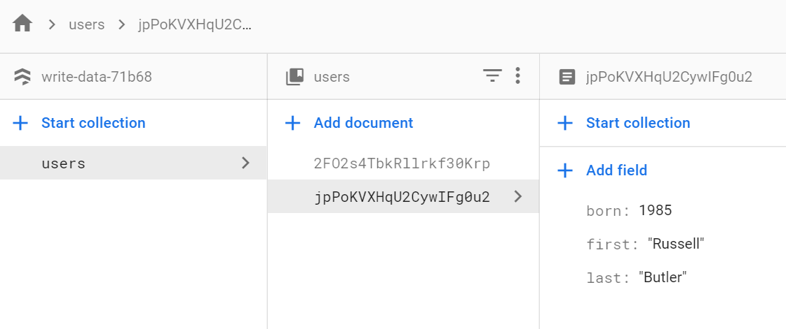
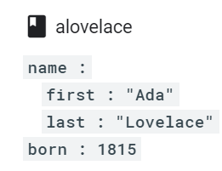
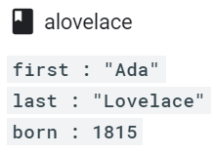
Documents
Unit of storage in Cloud Firestore is the document
A document is a lightweight record containing fields, which map to values
Each document is identified by a name
Complex, nested objects in a document are called maps
Documents are basically JSONs, you can treat them as lightweight JSON records
Documents support additional data types and are limited to 1mb
https://firebase.google.com/docs/firestore/data-model

Slide 15
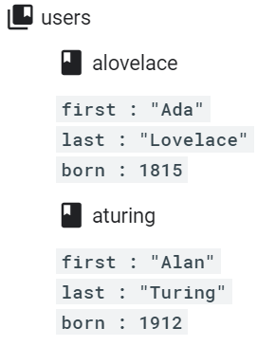
Collections
Documents live in collections, which are simply containers for documents
Cloud Firestore is schemaless, so you can put any fields in each document, and any type of data in those fields
Documents within same collection can all contain different fields, or store different types of data in those fields
Best practice to use same fields/data types across multiple documents (easier to query)
A collection contains documents and nothing else (no raw fields/other collections)
The names of documents within collections are unique
No need to create/delete collections, this happens automatically when document created
https://firebase.google.com/docs/firestore/data-model

Slide 16
References
Every document in cloud Firestore uniquely identified by location within database
Previous examples showed document alovelace within users collection
To refer to this location in code, create a reference to it:
Reference is a lightweight object pointing to a location in your database
Can create a reference whether or not data exists there
Can create references to collections:
For convenience, can also create references by specifying a path to a document or collection as a string, with path components separate by ‘/’
DocumentReference alovelaceDocumentRef = db.collection("users").document("alovelace");
CollectionReference usersCollectionRef = db.collection("users");
DocumentReference alovelaceDocumentRef = db.document("users/alovelace");
https://firebase.google.com/docs/firestore/data-model

Slide 17
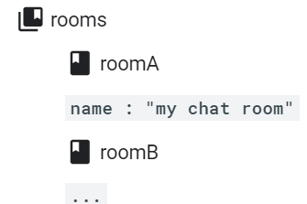
Hierarchical data
Consider an example chat app with messages and chat rooms
You can create a collection called rooms to store different chat rooms
Now that you have chat rooms, decide how to store your messages
May not want to store them n chat room’s document
Documents in Cloud Firestore should be lightweight, chat room can contain many msgs
Can create additional collections within chat room’s document, as subcollections
https://firebase.google.com/docs/firestore/data-model

Slide 18
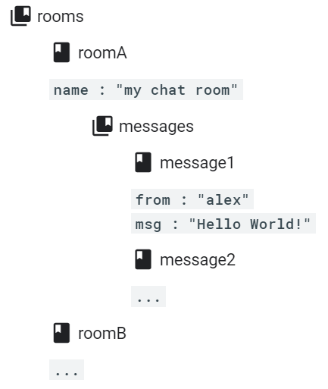
Subcollections
Best way to store messages in chat room example is using subcollections
A subcollection is a collection associated with a specific document
Can create subcollection called messages for every room document in your rooms collection
In this example, would create a reference to a message in subcollection with following code:
Notice alternating pattern of collections and docs.
Subcollections allow you to structure data hierarchically, making data easier to access
To get all messages in roomA, can create a collection referenceto the subcollection messages and interact with it like you would any other collection reference
DocumentReference messageRef = db .collection("rooms").document("roomA") .collection("messages").document("message1");
https://firebase.google.com/docs/firestore/data-model

Slide 19
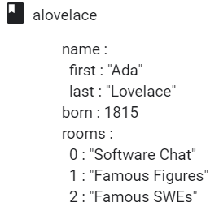
Choose a data structure
You have several options when you structure data in Cloud Firestore
Documents
Multiple collections
Subcollections within documents
Nested data in documents:
You can nest complex objects like arrays and maps within documents
Advantages:
If you have simple, fixed lists of data you want to keep within your documents, its easy to set up and streamlines data structure
Limitations
Not as scalable as other options, especially if data expands over time
Possible use case:
In chat app, store user’s 3 most recently visited chat rooms as nested list
https://firebase.google.com/docs/firestore/manage-data/structure-data

Slide 20
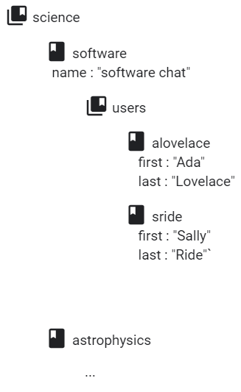
Choose a data structure
Subcollections:
Can create collections within documents when you have data that might expand over time
Advantages
As list grows, size of parent document does not change
Can also get full query capabilities on subcollections
Limitations
Cannot easily delete subcollections
Possible use case:
In chat app, create collections of users or messages within chat room documents
https://firebase.google.com/docs/firestore/manage-data/structure-data

Slide 21
Add data to Cloud Firestore
Several ways to write data to Cloud Firestore:
1) set data of document within a collection, explicitly specifying document id
2) add new document to collection. Document id is automatically generated
3) create empty document with automatically generated id, assign data later
Data types
Cloud Firestore lets your write a variety of data types inside a document, including strings, Booleans, numbers, dates, null, nested arrays and objects.
Write your own Java objects with custom classes, Cloud Firestore automatically converts these objects to supported data types
Follow link at bottom to see examples of:
Setting and adding documents
Updating specific fields of a document, including nested objects and arrays
https://firebase.google.com/docs/firestore/manage-data/add-data

Slide 22
Transactions and batched writes
Cloud Firestore supports atomic operations for reading/writing data
In a set of atomic operations, either all operations succeed, or none are applied
Two types of atomic operations in Cloud Firestore:
1) Transactions – a set of read and write operations on one or more documents
2) Batched writes – a set of write operations on one or more documents
Each transaction or batch of writes can write to maximum of 500 documents
Updating data with transactions:
Using Cloud Firestore client libraries, group multiple operations into 1 transaction
Transaction consists of any number of get() operations followed by any number of write operations such as set(), update(), or delete()
Transactions never partially apply writes, all writes execute at end of successful transaction
Follow link below for code examples:
https://firebase.google.com/docs/firestore/manage-data/transactions

Slide 23
Batched writes
If you do not need to read any documents in your operation set, can execute multiple write operations as a single batch containing any combination of set(), update(), or delete() operations.
Batch of writes completes atomically and can write to multiple documents
// Get a new write batch WriteBatch batch = db.batch(); // Set the value of 'NYC' DocumentReference nycRef = db.collection("cities").document("NYC"); batch.set(nycRef, new City()); // Update the population of 'SF' DocumentReference sfRef = db.collection("cities").document("SF"); batch.update(sfRef, "population", 1000000L); // Delete the city 'LA' DocumentReference laRef = db.collection("cities").document("LA"); batch.delete(laRef); // Commit the batch batch.commit().addOnCompleteListener(new OnCompleteListener<Void>() { @Override public void onComplete(@NonNull Task<Void> task) { // ... } });
https://firebase.google.com/docs/firestore/manage-data/transactions

Slide 24
Get data with Cloud Firestore
Two ways to retrieve data stored in Cloud Firestore
1) call a method to get the data
2) set a listener to receive data-change events
When you set listener, Cloud Firestore sends your listener an initial snapshot of the data, and then another snapshot each time the document changes
Retrieve contents of a single document using get():
DocumentReference docRef = db.collection("cities").document("SF"); docRef.get().addOnCompleteListener(new OnCompleteListener<DocumentSnapshot>() { @Override public void onComplete(@NonNull Task<DocumentSnapshot> task) { if (task.isSuccessful()) { DocumentSnapshot document = task.getResult(); if (document.exists()) { Log.d(TAG, "DocumentSnapshot data: " + document.getData()); } else { Log.d(TAG, "No such document"); } } else { Log.d(TAG, "get failed with ", task.getException()); } } });
https://firebase.google.com/docs/firestore/query-data/get-data

Slide 25
Get realtime updates with Cloud Firestore
You can listen to a document with the onSnapshot() method
Initial call using callback you provide creates a document snapshot immediately with the current contents of a single document
Then, each time contents change, another call updates the document snapshot
final DocumentReference docRef = db.collection("cities").document("SF"); docRef.addSnapshotListener(new EventListener<DocumentSnapshot>() { @Override public void onEvent(@Nullable DocumentSnapshot snapshot, @Nullable FirebaseFirestoreException e) { if (e != null) { Log.w(TAG, "Listen failed.", e); return; } if (snapshot != null && snapshot.exists()) { Log.d(TAG, "Current data: " + snapshot.getData()); } else { Log.d(TAG, "Current data: null"); } } });
https://firebase.google.com/docs/firestore/query-data/listen

Slide 26
Listen to multiple documents in a collection
Example: to listen to all documents with a state CA:
Snapshot handler will receive new query snapshot every time the query results change (when a document is added, removed, or modified)
db.collection("cities") .whereEqualTo("state", "CA") .addSnapshotListener(new EventListener<QuerySnapshot>() { @Override public void onEvent(@Nullable QuerySnapshot value, @Nullable FirebaseFirestoreException e) { if (e != null) { Log.w(TAG, "Listen failed.", e); return; } List<String> cities = new ArrayList<>(); for (QueryDocumentSnapshot doc : value) { if (doc.get("name") != null) { cities.add(doc.getString("name")); } } Log.d(TAG, "Current cites in CA: " + cities); } });
https://firebase.google.com/docs/firestore/query-data/listen

Slide 27
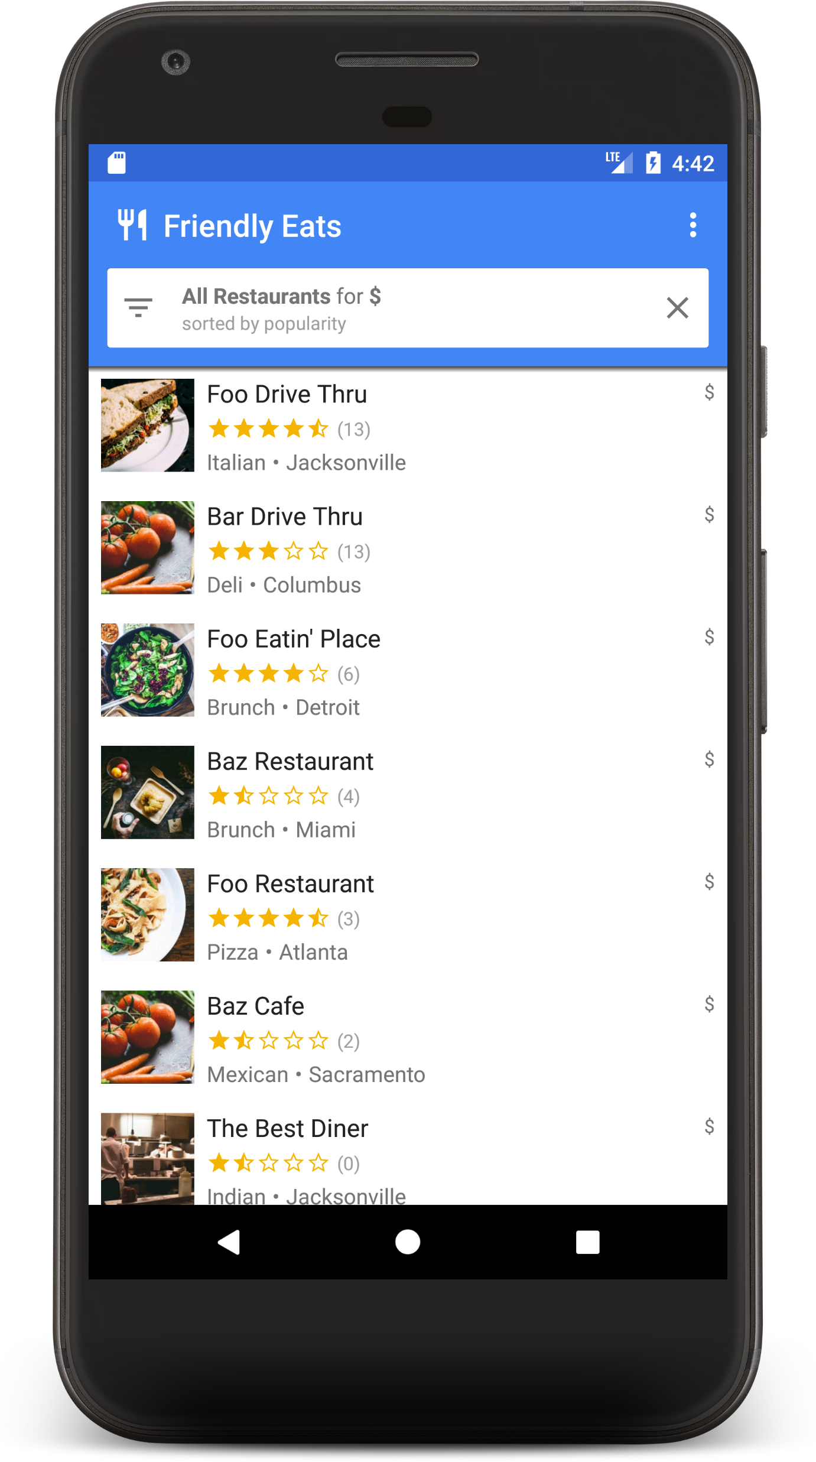
Friendly Eats
Restaurant recommendation app for Android backed by Cloud Firestore
https://codelabs.developers.google.com/codelabs/firestore-android/#0
Learn:
Read and write data to Firestore from Android app
Listen to changes in Firestore data in real time
Use Firebase authentication and security rules to secure Firestore data
Write complex Firestore queries

Slide 28
Authentication
Easily add sign-in to your Android app with Firebase UI
FirebaseUI is a library built on top of Firebase Authentication SDK that provides drop-in UI flows for use in your app. Provides the following benefits:
Multiple providers – sign-in flows for email/pwd, Google sign-in, Facebook login, etc.
Account management – flows to handle account mgmt. tasks (creation, pwd reset, etc.)
Account linking – flows to safely link user accounts across identity providers
Anonymous user upgrading – flows to safely upgrade anonymous users
Custom themes – customize look of FirebaseUI to match your app
Getting started
Add Firebase to project (if you haven’t already)
Add dependencies for FirebaseUI to app-level build.gradle file
Can also include Facebook/Twitter SDKs
In firebase console, open authentication section and enable sign-in methods you want
https://firebase.google.com/docs/auth/android/firebaseui

Slide 29
Sign in
To start FirebaseUI sign-in flow, create sign-in intent with preferred method:
When sign-in completes, will receive result in onActivityResult()
Follow link below for more information on:
Email link authentication
How to sign out
Customizing the FirebaseUI theme to match your app
// Choose authentication providers List<AuthUI.IdpConfig> providers = Arrays.asList( new AuthUI.IdpConfig.EmailBuilder().build(), new AuthUI.IdpConfig.PhoneBuilder().build(), new AuthUI.IdpConfig.GoogleBuilder().build(), new AuthUI.IdpConfig.FacebookBuilder().build(), new AuthUI.IdpConfig.TwitterBuilder().build()); // Create and launch sign-in intent startActivityForResult( AuthUI.getInstance() .createSignInIntentBuilder() .setAvailableProviders(providers) .build(), RC_SIGN_IN);
https://firebase.google.com/docs/auth/android/firebaseui

