Slide 1
CS230 Developing Mobile Apps
Lecture 12

Slide 2
Content Providers
Content providers:
Help an app manage its stored data
Provide a way to share data with other apps
Encapsulate data
Provide mechanisms for defining data security
Content providers are the standard interface connecting data in one process with code running in another process
https://developer.android.com/guide/topics/providers/content-providers

Slide 3
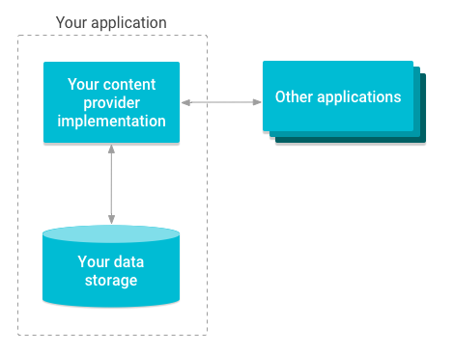
Content providers manage access to storage
Implementing a content provider has many advantages
Can configure a content provider to allow other apps to securely access and modify your app’s data
Use content providers if you plan to share data
May still use if you don’t plan to share, because they provide a nice abstraction
https://developer.android.com/guide/topics/providers/content-providers

Slide 4
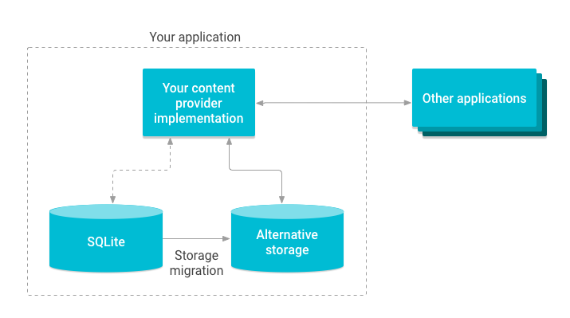
Illustration of migrating content provider storage:
Abstraction provided by content providers allows you to make modifications to your app data storage implementation without affecting other existing apps that rely on access to your data
Example: swap out an SQLite database for external storage
https://developer.android.com/guide/topics/providers/content-providers

Slide 5
Classes that rely on ContentProvider
AbstractThreadedSyncAdapter
CursorAdapter
CursorLoader
If you make use of any of these classes, need to implement content provider
Also need content provider in the following cases:
1) want to implement custom search suggestions in app
2) need to expose your application data to widgets
3) want to copy/paste complex data/files from your app to other apps
Android framework includes content providers managing data such as audio, video, images, and contact information. These are accessible to any Android app
Use content provider to access a variety of data storage sources, including:
Structured data (SQLite relational database)
Unstructured data (image files)
https://developer.android.com/guide/topics/providers/content-providers

Slide 6
Advantages of content provider
Content providers offer granular control over permissions for accessing data
Can choose to restrict access to content provider to your app only
Can grant blanket permission to access data from other apps
Can configure different permissions for reading/writing data
Use content provider to abstract away details for accessing different data sources
Example: your app stores structured records in SQLite database, as well as video and audio files. Use a content provider to access all of this data in the same way
We will now look at:
Content provider basics – access/update data using existing content provider
Creating a content provider – design and implement your own content provider
Calendar provider – access calendar provider (part of Android platform)
Contacts provider – access contacts provider (part of Android platform)
https://developer.android.com/guide/topics/providers/content-providers

Slide 7
https://developer.android.com/guide/topics/providers/content-provider-basics

Slide 8
https://developer.android.com/guide/topics/providers/content-provider-basics

Slide 9
https://developer.android.com/guide/topics/providers/content-provider-basics

Slide 10
https://developer.android.com/guide/topics/providers/content-provider-basics

Slide 11
https://developer.android.com/guide/topics/providers/content-provider-basics

Slide 12
https://developer.android.com/guide/topics/providers/content-provider-basics

Slide 13
https://developer.android.com/guide/topics/providers/content-provider-basics

Slide 14
https://developer.android.com/guide/topics/providers/content-provider-basics

