Slide 1
CS230 Developing Mobile Apps
Lecture 5

Slide 2
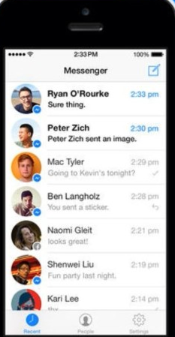
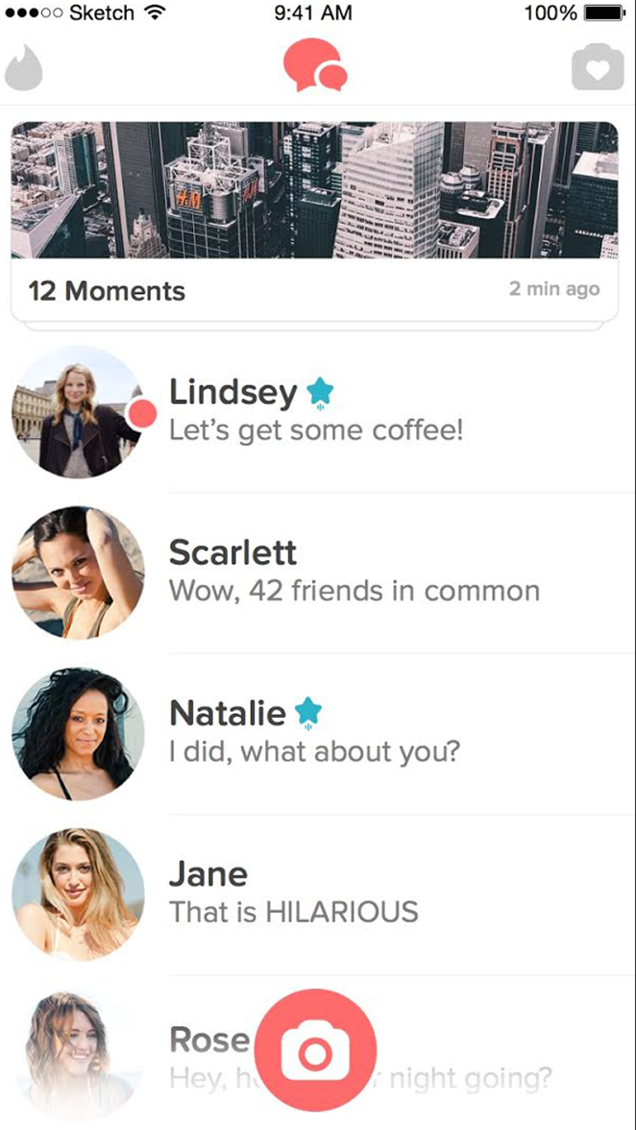
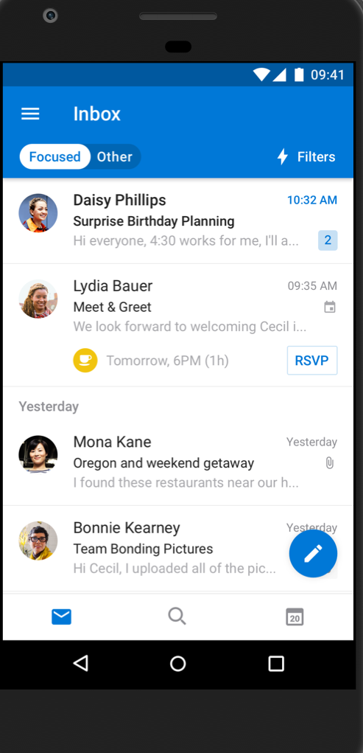
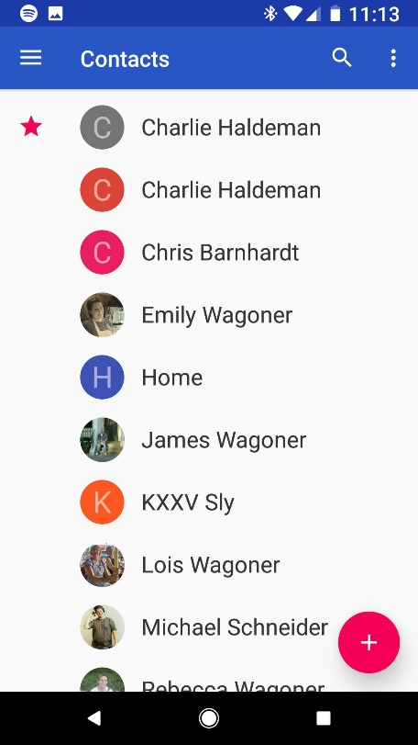
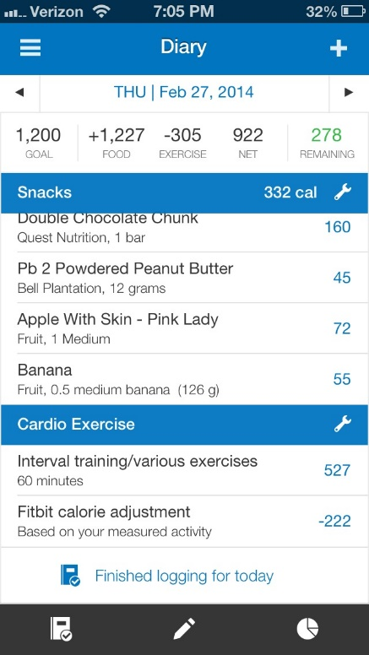
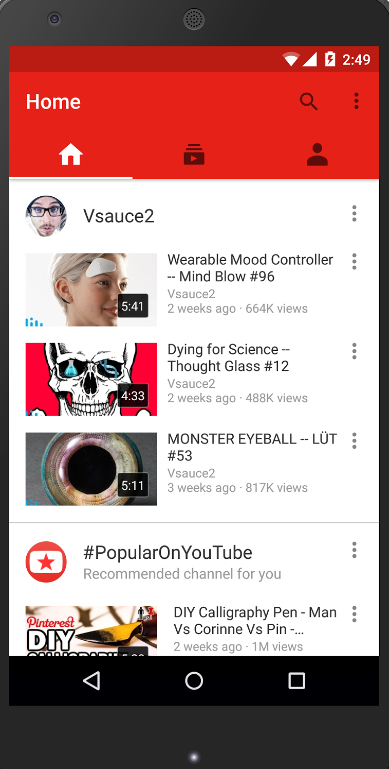
Assignment 1
Displaying a list of expandable items is probably the most common pattern in app design
contacts
myfitnesspal
youtube
tinder
outlook
messenger
…just to name a few

Slide 3
RecyclerView

