Slide 1
CS230 Developing Mobile Apps
Lecture 4

Slide 2
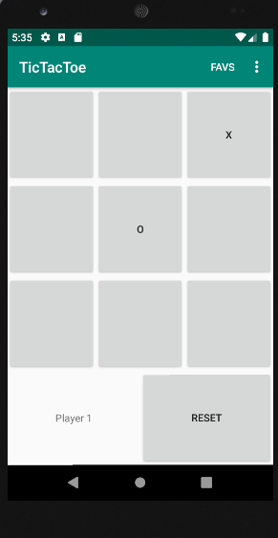
Lab 1 recap
I will go around and look at your lab 1 while you start working on lab 2
So far we have seen:
How to create layouts in XML
How to access and assign behavior to XML-defined Widgets using java
Basic lifecycle method (onCreate())
Activities (MainActivity.java)
In Lab 2, we will learn
How to preserve UI state across lifecycle changes
How to add items to the app bar and define a settings screen
Fragments and the back stack

Slide 3

Problem with Lab 1: onDestroy() kills our button state, messing up our game
Two common actions result in our activity’s destruction (onDestroy())
Device rotation
Back button press
(why? Because it’s a configuration change)
Static variables are still alive (because the process is still running)
If no Activities/Services are running within the process, higher chance of being killed
By default, all components of the same application run in the same process
Solution: somehow, we need to save the UI state and restore it when onCreate() is called again
Multiple ways to accomplish this

Slide 4
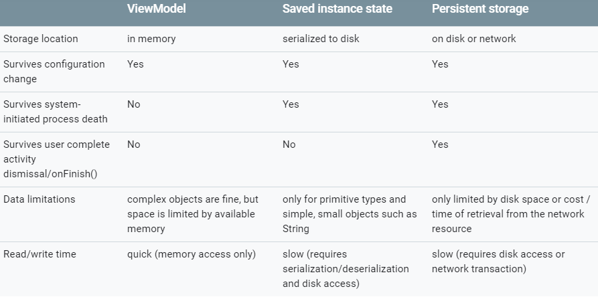
Saving UI states
Use combination of ViewModel objects, onSaveInstanceState(), and/or local storage
Regardless of approach, ensure your app meets user expectations with respect to their UI and provides smooth, snappy UI

Slide 5
ViewModel and savedInstanceState
For TicTacToe, just using savedInstance state is enough
Override onSaveInstanceState() and onRestoreInstanceState()
Alternatively, create a ViewModel class to track the Tic Tac Toe board’s state

Slide 6
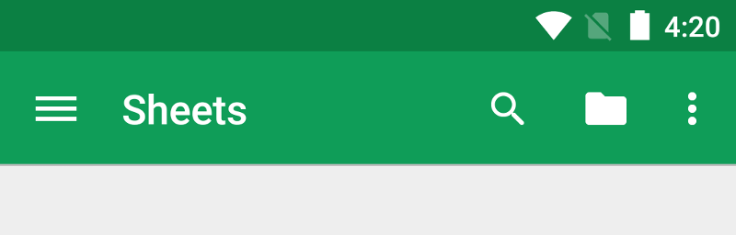
App Bar
The App Bar, also known as the Action Bar, is one of the most important design elements in your app’s activities, because it provides visual structure and interactive elements familiar to user
Using the app bar makes your app consistent with other Android apps
Key features of App Bar:
Dedicated screen space for giving your app identity and informing the user of their location within the app
Access to important actions (such as search) in a predictable way
Support for navigation and view switching
https://developer.android.com/training/appbar

Slide 7
Fragments
We have already seen an Activity (MainActivity.java), an activity is a single, focused thing the user can do, almost all Activities interact with the user, so the Activity class takes care of creating a window in which you can place your UI
A Fragment represents a portion of a user interface, you can combine multiple fragments in a single Activity, or reuse a fragment in multiple activities
Think of a Fragment as a modular section of an Activity, or sub-Activity
Fragments are always hosted in Activities, and tied to Activity lifecycle
https://developer.android.com/guide/components/fragments

Slide 8
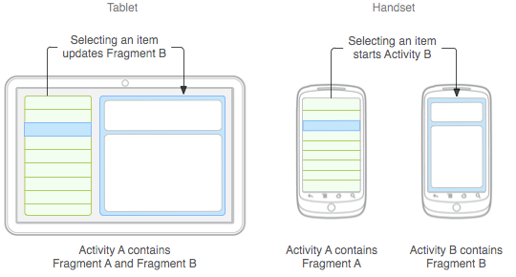
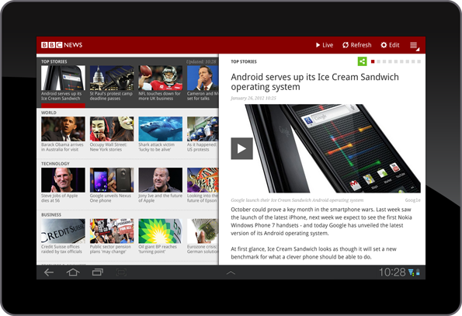
Fragment example
News app example: show list of articles on left (Fragment A), and a full article on right (Fragment B)
Allows to display the list and the full article within a single activity
Can customize your app’s behavior based on device (tablet vs handheld)
https://developer.android.com/guide/components/fragments

Slide 9
Tasks and the Back stack
A task is a collection of Activities that users interact with when performing a certain job
Activities are arranged in a stack (the back stack) in the order in which the Activity is opened
Example: an email app may have two Activities
Activity 1: display a list of emails that the user can select
Activity 2: view an individual email message
When the user selects a message, a new Activity starts to display the message, and is added to the back stack. If the user presses back, the individual message Activity is popped off the back stack and destroyed
https://developer.android.com/guide/components/activities/tasks-and-back-stack

Slide 10
Lab 2: Add preferences screen and options menu, handling lifecycle changes
Create a new folder in res called menu
Within menu, create menu.xml
Add some items to the menu
Settings, favorites (don’t forget to add the strings in res/values/strings.xml)
Override onCreateOptionsMenu and onOptionsItemSelected in MainActivity (google this)
Create the preferences xml and java class, inflate from onOptionsItemSelected in MainActivity
Handle lifecycle changes so that game state is preserved when switching activities
Items to add to the menu
<item android:id="@+id/action_favorite" android:icon="@drawable/ic_favorite_black_48dp" android:title="@string/action_favorite" app:showAsAction="ifRoom"/> <item android:id="@+id/action_settings" android:title="@string/action_settings" app:showAsAction="never"/>
@Override public boolean onOptionsItemSelected(MenuItem item) { switch (item.getItemId()) { case R.id.action_settings: // User chose the "Settings" item, show the app settings UI... getSupportFragmentManager() .beginTransaction() .replace(R.id.linear_layout, new MySettingsFragment()) .addToBackStack("Tag") .commit(); return true;
Inflating the preferences (settings) fragment from within onOptionsItemSelected

Slide 11
Assignment 1
Use an ArrayAdapter to display a list of email titles loaded from Resources. Select from the list of email titles to display the full email contents in a separate Fragment.

