Slide 1
CS230 Developing Mobile Apps
Lecture 5

Slide 2
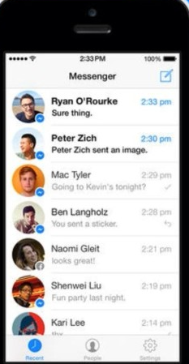
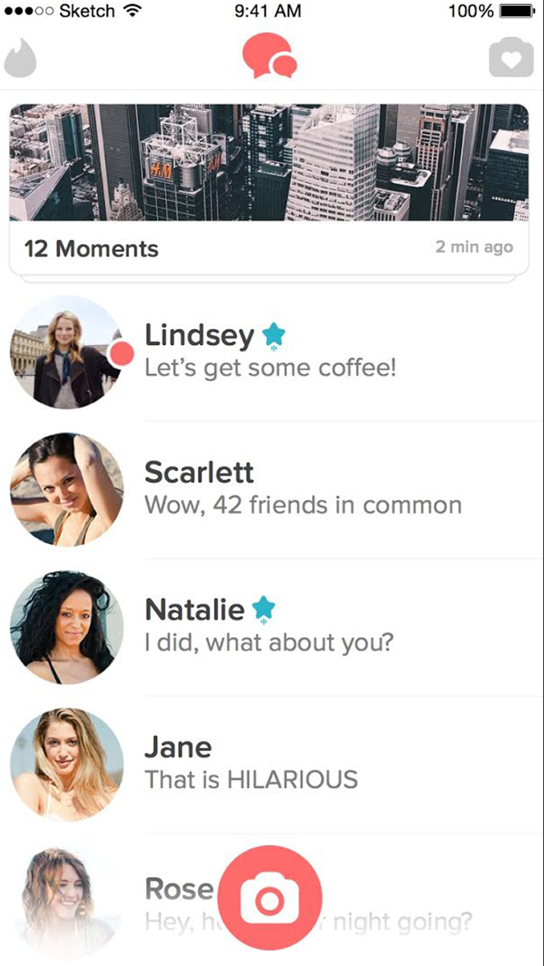
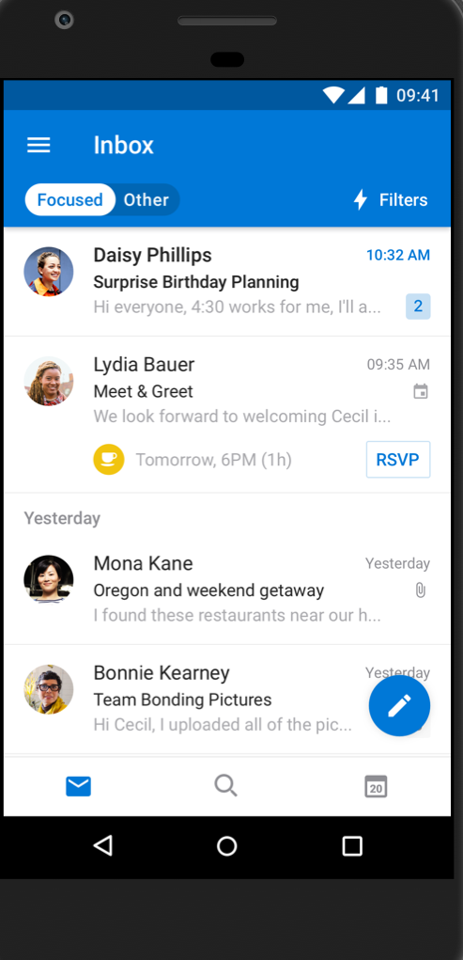
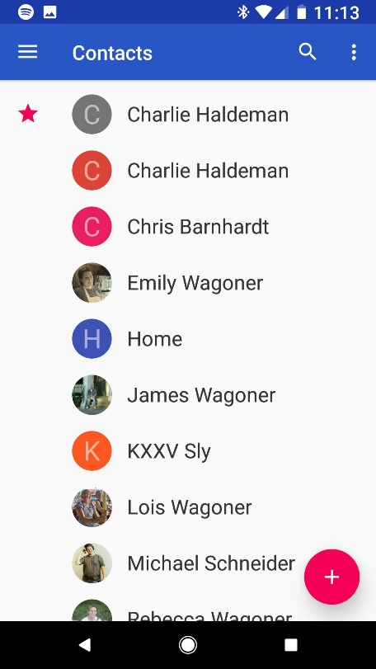
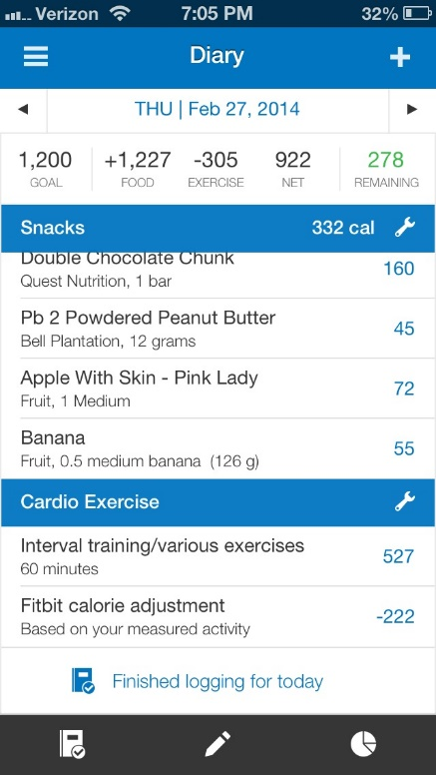
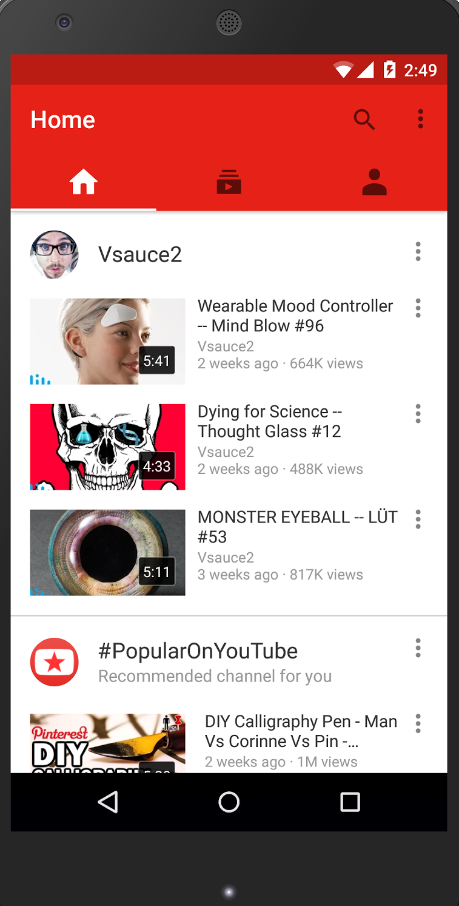
Assignment 1
Displaying a list of expandable items is probably the most common pattern in app design
contacts
myfitnesspal
youtube
tinder
outlook
messenger
…just to name a few

Slide 3
Create a list with RecyclerView
RecyclerView is a more advanced and flexible version of ListView
ListView displays a vertically scrollable collection of views, where each view is positioned immediately below the previous view in the list
ListView is an adapter view that doesn’t know the details of the items it displays, but instead requests views on demand from a listAdapter as needed
RecyclerView requires you to define a ViewHolder (static) class
RecyclerView supports 3 types of predefined layout managers: LinearLayoutManager, StaggeredGridLayoutManager, GridLayoutManager
Handles item animations (item addition, deletion, etc.)
https://developer.android.com/guide/topics/ui/layout/recyclerview
https://developer.android.com/reference/android/widget/ListView.html

Slide 5
Setting up RecyclerView (in MainActivity)
public class MyActivity extends Activity { private RecyclerView recyclerView; private RecyclerView.Adapter mAdapter; private RecyclerView.LayoutManager layoutManager; @Override protected void onCreate(Bundle savedInstanceState) { super.onCreate(savedInstanceState); setContentView(R.layout.my_activity); recyclerView = (RecyclerView) findViewById(R.id.my_recycler_view); // use this setting to improve performance if you know that changes // in content do not change the layout size of the RecyclerView recyclerView.setHasFixedSize(true); // use a linear layout manager layoutManager = new LinearLayoutManager(this); recyclerView.setLayoutManager(layoutManager); // specify an adapter (see also next example) mAdapter = new MyAdapter(myDataset); recyclerView.setAdapter(mAdapter); } // ... }

Slide 6
RecyclerView Adapter
public class MyAdapter extends RecyclerView.Adapter<MyAdapter.MyViewHolder> { private String[] mDataset; // Provide a reference to the views for each data item // Complex data items may need more than one view per item, and // you provide access to all the views for a data item in a view holder public static class MyViewHolder extends RecyclerView.ViewHolder { // each data item is just a string in this case public TextView textView; public MyViewHolder(TextView v) { super(v); textView = v; } } // Provide a suitable constructor (depends on the kind of dataset) public MyAdapter(String[] myDataset) { mDataset = myDataset; } // Create new views (invoked by the layout manager) @Override public MyAdapter.MyViewHolder onCreateViewHolder(ViewGroup parent,int viewType) { // create a new view TextView v = (TextView) LayoutInflater.from(parent.getContext()) .inflate(R.layout.my_text_view, parent, false); ... MyViewHolder vh = new MyViewHolder(v); return vh; } // Replace the contents of a view (invoked by the layout manager) @Override public void onBindViewHolder(MyViewHolder holder, int position) { // - get element from your dataset at this position // - replace the contents of the view with that element holder.textView.setText(mDataset[position]); } // Return the size of your dataset (invoked by the layout manager) @Override public int getItemCount() {return mDataset.length;} }

Slide 7
Lab 3: sending data between apps using Intent

