Slide 1
CS405/505
Data Mining
Lecture 17

Slide 2
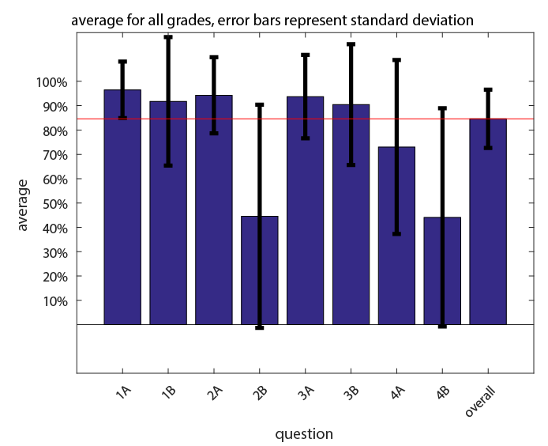
Midterm results

Slide 3
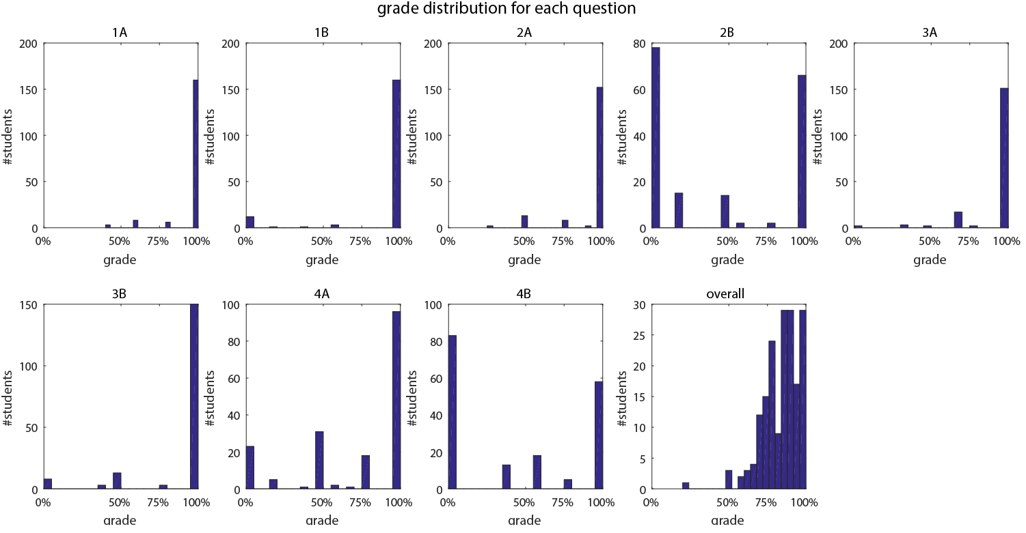
Midterm results

Slide 4
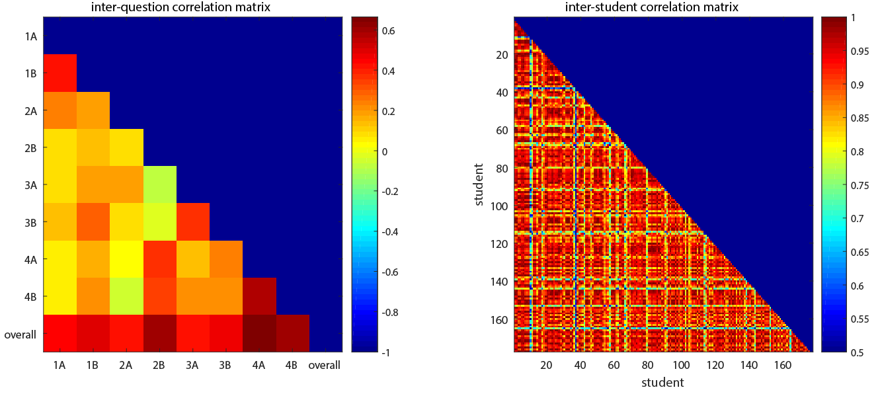
Midterm results

Slide 5
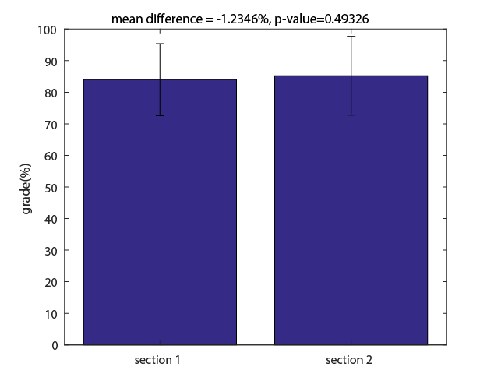
Section 1 vs section 2
Section 1 = 11:30-12:30
Section 2 = 12:30-1:30
Section 2 scored 1.2% higher on average, but the difference was not significant (p=0.49)

Slide 6
Midterm solutions: question 1
Question 1A: using the 1R algorithm, construct the table showing the rules predicting the outcome of >50 jumps for each attribute-value and overall error rate for each attribute
Attribute | Rules | Errors | Total Errors
weight | Heavy->yes | 4/9 | 9/20
 | Light->no | 5/11
heartrate | Slow->yes | 4/10 | 8/20
 | Fast->no | 4/10
1A
Question 1B: using the rules with lowest error rate from (A), predict outcome of >50 jumps for two instances :
instance 1: [weight=heavy, heartrate=slow] -> >50 jumps=yes
instance 2: [weight=light, heartrate=fast] -> >50 jumps=no
1B

Slide 7
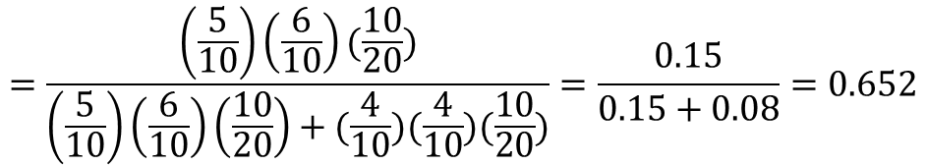
Question 2:
2A) using Naïve Bayes algorithm, find P(>50 jumpes = yes | weight=heavy, heartrate=slow)
weight |  |  | heartrate
 | yes | no |  | yes | no
heavy | 5/10 | 4/10 | Slow | 6/10 | 4/10
light | 5/10 | 6/10 | fast | 4/10 | 6/10
$$p\left(yes | heavy,slow\right)= \frac{p\left(heavy | yes\right)p\left(slow | yes\right)p(yes)}{p\left(heavy | yes\right)p\left(slow | yes\right)p\left(yes\right)+p\left(heavy | no\right)p\left(slow | no\right)p(no)}$$
$$=\frac{\left(\frac{5}{10}\right)\left(\frac{6}{10}\right)(\frac{10}{20})}{\left(\frac{5}{10}\right)\left(\frac{6}{10}\right)\left(\frac{10}{20}\right)+(\frac{4}{10})(\frac{4}{10})(\frac{10}{20})}=\frac{0.15}{0.15+0.08}=0.652$$

Slide 8
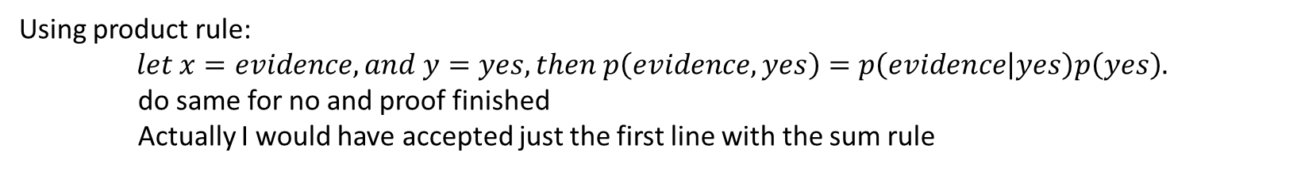
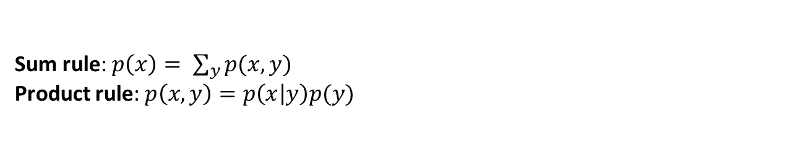
Question 2
2B) the denominator in Bayes’ Theorem is the overall probability of the evidence, in 2A this is the probability that the person is both heavy and slow: $p\left(yes | evidence\right)=\frac{p\left(evidence | yes\right)p(yes)}{p(evidence)}$
Show, using the sum and product rules of probability, that:
$p\left(evidence\right)=p\left(evidence | yes\right)p\left(yes\right)+p\left(evidence | no\right)p(no)$
Sum rule: $p\left(x\right)= \sum_{y}{p(x,y)}$
Product rule: $p\left(x,y\right)=p\left(x | y\right)p(y)$
Using sum rule:
$$let x=evidence, and y=\left[yes,no\right], then p\left(evidence\right)=p\left(evidence,yes\right)+p(evidence,no)$$
Using product rule:
$$let x=evidence, and y=yes, then p\left(evidence,yes\right)=p\left(evidence | yes\right)p\left(yes\right).$$
do same for no and proof finished
Actually I would have accepted just the first line with the sum rule

Slide 9

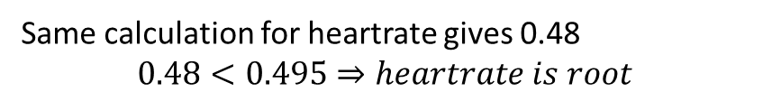
Question 3
3A) using gini index, find the attribute that should be placed as root for decision tree constructed on this dataset.
$$gini\left(weight\right)=\frac{9}{20}gini\left(\frac{5}{9},\frac{4}{9}\right)+\frac{11}{20}gini\left(\frac{5}{11},\frac{6}{11}\right)$$
$$=\frac{9}{20}\left(1−{\left(\frac{5}{9}\right)}^{2}−{\left(\frac{4}{9}\right)}^{2}\right)+\frac{10}{20}\left(1−{\left(\frac{5}{11}\right)}^{2}−{\left(\frac{5}{11}\right)}^{2}\right)$$
$$=0.222+0.273=0.495$$
Same calculation for heartrate gives 0.48
$$0.48<0.495⇒heartrate is root$$

Slide 10
Question 3
3B) list the subset of instances that reach the each child node of the root node from (A)
heartrate
slow
fast
Yes
Yes
Yes
No
Yes
No
No
No
Yes
yes
Yes
No
No
No
No
No
Yes
Yes
Yes
no

Slide 11
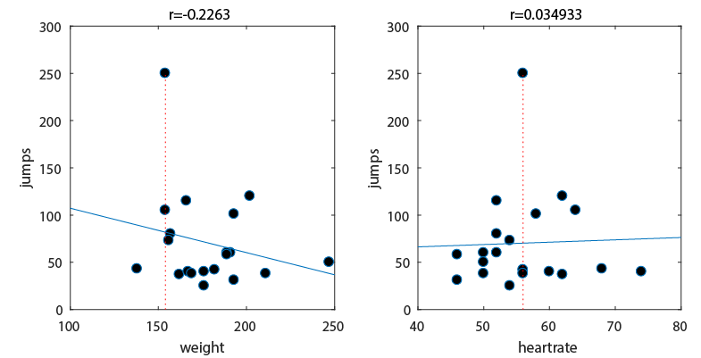
Question 4
Plot two separate scatter plots, and estimate best fit line for each.
Which attribute has highest r-value with jumps?

Slide 12
Projections
PCA: orthogonal linear transform projecting the data into a new coordinate system
ICA: separates multivariate signal into statistically independent sub-components
Discrete Fourier transform: decomposes a function of time into its constituent frequencies

Slide 13
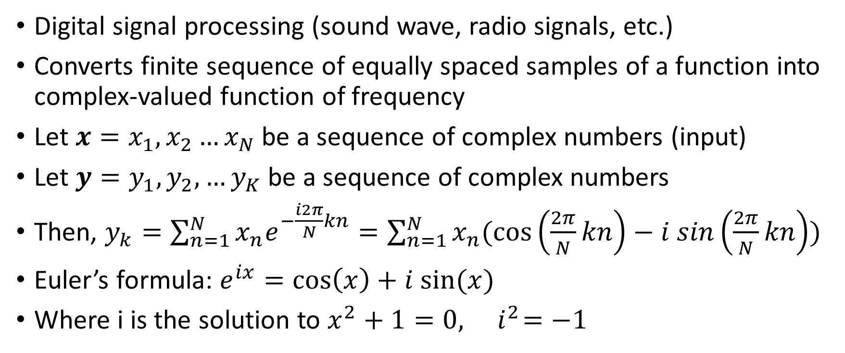
Discrete Fourier Transform
Digital signal processing (sound wave, radio signals, etc.)
Converts finite sequence of equally spaced samples of a function into complex-valued function of frequency
Let $x=x_{1},x_{2}…x_{N}$ be a sequence of complex numbers (input)
Let $y=y_{1},y_{2},…y_{K}$ be a sequence of complex numbers
Then, $y_{k}=\sum_{n=1}^{N}{x_{n}e^{−\frac{i2π}{N}kn}}=\sum_{n=1}^{N}{x_{n}(\cos\left(\frac{2π}{N}kn\right)−i sin\left(\frac{2π}{N}kn\right))}$
Euler’s formula: $e^{ix}=\cos\left(x\right)+i sin⁡(x)$
Where i is the solution to $x^{2}+1=0, { i}^{2}=−1$

Slide 14
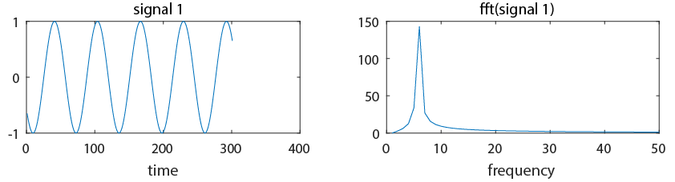
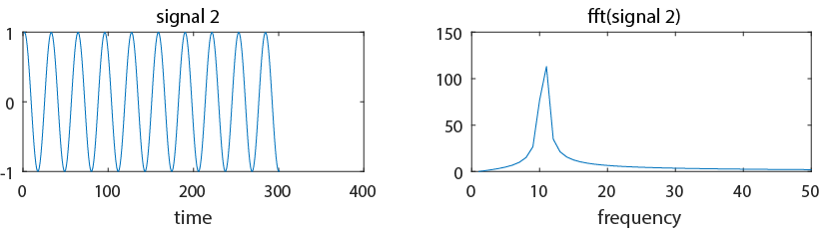
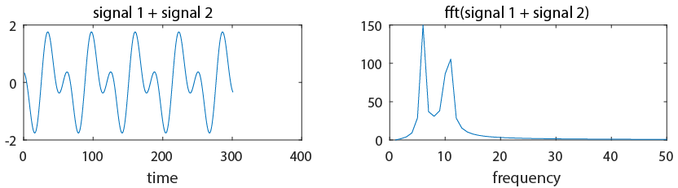
Example:
Basic signal processing:
frequency units (Hz)
Linearity of Fourier transform
Fourier transform is good at representing oscillatory signals

Slide 15
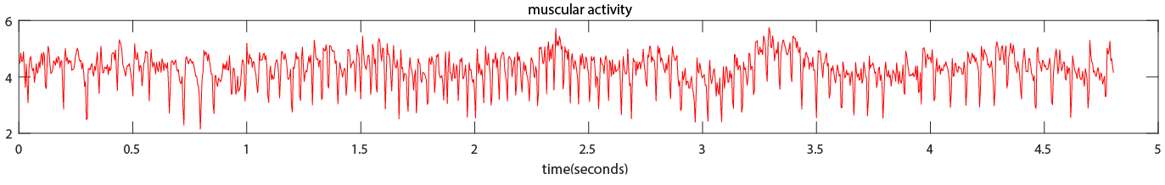
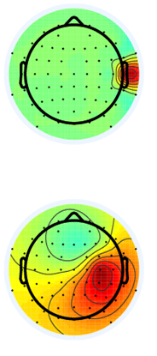
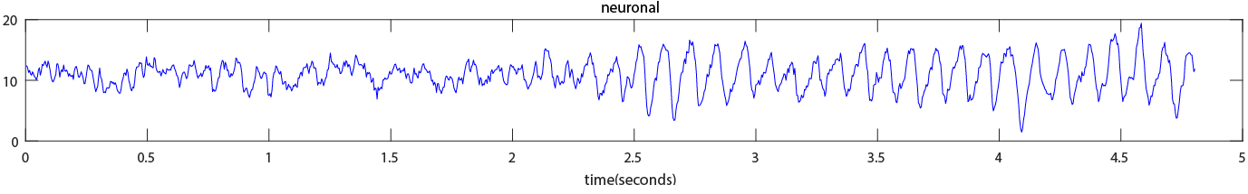
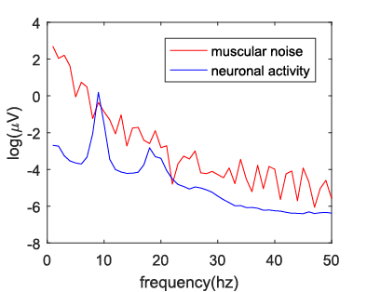
Example: EEG analysis
Muscular/neuronal activity separated by ICA have different frequency content
Easy to see which is which by performing Fourier transform on ICA component time series
Can automatically clean by finding noise using Fourier transform
Can also characterize different people’s brain rhythms frequency

Slide 16
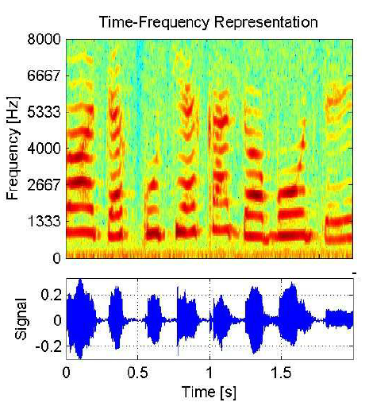
Time-frequency decomposition
Calculate a the Fourier transform in a sliding window over the entire signal
Shows the evolution of frequency content with time
Useful in many applications, including:
  Vibro-acoustics (machine fault diagnosis)
  Biomedical signal analysis
  Speech recognition
  Etc.
Deep learning convolutional autoencoders now being trained to make time-frequency analysis obsolete
  https://pdfs.semanticscholar.org/9604/46fd8f5df431f80e030c4d91484aa6a64d3e.pdf
https://www.researchgate.net/publication/269463091_Joint_Time-Frequency_And_Wavelet_Analysis-An_Introduction

Slide 17
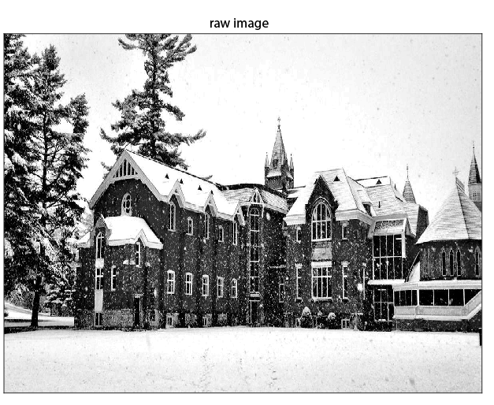
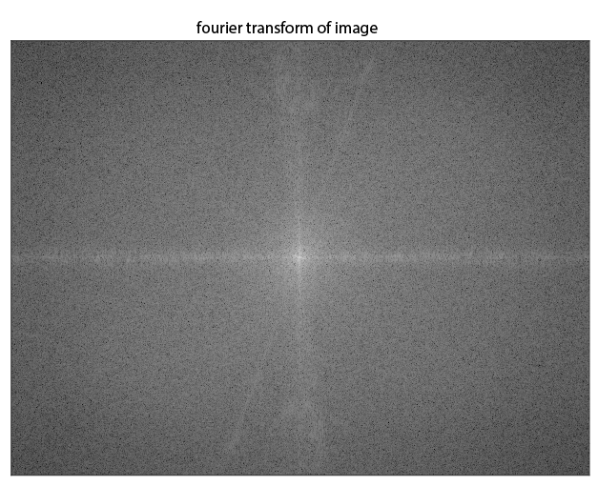
Example: image processing
‘image space’
‘frequency space’

Slide 18
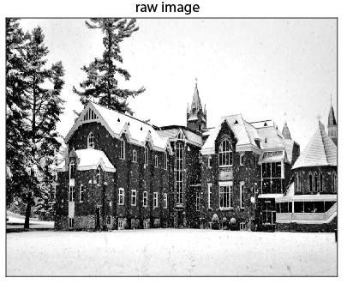
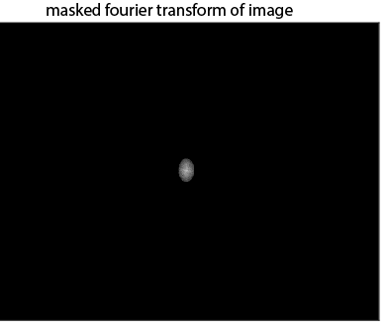
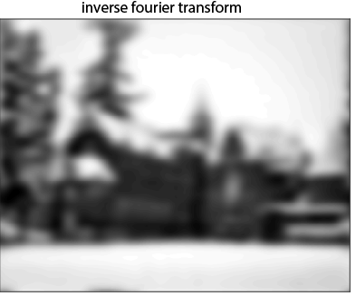
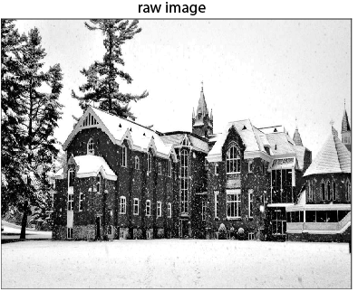
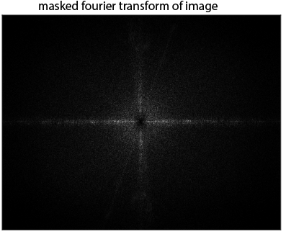
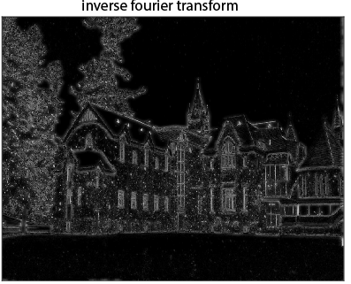
Frequency space manipulations
Removing high frequencies (top), removing low frequencies (bottom)

Slide 19
Other important projections
We have seen:
  Principal component analysis (PCA)
  Partial least squares (PLS)
  Independent component analysis (ICA)
  Fourier transform
Others include:
  Matching pursuit (used in dictionary learning)
  Linear discriminant analysis
  Quadratic discriminant analysis
  Many more:
    https://scikit-learn.org/stable/modules/classes.html#module-sklearn.decomposition

Slide 20
Plan for rest of course
Chapter 7: extending instance based and linear models
  Instance based learning
  Support vector machines
  Multilayer perceptrons
  Stochastic gradient descent
  Model trees
Chapter 9: Probabilistic methods
  Bayesian networks
  Gaussian mixture modeling
  Kernel density estimation
  Markov models
  Gradient descent
Chapter 12: Ensemble learning
  Combining multiple models
  Bagging, boosting
  Random forests
Chapter 11: Deep learning
Assignment 2:
Basic numpy + algorithms
Assignment 3:
Model selection in sklearn
Final project:
Model selection + ensemble learning in sklearn

