Slide 2
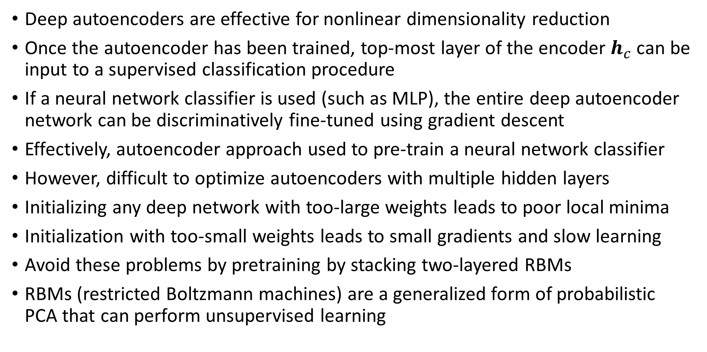
Pretraining deep autoencoders with RBMs
Deep autoencoders are effective for nonlinear dimensionality reduction
Once the autoencoder has been trained, top-most layer of the encoder $h_{c}$ can be input to a supervised classification procedure
If a neural network classifier is used (such as MLP), the entire deep autoencoder network can be discriminatively fine-tuned using gradient descent
Effectively, autoencoder approach used to pre-train a neural network classifier
However, difficult to optimize autoencoders with multiple hidden layers
Initializing any deep network with too-large weights leads to poor local minima
Initialization with too-small weights leads to small gradients and slow learning
Avoid these problems by pretraining by stacking two-layered RBMs
RBMs (restricted Boltzmann machines) are a generalized form of probabilistic PCA that can perform unsupervised learning

Slide 3
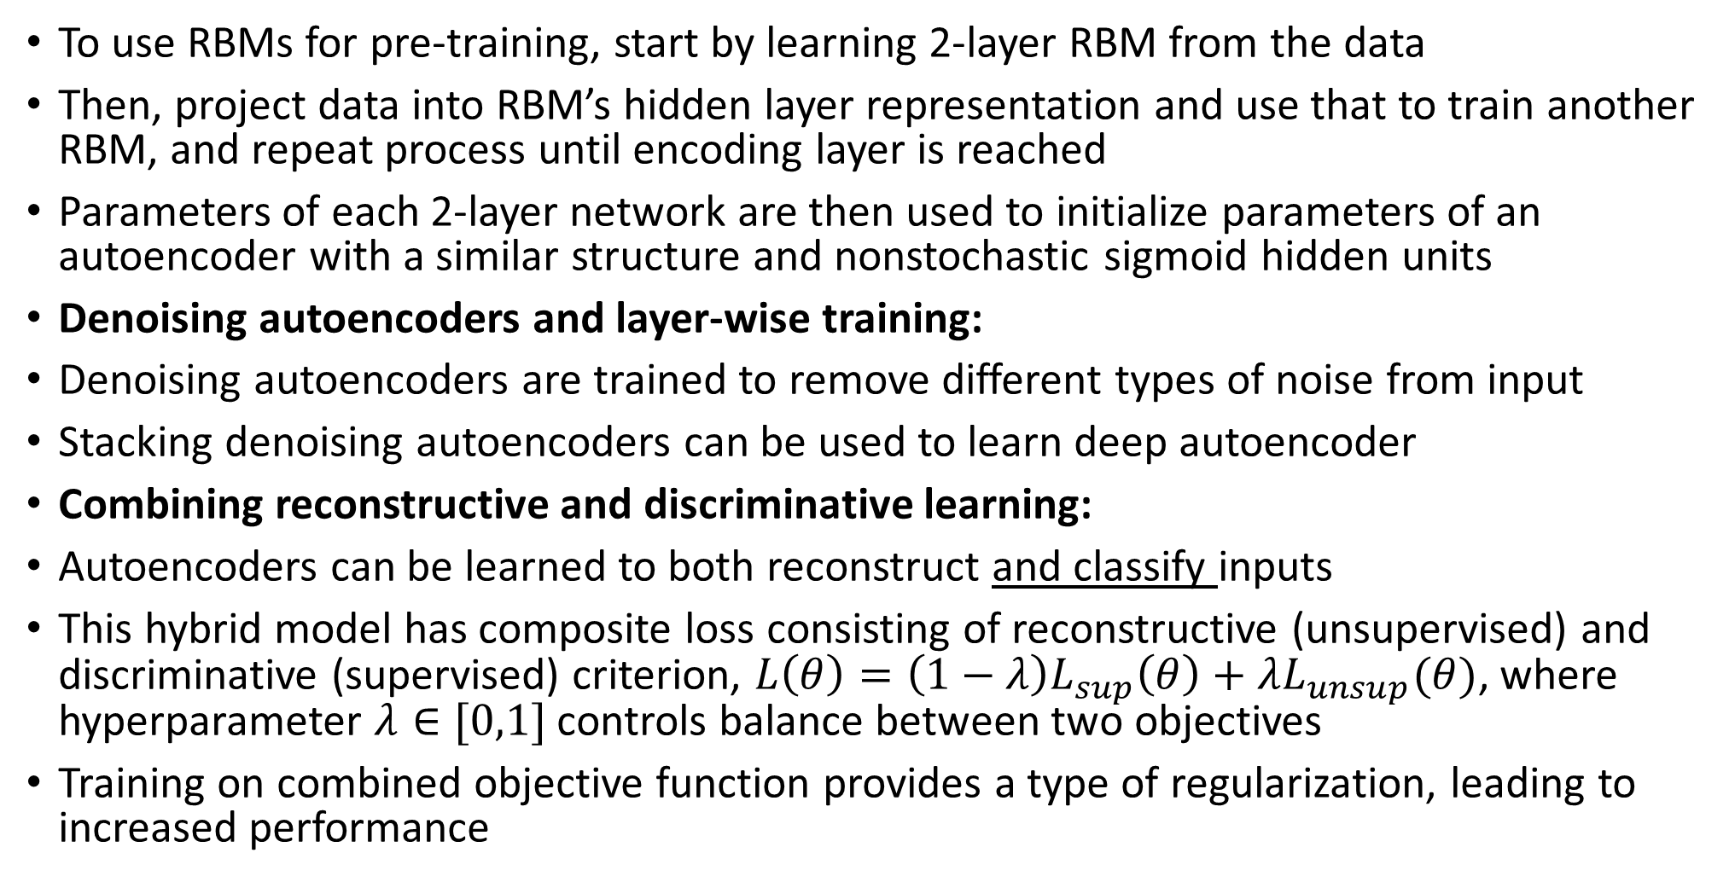
Pretraining deep autoencoders with RBMs
To use RBMs for pre-training, start by learning 2-layer RBM from the data
Then, project data into RBM’s hidden layer representation and use that to train another RBM, and repeat process until encoding layer is reached
Parameters of each 2-layer network are then used to initialize parameters of an autoencoder with a similar structure and nonstochastic sigmoid hidden units
Denoising autoencoders and layer-wise training:
Denoising autoencoders are trained to remove different types of noise from input
Stacking denoising autoencoders can be used to learn deep autoencoder
Combining reconstructive and discriminative learning:
Autoencoders can be learned to both reconstruct and classify inputs
This hybrid model has composite loss consisting of reconstructive (unsupervised) and discriminative (supervised) criterion, $L\left(θ\right)=\left(1−λ\right)L_{sup}\left(θ\right)+λL_{unsup}(θ)$, where hyperparameter $λ∈[0,1]$ controls balance between two objectives
Training on combined objective function provides a type of regularization, leading to increased performance

Slide 4
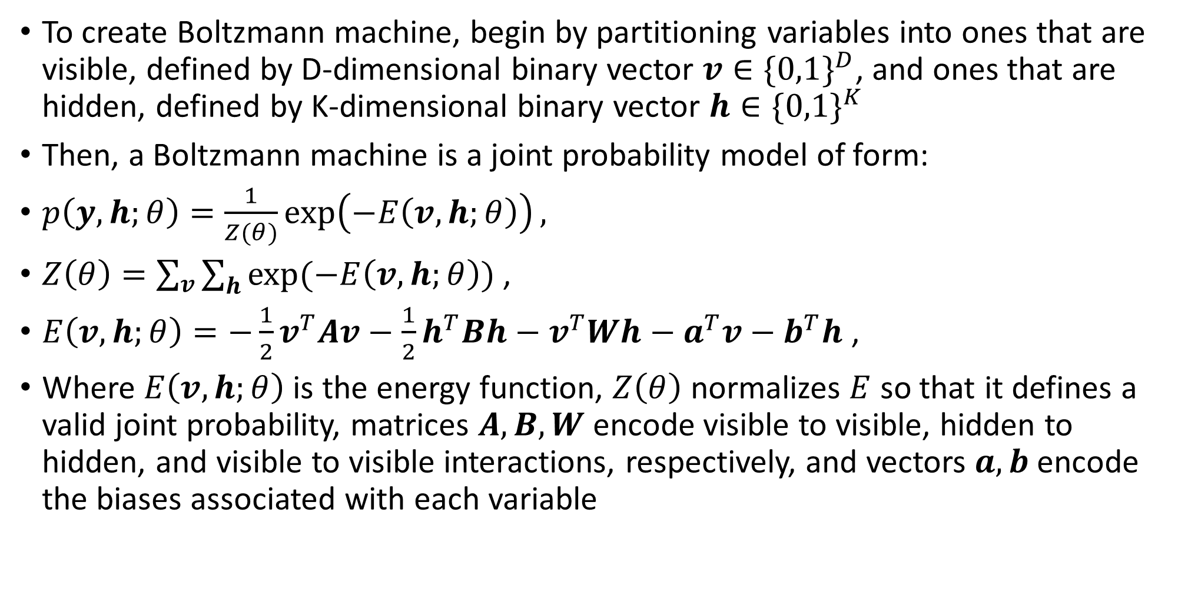
Boltzmann machine
To create Boltzmann machine, begin by partitioning variables into ones that are visible, defined by D-dimensional binary vector $v∈{\{0,1\}}^{D}$, and ones that are hidden, defined by K-dimensional binary vector $h∈{\{0,1\}}^{K}$
Then, a Boltzmann machine is a joint probability model of form:
$p\left(y,h;θ\right)=\frac{1}{Z(θ)}\exp\left(−E\left(v,h;θ\right)\right),$
$Z\left(θ\right)=\sum_{v}{\sum_{h}{exp⁡(−E\left(v,h;θ\right))}}$ ,
$E\left(v,h;θ\right)=−\frac{1}{2}v^{T}Av−\frac{1}{2}h^{T}Bh−v^{T}Wh−a^{T}v−b^{T}h$ ,
Where $E\left(v,h;θ\right)$ is the energy function, $Z\left(θ\right)$ normalizes $E$ so that it defines a valid joint probability, matrices $A,B,W$ encode visible to visible, hidden to hidden, and visible to visible interactions, respectively, and vectors $a,b$ encode the biases associated with each variable

Slide 5
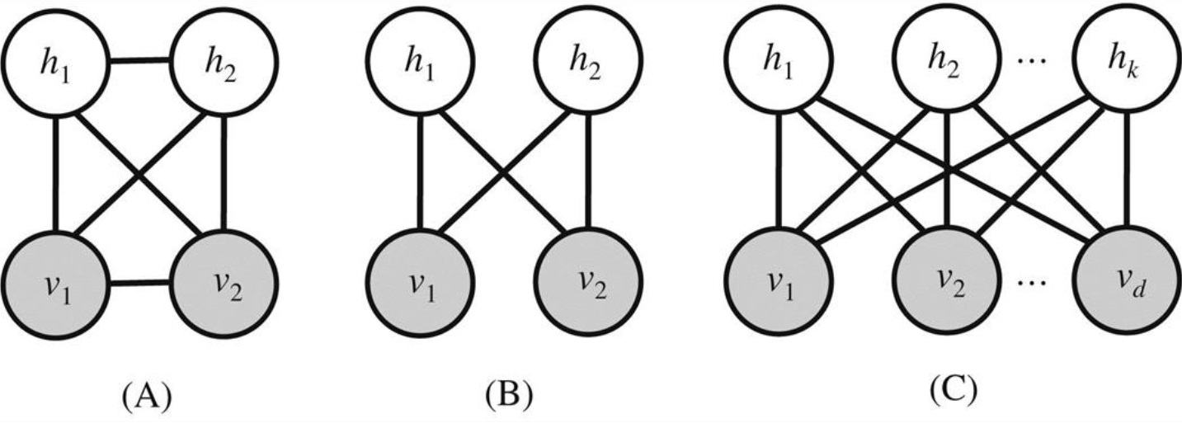
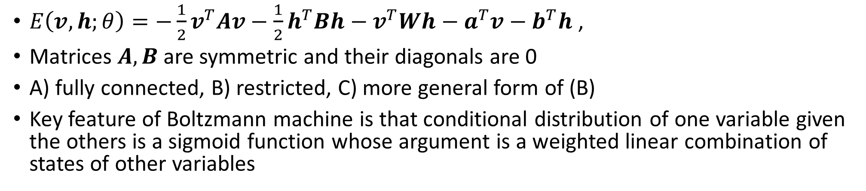
Boltzmann machine
$E\left(v,h;θ\right)=−\frac{1}{2}v^{T}Av−\frac{1}{2}h^{T}Bh−v^{T}Wh−a^{T}v−b^{T}h$ ,
Matrices $A,B$are symmetric and their diagonals are 0
A) fully connected, B) restricted, C) more general form of (B)
Key feature of Boltzmann machine is that conditional distribution of one variable given the others is a sigmoid function whose argument is a weighted linear combination of states of other variables

