Slide 1
CS405/505 Data Mining
Lecture 16

Slide 2
Administrative slide
Midterm
Assignment 2
Assignment 3 + final project
Python demonstrations?

Slide 3
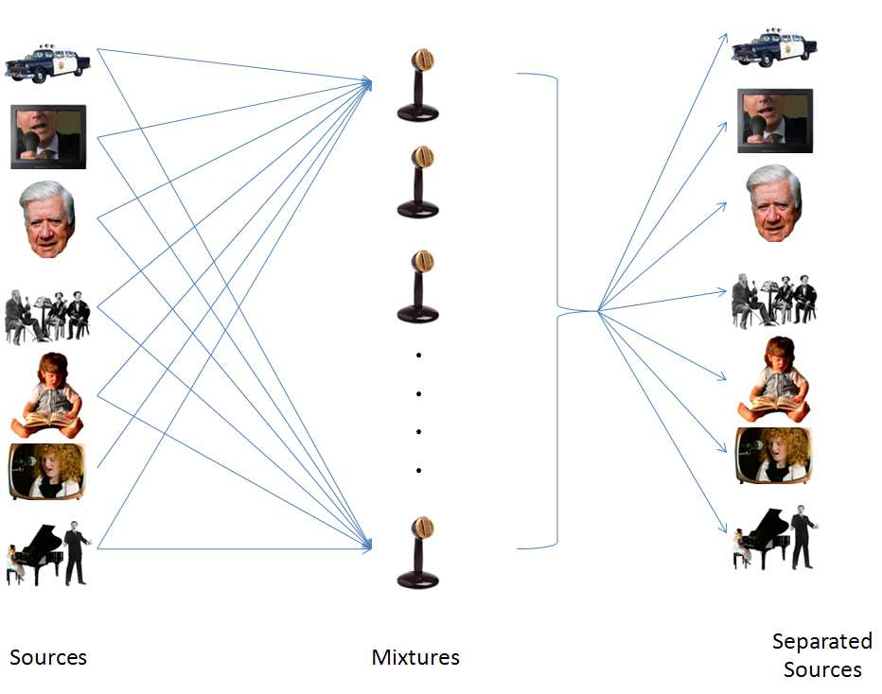
Independent Component Analysis (ICA)
Decompose multivariate signal into independent non-gaussian signals
Cocktail party problem:
Input: mixed signal (what we measure)
Output: unmixed signal (independent components)
ICA is a blind signal separation technique
Two primary assumptions of ICA
Source signals are independent
Source signal distributions are non-gaussian

Slide 4
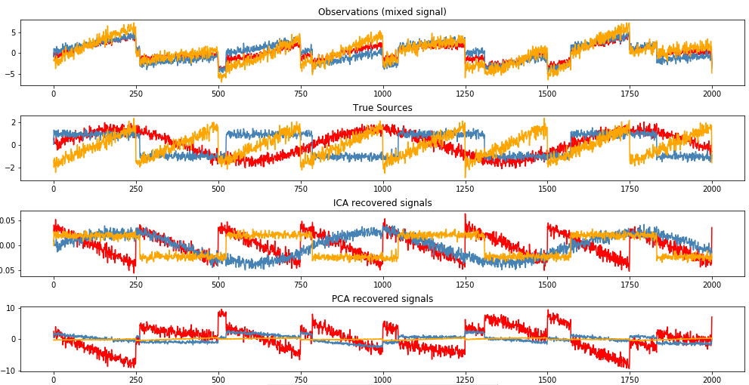
The power of ICA
https://scikit-learn.org/stable/auto_examples/decomposition/plot_ica_blind_source_separation.html#sphx-glr-auto-examples-decomposition-plot-ica-blind-source-separation-py

Slide 5
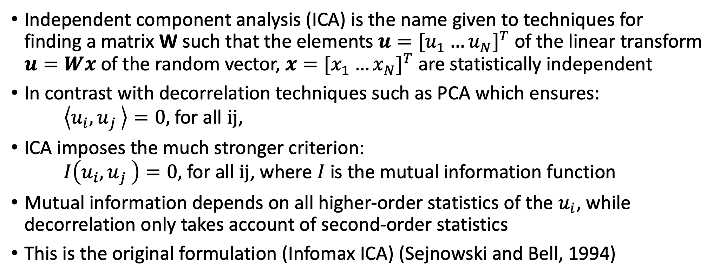
General definition of ICA
Independent component analysis (ICA) is the name given to techniques for finding a matrix W such that the elements $u={[u_{1}^{ }…u_{N}^{ }]}^{T}$ of the linear transform $u=Wx$ of the random vector, $x={[x_{1}^{ }…x_{N}^{ }]}^{T}$ are statistically independent
In contrast with decorrelation techniques such as PCA which ensures: $\left\langle u_{i}{,u}_{j}\right\rangle =0,$ for all ij,
ICA imposes the much stronger criterion: $I\left(u_{i}{,u}_{j}\right)=0,$ for all ij, where $I$ is the mutual information function
Mutual information depends on all higher-order statistics of the $u_{i}$, while decorrelation only takes account of second-order statistics
This is the original formulation (Infomax ICA) (Sejnowski and Bell, 1994)
http://www.inf.fu-berlin.de/lehre/WS05/Mustererkennung/infomax/infomax.pdf

Slide 6
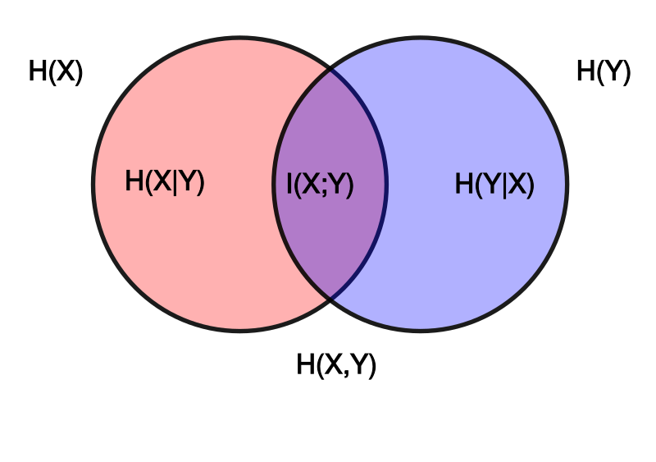
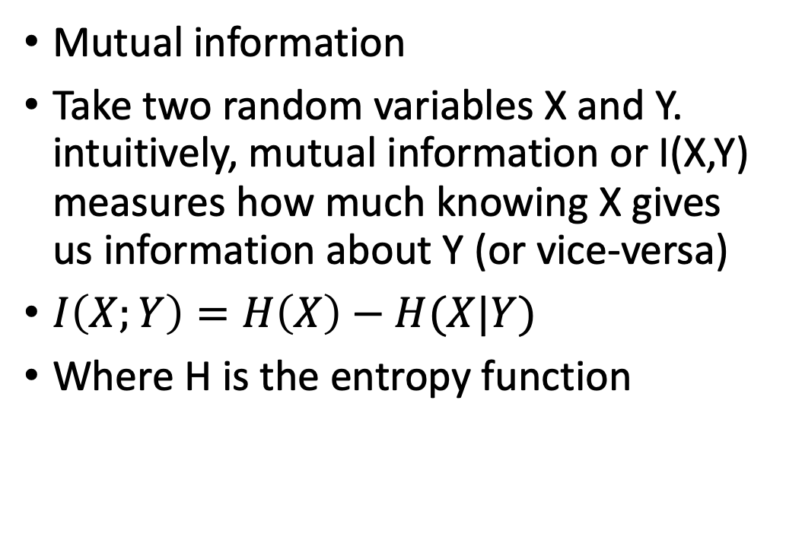
Measures of Independence: Mutual information
Mutual information
Take two random variables X and Y. intuitively, mutual information or I(X,Y) measures how much knowing X gives us information about Y (or vice-versa)
$I\left(X;Y\right)=H\left(X\right)−H(X|Y)$
Where H is the entropy function

Slide 7
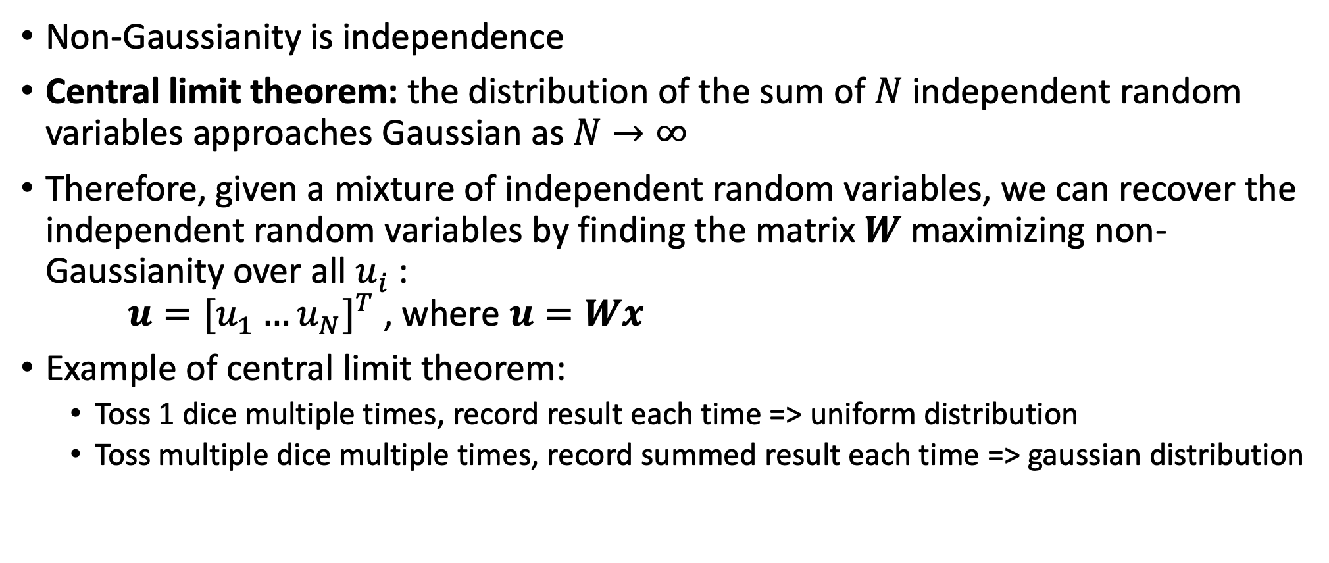
Measures of independence: non-Gaussianity
Non-Gaussianity is independence
Central limit theorem: the distribution of the sum of $N$ independent random variables approaches Gaussian as $N→∞$
Therefore, given a mixture of independent random variables, we can recover the independent random variables by finding the matrix $W$ maximizing non-Gaussianity over all $u_{i}^{ }$: $u={[u_{1}^{ }…u_{N}^{ }]}^{T}$ , where $u=Wx$
Example of central limit theorem:
Toss 1 dice multiple times, record result each time => uniform distribution
Toss multiple dice multiple times, record summed result each time => gaussian distribution

Slide 8
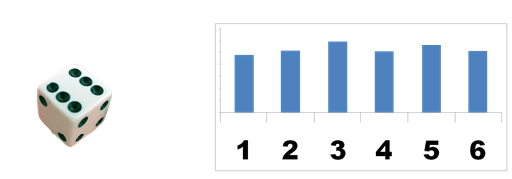
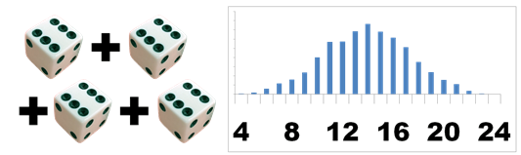
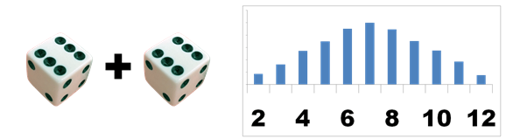
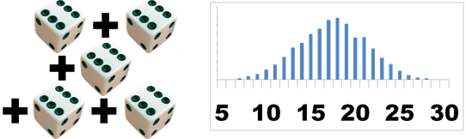
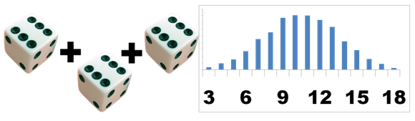
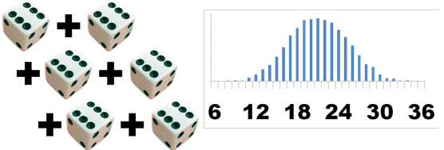
Central limit theorem: dice example
https://www.muelaner.com/uncertainty-of-measurement/attachment/central-limit-theorem/

Slide 9
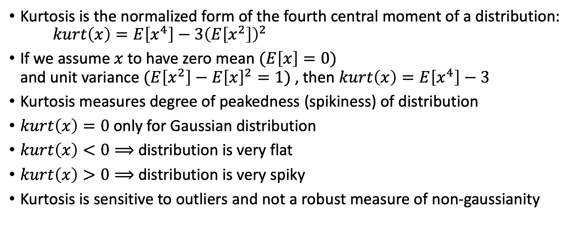
Quantifying non-Gaussianity: Kurtosis
Kurtosis is the normalized form of the fourth central moment of a distribution: $kurt\left(x\right)=E\left[x^{4}\right]−3{\left(E\left[x^{2}\right]\right)}^{2}$
If we assume $x$ to have zero mean $(E\left[x\right]=0)$ and unit variance $(E\left[x^{2}\right]−{E\left[x\right]}^{2}=1)$ , then $kurt\left(x\right)=E\left[x^{4}\right]−3$
Kurtosis measures degree of peakedness (spikiness) of distribution
$kurt\left(x\right)=0$ only for Gaussian distribution
$kurt\left(x\right)<0⟹$ distribution is very flat
$kurt\left(x\right)>0⟹$ distribution is very spiky
Kurtosis is sensitive to outliers and not a robust measure of non-gaussianity

Slide 10
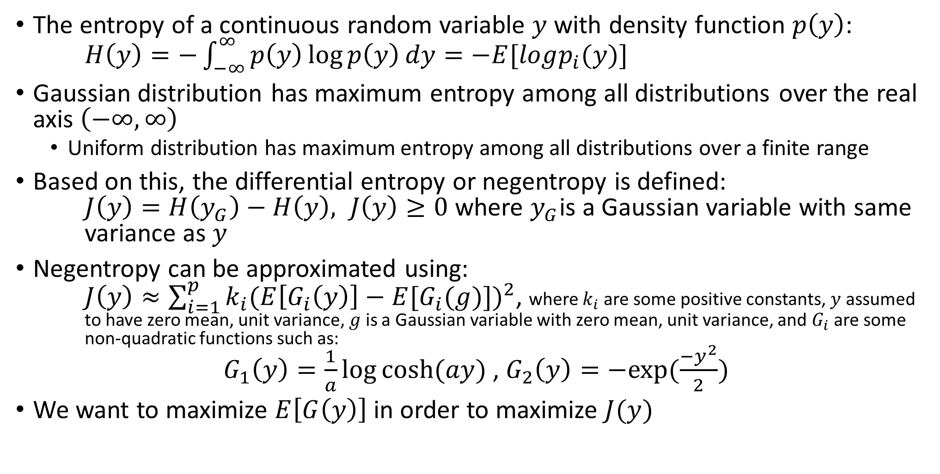
Quantifying non-Gaussianity: Negentropy
The entropy of a continuous random variable $y$ with density function $p\left(y\right)$: $H\left(y\right)=−\int_{−∞}^{∞}{p\left(y\right)\log{p\left(y\right)}dy=−E[logp_{i}(y)]}$
Gaussian distribution has maximum entropy among all distributions over the real axis $\left(−∞,∞\right)$
Uniform distribution has maximum entropy among all distributions over a finite range
Based on this, the differential entropy or negentropy is defined: $J\left(y\right)=H\left(y_{G}\right)−H\left(y\right), J\left(y\right)≥0$ where $y_{G}$is a Gaussian variable with same variance as $y$
Negentropy can be approximated using: $J\left(y\right)≈\sum_{i=1}^{p}{k_{i}{(E\left[G_{i}\left(y\right)\right]−E[G_{i}(g)])}^{2}}$, where $k_{i}$ are some positive constants, $y$ assumed to have zero mean, unit variance, $g$ is a Gaussian variable with zero mean, unit variance, and $G_{i}$ are some non-quadratic functions such as: $G_{1}\left(y\right)=\frac{1}{a}\log{cosh⁡(ay)}$ , $G_{2}\left(y\right)=−exp⁡(\frac{{−y}^{2}}{2})$
We want to maximize $E\left[G\left(y\right)\right]$ in order to maximize $J(y)$
http://fourier.eng.hmc.edu/e161/lectures/ica/node4.html

Slide 11
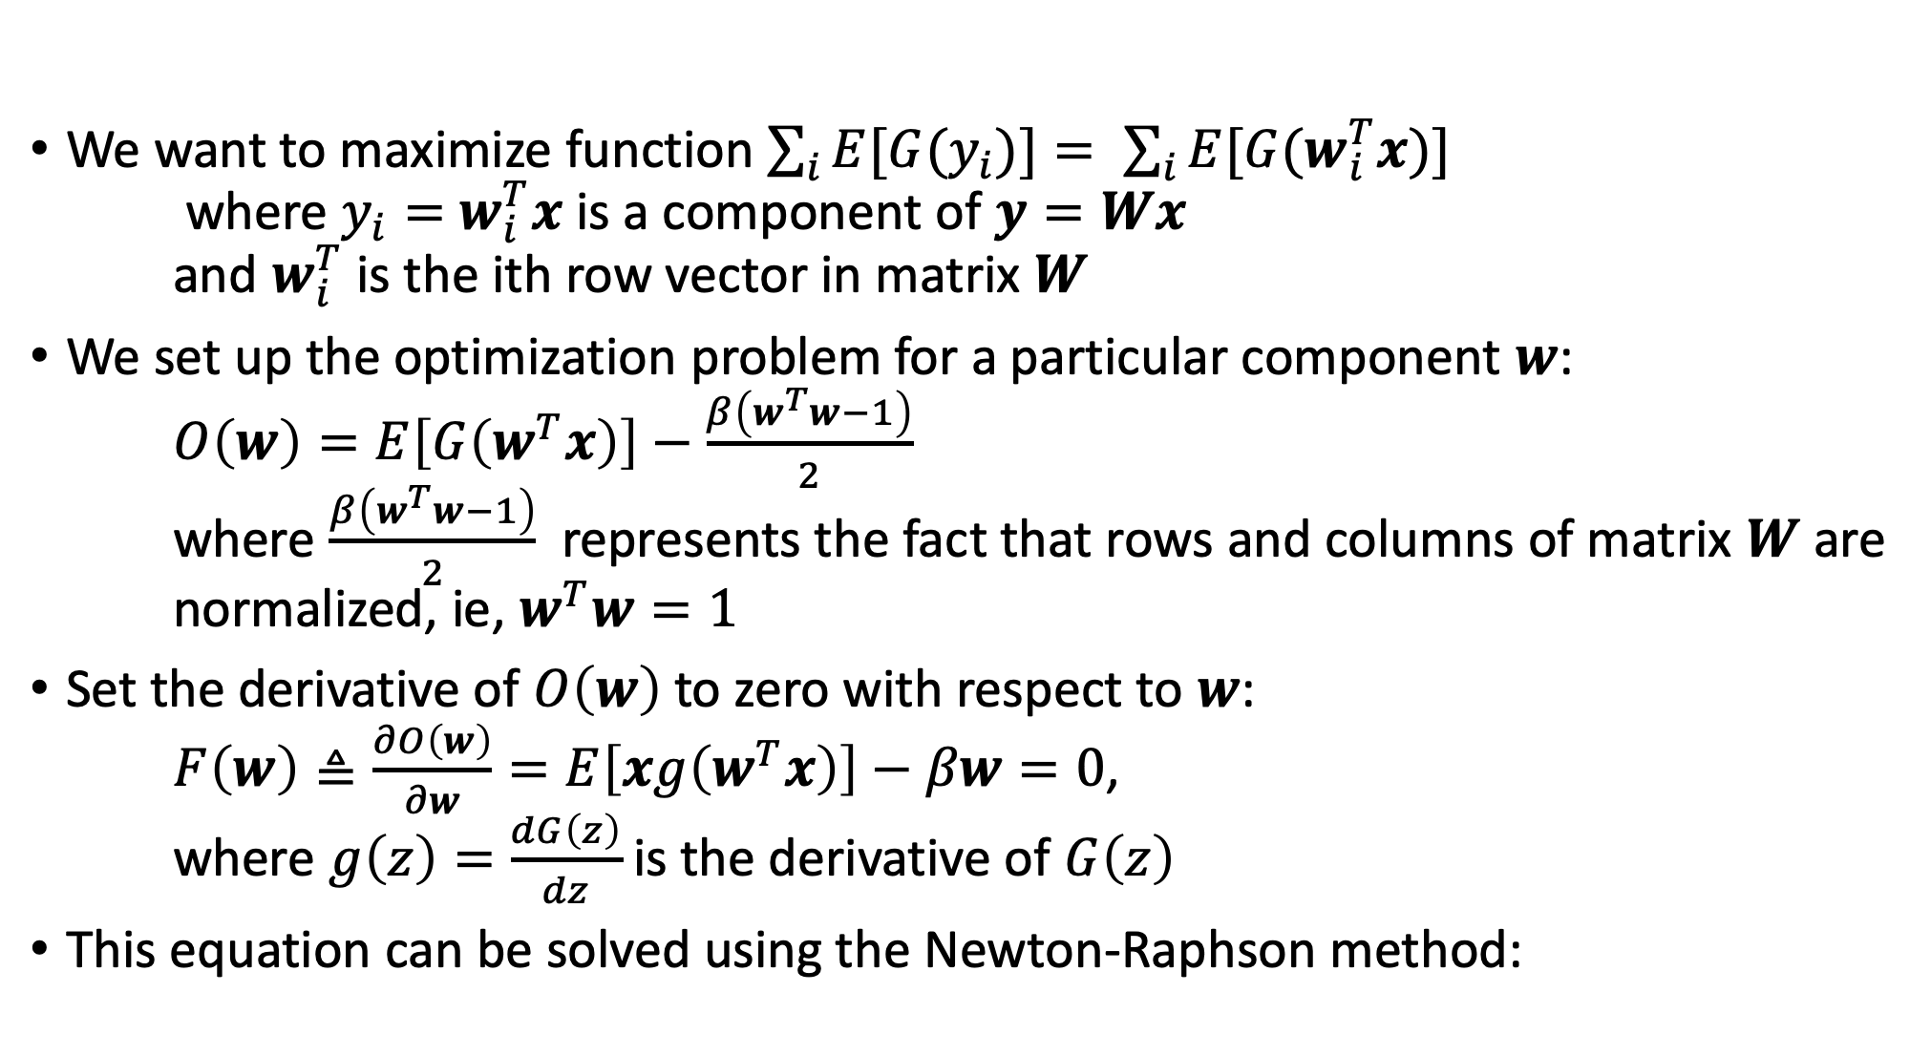
ICA algorithm (fastICA)
We want to maximize function $\sum_{i}{E[G{(y}_{i})]}= \sum_{i}{E[G(w_{i}^{T}x)]}$ where $y_{i}=$ $w_{i}^{T}x$ is a component of $y=Wx$ and $w_{i}^{T}$ is the ith row vector in matrix $W$
We set up the optimization problem for a particular component $w$: $O\left(w\right)=E\left[G\left(w^{T}x\right)\right]−\frac{β\left(w^{T}w−1\right)}{2}$ where $\frac{β\left(w^{T}w−1\right)}{2}$ represents the fact that rows and columns of matrix $W$ are normalized, ie, $w^{T}w=1$
Set the derivative of $O\left(w\right)$ to zero with respect to $w$: $F\left(w\right)≜\frac{∂O\left(w\right)}{∂w}=E\left[xg\left(w^{T}x\right)\right]−βw=0$, where $g\left(z\right)=\frac{dG\left(z\right)}{dz}$ is the derivative of $G\left(z\right)$
This equation can be solved using the Newton-Raphson method:
http://fourier.eng.hmc.edu/e161/lectures/ica/node7.html

Slide 12
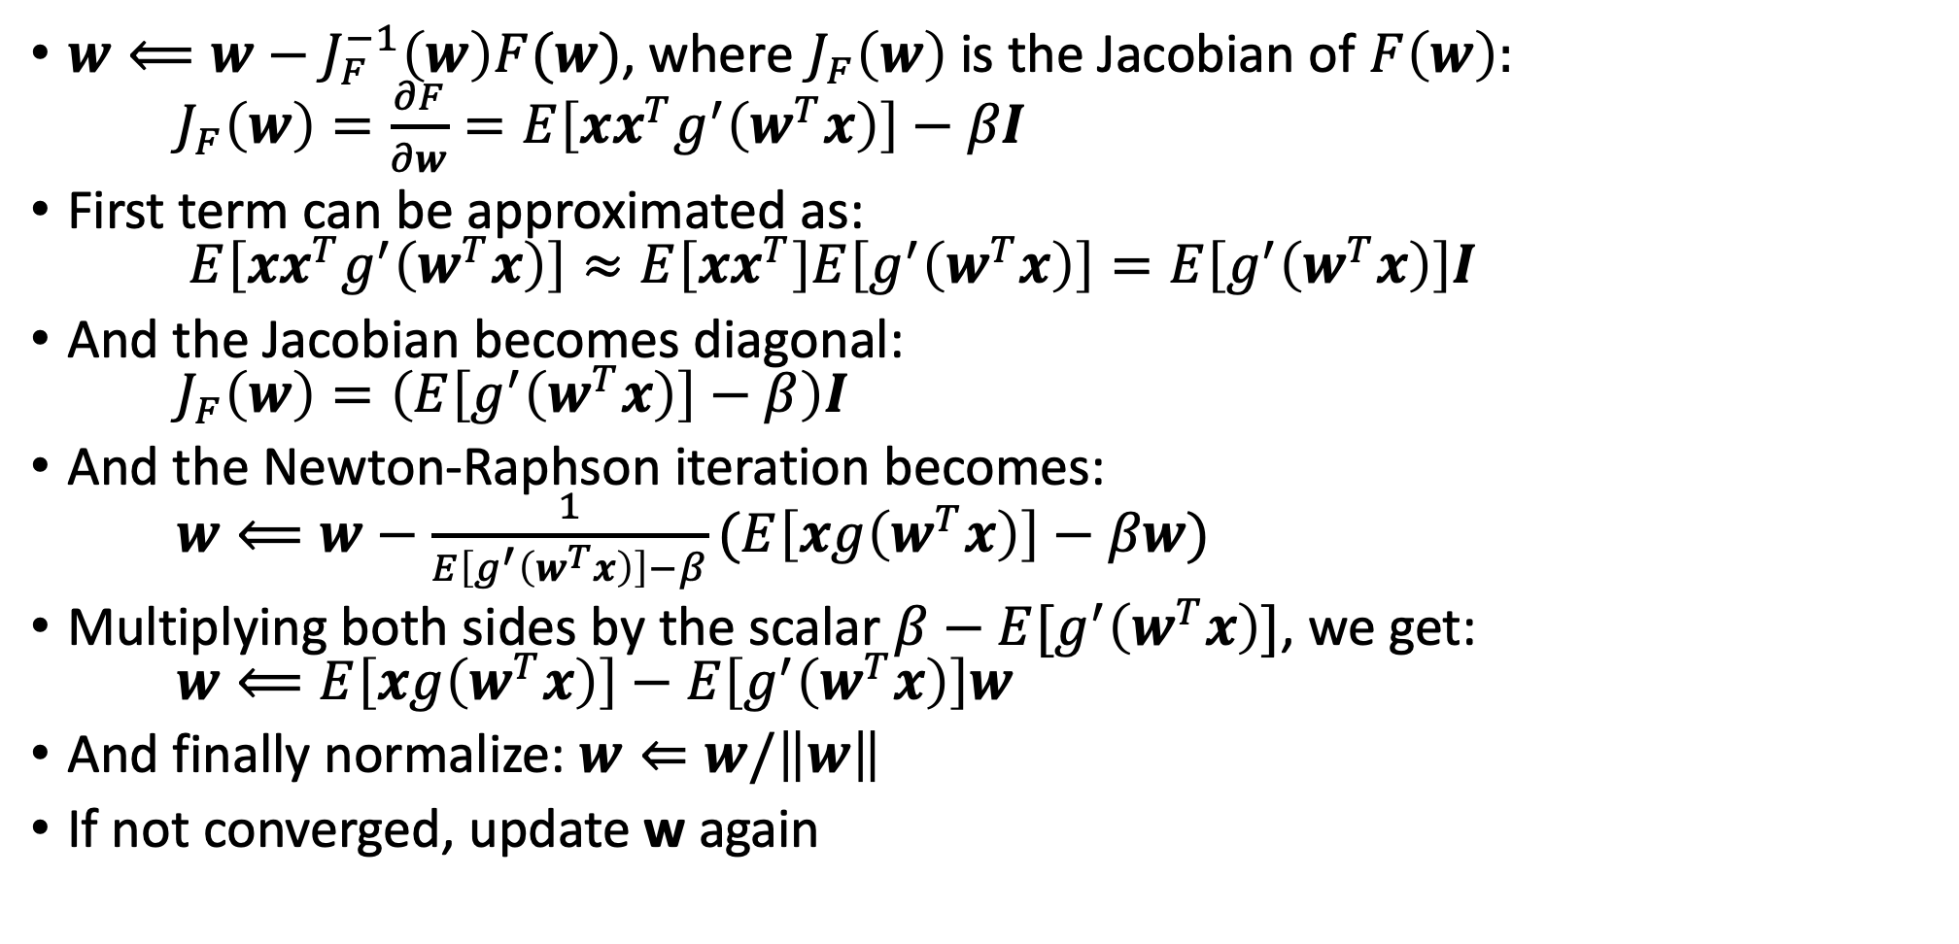
Newton-Raphson method:
To solve an algebraic equation $f\left(x\right)=0,$ select an initial random guess $x_{0}$ and follow the iteration: $x \overset{⇐}{ } x−\frac{f(x)}{f^{′}(x)}$
$w⟸w−J_{F}^{−1}\left(w\right)F(w)$, where $J_{F}\left(w\right)$ is the Jacobian of $F\left(w\right):$ $J_{F}\left(w\right)=\frac{∂F}{∂w}=E\left[xx^{T}g^{′}\left(w^{T}x\right)\right]−βI$
First term can be approximated as: $E\left[xx^{T}g^{′}\left(w^{T}x\right)\right]≈E\left[xx^{T}\right]E\left[g^{′}\left(w^{T}x\right)\right]=E\left[g^{′}\left(w^{T}x\right)\right]I$
And the Jacobian becomes diagonal: $J_{F}\left(w\right)=\left(E\left[g^{′}\left(w^{T}x\right)\right]−β\right)I$
And the Newton-Raphson iteration becomes: $w⟸w−\frac{1}{E\left[g^{′}\left(w^{T}x\right)\right]−β}(E\left[xg\left(w^{T}x\right)\right]−βw)$
Multiplying both sides by the scalar $β−E[g^{′}\left(w^{T}x\right)]$, we get: $w⟸E\left[xg\left(w^{T}x\right)\right]−E\left[g^{′}\left(w^{T}x\right)\right]w$
And finally normalize: $w⇐w/\left\|w\right\|$
If not converged, update w again
In vector calculus, the Jacobian matrix of a vector valued function in several variables is the matrix of all its first order partial derivatives
http://fourier.eng.hmc.edu/e161/lectures/ica/node7.html

Slide 13
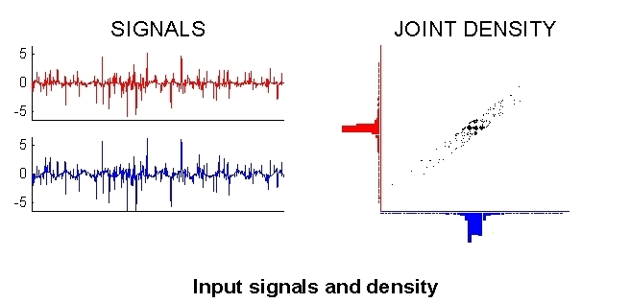
fastICA example
http://research.ics.aalto.fi/ica/icademo/

Slide 14
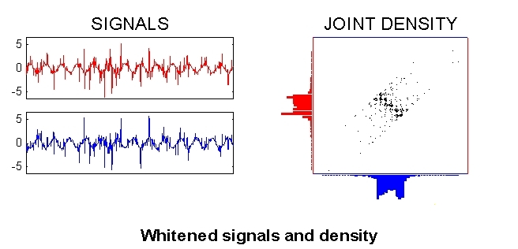
fastICA example
http://research.ics.aalto.fi/ica/icademo/

Slide 15
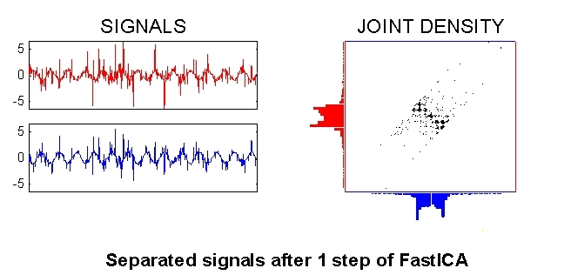
fastICA example
http://research.ics.aalto.fi/ica/icademo/

Slide 16
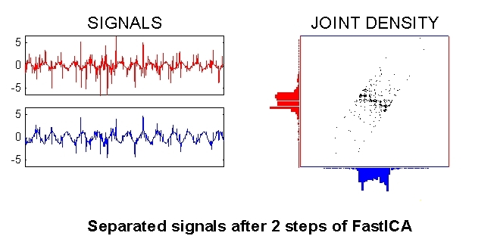
fastICA example
http://research.ics.aalto.fi/ica/icademo/

Slide 17
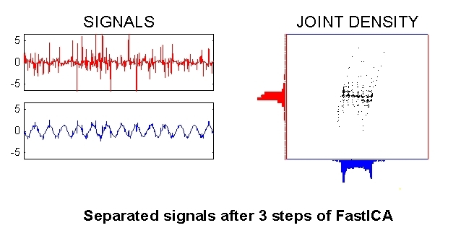
fastICA example
http://research.ics.aalto.fi/ica/icademo/

Slide 18
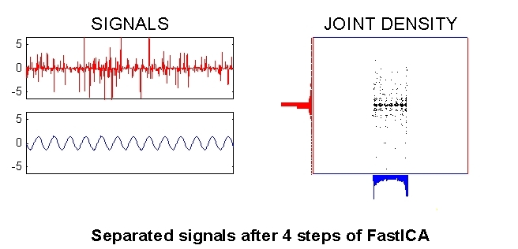
fastICA example
http://research.ics.aalto.fi/ica/icademo/

Slide 19
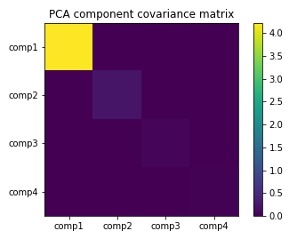
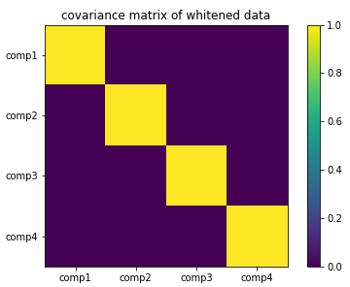
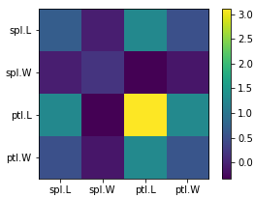
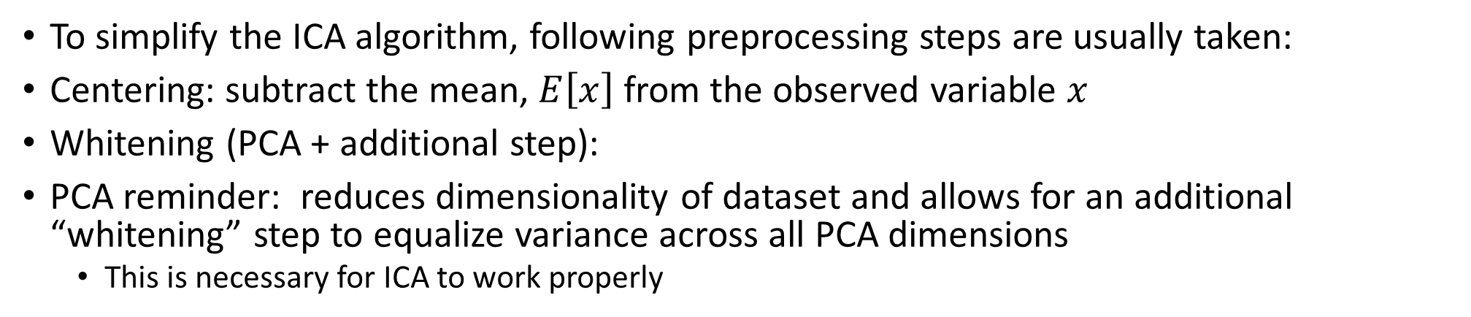
Preprocessing for ICA:
To simplify the ICA algorithm, following preprocessing steps are usually taken:
Centering: subtract the mean, $E\left[x\right]$ from the observed variable $x$
Whitening (PCA + additional step):
PCA reminder: reduces dimensionality of dataset and allows for an additional “whitening” step to equalize variance across all PCA dimensions
This is necessary for ICA to work properly
Covariance matrix

Slide 20
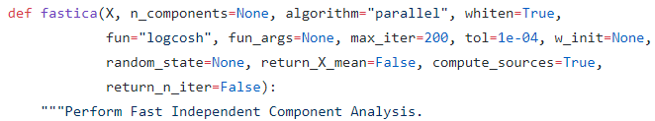
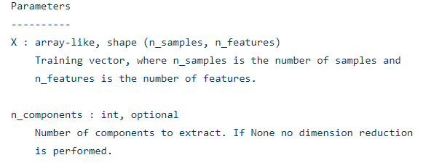
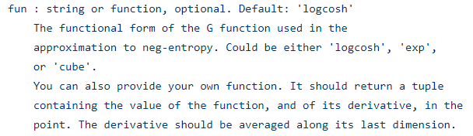
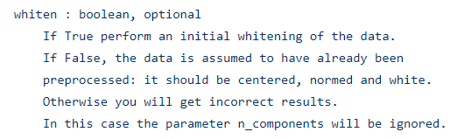

fastICA implementation: sklearn.decomposition.fastica_.py

Slide 21
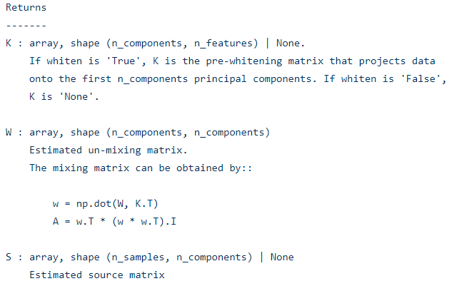
fastICA implementation: sklearn.decomposition.fastica_.py

Slide 22

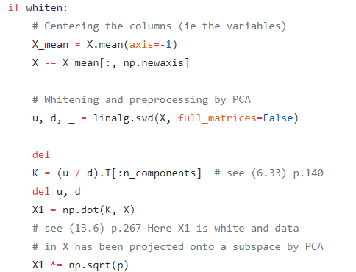
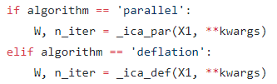
fastICA implementation: sklearn.decomposition.fastica_.py
Pre-whitening step

Slide 23
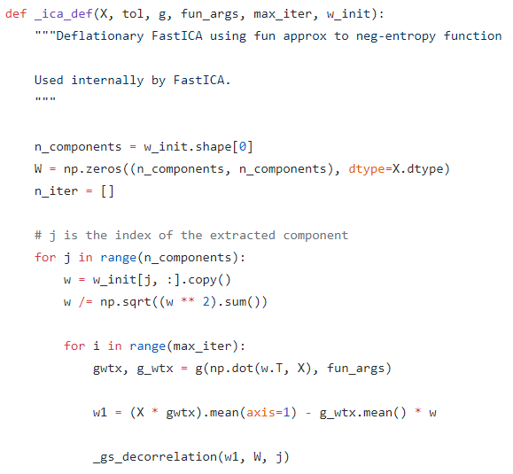
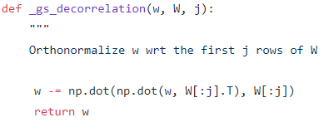
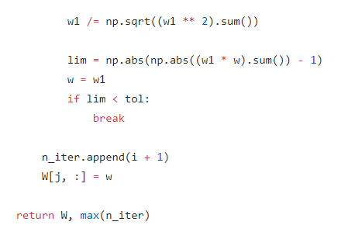
fastICA implementation: sklearn.decomposition.fastica_.py
Iteratively finding weights

Slide 24
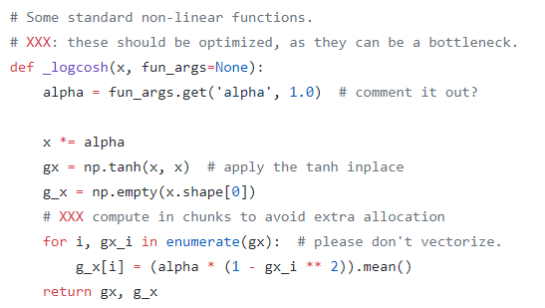
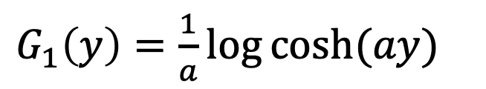
fastICA implementation: sklearn.decomposition.fastica_.py
Negentropy approximation function
$G_{1}\left(y\right)=\frac{1}{a}\log{cosh⁡(ay)}$

Slide 25

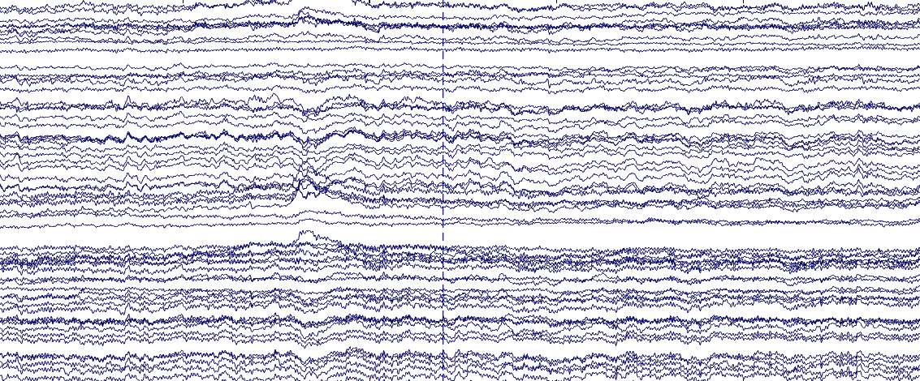
Application: separating muscular activity from neuronal activity in EEG recordings
Each electrode has a time series (EEG cap is a grid of sensors)

Slide 26
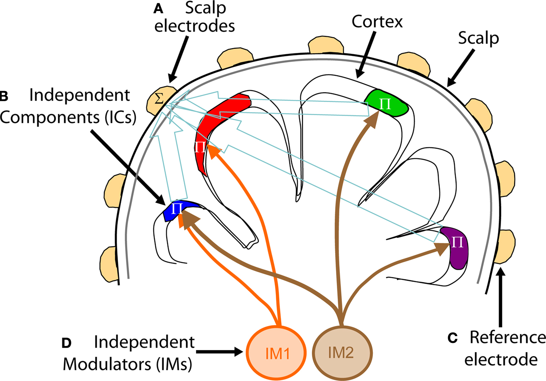
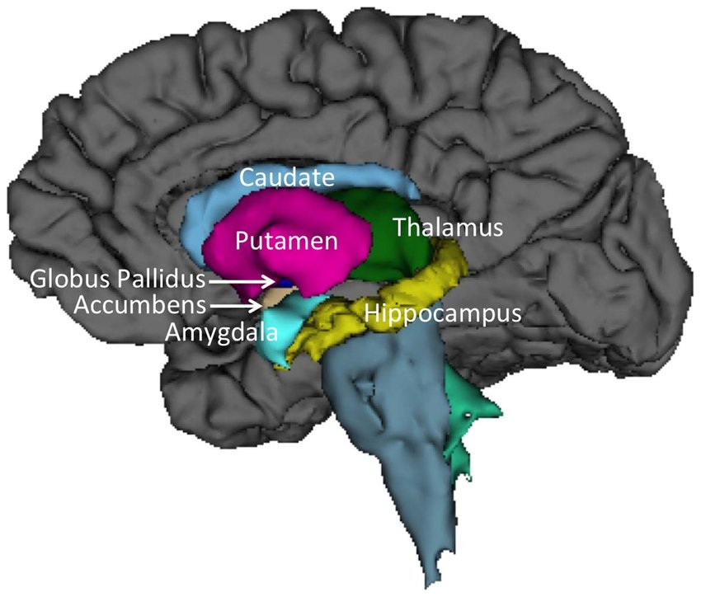
EEG measures summed cortical activity, which is influenced by independent deep brain modulators
https://www.frontiersin.org/articles/10.3389/neuro.09.061.2009/full

Slide 27
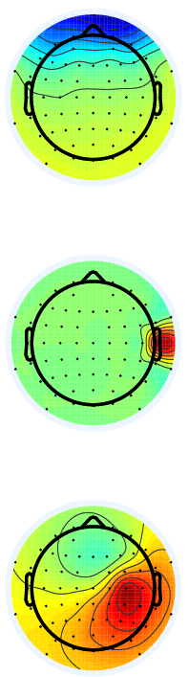
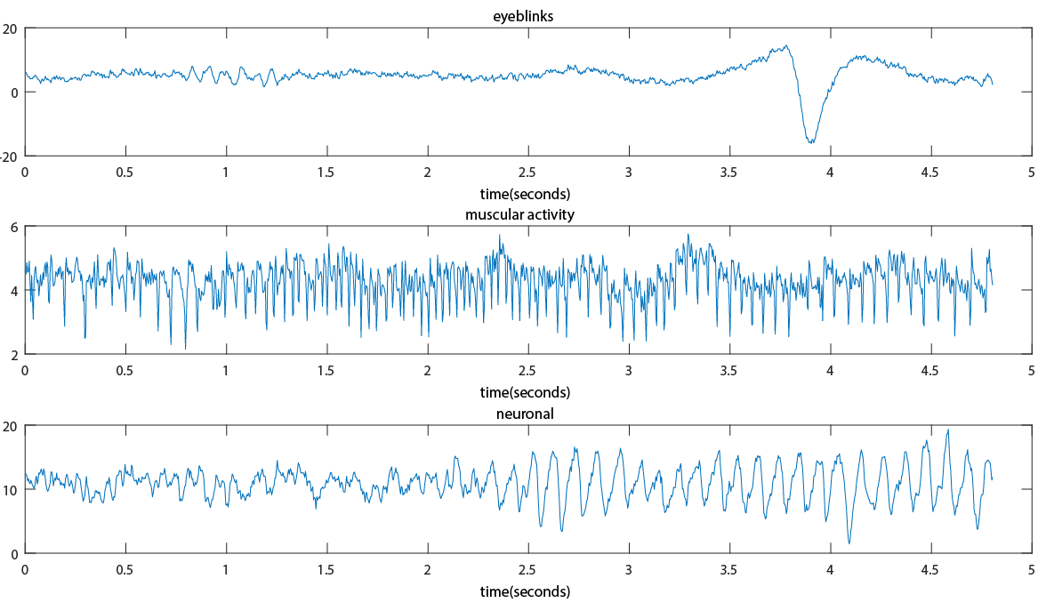
Isolating noise (eyeblinks, muscular artifacts)
Weight maps

Slide 28
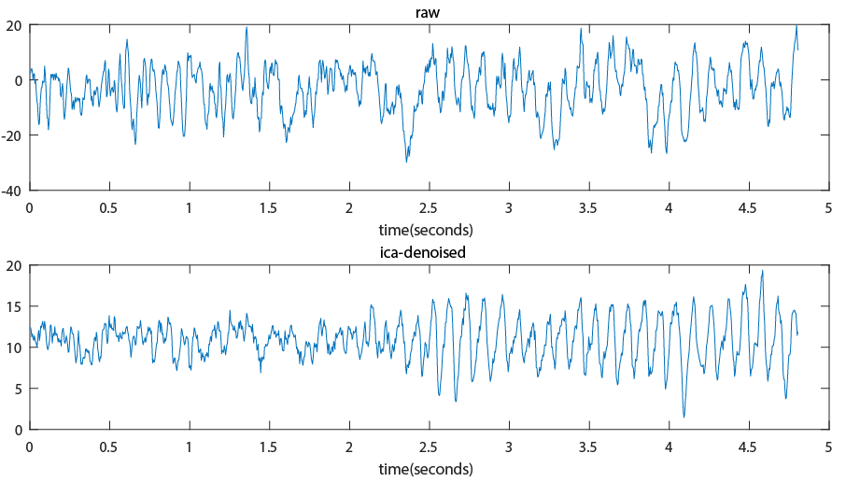
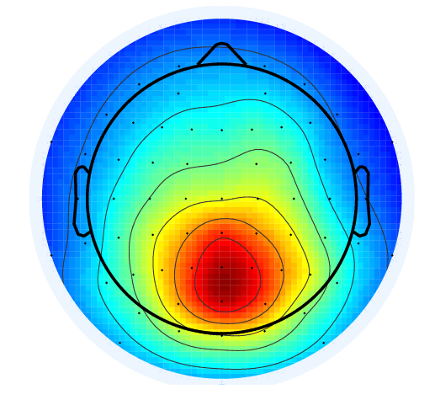
Raw vs ICA-denoised signal
Component weight map

Slide 29
Summary
ICA decomposes multivariate signal into independent non-gaussian signals
Example: 64 channels, 100000 timepoints -> 64 components, 100000 timepoints
Quantifying independence: Mutual information, kurtosis, negentropy
Non-gaussianity and the central limit theorem
ICA requires a preprocessing step using PCA ‘whitening’ to work correctly
ICA algorithm iteratively finds independent components using Newton-Raphson
Widely applicable (multi-channel timeseries analysis, image processing, etc.)
http://arnauddelorme.com/ica_for_dummies/

