Slide 1
CS405/505 Data Mining
Lecture 30

Slide 2
Outline
Some useful tips for the final project:
Gradient boosting classifier hyperparameter tuning
Multi-instance learning
Semi-supervised learning
Remember: 3 things to submit for final project:
1) .txt file with 5000 rows, 2 columns – [id, p(isDefault=1)]
2) .py file(s) with code
3) .pdf for part b (explain your choice of algorithm and attributes, etc.)
Will update datasets tonight (+500 labels, more unlabeled instances)

Slide 3
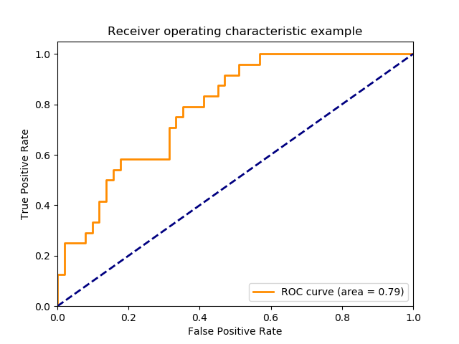
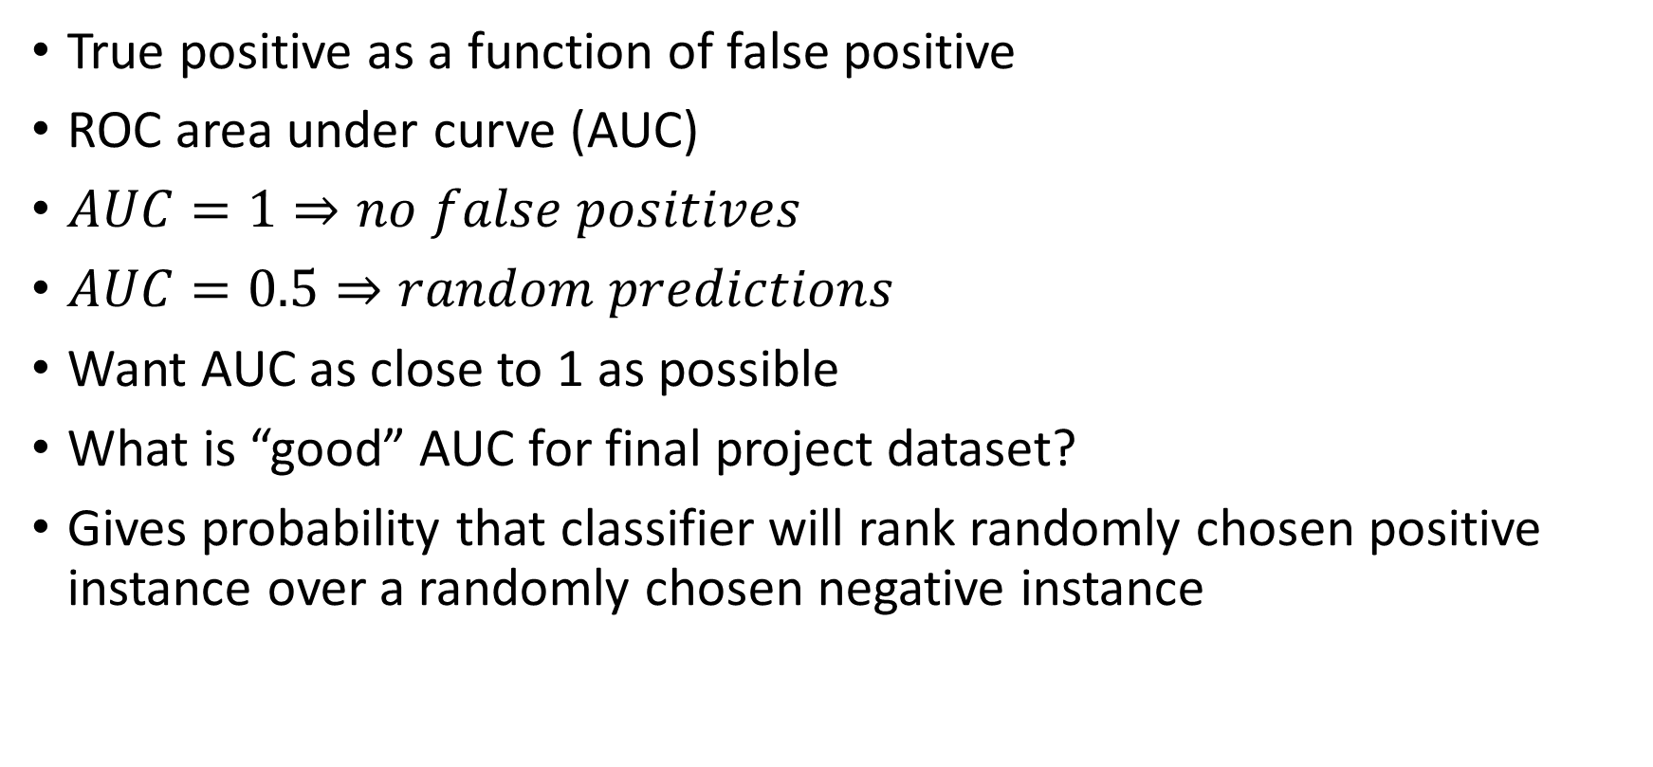
ROC reminder
True positive as a function of false positive
ROC area under curve (AUC)
$AUC=1⇒no false positives$
$AUC=0.5⇒random predictions$
Want AUC as close to 1 as possible
What is “good” AUC for final project dataset?
Gives probability that classifier will rank randomly chosen positive instance over a randomly chosen negative instance

Slide 4
Hyperparameter tuning
Hyper-parameters are parameters that are not directly learned by model
Typically passed as arguments to the model you are constructing
Examples: number of layers/neurons, kernel, tree depth, etc.
Two ways to tune hyperparameters:
1) grid search
2) random search

Slide 5
Multi-instance learning
Each instance is a bag of instances
Two methods:
1) aggregating the input (convert to single-instance learning)
Calculate mean, std, skew, etc over individual instances in bag
2) aggregating the output
Propagate the bag’s label to each individual instance
Classify each individual instance, assign majority class to bag
Our situation: a bag of transactions (withdrawals/deposits)

Slide 6
Semi-supervised learning
Semi-supervised learning is when some of training instances are unlabeled
Want to make use of additional unlabeled data to:
Capture shape of underlying data distribution
Generalize to new samples
Semi-supervised techniques perform best when we have large amount of unlabeled data and small amount of labeled data
Our situation: 10000 labeled instances + 15000 unlabeled instances
(5000 unlabeled in original dataset, plus an additional 10000 unlabeled I just provided)
Sklearn has two functions LabelPropagation and LabelSpreading

Slide 7
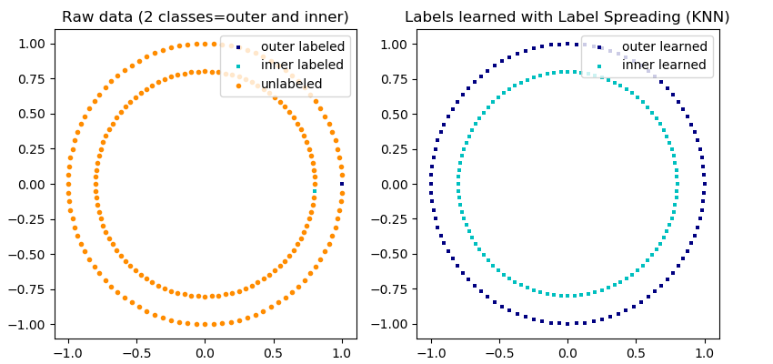
LabelPropagation and LabelSpreading
Use -1 to denote class of unlabeled instance
Label propagation/spreading work by constructing a similarity graph over all items in the input dataset
Example of label-propagation: the structure of the unlabeled observations is consistent with the class structure, thus the class label can be propagated to the unlabeled observations of the training set

