Slide 1
CS405/505 Data Mining
Lecture 15

Slide 2
Assignment #1 solutions
1a: which attribute produces lowest error rate for predicting the outcome of >10 chin-ups?
Answer: waist (4/20)
1b: what is the error rate of rules assigned using attribute from A?
Either 4/20, OR list error rate for each rule separately (vague question)
2a: what is P(>10=yes|weight=heavy,waist=wide,heartrate=slow)?
Answer: 0.0873 (not 0.085!) – rounding errors?
2b: which values of waist, weight, and heartrate yield highest P(>10chinups=yes)
Answer: waist=thin, weight=light, heartrate=fast
3a: which attribute offers the best (most pure) initial split?
Answer: waist (gini = 0.3192)
3b: list all the rules that can be read from the tree and compare them to 1R
If waist=wide and heartrate=slow then >10 chin-ups=no
If waist=thin and heartrate=slow then >10 chin-ups=yes
If waist=thin and heartrate=fast and weight=light then >10 chinups=yes
If waist=wide and heartrate=fast and weight=heavy then >10 chinups=no
Comparison to 1R: same error rate (4/20), root of decision tree is same attribute as rules from 1R

Slide 3


Practice midterm
For midterm, you should know:
Create table for 1R with rules and error rate
Use Bayes’ theorem to compute likelihood and probabilities for Naïve Bayes
Small proof about Bayes’s Theorem/Naïve Bayes
Be able to construct a decision tree (not just root, multiple levels)
Use matrix multiplication
Understand Pearson’s correlation coefficient
wrong
right

Slide 4
Projections
Data often calls for general mathematical transformations of a set of attributes
Some examples:
Subtracting one attribute from another (age, temperature) to yield new attribute
Concatenating several nominal attributes together, to yield a single, longer string
Clustering the attributes, and assigning a new attribute based on nearest cluster
Time series transformations (Fourier Transform)
In math, a projection is a function or mapping that transforms data in some way
Take a dataset with k numeric attributes
If k=3, you can visualize all the data in a 3 dimensional scatter plot
The axes of the scatter plot are defined by the measurements/data acquisition
Using projections, we can define a new set of axes depending on the data itself

Slide 5
Principal component analysis (PCA)
PCA is a statistical procedure that uses an orthogonal transform to convert a set of observations of possibly correlated variables into a set of linearly uncorrelated variables called principle components
First component has largest variance (accounts for as much data as possible)
Successive components have highest variance possible under the constraint that they are orthogonal to preceding components
Computing PCA:
1) Calculate the covariance matrix of the original coordinates
2) Diagonalize the covariance matrix to find the eigenvalues/eigenvectors (eigenvectors are the new axes of transformed space)
Can also be thought of as fitting a k-dimensional ellipsoid to the data (where k is the number of attributes), each axis of ellipsoid represents a principle component

Slide 6
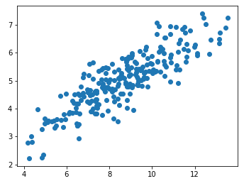
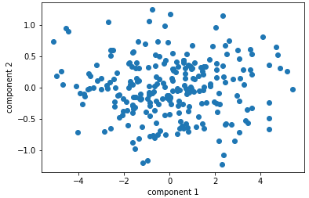
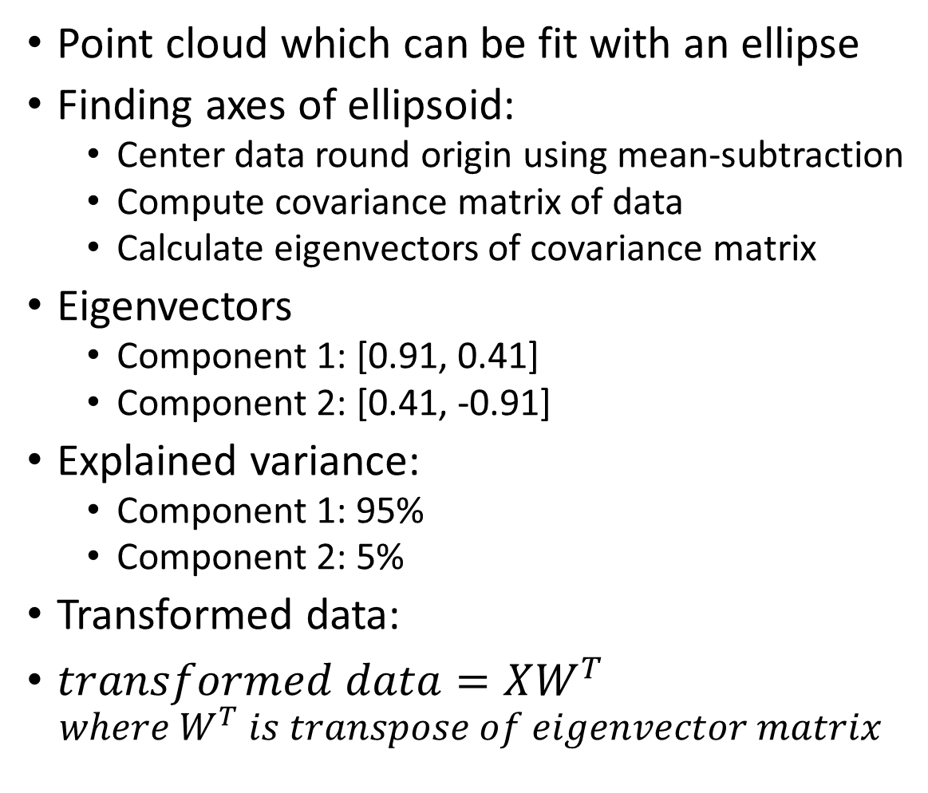
PCA intuition
Point cloud which can be fit with an ellipse
Finding axes of ellipsoid:
Center data round origin using mean-subtraction
Compute covariance matrix of data
Calculate eigenvectors of covariance matrix
Eigenvectors
Component 1: [0.91, 0.41]
Component 2: [0.41, -0.91]
Explained variance:
Component 1: 95%
Component 2: 5%
Transformed data:
$transformed data=XW^{T}$ $where W^{T} is transpose of eigenvector matrix$

Slide 7
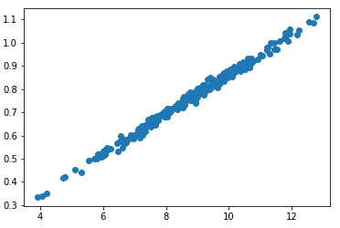
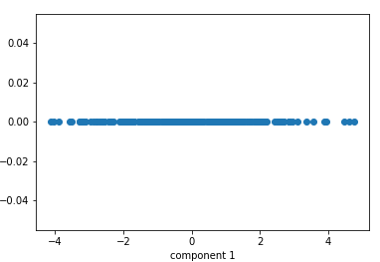
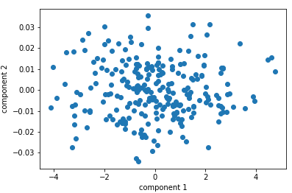
Why do PCA? (Extreme example)
Do we really need 2 axes to represent this dataset?
Do PCA, and leave out second component

Slide 8
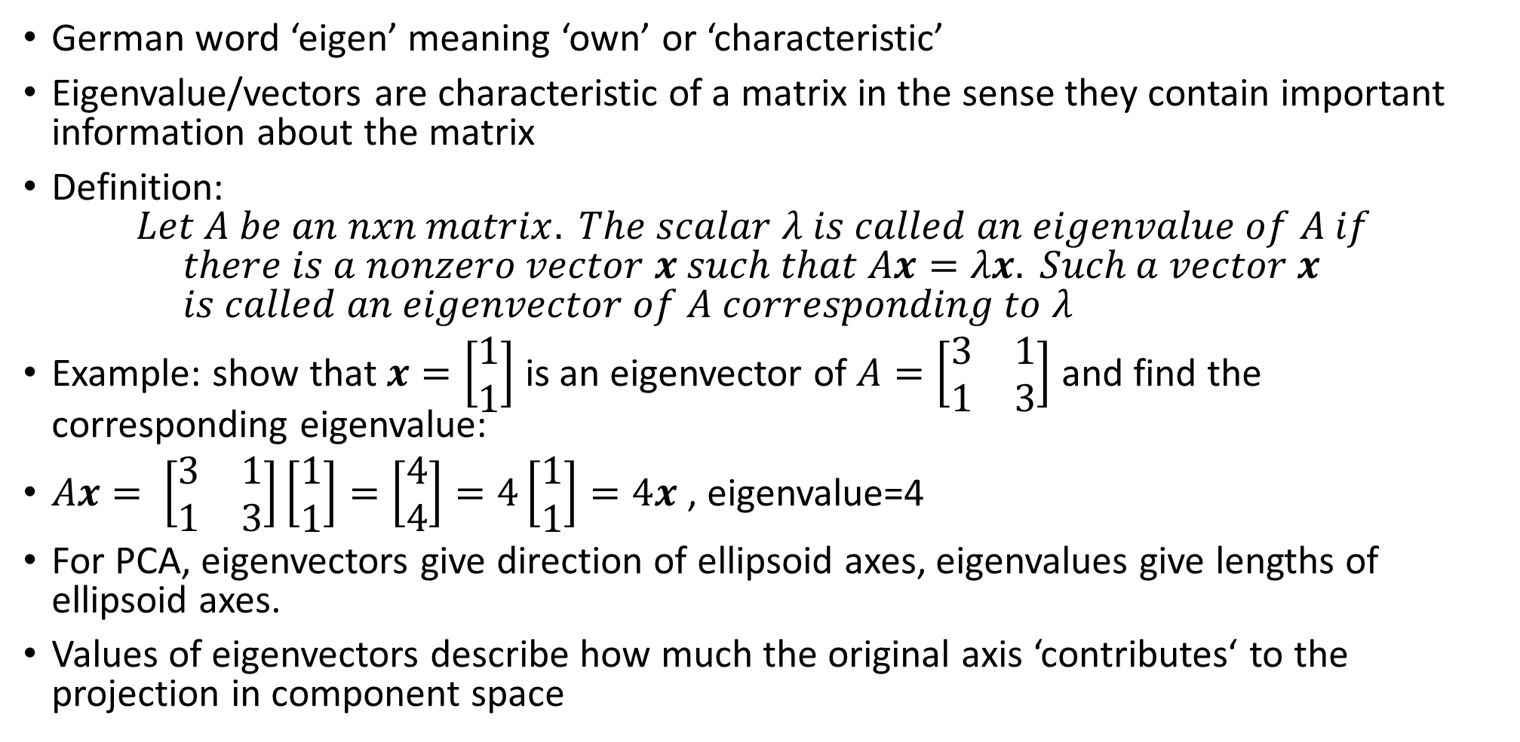
Eigenvalues, Eigenvectors
German word ‘eigen’ meaning ‘own’ or ‘characteristic’
Eigenvalue/vectors are characteristic of a matrix in the sense they contain important information about the matrix
Definition: $Let A be an nxn matrix. The scalar λ is called an eigenvalue of A if$ $there is a nonzero vector x such that Ax=λx. Such a vector x$ $is called an eigenvector of A corresponding to λ$
Example: show that $x=\left[\begin{matrix}1 \\ 1\end{matrix}\right]$ is an eigenvector of $A=\left[\begin{matrix}3 & 1 \\ 1 & 3\end{matrix}\right]$ and find the corresponding eigenvalue:
$Ax= \left[\begin{matrix}3 & 1 \\ 1 & 3\end{matrix}\right]\left[\begin{matrix}1 \\ 1\end{matrix}\right]=\left[\begin{matrix}4 \\ 4\end{matrix}\right]=4\left[\begin{matrix}1 \\ 1\end{matrix}\right]=4x$ , eigenvalue=4
For PCA, eigenvectors give direction of ellipsoid axes, eigenvalues give lengths of ellipsoid axes.
Values of eigenvectors describe how much the original axis ‘contributes‘ to the projection in component space

Slide 9
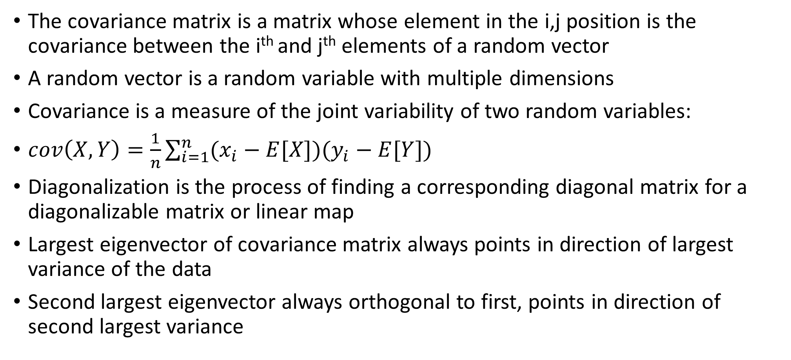
Covariance matrix diagonalization
The covariance matrix is a matrix whose element in the i,j position is the covariance between the i^{th} and j^{th} elements of a random vector
A random vector is a random variable with multiple dimensions
Covariance is a measure of the joint variability of two random variables:
$cov\left(X,Y\right)=\frac{1}{n}\sum_{i=1}^{n}{(x_{i}−E[X])(y_{i}−E[Y])}$
Diagonalization is the process of finding a corresponding diagonal matrix for a diagonalizable matrix or linear map
Largest eigenvector of covariance matrix always points in direction of largest variance of the data
Second largest eigenvector always orthogonal to first, points in direction of second largest variance

Slide 10
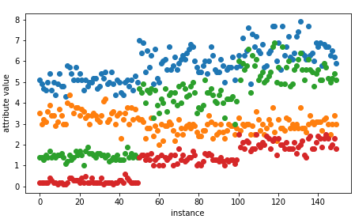
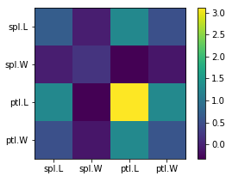
Covariance of iris data
150 columns (instances)
4 rows (attributes)
Raw data
setosa
versicolor
virginica
Covariance matrix
sepal length
sepal width
petal length
petal width

Slide 11
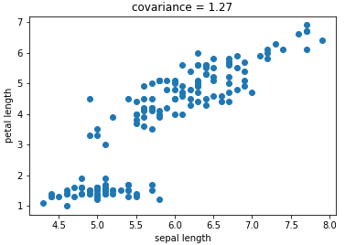
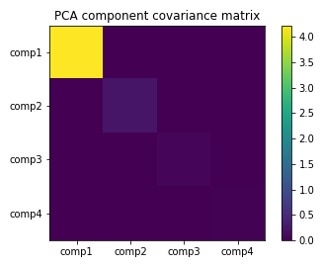
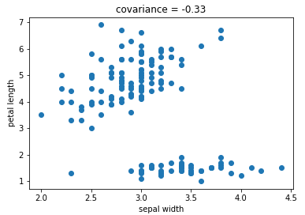
Example: iris data covariance
Covariance matrix
This covariance matrix is not diagonal (covariances are not zero)
Covariance matrix of PCA components is diagonal, because all off-diagonal elements are zero (the covariance between different components is zero)

Slide 12
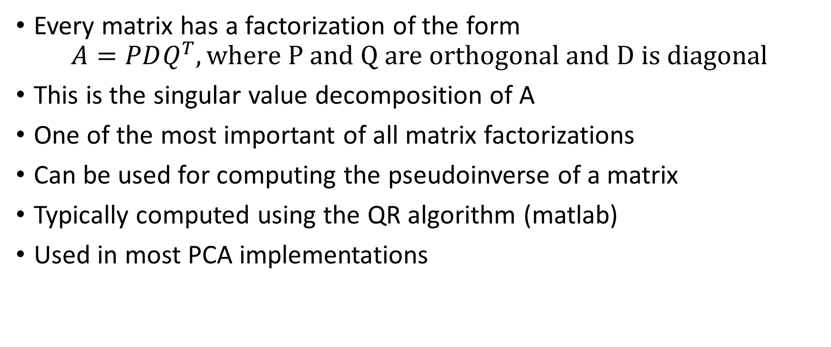
Singular value decomposition
Every matrix has a factorization of the form
$$A=PDQ^{T}, where P and Q are orthogonal and D is diagonal$$
This is the singular value decomposition of A
One of the most important of all matrix factorizations
Can be used for computing the pseudoinverse of a matrix
Typically computed using the QR algorithm (matlab)
Used in most PCA implementations

Slide 13
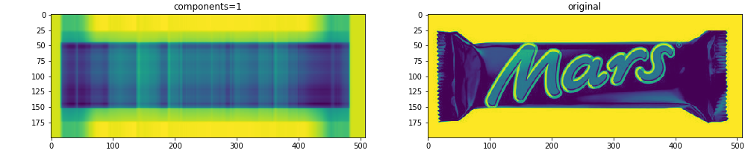
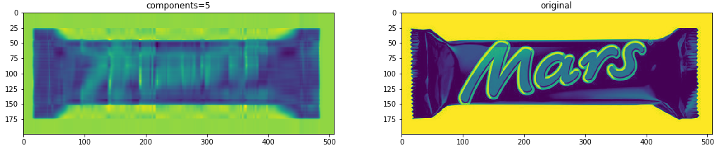
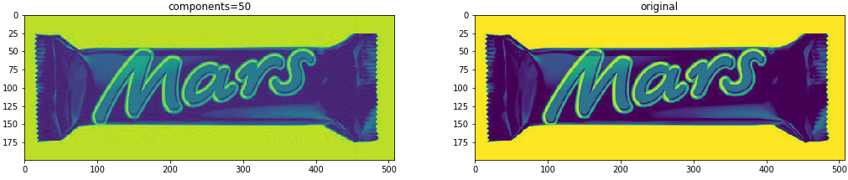
PCA for image compression
99.8% compression
99% compression
90% compression

Slide 14
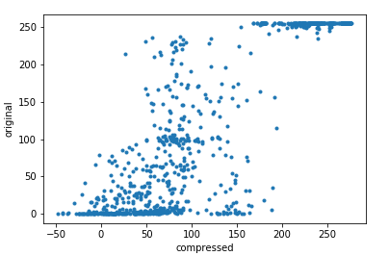
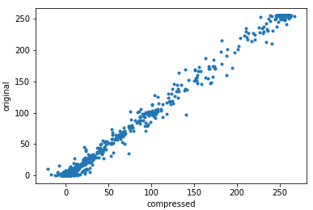
“explained variance”
Accounts for 77% of variance
of original image
Accounts for 99.6% of variance
of original image

Slide 15
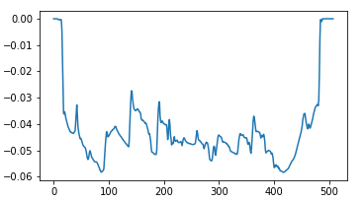


Components (1 component)
(transformed)
(mean_bar)
component 1
X_transformed = np.dot(X, self.components_.T)

Slide 16
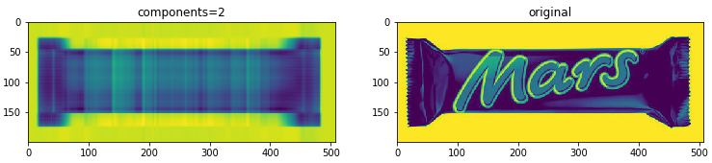
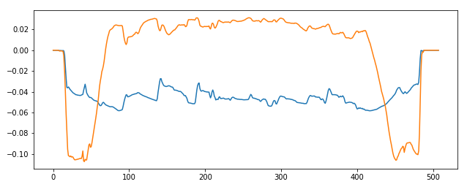
Components (2 components)
component 1,2

Slide 17

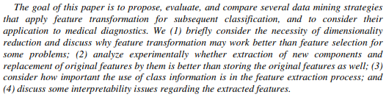
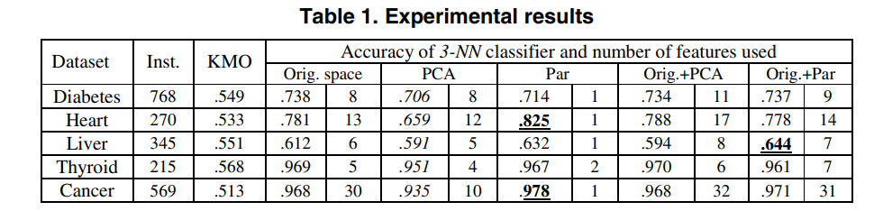
Can preprocessing using PCA hurt classification results?
Short answer: yes
Long answer: “PCA is based on extracting the axes on which data shows the highest variability. Although PCA spreads out data in the new basis, and can be of great help in unsupervised learning, there is no guarantee that the new axes uncovered by PCA are consistent with the discriminatory features of the dataset”
(full article available on Moodle)
https://www.researchgate.net/post/Is_there_a_specific_reason_that_using_PCA_gives_worse_results_than_without_using_it_in_SVM_classification
https://stats.stackexchange.com/questions/52773/what-can-cause-pca-to-worsen-results-of-a-classifier

Slide 18
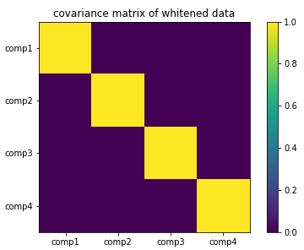
Data whitening
A whitening transform transforms a vector of random variables into a set of new variables whose covariance is the identity matrix
Random variables from a whitened dataset are all uncorrelated with variance=1
Also known as sphering the data (sphering matrix)
Important pre-processing step in time series analysis

Slide 19
Partial least squares regression
Components output by PCA are linear combinations of dataset attributes
PCA considers only the attributes, not the output class (unsupervised)
Partial least squares regression (PLS) takes the class into account when constructing the new coordinate system
PLS finds components (coefficients) that explain lots of variance and are correlated to the class of interest (supervised learning)
Simple algorithm to find attribute coefficients for PLS:
0) standardize input attributes to 0 mean, unit variance (variance=1)
1) attribute coefficients for first PLS direction found by taking dot product between each attribute vector and class vector in turn (each dot product sum becomes attribute’s weight)
2) to find second direction, do same thing but replace original attribute vector with residuals from prediction output by first PLS weight vector
3) continue until you reach the desired number of components

Slide 20
Python examples:
Preprocessing:
Effects of PCA on performance of Gaussian Naïve Bayes classifier
Effects of PLS on performance Gaussian Naïve Bayes classifier

