Slide 1
CS405/505 Data Mining
Lecture 7

Slide 2
Administrative slide
Assignment submission format
On paper, build table for 1R/Naïve Bayes, show full decision tree + calculations
Question 3
Decision tree will not always yield pure nodes
Midterm open book?
Not open book, but I will provide algorithms with handout to refresh memory

Slide 3
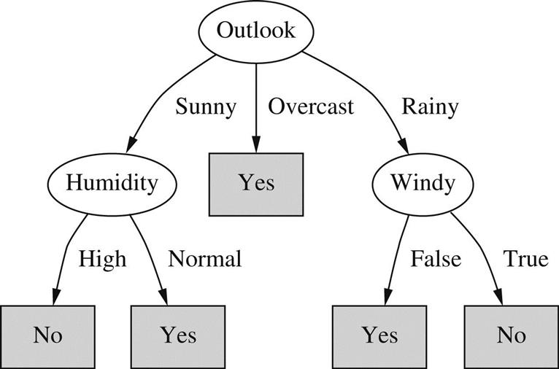
4.6 Linear Models
Decision trees and rules work most naturally with nominal attributes
Can be extended to deal with numerical attributes (Chapter 6, 8)
Linear models work more naturally with numerical attributes/classes

Slide 4
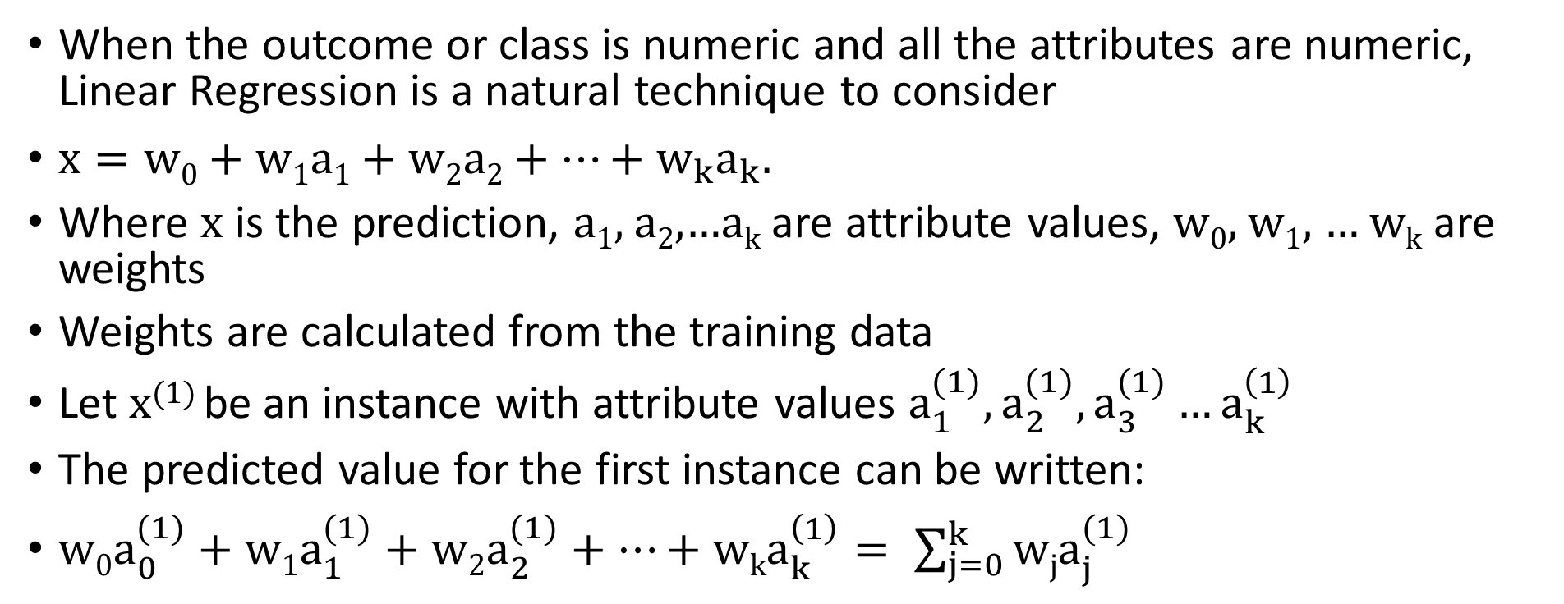
Linear Regression
When the outcome or class is numeric and all the attributes are numeric, Linear Regression is a natural technique to consider
$x=w0+w1a1+w2a2+…+w_{k}a_{k}. .$
Where x is the prediction, a₁, a₂,…a_{k} are attribute values, w₀, w₁, … w_{k} are weights
Weights are calculated from the training data
Let x⁽¹⁾ be an instance with attribute values $a_{1}^{(1)},a_{2}^{(1)},a_{3}^{(1)}…a_{k}^{\left(1\right)}$
The predicted value for the first instance can be written:
$w0a_{0}^{(1)}+w1a_{1}^{(1)}+w2a_{2}^{(1)}+…+wka_{k}^{\left(1\right)}= \sum_{j=0}^{k}{wja_{j}^{(1)}}$

Slide 5
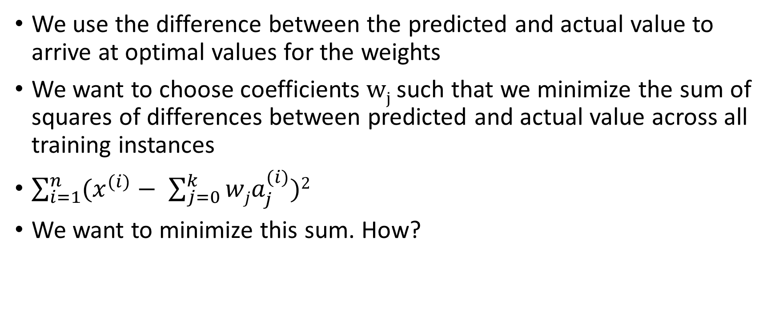
Least squares linear regression
We use the difference between the predicted and actual value to arrive at optimal values for the weights
We want to choose coefficients w_{j} such that we minimize the sum of squares of differences between predicted and actual value across all training instances
$\sum_{i=1}^{n}{(x^{(i)}− \sum_{j=0}^{k}{wja_{j}^{(i)})2}}$
We want to minimize this sum. How?

Slide 6
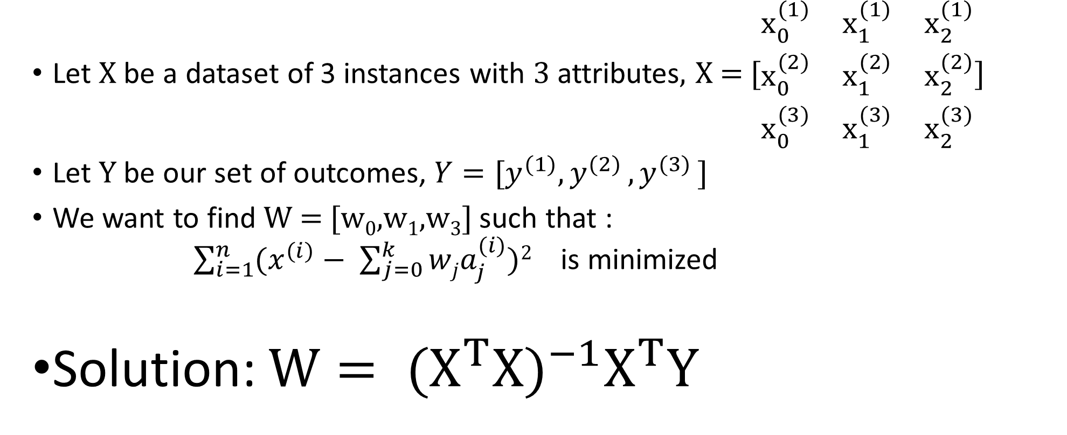
Finding the weights (matrix form)
Let X be a dataset of 3 instances with 3 attributes, X = [$\begin{matrix}x_{0}^{(1)} & x_{1}^{(1)} & x_{2}^{(1)} \\ x_{0}^{(2)} & x_{1}^{(2)} & x_{2}^{(2)} \\ x_{0}^{(3)} & x_{1}^{(3)} & x_{2}^{(3)}\end{matrix}$]
Let Y be our set of outcomes, $Y=[y^{(1)}{,y}^{(2)}{,y}^{(3)}]$
We want to find W = [w₀,w₁,w₃] such that : $\sum_{i=1}^{n}{(x^{(i)}− \sum_{j=0}^{k}{wja_{j}^{(i)})2}}$ is minimized
Solution: $W= {(X^{T}X)}^{−1}X^{T}Y$
linear_regression.py

Slide 7
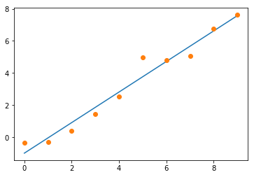
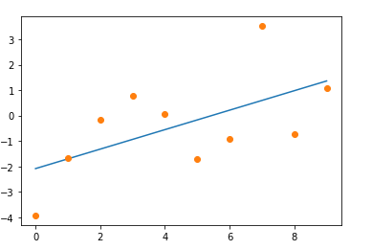
Linear Regression for best fit line
This is the special case where we have instances with only one feature
ie, the numbers on the x-axis
How can we quantify the “goodness of fit”?
Pearson correlation coefficient

Slide 8
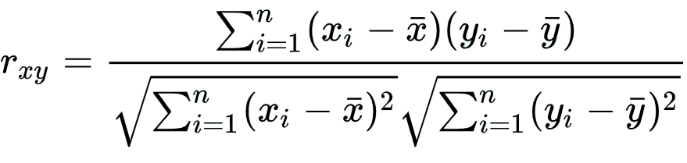
Pearson correlation coefficient (r)

Slide 9
Neuroimaging example in python
Numpy to calculate W and Pearson’s correlation in one line of code
Susceptibility of Pearson’s correlation to noise and outliers
Real world example from my Ph.D. works

