Slide 1
CS405/505 Data Mining
Lecture 14

Slide 2
Data transformations (Chapter 8)
We can apply transformations to raw datasets to make it easier to learn model
In this chapter:
1) attribute selection methods (remove irrelevant/redundant attributes)
2) discretization methods (turn numerical attributes into discrete attributes)
3) data projections (put data into a space more suitable for learning)
Principle component analysis
Independent component analysis
Partial least squares regression
Linear discriminant analysis
Fourier transform
4) Sampling (using less data than is available)
5) Data cleansing (artifact removal, denoising)
6) Transforming multi-class problems into binary class problems

Slide 3
Introduction
Previously, we examined a wide range of machine learning algorithms
Trees, rules, linear models, instance-based schemes, clustering, etc.
How to choose the best algorithm? Try them all?
We can improve performance by using test set or cross validation
There are other ways to improve performance
Massaging the input: 6 different ways (previous slide)
The way we massage the input depends on the algorithm we are using

Slide 4
Attribute selection
Machine learning algorithms are designed to learn which attributes are most important for making decisions
Example: decision trees split on the attribute with most information gain
However, adding random binary attribute to dataset causes decision tree performance to deteriorate by 5-10%
Why? Because at some point down the tree, random attribute will be split on
Instance space fragmentation (decision trees, rules)
Instance-based techniques also susceptible to irrelevant attributes (locality)
# training instances needed increases exponentially with number of irrelevant attributes
Naïve Bayes ignores irrelevant attributes, but susceptible to redundant attributes
Does not fragment instance space, assumes by design all attributes are independent
Common to precede learning with attribute selection stage
Eliminate all but most relevant of attributes

Slide 5
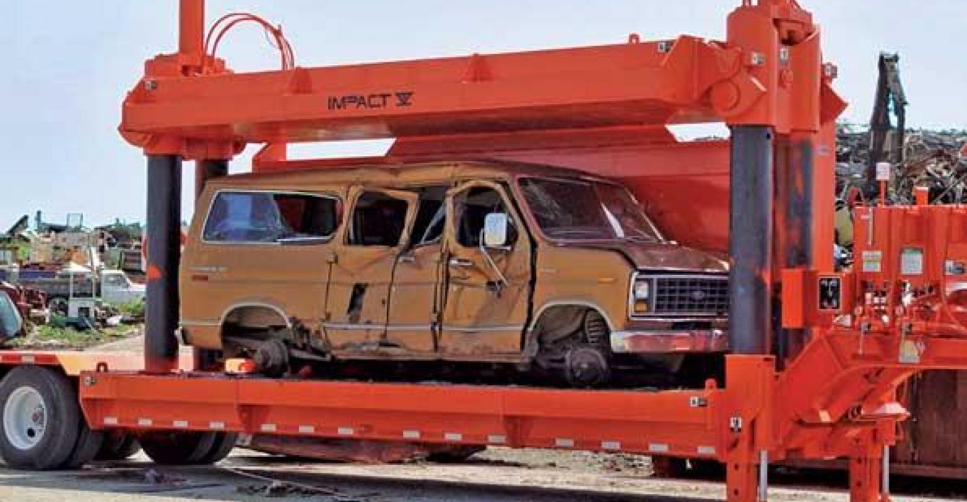
Attribute selection: car crushing example
You want to estimate the cost of crushing a car
You are given the following attributes:
a₁) length of car
a₂) weight of car
a₃) fuel remaining in car
a₄) color of car
Which attributes should you keep for your model, which should you exclude?
Three objectives of attribute selection:
1) improve prediction performance
2) faster, more cost-effective predictors
3) better understand underlying data

Slide 6
Attribute selection
Two fundamentally different approaches to attribute selection
1) Filter method: make independent assessment based on data characteristics
Attribute set is filtered to produce most promising attribute set before learning commences
2) Wrapper method: evaluate algorithm’s performance on subset of attributes
Learning algorithm is wrapped into the selection process
A simple filter method: use just enough attributes to divide up instance space in a way that separates all training instances
Select smallest attribute subset that distinguishes all instances uniquely
Can be found through exhaustive search

Slide 7
Machine learning algorithms for attribute selection
Can also use machine learning algorithms for attribute selection
Example: run decision tree on dataset, and keep only attributes used to build tree
Example: run 1R on dataset, rank attributes based on accuracy
Example: build linear model on dataset, rank attributes based on size of weights
Recursive feature elimination – eliminate worst attribute one at a time
Step 1: build linear model
Step 2: rank attributes based on size of weights
Step 3: remove lowest ranked attribute
Step 4: repeat
Works well for identifying important genes for cancer classification

Slide 8
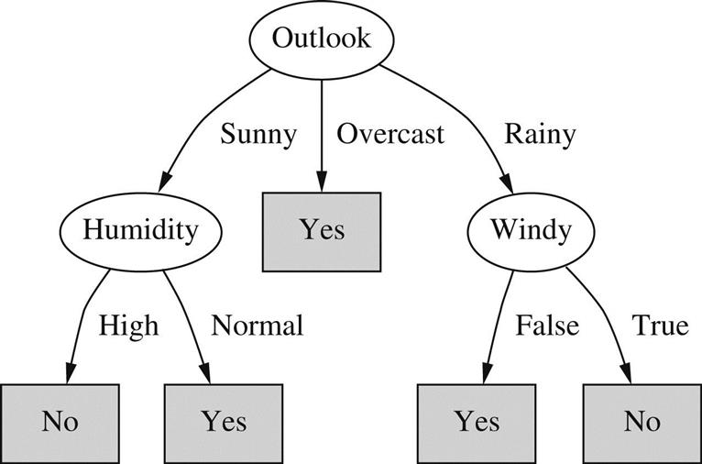
Decision tree for attribute selection
Dataset had 4 attributes:
Outlook
Temperature
Humidity
Windy
Only 3 are used to build tree
Temperature irrelevant?

Slide 9
Instance-based learning methods for attribute selection
Sample instances randomly from training set, check neighbouring records of same and different classes
“near hit” = neighbouring instance with same class
“near miss” = neighbouring instance with different class
Near hit has different value for certain attribute? Decrease attribute importance
Near miss has different value for certain attribute? Increase attribute importance
Repeat many times, take only attributes with high importance
This method will not detect redundant attributes (attributes correlated with other attributes)

Slide 10
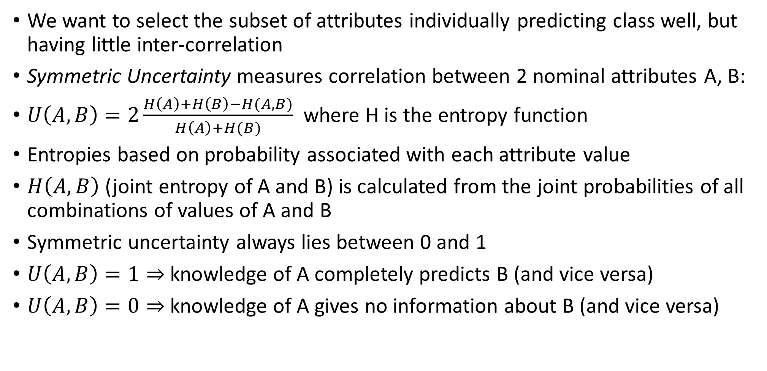
Filter: Eliminating redundant/irrelevant attributes
We want to select the subset of attributes individually predicting class well, but having little inter-correlation
Symmetric Uncertainty measures correlation between 2 nominal attributes A, B:
$U\left(A,B\right)=2\frac{H\left(A\right)+H\left(B\right)−H(A,B)}{H\left(A\right)+H(B)}$ where H is the entropy function
Entropies based on probability associated with each attribute value
$H\left(A,B\right)$ (joint entropy of A and B) is calculated from the joint probabilities of all combinations of values of A and B
Symmetric uncertainty always lies between 0 and 1
$U\left(A,B\right)=1⇒$knowledge of A completely predicts B (and vice versa)
$U\left(A,B\right)=0⇒$knowledge of A gives no information about B (and vice versa)

Slide 11
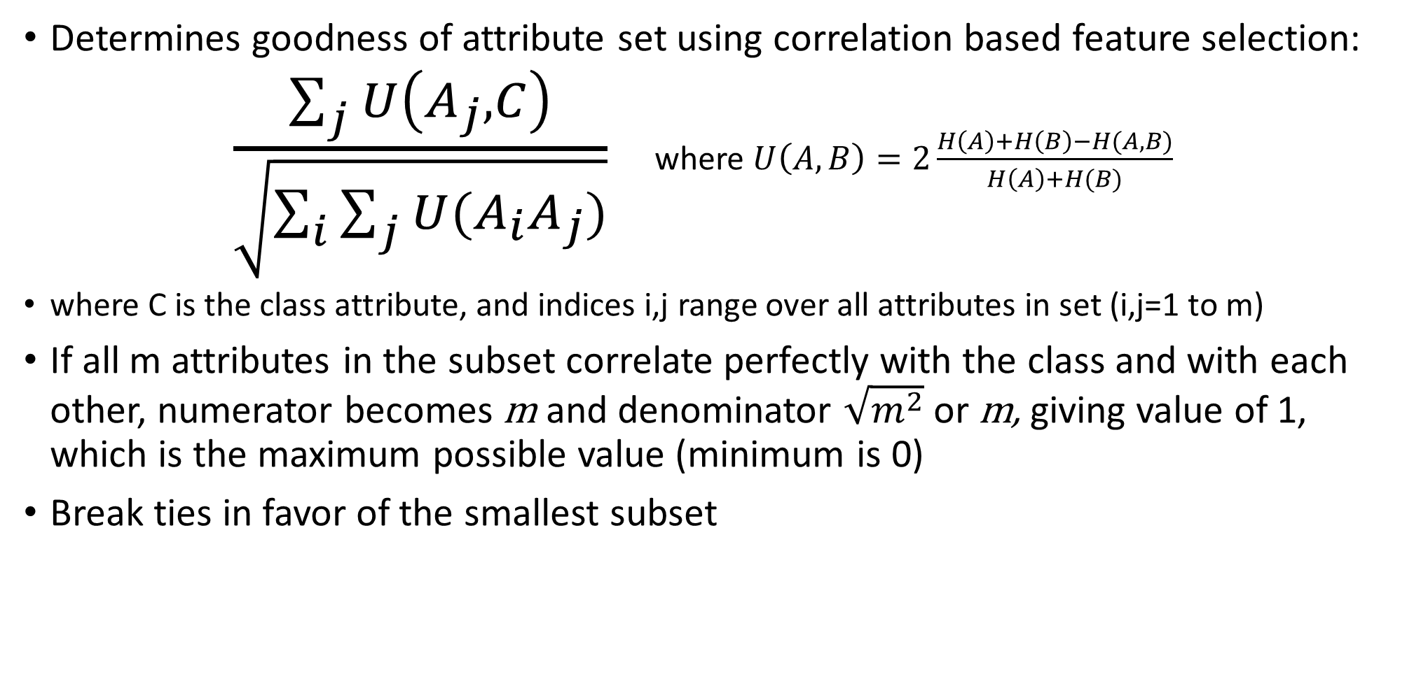
Filter: Eliminating redundant/irrelevant attributes
Determines goodness of attribute set using correlation based feature selection:
$\frac{\sum_{j}{U\left(A_{j},C\right)}}{\sqrt{\sum_{i}{\sum_{j}{U(A_{i}A_{j})}}}}$ where $U\left(A,B\right)=2\frac{H\left(A\right)+H\left(B\right)−H(A,B)}{H\left(A\right)+H(B)}$
where C is the class attribute, and indices i,j range over all attributes in set (i,j=1 to m)
If all m attributes in the subset correlate perfectly with the class and with each other, numerator becomes m and denominator $\sqrt{m^{2}}$ or m, giving value of 1, which is the maximum possible value (minimum is 0)
Break ties in favor of the smallest subset

Slide 12
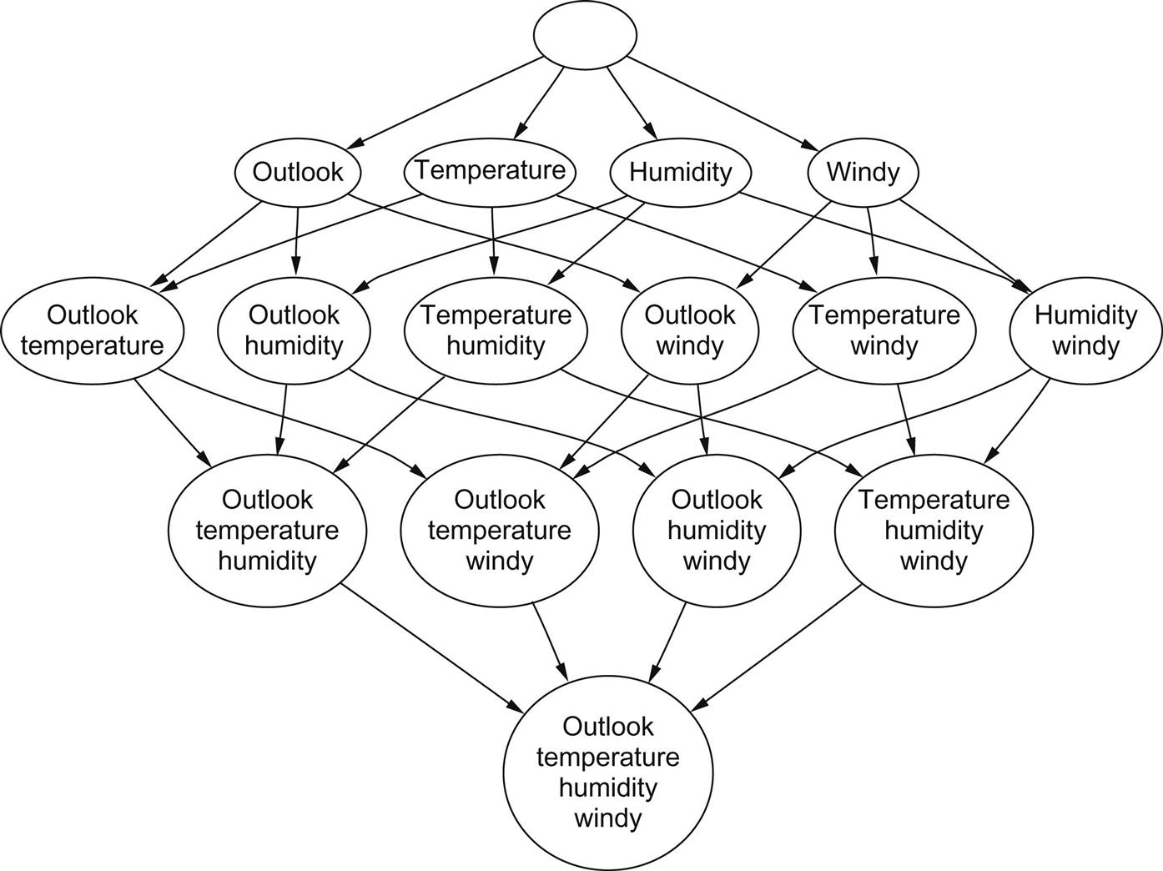
Wrapper: Searching the attribute space
Most attribute selection methods involve searching the space of attributes for subset most likely to best predict the class
Number of possible attribute subsets increases exponentially with number of attributes
Typically, space is searched greedily either from top to bottom or bottom to top
Top to bottom: forward selection, starting with no attributes and adding them one at a time.
Bottom to top: backward elimination, starting with full set and deleting attributes one at a time.

Slide 13
Forward selection and backward elimination
Forward selection: each attribute not already in the current subset is tentatively added and resulting set of attributes evaluated (will see how in following section)
The evaluation produces numeric measure of expected performance of subset
If no attribute improves expected performance, forward selection ends
This is a standard greedy search procedure to find locally optimal attribute set
Backward elimination: similar to forward selection but starting with full attribute set, and tentatively removing attributes and evaluating expected performance.
Can add small bias term to both procedures to encourage smaller attribute sets
More sophisticated search schemes:
Best-first search (keeps a list of all attribute subsets, can revisit earlier configurations)
Beam search (has maximum fixed number of attributes that can be selected)
Genetic algorithm search (uses random perturbations of a current list of candidate subsets)

Slide 14
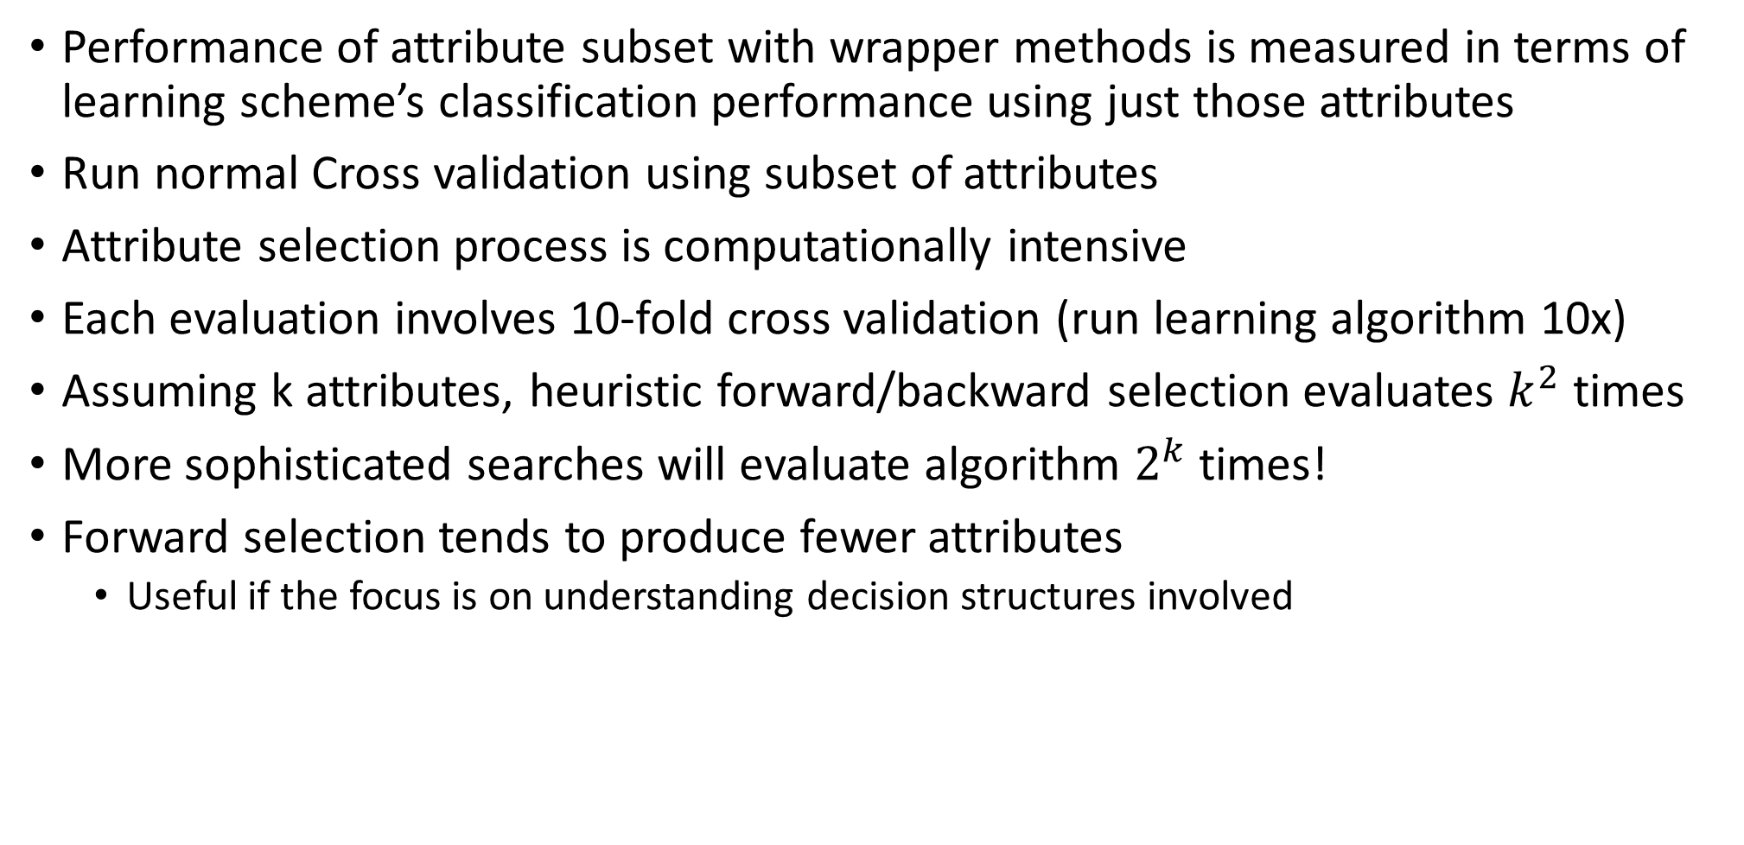
Evaluating performance of wrapper methods
Performance of attribute subset with wrapper methods is measured in terms of learning scheme’s classification performance using just those attributes
Run normal Cross validation using subset of attributes
Attribute selection process is computationally intensive
Each evaluation involves 10-fold cross validation (run learning algorithm 10x)
Assuming k attributes, heuristic forward/backward selection evaluates $k^{2}$ times
More sophisticated searches will evaluate algorithm $2^{k}$ times!
Forward selection tends to produce fewer attributes
Useful if the focus is on understanding decision structures involved

Slide 15
Race search
Want to decide early to stop evaluating a subset of attributes (as soon as it becomes apparent it will not lead to higher accuracy than another subset)
Use paired statistical significance test (t-test), between the classifier using attributes currently under evaluation, and all other classifiers obtained so far
Set up the paired t-test as follows:
Consider two classifiers, A and B
For each instance, add a number to both lists representing A and B’s relative performance
Example: classifier A correctly classifies instance i, classifier B incorrectly classifies i
In this case, element i of classifier A’s list would be set to 1, and -1 for classifier B’s list
If both classifiers classify i the same way, element i of both lists is assigned 0
Perform paired t-test between list A and list B, to see if one classifier is significantly better
This methodology is called the race search
Race search allows us to prematurely terminate cross-validation

Slide 16
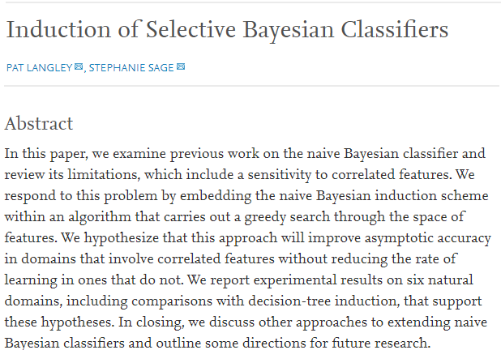
Success story
Scheme-specific attribute selection has shown good results for Naïve Bayes
Naïve Bayes deals well with random attributes, but can be misled in the presence of dependencies amongst attributes or redundant attributes
Simple use of forward selection can avoid this problem
Forward selection able to detect when redundant attribute is about to be added
Evaluate performance of Naïve Bayes on training set for every step of forward selection, only use subset of attributes for which Naïve Bayes performs well
Selective Naïve Bayes
Performs well and reliably in practice

Slide 17
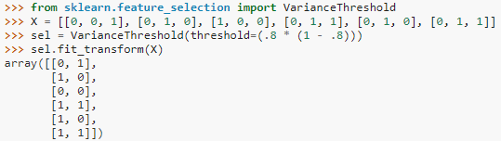
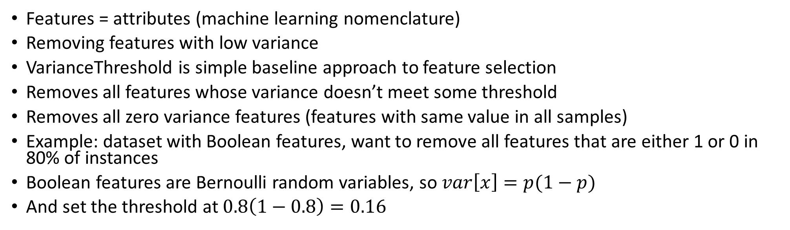
Feature selection with sklearn
Features = attributes (machine learning nomenclature)
Removing features with low variance
VarianceThreshold is simple baseline approach to feature selection
Removes all features whose variance doesn’t meet some threshold
Removes all zero variance features (features with same value in all samples)
Example: dataset with Boolean features, want to remove all features that are either 1 or 0 in 80% of instances
Boolean features are Bernoulli random variables, so $var\left[x\right]=p(1−p)$
And set the threshold at $0.8\left(1−0.8\right)=0.16$
As expected, VarianceThreshold has removed the first column which has a probability p=5/6 > 0.8 of containing a zero
https://scikit-learn.org/stable/modules/feature_selection.html

Slide 18
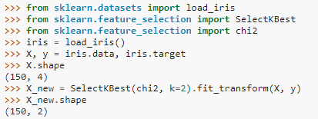
Univariate feature selection with sklearn
Univariate feature selection selects the best features based on univariate statistical tests
Can be seen as a pre-processing step to an estimator
Several functions:
SelectKBest (removes all but k highest scoring features)
SelectPercentile (removes all but user-specified highest scoring percentage of features)
GenericUnivariateSelect (selects best univariate selection strategy with hyperparameter search estimator)
Example: perform chi-squared to samples to retrieve only two best features:
Methods based on F-test estimate degree of linear dependency between two features. Other methods like mutual information can capture any kind of statistical dependency, but being nonparametric require more samples for accurate estimation.
https://scikit-learn.org/stable/modules/feature_selection.html

Slide 19
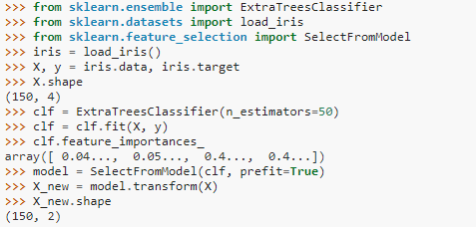
Tree based feature selection in sklearn
Tree based estimates can be used to compute feature importance
Irrelevant features can then be discarded
https://scikit-learn.org/stable/modules/feature_selection.html

Slide 20
Is attribute selection even necessary in 2019?
Usual reasons for attribute selection are:
1) efficiency – faster to fit a smaller model, cheaper to collect fewer predictors
2) interpretability – knowing ‘important’ attributes gives insight into problem
Assume the goal is simply prediction on unseen test set
It is now known that many attribute selection methods are ineffective/dangerous
The model should do the work of finding the best attributes
Is there any reason to do attribute selection if only goal is predictive accuracy?
Google claims to use over 5 billion attributes in current version of PageRank
Recent shift (since ~2015) towards convolutional neural networks that can handle high dimensional data (millions of attributes) effectively
https://stats.stackexchange.com/questions/215154/variable-selection-for-predictive-modeling-really-needed-in-2016

Slide 21
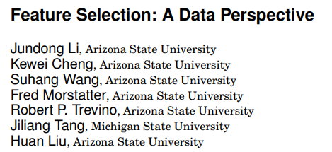
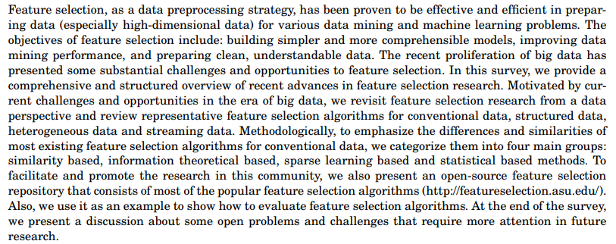
(2019)
(full article available on Moodle)

Slide 22
Summary
1) attribute selection used to improve:
Performance (decrease risk of overfitting)
Speed (faster to learn on fewer attributes)
Interpretability
2) two basic types of attribute selection
Filter method
Wrapper method
3) Statistical tests often used to evaluate performance on different attributes
T-test
Chi-squared
F-test
Next lecture: projections

