Slide 1
CS405/505 Data Mining
Lecture 8

Slide 2
Assignment 1
Building decision tree – children cannot split on same attribute as parent, but siblings can split on same attribute
parent
Waist=wide
Waist=thin
sibling
sibling
Hr=fast
Hr=slow
Hr=fast
Hr=slow

Slide 3
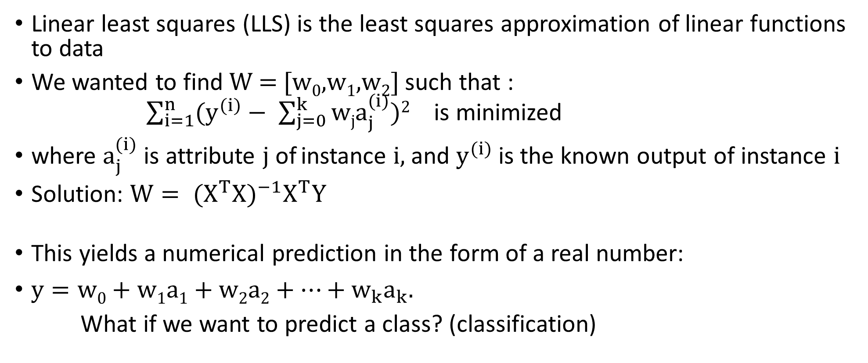
Linear least squares
Linear least squares (LLS) is the least squares approximation of linear functions to data
We wanted to find W = [w₀,w₁,w₂] such that : $\sum_{i=1}^{n}{(y^{(i)}− \sum_{j=0}^{k}{wja_{j}^{(i)})2}}$ is minimized
where $a_{j}^{(i)}$ is attribute j of instance i, and $y^{(i)}$ is the known output of instance i
Solution: $W= {(X^{T}X)}^{−1}X^{T}Y$
This yields a numerical prediction in the form of a real number:
$y=w0+w1a1+w2a2+…+w_{k}a_{k}. .$
What if we want to predict a class? (classification)

Slide 4
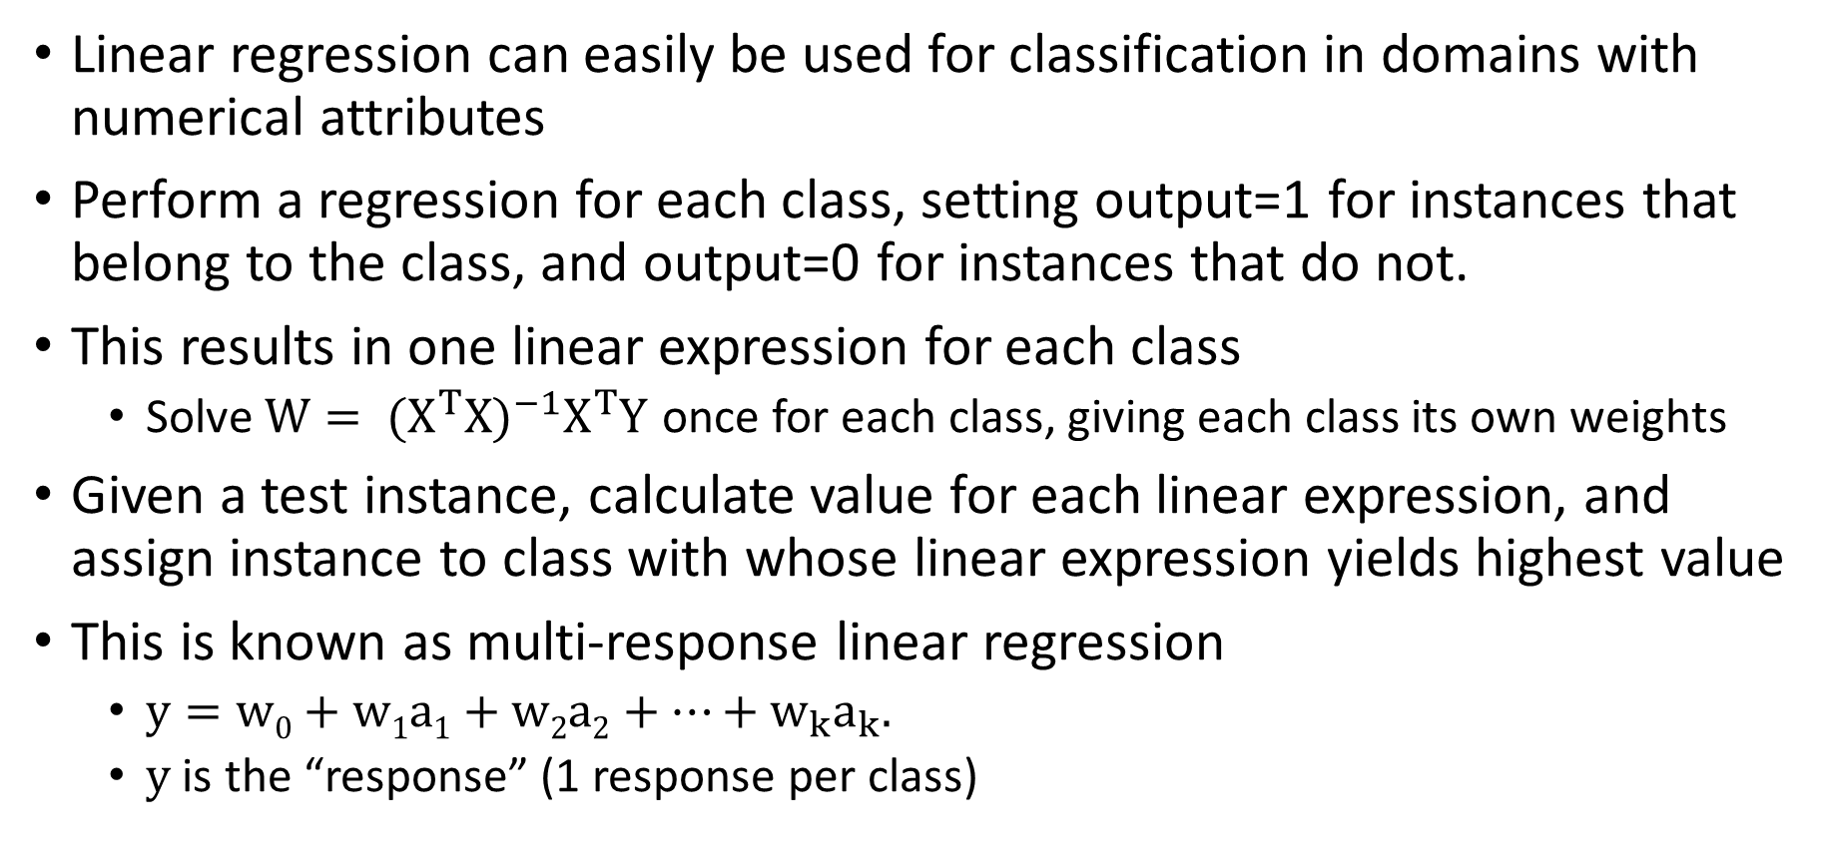
Linear Classification:
Linear regression can easily be used for classification in domains with numerical attributes
Perform a regression for each class, setting output=1 for instances that belong to the class, and output=0 for instances that do not.
This results in one linear expression for each class
Solve $W= {(X^{T}X)}^{−1}X^{T}Y$ once for each class, giving each class its own weights
Given a test instance, calculate value for each linear expression, and assign instance to class with whose linear expression yields highest value
This is known as multi-response linear regression
$y=w0+w1a1+w2a2+…+w_{k}a_{k}. .$
y is the “response” (1 response per class)

Slide 5
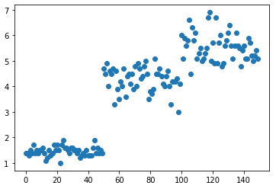
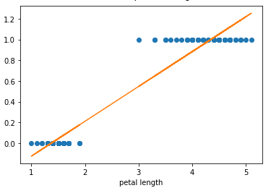
Example of Linear classification
Iris dataset. We want to use linear regression to classify a flower
For this example, use only setosa and versicolor (2 classes), use only petal length attribute
virginicas
versicolors
petal length
versicolors
setosas
setosas
Linear expression for versicolor class using petal length attribute:
$$versicolor=−0.46+0.33∗\left(petal length\right)$$

Slide 6
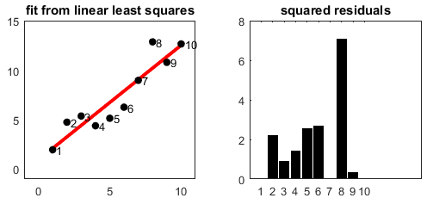
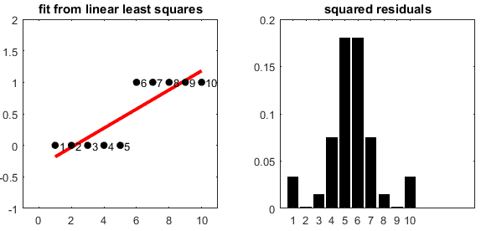
Least squares regression and the Normal distribution
Important assumptions of Linear Least Squares:
Residual error has mean=0
Residuals are uncorrelated (cannot be predicted based on residual from previous observations)
Residuals are normally distributed with same standard deviation
A) typical case where the assumptions hold
B) prediction for a single class from multi-response linear regression (setting output to zero or 1)
Slope=0.156, intercept=-0.33
The response (y) is not a probability
A)
B)

Slide 7
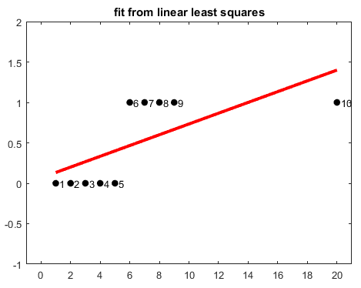
Extreme example

Slide 8
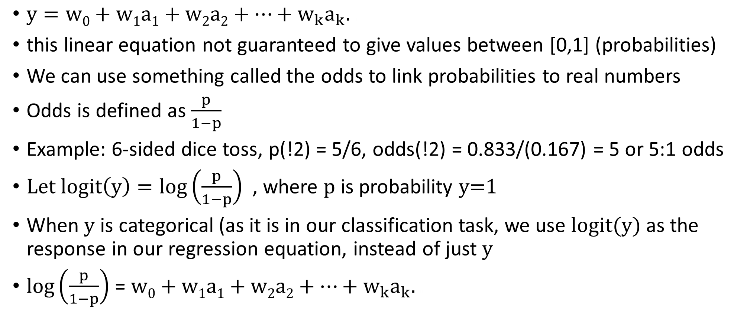
The Logit Link function
$y=w0+w1a1+w2a2+…+w_{k}a_{k}. .$
this linear equation not guaranteed to give values between [0,1] (probabilities)
We can use something called the odds to link probabilities to real numbers
Odds is defined as $\frac{p}{1−p}$
Example: 6-sided dice toss, p(!2) = 5/6, odds(!2) = 0.833/(0.167) = 5 or 5:1 odds
$Let logit\left(y\right)=\log\left(\frac{p}{1−p}\right)$, where p is probability y=1
When y is categorical (as it is in our classification task, we use logit(y) as the response in our regression equation, instead of just y
$\log\left(\frac{p}{1−p}\right)$ = $w0+w1a1+w2a2+…+w_{k}a_{k}. .$

Slide 9
Logistic regression
In logistic regression we are estimating an unknown p for any given linear combination of the independent variables
The log of the odds ratio (the Logit Link function or Logit) maps the linear combination of variables that could result in any value onto the Bernoulli probability distribution with a domain from 0 to 1
Logistic regression performs classification, not regression
In probability theory and statistics, the Bernoulli distribution is the discrete probability distribution of a random variable which takes the value 1 with probability p and the value 0 with probability 1-p

Slide 10
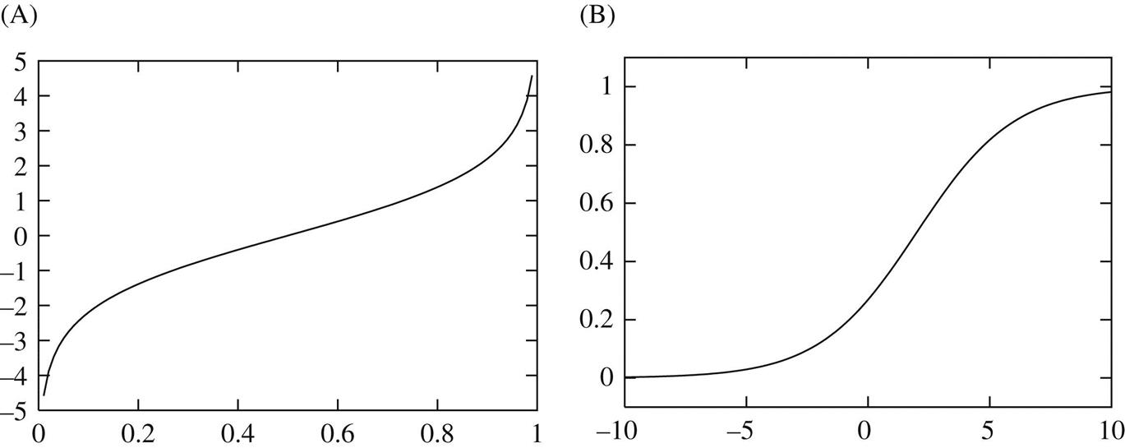
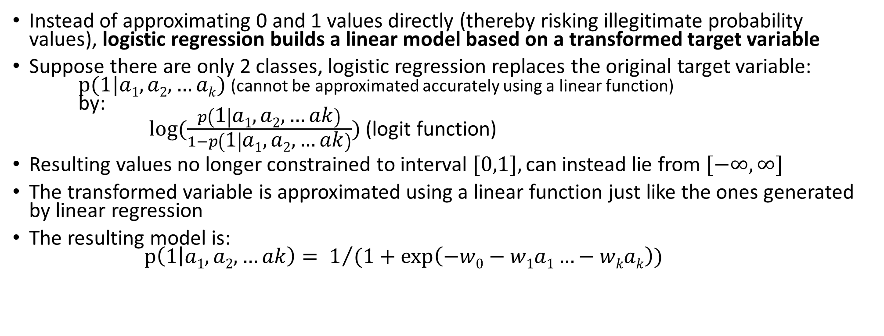
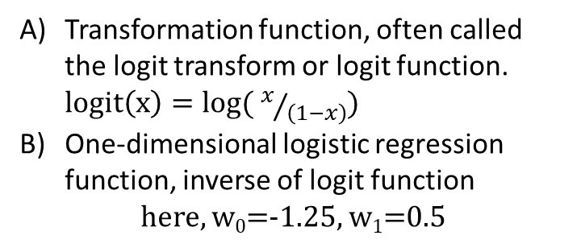
Logistic Regression and the Logit transformation
Instead of approximating 0 and 1 values directly (thereby risking illegitimate probability values), logistic regression builds a linear model based on a transformed target variable
Suppose there are only 2 classes, logistic regression replaces the original target variable: $p(1|a1,a2,…ak)$ (cannot be approximated accurately using a linear function) by: $log⁡(\frac{p\left(1 | a1,a2,…ak\right)}{1−p\left(1 | a1,a2,…ak\right)})$ (logit function)
Resulting values no longer constrained to interval [0,1], can instead lie from $[−∞,∞]$
The transformed variable is approximated using a linear function just like the ones generated by linear regression
The resulting model is: $p\left(1 | a1,a2,…ak\right)= 1/{(1+\exp\left(−w0−w1a1…−wkak\right))}$
Transformation function, often called the logit transform or logit function. $logit\left(x\right)=log( x/{\left(1−x\right)})$
One-dimensional logistic regression function, inverse of logit function
here, w₀=-1.25, w₁=0.5

Slide 11
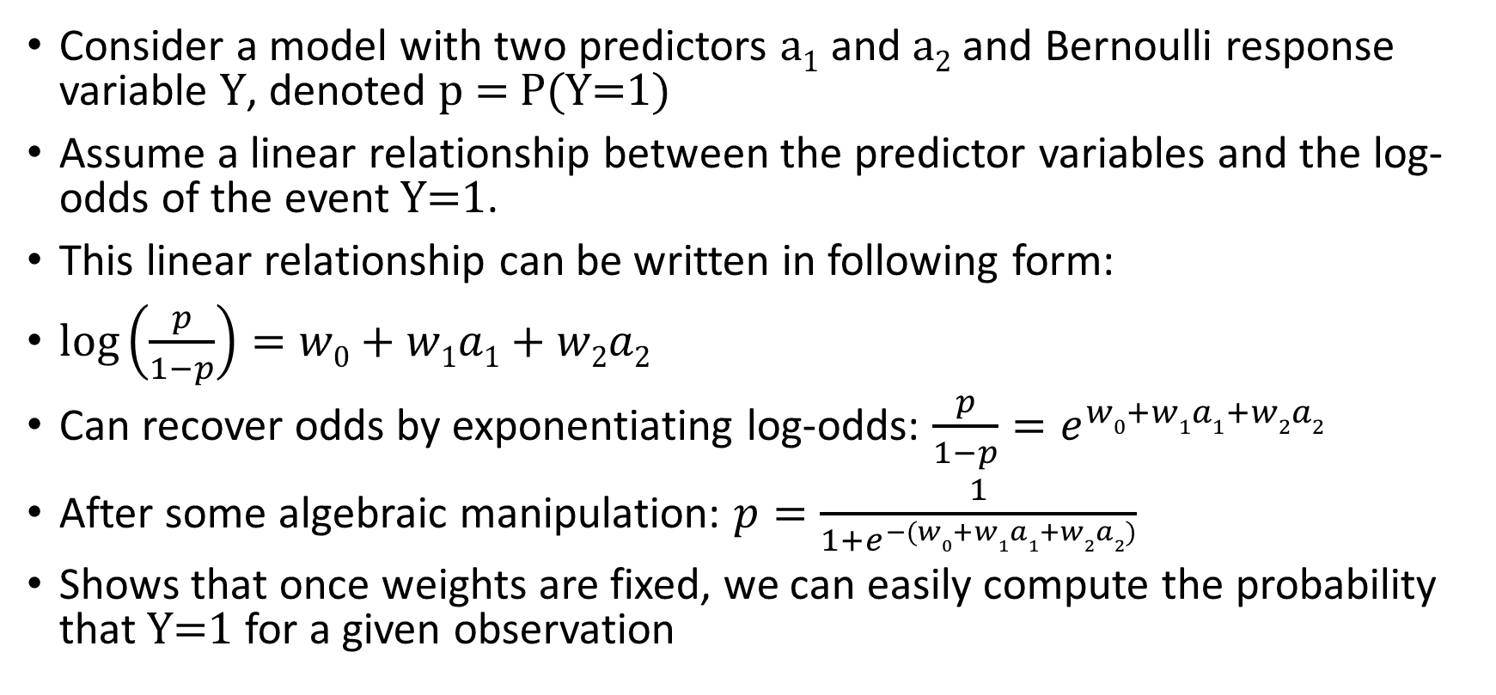
Logistic model example
Consider a model with two predictors a₁ and a₂ and Bernoulli response variable Y, denoted p = P(Y=1)
Assume a linear relationship between the predictor variables and the log-odds of the event Y=1.
This linear relationship can be written in following form:
$\log\left(\frac{p}{1−p}\right)=w0+w1a1+w2a2$
Can recover odds by exponentiating log-odds: $\frac{p}{1−p}=e^{w0+w1a1+w2a2}$
After some algebraic manipulation: $p=\frac{1}{1+e^{−(w0+w1a1+w2a2)}}$
Shows that once weights are fixed, we can easily compute the probability that Y=1 for a given observation

Slide 12
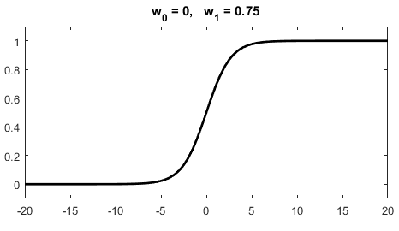
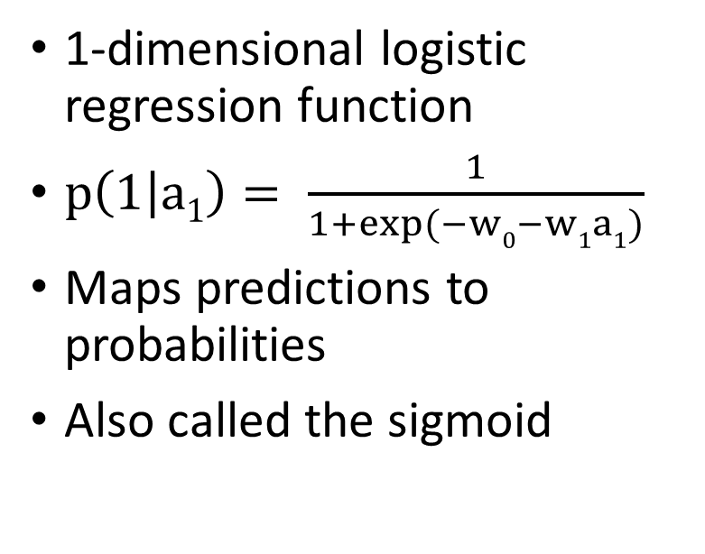
Logistic regression function
1-dimensional logistic regression function
$p\left(1 | a1\right)= \frac{1}{1+exp⁡(−w0−w1a1)}$
Maps predictions to probabilities
Also called the sigmoid

Slide 13
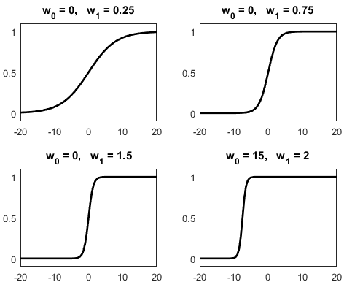

Different logistic regression function (sigmoid) shapes
$p\left(1 | a1\right)= \frac{1}{1+exp⁡(−w0−w1a1)}$
w₀ is the ‘intercept’
w₁ is the ‘slope’

Slide 14
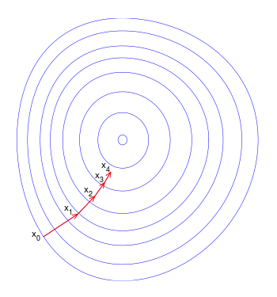
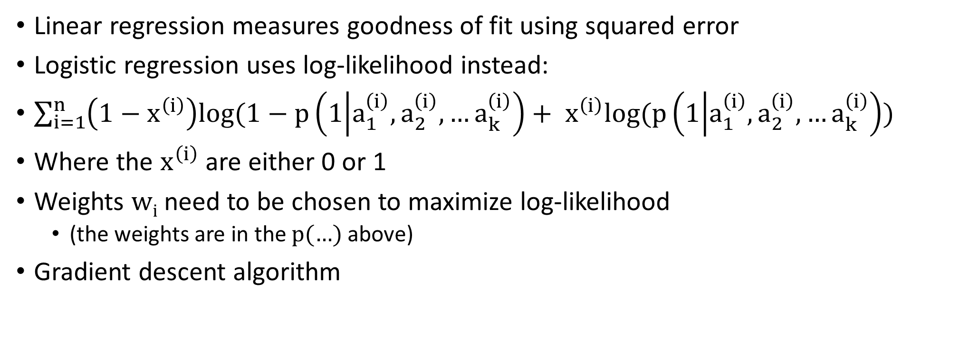
Finding the weights in logistic regression
Linear regression measures goodness of fit using squared error
Logistic regression uses log-likelihood instead:
$\sum_{i=1}^{n}{\left(1−x^{\left(i\right)}\right)log⁡(1−p\left(1 | a_{1}^{\left(i\right)},a_{2}^{\left(i\right)},…a_{k}^{\left(i\right)}\right)+ x^{\left(i\right)}log⁡(p\left(1 | a_{1}^{\left(i\right)},a_{2}^{\left(i\right)},…a_{k}^{\left(i\right)}\right))}$
Where the $x^{\left(i\right)}$ are either 0 or 1
Weights w_{i} need to be chosen to maximize log-likelihood
(the weights are in the p(…) above)
Gradient descent algorithm

Slide 15
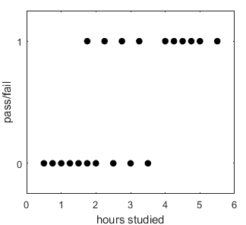
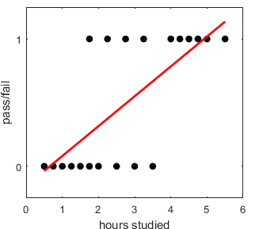
Example: probability of passing an exam
A group of 20 students spends between 0 and 6 hours studying for an exam. How does the number of hours studying affect the probability of the student passing the exam?
Least squares linear regression gives intercept=-0.154, slope=0.235
3 hours studied = -0.154 + (0.235)*3 = 0.55, ok, but what does this mean? (its not a probability)
What does logistic regression give?
Turn to python for the solution

Slide 16
Recap
Linear classification violates key assumptions of linear least squares
Use logistic regression for numerical prediction instead
We will see the sigmoid more when we look at neural networks
Next class: perceptron

