Slide 1
CS405/505 Data Mining
Lecture 9

Slide 2
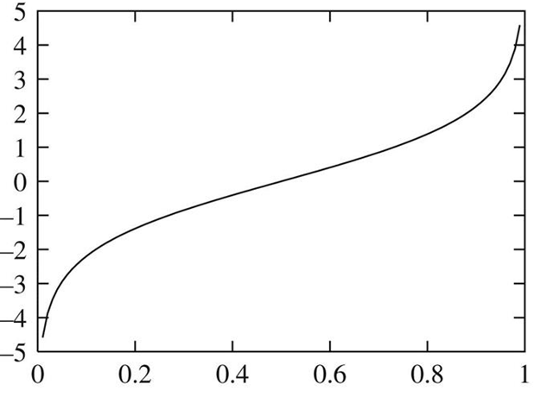
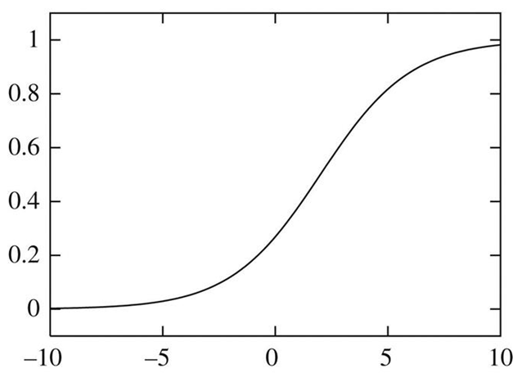
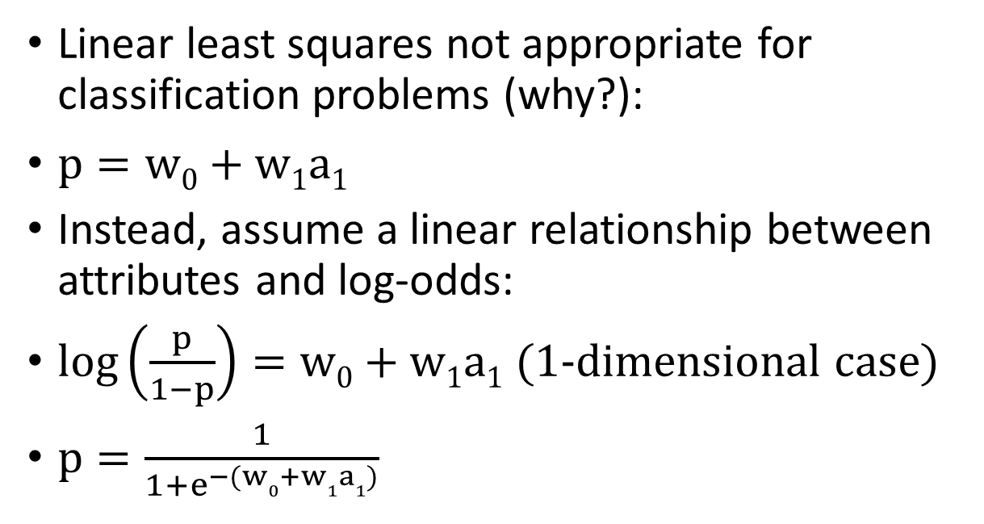
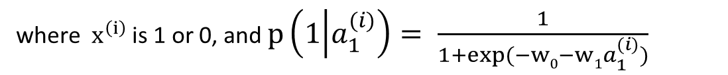

Logistic Regression recap
Logit transform
Linear least squares not appropriate for classification problems (why?):
$p=w0+w1a1$
Instead, assume a linear relationship between attributes and log-odds:
$\log\left(\frac{p}{1−p}\right)=w0+w1a1$ (1-dimensional case)
$p=\frac{1}{1+e^{−(w0+w1a1)}}$
Logistic regression function (sigmoid)
Solve for weights using gradient descent on maximum likelihood function:
$$\sum_{i=1}^{n}{\left(1−x^{\left(i\right)}\right)log⁡(1−p\left(1 | a_{1}^{\left(i\right)} \right)+ x^{\left(i\right)}log⁡(p\left(1 | a_{1}^{\left(i\right)}\right))}$$
where $x^{\left(i\right)}$ is 1 or 0, and $p\left(1 | a_{1}^{(i)}\right)= \frac{1}{1+exp⁡(−w0−w1a_{1}^{(i)})}$
https://datascience.stackexchange.com/questions/53226/what-is-the-purpose-of-logit-function-at-what-stage-of-model-building-process-t

Slide 3
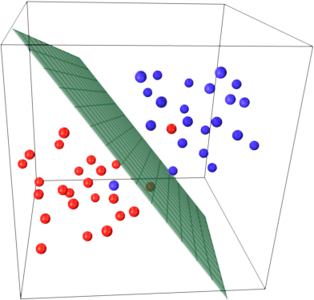
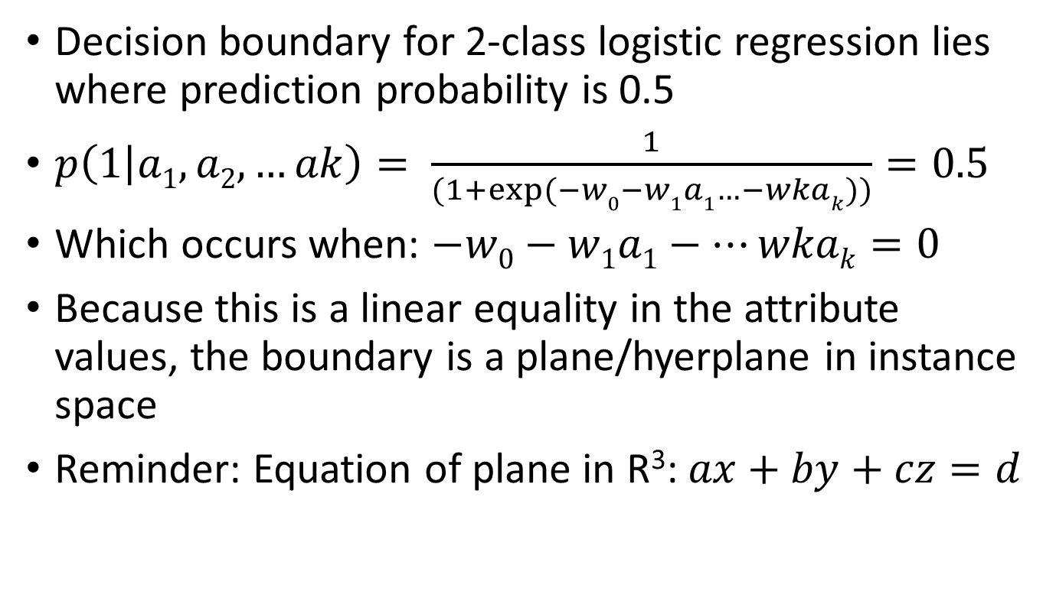
Decision boundaries
Decision boundary for 2-class logistic regression lies where prediction probability is 0.5
$p\left(1 | a1,a2,…ak\right)= \frac{1}{(1+exp⁡(−w0−w1a1…−wkak))}=0.5$
Which occurs when: $−w0−w1a1−…wkak=0$
Because this is a linear equality in the attribute values, the boundary is a plane/hyerplane in instance space
Reminder: Equation of plane in R³: $ax+by+cz=d$

Slide 4
Linear classification using the Perceptron
Logistic regression attempts to produce accurate probability estimates by maximizing the log-likelihood over the training data
This naturally leads to accurate classification, given new instances
However, if our sole purpose is to predict class labels, a different approach is to learn a hyperplane separating instances of our classes
If the data can be separated perfectly into two groups using a hyperplane, it is said to be linearly separable
If the data is linearly separable, there is a very simple algorithm for finding the separating hyperplane

Slide 5
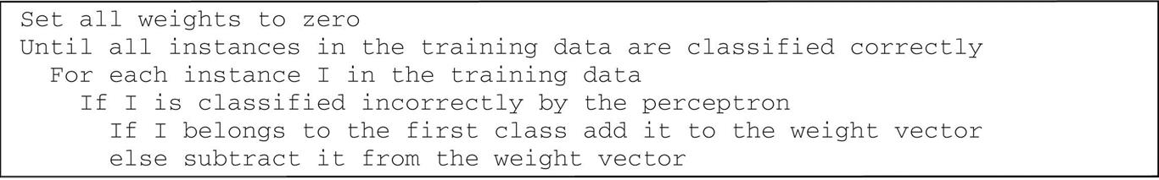
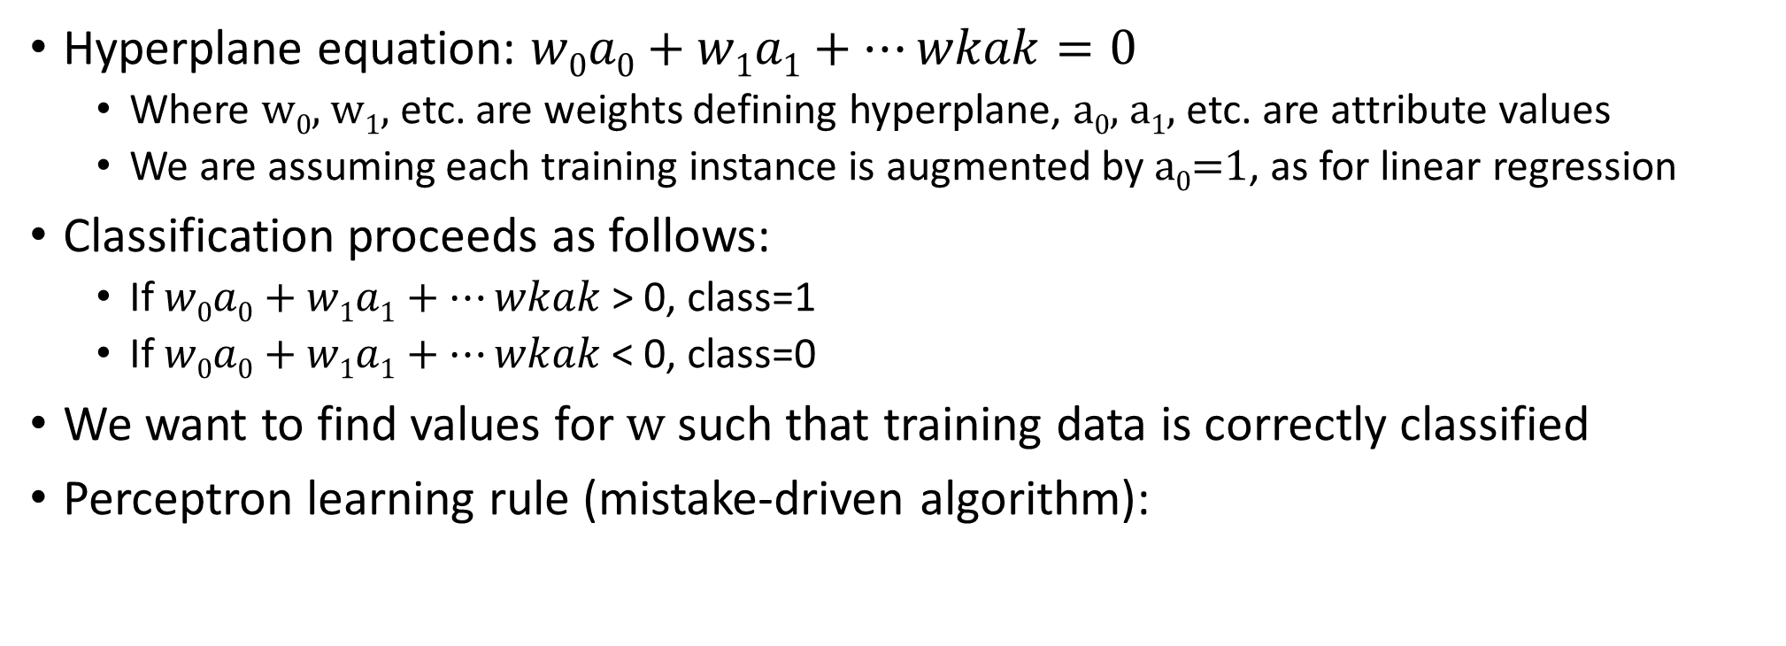
Perceptron learning rule
Hyperplane equation: $w0a0+w1a1+…wkak=0$
Where w₀, w₁, etc. are weights defining hyperplane, a₀, a₁, etc. are attribute values
We are assuming each training instance is augmented by a₀=1, as for linear regression
Classification proceeds as follows:
If $w0a0+w1a1+…wkak$ > 0, class=1
If $w0a0+w1a1+…wkak$ < 0, class=0
We want to find values for w such that training data is correctly classified
Perceptron learning rule (mistake-driven algorithm):

Slide 6
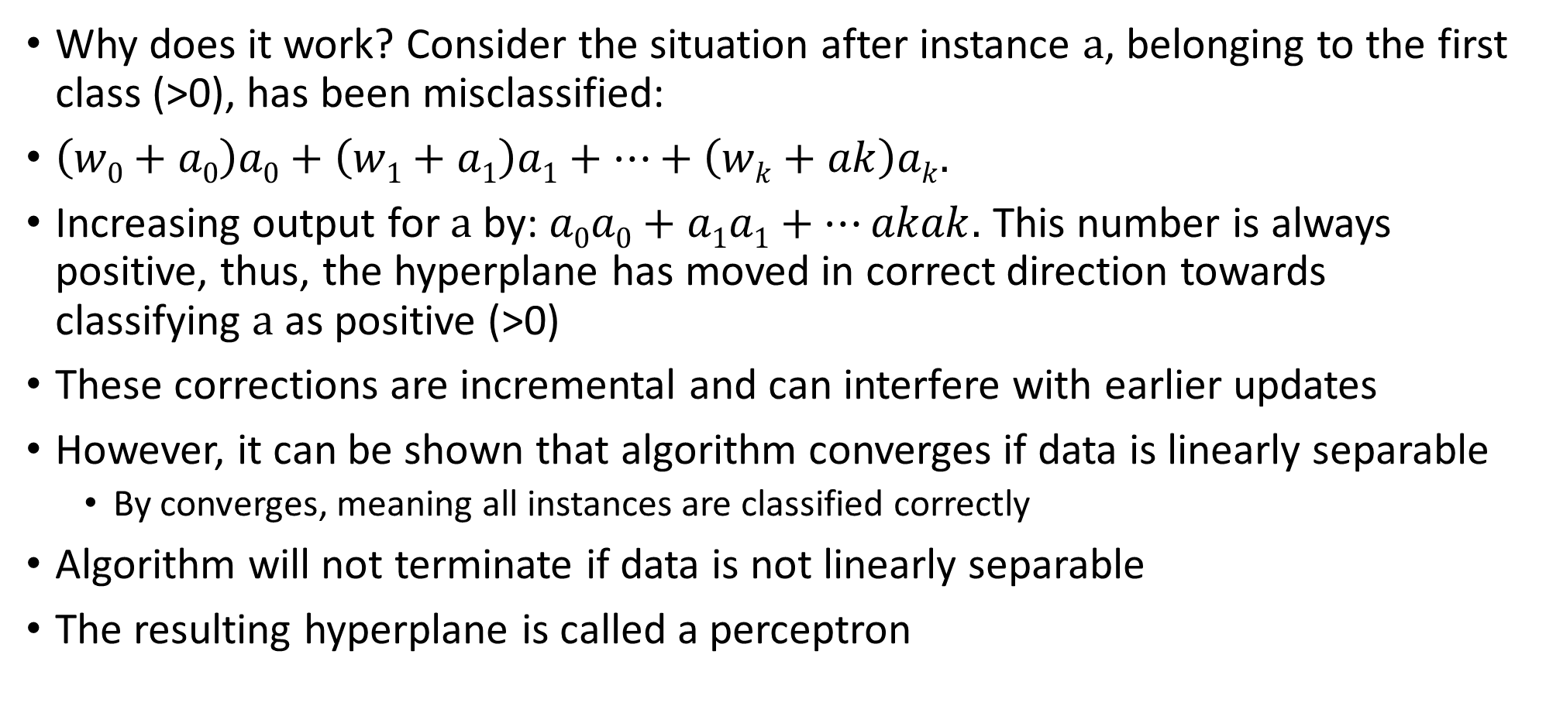
Perceptron learning rule
Why does it work? Consider the situation after instance a, belonging to the first class (>0), has been misclassified:
$\left(w0+a0\right)a0+\left(w1+a1\right)a1+…+\left(wk+ak\right)ak.$
Increasing output for a by: $a0a0+a1a1+…akak.$ This number is always positive, thus, the hyperplane has moved in correct direction towards classifying a as positive (>0)
These corrections are incremental and can interfere with earlier updates
However, it can be shown that algorithm converges if data is linearly separable
By converges, meaning all instances are classified correctly
Algorithm will not terminate if data is not linearly separable
The resulting hyperplane is called a perceptron

Slide 7
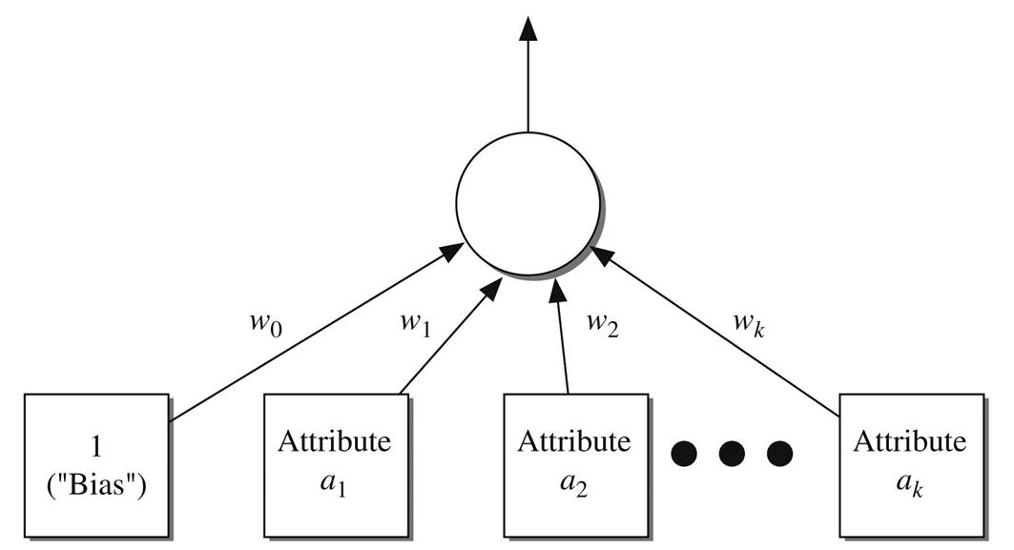
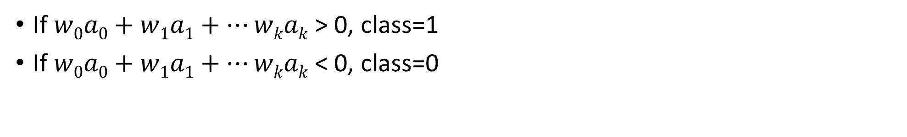
Perceptron
If $w0a0+w1a1+…wkak$ > 0, class=1
If $w0a0+w1a1+…wkak$ < 0, class=0

Slide 8
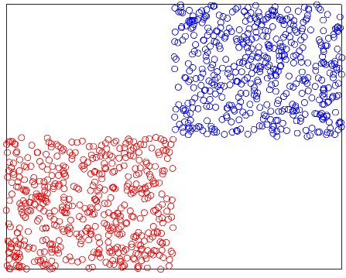
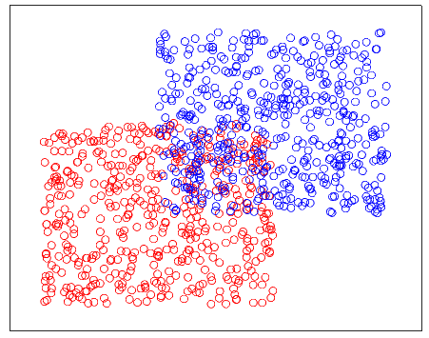
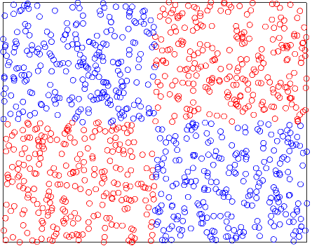
Examples: perceptron performance
100% accuracy
85% accuracy
50% accuracy

Slide 9
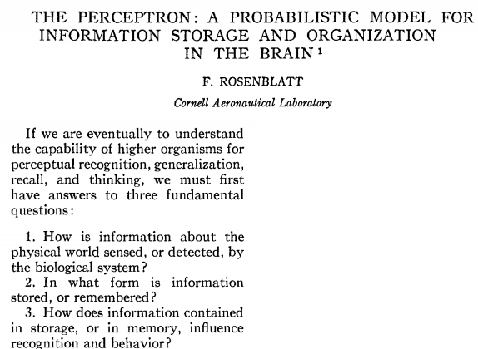
“By the study of systems such as the perceptron, it is hoped that fundamental laws of organization which are common to all information handling systems, machines and people alike, may eventually be understood”
(full article available on Moodle)

Slide 10
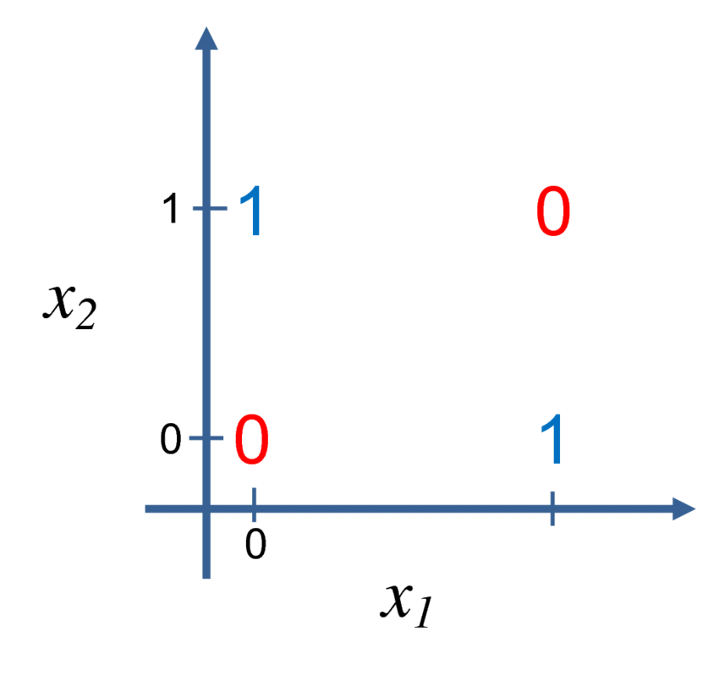


Perceptrons and XOR
Perceptron achieves 50% accuracy here
Single-layer perceptrons (1-neuron) cannot learn the xor function
This realization lead to a decrease in interest in AI, known as the “AI winter” of the 1980s
AI winter refers to a chain reaction beginning with pessimism in the press, followed by severe cutback in funding, followed by end of serious research
XOR function

Slide 11
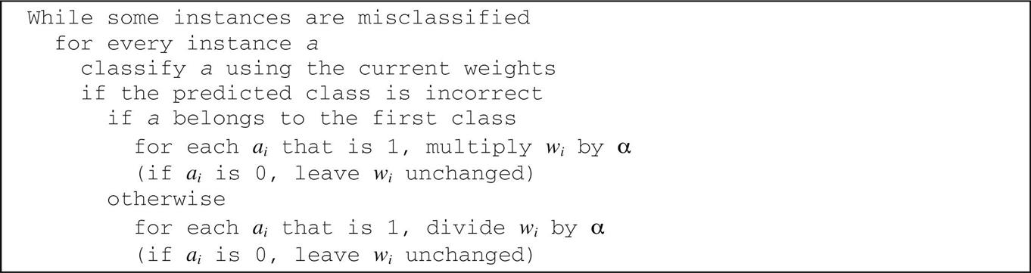
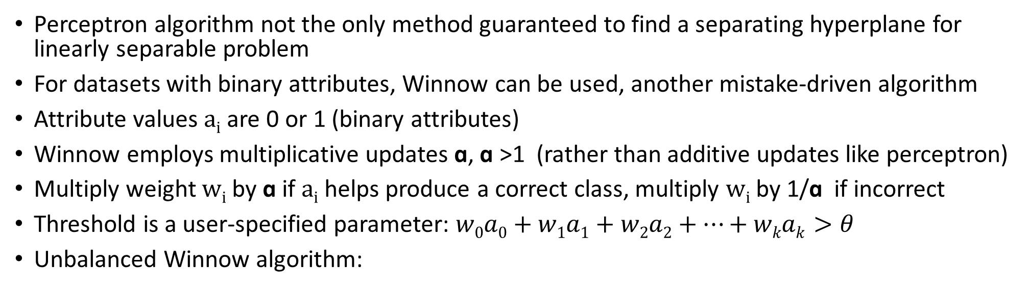
Linear classification using Winnow
Perceptron algorithm not the only method guaranteed to find a separating hyperplane for linearly separable problem
For datasets with binary attributes, Winnow can be used, another mistake-driven algorithm
Attribute values a_{i} are 0 or 1 (binary attributes)
Winnow employs multiplicative updates ɑ, ɑ >1 (rather than additive updates like perceptron)
Multiply weight w_{i} by ɑ if a_{i} helps produce a correct class, multiply w_{i} by 1/ɑ if incorrect
Threshold is a user-specified parameter: $w0a0+w1a1+w2a2+…+wkak>θ$
Unbalanced Winnow algorithm:

Slide 12
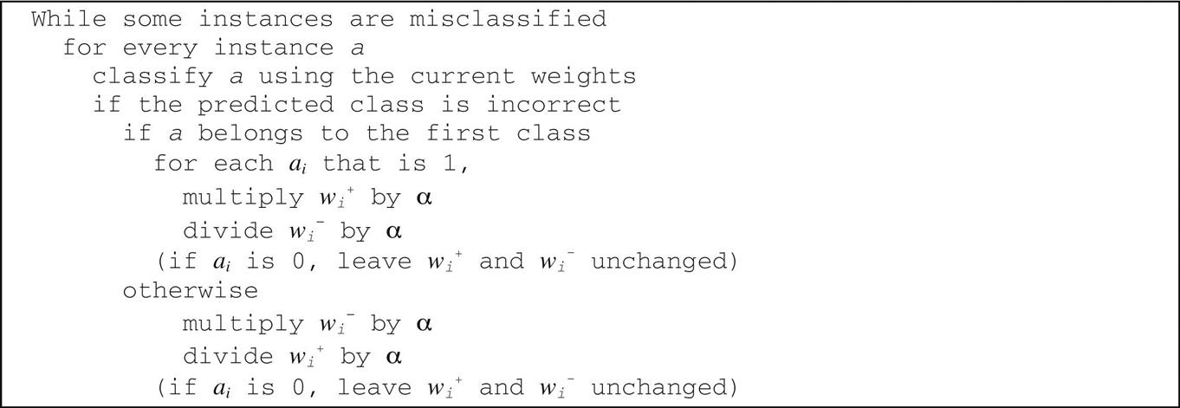
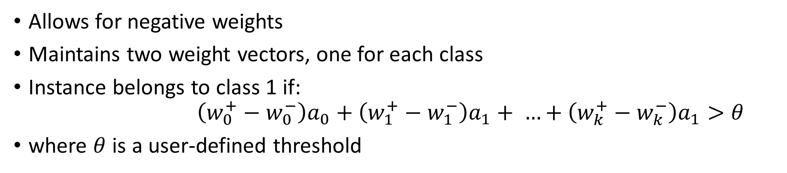
Balanced Winnow
Allows for negative weights
Maintains two weight vectors, one for each class
Instance belongs to class 1 if: $\left(w_{0}^{+}−w_{0}^{−}\right)a_{0}+\left(w_{1}^{+}−w_{1}^{−}\right)a_{1}+ …+\left(w_{k}^{+}−w_{k}^{−}\right)a_{1}>θ$
where $θ$ is a user-defined threshold

Slide 13

Advantages of Winnow
Winnow is very effective at honing in on relevant features in a dataset, therefore it is called an attribute-efficient learner
Good candidate in a dataset with lots of binary features, most of them irrelevant
Both Winnow and perceptron can be used for real-time classification (concept description is incrementally updated as new instances arrive)
Winnowing is an agricultural method developed by ancient cultures for separating grain from hay

Slide 14
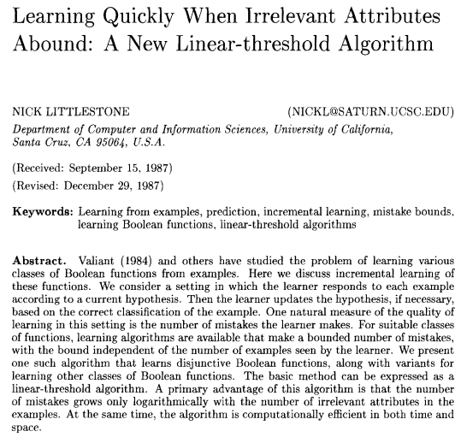
(from introduction) “in this paper, we consider learning from examples in a situation in which the goal of the learner is simply to make few mistakes…we are interested in cases where the correct-response function depends on only a small proportion of the attributes in each example”
Winnow original paper (available on Moodle)

Slide 15
Winnow Applications
Classifying large collections of documents (patent applications)
Spam filtering
Context-sensitive spelling correction

Slide 16
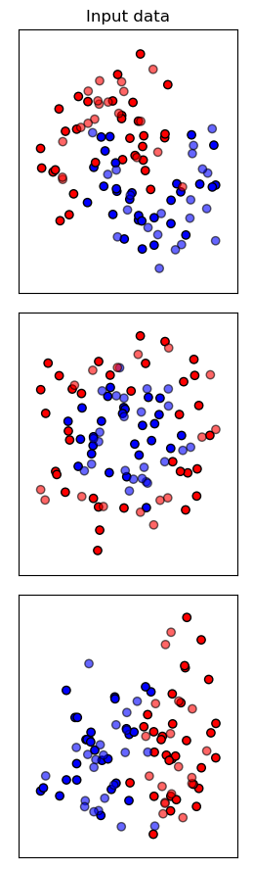
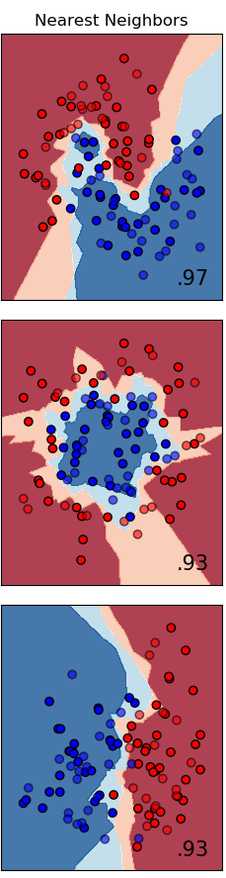
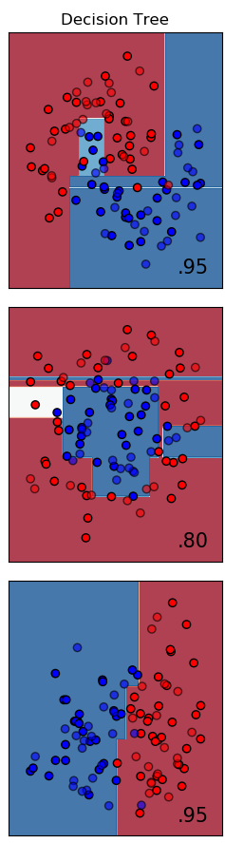
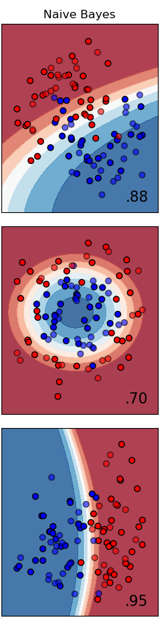
Decision boundaries for different classifiers
1) input data
2) Decision boundary generated by nearest-neighbour classifier
3) Decision boundary generated by decision tree
4) decision boundary generated by Naive Bayes
https://scikit-learn.org/stable/auto_examples/classification/plot_classifier_comparison.html#sphx-glr-auto-examples-classification-plot-classifier-comparison-py

Slide 17
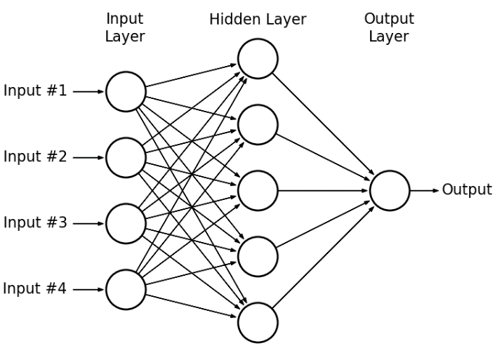
Python example: multi-layer perceptron
Multi-layer perceptron:
Handwritten digit classification
Weight matrix visualization

