Slide 1
CS405/505 Data Mining
Lecture 10

Slide 2
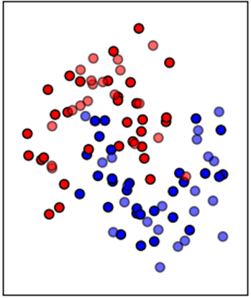
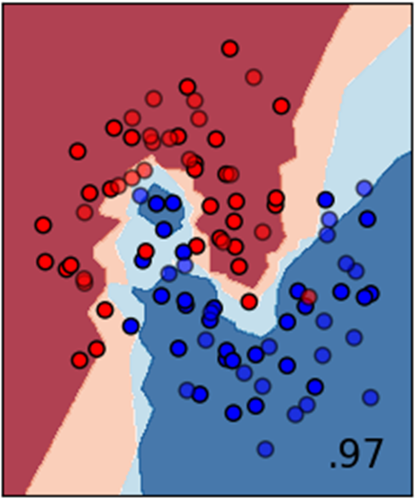
4.7 Instance based ‘learning’
Instance based learning works by storing training examples, and classifying new instances based on distance from training examples
Lazy learner (waits for new instances, performs computation at classification time)
Non-parametric method (works well even when decision boundary is irregular)
https://scikit-learn.org/stable/auto_examples/classification/plot_classifier_comparison.html
https://scikit-learn.org/stable/modules/neighbors.html

Slide 3
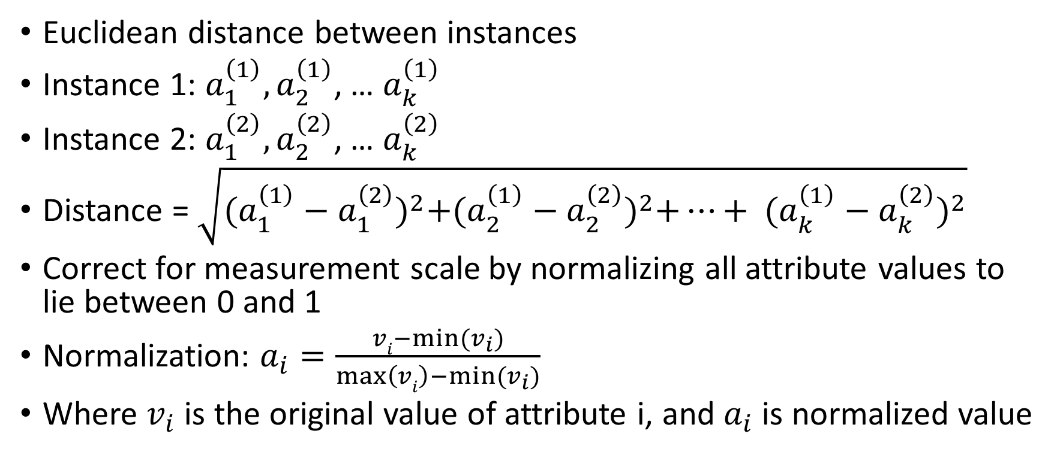
The distance function
Euclidean distance between instances
Instance 1: $a_{1}^{\left(1\right)},a_{2}^{\left(1\right)}$, … $a_{k}^{\left(1\right)}$
Instance 2: $a_{1}^{\left(2\right)},a_{2}^{\left(2\right)}$, … $a_{k}^{\left(2\right)}$
Distance = $\sqrt{{(a_{1}^{\left(1\right)}−a_{1}^{\left(2\right)})}^{2}+{(a_{2}^{\left(1\right)}−a_{2}^{\left(2\right)})}^{2}+…+ {(a_{k}^{\left(1\right)}−a_{k}^{\left(2\right)})}^{2}}$
Correct for measurement scale by normalizing all attribute values to lie between 0 and 1
Normalization: $a_{i}=\frac{vi−min⁡(v_{i})}{\max\left(vi\right)−min⁡(v_{i})}$
Where $v_{i}$ is the original value of attribute i, and $a_{i}$ is normalized value

Slide 4
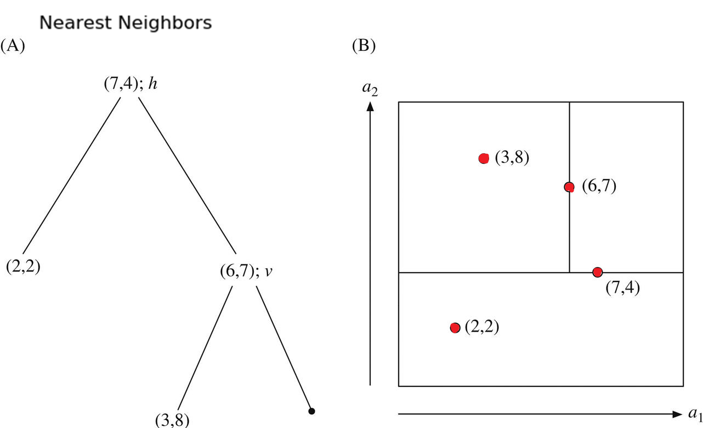
Finding nearest neighbours efficiently
We have some instances and a distance function. Problem solved?
What if we have millions of stored instances? Compute distance between new instance and all of them?
We can find nearest neighbours more efficiently by representing the training set as a tree
kD trees are binary trees that recursively divide instance space using hyperplanes
A) kD tree example with k=2 (2 attributes)
B) four training instances represented in (A) along with hyperplanes constituting tree

Slide 5
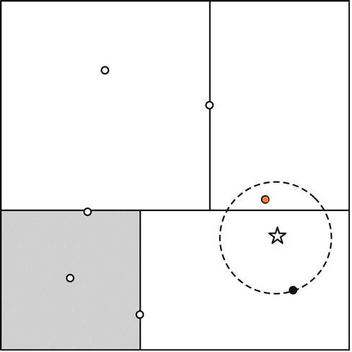
How does kD tree help find nearest neighbours fast?
To locate nearest neighbour of a given target point, follow the tree down from its root to locate the region containing the target point
We want to find the nearest neighbour of the new instance (star)
Following the tree leads us to the subsection whose leaf node is colored black (good first approximation)
The nearest neighbour must lie within the circle.
First check if black node’s sibling (gray box) touches circle (it doesn’t)
Then, check sibling of parent node (upper half) – it does touch the circle, so we check its children
Top right (which is daughter of the upper half node) intersects the circle so we descend into it and find it contains a closer point (orange)
With a “good” (well balanced) tree this procedure takes O(log2(n)) time, where n is #instances

Slide 6
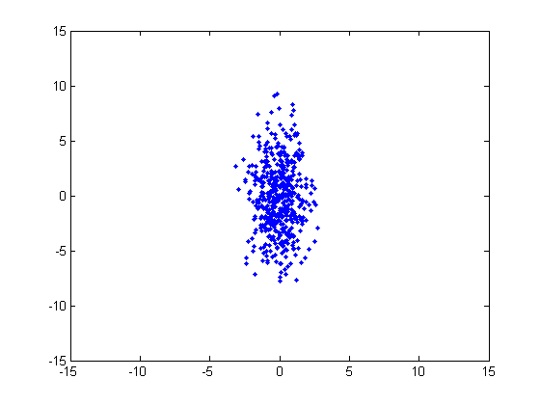
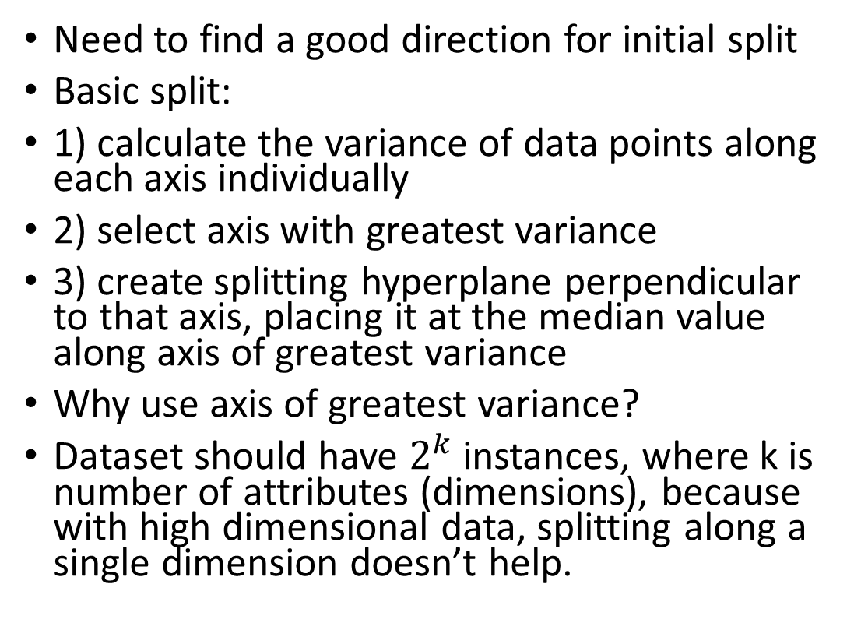
Building a good tree
Need to find a good direction for initial split
Basic split:
1) calculate the variance of data points along each axis individually
2) select axis with greatest variance
3) create splitting hyperplane perpendicular to that axis, placing it at the median value along axis of greatest variance
Why use axis of greatest variance?
Dataset should have $2^{k}$instances, where k is number of attributes (dimensions), because with high dimensional data, splitting along a single dimension doesn’t help.
Split 2
Split 3
Split 1
https://stackoverflow.com/questions/37132774/why-k-d-trees-is-not-used-for-high-dimensional-data

Slide 7
Incrementally updating the kD tree
One of the advantages of instance-based learning over other machine learning methods is that new examples can be added to training set at any time
Therefore, we want to be able to incrementally update kD tree with new points
Incrementally updating the tree:
1) determine which leaf node contains new point, find its hyperrectangle
2) if it is empty, place the new point there
3) otherwise, split the hyperrectangle along its longest dimension (to preserve squareness)
kD trees are good, but rectangles/squares are not the best shape to use because of their corners (which leads to unnecessary backtracking).
The solution? Use hyperspheres (Ball tree), not hyperrectangles

Slide 8
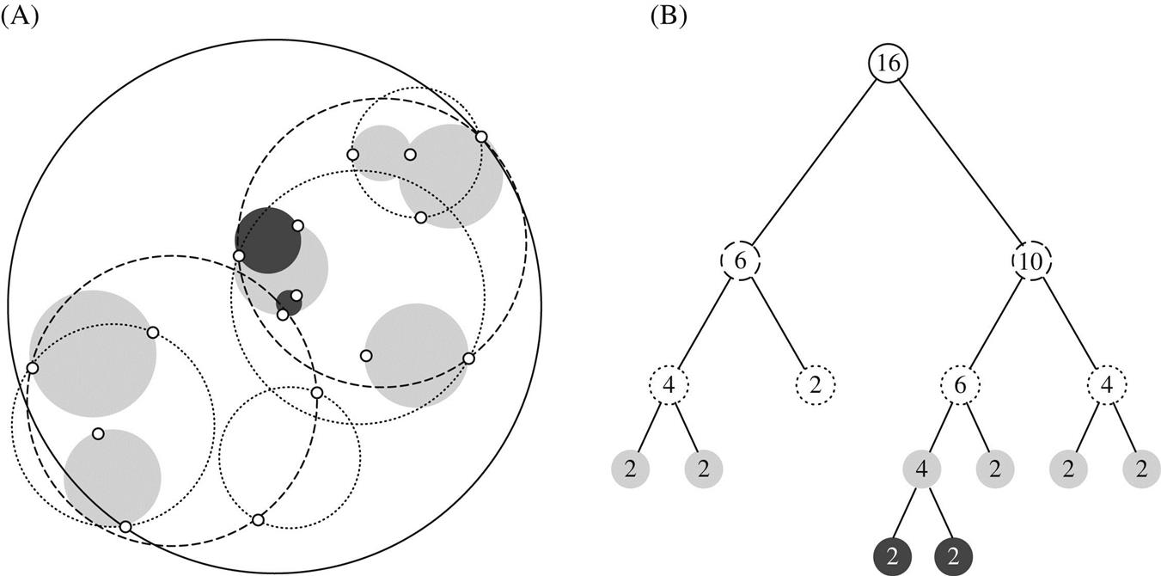
Ball tree
A ball tree is a binary tree in which every node defines a D-dimensional hypersphere, or ball, containing a subset of points to be searched
Enables fast nearest neighbour search
Built in the same way as kD trees (using kD algorithm)
Ball tree for 16 instances
Instances and balls
Corresponding tree
Circles at different levels are indicated by style of dash, smaller circles drawn in shades of gray

Slide 9
4.8 Clustering
Clustering is the task of grouping a set of objects in such a way that objects in the same group (cluster) are more similar to each other than to those in other groups
Exploratory data mining, used for knowledge discovery
Clustering techniques are applied when there is no class to be predicted but rather we want to divide instances into natural groups
The clusters will presumably reflect some underlying structure in the data
The classic clustering technique is called k-means clustering, it is an iterative distance-based technique

Slide 10
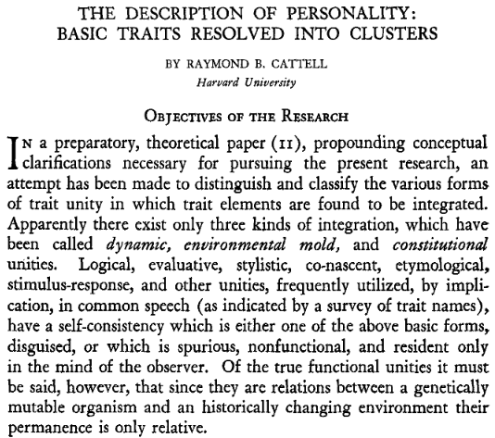
“One hundred adults, sampled as evenly as possible from the general population, were rated on 171 traits. On the basis of correlations these variables were grouped into clusters…” – Cattell 1943
(available on Moodle)

Slide 11
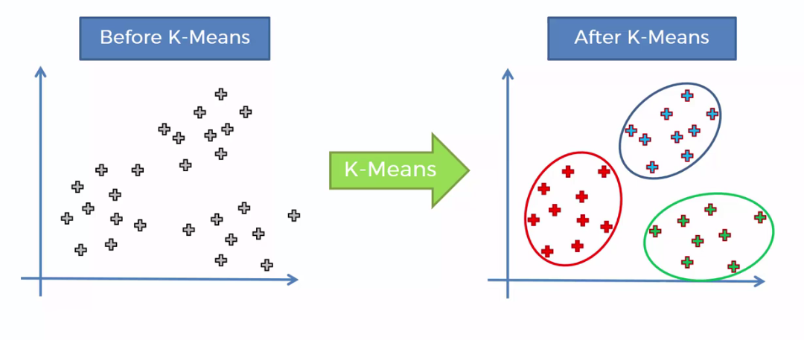
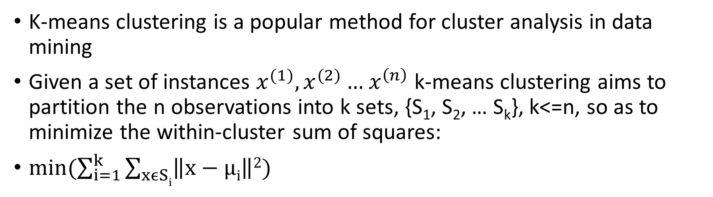
K-means clustering
K-means clustering is a popular method for cluster analysis in data mining
Given a set of instances $x^{(1)},x^{(2)}…{ x}^{\left(n\right)}$ k-means clustering aims to partition the n observations into k sets, {S₁, S₂, … S_{k}}, k<=n, so as to minimize the within-cluster sum of squares:
$min(\sum_{i=1}^{k}{\sum_{xϵSi}{\left\|x−μi\right\|2}})$

Slide 12
K-means algorithm
Iterative refinement technique with two steps:
Step 0: random cluster center initialization (k cluster centers)
Step 1: Assignment step – assign each instance to the closest cluster center
Step 2: Update step – update each cluster center by recalculating mean over all instances belonging to that cluster
STOP when assignments (step 1) no longer change (clusters are stable)
Not guaranteed to find the optimal cluster centers
Try algorithm multiple times with different random cluster center initializations

Slide 13
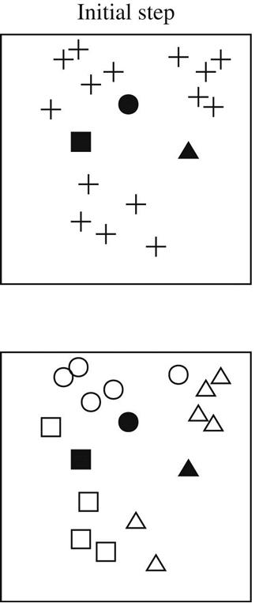
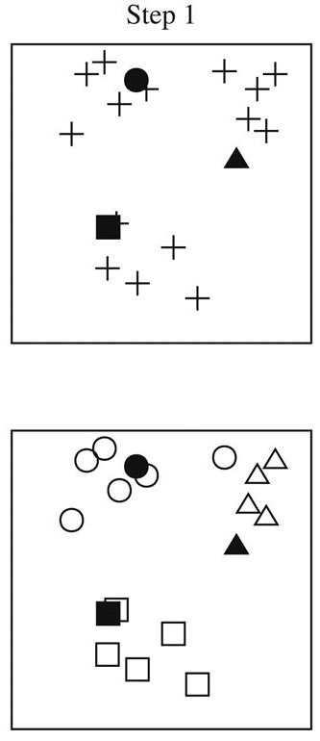
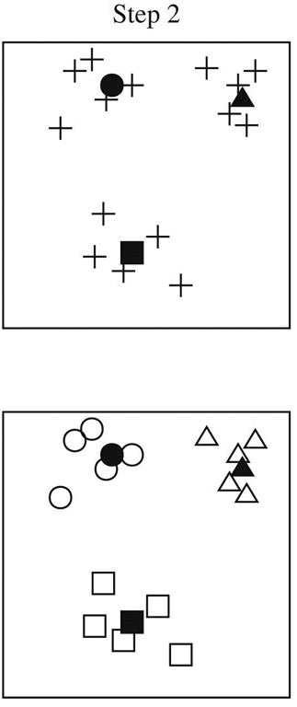
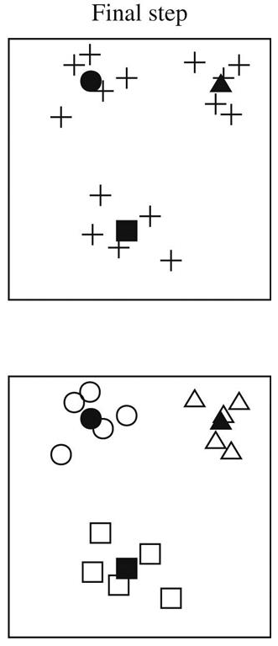
K-means

Slide 14
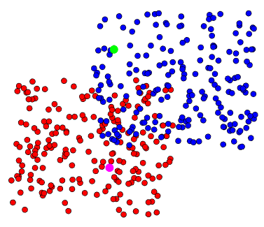
K-means example:
Matlab example
400 points generated randomly around two points in 2d space
Random initialization of k=2 cluster centers
kmeans_Example.m

Slide 15
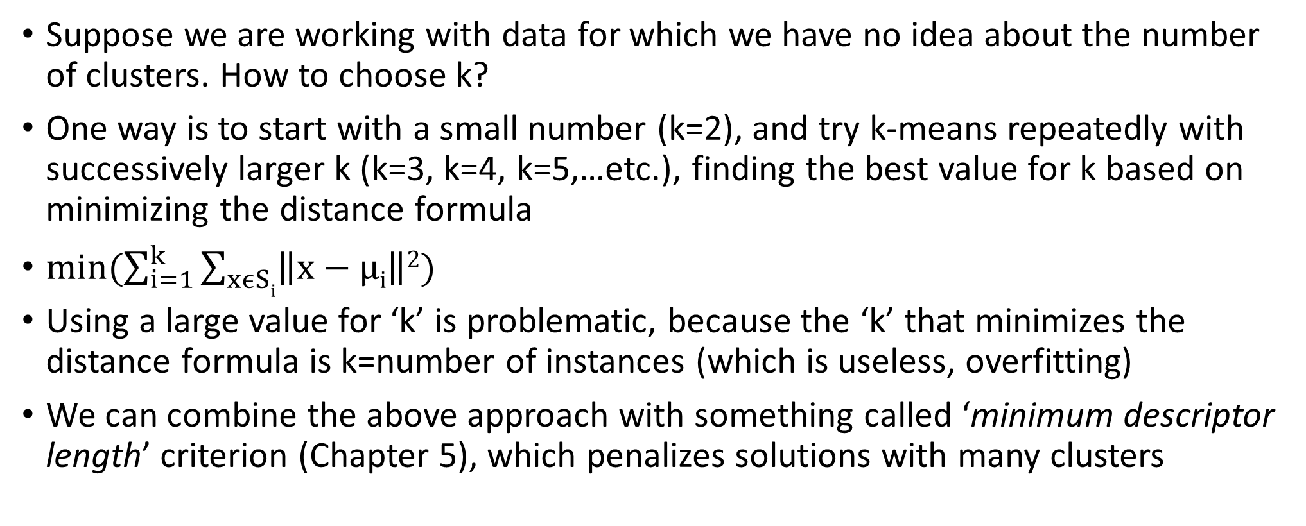
Choosing number of clusters
Suppose we are working with data for which we have no idea about the number of clusters. How to choose k?
One way is to start with a small number (k=2), and try k-means repeatedly with successively larger k (k=3, k=4, k=5,…etc.), finding the best value for k based on minimizing the distance formula
$min(\sum_{i=1}^{k}{\sum_{xϵSi}{\left\|x−μi\right\|2}})$
Using a large value for ‘k’ is problematic, because the ‘k’ that minimizes the distance formula is k=number of instances (which is useless, overfitting)
We can combine the above approach with something called ‘minimum descriptor length’ criterion (Chapter 5), which penalizes solutions with many clusters

Slide 16
Hierarchical (agglomerative) clustering
Bottom up clustering
Begin by regarding each individual instance as a cluster
Find the two closest clusters and merge them
Continue until all clusters have been merged into one
Keeping track of the merges forms a hierarchical clustering structure also known as a binary dendrogram
How to measure distance between two clusters? (many metrics)
Single linkage (distance between two closest members of a pair of clusters)
Complete linkage (distance between two furthest members of a pair of clusters)
Centroid linkage (distance between two centroids of a pair of clusters)
Average linkage (average distance between each pair of members of two clusters)
Ward’s linkage (minimize within cluster variance)

Slide 17
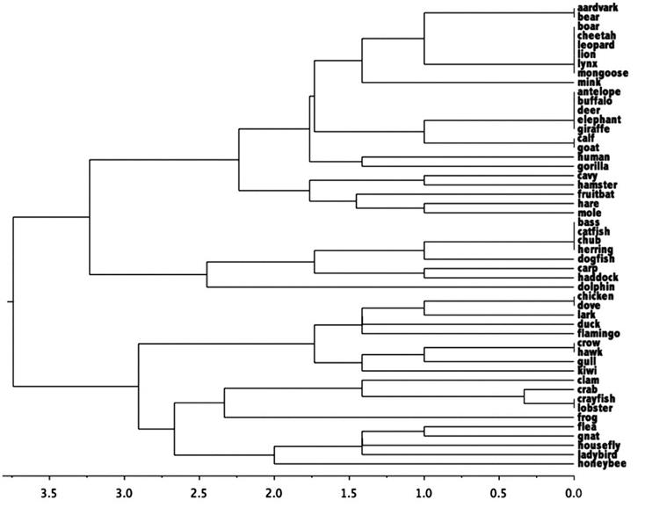
Example of Hierarchical clustering
Dataset: 50 examples of different creatures
One numeric attribute (number of legs) and 15 Boolean attribues (has feathers, lays eggs, venomous, etc.)
Height of each node in the dendrogram is proportional to dissimilarity between children measured as Euclidean distance between instances
(compete linkage distance metric used here)

Slide 18
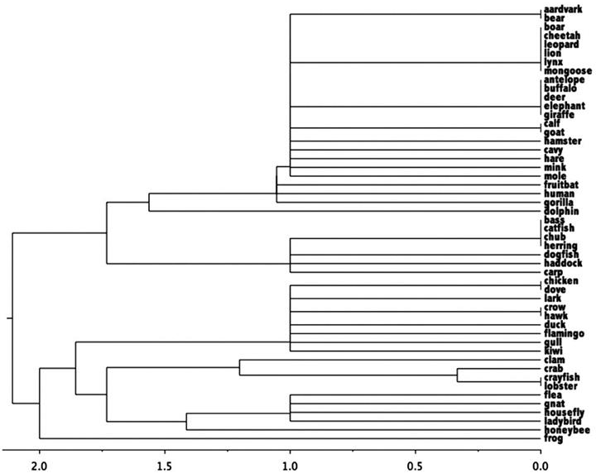
Same dataset, but for single-linkage distance metric
Single linkage produces clusters with large diameters at low levels of the tree. Why?

Slide 19
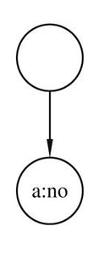
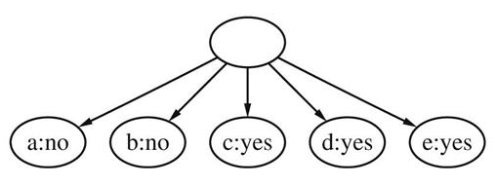
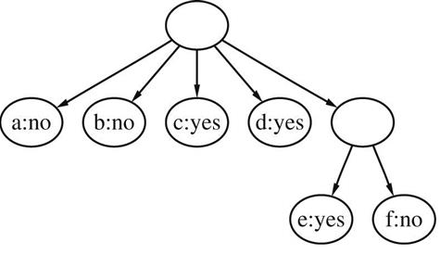
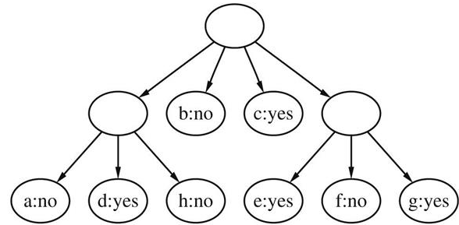
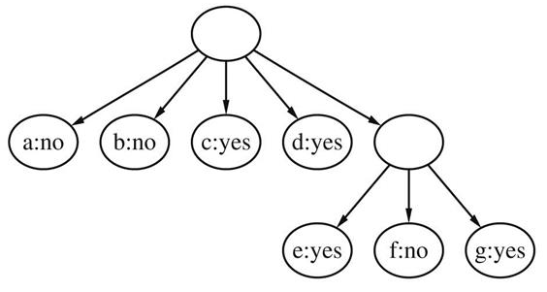
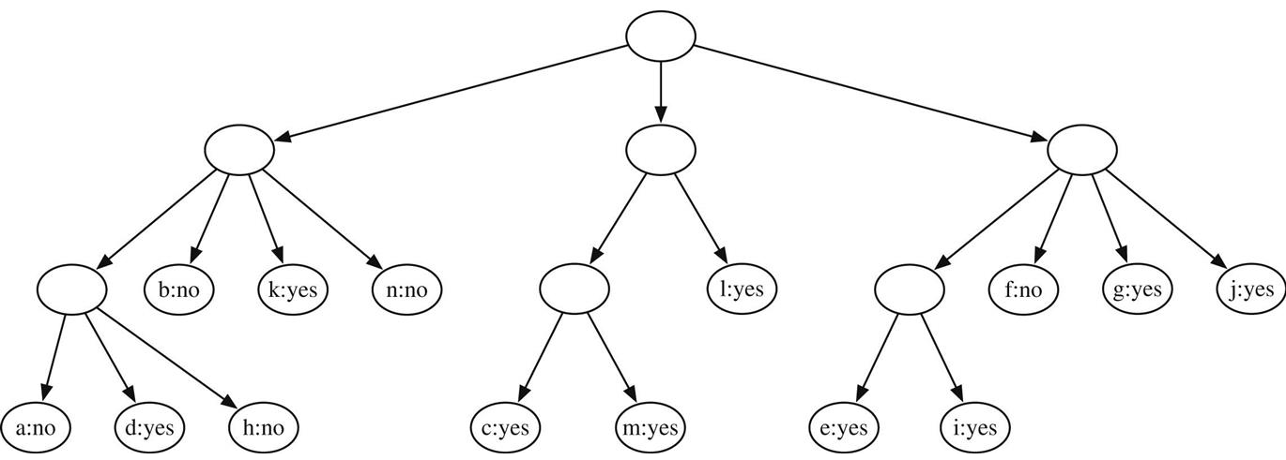
Incremental clustering
Process each new instance by tentatively placing it into each of the existing leaves and evaluating category utility of resulting top level node’s children to see if leaf is a good ‘host’, for first 5 instances it is better to form a new leaf for each instance
With the 6th instance (f) it becomes beneficial to form a cluster, joining f with e
K-means clustering iterates over entire dataset until convergence
Hierarchical clustering examines all clusters at each stage of merging
Incremental clustering works incrementally, building a tree instance by instance
The key in deciding how and where to update the tree is a quantity called category utility which measures the overall quality of a partition into clusters
Example: weather data (14 instances, labeled with letters a to n)
Start adding instances to root node
Problem: continuing in this way makes the final clustering dependent on the ordering of examples
Next example (g) is placed in the same cluster (the clustering procedure is called twice here, once for the root, and once for the parent of e/f)
To avoid this problem, whenever nodes at a level are scanned for a suitable host, both the best matching node and the runner up are noted, and consideration is given to merging the best matching and the runner up before merging new instance with host (a & d here)
Final hierarchy for all
14 examples from the weather data

Slide 20
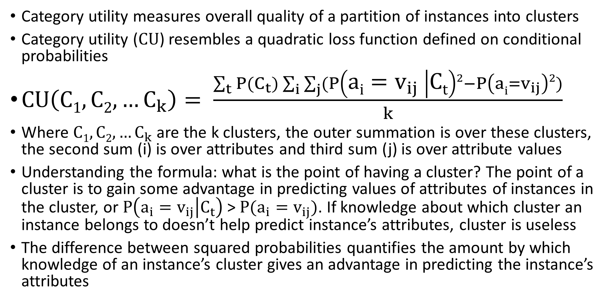
Category Utility (nominal attributes)
Category utility measures overall quality of a partition of instances into clusters
Category utility (CU) resembles a quadratic loss function defined on conditional probabilities
$CU\left(C1,C2,…C_{k}\right)= \frac{\sum_{t}{P(C_{t})\sum_{i}{\sum_{j}{(P\left(ai=v_{ij} | Ct\right)2−P\left(ai=v_{ij}\right)2)}}}}{k}$
Where $C1,C2,…C_{k}$ are the k clusters, the outer summation is over these clusters, the second sum (i) is over attributes and third sum (j) is over attribute values
Understanding the formula: what is the point of having a cluster? The point of a cluster is to gain some advantage in predicting values of attributes of instances in the cluster, or $P\left(a_{i}=v_{ij} | C_{t}\right)$ > $P(a_{i}=v_{ij})$. If knowledge about which cluster an instance belongs to doesn’t help predict instance’s attributes, cluster is useless
The difference between squared probabilities quantifies the amount by which knowledge of an instance’s cluster gives an advantage in predicting the instance’s attributes

Slide 21
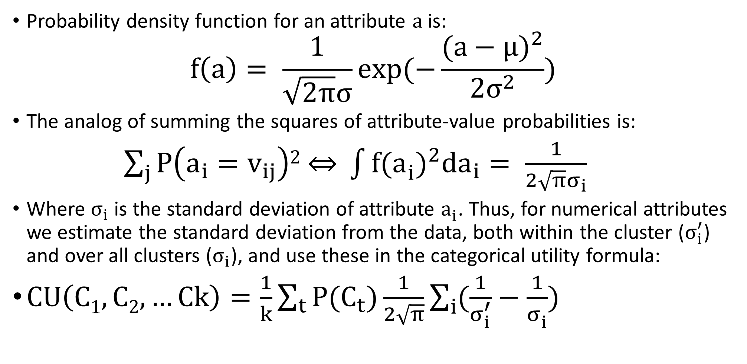
Category utility (numerical attributes)
Probability density function for an attribute a is:
$$f\left(a\right)= \frac{1}{\sqrt{2π}σ}exp⁡(−\frac{{(a−μ)}^{2}}{2σ^{2}})$$
The analog of summing the squares of attribute-value probabilities is:
$\sum_{j}{P\left(a_{i}=v_{ij}\right)2 \overset{⇔}{ }} \int{{f(a_{i}^{ })}^{2}da_{i}= \frac{1}{2\sqrt{π}σ_{i}}}$
Where $σ_{i}$ is the standard deviation of attribute $a_{i}^{ }$. Thus, for numerical attributes we estimate the standard deviation from the data, both within the cluster ($σ_{i}^{′}$) and over all clusters ($σ_{i}$), and use these in the categorical utility formula:
$CU\left(C1,C2,…Ck\right)=\frac{1}{k}\sum_{t}{P(C_{t})\frac{1}{2\sqrt{π}}\sum_{i}{(\frac{1}{σ_{i}^{′}}−\frac{1}{σ_{i}^{ }})}}$

Slide 22

Example of k-means in python
Cluster the pixels using k-means
Build a decision tree based on classes assigned by k-means

