Slide 1
CS 405/505 Data Mining
Lecture 11

Slide 2
Administration
Exam = Assignment 1 (1R, Naïve Bayes, Decision tree)
Similar dataset, similar questions
Practice exam
Marking assignment should be done by Monday before exam

Slide 3
Chapter 5: Credibility
The success of machine learning in practical applications depends on proper evaluation
We will discuss how the quality of predictions can be measured reliably
Today:
Basic train-test setup
Cross validation and bootstrap
Statistical significance tests for comparing performance of two algorithms

Slide 4
Introduction
Evaluation is the key to making real progress in data mining
Performance on training set rarely predicts performance on real-world test set
Quality, labeled data is often scarce (example: tumor segmentations)
We want to predict performance based on limited data

Slide 5
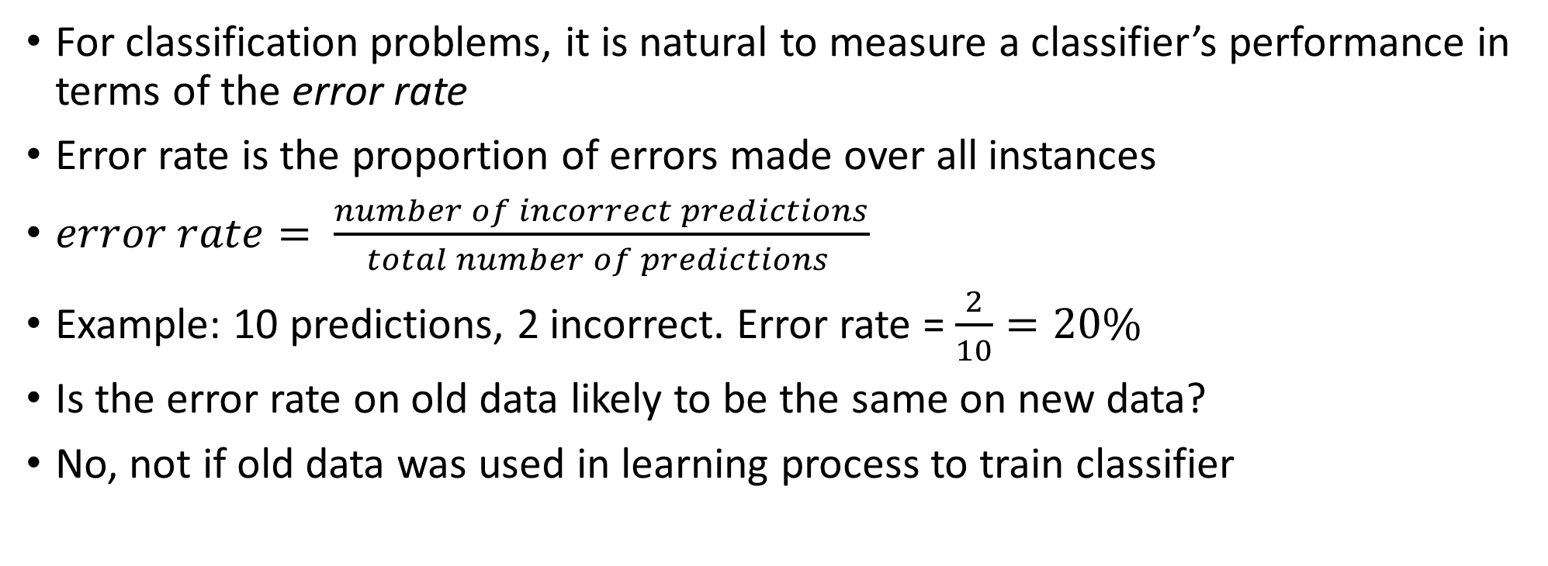
5.1 Training and testing
For classification problems, it is natural to measure a classifier’s performance in terms of the error rate
Error rate is the proportion of errors made over all instances
$error rate= \frac{number of incorrect predictions}{total number of predictions }$
Example: 10 predictions, 2 incorrect. Error rate = $\frac{2}{10}=20\%$
Is the error rate on old data likely to be the same on new data?
No, not if old data was used in learning process to train classifier

Slide 6
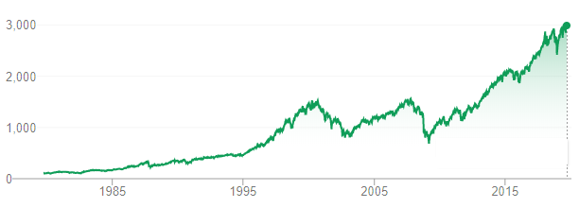
Predicting future stock market from historical data?
Error rate on training set not likely to be a good indicator of performance on future data
This is why most trading algorithms fail miserably
Training data?

Slide 7
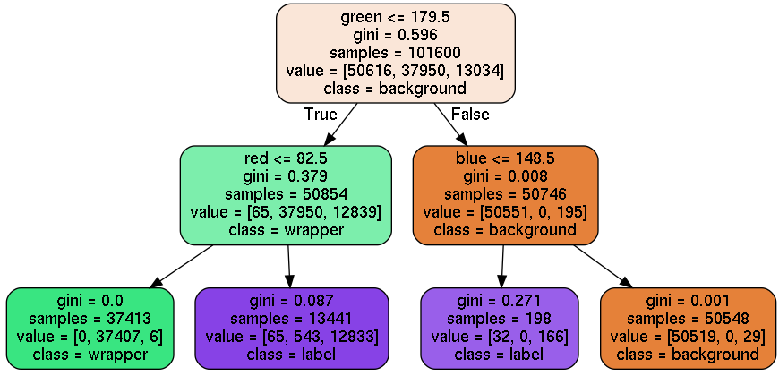


Mars bar example
Mars bar in lighting condition 1
Mars bar in lighting condition 2
These rules (learned on mars bar 1) would fail miserably on the same mars bar in slightly different lighting conditions

Slide 8
Training dataset and Test dataset
Error rate on training data called the resubstitution error
Calculated by resubstituting training instances into classifier constructed from them
To predict performance of classifier on new data, need to assess its error rate on a dataset that played no role in formation of classifier
Instance based learning is a different situation (why?)
Test data must not be used in any way to create the classifier
Training data, validation data, test data:
Training data used to learn a classifier
Test data used to calculate error rate of final, optimized method
Holdout method: training on 2/3 of data, holding 1/3 of data for testing

Slide 9
5.2 Predicting Performance
Suppose we measure error rate of classifier on a test set, get 75% success rate.
Success rate = 1-error rate
Is 75% the true success rate?
How confident are we?
Is the true success rate within 5% of our number? 10%?
Our confidence depends on size of test set (more instances = more confidence)
Test set of 10,000 instances vs test set of 100 instances, how much more confident when we have 10,000 vs 100 instances?
Example 1: with 750 successes in 1000 trials, we are 80% confident the true success rate lies between 73.2% and 76.7%
Example 2: with 75 successes in 100 trials, we are 80% confident the true success rate lies between 69.1% and 80.1%

Slide 10
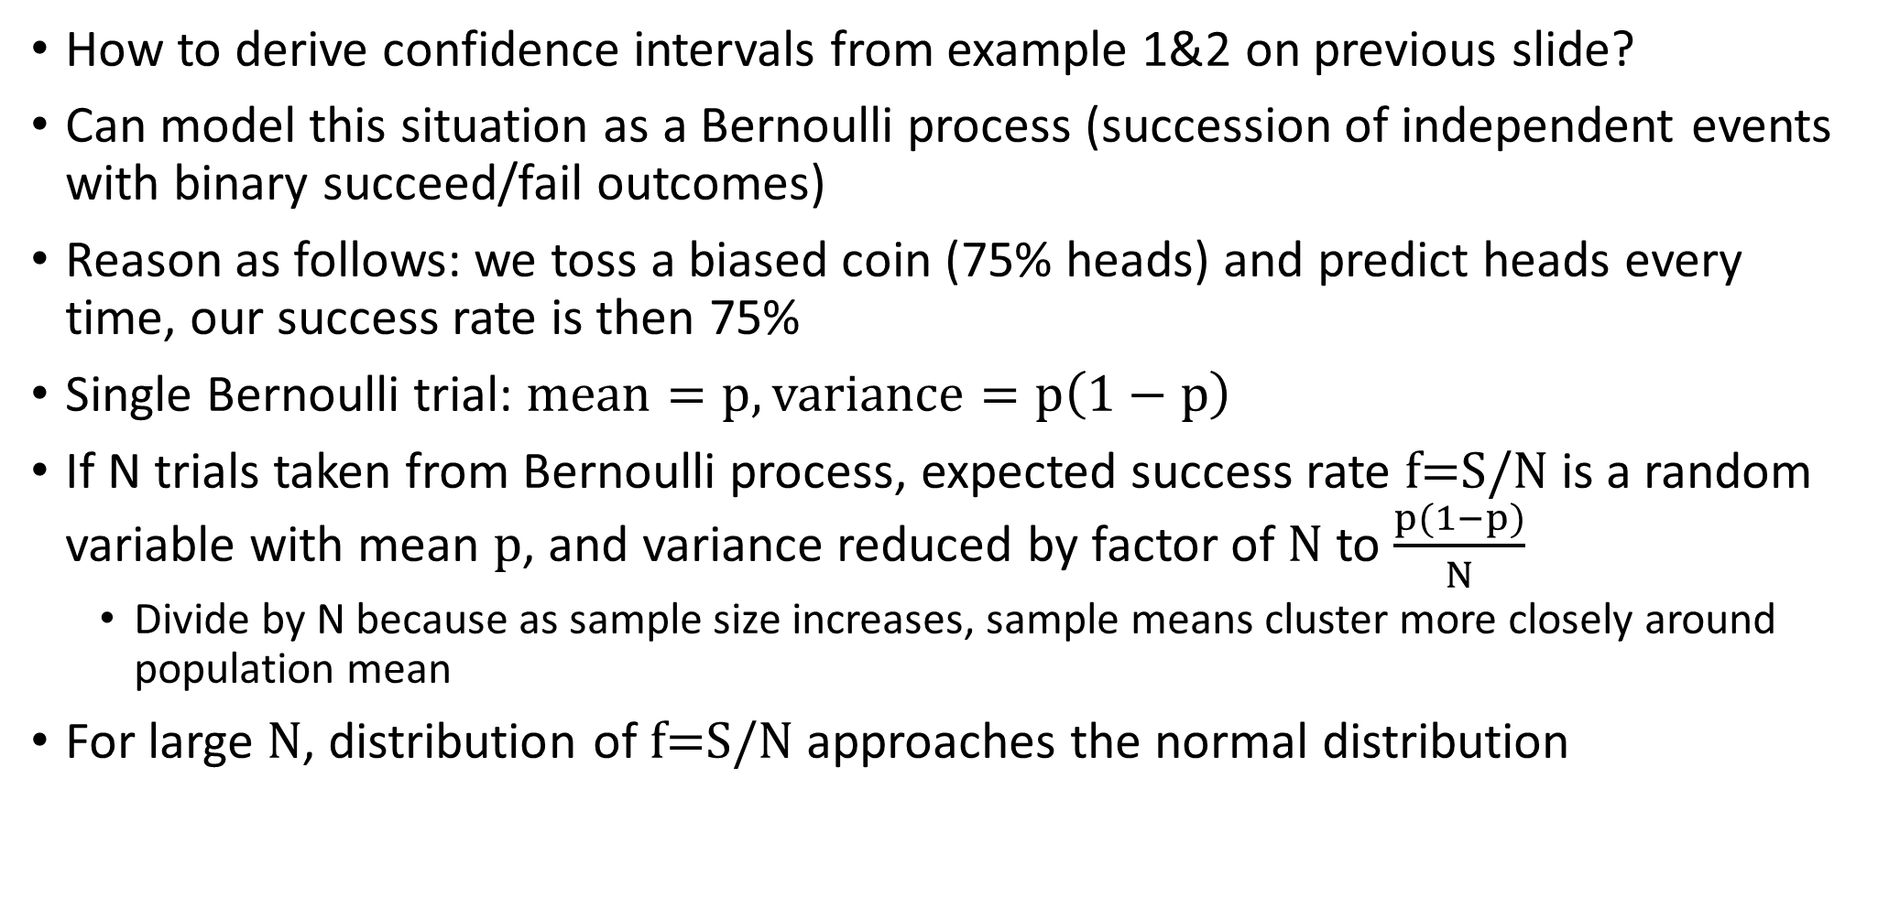
Confidence intervals
How to derive confidence intervals from example 1&2 on previous slide?
Can model this situation as a Bernoulli process (succession of independent events with binary succeed/fail outcomes)
Reason as follows: we toss a biased coin (75% heads) and predict heads every time, our success rate is then 75%
Single Bernoulli trial: $mean=p, variance=p\left(1−p\right)$
If N trials taken from Bernoulli process, expected success rate f=S/N is a random variable with mean p, and variance reduced by factor of N to $\frac{p(1−p)}{N}$
Divide by N because as sample size increases, sample means cluster more closely around population mean
For large N, distribution of f=S/N approaches the normal distribution

Slide 11
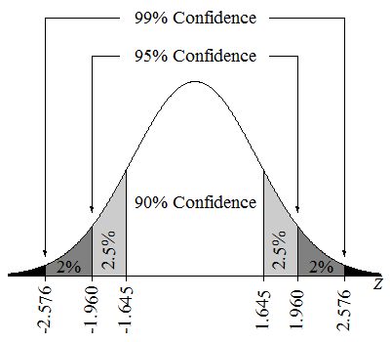
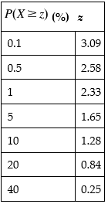
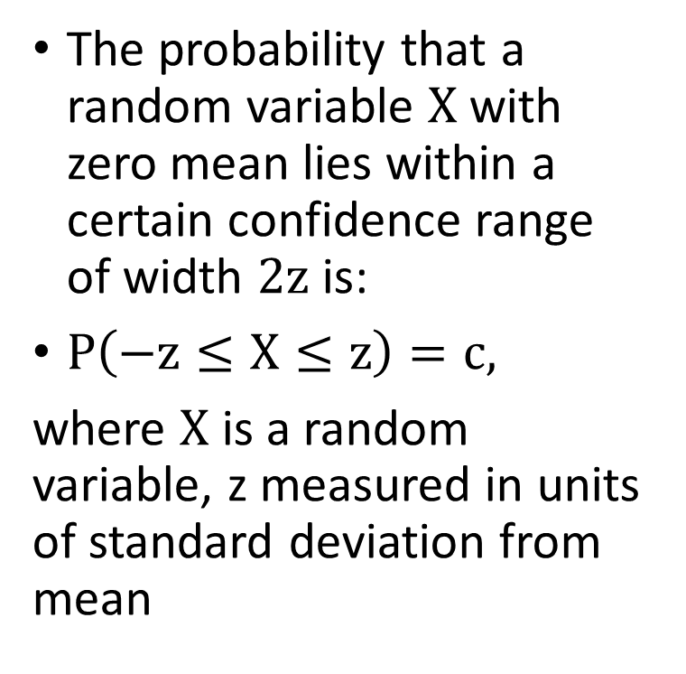
Confidence intervals
one-tailed probability table
The probability that a random variable X with zero mean lies within a certain confidence range of width 2z is:
$P\left(−z≤X≤z\right)=c,$
where X is a random variable, z measured in units of standard deviation from mean

Slide 12
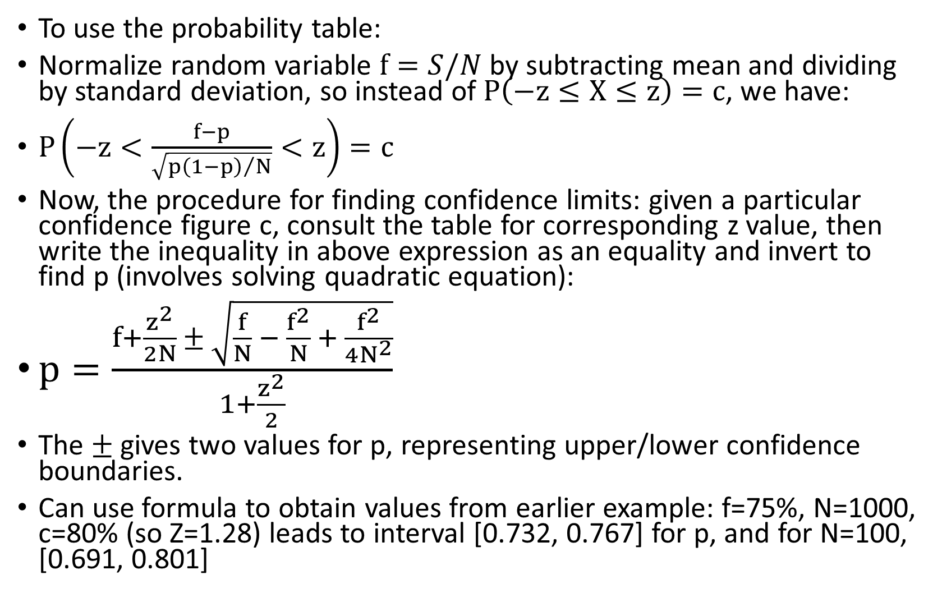
Confidence intervals
To use the probability table:
Normalize random variable $f=S/N$ by subtracting mean and dividing by standard deviation, so instead of $P\left(−z≤X≤z\right)=c$, we have:
$P\left(−z<\frac{f−p}{\sqrt{{p\left(1−p\right)}/N}}<z\right)=c$
Now, the procedure for finding confidence limits: given a particular confidence figure c, consult the table for corresponding z value, then write the inequality in above expression as an equality and invert to find p (involves solving quadratic equation):
$p=\frac{f+\frac{z^{2}}{2N} ± \sqrt{\frac{f}{N} − \frac{f^{2}}{N} + \frac{f^{2}}{4N^{2}}}}{1+\frac{z^{2}}{2}}$
The $±$ gives two values for p, representing upper/lower confidence boundaries.
Can use formula to obtain values from earlier example: f=75%, N=1000, c=80% (so Z=1.28) leads to interval [0.732, 0.767] for p, and for N=100, [0.691, 0.801]

Slide 13
5.3 Cross validation
What to do when the amount of data for training/testing is limited?
Holdout method reserves 1/3 of data for testing, trains on other 2/3
Make sure classes are equally represented in test/training sets (stratification)
3-fold cross validation: run the training algorithm three times, with a different 1/3 of the data as test set each time
Average the error rate across these 3 separate runs
Error rate 1
Error rate 2
Error rate 3
train
train
test
train
test
train
test
train
train

Slide 14
Stratified 10-fold cross-validation
Data is divided randomly into 10 equal subsets, with each class represented equally in each subset (stratified)
Learning scheme is trained 10 separate times, and tested each time on a different 10% of the data, error rate is averaged across the 10 test sets
Why 10? Arbitrary, but has become the standard method
10 times 10-fold cross-validation: repeat 10-fold cross validation 10 times, average the error rate across all 100 trials

Slide 15
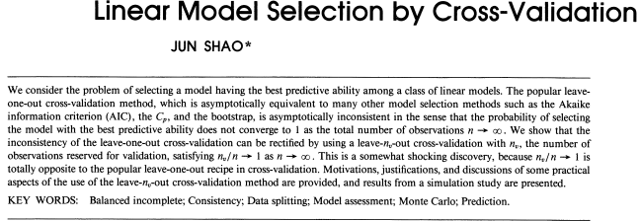
Leave-one-out cross-validation
Leave-one-out cross-validation: n-fold cross validation, where n is the number of instances in the dataset.
Each instance in turn is left out, and learning scheme is trained on all remaining instances.
Advantages:
Greatest possible amount of data used for training in each case
No random sampling involved (procedure is deterministic)
Disadvantages:
Computationally intensive
Cannot be stratified (why?)
(Available on Moodle)

Slide 16
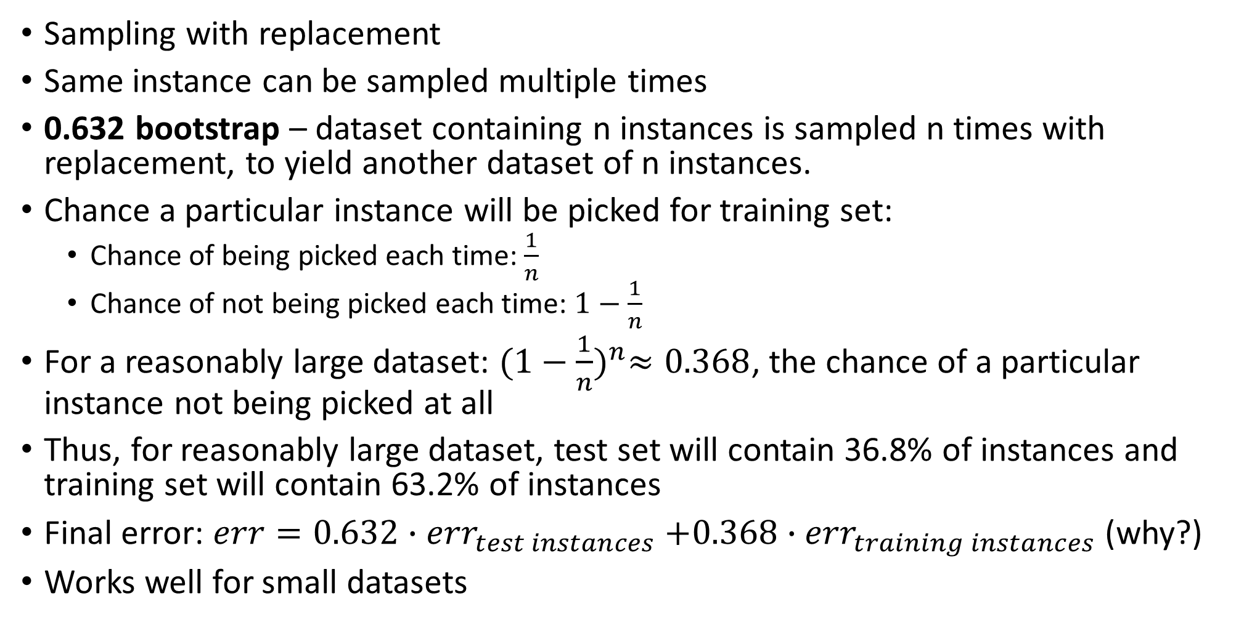
Bootstrap
Sampling with replacement
Same instance can be sampled multiple times
0.632 bootstrap – dataset containing n instances is sampled n times with replacement, to yield another dataset of n instances.
Chance a particular instance will be picked for training set:
Chance of being picked each time: $\frac{1}{n}$
Chance of not being picked each time: $1−\frac{1}{n}$
For a reasonably large dataset: ${(1−\frac{1}{n})}^{n}≈0.368$, the chance of a particular instance not being picked at all
Thus, for reasonably large dataset, test set will contain 36.8% of instances and training set will contain 63.2% of instances
Final error: $err=0.632{∙err}_{test instances}+0.368∙{err}_{training instances}$ (why?)
Works well for small datasets

Slide 17
5.5 Hyperparameter selection
Many learning algorithms have hyperparameters that can be tuned to optimize their behavior (different from normal parameters such as weights in linear regression)
Examples: ‘k’ from k-means clustering, or number of layers in a neural network, or number of coefficients in a polynomial
Best performance on test set is achieved by using hyperparameters that suit the characteristics of the data
Don’t cheat by using test set to select for hyperparameters
Instead, use something called a validation set
Run algorithm multiple times on training set with different hyperparameters values, evaluate resulting models on validation set (Hyperparameter tuning)
Choose best hyperparameter values, re-train model using best hyperparameter values on the full training set (validation + training set).
After fixing hyperparameters for final model, estimate performance on test set
Hyper-parameter tuning is computationally expensive (grid search)
Final project

Slide 18
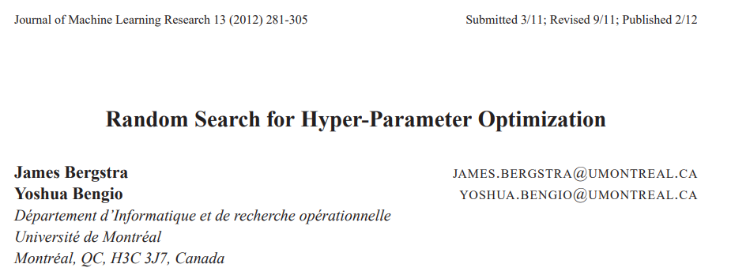

“this paper shows empirically and theoretically that randomly chosen trials are more efficient for hyper-parameter optimization than trials on a grid…compared with neural networks configured by a pure grid search, we find random search over the same domain is able to find models as good or better in a fraction of the computation time”
Yoshua Bengio
2019 Turing Award Recipient

Slide 19
Comparing data mining schemes
How to compare the results from two different algorithms on same dataset?
Simply choose the algorithm with highest success rate?
This problem occurs often in machine learning research, to publish you must show your algorithm achieves significantly better results than state of the art
Solution: use multiple datasets (or cross-validation on a single dataset) to generate a sample of success rates for each algorithm and perform a t-test to compare performance across different algorithms
65%
88%
77%
57%
98%
93%
94%
89%
Algorithm 1 performance on n=4 datasets
Mean success rate = (98+65+77+94)/4 = 83.5%
Algorithm 2 performance on same datasets
Mean success rate = (93+88+57+89)/4 = 81.8%
Is Algorithm 1 significantly better than Algorithm 2?

Slide 20
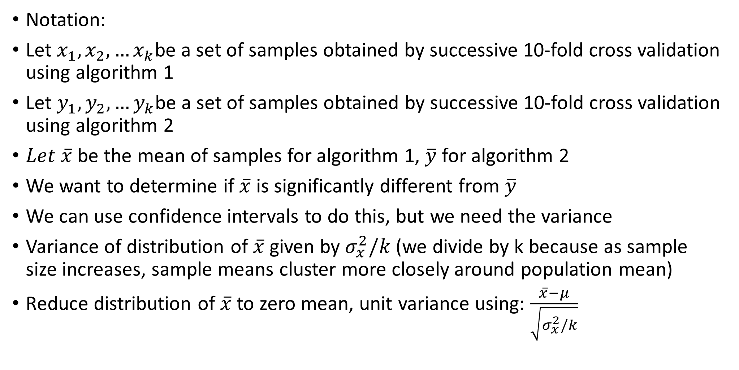
Student’s T-test
Notation:
Let $x_{1},x_{2},…x_{k}$be a set of samples obtained by successive 10-fold cross validation using algorithm 1
Let $y_{1},y_{2},…y_{k}$be a set of samples obtained by successive 10-fold cross validation using algorithm 2
$Let \overline{x}$ be the mean of samples for algorithm 1, $\overline{y}$ for algorithm 2
We want to determine if $\overline{x}$ is significantly different from $\overline{y}$
We can use confidence intervals to do this, but we need the variance
Variance of distribution of $\overline{x}$ given by $σ_{x}^{2}/k$ (we divide by k because as sample size increases, sample means cluster more closely around population mean)
Reduce distribution of $\overline{x}$ to zero mean, unit variance using: $\frac{\overline{x}−μ}{\sqrt{σ_{x}^{2}/k}}$

Slide 21
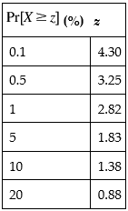
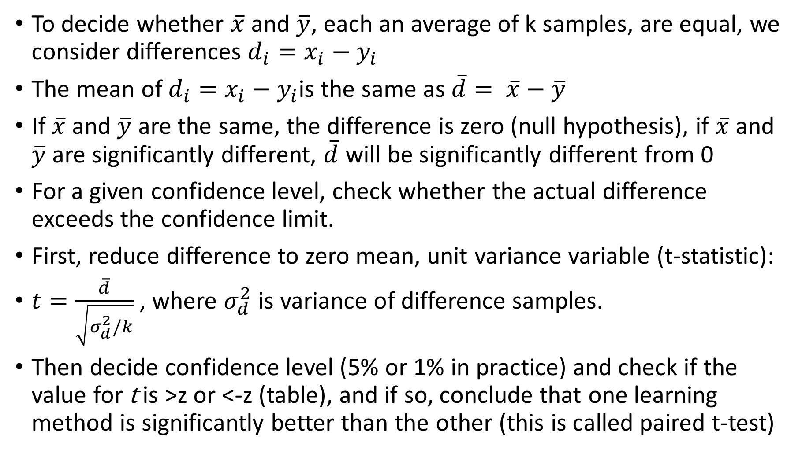
Student’s T-test
To decide whether $\overline{x}$ and $\overline{y}$, each an average of k samples, are equal, we consider differences $d_{i}=x_{i}−y_{i}$
The mean of $d_{i}=x_{i}−y_{i}$is the same as $\overline{d}= \overline{x}−\overline{y}$
If $\overline{x}$ and $\overline{y}$ are the same, the difference is zero (null hypothesis), if $\overline{x}$ and $\overline{y}$ are significantly different, $\overline{d}$ will be significantly different from 0
For a given confidence level, check whether the actual difference exceeds the confidence limit.
First, reduce difference to zero mean, unit variance variable (t-statistic):
$t=\frac{\overline{d}}{\sqrt{σ_{d}^{2}/k}}$ , where $σ_{d}^{2}$ is variance of difference samples.
Then decide confidence level (5% or 1% in practice) and check if the value for t is >z or <-z (table), and if so, conclude that one learning method is significantly better than the other (this is called paired t-test)

Slide 22
P-hacking
P-value hacking, also known as data dredging, data fishing, and data snooping is the misuse of data analysis to find patterns in data that can be represented as statistically significant when in fact there is no real underlying effect
In statistical hypothesis testing, the p-value or probability value is the probability that, when the null hypothesis is true, the observed effect would be found.
Example: clinical trial observes reduction in symptoms post-treatment, but is it significant? P-value gives probability that reduction in symptoms happened by chance.
Typically, p<0.05 is required for publication in academic journals
P-hacking epidemic in the biological/social sciences (reference below)
Relationship of p-hacking to training/test data: using the test set multiple times to rank different classifiers and optimize hyperparameters (test set ends up being used indirectly in creation of classifier)
“The extent and consequences of p-hacking in science”: https://journals.plos.org/plosbiology/article?id=10.1371/journal.pbio.1002106

Slide 23
Recap
Test set and training set are required if you want to estimate error rate on new data
Bootstrap and cross validation allow to estimate error more robustly given small training set
Hyperparameter optimization can improve results drastically, but avoid p-hacking/data snooping (don’t use test set for hyperparameter optimization)
Next week: loss functions, MDL principle, finish chapter 5

