Slide 1
CS405/505 Data Mining
Lecture 18

Slide 2
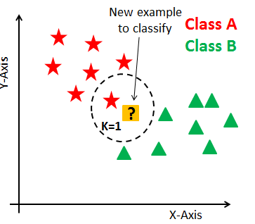
Chapter 7: extending instance-based and linear models
Overview:
Instance based learning and linear models are classic techniques used for decades to solve prediction tasks in statistics
We will extend these basic methods to tackle more challenging tasks
Instance based learning:
Sensitive to noise and irrelevant attributes
Sensitive to choice of distance function
Requires entire training dataset to be stored
Provides no insight into what has been ‘learned’
Linear models:
Extend applicability to cases where output is not a linear function of attributes
The ‘kernel trick’ resolves this issue, used in SVM, kernel regression, and kernel perceptron
Neural networks apply nonlinear transformation to output of linear models (multilayer perceptron)

Slide 3
Instance-based learning
Nearest neighbor rule can be used for basic instance-based learning
Simple nearest neighbor suffers from some shortcoming:
1) Slow for large training sets (too many exemplars)
2) Performs poorly on noisy data
3) Performs poorly when distance function takes irrelevant attributes into account
4) Does not provide structural description
1) reducing number of exemplars:
(exemplar refers to already-seen instance used for classification)
One solution: only update dataset when a misclassification occurs
Ideally, only a single exemplar stored for each important region of instance space
This does not work well in the case of noisy exemplars (we only update instance space when misclassification occurs, noisy instances lead to misclassification)
Set of stored exemplars will accumulate least useful exemplars (noisy ones)

Slide 4
Pruning noisy exemplars
Noisy exemplars lower performance of any nearest neighbor scheme because they cause new instances to be misclassified
Two ways of dealing with this:
1) average over k-nearest neighbors, and take majority class
Need to choose ‘k’, more noise=> greater value of k
2) monitor performance of stored exemplars, discard poor performers
Set two thresholds: lower and upper performance bounds
If exemplar’s performance drops below lower bound, discard it
If performance rises above upper bound, use it to predict new instances
IB3 instance based learner version 3 uses confidence limits to set these bounds
Confidence level of 5% used to determine acceptance (95% sure its good)
Confidence level of 12.5% used to determine rejection (87.5% sure its bad)

Slide 5
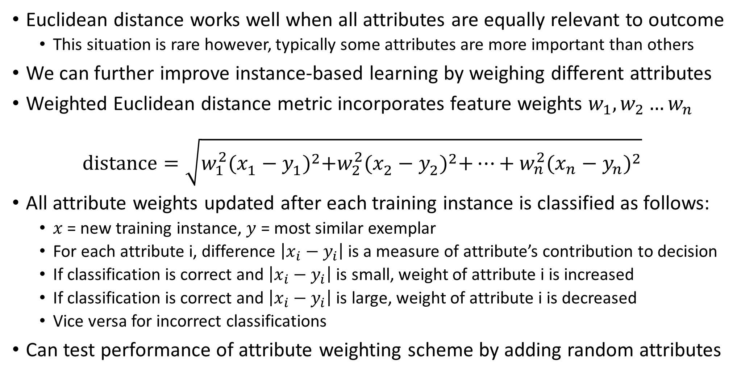
Weighting attributes
Euclidean distance works well when all attributes are equally relevant to outcome
This situation is rare however, typically some attributes are more important than others
We can further improve instance-based learning by weighing different attributes
Weighted Euclidean distance metric incorporates feature weights $w_{1},w_{2}…w_{n}$ $distance=\sqrt{w_{1}^{2}{(x_{1}^{ }−y_{1}^{ })}^{2}+w_{2}^{2}{(x_{2}^{ }−y_{2}^{ })}^{2}+…+w_{n}^{2}{(x_{n}^{ }−y_{n}^{ })}^{2}}$
All attribute weights updated after each training instance is classified as follows:
$x$ = new training instance, $y$ = most similar exemplar
For each attribute i, difference $\left|x_{i}−y_{i}\right|$ is a measure of attribute’s contribution to decision
If classification is correct and $\left|x_{i}−y_{i}\right|$ is small, weight of attribute i is increased
If classification is correct and $\left|x_{i}−y_{i}\right|$ is large, weight of attribute i is decreased
Vice versa for incorrect classifications
Can test performance of attribute weighting scheme by adding random attributes

Slide 6
Generalizing Exemplars
Generalized exemplars are rectangular regions of instance space (hyperrectangles)
When new exemplar is classified correctly, generalize it by merging it with the nearest exemplar of the same class, creating a hyperrectangle
If nearest exemplar is itself a hyperrectangle, expand its boundaries to include the new instance
If new exemplar is incorrectly classified by hyperrectangle, shrink the boundary
Distance functions for generalized exemplars:
dist(instance, hyperrectangle) = 0 if instance lies within hyperrectangle
Otherwise, use the distance to nearest part of hyperrectangle

Slide 7
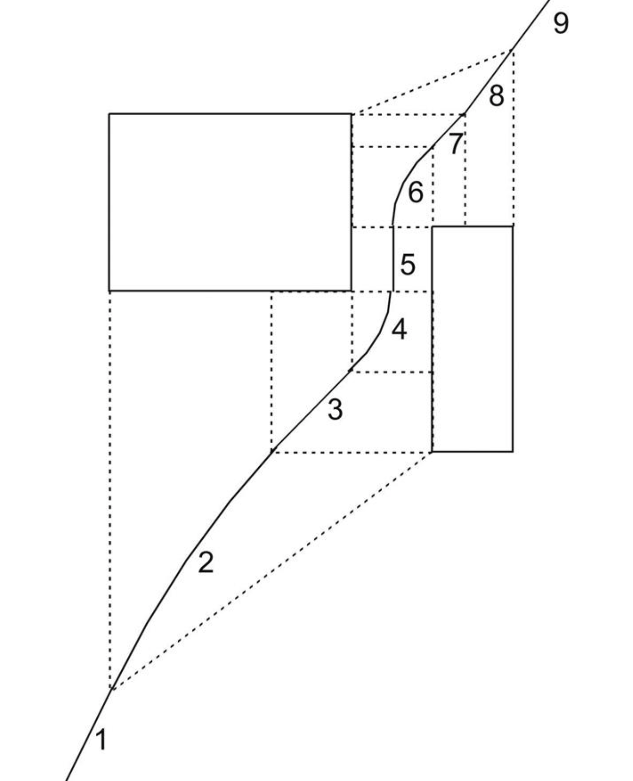
Hyperrectangle distance function
Implicit boundaries are formed between two rectangular classes if distance function measures distance to nearest point on rect.
Boundary is complicated, but generated implicitly by the nearest-neighbor calculation

Slide 8
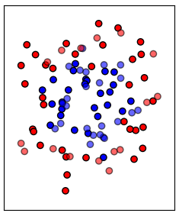
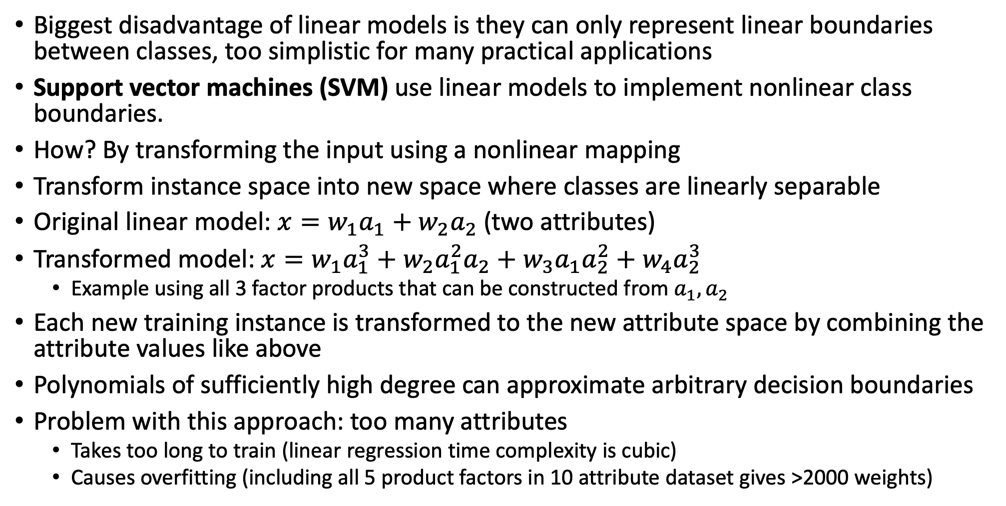
7.2 Extending Linear Models
Biggest disadvantage of linear models is they can only represent linear boundaries between classes, too simplistic for many practical applications
Support vector machines (SVM) use linear models to implement nonlinear class boundaries.
How? By transforming the input using a nonlinear mapping
Transform instance space into new space where classes are linearly separable
Original linear model: $x=w_{1}a_{1}+$ $w_{2}a_{2}$ (two attributes)
Transformed model: $x=w_{1}a_{1}^{3}+w_{2}a_{1}^{2}a_{2}+w_{3}a_{1}a_{2}^{2}+w_{4}a_{2}^{3}$
Example using all 3 factor products that can be constructed from $a_{1}, a_{2}$
Each new training instance is transformed to the new attribute space by combining the attribute values like above
Polynomials of sufficiently high degree can approximate arbitrary decision boundaries
Problem with this approach: too many attributes
Takes too long to train (linear regression time complexity is cubic)
Causes overfitting (including all 5 product factors in 10 attribute dataset gives >2000 weights)

Slide 9
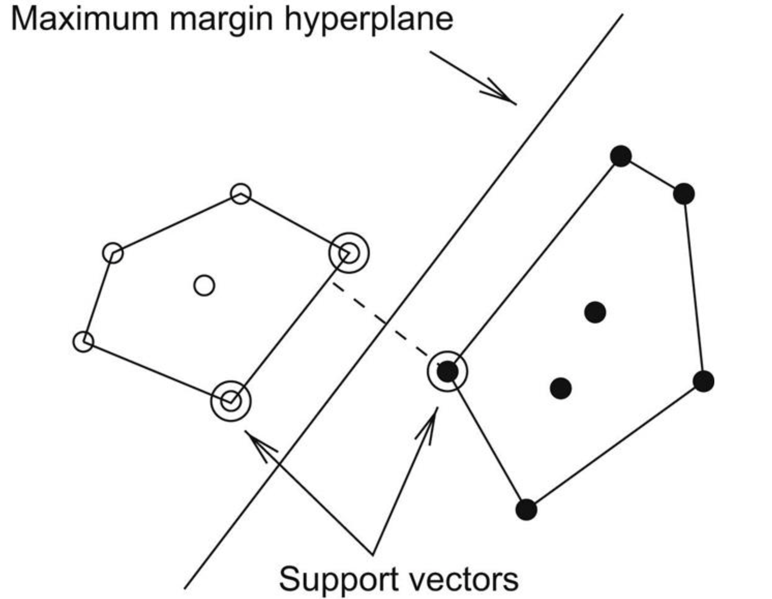
The maximum margin hyperplane
SVMs address the overfitting/high training time problems introduced by combining attributes and adding more weights
SVM based on an algorithm finding a special kind of linear model: the maximum margin hyperplane
Assuming classes are linearly separable, maximum margin hyperplane is the hyperplane that gives greatest separation between classes
Maximum margin hyperplane is the perpendicular bisector of shortest line connecting the convex hull of two classes
Instances closest to maximum margin hyperplane are called support vectors
Always at least 1 per class, usually more
All other training instances are irrelevant

Slide 10
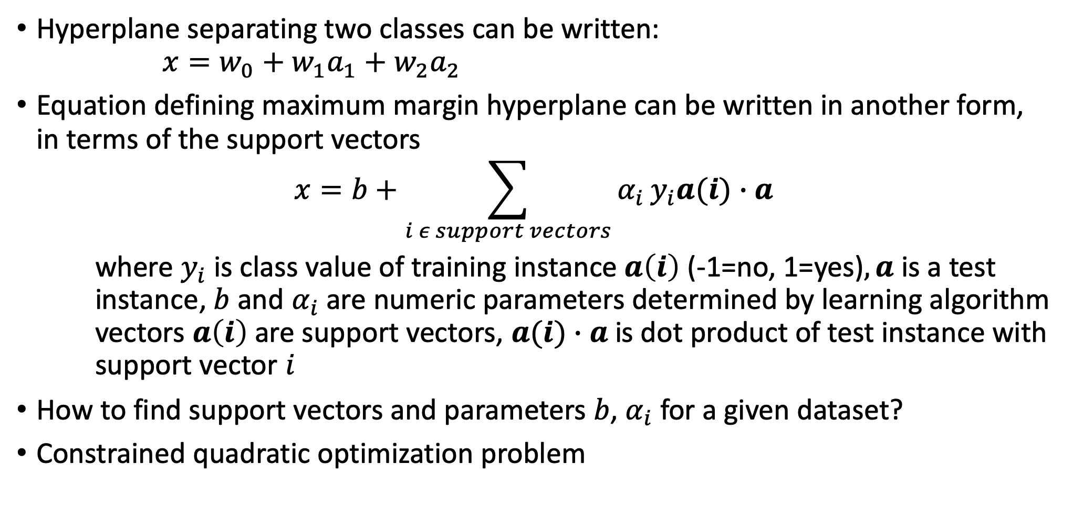
Support vector machine
Hyperplane separating two classes can be written: $x=w_{0}+w_{1}a_{1}+w_{2}a_{2}$
Equation defining maximum margin hyperplane can be written in another form, in terms of the support vectors
$$x=b+\sum_{i ε support vectors}{α_{i}}y_{i}a(i)∙a$$
where $y_{i}$ is class value of training instance $a\left(i\right)$ (-1=no, 1=yes)$, a$ is a test instance, $b$ and $α_{i}$are numeric parameters determined by learning algorithm vectors $a\left(i\right)$ are support vectors, $a(i)∙a$ is dot product of test instance with support vector $i$
How to find support vectors and parameters $b$, $α_{i}$ for a given dataset?
Constrained quadratic optimization problem

Slide 11
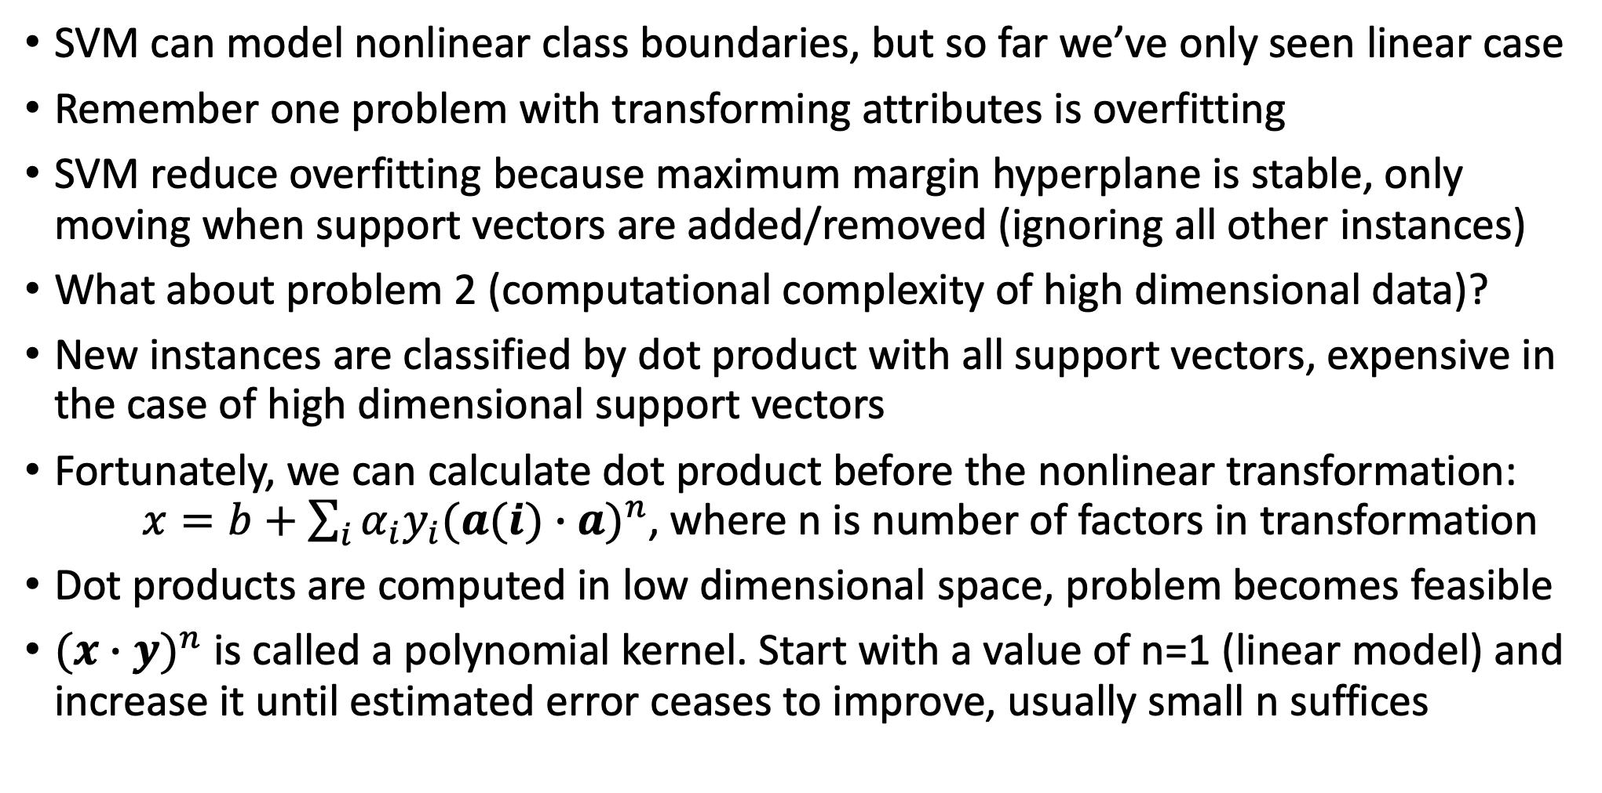
Nonlinear class boundaries
SVM can model nonlinear class boundaries, but so far we’ve only seen linear case
Remember one problem with transforming attributes is overfitting
SVM reduce overfitting because maximum margin hyperplane is stable, only moving when support vectors are added/removed (ignoring all other instances)
What about problem 2 (computational complexity of high dimensional data)?
New instances are classified by dot product with all support vectors, expensive in the case of high dimensional support vectors
Fortunately, we can calculate dot product before the nonlinear transformation: $x=b+\sum_{i}{α_{i}y_{i}{(a(i)∙a)}^{n}}$, where n is number of factors in transformation
Dot products are computed in low dimensional space, problem becomes feasible
${(x∙y)}^{n}$ is called a polynomial kernel. Start with a value of n=1 (linear model) and increase it until estimated error ceases to improve, usually small n suffices

Slide 12
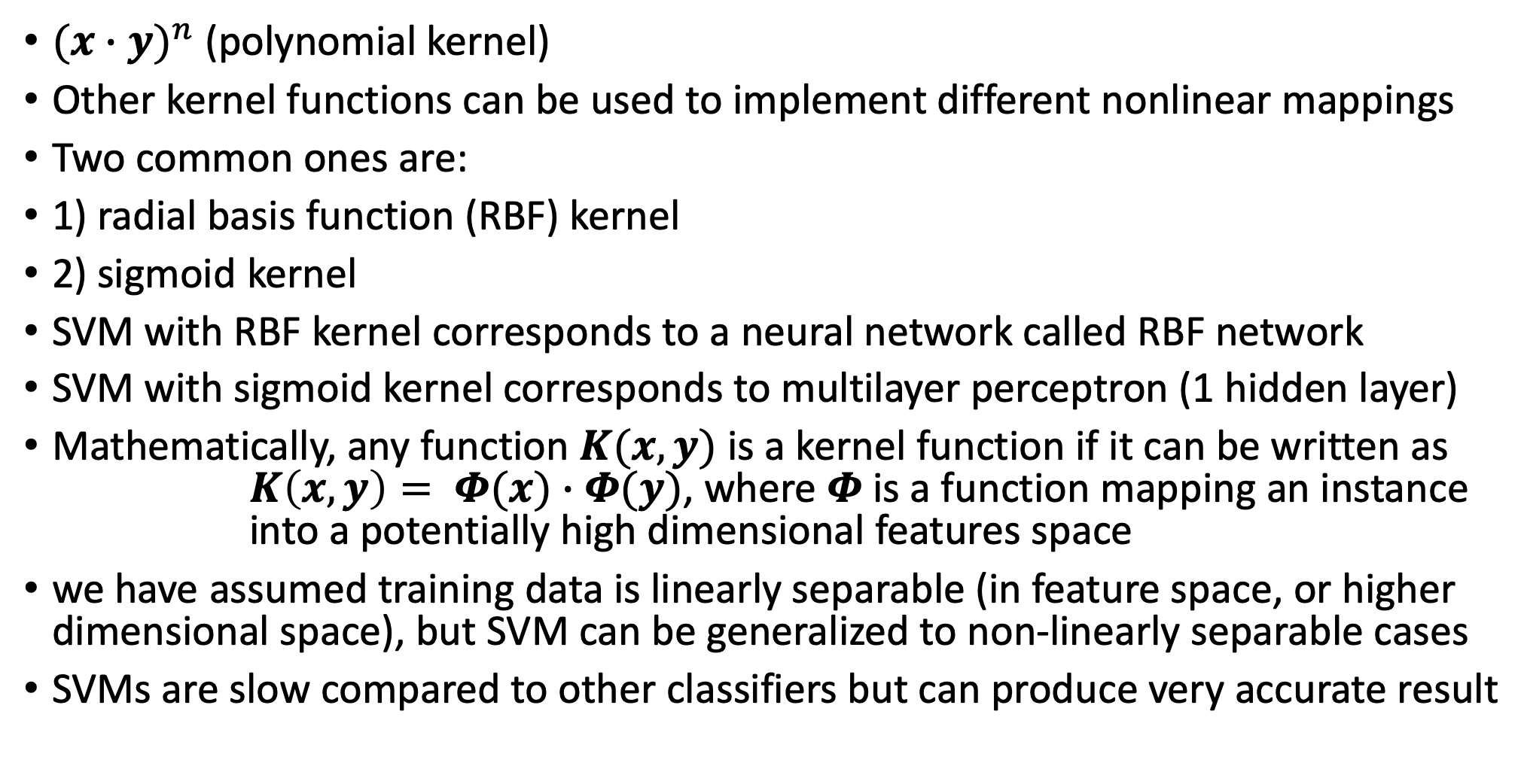
Kernel functions
${(x∙y)}^{n}$ (polynomial kernel)
Other kernel functions can be used to implement different nonlinear mappings
Two common ones are:
1) radial basis function (RBF) kernel
2) sigmoid kernel
SVM with RBF kernel corresponds to a neural network called RBF network
SVM with sigmoid kernel corresponds to multilayer perceptron (1 hidden layer)
Mathematically, any function $K(x,y)$ is a kernel function if it can be written as $K\left(x,y\right)= Φ(x)∙Φ(y)$, where $Φ$ is a function mapping an instance into a potentially high dimensional features space
we have assumed training data is linearly separable (in feature space, or higher dimensional space), but SVM can be generalized to non-linearly separable cases
SVMs are slow compared to other classifiers but can produce very accurate result

Slide 13
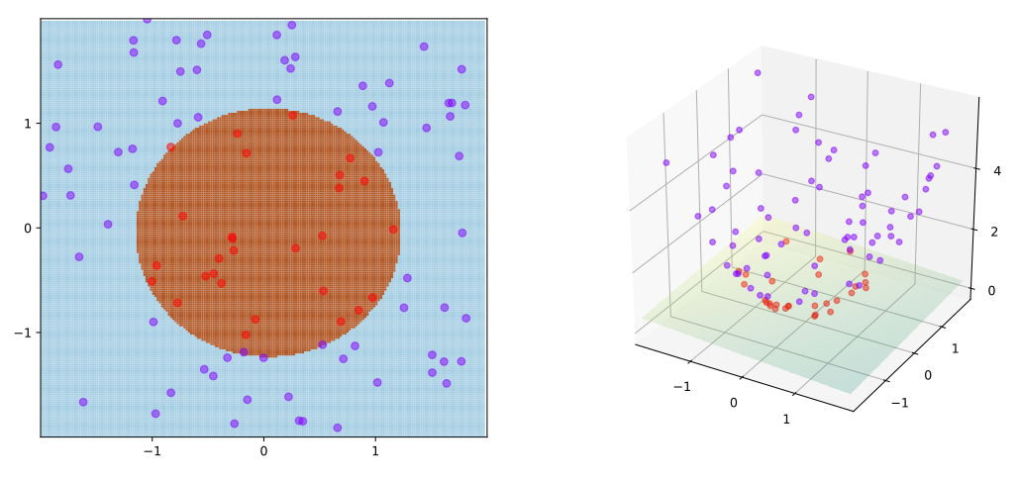
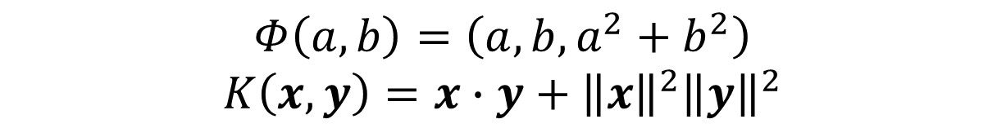
$$Φ\left(a,b\right)=\left(a,b,a^{2}+b^{2}\right)$$
$$K\left(x,y\right)=x∙y+{\left\|x\right\|}^{2}{\left\|y\right\|}^{2}$$
https://en.wikipedia.org/wiki/Kernel_method

Slide 14
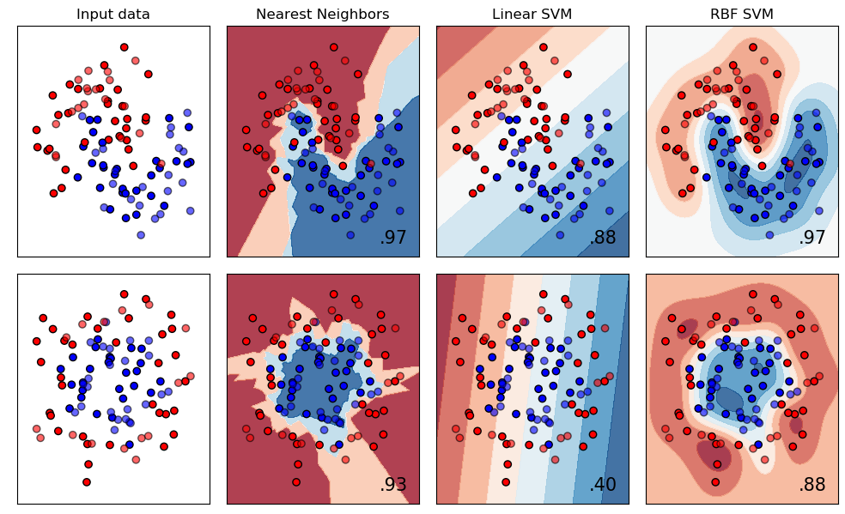

Slide 15
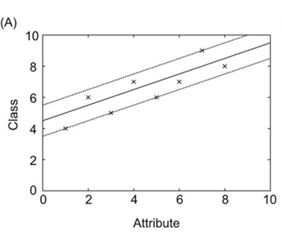
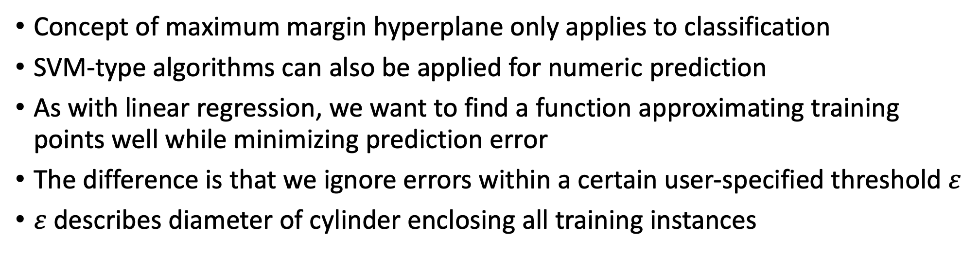
Support vector regression
Concept of maximum margin hyperplane only applies to classification
SVM-type algorithms can also be applied for numeric prediction
As with linear regression, we want to find a function approximating training points well while minimizing prediction error
The difference is that we ignore errors within a certain user-specified threshold $ε$
$ε$ describes diameter of cylinder enclosing all training instances

Slide 16
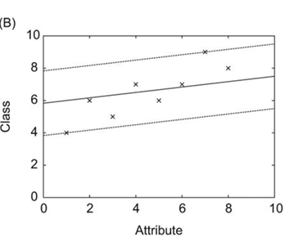
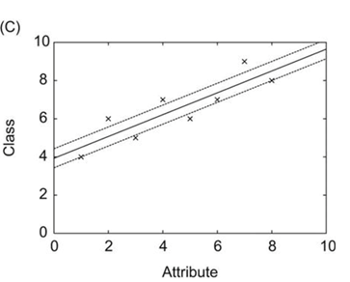
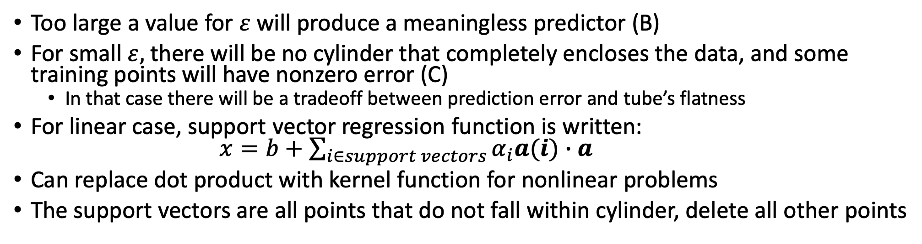
Support vector regression
Too large a value for $ε$ will produce a meaningless predictor (B)
For small $ε,$there will be no cylinder that completely encloses the data, and some training points will have nonzero error (C)
In that case there will be a tradeoff between prediction error and tube’s flatness
For linear case, support vector regression function is written: $x=b+\sum_{i∈support vectors}{α_{i}a(i)∙a}$
Can replace dot product with kernel function for nonlinear problems
The support vectors are all points that do not fall within cylinder, delete all other points

Slide 17
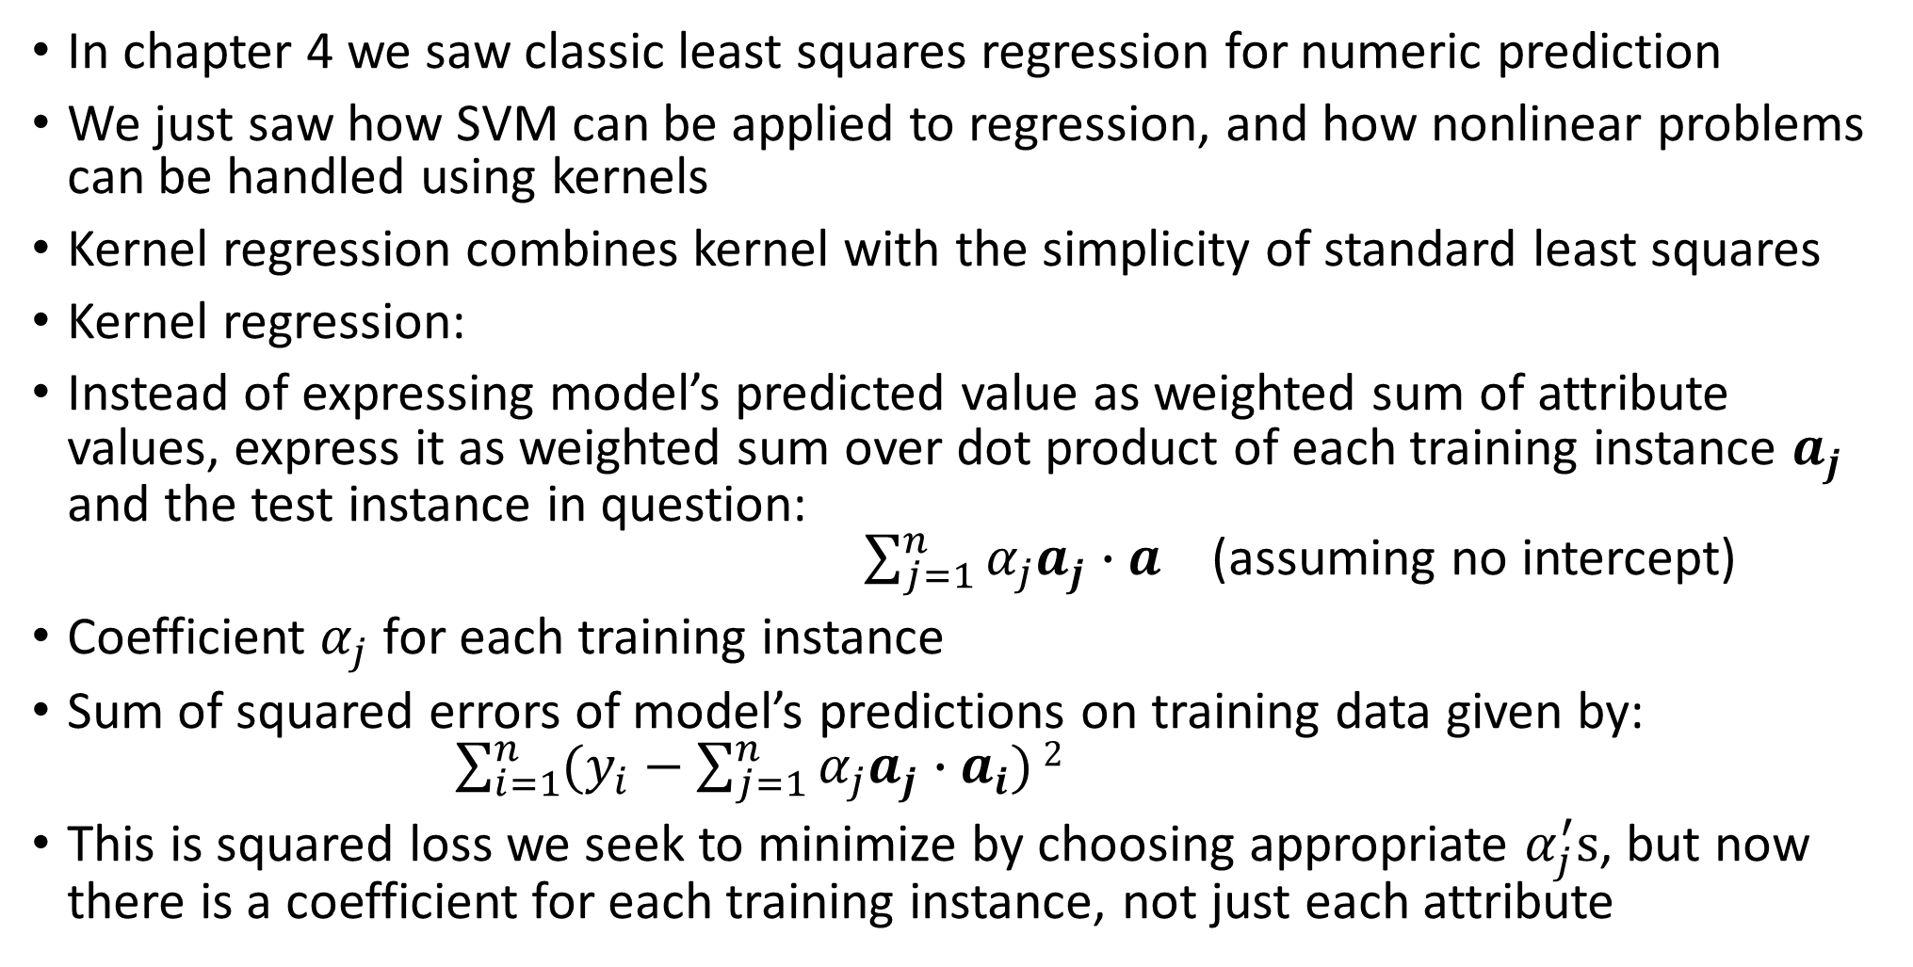
Kernel ridge regression
In chapter 4 we saw classic least squares regression for numeric prediction
We just saw how SVM can be applied to regression, and how nonlinear problems can be handled using kernels
Kernel regression combines kernel with the simplicity of standard least squares
Kernel regression:
Instead of expressing model’s predicted value as weighted sum of attribute values, express it as weighted sum over dot product of each training instance $a_{j}$ and the test instance in question: $\sum_{j=1}^{n}{α_{j}a_{j}∙a}$ (assuming no intercept)
Coefficient $α_{j}$ for each training instance
Sum of squared errors of model’s predictions on training data given by: $\sum_{i=1}^{n}{(y_{i}−\sum_{j=1}^{n}{α_{j}a_{j}∙a_{i}})}2$
This is squared loss we seek to minimize by choosing appropriate $α_{j}^{′}s$, but now there is a coefficient for each training instance, not just each attribute

Slide 18
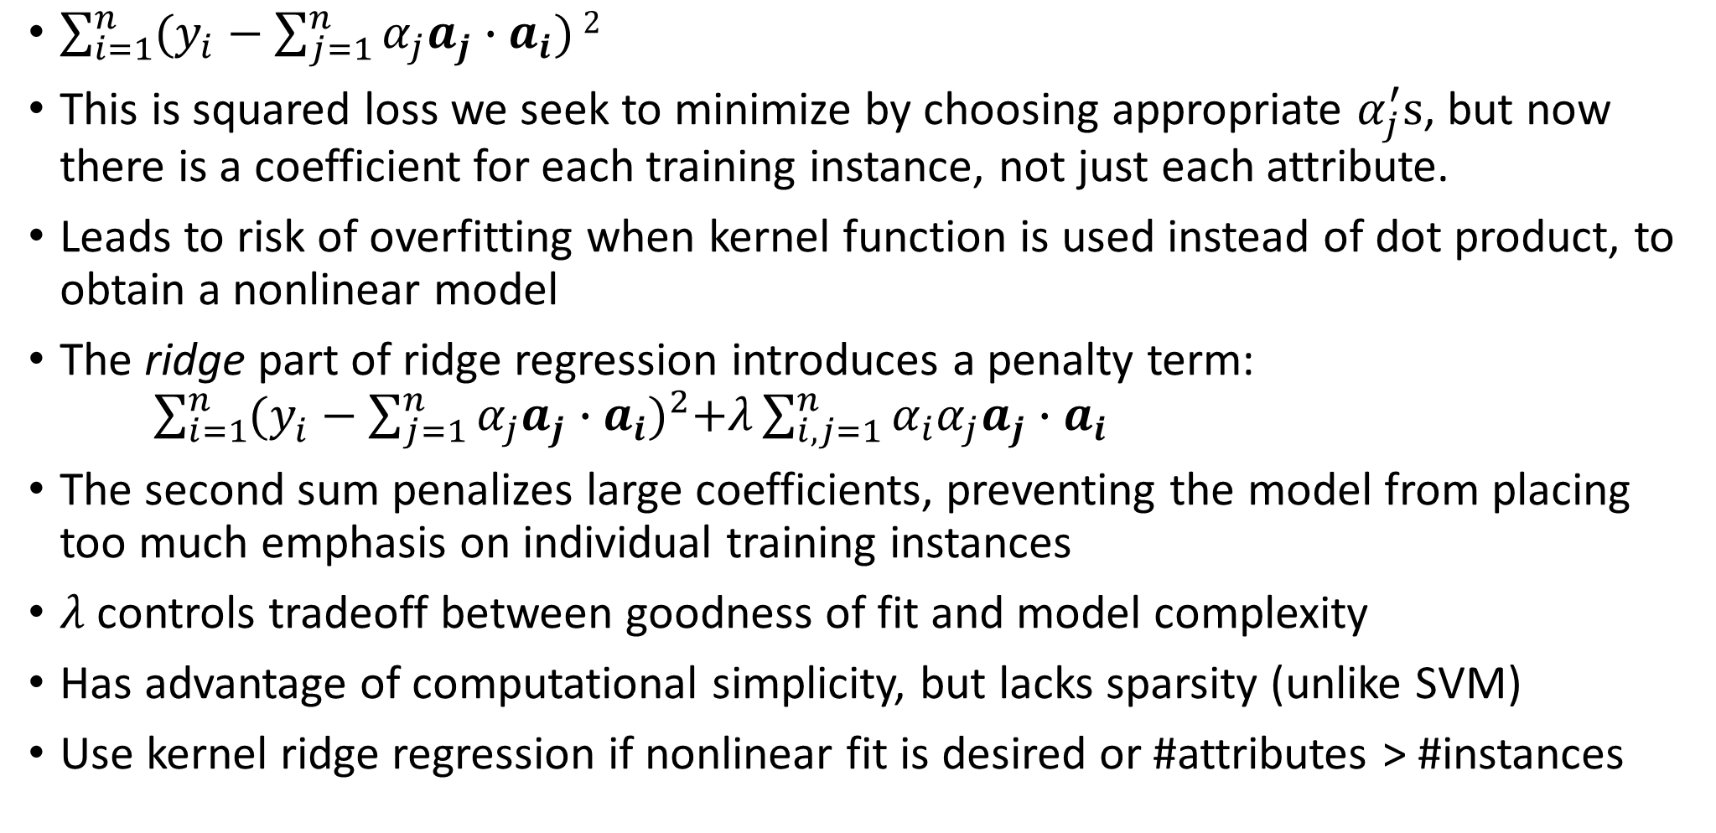
Kernel ridge regression
$\sum_{i=1}^{n}{(y_{i}−\sum_{j=1}^{n}{α_{j}a_{j}∙a_{i}})}2$
This is squared loss we seek to minimize by choosing appropriate $α_{j}^{′}s$, but now there is a coefficient for each training instance, not just each attribute.
Leads to risk of overfitting when kernel function is used instead of dot product, to obtain a nonlinear model
The ridge part of ridge regression introduces a penalty term: $\sum_{i=1}^{n}{{(y_{i}^{ }−\sum_{j=1}^{n}{α_{j}a_{j}∙a_{i}})}^{2}+λ\sum_{i,j=1}^{n}{α_{i}α_{j}a_{j}∙a_{i}}}$
The second sum penalizes large coefficients, preventing the model from placing too much emphasis on individual training instances
$λ$ controls tradeoff between goodness of fit and model complexity
Has advantage of computational simplicity, but lacks sparsity (unlike SVM)
Use kernel ridge regression if nonlinear fit is desired or #attributes > #instances

Slide 19
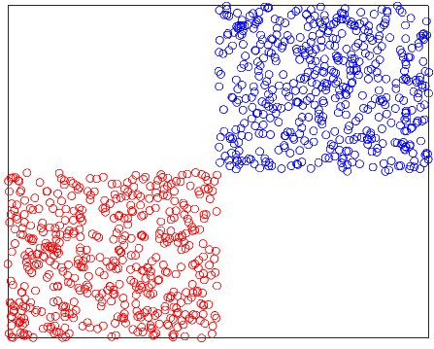
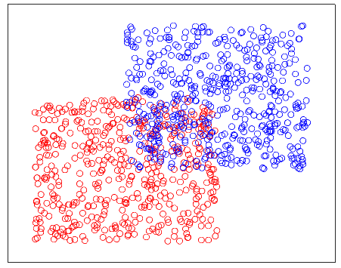
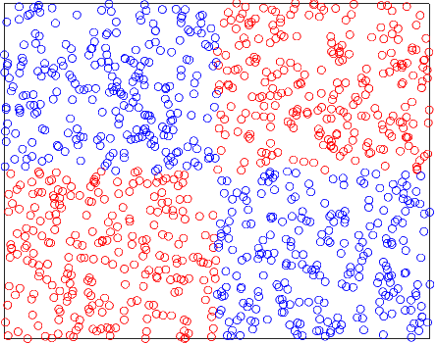
Kernel perceptron
Chapter 4 we saw the perceptron which could not handle xor function (or any classification problem with non-linear class boundary)
100% accuracy
85% accuracy
50% accuracy

Slide 20
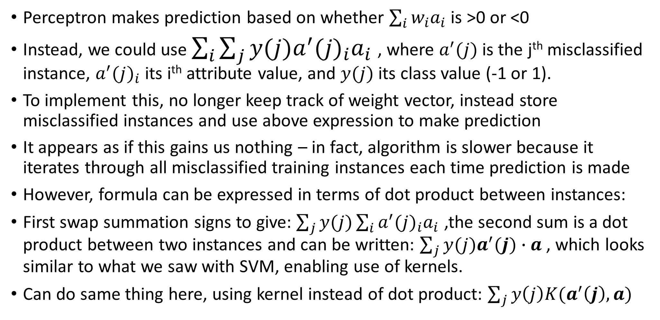
Kernel perceptron
Perceptron makes prediction based on whether $\sum_{i}{w_{i}a_{i}}$ is >0 or <0
Instead, we could use $\sum_{i}{\sum_{j}{y(j)a^{′}{(j)}_{i}a_{i}}}$ , where $a^{′}{(j)}_{ }$is the j^{th} misclassified instance, $a^{′}{(j)}_{i}$ its i^{th} attribute value, and $y(j)$ its class value (-1 or 1).
To implement this, no longer keep track of weight vector, instead store misclassified instances and use above expression to make prediction
It appears as if this gains us nothing – in fact, algorithm is slower because it iterates through all misclassified training instances each time prediction is made
However, formula can be expressed in terms of dot product between instances:
First swap summation signs to give: $\sum_{j}{y(j)\sum_{i}{a^{′}{(j)}_{i}a_{i}}}$ ,the second sum is a dot product between two instances and can be written: $\sum_{j}{y(j)a^{′}(j)∙a}$ , which looks similar to what we saw with SVM, enabling use of kernels.
Can do same thing here, using kernel instead of dot product: $\sum_{j}{y\left(j\right)K(a^{′}\left(j\right),a)}$

Slide 21
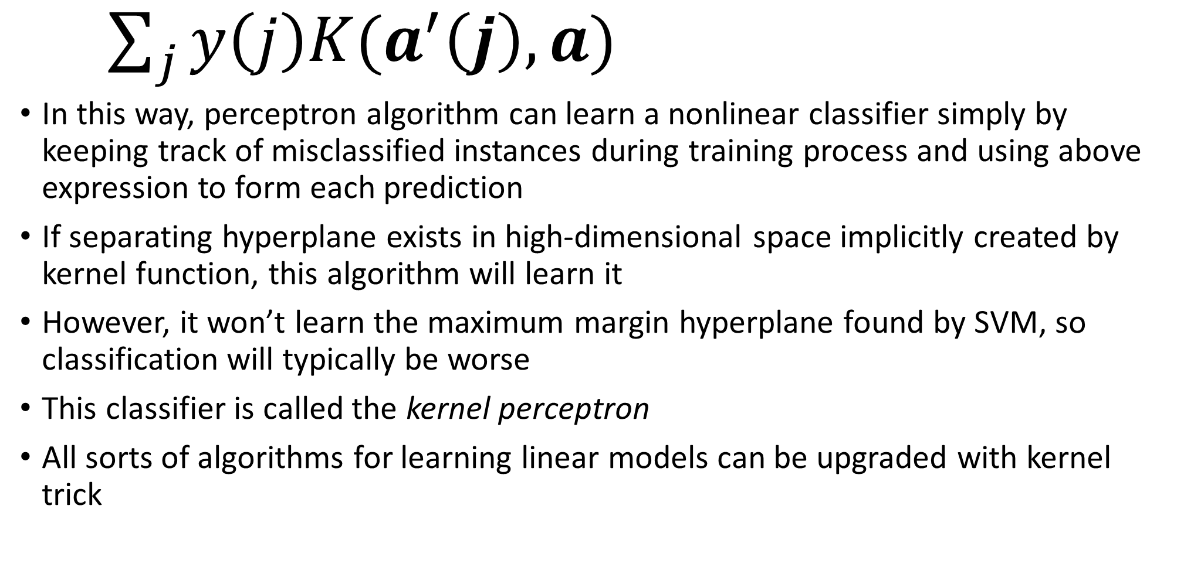
Kernel perceptron
$\sum_{j}{y\left(j\right)K(a^{′}\left(j\right),a)}$
In this way, perceptron algorithm can learn a nonlinear classifier simply by keeping track of misclassified instances during training process and using above expression to form each prediction
If separating hyperplane exists in high-dimensional space implicitly created by kernel function, this algorithm will learn it
However, it won’t learn the maximum margin hyperplane found by SVM, so classification will typically be worse
This classifier is called the kernel perceptron
All sorts of algorithms for learning linear models can be upgraded with kernel trick

Slide 22
Summary
Instance based learning
Weighing attributes
Generalizing exemplars
Kernel functions
Used by SVM to learn nonlinear decision boundaries
Kernel trick
Calculating dot product before nonlinear transformation
Support vector regression, kernel ridge regression, kernel perceptron
Next class: multilayer perceptrons, backpropagation, and stochastic gradient descent

