Slide 1
The Bayesian way

Slide 2
Statistics: “pertaining to matters of state”
Florence nightingale statistics lazaret wounded soldier mortality
Statistical mechanics
Quantum mechanics

Slide 3
Statistics has a threefold purpose
1) collecting and ordering data
2) systematizing, and summarizing in a few key numbers what the data are saying
3) using the collected data to estimate data we have yet to collect
Two worlds: the world of data, and the world of probability
Graph of height distribution vs probability distribution of height

Slide 4
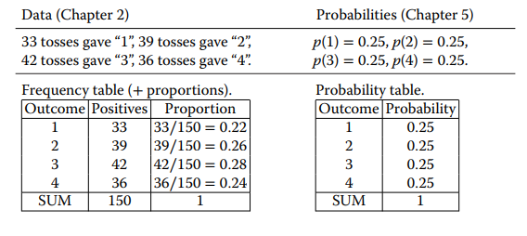
Pascal and Fermat’s game model
Calculates probability P of an event A
Uses two numbers: 1) positive states and 2) total states
Probability is then P(A) = positive / total
Probability is a proportion
Six sided die, event A = 1. positive = 1, total=6, P(1) = 1/6

Slide 5
Flipping a coin
What is the probability of 0 heads in 2 flips?
P(number of heads = 0) = |{TT}| / |{TT HT TH HH}| = 1/4
Length of positive list divided by length of total list

Slide 6
Covariance and correlation
Covariance of a variable with itself is its variance
cov(X,X) = SSxx = sum((x-mean(x)) .* (x-mean(x)))
cov(X,Y) = SSxy = sum((x-mean(x)) .*(y-mean(y)))
What do you get from this formula?
Difference between correlation and covariance?
Correlation tells you how strongly the variation of the two variables is linked
Covariance tells you a mix of the strength of the link and the size of the variation

Slide 7
Least squares regression
Start with a set of data points {(xi,yi)}, i=1 to n
Define design matrix X and response vector y:
X = [[1..1] ; [x1…xn]], y = [y1…yn]
Then beta = [alpha, beta] = (XTX)^-1XTy

Slide 8
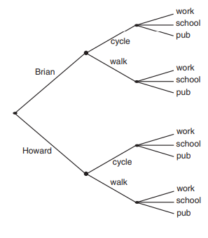
Combinatorics
The elements of product sets are sequences
If A = {a1,a2} and B = {b1,b2} then A x B = {(a1,b1),(a1,b2),(a2,b1),(a2,b2)}
Tree diagram is a product of sets

Slide 9
The concept of probability
As the legend goes, an exchange arose between Fermat and Pascal over how to fairly split the prize of a game that had been interrupted before its conclusion.
They decided to distribute the prize according to the probability of either player winning.
You are playing a game of dice for 20$. You will win if it lands a 1. otherwise you will lose. You should get 20/6 = $3.33 if the game is interrupted before your throw

Slide 10
Definitions of probability
There is no consensus among statisticians and probabilists
Two basic intuitions:
1) symmetry (we assign 1/6 to a fair die)
2) relative frequency (we attempt many throws and record the result)
Relative frequency will approach p as n->infinity
Subjective definition of probability: P(A) = m / (m+n),
Where m is the price for betting on something, and n is the price for betting against something

Slide 11
Frequentist definition of probability
If an experiment can be repeated in an identical manner but still have different outcomes, the outcome is said to be random.
We define the frequentist probability for a class of outcomes, A:
P(A) = lim n->infinity (Sn / n)
Where Sn is the frequency of outcomes of type A after n repetitions
P(A) is the limit of relative frequency as the number of trials tends to infinity
Frequentist approach is not objective

Slide 12
propensity
Probability (propensity) is a tendency towards different outcomes of a system, where the tendencies are inherent in the system itself.
P(A) is the degree to which this tendency points to the outcome A, often called a propensity.

Slide 13
Probability (Bayesian) pg77
Probability is a state or degree of knowledge.
Basic probabilities are defined from symmetry in our knowledge about the system.
If A and B are symmetrical (interchangeable) in the model, P(A) = P(B)

Slide 14
Bard, Frederick, and Sam
Bard the Bayesian
Frederick the Frequentist
The friend Sam
Sam notices a coin under a tablecloth. He can’t tell which side is up. He asks “what is the probability that it is heads?”
Bard: “There is a 0.5 probability heads is up. The symmetry of the coin means our state of knowledge is symmetrical with respect to the two alternatives, heads and tails”
Frederick: *lifts up the clothe - “when the outcome is fixed, the probability is either 0% or 100%, but we don’t know which”
Who is correct?

Slide 15
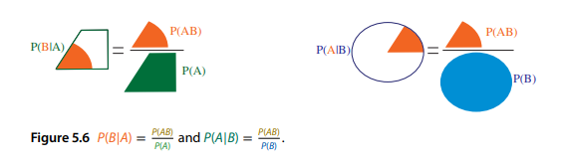
Conditional probability
The airplane is flying smoothly. What is the probability of crash?
The airplane engine is on fire. What is the probability of crash?
P(A|B) = P(AB) / P(B)
The ratio of the size of the smaller object to the larger object is the conditional probability

Slide 16

Bayes’ theorem
The crown jewel of statistics
Bayes’ theorem works like a function taking old probabilities and new data, and returning new probabilities
P(Ak|B) = P(B|Ak)P(Ak) / sumj(P(B|Aj)P(Aj))

