Slide 1
CS405/505 Data Mining
Lecture 16

Slide 2
Administrative slide
Midterm
Assignment 2
Assignment 3 + final project
Python demonstrations?

Slide 3
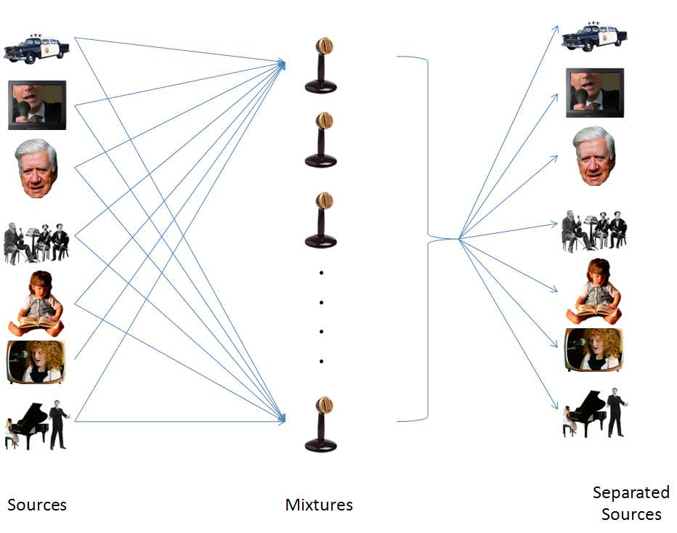
Independent Component Analysis (ICA)
Decompose multivariate signal into independent non-gaussian signals
Cocktail party problem:
Input: mixed signal (what we measure)
Output: unmixed signal (independent components)
ICA is a blind signal separation technique

Slide 4
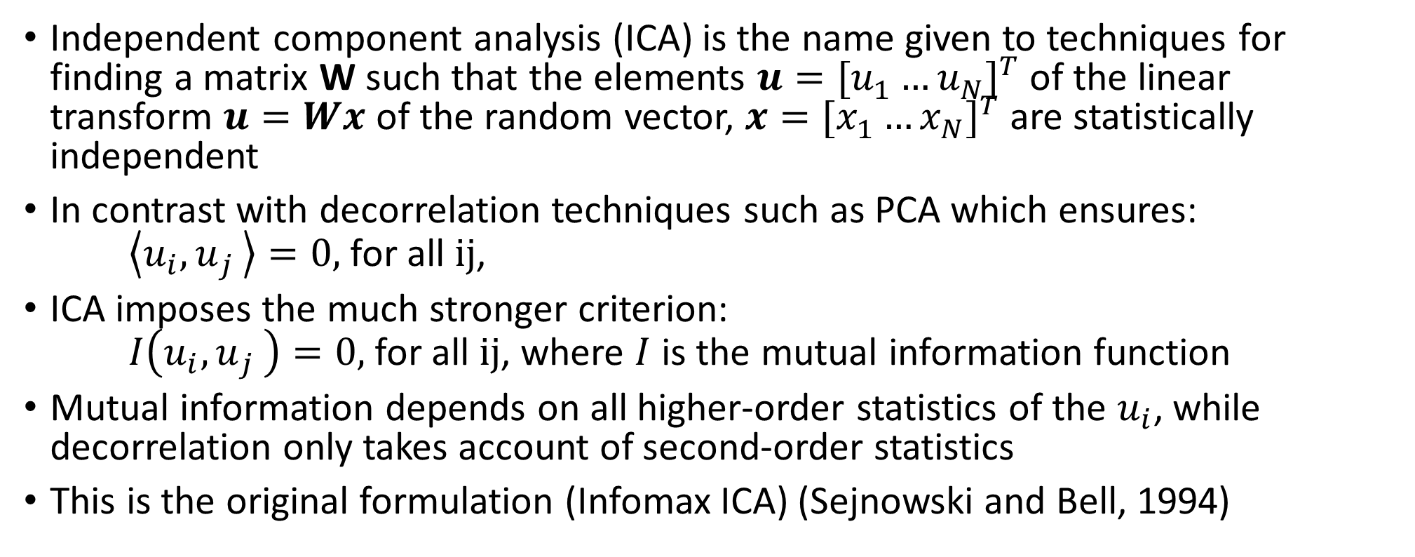
General definition of ICA
Independent component analysis (ICA) is the name given to techniques for finding a matrix W such that the elements $u={[u_{1}^{ }…u_{N}^{ }]}^{T}$ of the linear transform $u=Wx$ of the random vector, $x={[x_{1}^{ }…x_{N}^{ }]}^{T}$ are statistically independent
In contrast with decorrelation techniques such as PCA which ensures: $\left\langle u_{i}{,u}_{j}\right\rangle =0,$ for all ij,
ICA imposes the much stronger criterion: $I\left(u_{i}{,u}_{j}\right)=0,$ for all ij, where $I$ is the mutual information function
Mutual information depends on all higher-order statistics of the $u_{i}$, while decorrelation only takes account of second-order statistics
This is the original formulation (Infomax ICA) (Sejnowski and Bell, 1994)
http://www.inf.fu-berlin.de/lehre/WS05/Mustererkennung/infomax/infomax.pdf

Slide 5
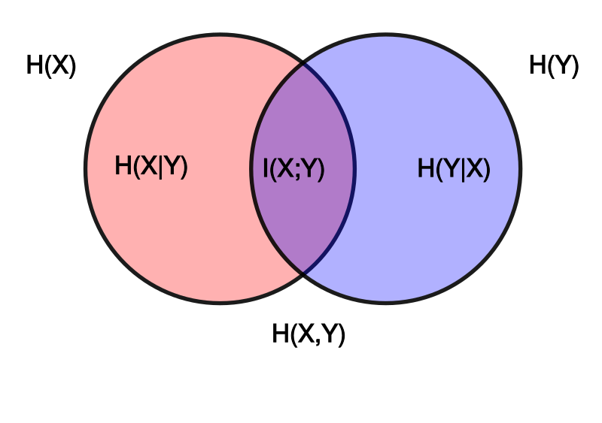
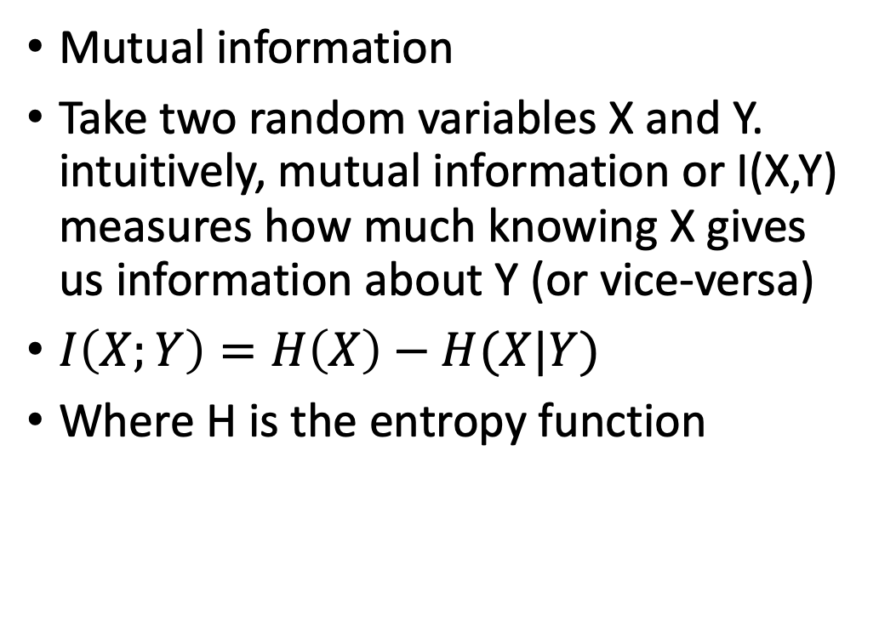
Measures of Independence: Mutual information
Mutual information
Take two random variables X and Y. intuitively, mutual information or I(X,Y) measures how much knowing X gives us information about Y (or vice-versa)
$I\left(X;Y\right)=H\left(X\right)−H(X|Y)$
Where H is the entropy function

Slide 6
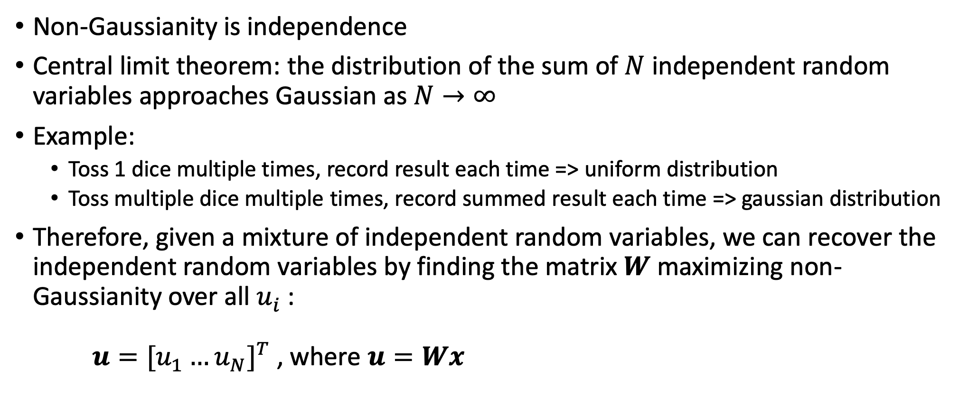
Measures of independence: non-Gaussianity
Non-Gaussianity is independence
Central limit theorem: the distribution of the sum of $N$ independent random variables approaches Gaussian as $N→∞$
Example:
Toss 1 dice multiple times, record result each time => uniform distribution
Toss multiple dice multiple times, record summed result each time => gaussian distribution
Therefore, given a mixture of independent random variables, we can recover the independent random variables by finding the matrix $W$ maximizing non-Gaussianity over all $u_{i}^{ }$: $u={[u_{1}^{ }…u_{N}^{ }]}^{T}$ , where $u=Wx$

Slide 7
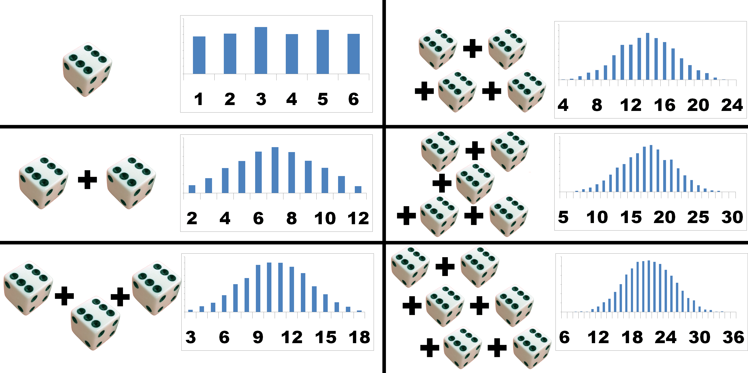
Central limit theorem: dice example
https://www.muelaner.com/uncertainty-of-measurement/attachment/central-limit-theorem/

Slide 8
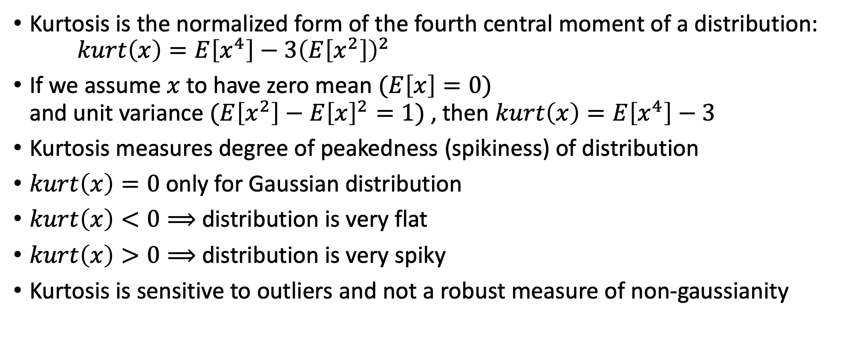
Quantifying non-Gaussianity: Kurtosis
Kurtosis is the normalized form of the fourth central moment of a distribution: $kurt\left(x\right)=E\left[x^{4}\right]−3{\left(E\left[x^{2}\right]\right)}^{2}$
If we assume $x$ to have zero mean $(E\left[x\right]=0)$ and unit variance $(E\left[x^{2}\right]−{E\left[x\right]}^{2}=1)$ , then $kurt\left(x\right)=E\left[x^{4}\right]−3$
Kurtosis measures degree of peakedness (spikiness) of distribution
$kurt\left(x\right)=0$ only for Gaussian distribution
$kurt\left(x\right)<0⟹$ distribution is very flat
$kurt\left(x\right)>0⟹$ distribution is very spiky
Kurtosis is sensitive to outliers and not a robust measure of non-gaussianity

Slide 9
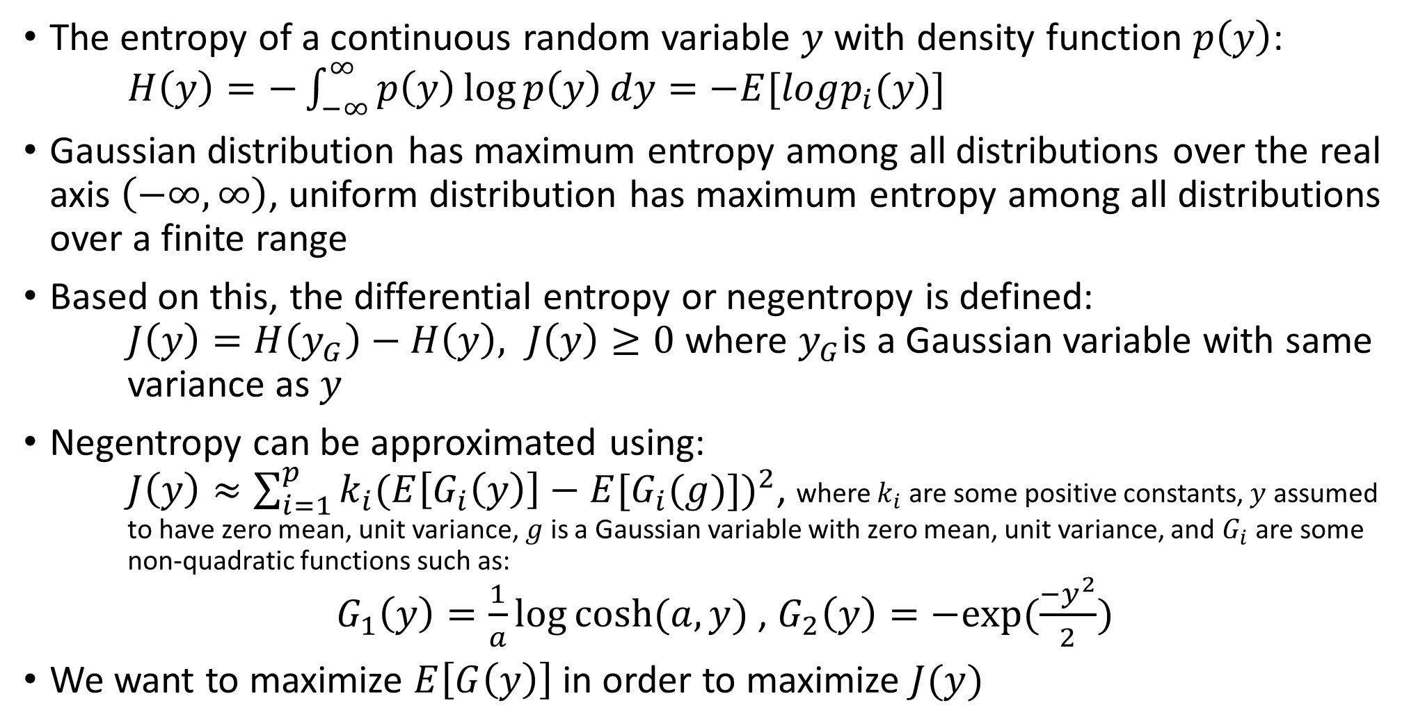
Quantifying non-Gaussianity: Negentropy
The entropy of a continuous random variable $y$ with density function $p\left(y\right)$: $H\left(y\right)=−\int_{−∞}^{∞}{p\left(y\right)\log{p\left(y\right)}dy=−E[logp_{i}(y)]}$
Gaussian distribution has maximum entropy among all distributions over the real axis $\left(−∞,∞\right)$, uniform distribution has maximum entropy among all distributions over a finite range
Based on this, the differential entropy or negentropy is defined: $J\left(y\right)=H\left(y_{G}\right)−H\left(y\right), J\left(y\right)≥0$ where $y_{G}$is a Gaussian variable with same variance as $y$
Negentropy can be approximated using: $J\left(y\right)≈\sum_{i=1}^{p}{k_{i}{(E\left[G_{i}\left(y\right)\right]−E[G_{i}(g)])}^{2}}$, where $k_{i}$ are some positive constants, $y$ assumed to have zero mean, unit variance, $g$ is a Gaussian variable with zero mean, unit variance, and $G_{i}$ are some non-quadratic functions such as: $G_{1}\left(y\right)=\frac{1}{a}\log{cosh⁡(a,y)}$ , $G_{2}\left(y\right)=−exp⁡(\frac{{−y}^{2}}{2})$
We want to maximize $E\left[G\left(y\right)\right]$ in order to maximize $J(y)$

Slide 10

Preprocessing for ICA:
To simplify the ICA algorithm, following preprocessing steps are usually taken:
Centering: subtract the mean, $E\left[x\right]$ from the observed variable $x$
Whitening (PCA + additional step):
PCA reminder:

Slide 11
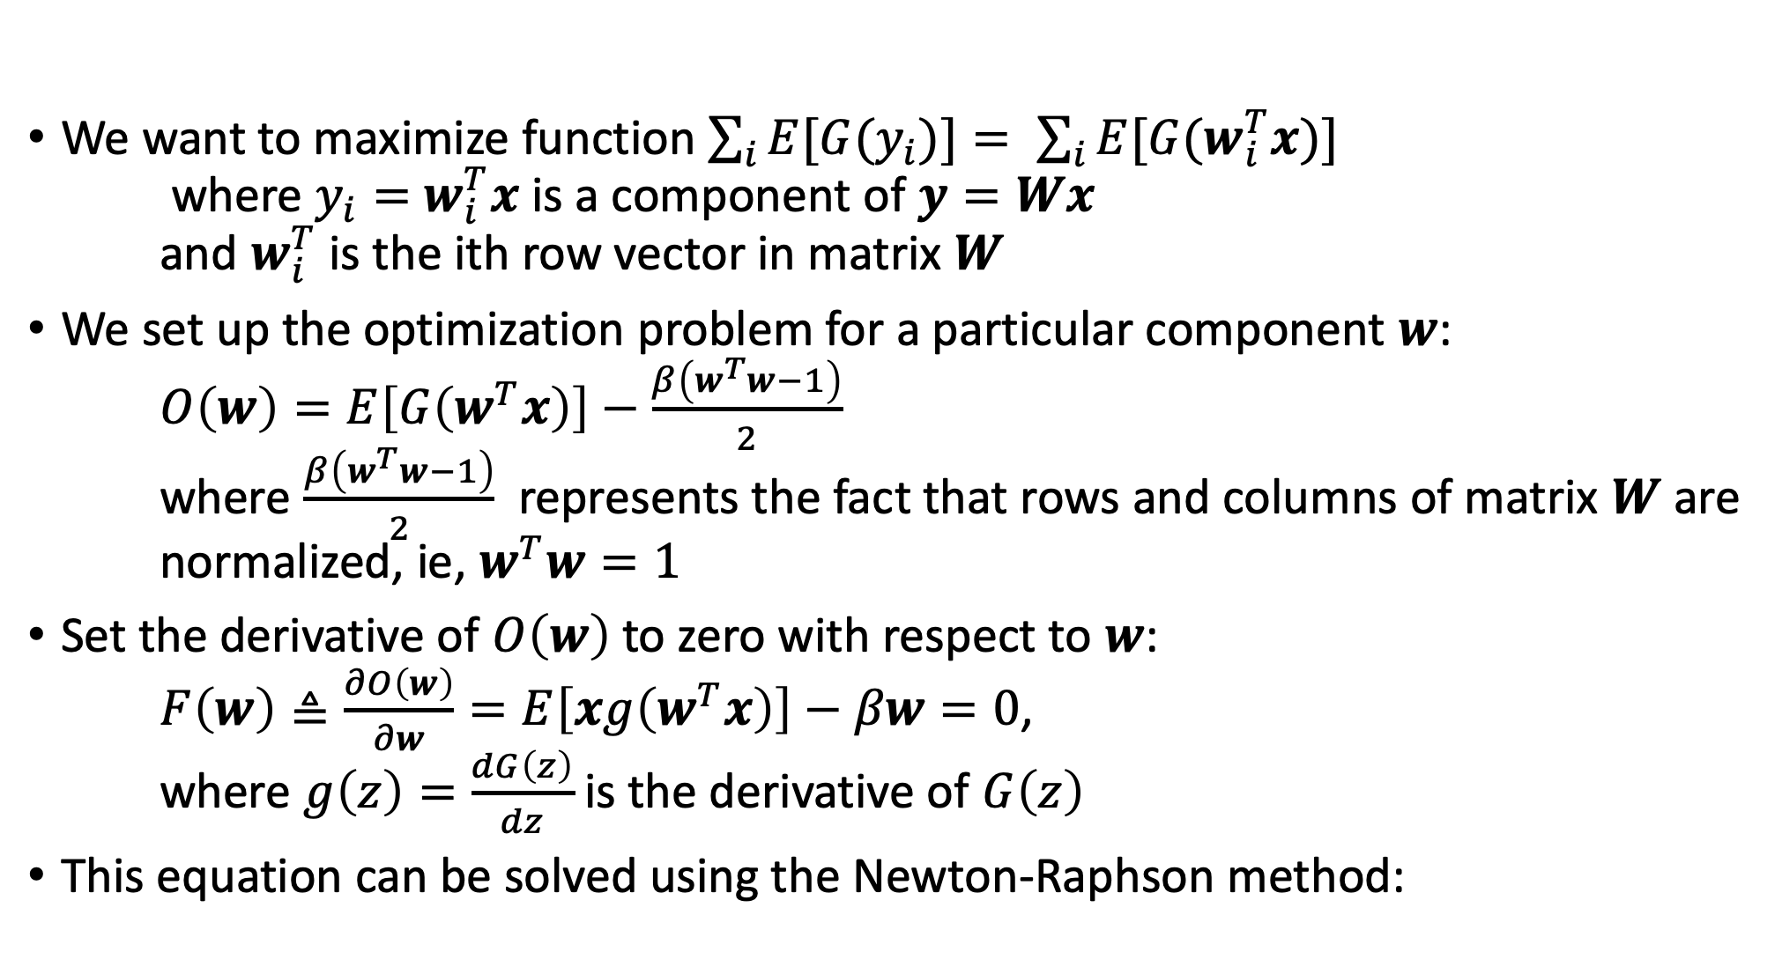
ICA algorithm (fastICA)
We want to maximize function $\sum_{i}{E[G{(y}_{i})]}= \sum_{i}{E[G(w_{i}^{T}x)]}$ where $y_{i}=$ $w_{i}^{T}x$ is a component of $y=Wx$ and $w_{i}^{T}$ is the ith row vector in matrix $W$
We set up the optimization problem for a particular component $w$: $O\left(w\right)=E\left[G\left(w^{T}x\right)\right]−\frac{β\left(w^{T}w−1\right)}{2}$ where $\frac{β\left(w^{T}w−1\right)}{2}$ represents the fact that rows and columns of matrix $W$ are normalized, ie, $w^{T}w=1$
Set the derivative of $O\left(w\right)$ to zero with respect to $w$: $F\left(w\right)≜\frac{∂O\left(w\right)}{∂w}=E\left[xg\left(w^{T}x\right)\right]−βw=0$, where $g\left(z\right)=\frac{dG\left(z\right)}{dz}$ is the derivative of $G\left(z\right)$
This equation can be solved using the Newton-Raphson method:

Slide 12
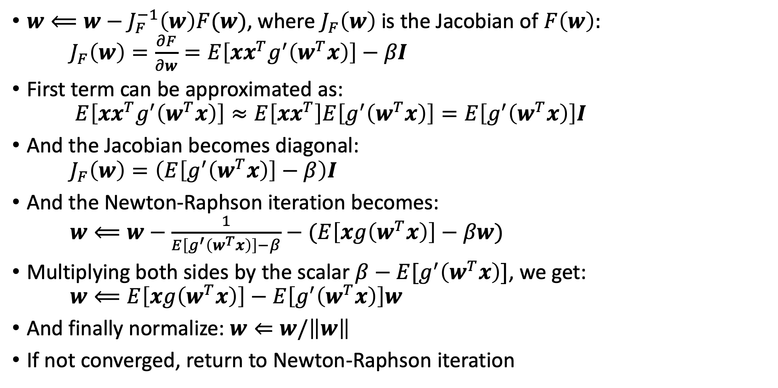
Newton-Raphson method:
$w⟸w−J_{F}^{−1}\left(w\right)F(w)$, where $J_{F}\left(w\right)$ is the Jacobian of $F\left(w\right):$ $J_{F}\left(w\right)=\frac{∂F}{∂w}=E\left[xx^{T}g^{′}\left(w^{T}x\right)\right]−βI$
First term can be approximated as: $E\left[xx^{T}g^{′}\left(w^{T}x\right)\right]≈E\left[xx^{T}\right]E\left[g^{′}\left(w^{T}x\right)\right]=E\left[g^{′}\left(w^{T}x\right)\right]I$
And the Jacobian becomes diagonal: $J_{F}\left(w\right)=\left(E\left[g^{′}\left(w^{T}x\right)\right]−β\right)I$
And the Newton-Raphson iteration becomes: $w⟸w−\frac{1}{E\left[g^{′}\left(w^{T}x\right)\right]−β}−$ $(E\left[xg\left(w^{T}x\right)\right]−βw)$
Multiplying both sides by the scalar $β−E[g^{′}\left(w^{T}x\right)]$, we get: $w⟸E\left[xg\left(w^{T}x\right)\right]−E\left[g^{′}\left(w^{T}x\right)\right]w$
And finally normalize: $w⇐w/\left\|w\right\|$
If not converged, return to Newton-Raphson iteration

Slide 13
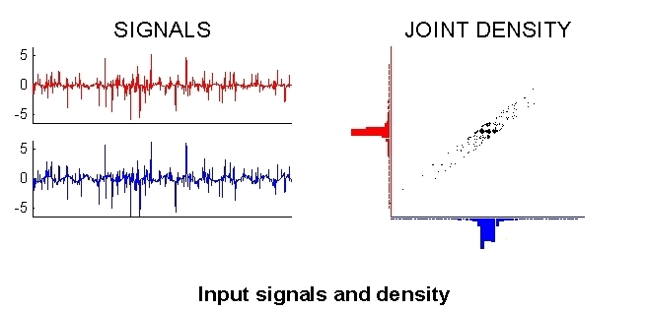
fastICA example

Slide 14
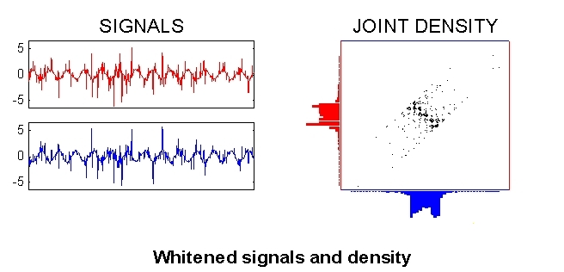
fastICA example

Slide 15
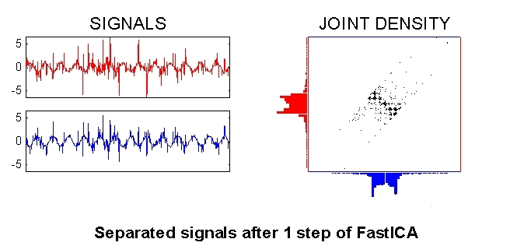
fastICA example

Slide 16
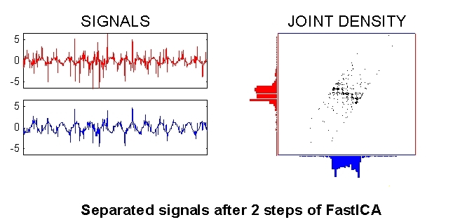
fastICA example

Slide 17
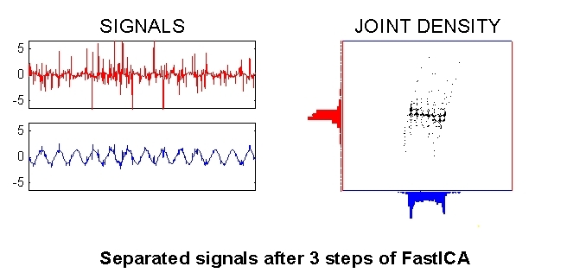
fastICA example

Slide 18
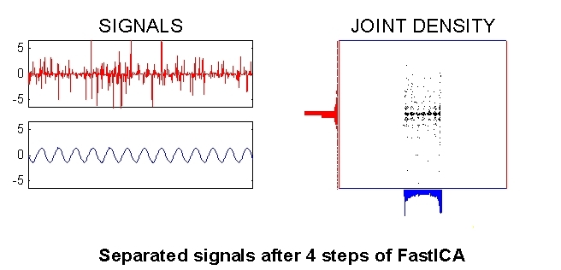
fastICA example

Slide 19
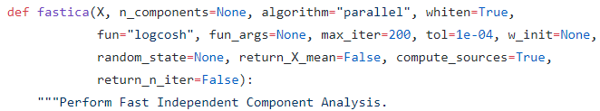
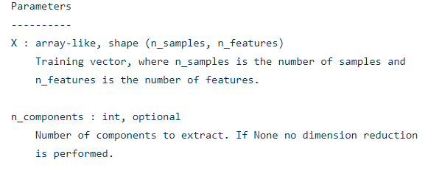
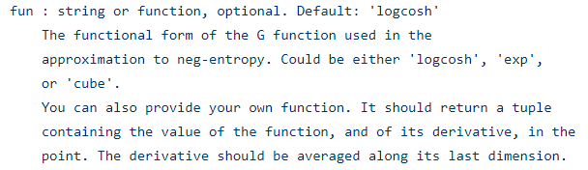
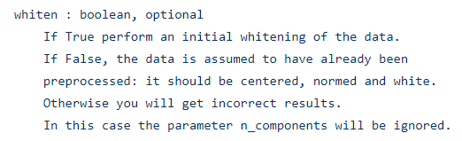

fastICA implementation: sklearn.decomposition.fastica_.py

Slide 20
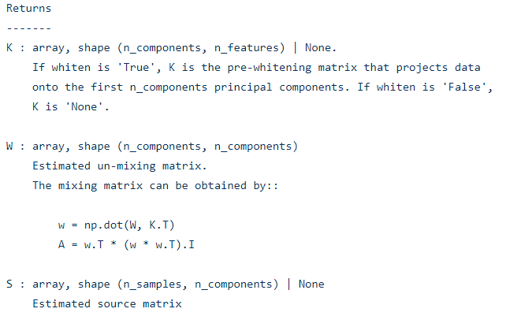
fastICA implementation: sklearn.decomposition.fastica_.py

Slide 21

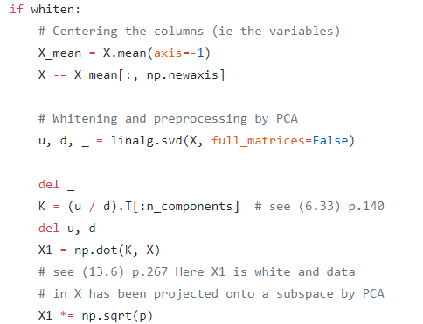
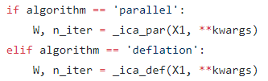
fastICA implementation: sklearn.decomposition.fastica_.py

Slide 22
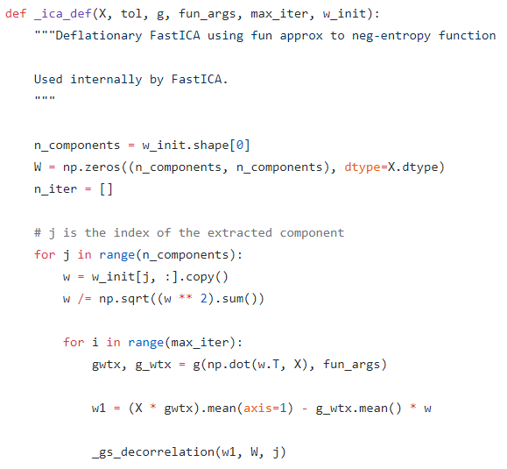
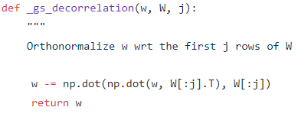
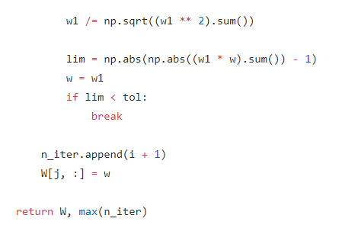
fastICA implementation: sklearn.decomposition.fastica_.py

Slide 23
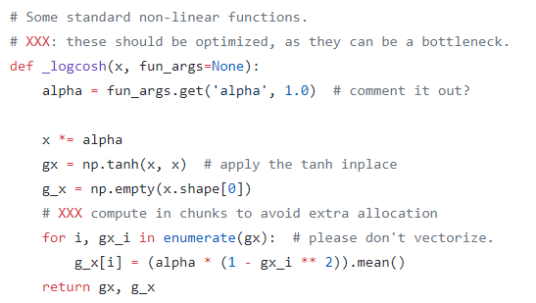
fastICA implementation: sklearn.decomposition.fastica_.py

Slide 24
Application: separating muscular activity from neuronal activity in EEG recordings

