Slide 1
CS405/505 Data Mining
Lecture 6

Slide 2
Administrative slide
Assignment now on Moodle (due Wednesday October 2nd)
Chapters 1-4 (Input, Output, 1R, Naïve Bayes, Decision Tree)
Midterm will be very similar (Wednesday October 9th)

Slide 3
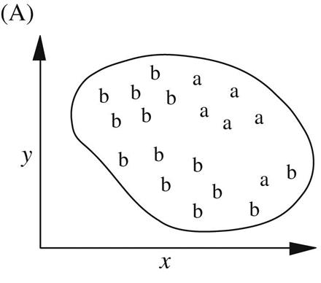
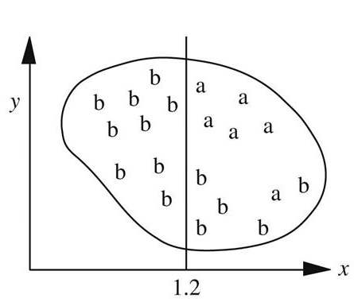
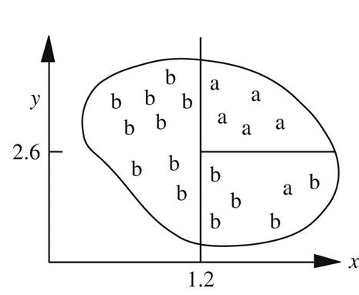

4.4 Covering Algorithms: Constructing Rules
Decision tree algorithms are based on a divide and conquer approach
An alternative approach is to take each class in turn and look for a rule that covers all instances belonging to that class
Called “covering” approach
Covering approach leads to set of rules rather than a Decision tree
We seek a rule covering the ‘a’ instances
First test in rule splits space vertically
Second test splits subspace horizontally
$$If x>1.2 and y>2.6 then class=a$$
Covering a
$$If x>1.4 and y<2.4 then class=a$$
$$If x≤1.2 then class=b$$
$$If x>1.2 and y≤2.6 then class=b$$
Covering b

Slide 4
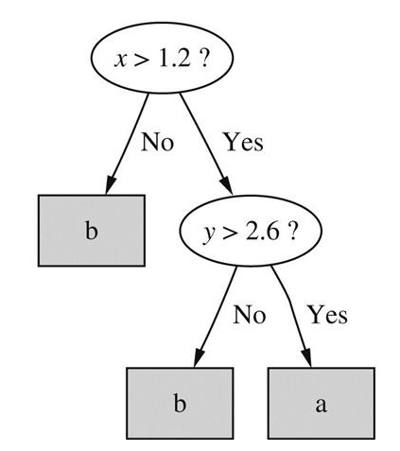
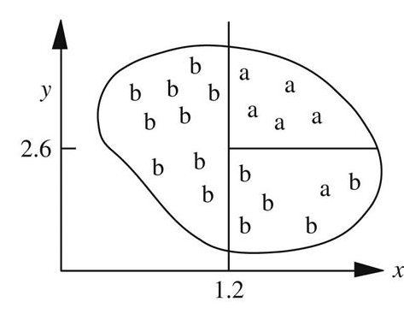
Rules vs Trees
Top down divide and conquer approach of Decision trees is superficially similar to a covering algorithm (especially in this example)
However, covering algorithms work by examining each class in turn, whereas divide and conquer algorithms create a single concept description applying to all classes
Example: replicated subtree problem
$$If x>1.2 and y>2.6 then class=a$$
$$If x>1.4 and y<2.4 then class=a$$

Slide 5
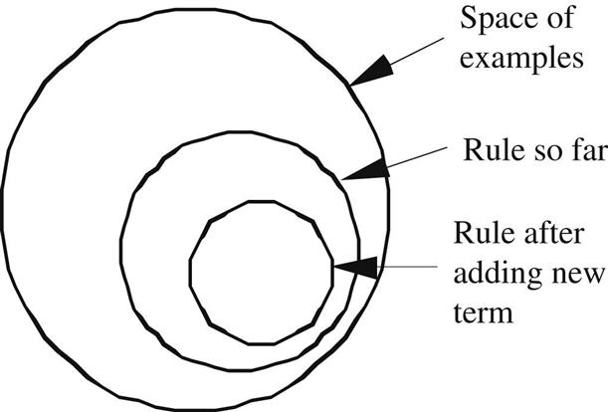
Rules vs Trees
Covering algorithms operate by adding tests to the rule under construction, trying to create a rule with maximum accuracy
Divide and conquer algorithms (Decision trees) operate by adding tests to the tree under construction, trying to maximize the separation between classes
Both procedures involve finding an attribute to split on
Criterion for best attribute is different in each case
Divide and conquer: select attribute maximizing information gain
Covering algorithm: choose attribute-value pair maximizing the probability of desired classification

Slide 6
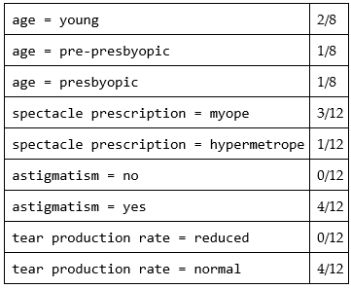
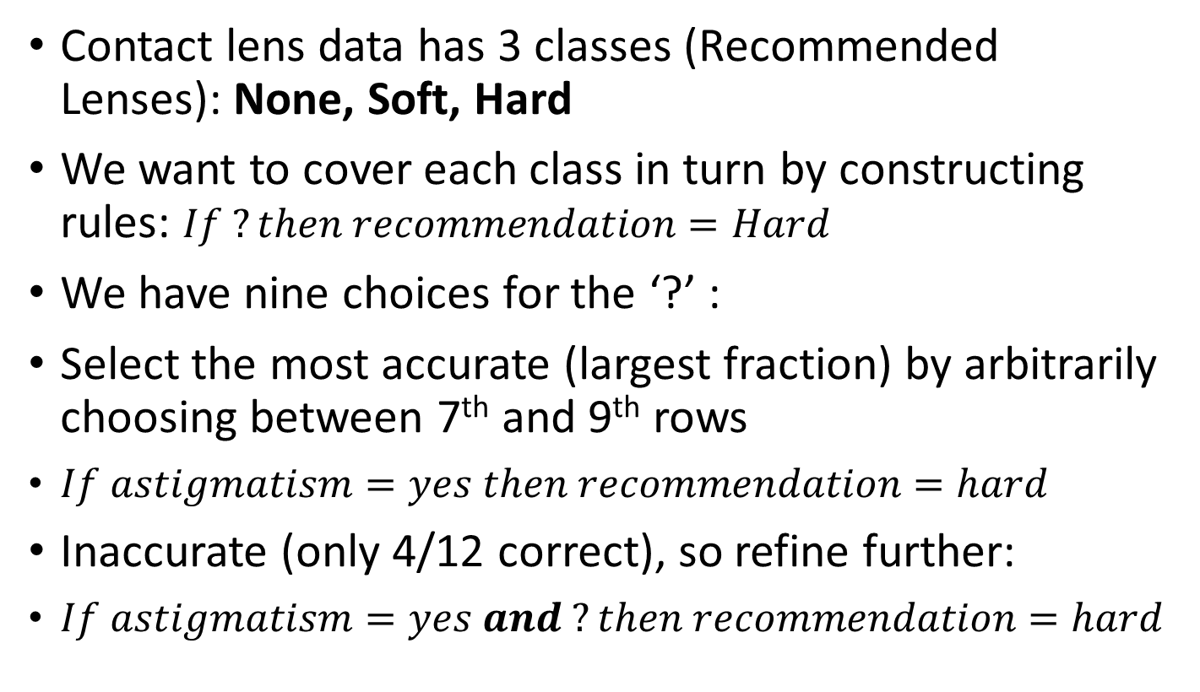
A simple covering algorithm
Fraction of correct instances singled out by the rule
Choice of rule
Contact lens data has 3 classes (Recommended Lenses): None, Soft, Hard
We want to cover each class in turn by constructing rules: $If ?then recommendation=Hard$
We have nine choices for the ‘?’ :
Select the most accurate (largest fraction) by arbitrarily choosing between 7th and 9th rows
$If astigmatism=yes then recommendation=hard$
Inaccurate (only 4/12 correct), so refine further:
$If astigmatism=yes and ?then recommendation=hard$
(this table applies to the instances with Recommendation=Hard)

Slide 7
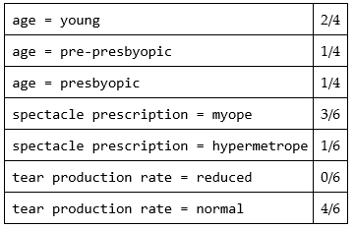
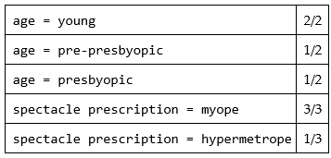
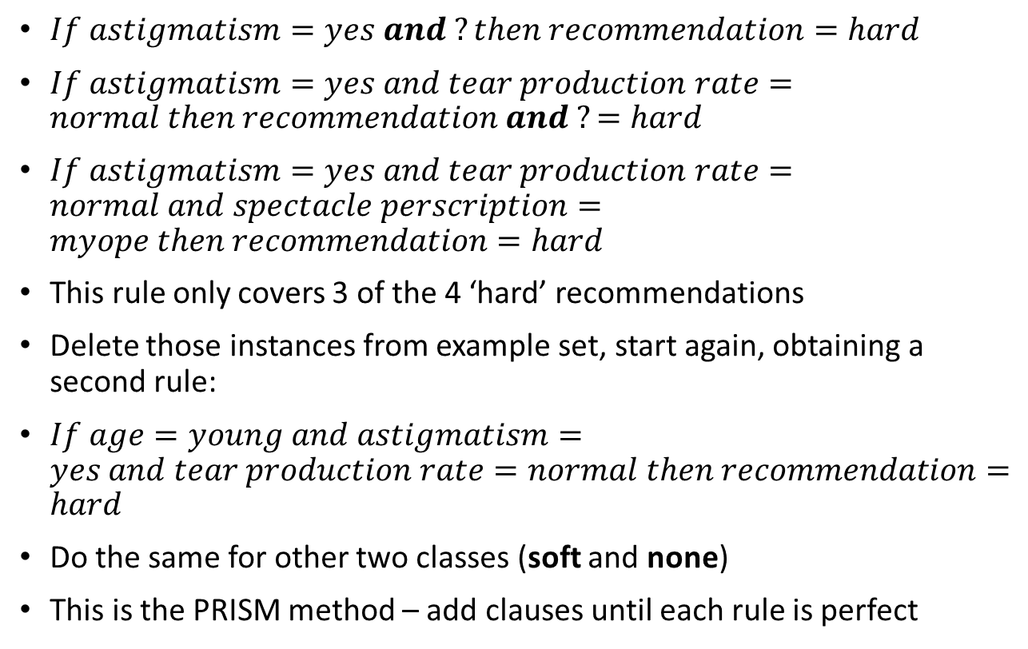
A simple covering algorithm
Possibilities for 2nd clause in rule antecedent
$If astigmatism=yes and ?then recommendation=hard$
$If astigmatism=yes and tear production rate=normal then recommendation and ?=hard$
$If astigmatism=yes and tear production rate=normal and spectacle perscription=myope then recommendation=hard$
This rule only covers 3 of the 4 ‘hard’ recommendations
Delete those instances from example set, start again, obtaining a second rule:
$If age=young and astigmatism=yes and tear production rate=normal then recommendation=hard$
Do the same for other two classes (soft and none)
This is the PRISM method – add clauses until each rule is perfect
Possibilities for 3rd clause in rule antecedent

Slide 8
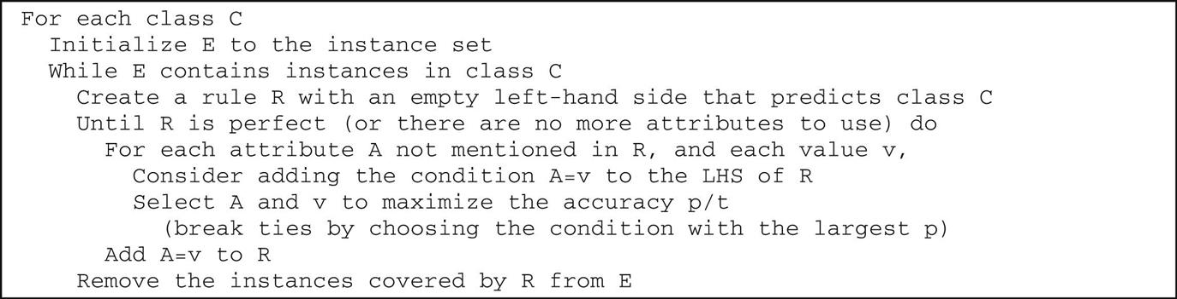
PRISM algorithm pseudocode
Outer ‘For’ loop iterates over the classes (For each class C)
‘While’ loop repeats until we have covered all instances of a given class
Note that we reinitialize E to the full instance set when starting on a new class

Slide 9
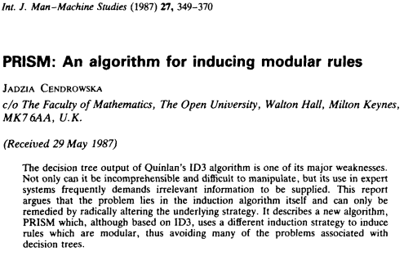
“PRISM produces its results as a set of modular rules which are maximally general when the training set is a complete one”
(available on Moodle)

Slide 10
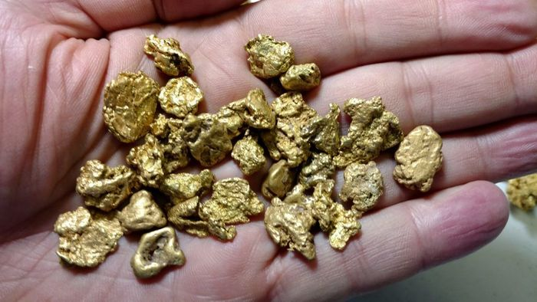
Does PRISM produce a Decision List, or Nuggets?
It may seem that PRISM creates a decision list (because instances covered by a completed rule are removed from instance set)
Thus subsequent rules are designed for instances not covered previously
However, we do not have to check the rules in turn (PRISM does not produce a decision list). Why not? Because all rules in the “list” predict the same class
Also, the outer ‘For’ loop (For each class C) can be executed in any order
We call methods such as PRISM “separate and conquer” because we separate out the instances covered by our rule as we proceed.
This contrasts with the “divide and conquer approach” of Decision trees, which divides the instances by splitting on some condition at each node
nuggets

Slide 11
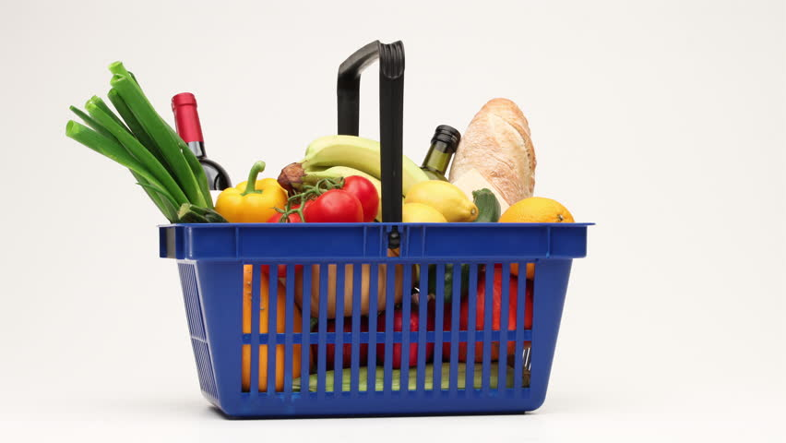
Mining Association Rules
You could use PRISM to find association rules, by replacing the class with some other attribute (or combination of attributes)
However, this would generate a massive number of rules, which would then need to be pruned down (computationally infeasible)
Instead we will capitalize on the fact we are interested only in association rules with high coverage/accuracy, or frequent item sets
An attribute-value pair is an item

Slide 12
Item Sets from weather data with coverage >= 2
 | One-Item Sets |  | Two-Item Sets |  | Three-Item Sets |  | Four-Item Sets
1 | Outlook=sunny | 5 | Outlook=sunny temperature=mild | 2 | Outlook=sunny temperature=hot humidity=high | 2 | Outlook=sunny temperature=hot humidity=high play=no | 2
2 | Outlook=overcast | 4 | Outlook=sunny temperature=hot | 2 | Outlook=sunny temperature=hot play=no | 2 | Outlook=sunny humidity=high windy=false play=no | 2
3 | Outlook=rainy | 5 | Outlook=sunny humidity=normal | 2 | Outlook=sunny humidity=normal play=yes | 2 | Outlook=overcast temperature=hot windy=false play=yes | 2
4 | Temperature=cool | 4 | Outlook=sunny humidity=high | 3 | Outlook=sunny humidity=high windy=false | 2 | Outlook=rainy temperature=mild windy=false play=yes | 2
5 | Temperature=mild | 6 | Outlook=sunny windy=true | 2 | Outlook=sunny humidity=high play=no | 3 | Outlook=rainy humidity=normal windy=false play=yes | 2
6 | Temperature=hot | 4 | Outlook=sunny windy=false | 3 | Outlook=sunny windy=false play=no | 2 | Temperature=cool humidity=normal windy=false play=yes | 2
7 | Humidity=normal | 7 | Outlook=sunny play=yes | 2 | Outlook=overcast temperature=hot windy=false | 2
8 | Humidity=high | 7 | Outlook=sunny play=no | 3 | Outlook=overcast temperature=hot play=yes | 2
9 | Windy=true | 6 | Outlook=overcast temperature=hot | 2 | Outlook=overcast humidity=normal play=yes | 2
10 | Windy=false | 8 | Outlook=overcast humidity=normal | 2 | Outlook=overcast humidity=high play=yes | 2
11 | Play=yes | 9 | Outlook=overcast humidity=high | 2 | Outlook=overcast windy=true play=yes | 2
12 | Play=no | 5 | Outlook=overcast windy=true | 2 | Outlook=overcast windy=false play=yes | 2
13 |  |  | Outlook=overcast windy=false | 2 | Outlook=rainy temperature=cool humidity=normal | 2
… |  |  | … |  | …
38 |  |  | Humidity=normal windy=false | 4 | Humidity=normal windy=false play=yes | 4
39 |  |  | Humidity=normal play=yes | 6 | Humidity=high windy=false play=no | 2
40 |  |  | Humidity=high windy=true | 3
… |  |  | …
47 |  |  | Windy=false play=no | 2
Assume we seek association rules with min. coverage = 2
Discard any item sets that apply to <2 instances
This leaves 47 two-item sets, 39 three-item sets, and 6 four-item sets

Slide 13
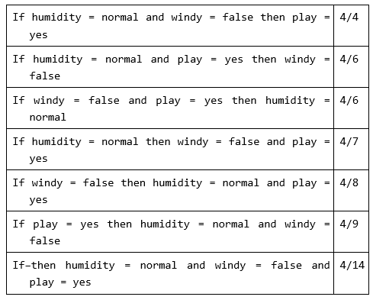
Association Rules and Accuracy
Accuracy of the association rule: Number of instances for which all three conditions are true (coverage) divided by number of instances for which antecedent only is true
Once the items sets with >= minimum coverage have been generated, next step is to convert them into rules with >= minimum accuracy
Some items sets will produce more than one rule, others will produce none.
Example: a 3-item set: humidity=normal, windy=false, play=yes
Leads to 7 potential rules
Interpreted as fraction, these numbers represent the proportion of instances on which the rule is correct (accuracy)

Slide 14
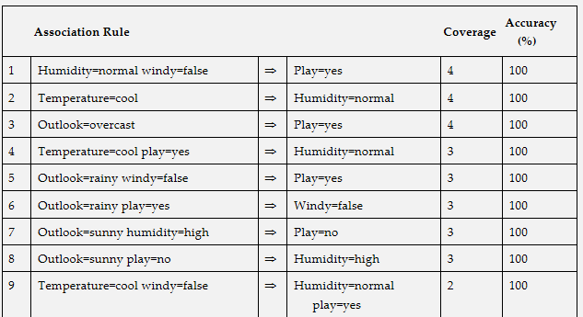
Final rule set for weather data with minimum coverage 2 and minimum accuracy 100%
58 total rules
3 with coverage 4, 5 with coverage 3, 50 with coverage 2
Only 7 have two conditions in the consequent, and none has more than 2
… 58 total rules

Slide 15
Generating Rules Efficiently
We will now consider a detailed algorithm for producing association rules with pre-specified minimum coverage and accuracy
The Apriori algorithm
Two stages:
1) generate item sets with minimum coverage
2) for each item set, determine rules with specified minimum accuracy

Slide 16
Stage 1: Generating Item Sets with minimum coverage
Operation 1: start by generating all 1-item sets with minimum coverage
Operation 2: use the 1-item sets to generate 2-item sets,
Operation 3: use 2-item sets to generate 3-item sets,
Etc.
Each operation involves a pass through the dataset to count the number of instances, storing surviving item sets in a hash table
Candidate 2-item sets are simply all possible pairs of surviving 1-item sets

Slide 17
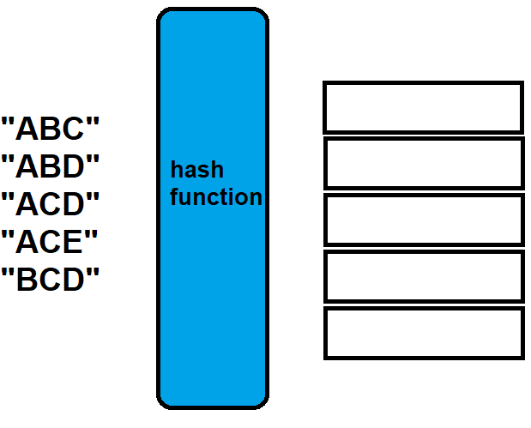
Hash Table
Schematic of mapping a string to an index using hash function
A hash table is a data structure that maps keys to values
A hash table uses a hash function to compute an index into an array
One of the most powerful features of hash tables is that they allow to rapidly determine if an item already exists in an array
Example of hash function to place strings into a hash table
Strings: “ABC”, “ABD”, “ACD”, “ACE”, “BCD”
Define hash function: sum of ascii values for each character modulo 293, or sum(chars)%293
So, for ABC we have 97+98+99 % 293 = 1
For ABD we have 97+98+100 % 293 = 2
Index 0
Index 1
Index 2
Index 3
Index 4
ascii is a character encoding standard for electronic communication that encodes alphabet characters into numbers
ascii lookup table:
A = 97
B = 98
C = 99
D = 100
E = 101

Slide 18
Example: generating candidate item sets
Suppose we have five 3-item sets:
(A B C), (A B D), (A C D), (A C E), (B C D)
Remember each ‘item’ is an attribute-value pair ie outlook=sunny
Union of first two sets = Union(ABC,ABD) = ABCD
This is a candidate 4-item set because all its 3-item subsets have >min. coverage
Question: is Union(ACD, ACE) = ACDE a candidate 4-item set?
We can check using our Hash Table
Compute H(ACD), H(ACE), H(ADE), and H(CDE) – if we find an empty index, we know that ACDE is not a candidate 4-item set
This example has only a single candidate 4-item set (ABCD)

Slide 19
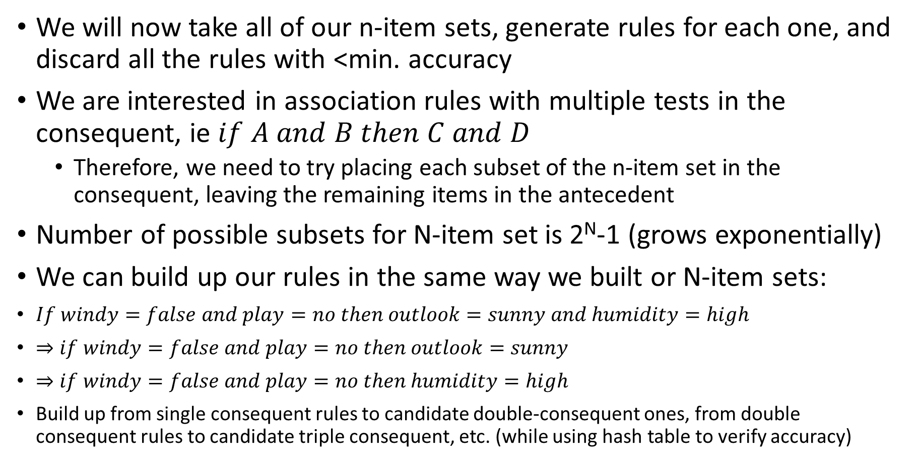
Stage 2: Generating Rules from item sets
We will now take all of our n-item sets, generate rules for each one, and discard all the rules with <min. accuracy
We are interested in association rules with multiple tests in the consequent, ie $if A and B then C and D$
Therefore, we need to try placing each subset of the n-item set in the consequent, leaving the remaining items in the antecedent
Number of possible subsets for N-item set is 2^{N}-1 (grows exponentially)
We can build up our rules in the same way we built or N-item sets:
$If windy=false and play=no then outlook=sunny and humidity=high$
$⇒if windy=false and play=no then outlook=sunny$
$⇒if windy=false and play=no then humidity=high$
Build up from single consequent rules to candidate double-consequent ones, from double consequent rules to candidate triple consequent, etc. (while using hash table to verify accuracy)

Slide 20
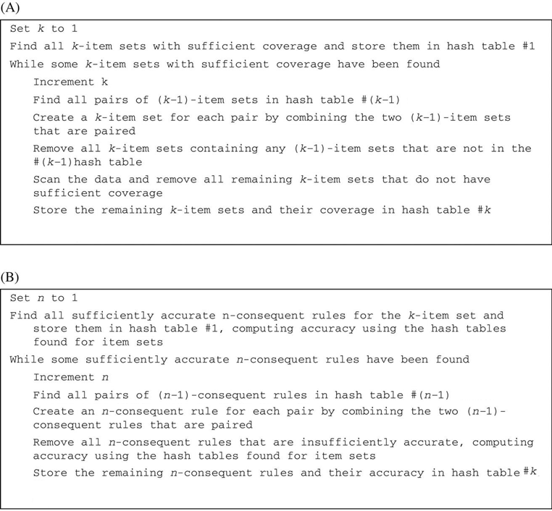
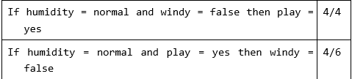
Pseudocode for Association Rule Mining
A) find all N-item sets with sufficient coverage
B) find all rules that are sufficiently accurate (given a single N-item set from A)
Part B relies only on hash tables generated in part A (doesn’t use raw data)
accuracy

Slide 21

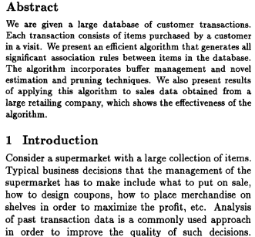
(on moodle)

Slide 22
Summary
Rules vs Trees
Separate and Conquer vs Divide and Conquer
Simple Covering Algorithm (PRISM algorithm)
Mining association rules (Apriori algorithm)
Next up: Linear models, instance-based learning, clustering

