Slide 1
Data Mining CS 405/505
Lecture 3
Monday, September 9th 2019

Slide 2
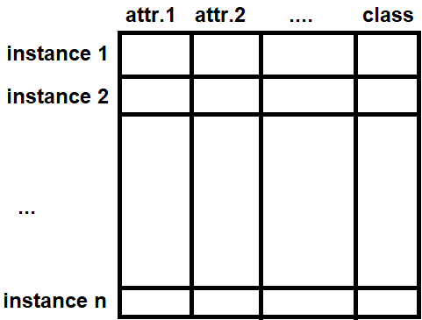

Review
Instances and attributes (features) are the input
The model produced by the machine learning algorithm is the output (concept)
Output of the model is the concept description
An instance of an iris flower with 4 attributes

Slide 3
Today’s Outline: all of chapter 3
High level overview of different types of output
Basic knowledge representation (decision tables)
Linear models
Decision trees
Rule sets (classification rules, association rules, exceptions to rules)
Instance-based learning
Clustering algorithm output (flat clusters, dendrograms)

Slide 4
3.1 Tables
Outlook | Temperature | Humidity | Windy | Play
Sunny | Hot | High | False | No
Sunny | Hot | High | True | No
Overcast | Hot | High | False | Yes
Rainy | Mild | High | False | Yes
Rainy | Cool | Normal | False | Yes
Rainy | Cool | Normal | True | No
Overcast | Cool | Normal | True | Yes
Sunny | Mild | High | False | No
Sunny | Cool | Normal | False | Yes
Rainy | Mild | Normal | False | Yes
Sunny | Mild | Normal | True | Yes
Overcast | Mild | High | True | Yes
Overcast | Hot | Normal | False | Yes
Rainy | Mild | High | True | No
Simplest way of representing the output is to make it the same as the input
Decision table for weather data (look up the appropriate conditions to decide to play/not play)
Can leave out some attributes if they are found to be irrelevant, reducing size of table
Attribute selection is discussed in chapter 8
When would a table not be appropriate?

Slide 5
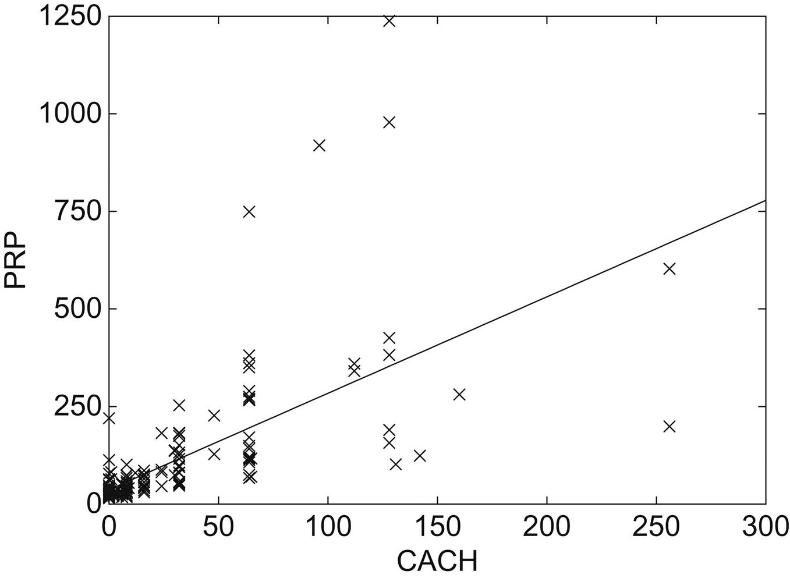
3.2 Linear Models
Output is a set of weights that we apply to attributes and sum (how do we get the weights?)
Easiest to visualize in 2 dimensions
Generate prediction by plugging observed value of CACH into expression to obtain a value for performance

Slide 6
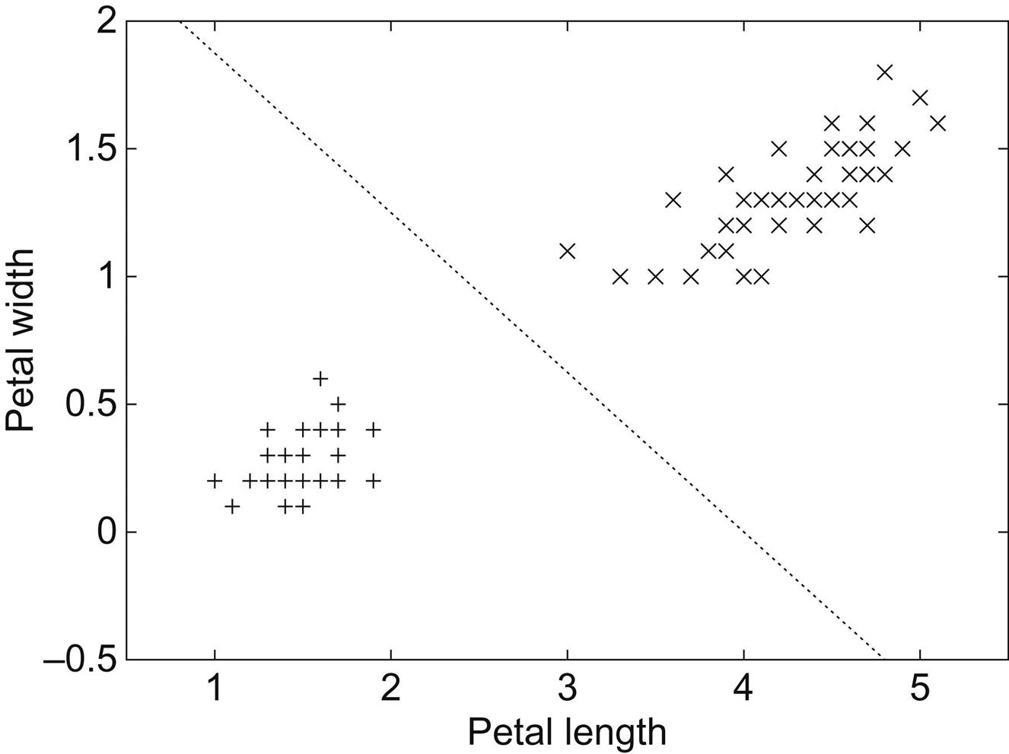
Linear models for decision boundary
Line produced by the model separates the two classes
Defines where decision changes from one class to another (Decision boundary)
Points lying on the line given by equation
Given a test instance, prediction is produced by plugging observed values of attributes in question into expression, and checking if >0 or <0
Extending model to multiple attributes results in hyperplane

Slide 7
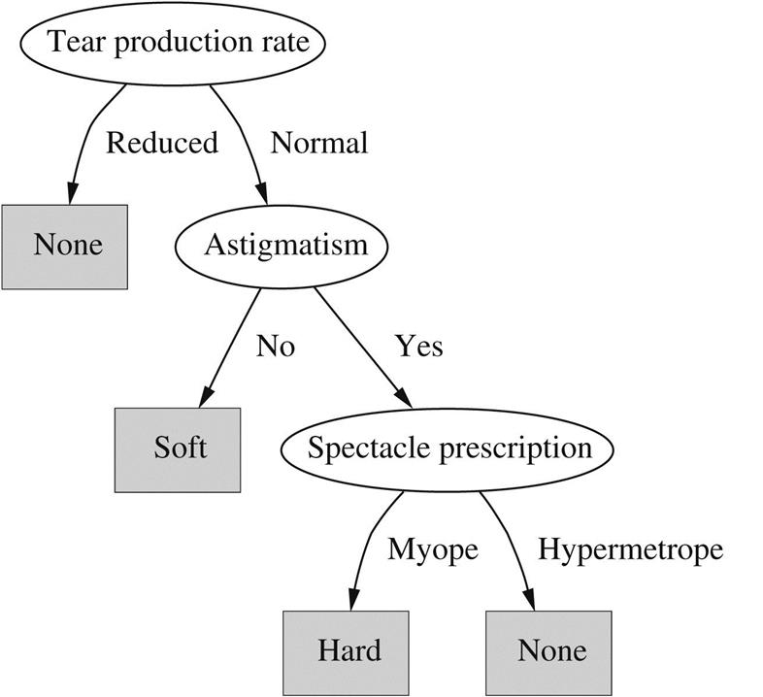
3.3 Trees
Example: contact lens data
Divide and conquer approach
Each node tests a given attribute, comparing it to a constant or nominal attr.
Leaf nodes give a classification that applies to all instances that reach the leaf
Unknown instances are routed down the tree according to value of attributes until a leaf is reached
Nominal attributes: number of children = number of possible values
Numerical attributes: two-way or three-way split (below, within, above)
Can also split on a combination of attributes, or by comparing attributes
Construct a decision tree by hand

Slide 8
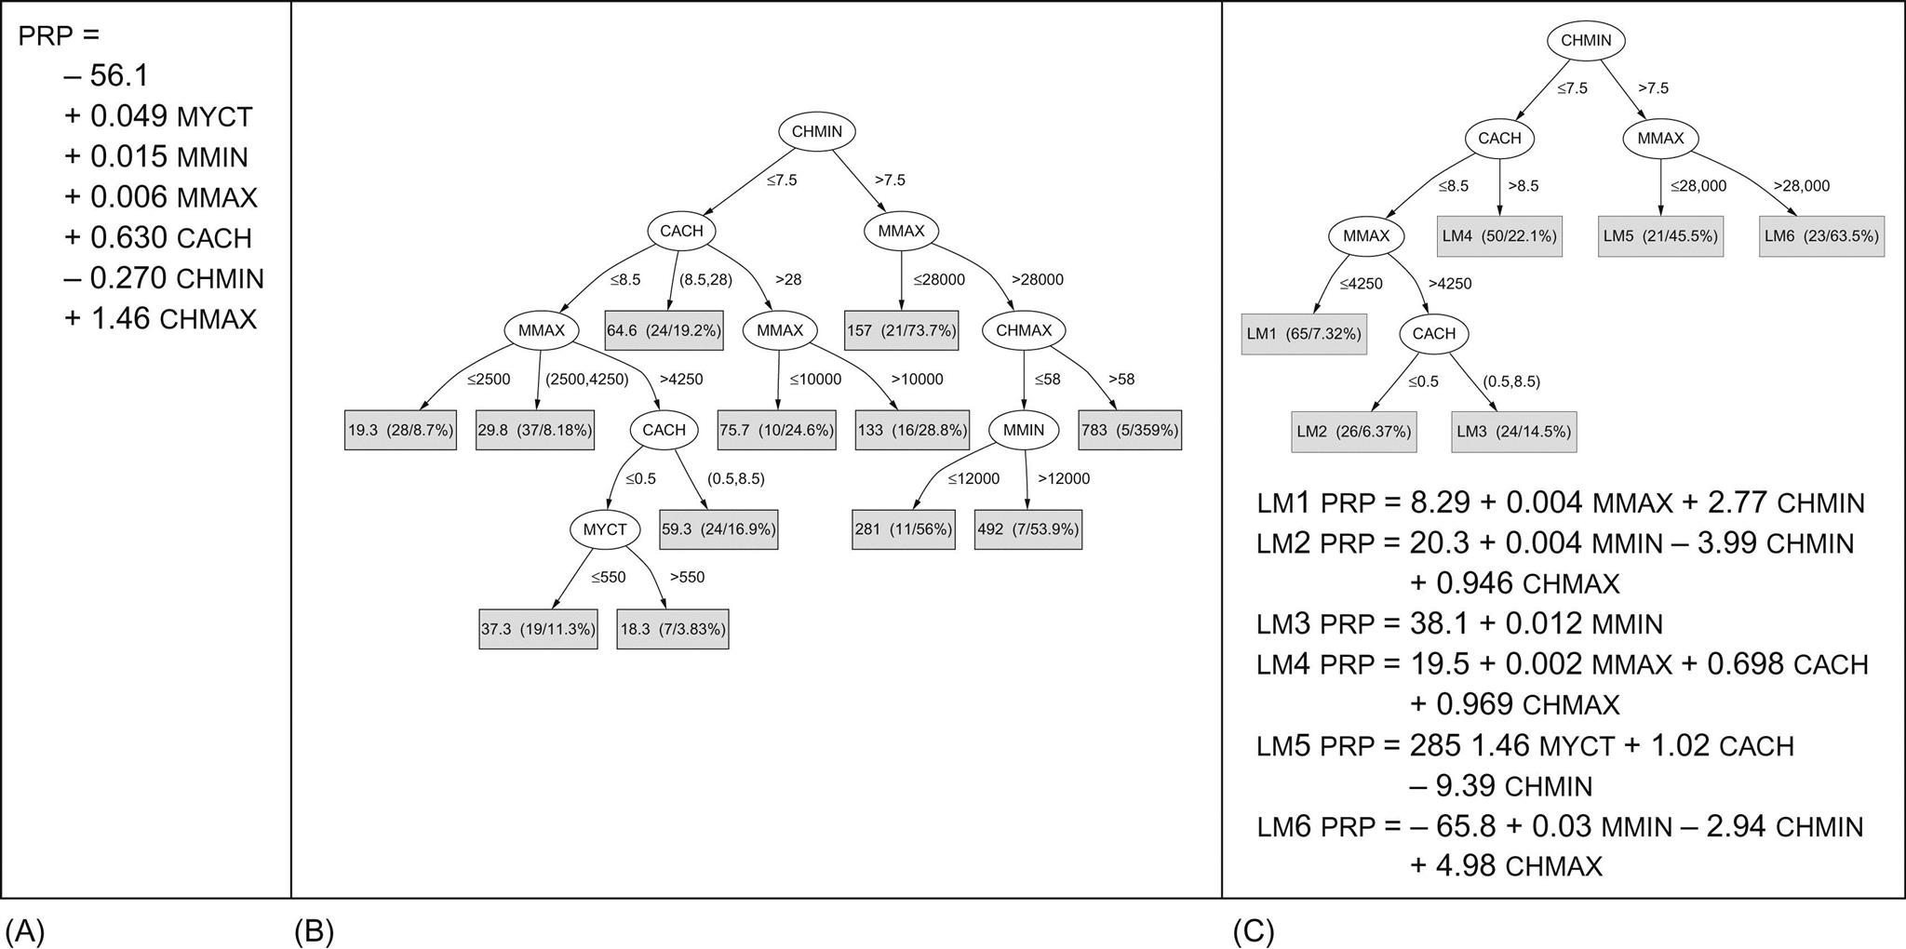
Linear regression, Regression tree, Model tree
A) Regression equation for
CPU performance
data
B) Regression tree for CPU performance data. Leaves of tree are numbers that represent the average outcome for instances that reach the leaf.
Larger, more complex than regression equation, but also more accurate than regression equation.
Model tree (leaves contain linear expressions)

Slide 9
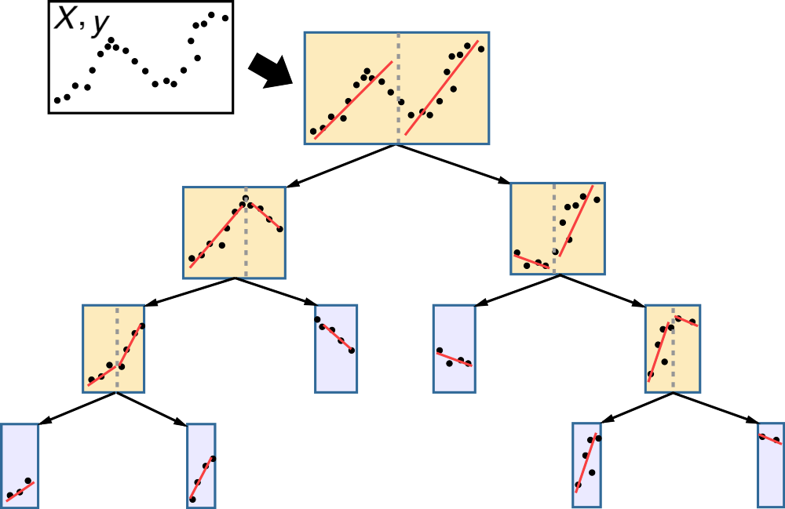
Model Tree example:
Combine regression equation with regression tree
Model tree approximates continuous functions by linear patches

Slide 10
3.4 Rules
Popular alternative to decision trees
Antecedent and consequent
antecedent
consequent

Slide 11
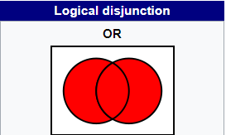
Classification Rules
Easy to read set of classification rules off a decision tree (one rule per leaf)
Antecedent = tests on nodes leading up to leaf
Consequent = class assigned by the leaf
Order in which rules are read off tree is irrelevant (unambiguous)
In general, rules read directly off decision tree are overly complex
Decision trees cannot easily express disjunction (“or”) implied among different rules in a set
Going from rules to tree? Difficult to transform a given set of rules into a decision tree

Slide 12
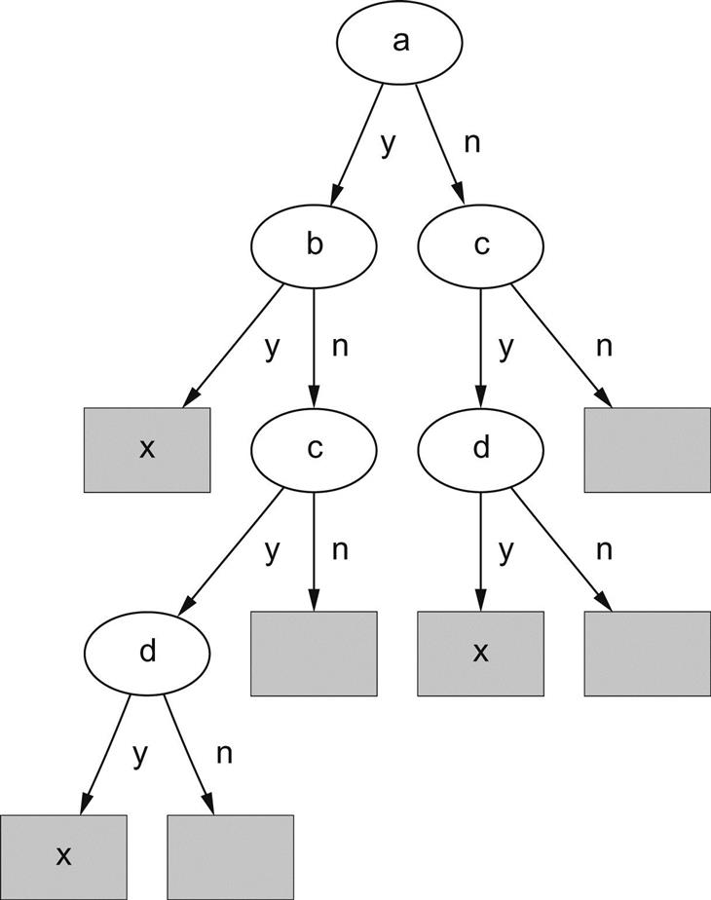

Example:
Rule 1
Rule 2
Take an example where two rules have the same structure but different attributes
Need to choose a single test for root node
If we choose ‘a’ as root node, the second rule must be repeated twice in the tree (replicated subtree problem)

Slide 13
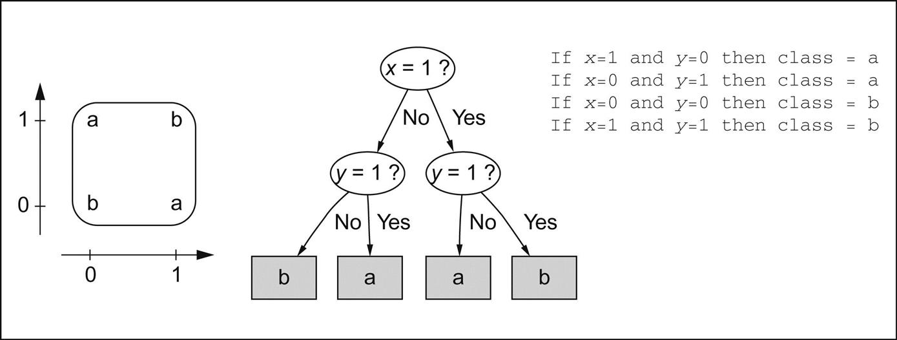
Representing XOR
Take XOR (exclusive-or) function, for example
Tree does not reflect true symmetry of problem
Rules are not notably more compact here, but in other situations rules are much more compact than trees

Slide 14
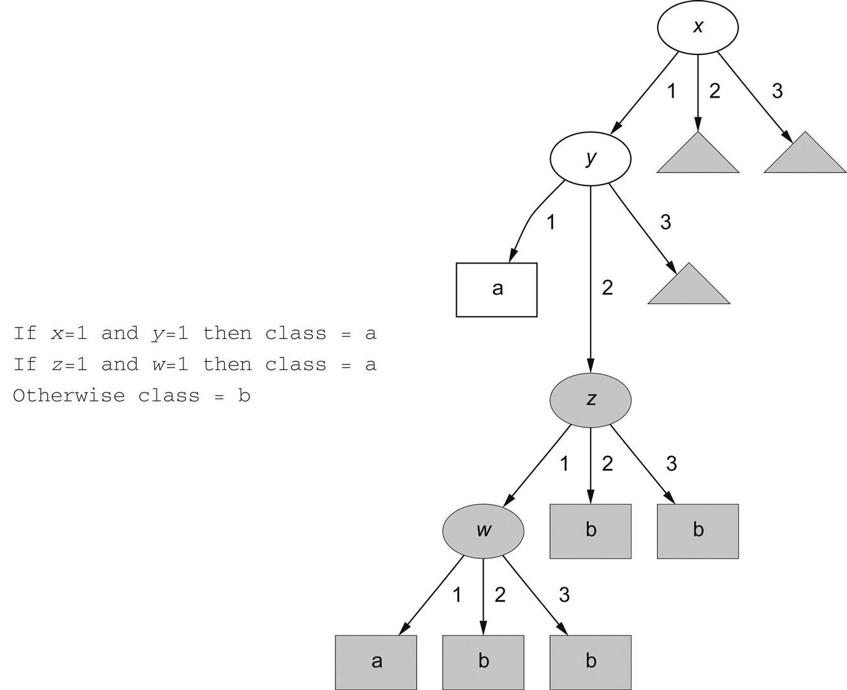
Replicated subtree problem
x, y, z, w can take values 1, 2, or 3
Default rules
Each small gray triangle contains the entire 3 level subtree in gray (child of node y)
Extreme example

Slide 15
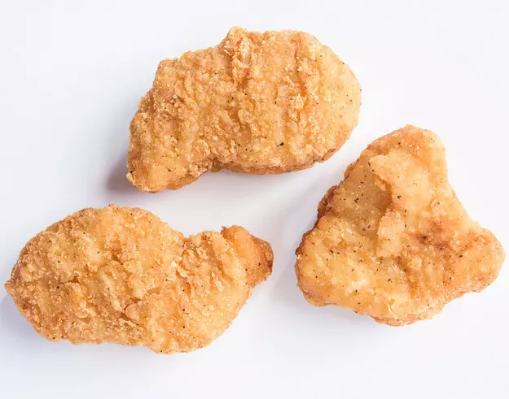
More about rules:
Rules are popular because each rule seems to represent an independent “nugget” of knowledge
New rules can be added to existing rule set without disturbing pre-existing rules, whereas adding to a tree may require reshaping the entire tree
However, this ignores the fact that some rule sets are to be interpreted in order (decision list)
Sometimes, different rules will classify the same instance differently (this never happens for decision trees)
Machine learning algorithms that generate rules invariably produce ordered rule sets (Decision lists)
Chicken nugget

Slide 16
Association rules
Association rules predict any attribute (not just class)
Can predict combinations of attributes
Not intended to be used together as a set (as with classification rules)
Express regularities underlying the dataset
Coverage – number of instances predicted correctly, or the proportion of all instances covered by the rules
Accuracy - number of instances predicted correctly, expressed as a proportion of all instances to which it applies
Coverage = number of days that are both cool, and have normal humidity
Accuracy = proportion of cool days with normal humidity

Slide 17
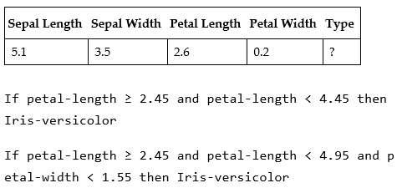

Rules with exceptions
Allowing classification rules to have exceptions, means we can make incremental modifications to rule set without reengineering entire set
Consider the iris problem, we find a new flower, classed by expert as I. setosa
Misclassified by two of the rules found earlier
Change bounds of existing rules?
Solution: add an exception!

Slide 18
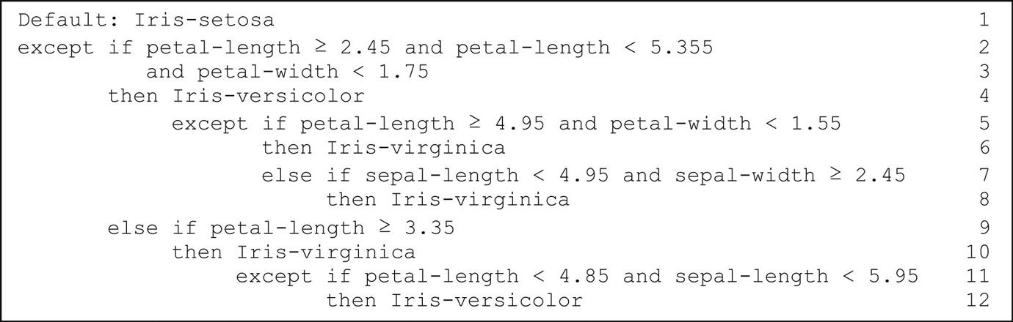
Full rule set with exceptions for iris dataset
Default outcome: I. setosa (normally choose most frequent class)
Mirrors how we think of real problems in our heads (more comprehensible than if…then…else)
Scales up well (locality property) – each individual statement needs only be considered in context of rules/exceptions that lead to it, whereas with decision lists, all prior rules need to be reviewed to determine the precise effect of an individual rule, crucial for understanding large rule sets

Slide 19


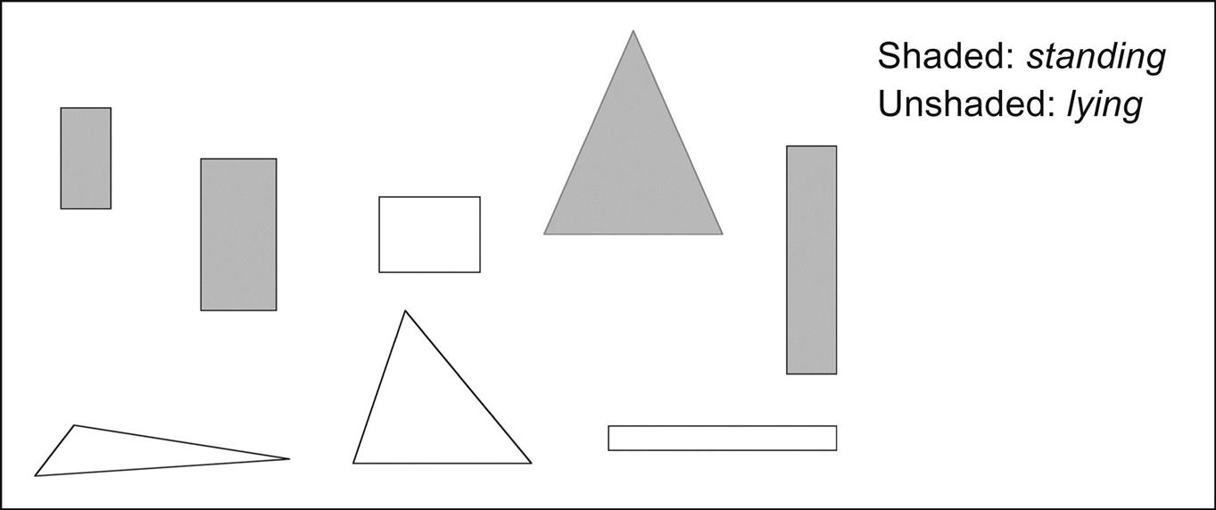
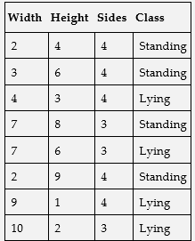
More expressive rules
Until now, we have only tested rules against a constant (iris dataset)
Suppose we have 8 blocks, and we wish to learn “standing” concept
Learning algorithm is given width, height, and number of sides
We can augment existing datasets by adding attributes such as width>height (Flinks example) - preprocessing

Slide 20
3.5 Instance based representation
Instead of creating rules, work directly from instances themselves
Store the set of training examples, and when we encounter a new instance, measure it against our stored examples using distance function
Eager vs lazy evaluation
K-nearest neighbour
Distance function (typically Euclidean, but what about nominal attributes)
Does not make explicit the structure that is learned

Slide 21
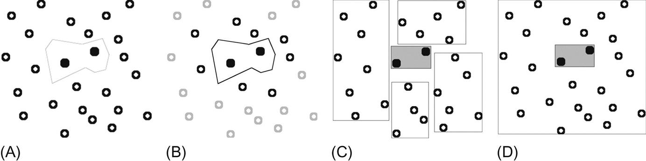
Implicit knowledge representation
Instances combined with distance metric carve out boundaries in instance space, distinguishing one class from another (output is implicit)
Simplest case: two instances, one of each class. Nearest neighbour rule splits instance space along perpendicular bisector of line joining two instances
Given several instances of each class, space is divided by a set of lines representing perpendicular bisectors of selected lines joining an instance of one class to one of another class (A)
Examples outside this decision boundary can be discarded (B)
Can explicitly generalize the instances by creating rectangular regions enclosing class (C)
Similar to rules that test a numeric variable against an upper and lower bound
Nested regions (region all one class contains sub-region of different class), similar to exceptions (D)

Slide 22
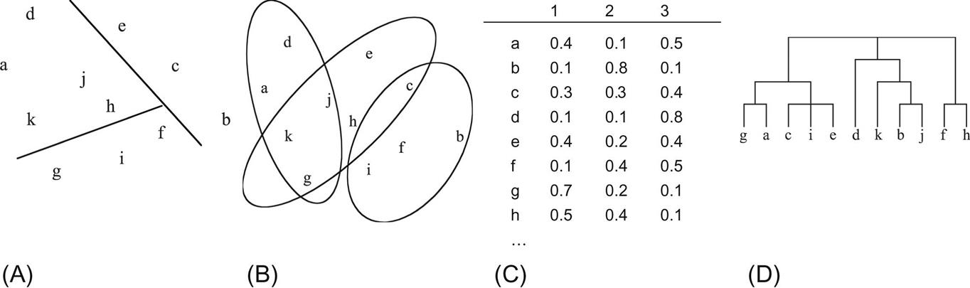
3.6 clusters
When clusters rather than a classifier is learned, output takes the form of a diagram showing which clusters a given instance belongs to (A)
Some algorithms allow one instance to belong to more than one cluster, so we can draw overlapping subsets representing each cluster (B)
Some algorithms associate instances with clusters probabilistically, so the output is a set of probabilities for each instance (C)
Some algorithms produce a hierarchical structure of clusters, where instance space is divided into fewer clusters at top level, each of which divides into subclusters, etc. (D)
Clustering is often used to find classes in unlabeled data, and then run the decision tree/rule generator

Slide 23
Recap chapter 3
Linear models
Decision trees
Rules
Instance-based representation

