Slide 2
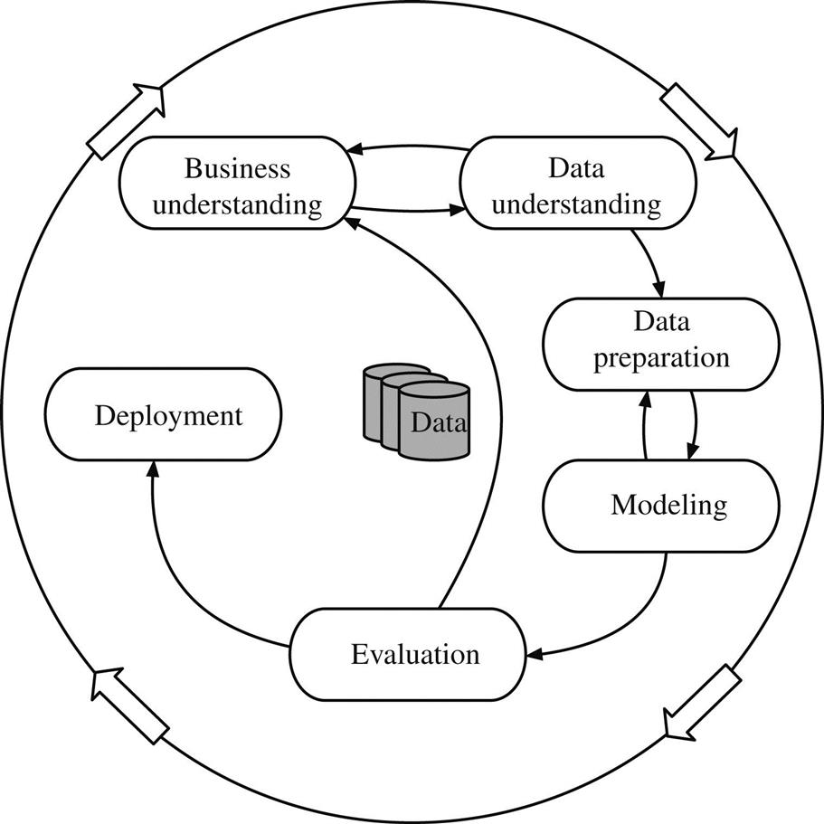
1.4 the data mining process

