Slide 1
CS405/505 Data Mining
Lecture 21

Slide 2
Backpropagation
Gradient computations decompose into a simple chain of matrix products

Slide 3
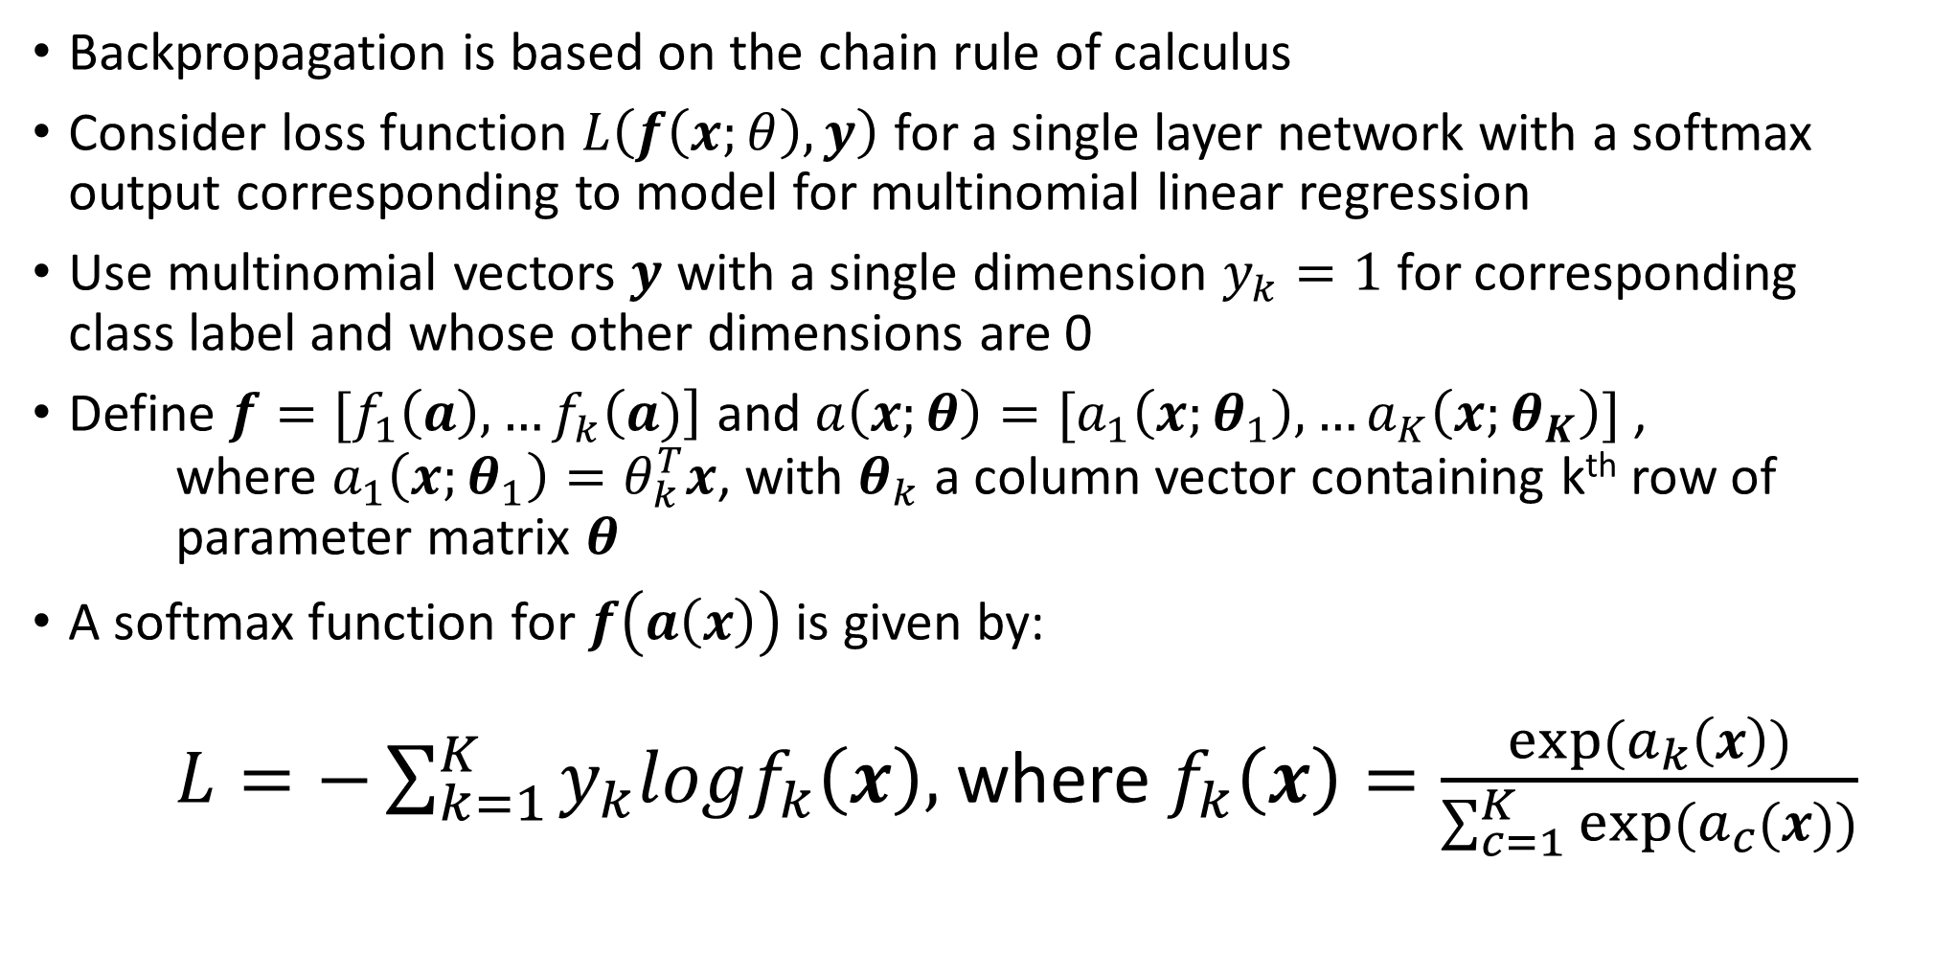
Backpropagation
Backpropagation is based on the chain rule of calculus
Consider loss function $L\left(f\left(x;θ\right),y\right)$ for a single layer network with a softmax output corresponding to model for multinomial linear regression
Use multinomial vectors $y$ with a single dimension $y_{k}=1$ for corresponding class label and whose other dimensions are 0
Define $f=[f_{1}\left(a\right),…f_{k}\left(a)\right]$ and $a\left(x;θ\right)=[a_{1}\left(x;θ_{1}\right),…a_{K}\left(x;θ_{K}\right)]$ , where $a_{1}\left(x;θ_{1}\right)=θ_{k}^{T}x$, with $θ_{k}$ a column vector containing k^{th} row of parameter matrix $θ$
A softmax function for $f\left(a\left(x\right)\right)$ is given by: $L=−\sum_{k=1}^{K}{y_{k}logf_{k}\left(x\right),}$ where $f_{k}\left(x\right)=\frac{exp⁡(a_{k}\left(x\right))}{\sum_{c=1}^{K}{exp⁡(a_{c}(x))}}$

Slide 4
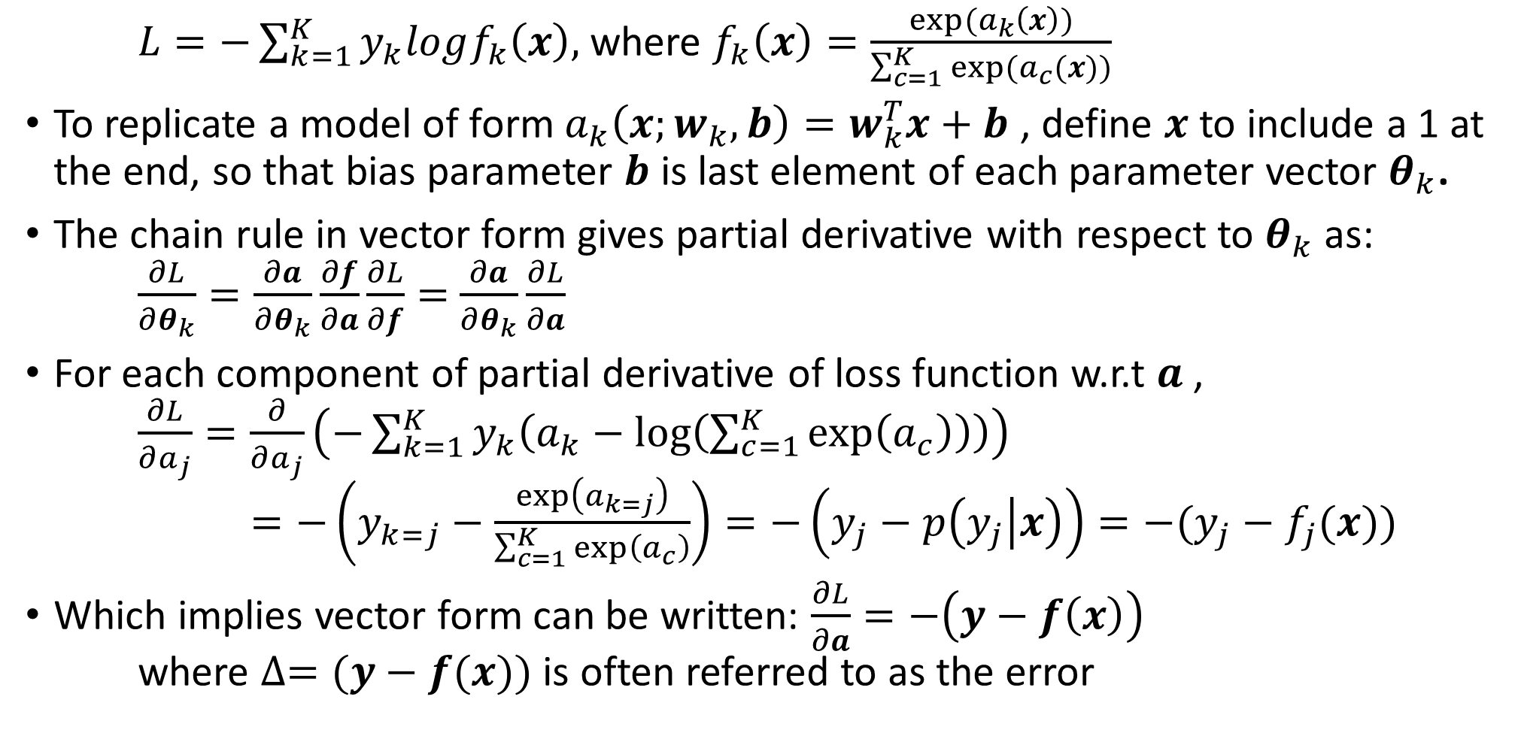
Backpropagation
$L=−\sum_{k=1}^{K}{y_{k}logf_{k}\left(x\right),}$ where $f_{k}\left(x\right)=\frac{exp⁡(a_{k}\left(x\right))}{\sum_{c=1}^{K}{exp⁡(a_{c}(x))}}$
To replicate a model of form $a_{k}\left(x;w_{k},b\right)=w_{k}^{T}x+b$ , define $x$ to include a 1 at the end, so that bias parameter $b$ is last element of each parameter vector $θ_{k}$.
The chain rule in vector form gives partial derivative with respect to $θ_{k}$ as: $\frac{∂L}{∂θ_{k}}=\frac{∂a}{∂θ_{k}}\frac{∂f}{∂a}\frac{∂L}{∂f}=$ $\frac{∂a}{∂θ_{k}}\frac{∂L}{∂a}$
For each component of partial derivative of loss function w.r.t $a$ , $\frac{∂L}{∂a_{j}}=\frac{∂}{∂a_{j}}\left(−\sum_{k=1}^{K}{y_{k}\left(a_{k}−\log\left(\sum_{c=1}^{K}{\exp\left(a_{c}\right)}\right)\right)}\right)$ $=−\left(y_{k=j}−\frac{\exp\left(a_{k=j}\right)}{\sum_{c=1}^{K}{\exp\left(a_{c}\right)}}\right)=−\left(y_{j}−p\left(y_{j} | x\right)\right)=−(y_{j}−f_{j}(x))$
Which implies vector form can be written: $\frac{∂L}{∂a}=−\left(y−f\left(x\right)\right)$ where $∆=(y−f(x))$ is often referred to as the error

Slide 5
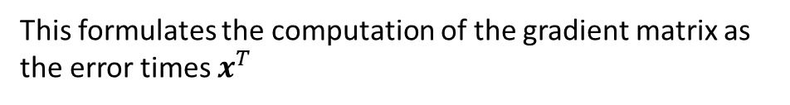
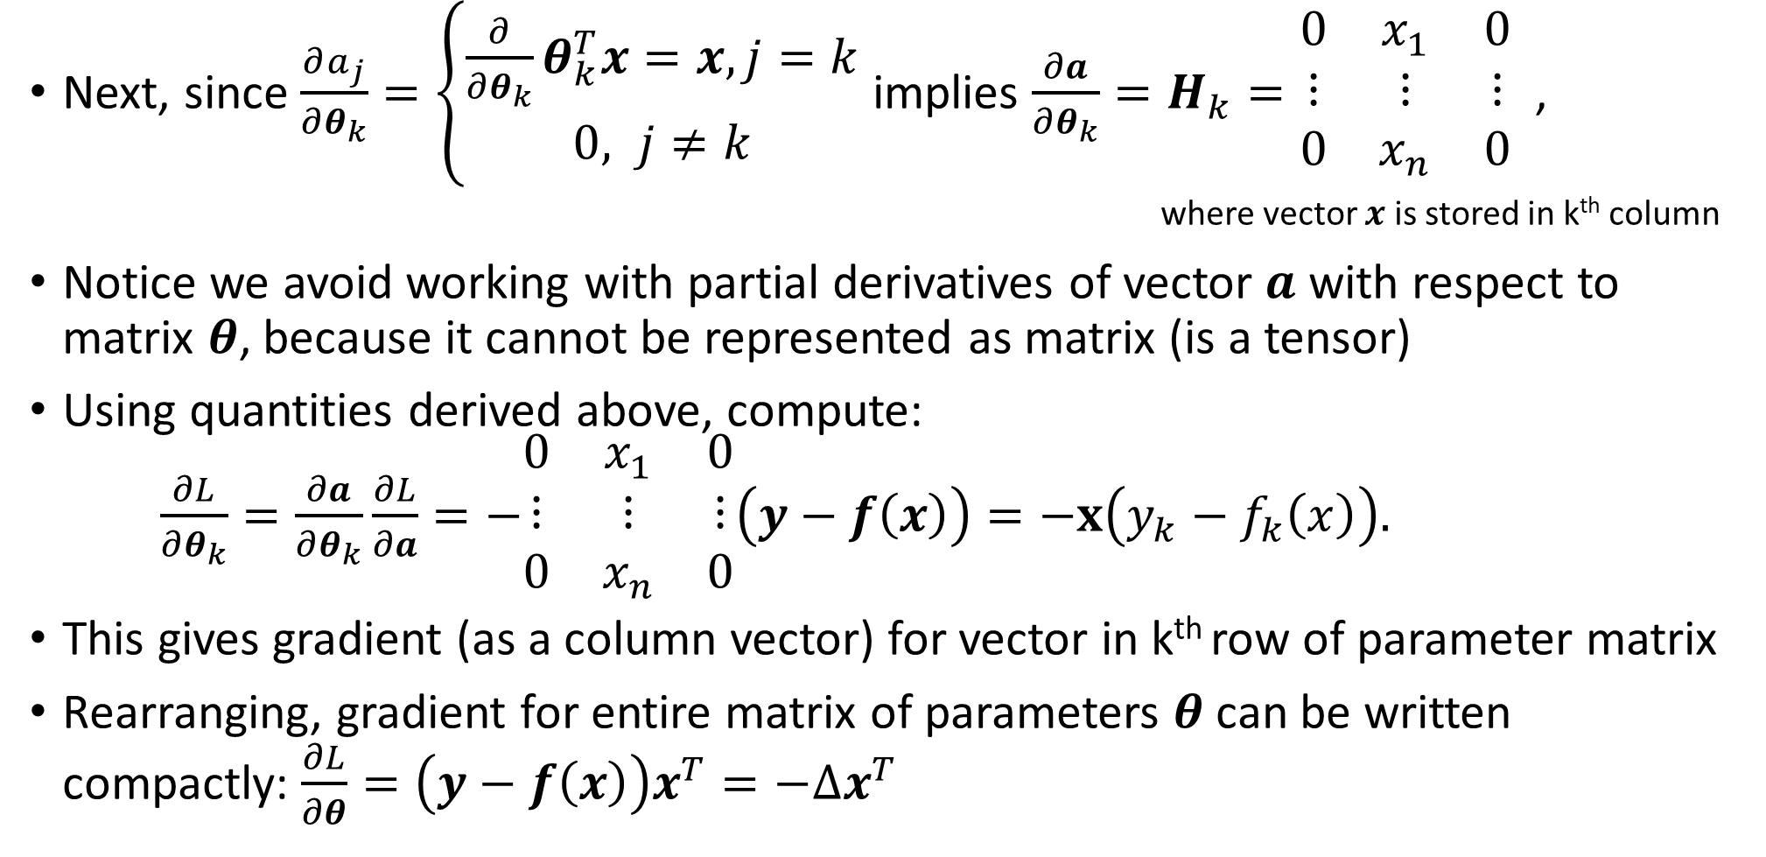
Backpropagation
Next, since $\frac{∂a_{j}}{∂θ_{k}}=\left\{\begin{aligned}\frac{∂}{∂θ_{k}}θ_{k}^{T}x=x, j=k \\ 0, j≠k\end{aligned}\right.$ implies $\frac{∂a}{∂θ_{k}}=H_{k}=\begin{matrix}0 & x_{1} & 0 \\ ⋮ & ⋮ & ⋮ \\ 0 & x_{n} & 0\end{matrix}$ , where vector $x$ is stored in k^{th} column
Notice we avoid working with partial derivatives of vector $a$ with respect to matrix $θ$, because it cannot be represented as matrix (is a tensor)
Using quantities derived above, compute: $\frac{∂L}{∂θ_{k}}=\frac{∂a}{∂θ_{k}}\frac{∂L}{∂a}=−\begin{matrix}0 & x_{1} & 0 \\ ⋮ & ⋮ & ⋮ \\ 0 & x_{n} & 0\end{matrix}\left(y−f\left(x\right)\right)=−x\left(y_{k}−f_{k}\left(x\right)\right).$
This gives gradient (as a column vector) for vector in k^{th} row of parameter matrix
Rearranging, gradient for entire matrix of parameters $θ$ can be written compactly: $\frac{∂L}{∂θ}=\left(y−f\left(x\right)\right)x^{T}=−∆x^{T}$
This formulates the computation of the gradient matrix as the error times $x^{T}$

Slide 6
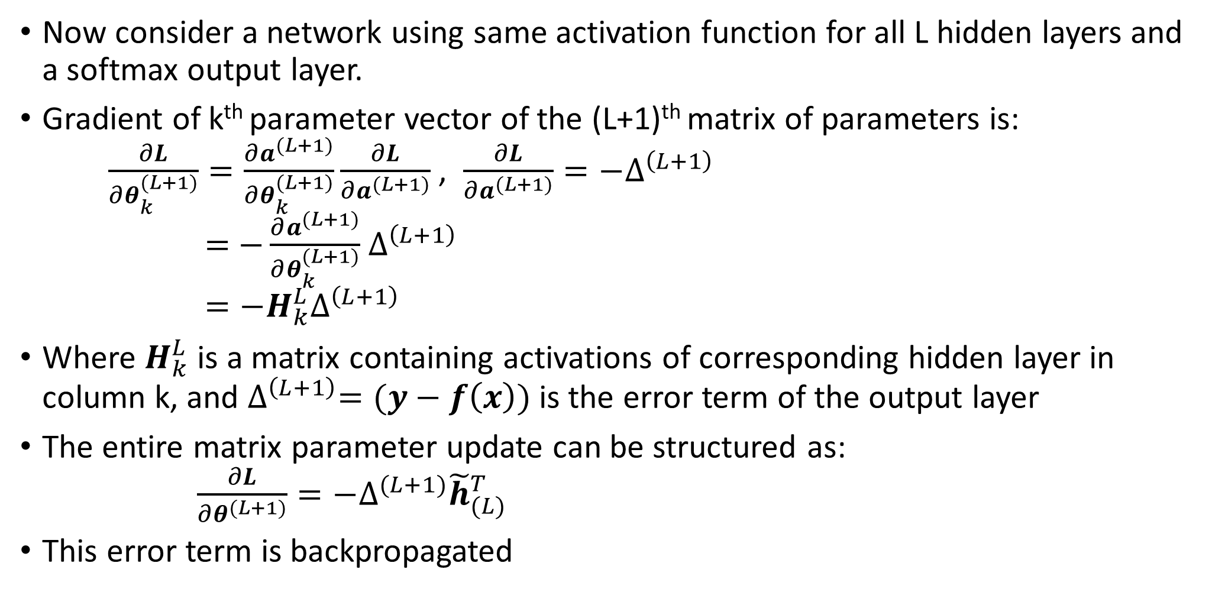
Backpropagation
Now consider a network using same activation function for all L hidden layers and a softmax output layer.
Gradient of k^{th} parameter vector of the (L+1)^{th} matrix of parameters is: $\frac{∂L}{∂θ_{k}^{(L+1)}}=\frac{∂a^{(L+1)}}{∂θ_{k}^{(L+1)}}\frac{∂L}{∂a^{(L+1)}}$ , $\frac{∂L}{∂a^{(L+1)}}=−∆^{\left(L+1\right)}$ $=$ $−\frac{∂a^{(L+1)}}{∂θ_{k}^{(L+1)}}$ $∆^{\left(L+1\right)}$ $=−H_{k}^{L}∆^{\left(L+1\right)}$
Where $H_{k}^{L}$ is a matrix containing activations of corresponding hidden layer in column k, and $∆^{\left(L+1\right)}=(y−f\left(x\right))$ is the error term of the output layer
The entire matrix parameter update can be structured as: $\frac{∂L}{∂θ^{(L+1)}}=−∆^{(L+1)}{\tilde{h}}_{(L)}^{T}$
This error term is backpropagated

Slide 7
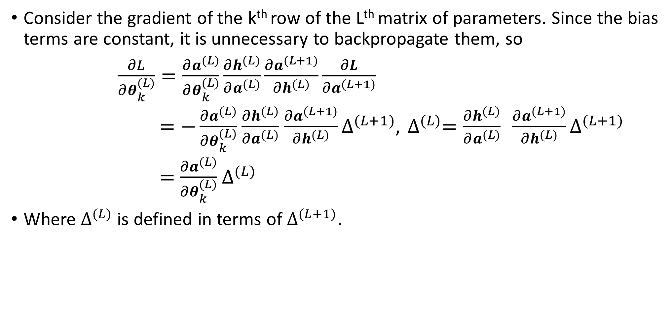
Backpropagation
Consider the gradient of the k^{th} row of the Lth matrix of parameters. Since the bias terms are constant, it is unnecessary to backpropagate them, so
$\frac{∂L}{∂θ_{k}^{(L)}}=\frac{∂a^{(L)}}{∂θ_{k}^{(L)}}\frac{∂h^{(L)}}{∂a^{(L)}}\frac{∂a^{(L+1)}}{∂h^{(L)}}\frac{∂L}{∂a^{(L+1)}}$
$=−\frac{∂a^{(L)}}{∂θ_{k}^{(L)}}$ $\frac{∂h^{(L)}}{∂a^{(L)}}$ $\frac{∂a^{(L+1)}}{∂h^{(L)}}∆^{(L+1)},$ $∆^{(L)}=\frac{∂h^{(L)}}{∂a^{(L)}} \frac{∂a^{(L+1)}}{∂h^{(L)}}∆^{(L+1)}$
$=$ $\frac{∂a^{(L)}}{∂θ_{k}^{(L)}}$ $∆^{(L)}$
Where $∆^{(L)}$ is defined in terms of $∆^{(L+1)}$.

Slide 8
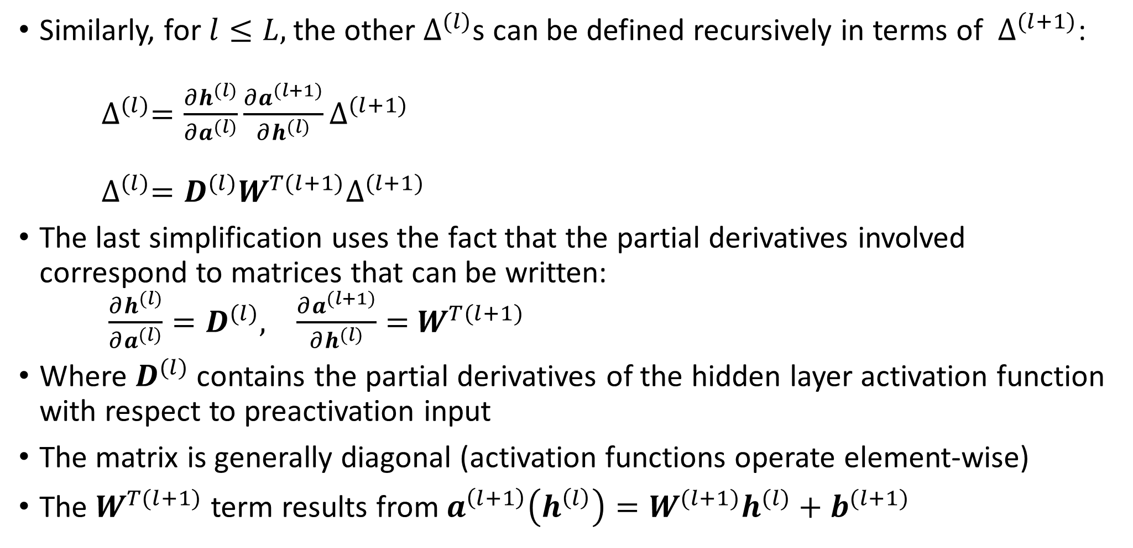
Backpropagation
Similarly, for $l≤L,$the other $∆^{(l)}$s can be defined recursively in terms of $∆^{(l+1)}$: $∆^{(l)}=\frac{∂h^{(l)}}{∂a^{(l)}}\frac{∂a^{(l+1)}}{∂h^{(l)}}∆^{(l+1)}$ $∆^{(l)}=D^{(l)}W^{T(l+1)}∆^{(l+1)}$
The last simplification uses the fact that the partial derivatives involved correspond to matrices that can be written: $\frac{∂h^{(l)}}{∂a^{(l)}}=D^{(l)},$ $\frac{∂a^{(l+1)}}{∂h^{(l)}}=$ $W^{T(l+1)}$
Where $D^{(l)}$ contains the partial derivatives of the hidden layer activation function with respect to preactivation input
The matrix is generally diagonal (activation functions operate element-wise)
The $W^{T(l+1)}$ term results from $a^{\left(l+1\right)}\left(h^{\left(l\right)}\right)=W^{(l+1)}h^{(l)}+b^{(l+1)}$

Slide 9
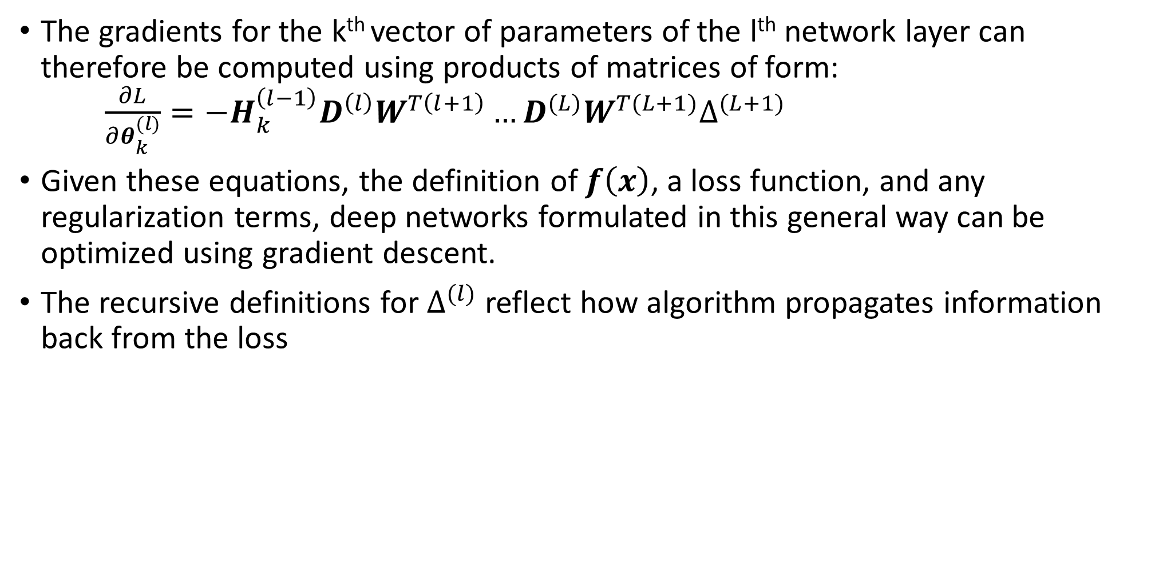
Backpropagation
The gradients for the k^{th} vector of parameters of the l^{th} network layer can therefore be computed using products of matrices of form: $\frac{∂L}{∂θ_{k}^{(l)}}=−H_{k}^{\left(l−1\right)}D^{\left(l\right)}W^{T\left(l+1\right)}…D^{(L)}W^{T(L+1)}∆^{(L+1)}$
Given these equations, the definition of $f\left(x\right)$, a loss function, and any regularization terms, deep networks formulated in this general way can be optimized using gradient descent.
The recursive definitions for $∆^{(l)}$ reflect how algorithm propagates information back from the loss

Slide 10
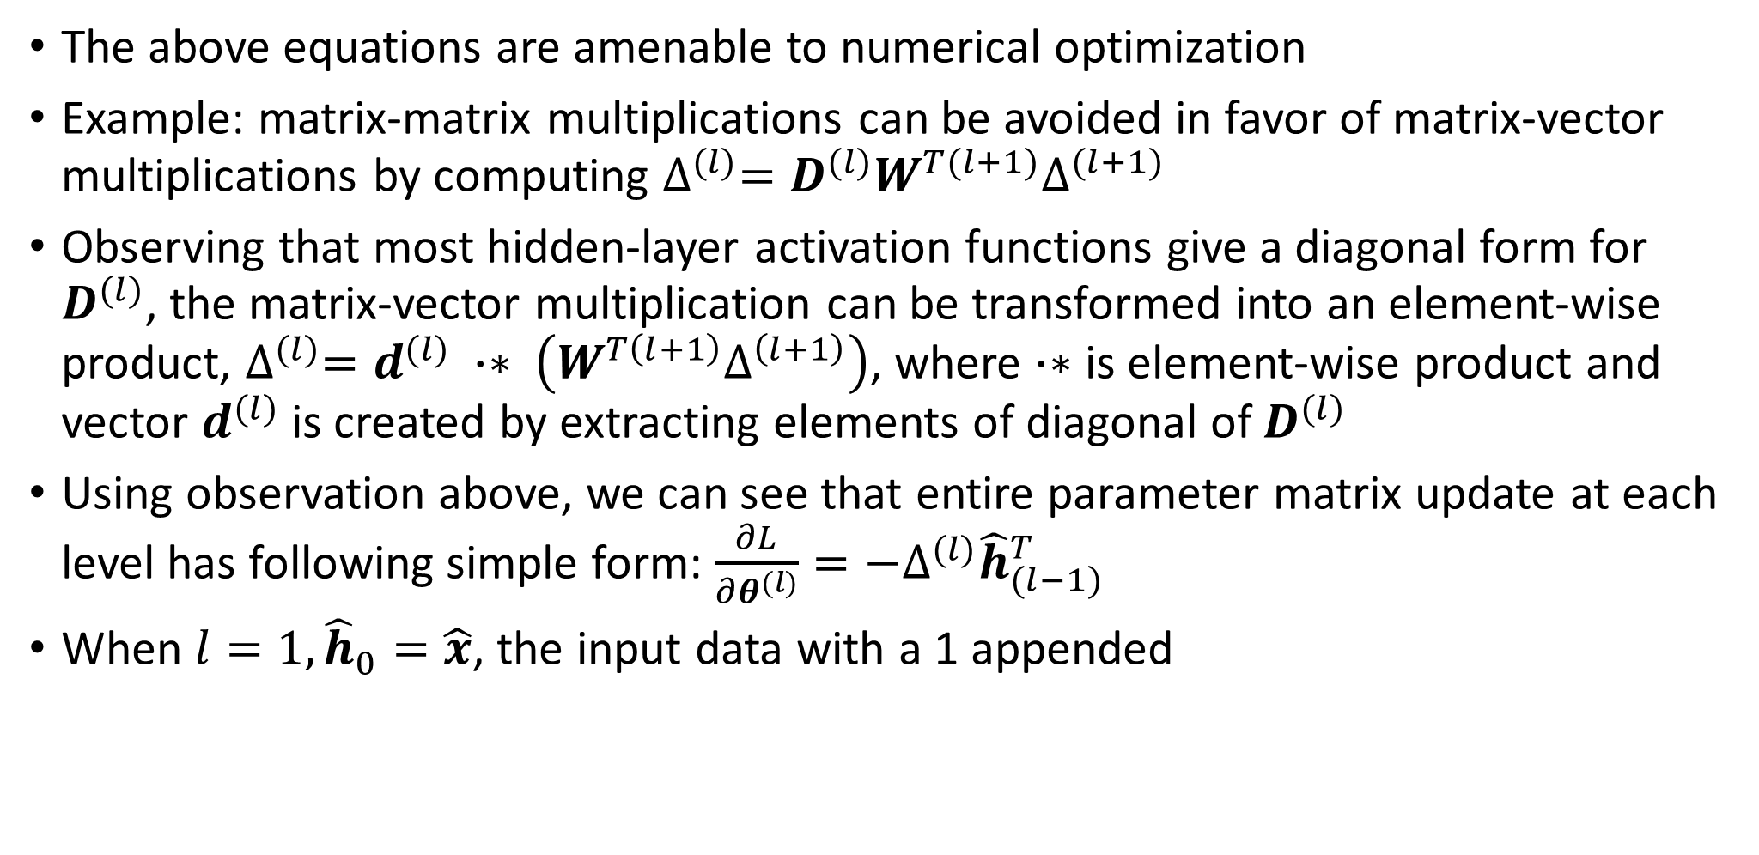
Backpropagation
The above equations are amenable to numerical optimization
Example: matrix-matrix multiplications can be avoided in favor of matrix-vector multiplications by computing $∆^{(l)}=D^{(l)}W^{T(l+1)}∆^{(l+1)}$
Observing that most hidden-layer activation functions give a diagonal form for $D^{(l)}$, the matrix-vector multiplication can be transformed into an element-wise product, $∆^{(l)}=d^{(l)} ∙∗ \left(W^{T\left(l+1\right)}∆^{\left(l+1\right)}\right)$, where $∙∗$ is element-wise product and vector $d^{(l)}$ is created by extracting elements of diagonal of $D^{(l)}$
Using observation above, we can see that entire parameter matrix update at each level has following simple form: $\frac{∂L}{∂θ^{(l)}}=−∆^{(l)}{\hat{h}}_{(l−1)}^{T}$
When $l=1, {\hat{h}}_{0}=\hat{x}$, the input data with a 1 appended

Slide 11
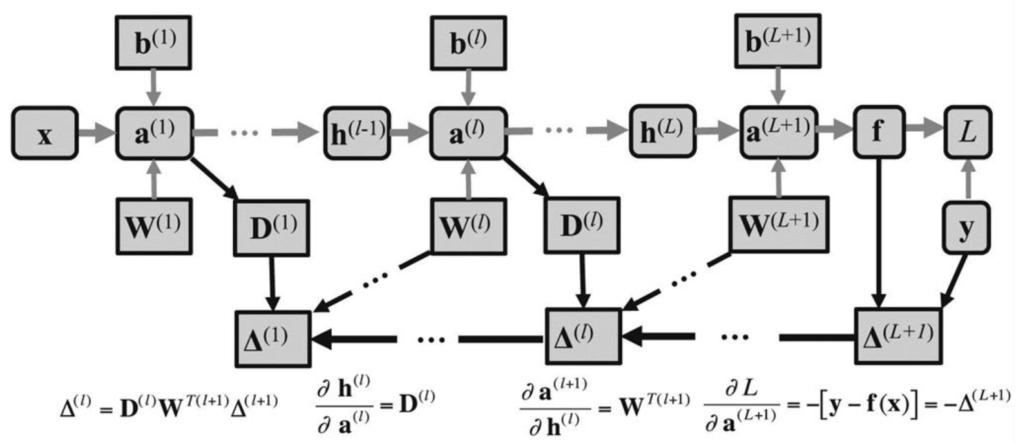
Backpropagation
Backpropagation in a deep network
Forward computation shown in gray arrows

Slide 12
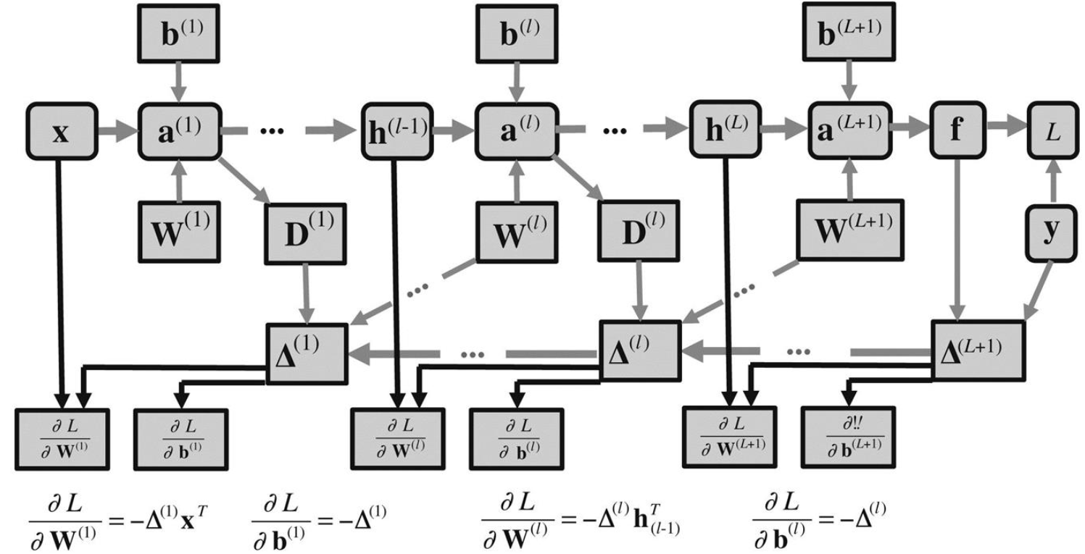
Backpropagation
Parameter updates (black arrows) that follow the forward and backward propagation steps (gray arrows)

Slide 13
Computation graphs and complex network structures
For a simple feedforward network, learning takes place in two phases: a forward pass and a backward pass
Using vector notation, we saw above that gradient computations decompose into a simple chain of matrix products
What if the graph does not have a simple layered structure?
More complex computations consisting of applying functions to intermediate results can also be represented by computation graphs
Implementing general mechanisms for efficient backpropagation is complex
Using concept of computation graph, gradient information simply needs to be propagated along the path found by reversing arrows in graph used to define steps of forward propagation of information
Learning in a deep network could be by gradient descent, or more sophisticated methods that exploit higher-order derivatives.
In practice, a variation of stochastic gradient descent based on mini-batches is by far the most popular method, software packages often optimized assuming this is the case

