Slide 1
CS405/505 Data Mining
Lecture 12

Slide 2
Assignment hint: first level of tree
waist
wide
thin
heartrate
heartrate
Practice exam with solutions will be released this Wednesday evening on Moodle

Slide 3
Recap
Our main goal was to predict future performance of our algorithm
Cross-validation, leave-one-out, bootstrap (test set, training set)
Hyperparameter tuning (test set, training set, validation set)
We were concerned mainly with classification accuracy on test set

Slide 4
5.7 Predicting probabilities and the loss function
Classification accuracy (correct or incorrect) can be seen as 0-1 loss function
Loss is 1 if incorrect, 0 if correct
Most learning schemes can associate a probability to predictions (Naïve Bayes)
If we are 99% sure our answer is correct but we get it wrong, should matter more
Similarly, if we are only 51% sure, and we get it wrong, should matter less
We will examine several different loss functions that can account for this

Slide 5
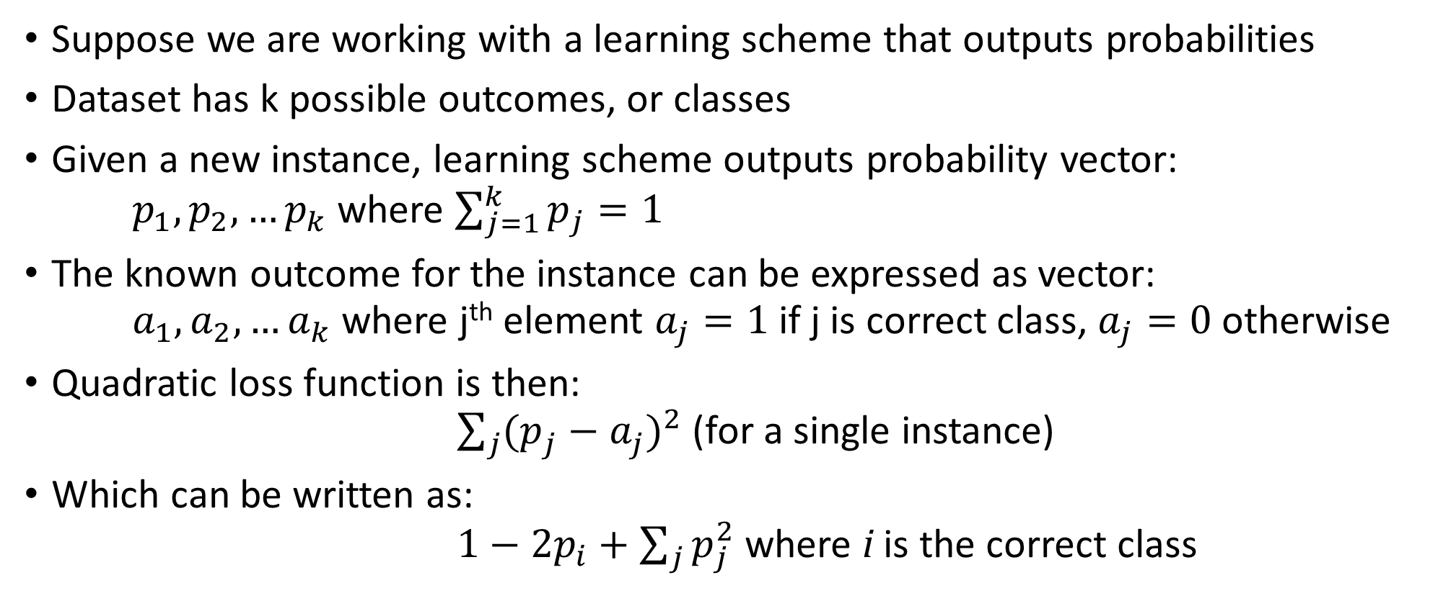
Quadratic loss function
Suppose we are working with a learning scheme that outputs probabilities
Dataset has k possible outcomes, or classes
Given a new instance, learning scheme outputs probability vector: $p_{1}, p_{2},…p_{k}$ where $\sum_{j=1}^{k}{p_{j}=1}$
The known outcome for the instance can be expressed as vector: $a_{1},a_{2},…a_{k}$ where j^{th} element $a_{j}=1$ if j is correct class, $a_{j}=0$ otherwise
Quadratic loss function is then: $\sum_{j}{{(p_{j}^{ }−a_{j}^{ })}^{2}}$ (for a single instance)
Which can be written as: $1−2p_{i}+\sum_{j}{p_{j}^{2}}$ where i is the correct class

Slide 6


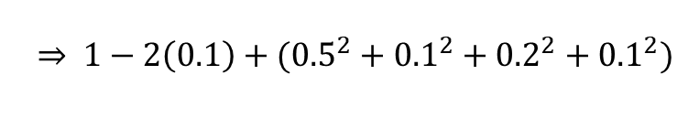

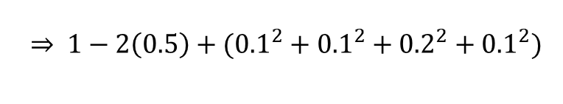
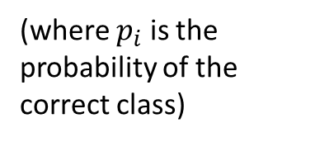
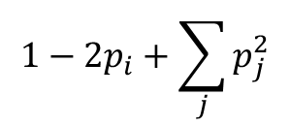
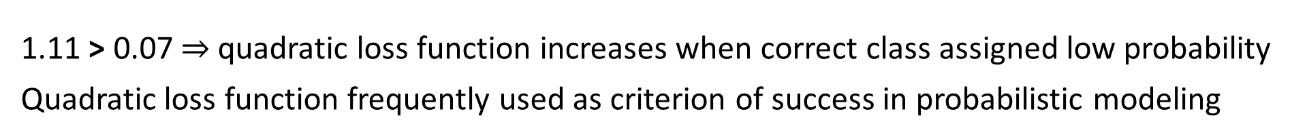
Quadratic loss function example:
Class probabilities ($p_{1}, p_{2},…p_{k}$) output by predictive model
Quadratic loss function:
(where $p_{i}$ is the probability of the correct class)
0.1
0.5
0.1
0.2
0.1
Here, k = 5
$$1−2p_{i}+\sum_{j}{p_{j}^{2}}$$
Known outcome ($a_{1},a_{2},…a_{k}$ )
$$\overset{⇒}{ } 1−2\left(0.5\right)+({0.1}^{2}+{0.1}^{2}+{0.2}^{2}+{0.1}^{2})$$
0
1
0
0
0
$=$ 0.07
(correct class is a₂ here)
If instead, the correct class was a₁ (but predictions remain the same) we would have:
$$\overset{⇒}{ } 1−2\left(0.1\right)+({0.5}^{2}+{0.1}^{2}+{0.2}^{2}+{0.1}^{2})$$
$=$ 1.11
1.11 > 0.07 quadratic loss function increases when correct class assigned low probability
Quadratic loss function frequently used as criterion of success in probabilistic modeling

Slide 7
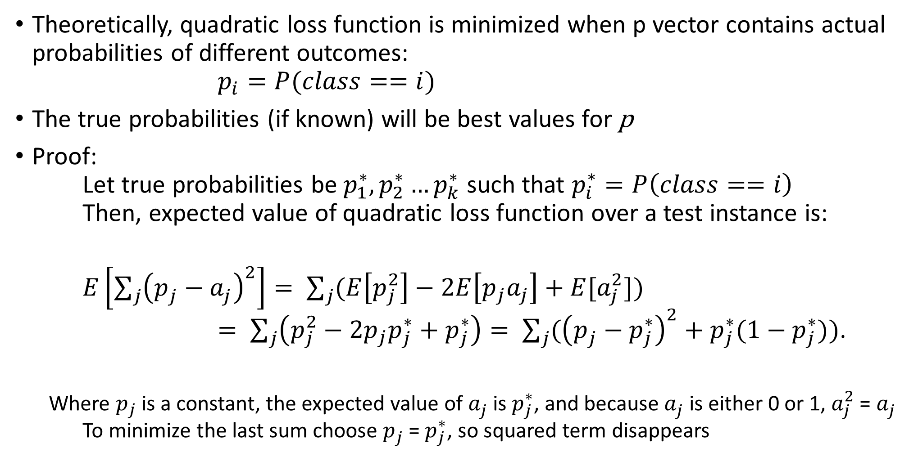
Quadratic loss function
Theoretically, quadratic loss function is minimized when p vector contains actual probabilities of different outcomes: $p_{i}=P(class==i)$
The true probabilities (if known) will be best values for p
Proof: Let true probabilities be $p_{1}^{∗},p_{2}^{∗}…p_{k}^{∗}$ such that $p_{i}^{∗}=P\left(class==i\right)$ Then, expected value of quadratic loss function over a test instance is:
$E\left[\sum_{j}{{\left(p_{j}^{ }−a_{j}^{ }\right)}^{2}}\right]= \sum_{j}{(E\left[p_{j}^{2}\right]−2E\left[p_{j}a_{j}\right]+E[a_{j}^{2}])}$ $= \sum_{j}{\left(p_{j}^{2}−2p_{j}p_{j}^{∗}+p_{j}^{∗}\right)= \sum_{j}{({\left(p_{j}^{ }−p_{j}^{∗}\right)}^{2}+p_{j}^{∗}(1−p_{j}^{∗}))}}$.
Where $p_{j}$ is a constant, the expected value of $a_{j}^{ }$ is $p_{j}^{∗}$, and because $a_{j}^{ }$ is either 0 or 1, $a_{j}^{2}$ = $a_{j}^{ }$ To minimize the last sum choose $p_{j}^{ }$ = $p_{j}^{∗}$, so squared term disappears

Slide 8
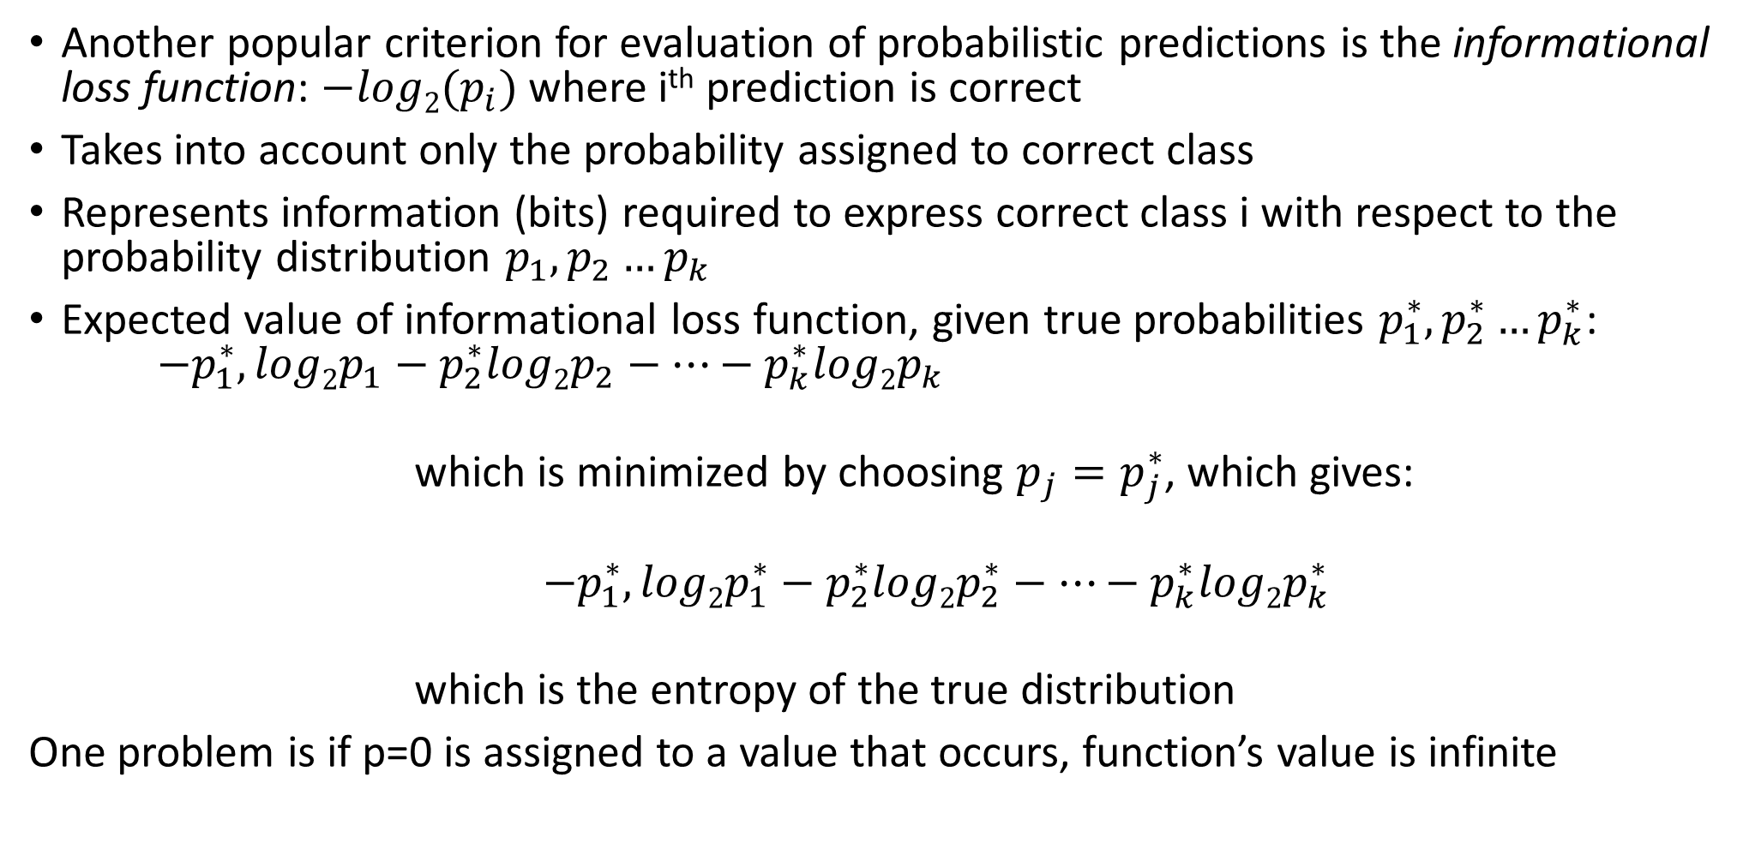
Informational loss function
Another popular criterion for evaluation of probabilistic predictions is the informational loss function: $−log2(p_{i})$ where i^{th} prediction is correct
Takes into account only the probability assigned to correct class
Represents information (bits) required to express correct class i with respect to the probability distribution $p_{1},p_{2}…p_{k}$
Expected value of informational loss function, given true probabilities $p_{1}^{∗},p_{2}^{∗}…p_{k}^{∗}$: $−p_{1}^{∗},log2p_{1}−p_{2}^{∗}log2p_{2}−…−p_{k}^{∗}log2p_{k}$
which is minimized by choosing $p_{j}=p_{j}^{∗}$, which gives:
$−p_{1}^{∗},log2p_{1}^{∗}−p_{2}^{∗}log2p_{2}^{∗}−…−p_{k}^{∗}log2p_{k}^{∗}$
which is the entropy of the true distribution
One problem is if p=0 is assigned to a value that occurs, function’s value is infinite

Slide 9
Which loss function to use?
Both give maximum reward to predictors capable of predicting true probabilities accurately, however there are some differences:
Quadratic loss function considers probabilities assigned to ALL classes
Informational loss function considers only probability assigned to correct class
Informational loss function gives massive penalties if you assign low probability to correct class (infinite penalty if you assign p=0 to correct class)
Quadratic loss function is more forgiving (can never exceed penalty of 2)
Informational loss function combines well with minimum descriptor length principle (MDL) because it is also measured in bits

Slide 10
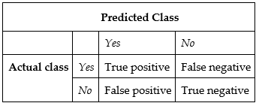
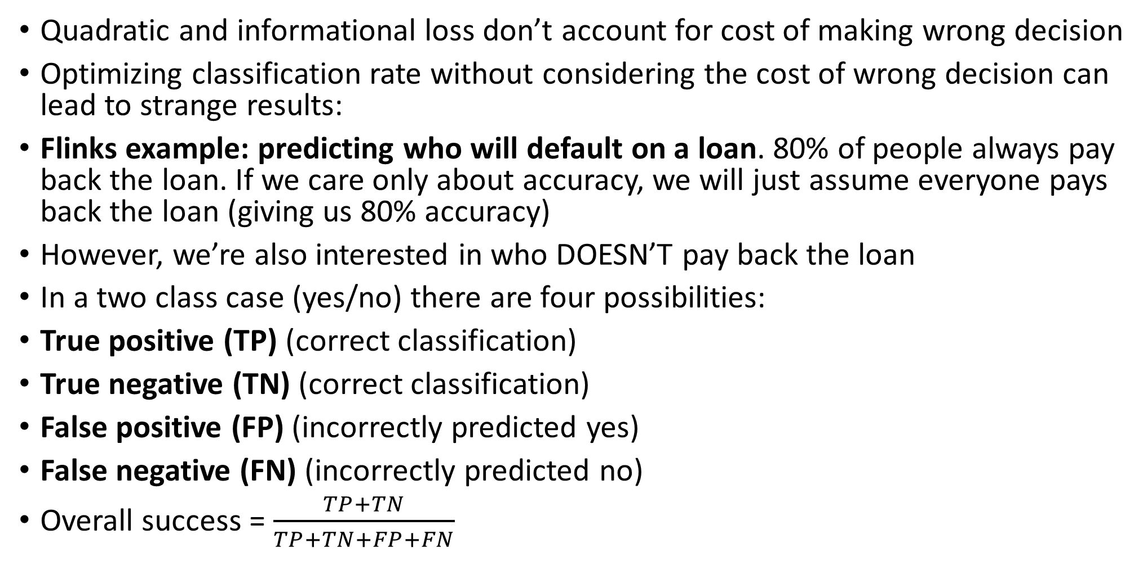
5.8 Counting the cost
Quadratic and informational loss don’t account for cost of making wrong decision
Optimizing classification rate without considering the cost of wrong decision can lead to strange results:
Flinks example: predicting who will default on a loan. 80% of people always pay back the loan. If we care only about accuracy, we will just assume everyone pays back the loan (giving us 80% accuracy)
However, we’re also interested in who DOESN’T pay back the loan
In a two class case (yes/no) there are four possibilities:
True positive (TP) (correct classification)
True negative (TN) (correct classification)
False positive (FP) (incorrectly predicted yes)
False negative (FN) (incorrectly predicted no)
Overall success = $\frac{TP+TN}{TP+TN+FP+FN}$

Slide 11
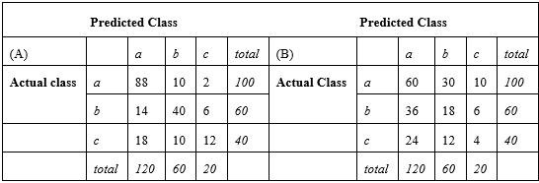
Confusion matrix
In multiclass prediction, result on a test set is displayed as two-dimensional confusion matrix, with a row and column for each class
Good results correspond to large numbers on the diagonal and zero off-diagonals
In A), there are 3 classes, 200 instances, 140 predicted correctly, 70% success rate
Seems good, but how many correct predictions would we expect by chance?
In B), results from random predictor (randomly picking same number of instances for each class as in A)
This random predictor gets 82 instances correct

Slide 12
Kappa statistic
Kappa statistic takes random predictor results into account by deducting #successes achieved randomly from predictor’s #successes:
For this example, our predictor (A) achieved 140 successes (88+40+12),
Random predictor achieved 82 successes (60+18+4)
140-82 = 58 extra successes (above what we expect by chance) out of a possible total of 200-82=118, for a 49.2% Kappa statistic (58/118)
Maximum Kappa value is 100%

Slide 13
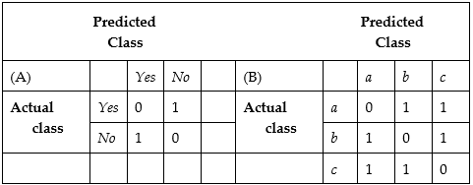
Cost-sensitive classification, cost matrix
We can assign different costs/benefits to classification outcomes (FP, FN, TP, TN)
A) assigning cost of 1 to FP and FN (two-class situation)
B) assigning cost of 1 to FP and FN (multi-class situation) (cost matrix)
Cost matrix replaces success rate by average cost per decision
Can calculate the cost of a learned model on a test set by summing the relevant element of cost matrix across all predictions

Slide 14
Cost-sensitive learning
Previously, we ignored cost at training time, using cost matrix only on test set
Can use cost matrix during training, training the classifier according to cost matrix
Simplest technique is to artificially vary proportion of classes in training set:
Flinks example: 80% pay back, 20% don’t pay back. Train on a 50:50 split instead of the full dataset
Can do this several ways:
1) Duplicate instances of the class you want to enhance
2) Leave out instances of classes other than the one you want to enhance
3) Assign weights to different classes

Slide 15
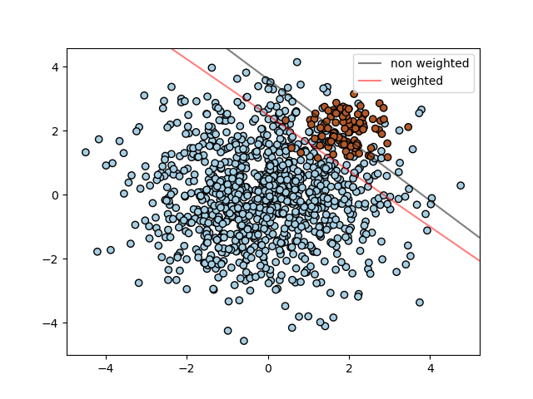
Example of effects of weighting on decision boundary learning:
Blue = class 1
Brown = class 2
Fewer brown instances, but we care more about classifying them correctly
https://scikit-learn.org/stable/auto_examples/svm/plot_separating_hyperplane_unbalanced.html

Slide 16
Lift charts
Use lift charts when you don’t know the cost and want to examine different cases
Example: direct mailing business contemplating a mass mailout of a promotional offer to 1,000,000 households across America
Most will not respond, based on previous promotions, may 0.1% (1,000 people)
Suppose, using data mining we can identify a subset of 100,000 households with 0.4% response rate (400 people)
Should we mail to everyone, or only the subset of 100,000?
Depends on cost of mailing compared with return gained from each response
Lift factor is the increase in response rate obtained by targeting a subset (4x here)
May want to evaluate other possibilities (400,000 households @ 0.2% response)

Slide 17
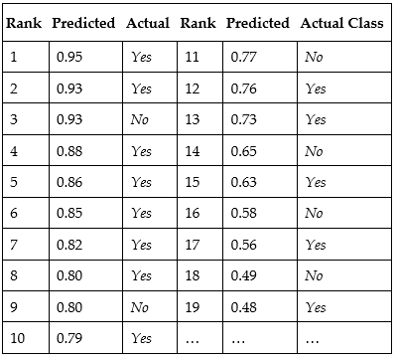
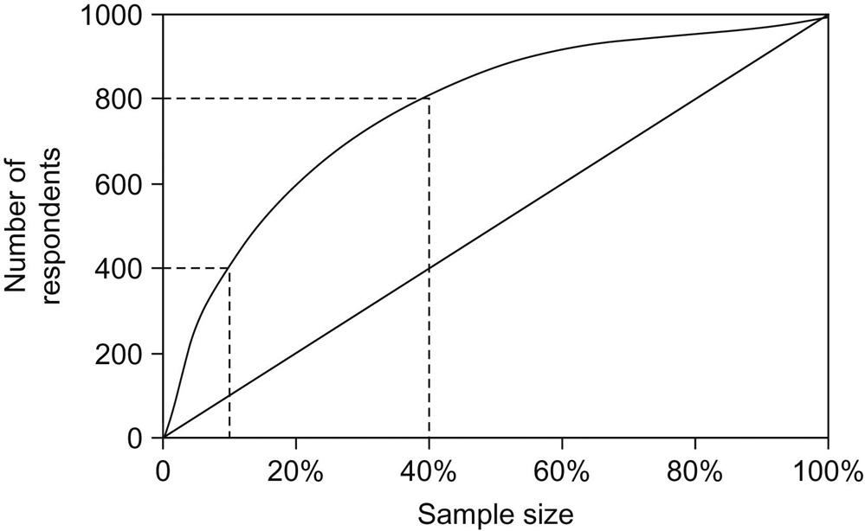
Lift charts
Can use probabilistic predictions to sort test instances
Example: small dataset with 120 instances, 60=yes, 60=no
Example lift chart: sort candidates for mailing campaign, plot number of responses vs sample size
Want to be in the upper left hand side of this lift chart (1000 respondents for 1000 mail outs)
Definitely need to be above diagonal (response from random sampling)

Slide 18
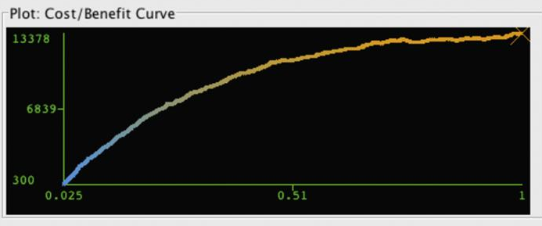
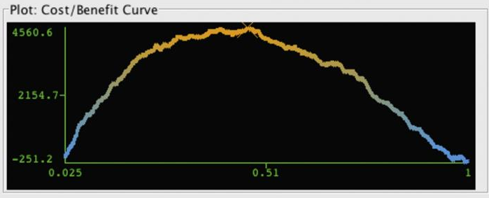
Real world example
A) cost of mailing = $0.50, benefit of response = $15.00, better to mail to the entire population
B) cost of mailing = $0.80, benefit of response = $15.00, better to mail to only top ~46% of population most likely to respond
Lift charts are a valuable tool, widely used in marketing applications
A)
B)

Slide 19
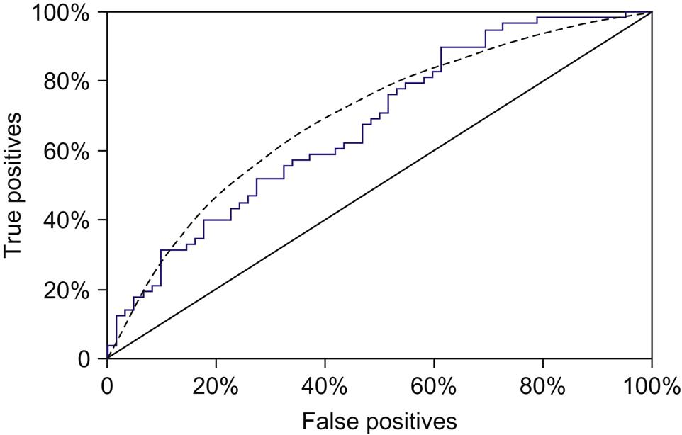
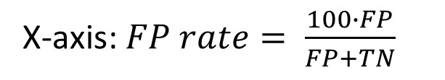
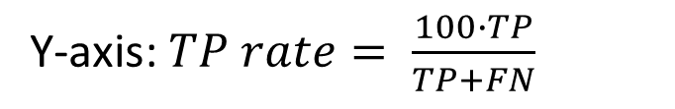
ROC curves
ROC receiver operating characteristics a term from signal detection
Used when learner wants to select samples of test instances with higher proportion of positives
Plots true positive (TP) rate on y-axis, false positive (FP) rate on x-axis
Jagged line plotted directly from the table, smooth dotted line hypothetical average obtained by 10-fold cross-validation
Y-axis: $TP rate= \frac{100∙TP}{TP+FN}$
X-axis: $FP rate= \frac{100∙FP}{FP+TN}$

Slide 20
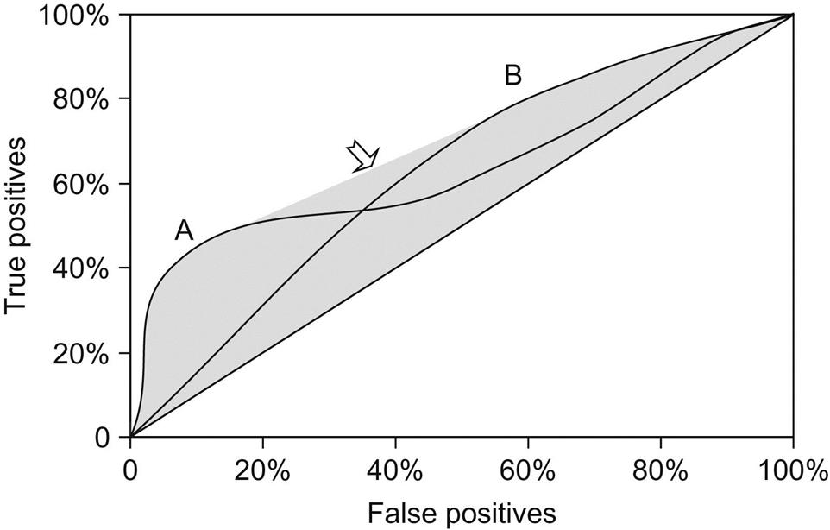
ROC curves obtained from different learning schemes
Some learning schemes are better at targeting a small, focused sample of instances (A)
Others perform better when you want to use more of your data (B)
Can combine algorithms A and B if you want to operate in the shaded middle region (arrow)

Slide 21
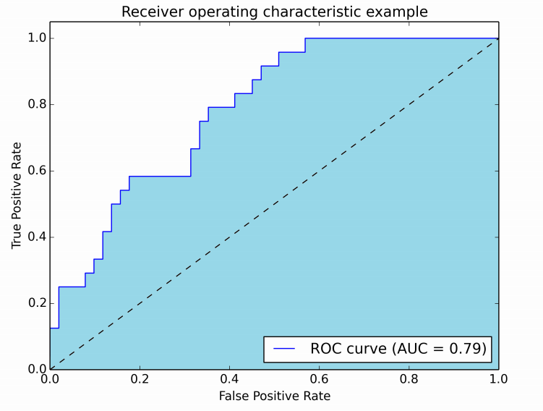
Area under ROC (Final project evaluation)
Area under ROC summarizes the ROC curve in a single quantity
The larger the area, the better the model
Can interpret the area as the probability that your classifier ranks a randomly chosen positive instance above a randomly chosen negative instance
“your goal is to build a model that predicts the probability that a given customer will default on a loan, the quality of your predictions will be assessed using the Area Under the Curve”
https://scikit-learn.org/stable/modules/generated/sklearn.metrics.roc_auc_score.html

Slide 22
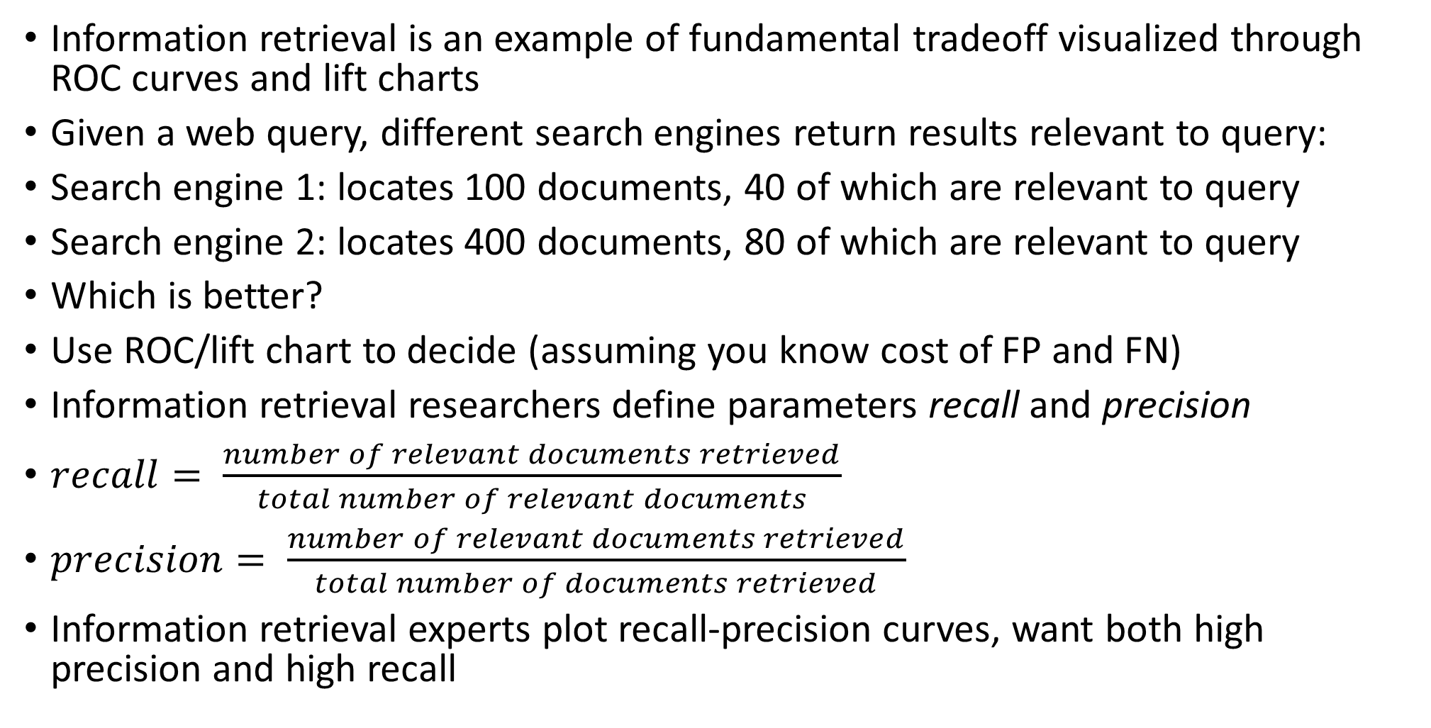
Recall-Precision curves
Information retrieval is an example of fundamental tradeoff visualized through ROC curves and lift charts
Given a web query, different search engines return results relevant to query:
Search engine 1: locates 100 documents, 40 of which are relevant to query
Search engine 2: locates 400 documents, 80 of which are relevant to query
Which is better?
Use ROC/lift chart to decide (assuming you know cost of FP and FN)
Information retrieval researchers define parameters recall and precision
$recall= \frac{number of relevant documents retrieved}{total number of relevant documents}$
$precision= \frac{number of relevant documents retrieved}{total number of documents retrieved}$
Information retrieval experts plot recall-precision curves, want both high precision and high recall

Slide 23
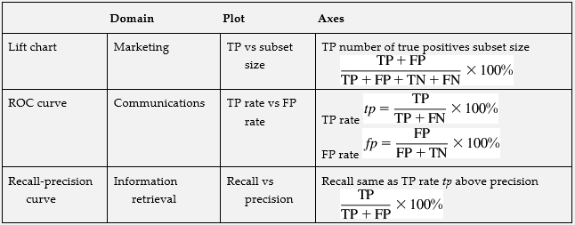
Domain specific applications
3 basic ways of evaluating same tradeoff
Basic goal is to choose a set of instances that has a high proportion of success, and also contains a high proportion of all successes in the dataset (coverage)
Different techniques give different tradeoffs
Medical professionals talk about sensitivity of various techniques (proportion of people with disease and also test positive for disease, TP) and specificity (proportion of people without the disease who have a negative result (1-FP).
https://acutecaretesting.org/en/articles/precision-recall-curves-what-are-they-and-how-are-they-used

Slide 24
Summary
Loss function to evaluate probabilistic predictions
Cost-sensitive learning
Lift chart, ROC, recall-precision curves
Recall-precision curves are better when classes are imbalanced
See link below
Next class: cost curves and the MDL principle
Evaluating credit card fraud prediction on unbalanced data using ROC and precision-recall curves:
https://www.kaggle.com/lct14558/imbalanced-data-why-you-should-not-use-roc-curve

