Slide 1
CS405/505 Data Mining
Lecture 27

Slide 2
Probabilistic methods
Probabilistic methods are the basis for many data mining techniques
We have seen Naïve Bayes, a model that maximizes likelihood of an event
We will formalize the notion of likelihood
Will see how maximizing likelihoods underlies many estimation problems
Will see Bayesian networks and other probabilistic methods
Aside:
Probability is required to describe quantum phenomena
Many-worlds interpretation of quantum mechanics:
https://en.wikipedia.org/wiki/Many-worlds_interpretation

Slide 3
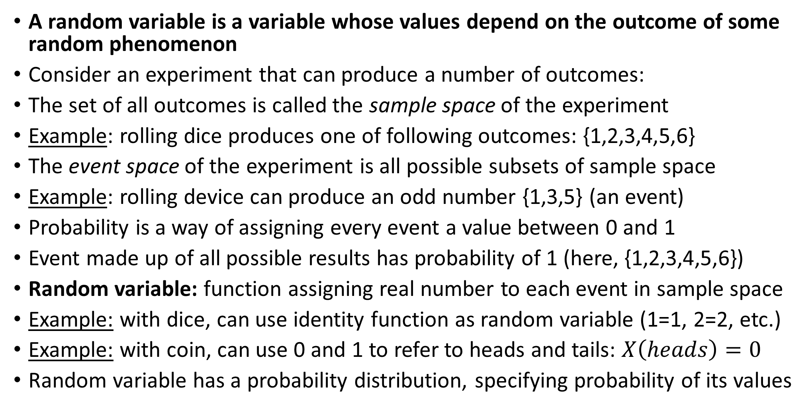
Random variables
A random variable is a variable whose values depend on the outcome of some random phenomenon
Consider an experiment that can produce a number of outcomes:
The set of all outcomes is called the sample space of the experiment
Example: rolling dice produces one of following outcomes: {1,2,3,4,5,6}
The event space of the experiment is all possible subsets of sample space
Example: rolling device can produce an odd number {1,3,5} (an event)
Probability is a way of assigning every event a value between 0 and 1
Event made up of all possible results has probability of 1 (here, {1,2,3,4,5,6})
Random variable: function assigning real number to each event in sample space
Example: with dice, can use identity function as random variable (1=1, 2=2, etc.)
Example: with coin, can use 0 and 1 to refer to heads and tails: $X\left(heads\right)=0$
Random variable has a probability distribution, specifying probability of its values

Slide 4
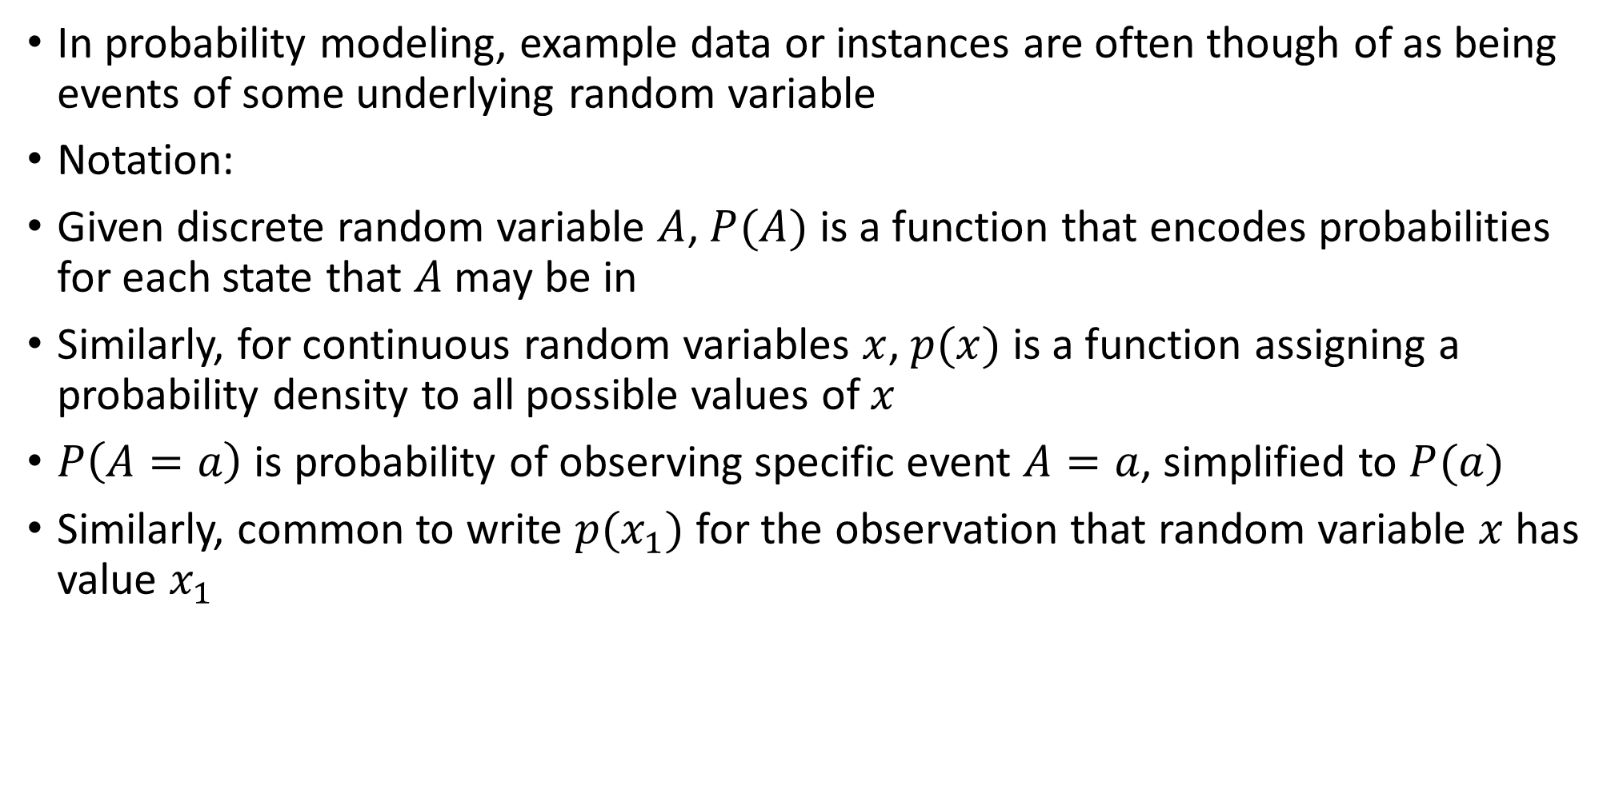
9.1 Foundations
In probability modeling, example data or instances are often though of as being events of some underlying random variable
Notation:
Given discrete random variable $A$, $P(A)$ is a function that encodes probabilities for each state that $A$may be in
Similarly, for continuous random variables $x$, $p(x)$ is a function assigning a probability density to all possible values of $x$
$P\left(A=a\right)$ is probability of observing specific event $A=a$, simplified to $P(a)$
Similarly, common to write $p(x_{1})$ for the observation that random variable $x$ has value $x_{1}$

Slide 5
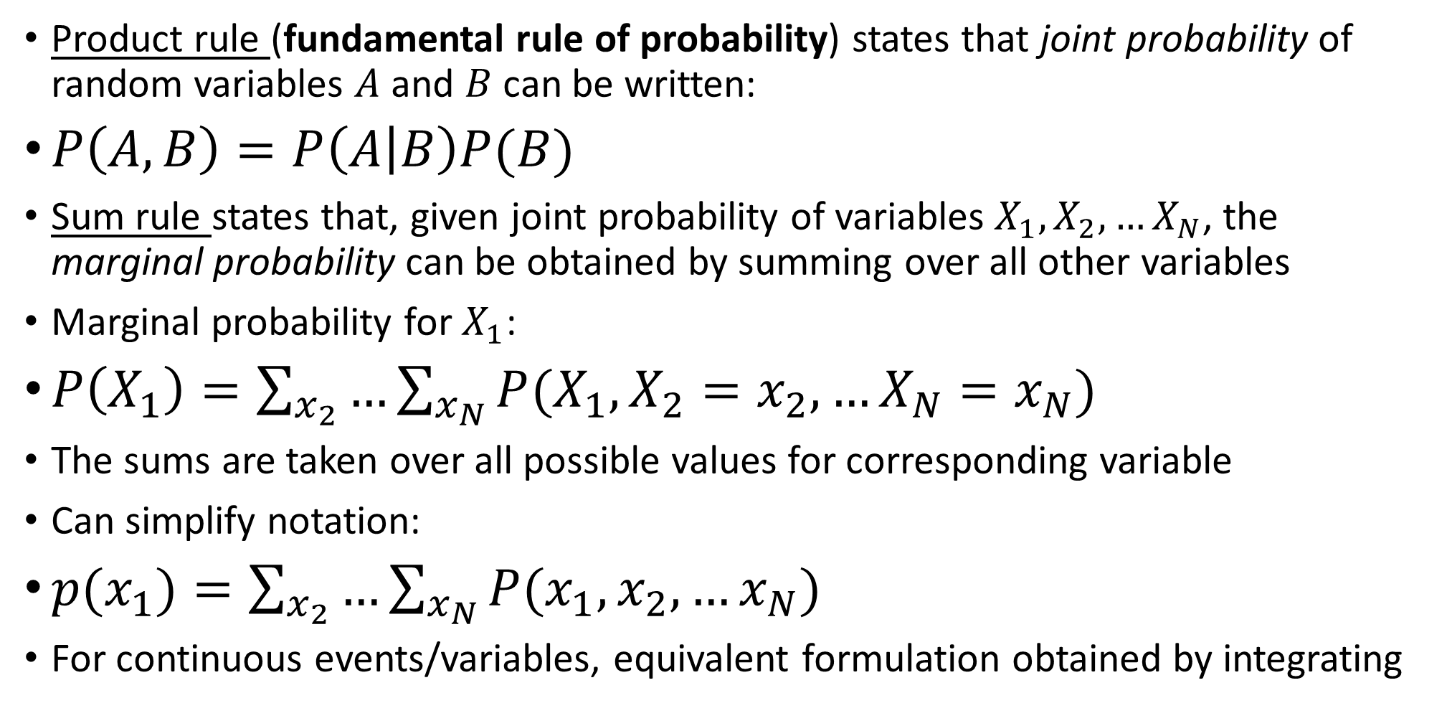
Rules of probability
Product rule (fundamental rule of probability) states that joint probability of random variables $A$ and $B$ can be written:
$P\left(A,B\right)=P\left(A | B\right)P(B)$
Sum rule states that, given joint probability of variables $X_{1},X_{2},…X_{N}$, the marginal probability can be obtained by summing over all other variables
Marginal probability for $X_{1}$:
$P\left(X_{1}\right)=\sum_{x_{2}}{…\sum_{x_{N}}{P(X_{1},X_{2}=x_{2},…X_{N}=x_{N})}}$
The sums are taken over all possible values for corresponding variable
Can simplify notation:
$p{(x}_{1})=\sum_{x_{2}}{…\sum_{x_{N}}{P(x_{1},x_{2},…x_{N})}}$
For continuous events/variables, equivalent formulation obtained by integrating

Slide 6
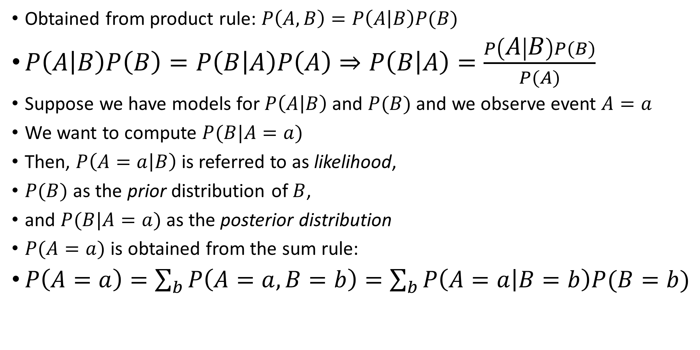
Bayes’ Rule
Obtained from product rule: $P\left(A,B\right)=P\left(A | B\right)P(B)$
$P\left(A | B\right)P\left(B\right)=P\left(B | A\right)P\left(A\right)⇒P\left(B | A\right)=\frac{P\left(A | B\right)P(B)}{P(A)}$
Suppose we have models for $P\left(A | B\right)$ and $P(B)$ and we observe event $A=a$
We want to compute $P(B|A=a)$
Then, $P\left(A=a | B\right)$ is referred to as likelihood,
$P(B)$ as the prior distribution of $B$,
and $P(B|A=a)$ as the posterior distribution
$P(A=a)$ is obtained from the sum rule:
$P\left(A=a\right)=\sum_{b}{P\left(A=a,B=b\right)=\sum_{b}{P\left(A=a | B=b\right)P(B=b)}}$

Slide 7
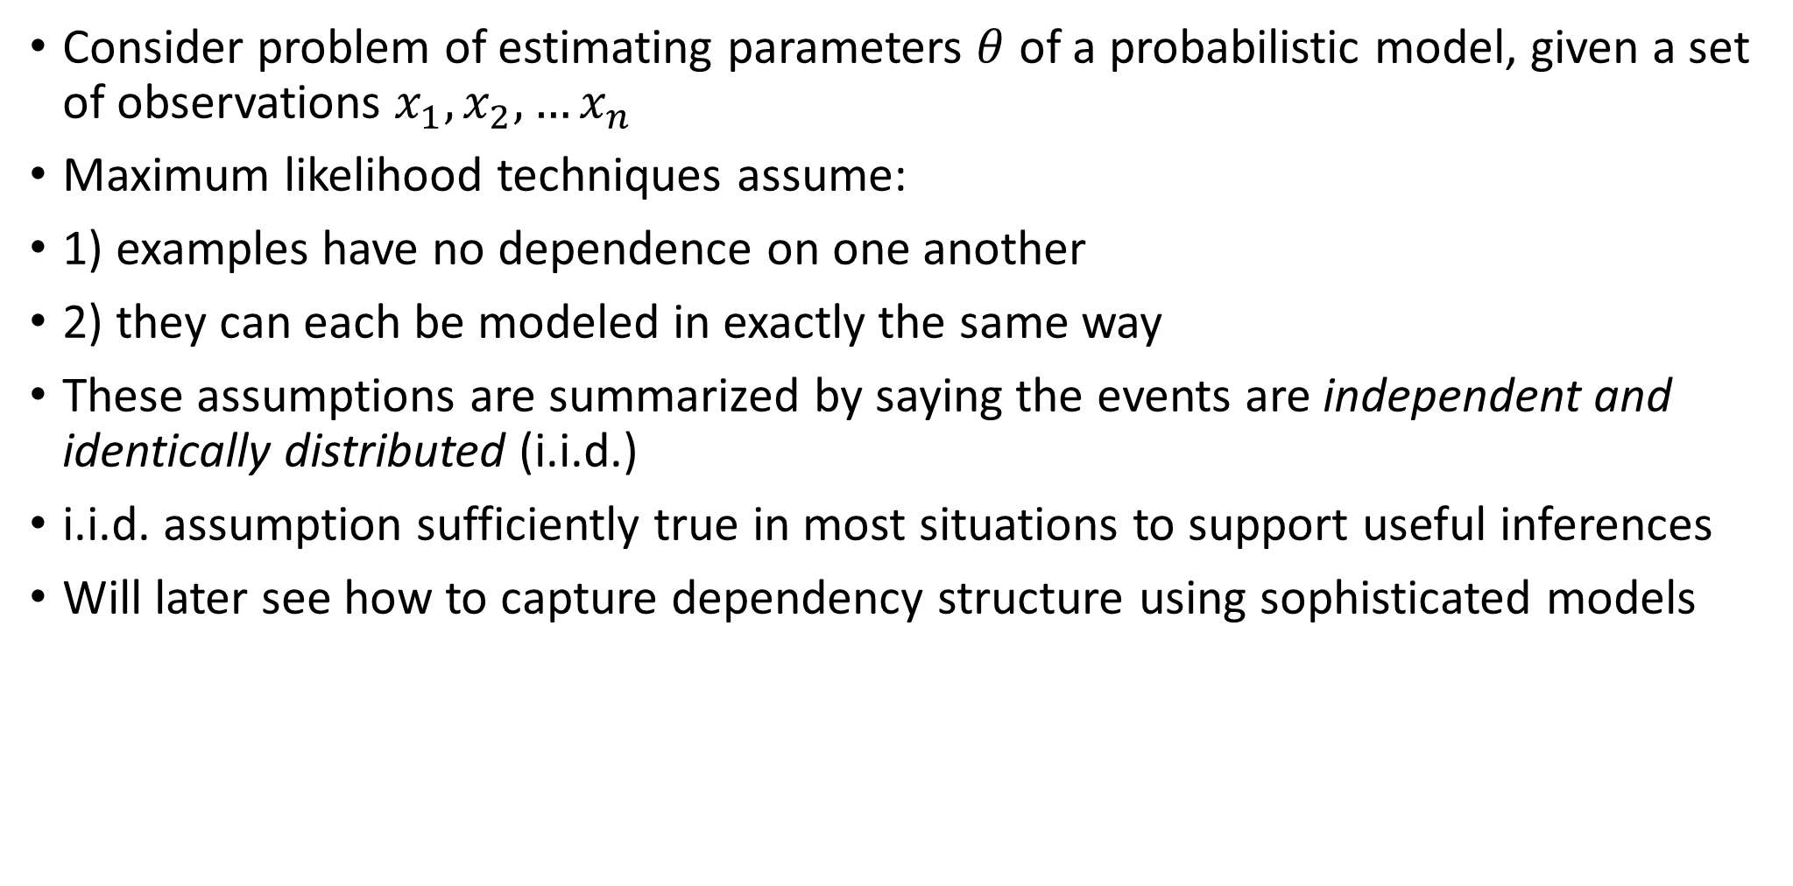
Maximum Likelihood Estimation
Consider problem of estimating parameters $θ$ of a probabilistic model, given a set of observations $x_{1},x_{2},…x_{n}$
Maximum likelihood techniques assume:
1) examples have no dependence on one another
2) they can each be modeled in exactly the same way
These assumptions are summarized by saying the events are independent and identically distributed (i.i.d.)
i.i.d. assumption sufficiently true in most situations to support useful inferences
Will later see how to capture dependency structure using sophisticated models

Slide 8
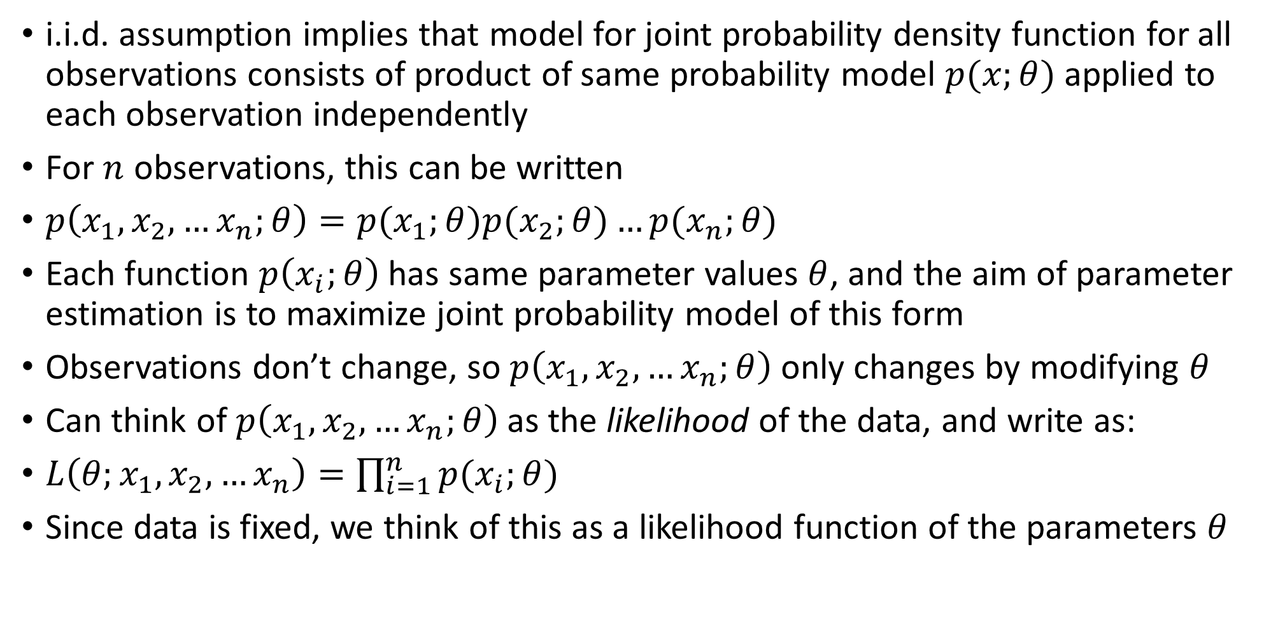
Maximum Likelihood Estimation
i.i.d. assumption implies that model for joint probability density function for all observations consists of product of same probability model $p(x;θ)$ applied to each observation independently
For $n$ observations, this can be written
$p\left(x_{1},x_{2},…x_{n};θ\right)=p(x_{1};θ)p(x_{2};θ)…p(x_{n};θ)$
Each function $p\left(x_{i};θ\right)$has same parameter values $θ$, and the aim of parameter estimation is to maximize joint probability model of this form
Observations don’t change, so $p\left(x_{1},x_{2},…x_{n};θ\right)$only changes by modifying $θ$
Can think of $p\left(x_{1},x_{2},…x_{n};θ\right)$ as the likelihood of the data, and write as:
$L\left(θ;x_{1},x_{2},…x_{n}\right)=\prod_{i=1}^{n}{p(x_{i};θ)}$
Since data is fixed, we think of this as a likelihood function of the parameters $θ$

Slide 9
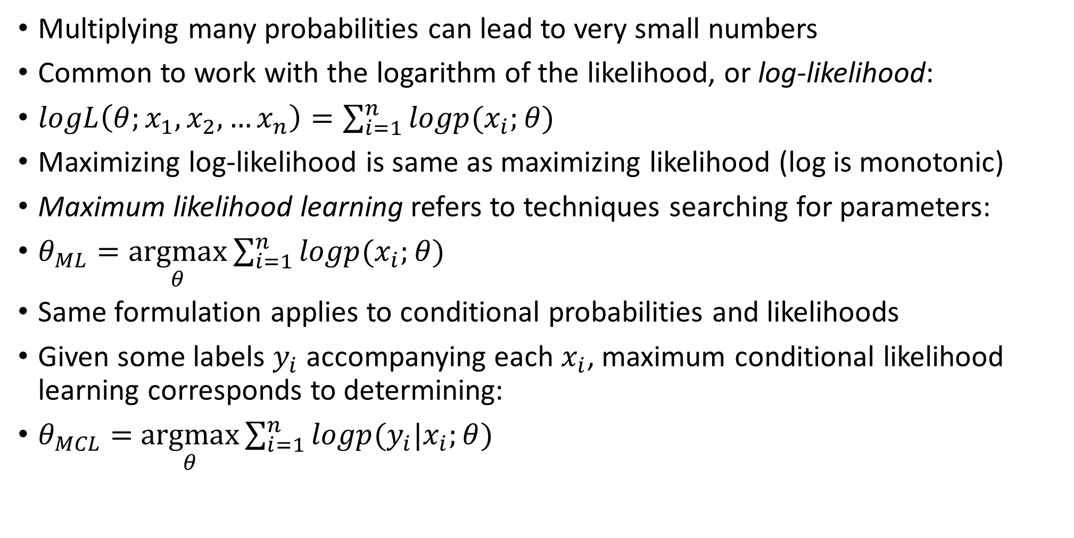
Log likelihood
Multiplying many probabilities can lead to very small numbers
Common to work with the logarithm of the likelihood, or log-likelihood:
$logL\left(θ;x_{1},x_{2},…x_{n}\right)=\sum_{i=1}^{n}{logp(x_{i};θ)}$
Maximizing log-likelihood is same as maximizing likelihood (log is monotonic)
Maximum likelihood learning refers to techniques searching for parameters:
$θ_{ML}=\underset{θ}{argmax}{\sum_{i=1}^{n}{logp(x_{i};θ)}}$
Same formulation applies to conditional probabilities and likelihoods
Given some labels $y_{i}$ accompanying each $x_{i}$, maximum conditional likelihood learning corresponds to determining:
$θ_{MCL}=$ $\underset{θ}{argmax}{\sum_{i=1}^{n}{logp(y_{i}|x_{i};θ)}}$

Slide 10
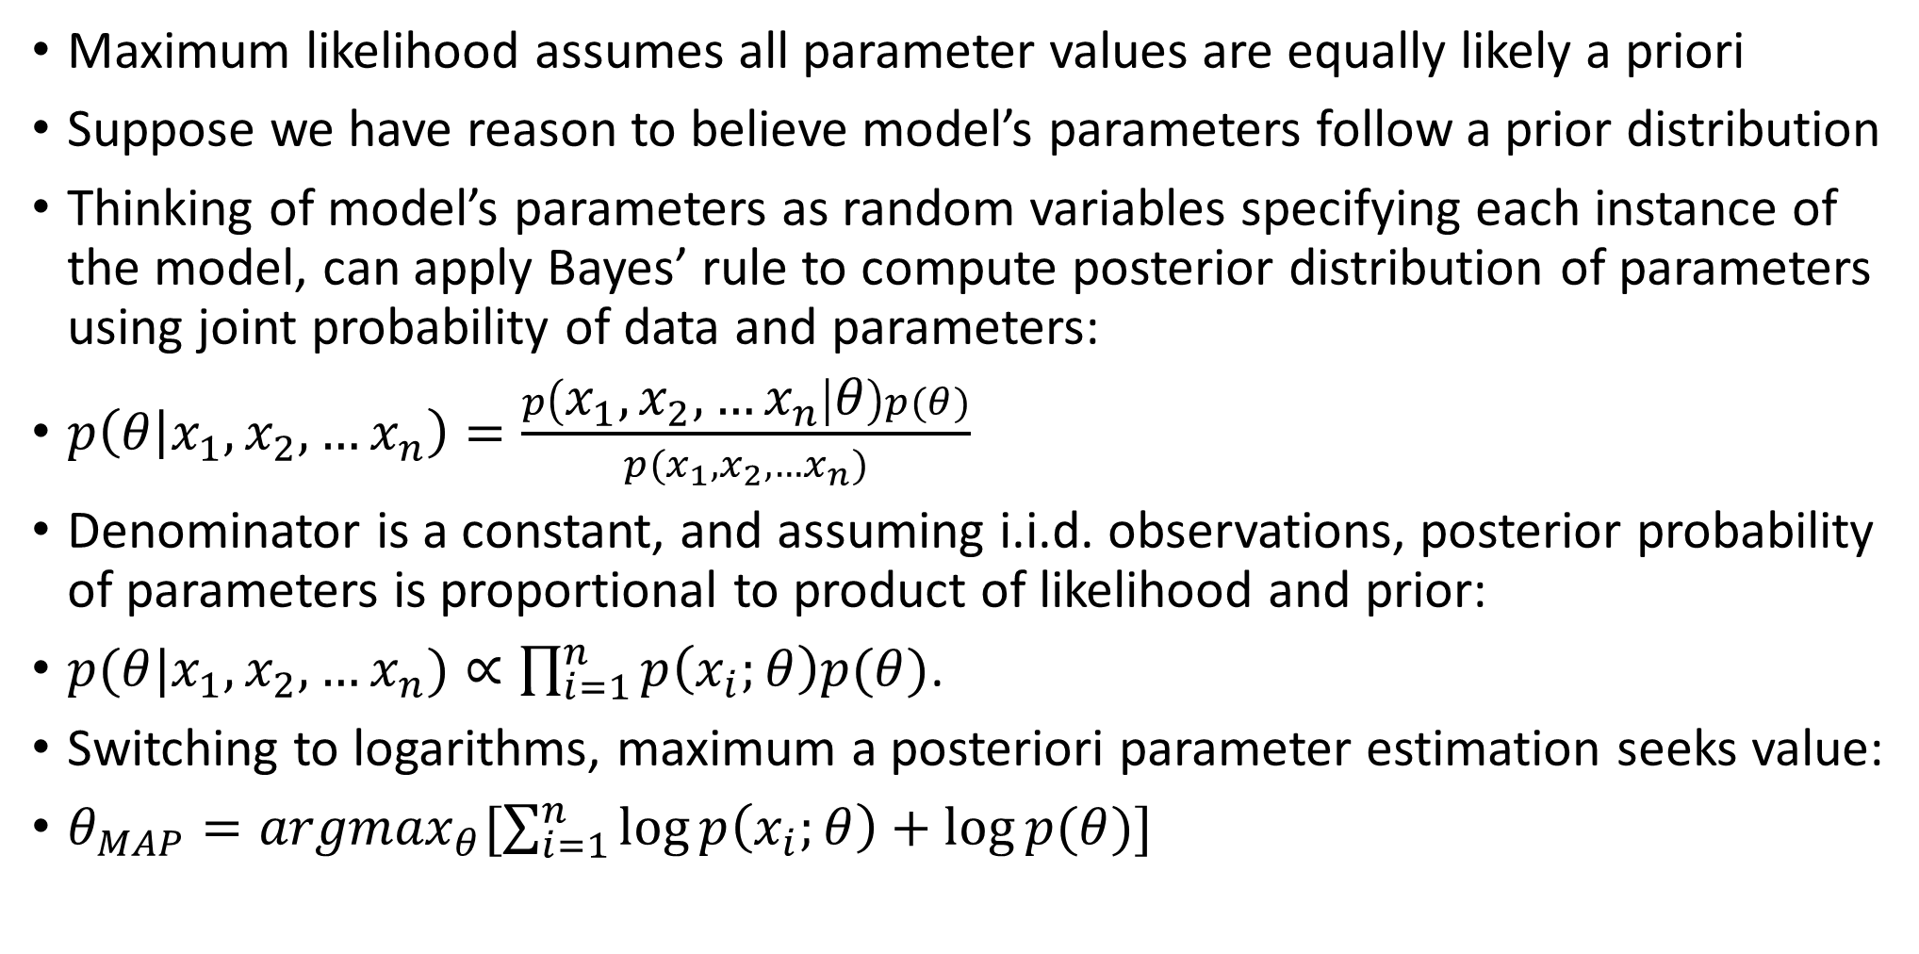
Maximum a Posteriori parameter estimation
Maximum likelihood assumes all parameter values are equally likely a priori
Suppose we have reason to believe model’s parameters follow a prior distribution
Thinking of model’s parameters as random variables specifying each instance of the model, can apply Bayes’ rule to compute posterior distribution of parameters using joint probability of data and parameters:
$p\left(θ | x_{1},x_{2},…x_{n}\right)=\frac{p\left(x_{1},x_{2},…x_{n} | θ\right)p(θ)}{p(x_{1},x_{2},…x_{n})}$
Denominator is a constant, and assuming i.i.d. observations, posterior probability of parameters is proportional to product of likelihood and prior:
$p(θ|x_{1},x_{2},…x_{n})∝\prod_{i=1}^{n}{p\left(x_{i};θ\right)p(θ)}$.
Switching to logarithms, maximum a posteriori parameter estimation seeks value:
$θ_{MAP}={argmax}_{θ}[\sum_{i=1}^{n}{\log{p\left(x_{i};θ\right)}+log⁡p(θ)}]$

Slide 11
9.2 Bayesian Networks
Naïve Bayes classifier produces probability estimates rather than 0/1 classes
Most classifiers can yield probabilities
Example - decision tree – compute relative frequency of each class in a given leaf
Probability estimates are often more useful than plain predictions
Allows predictions to be ranked, and expected cost minimized
Classification learning is the task of learning class probability estimates from data
Can view classification as estimating conditional probability distribution of values of class attribute, given the values of the other attributes
Viewed this way, Naïve Bayes classifier (and others) are an alternative way of representing a conditional probability distribution
However, Naïve Bayes can only represent simple distributions
Decision trees can represent arbitrary distributions, but have their own drawbacks
Fragmented training set (resulting in less reliable probability estimates), replicated subtrees, etc.
There is an alternative: a theoretically well-founded way of representing probability distributions concisely and comprehensibly in a graphical manner: Bayesian Networks

Slide 12
Bayesian networks
Bayesian networks are drawn as a network of nodes, one for each attribute, connected by directed edges such that no cycles exist – a directed, acyclic graph
We will make some simplifying assumptions when describing Bayesian networks:
1) all attributes are nominal, corresponding to discrete random variables
2) no missing values, data is complete
3) we will defer discussion of hidden attributes until later

Slide 13
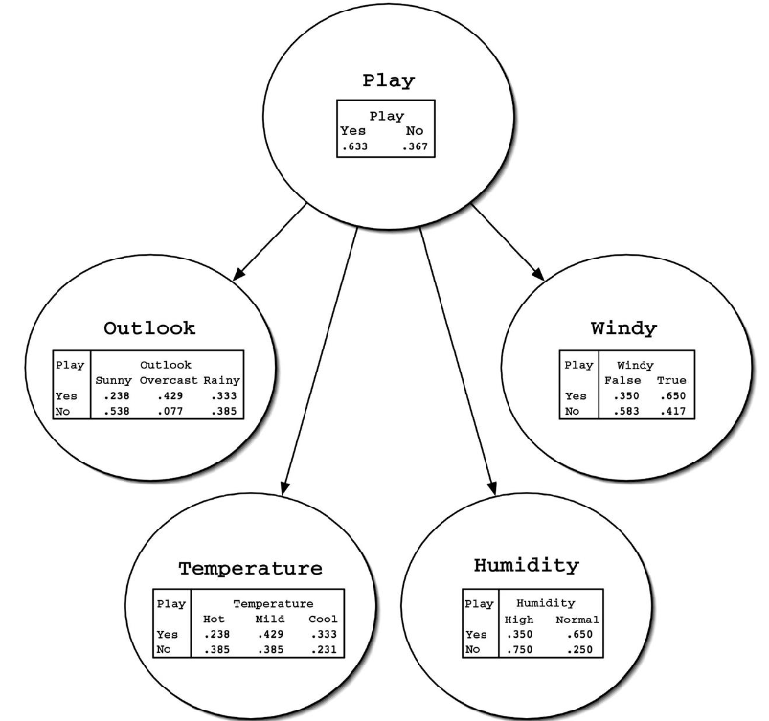
Bayesian networks
Simple Bayesian network for weather data
Has node for each of the 4 attributes, and node for class
Edges from ‘play’ node to each of the attribute nodes
Information in tables defines a probability distribution used to predict class probabilities for any given instance
Attribute nodes have two parts:
On the left, values for ‘play’
On the right, corresponding probabilities for each value of the attribute represented by the node
Each row defines a probability distribution over the values of the node’s attribute
Nodes that are not connected (no path from one node to another) represent conditionally independent variables

Slide 14
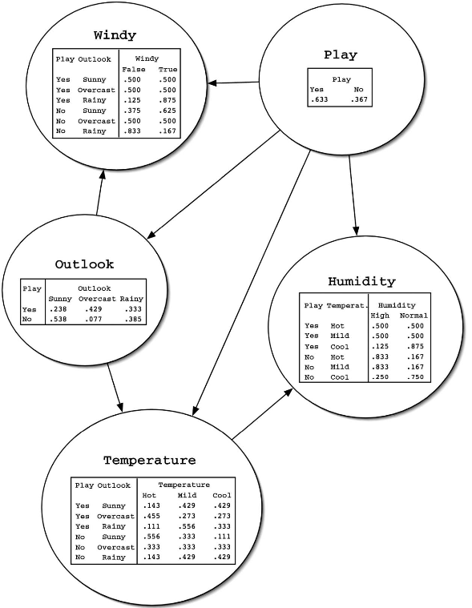
A more complex network
Three of the attribute nodes (windy, temperature, humidity) now have two parents
Again, a column on left for each parent, and as many columns on right as the attribute has values
Consider first row of ‘temperature’ table:
Left side gives value for each parent attribute (play and outlook)
Right side gives probability for each value of temperature
First number (0.143) is the probability of temperature taking value ‘hot’, given that ‘play’ and ‘outlook’ have values ‘yes’ and ‘sunny’, respectively

Slide 15
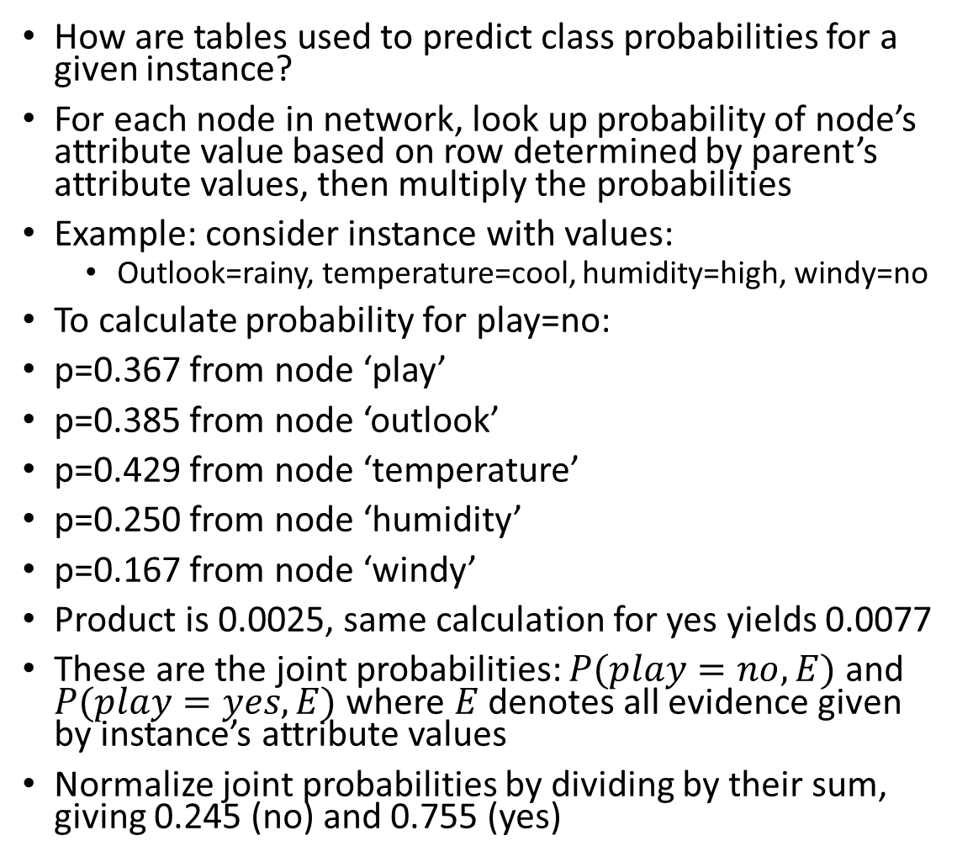
Bayesian networks
How are tables used to predict class probabilities for a given instance?
For each node in network, look up probability of node’s attribute value based on row determined by parent’s attribute values, then multiply the probabilities
Example: consider instance with values:
Outlook=rainy, temperature=cool, humidity=high, windy=no
To calculate probability for play=no:
p=0.367 from node ‘play’
p=0.385 from node ‘outlook’
p=0.429 from node ‘temperature’
p=0.250 from node ‘humidity’
p=0.167 from node ‘windy’
Product is 0.0025, same calculation for yes yields 0.0077
These are the joint probabilities: $P(play=no,E)$ and $P(play=yes,E)$ where $E$ denotes all evidence given by instance’s attribute values
Normalize joint probabilities by dividing by their sum, giving 0.245 (no) and 0.755 (yes)

Slide 16
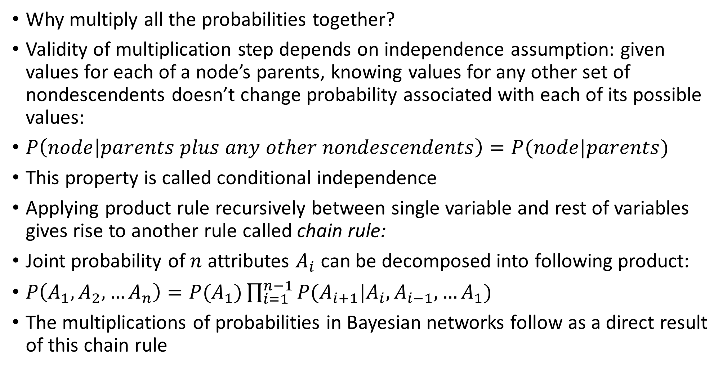
Bayesian networks
Why multiply all the probabilities together?
Validity of multiplication step depends on independence assumption: given values for each of a node’s parents, knowing values for any other set of nondescendents doesn’t change probability associated with each of its possible values:
$P\left(node | parents plus any other nondescendents\right)=P(node|parents)$
This property is called conditional independence
Applying product rule recursively between single variable and rest of variables gives rise to another rule called chain rule:
Joint probability of $n$ attributes $A_{i}$ can be decomposed into following product:
$P\left(A_{1},A_{2},…A_{n}\right)=P(A_{1})\prod_{i=1}^{n−1}{P(A_{i+1}|A_{i},A_{i−1},…A_{1})}$
The multiplications of probabilities in Bayesian networks follow as a direct result of this chain rule

Slide 17
Summary
Chapter 9 probability
Random variable: function assigning real number to an event
Classification learning is equivalent to estimating conditional probabilities
Bayesian networks represent probability distributions concisely
Next class: algorithms for learning Bayesian networks

