Slide 1
CS405/505 Data Mining
Lecture 28

Slide 2
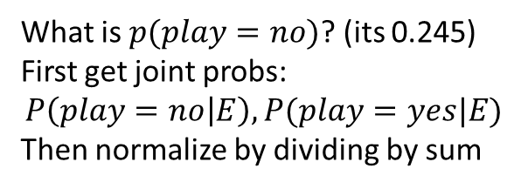
Bayesian networks
Play
Windy
Play
Yes | No
0.633 | 0.367
Play | Outlook | Windy
 |  | False | True
Yes | Sunny | 0.500 | 0.500
Yes | Overcast | 0.500 | 0.500
Yes | Rainy | 0.125 | 0.875
No | Sunny | 0.375 | 0.625
No | Overcast | 0.500 | 0.500
No | Rainy | 0.833 | 0.167
Humidity
Play | Temperature | Humidity
 |  | High | Normal
Yes | Hot | 0.500 | 0.500
Yes | Mild | 0.500 | 0.500
Yes | Cool | 0.125 | 0.875
No | Hot | 0.833 | 0.167
No | Mild | 0.833 | 0.167
No | Cool | 0.250 | 0.750
Outlook
Play | Outlook
 | Sunny | Overcast | Rainy
Yes | 0.238 | 0.429 | 0.333
No | 0.538 | 0.077 | 0.385
Temperature
A Bayesian network is a probabilistic graphical model representing a set of variables and their conditional dependencies via a directed acyclic graph (DAG)
Play | Outlook | Temperature
 |  | Hot | Mild | Cool
Yes | Sunny | 0.143 | 0.429 | 0.429
Yes | Overcast | 0.455 | 0.273 | 0.273
Yes | Rainy | 0.111 | 0.556 | 0.333
No | Sunny | 0.556 | 0.333 | 0.111
No | Overcast | 0.333 | 0.333 | 0.333
No | Rainy | 0.143 | 0.429 | 0.429
Consider instance:
Outlook=rainy
Temperature=cool
Humidity=high
Windy=true
What is $p(play=no)$? (its 0.245)
First get joint probs:
$$P\left(play=no | E\right), P(play=yes|E)$$
Then normalize by dividing by sum

Slide 3
Learning Bayesian networks
Define two components to construct learning algorithm for Bayesian networks:
1) a function for evaluating a given network based on the data
2) a method of searching through a space of possible networks
Quality of a given network measured by probability of data, given the network
Use log-likelihood to avoid very small numbers
Assume that structure of network (nodes and edges) is given
Easy to estimate conditional probability tables:
Just compute relative frequencies of associated combinations of attribute values in the training data
To avoid zero-frequency problem, each count is initialized with a constant

Slide 4
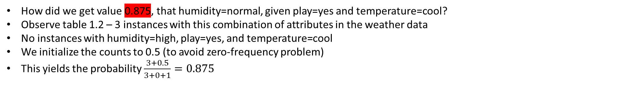
Example (weather data)
Table 1.2
Outlook | Temperature | Humidity | Windy | Play
Sunny | Hot | High | False | No
Sunny | Hot | High | True | No
Overcast | Hot | High | False | Yes
Rainy | Mild | High | False | Yes
Rainy | Cool | Normal | False | Yes
Rainy | Cool | Normal | True | No
Overcast | Cool | Normal | True | Yes
Sunny | Mild | High | False | No
Sunny | Cool | Normal | False | Yes
Rainy | Mild | Normal | False | Yes
Sunny | Mild | Normal | True | Yes
Overcast | Mild | High | True | Yes
Overcast | Hot | Normal | False | Yes
Rainy | Mild | High | True | No
Play
Humidity
Play | Temperature | Humidity
 |  | High | Normal
Yes | Hot | 0.500 | 0.500
Yes | Mild | 0.500 | 0.500
Yes | Cool | 0.125 | 0.875
No | Hot | 0.833 | 0.167
No | Mild | 0.833 | 0.167
No | Cool | 0.250 | 0.750
Temperature
How did we get value 0.875, that humidity=normal, given play=yes and temperature=cool?
Observe table 1.2 – 3 instances with this combination of attributes in the weather data
No instances with humidity=high, play=yes, and temperature=cool
We initialize the counts to 0.5 (to avoid zero-frequency problem)
This yields the probability $\frac{3+0.5}{3+0+1}=0.875$

Slide 5
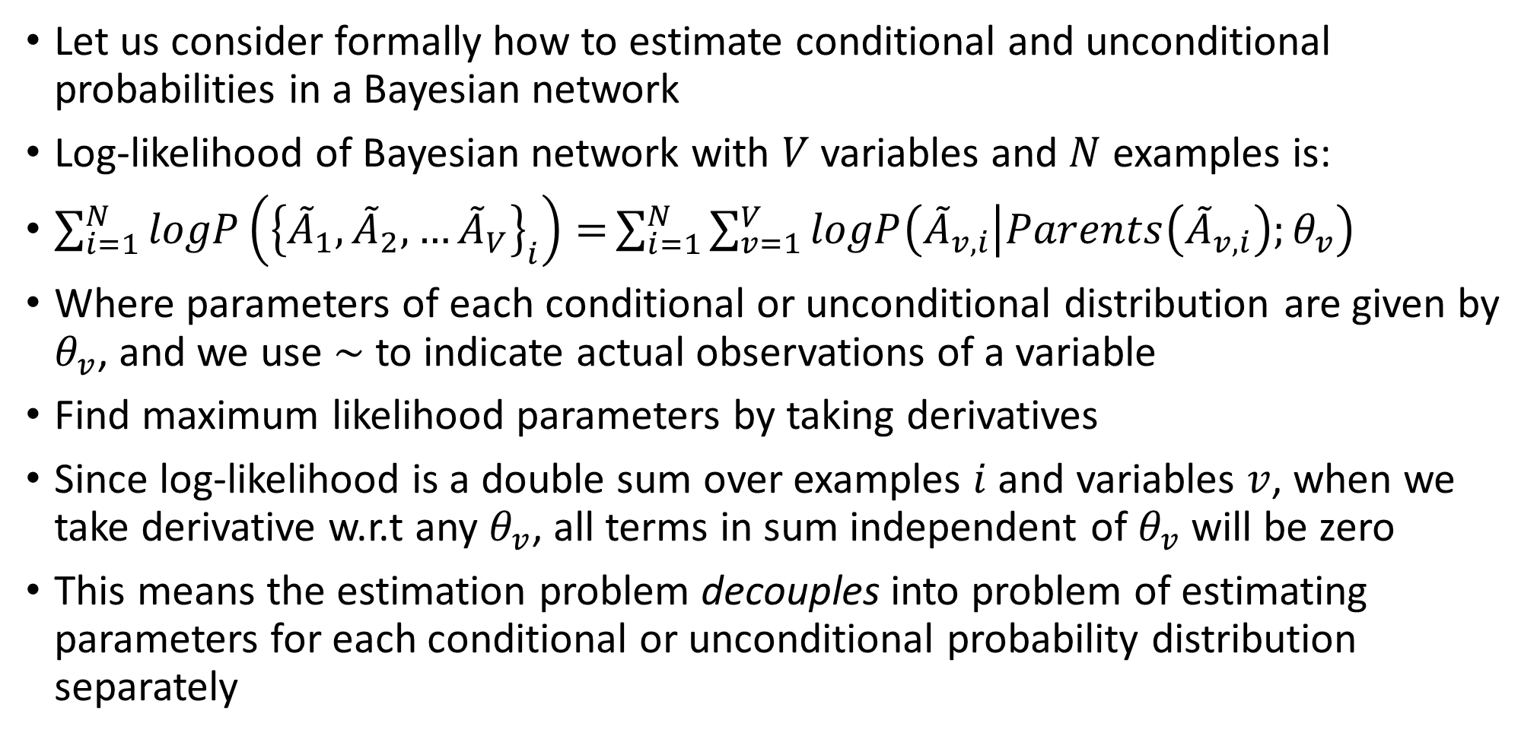
Estimating conditional and unconditional probabilities in Bayesian network:
Let us consider formally how to estimate conditional and unconditional probabilities in a Bayesian network
Log-likelihood of Bayesian network with $V$ variables and $N$ examples is:
$\sum_{i=1}^{N}{logP\left({\left\{{\tilde{A}}_{1},{\tilde{A}}_{2},…{\tilde{A}}_{V}\right\}}_{i}\right)=}\sum_{i=1}^{N}{\sum_{v=1}^{V}{logP\left({\tilde{A}}_{v,i} | Parents\left({\tilde{A}}_{v,i}\right);θ_{v}\right)}}$
Where parameters of each conditional or unconditional distribution are given by $θ_{v}$, and we use $\sim$ to indicate actual observations of a variable
Find maximum likelihood parameters by taking derivatives
Since log-likelihood is a double sum over examples $i$ and variables $v$, when we take derivative w.r.t any $θ_{v}$, all terms in sum independent of $θ_{v}$ will be zero
This means the estimation problem decouples into problem of estimating parameters for each conditional or unconditional probability distribution separately

Slide 6
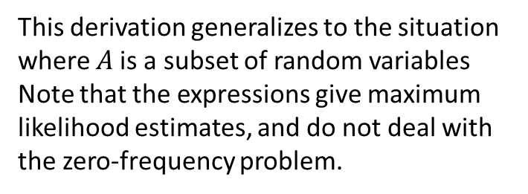
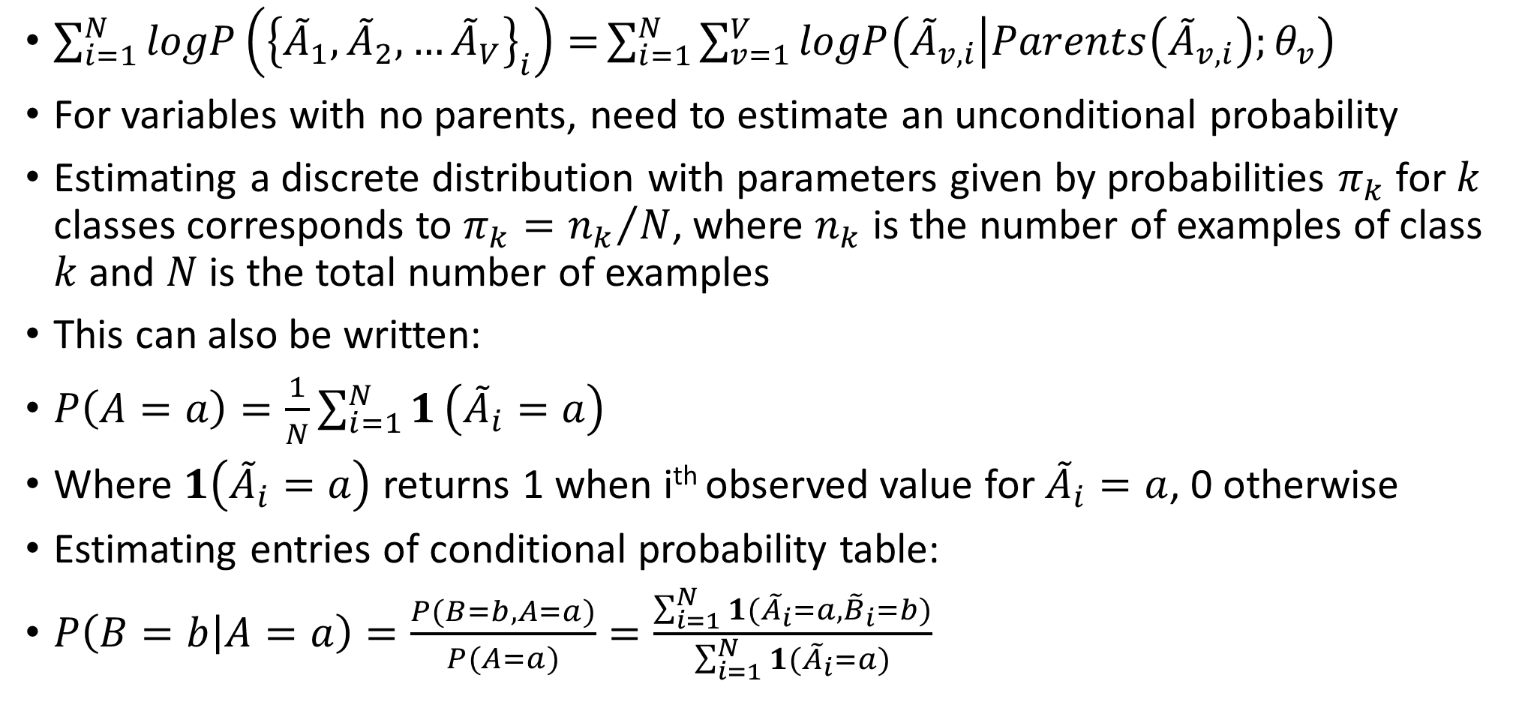
Estimating conditional and unconditional probabilities in Bayesian network:
$\sum_{i=1}^{N}{logP\left({\left\{{\tilde{A}}_{1},{\tilde{A}}_{2},…{\tilde{A}}_{V}\right\}}_{i}\right)=}\sum_{i=1}^{N}{\sum_{v=1}^{V}{logP\left({\tilde{A}}_{v,i} | Parents\left({\tilde{A}}_{v,i}\right);θ_{v}\right)}}$
For variables with no parents, need to estimate an unconditional probability
Estimating a discrete distribution with parameters given by probabilities $π_{k}$ for $k$ classes corresponds to $π_{k}={n_{k}}/N$, where $n_{k}$ is the number of examples of class $k$ and $N$ is the total number of examples
This can also be written:
$P\left(A=a\right)=\frac{1}{N}\sum_{i=1}^{N}{1}\left({\tilde{A}}_{i}=a\right)$
Where $1\left({\tilde{A}}_{i}=a\right)$ returns 1 when i^{th} observed value for ${\tilde{A}}_{i}=a$, 0 otherwise
Estimating entries of conditional probability table:
$P\left(B=b | A=a\right)=\frac{P(B=b,A=a)}{P(A=a)}=\frac{\sum_{i=1}^{N}{1({\tilde{A}}_{i}=a,{\tilde{B}}_{i}=b)}}{\sum_{i=1}^{N}{1}({\tilde{A}}_{i}=a)}$
This derivation generalizes to the situation where $A$is a subset of random variables
Note that the expressions give maximum likelihood estimates, and do not deal with the zero-frequency problem.

Slide 7
Learning network structure
Nodes of network are predetermined (one for each attribute, including class)
To find edges, search through possible space of edges, estimating conditional probability tables for each set, and computing log-likelihood of resulting network
Higher log likelihood for given edge set = better network
Bayesian network learning algorithms differ mainly in the way in which they search the space of network structures (edge sets)
Problem: easy to overfit training data by adding more edges
Use cross-validation to estimate goodness-of-fit, or
Add penalty for network complexity based on number of parameters

Slide 8
Specific algorithms for learning Bayesian Networks
Simple and fast learning algorithm: K2
Starts with a fixed ordering of nodes (attributes)
Processes each node (attribute) in turn
Greedily considers adding edges from previously processed node to current one
In each step, adds the edge that maximizes the network’s score
When there is no further improvement, moves to next node
Avoids cycles because only edges from previously processed node are considered
Result depends on initial ordering, run algorithm several times
Naïve Bayes is a network with edge from class attribute to each other attribute
K2 can use Naïve Bayes as starting point (make class variable first in ordering)
Another helpful trick: ensure every attribute in data is in the Markov Blanket of the node that represents the class attribute

Slide 9
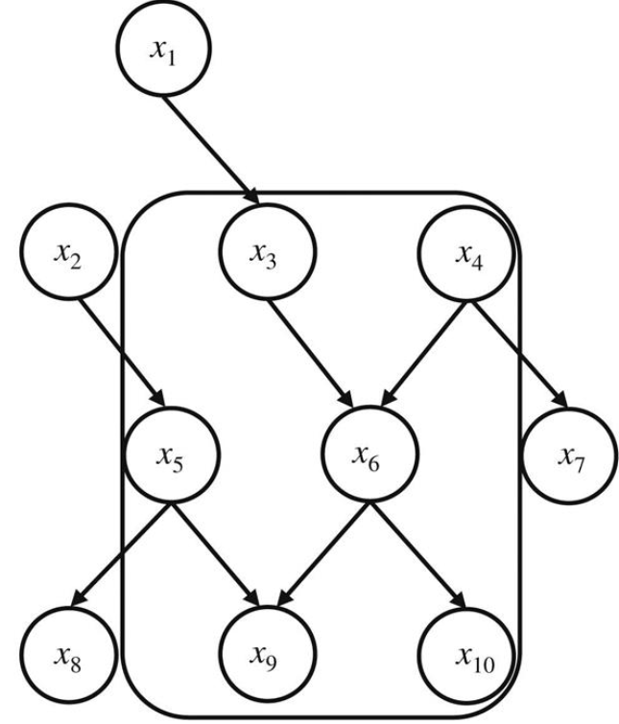
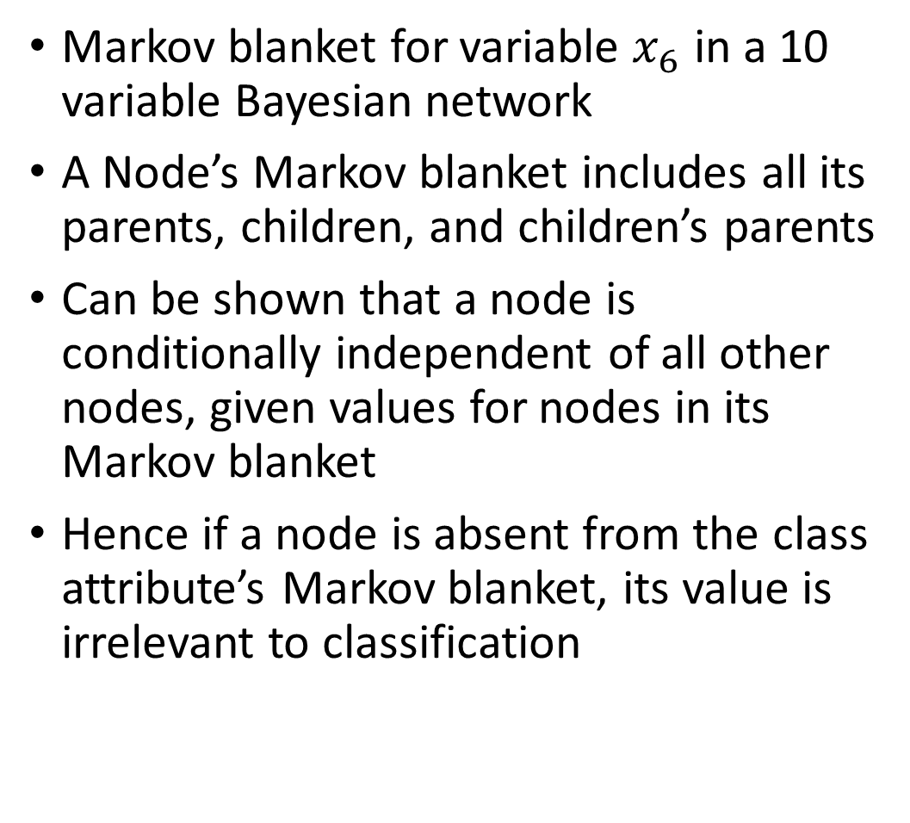
Markov blanket
Markov blanket for variable $x_{6}$ in a 10 variable Bayesian network
A Node’s Markov blanket includes all its parents, children, and children’s parents
Can be shown that a node is conditionally independent of all other nodes, given values for nodes in its Markov blanket
Hence if a node is absent from the class attribute’s Markov blanket, its value is irrelevant to classification

Slide 10
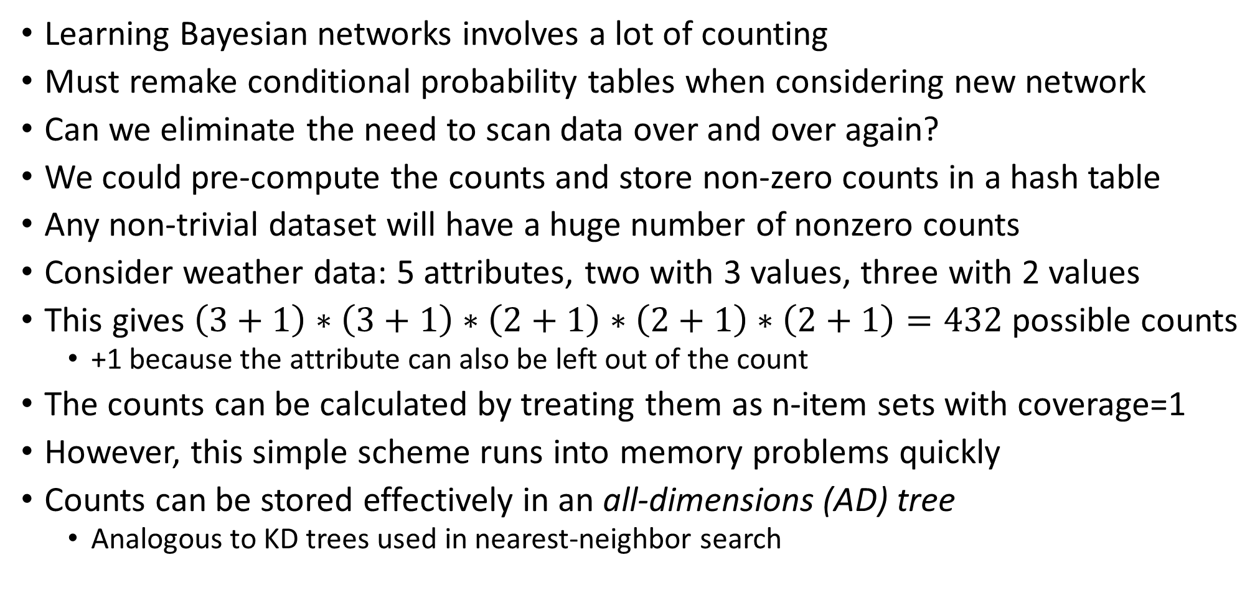
Data structures for fast learning
Learning Bayesian networks involves a lot of counting
Must remake conditional probability tables when considering new network
Can we eliminate the need to scan data over and over again?
We could pre-compute the counts and store non-zero counts in a hash table
Any non-trivial dataset will have a huge number of nonzero counts
Consider weather data: 5 attributes, two with 3 values, three with 2 values
This gives $\left(3+1\right)∗\left(3+1\right)∗\left(2+1\right)∗\left(2+1\right)∗\left(2+1\right)=432$ possible counts
+1 because the attribute can also be left out of the count
The counts can be calculated by treating them as n-item sets with coverage=1
However, this simple scheme runs into memory problems quickly
Counts can be stored effectively in an all-dimensions (AD) tree
Analogous to KD trees used in nearest-neighbor search

Slide 11
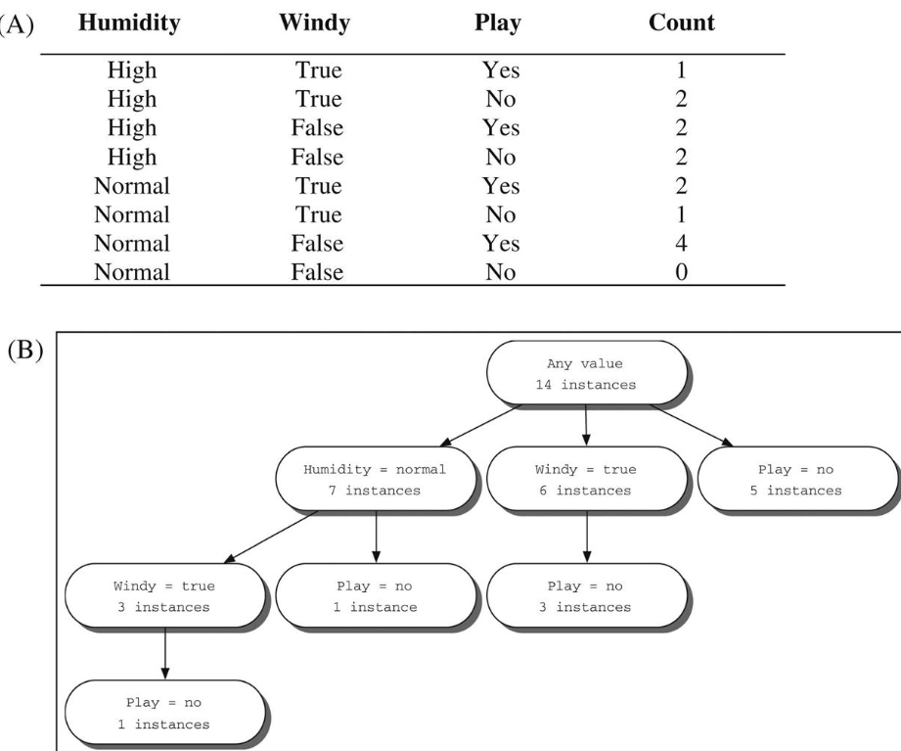
AD tree
A) Reduced version of weather data, using only humidity, windy, and play
B) AD tree for this data
Each node tells how many instances exhibit the attribute values tested along the path from the root to node
Example: leftmost leaf says there is one instance with values humidity=normal, windy=true, play=no, and rightmost leaf says there are 5 instances with play=no

Slide 12

PyMC3 is a probabilistic programming package for python that allows users to fit Bayesian models using a variety of numerical methods, notably Markov chain Monte Carlo and variational inference
PyMC3 strives to make Bayesian modeling as simple and painless as possible, allowing users to focus on their scientific problem
https://docs.pymc.io/

Slide 13
Clustering and probability density estimation
From a probabilistic perspective, the goal of clustering is to find the most likely set of clusters given the data
Instances have a probability of belonging to a given cluster
Foundation for statistical clustering is a statistical method: finite mixture model
A mixture is a set of k probability distributions, representing k clusters, that govern the attribute values for members in the cluster
In other words, each distribution gives the probability that given instance would have a certain set of attribute values if it were known to be a member of cluster
Each cluster has a different distribution
Particular instance “really” belongs to only one cluster, but not known which one
Clusters are not equally likely, there is a probability distribution that reflects their relative populations

Slide 14
Expectation maximization for mixture of Gaussians
Simplest finite mixture situation:
One numerical attribute, with gaussian distribution for each cluster
Each cluster has a different mean and variance
Clustering problem is to take a set of instances (here each instance is a number) and a prespecified number of clusters, and find the following:
Each cluster’s mean and variance
Population distribution between the clusters
The mixture model combines several normal distributions, and its probability density function looks like a mountain range with a peak for each component

Slide 15
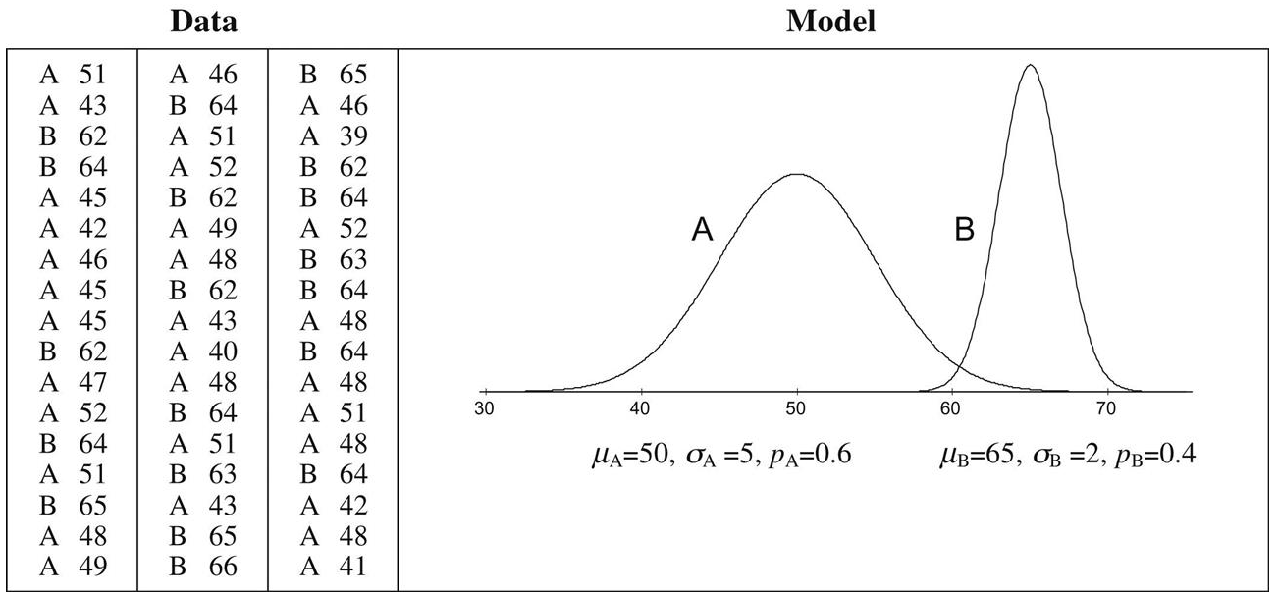
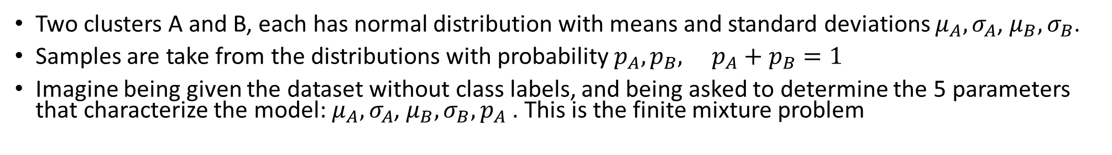
A two-class mixture model
Two clusters A and B, each has normal distribution with means and standard deviations $μ_{A}, σ_{A}$, $μ_{B}, σ_{B}$.
Samples are take from the distributions with probability $p_{A}, p_{B}, p_{A}+p_{B}=1$
Imagine being given the dataset without class labels, and being asked to determine the 5 parameters that characterize the model: $μ_{A}, σ_{A}$, $μ_{B}, σ_{B},p_{A}$. This is the finite mixture problem

Slide 16
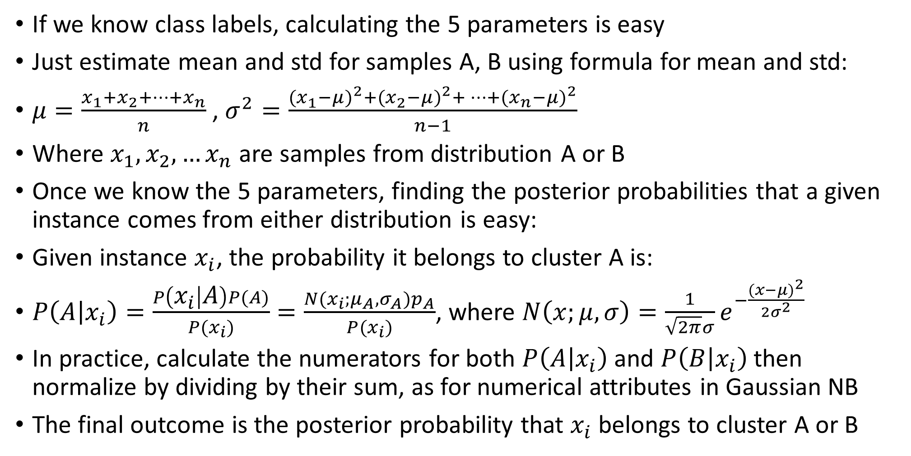
Finite mixture problem
If we know class labels, calculating the 5 parameters is easy
Just estimate mean and std for samples A, B using formula for mean and std:
$μ=\frac{x_{1}+x_{2}+…+x_{n}}{n}$ , $σ^{2}=\frac{{(x_{1}^{ }−μ)}^{2}+{(x_{2}^{ }−μ)}^{2}+…+{(x_{n}^{ }−μ)}^{2}}{n−1}$
Where $x_{1},x_{2},…x_{n}$ are samples from distribution A or B
Once we know the 5 parameters, finding the posterior probabilities that a given instance comes from either distribution is easy:
Given instance $x_{i}$, the probability it belongs to cluster A is:
$P\left(A | x_{i}\right)=\frac{P\left(x_{i} | A\right)P(A)}{P(x_{i})}=\frac{N(x_{i};μ_{A},σ_{A})p_{A}}{P(x_{i})}$, where $N\left(x;μ,σ\right)=\frac{1}{\sqrt{2π}σ}e^{−\frac{{(x−μ)}^{2}}{2σ^{2}}}$
In practice, calculate the numerators for both $P\left(A | x_{i}\right)$ and $P\left(B | x_{i}\right)$ then normalize by dividing by their sum, as for numerical attributes in Gaussian NB
The final outcome is the posterior probability that $x_{i}$belongs to cluster A or B

Slide 17
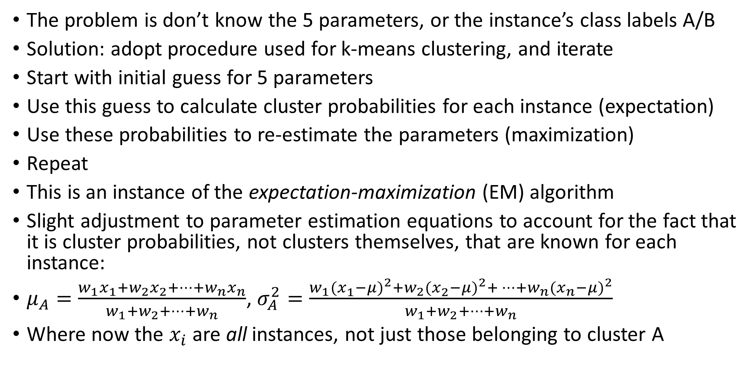
Finite mixture problem
The problem is don’t know the 5 parameters, or the instance’s class labels A/B
Solution: adopt procedure used for k-means clustering, and iterate
Start with initial guess for 5 parameters
Use this guess to calculate cluster probabilities for each instance (expectation)
Use these probabilities to re-estimate the parameters (maximization)
Repeat
This is an instance of the expectation-maximization (EM) algorithm
Slight adjustment to parameter estimation equations to account for the fact that it is cluster probabilities, not clusters themselves, that are known for each instance:
$μ_{A}=\frac{w_{1}x_{1}+w_{2}x_{2}+…+w_{n}x_{n}}{w_{1}+w_{2}+…+w_{n}}$, $σ_{A}^{2}=\frac{w_{1}{(x_{1}^{ }−μ)}^{2}+w_{2}{(x_{2}^{ }−μ)}^{2}+…+w_{n}{(x_{n}^{ }−μ)}^{2}}{w_{1}+w_{2}+…+w_{n}}$
Where now the $x_{i}$ are all instances, not just those belonging to cluster A

Slide 18
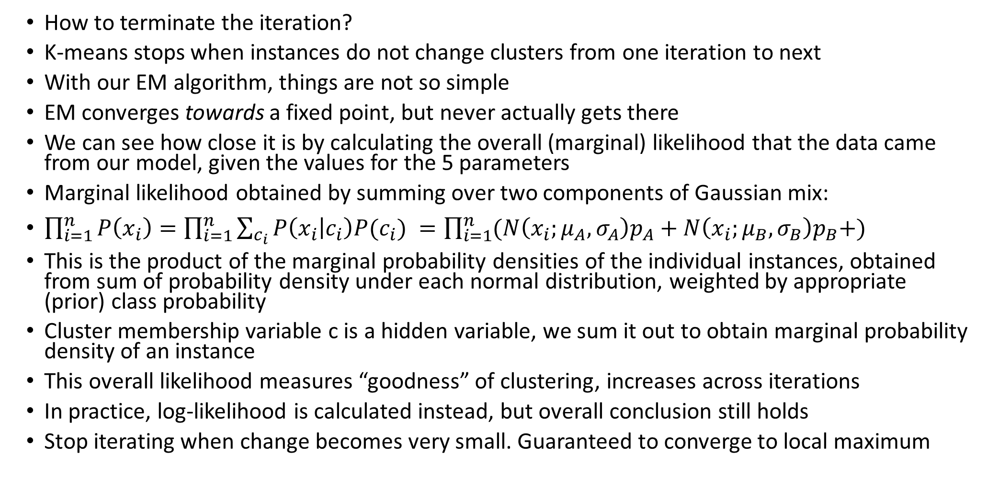
Finite mixture problem
How to terminate the iteration?
K-means stops when instances do not change clusters from one iteration to next
With our EM algorithm, things are not so simple
EM converges towards a fixed point, but never actually gets there
We can see how close it is by calculating the overall (marginal) likelihood that the data came from our model, given the values for the 5 parameters
Marginal likelihood obtained by summing over two components of Gaussian mix:
$\prod_{i=1}^{n}{P\left(x_{i}\right)=\prod_{i=1}^{n}{\sum_{c_{i}}{P\left(x_{i} | c_{i}\right)P(c_{i}) }=\prod_{i=1}^{n}{(N\left({x_{i};μ}_{A},σ_{A}\right)p_{A}+N\left({x_{i};μ}_{B},σ_{B}\right)p_{B}+)}}}$
This is the product of the marginal probability densities of the individual instances, obtained from sum of probability density under each normal distribution, weighted by appropriate (prior) class probability
Cluster membership variable c is a hidden variable, we sum it out to obtain marginal probability density of an instance
This overall likelihood measures “goodness” of clustering, increases across iterations
In practice, log-likelihood is calculated instead, but overall conclusion still holds
Stop iterating when change becomes very small. Guaranteed to converge to local maximum

Slide 19
Summary
Next: extending the mixture model to more realistic situations

