Slide 1
CS405/505 Data Mining
Lecture 8

Slide 2
Admin
Building decision tree – children cannot split on same attribute as parent

Slide 3
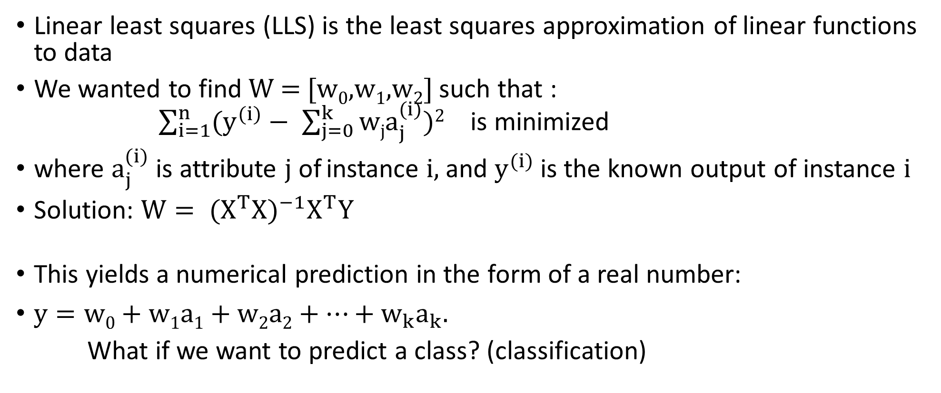
Linear least squares
Linear least squares (LLS) is the least squares approximation of linear functions to data
We wanted to find W = [w₀,w₁,w₂] such that : $\sum_{i=1}^{n}{(y^{(i)}− \sum_{j=0}^{k}{wja_{j}^{(i)})2}}$ is minimized
where $a_{j}^{(i)}$ is attribute j of instance i, and $y^{(i)}$ is the known output of instance i
Solution: $W= {(X^{T}X)}^{−1}X^{T}Y$
This yields a numerical prediction in the form of a real number:
$y=w0+w1a1+w2a2+…+w_{k}a_{k}. .$
What if we want to predict a class? (classification)

Slide 4
Linear Classification:
Linear regression can easily be used for classification in domains with numerical attributes
Perform a regression for each class, setting output=1 for instances that belong to the class, and output=0 for instances that do not.
This results in one linear expression for each class
Given a test instance, calculate value for each linear expression, and assign instance to class with whose linear expression yields highest value
This is known as multi-response linear regression
Drawbacks:
Does not yield probabilities (difficult to interpret/give confidence)
Least-squares regression assumes errors are statistically independent and normally distributed, with the same standard deviation (not true when output is only 0 or 1)

Slide 5
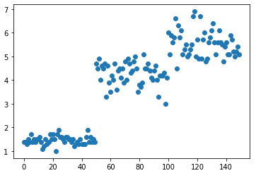
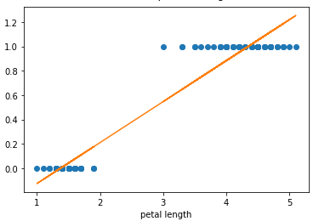
Example of Linear classification
Iris dataset. We want to use linear regression to classify a flower
For this example, use only setosa and versicolor (2 classes)
virginicas
versicolors
petal length
versicolors
setosas
setosas
Linear expression for versicolor class using petal length attribute:
$$versicolor=−0.46+0.33∗\left(petal length\right)$$
multiresponse_iris.py

Slide 6
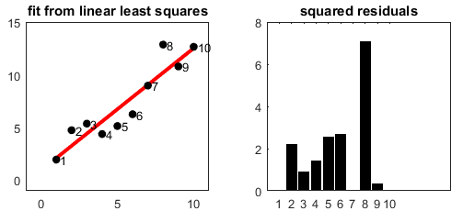
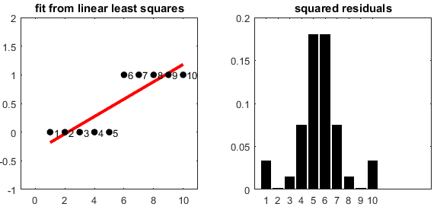
Least squares regression and the Normal distribution
Important assumptions of Linear Least Squares:
Residual error has mean=0
Residuals are uncorrelated (cannot be predicted based on residual from previous observations)
Residuals are normally distributed with same standard deviation
A) typical case where the assumptions hold
B) prediction for a single class from multi-response linear regression (setting output to zero or 1)
Slope=0.156, y-intercept=-0.33

Slide 7
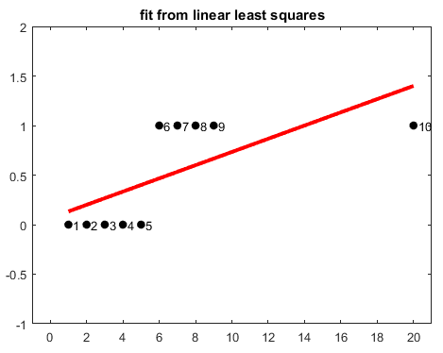

Extreme example
Clearly, we need a better function than $x=w0+w1a1$

Slide 8
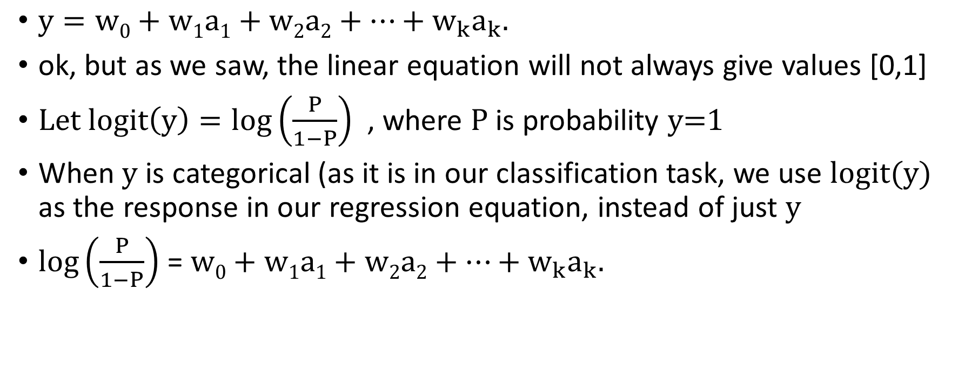
The Logit Link function
$y=w0+w1a1+w2a2+…+w_{k}a_{k}. .$
ok, but as we saw, the linear equation will not always give values [0,1]
$Let logit\left(y\right)=\log\left(\frac{P}{1−P}\right)$, where P is probability y=1
When y is categorical (as it is in our classification task, we use logit(y) as the response in our regression equation, instead of just y
$\log\left(\frac{P}{1−P}\right)$ = $w0+w1a1+w2a2+…+w_{k}a_{k}. .$

Slide 9
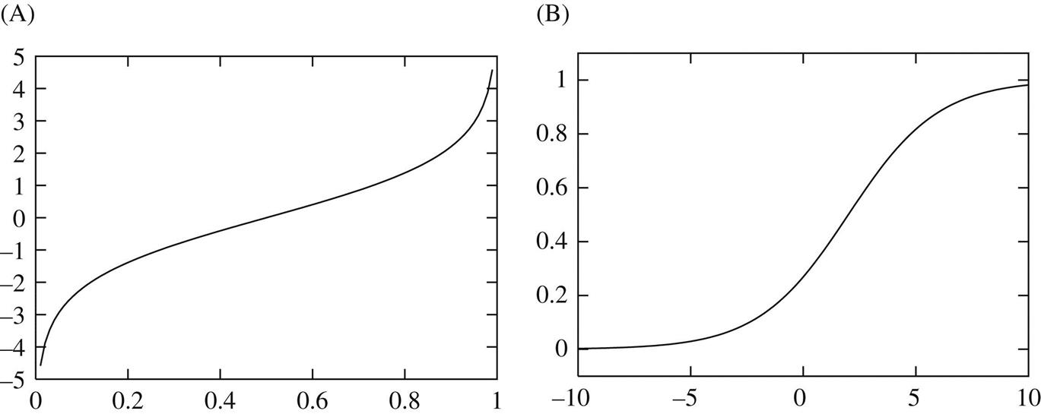
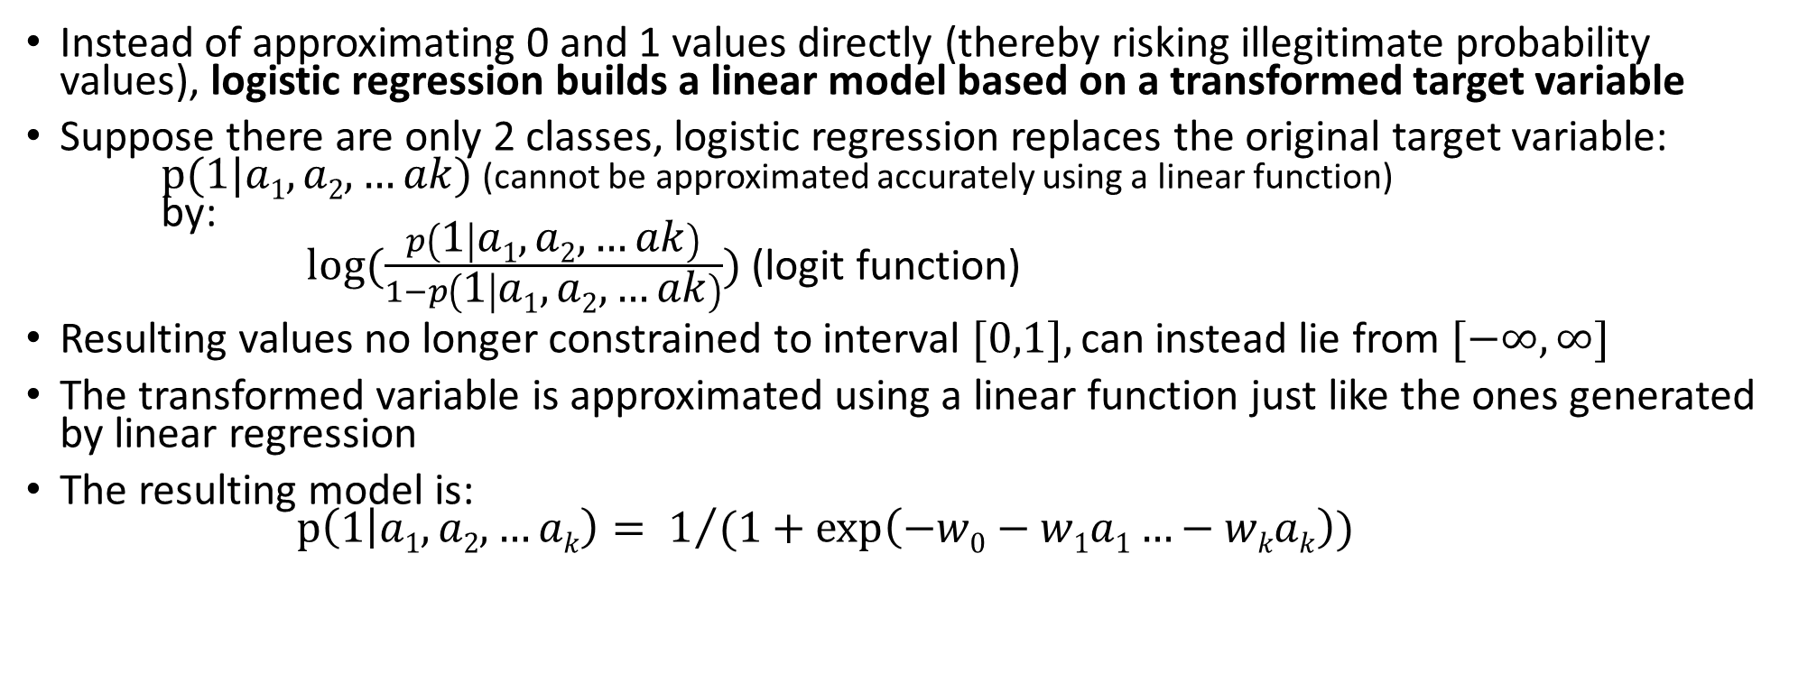
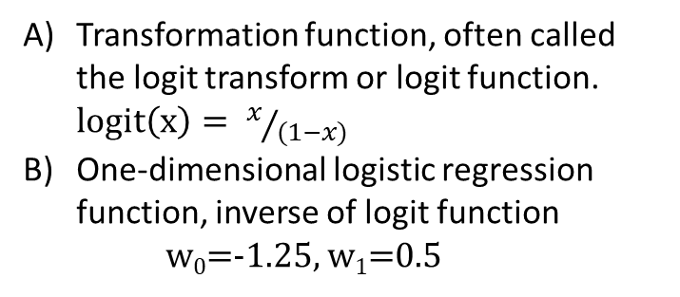
Logistic Regression and the Logit transformation
Instead of approximating 0 and 1 values directly (thereby risking illegitimate probability values), logistic regression builds a linear model based on a transformed target variable
Suppose there are only 2 classes, logistic regression replaces the original target variable: $p(1|a1,a2,…ak)$ (cannot be approximated accurately using a linear function) by: $log⁡(\frac{p\left(1 | a1,a2,…ak\right)}{1−p\left(1 | a1,a2,…ak\right)})$ (logit function)
Resulting values no longer constrained to interval [0,1], can instead lie from $[−∞,∞]$
The transformed variable is approximated using a linear function just like the ones generated by linear regression
The resulting model is: $p\left(1 | a1,a2,…ak\right)= 1/{(1+\exp\left(−w0−w1a1…−wkak\right))}$
Transformation function, often called the logit transform or logit function. $logit\left(x\right)= x/{(1−x)}$
One-dimensional logistic regression function, inverse of logit function
w₀=-1.25, w₁=0.5

Slide 10
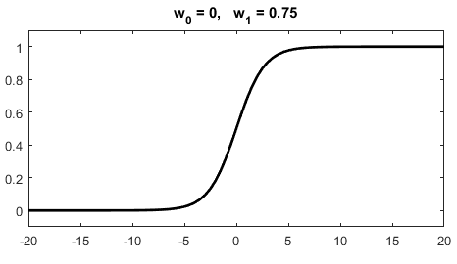
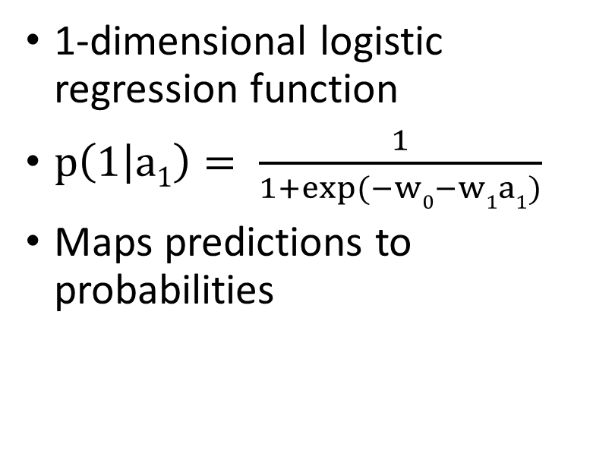
Logistic regression function
1-dimensional logistic regression function
$p\left(1 | a1\right)= \frac{1}{1+exp⁡(−w0−w1a1)}$
Maps predictions to probabilities

Slide 11
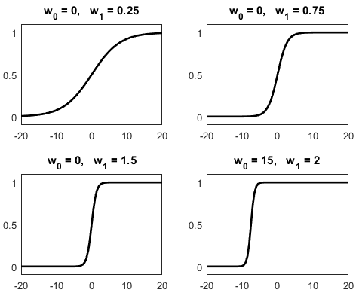

More logistic regression functions
$p\left(1 | a1\right)= \frac{1}{1+exp⁡(−w0−w1a1)}$
w₀ is the ‘intercept’
w₁ is the ‘slope’

Slide 12
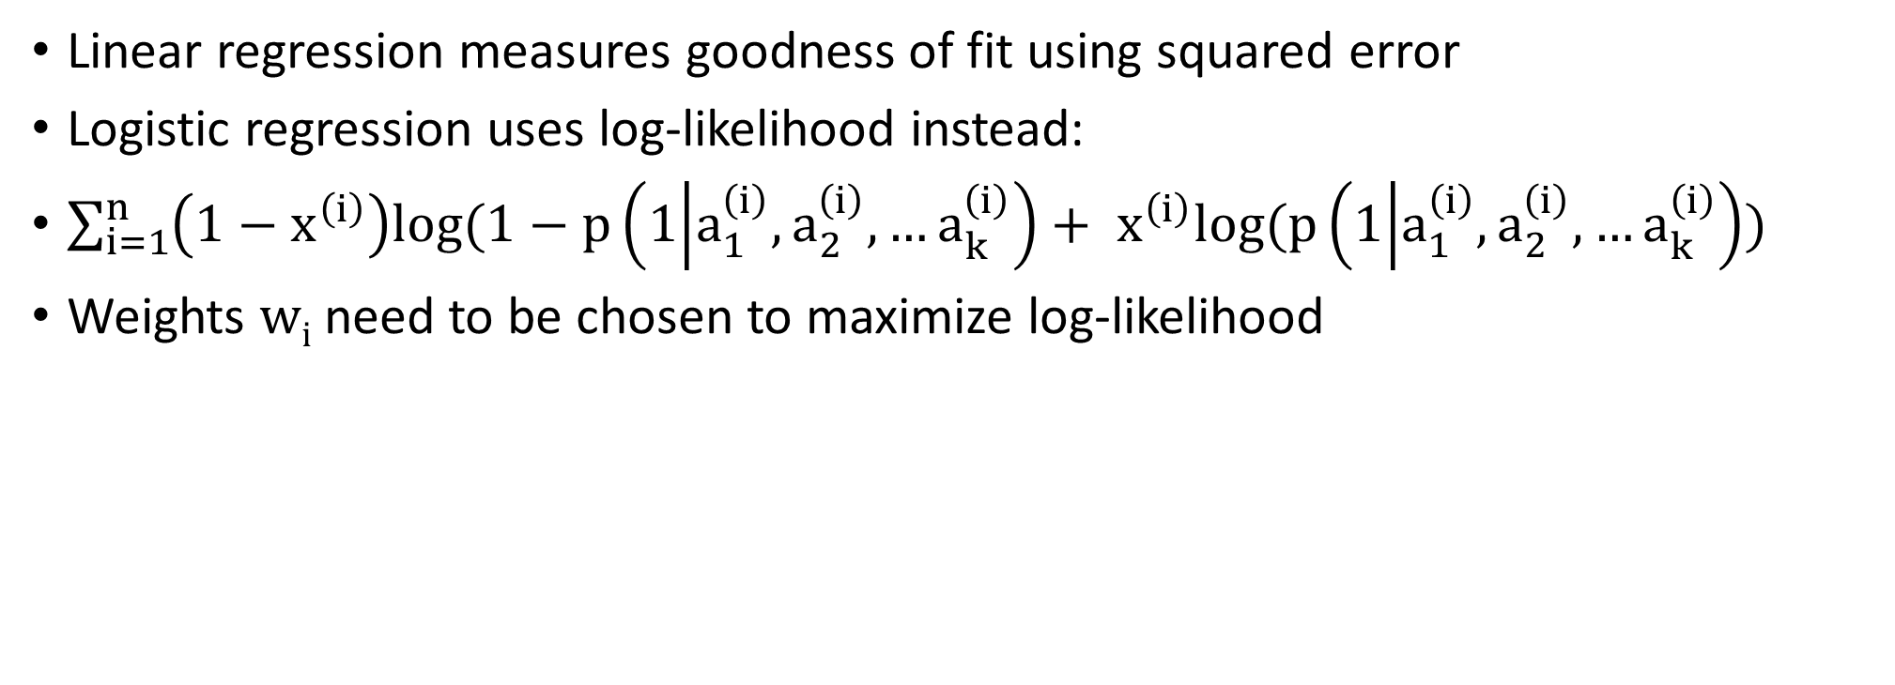
Finding the weights in logistic regression
Linear regression measures goodness of fit using squared error
Logistic regression uses log-likelihood instead:
$\sum_{i=1}^{n}{\left(1−x^{\left(i\right)}\right)log⁡(1−p\left(1 | a_{1}^{\left(i\right)},a_{2}^{\left(i\right)},…a_{k}^{\left(i\right)}\right)+ x^{\left(i\right)}log⁡(p\left(1 | a_{1}^{\left(i\right)},a_{2}^{\left(i\right)},…a_{k}^{\left(i\right)}\right))}$
Weights w_{i} need to be chosen to maximize log-likelihood

Slide 13
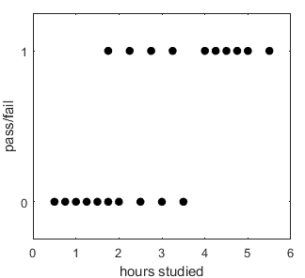
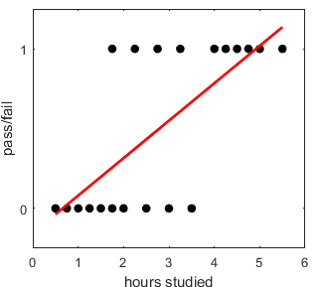
Example: probability of passing an exam
A group of 20 students spends between 0 and 6 hours studying for an exam. How does the number of hours studying affect the probability of the student passing the exam?
Least squares linear regression gives intercept=-0.154, slope=0.235
3 hours studied = -0.154 + (0.235)*3 = 0.55, ok, but what does this mean? (its not a probability)
Turn to python for the solution

Slide 14
Perceptron

