Slide 1
CS405/505 Data Mining
Lecture 5

Slide 2
Administrative slide
Assignment 1 (chapters 1-4.6 inclusive)
1R, Naïve Bayes, Decision Trees (today), Rules (next Monday), Linear Models (next Wed)
algorithmic problems with toy datasets, conceptual problems
Released Monday September 16th , due Wednesday October 2nd
Midterm – same as Assignment 1
Will take place Wednesday October 9th
Slides on Moodle after each lecture (read book if you want preview)

Slide 3
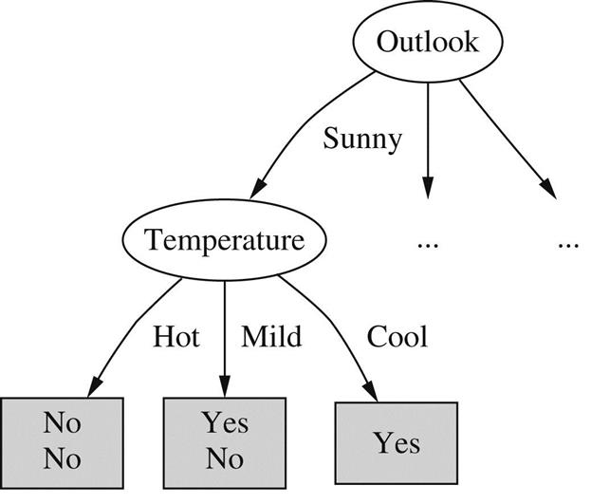
4.3 Divide and Conquer: Constructing Decision Trees
Problem of constructing decision tree can be expressed recursively
1) select an attribute to place at root node
2) make a branch for each possible value of the attribute
Splits example set into subsets, one for each value of attribute
3) repeat 1&2 recursively (for each branch) using only those instances that actually reach the branch
4) stop splitting when all instances at a given node have the same classification
How to determine which attribute to split on?

Slide 4
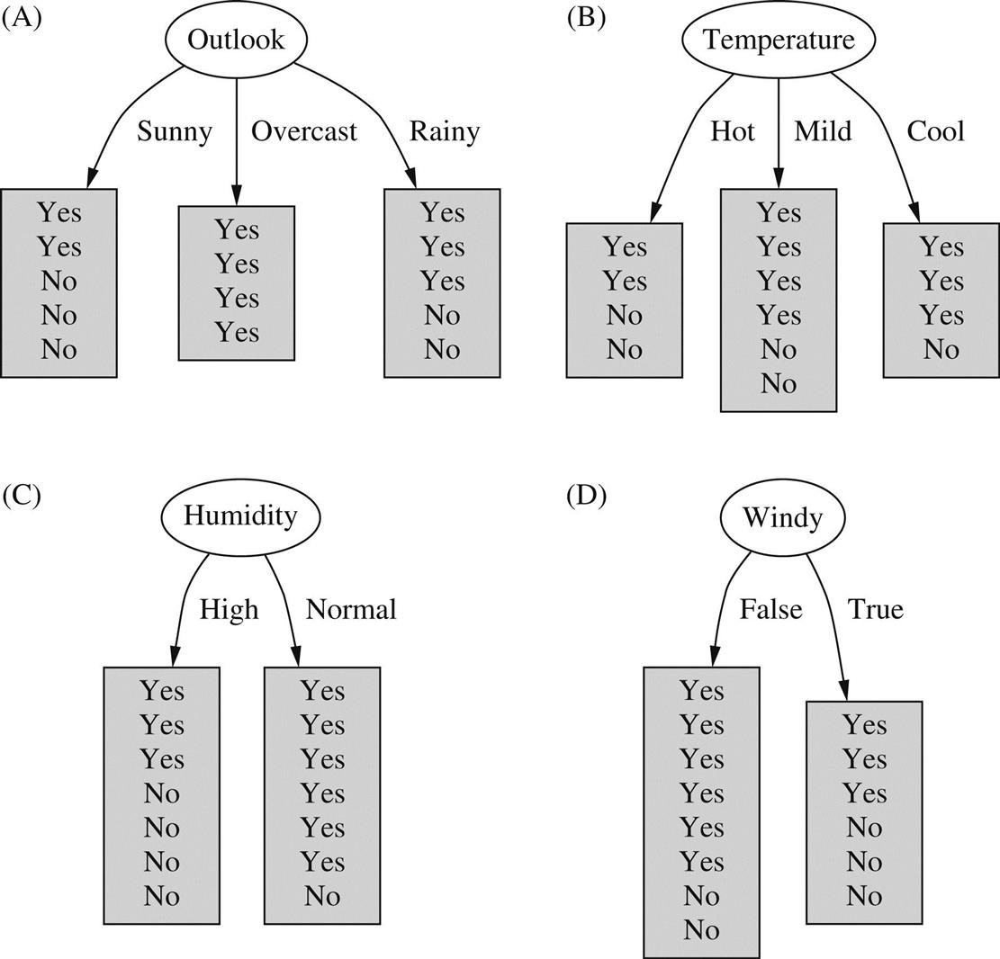
Splitting the weather data
Which split is best?
Hint: we seek small (short) trees
We are interested in the “purity” of each node
Therefore, we should split on the attribute that produces the purest child nodes
How can we measure purity?

Slide 5
How to measure purity of split
We want a measure of information that does the following:
1) when the split is pure (all one class), required info is zero
2) when the number of yes’s equals number of no’s, required info is maximized
3) applicable to multiclass situations (not just 2 classes Yes/No)
4) obeys the multistage property
Multistage property example:
Suppose we have an attribute with 3 values:
A (2 instances),
B (3 instances),
C (4 instances)
We can split once (one decision), or twice (two decisions)
Information should be the same in both cases
9
9
=
2
3
4
2
7
(one decision)
3
4
(two decisions)

Slide 6
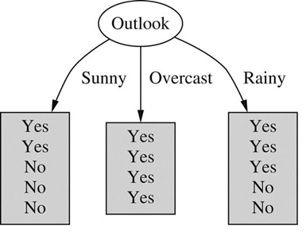
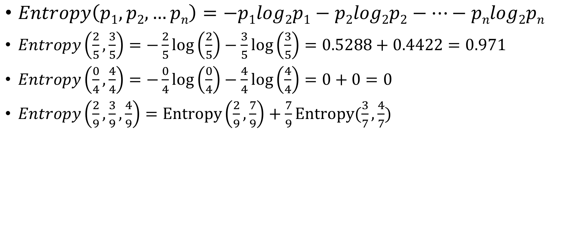
Entropy
$Entropy\left(p1,p2,…pn\right)=−p1log2p1−p2log2p2−…−pnlog2pn$
$Entropy\left(\frac{2}{5},\frac{3}{5}\right)=−\frac{2}{5}\log\left(\frac{2}{5}\right)−\frac{3}{5}\log\left(\frac{3}{5}\right)=0.5288+0.4422=0.971$
$Entropy\left(\frac{0}{4},\frac{4}{4}\right)=−\frac{0}{4}\log\left(\frac{0}{4}\right)−\frac{4}{4}\log\left(\frac{4}{4}\right)=0+0=0$
$Entropy\left(\frac{2}{9},\frac{3}{9},\frac{4}{9}\right)=Entropy\left(\frac{2}{9},\frac{7}{9}\right)+\frac{7}{9}Entropy(\frac{3}{7},\frac{4}{7})$
9
9
=
2
3
4
2
7
(one decision)
3
4
(two decisions)

Slide 7
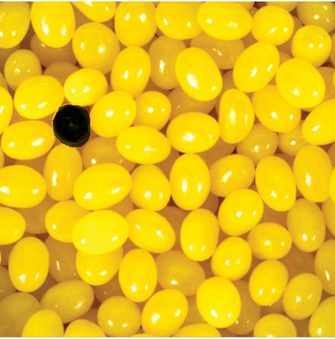
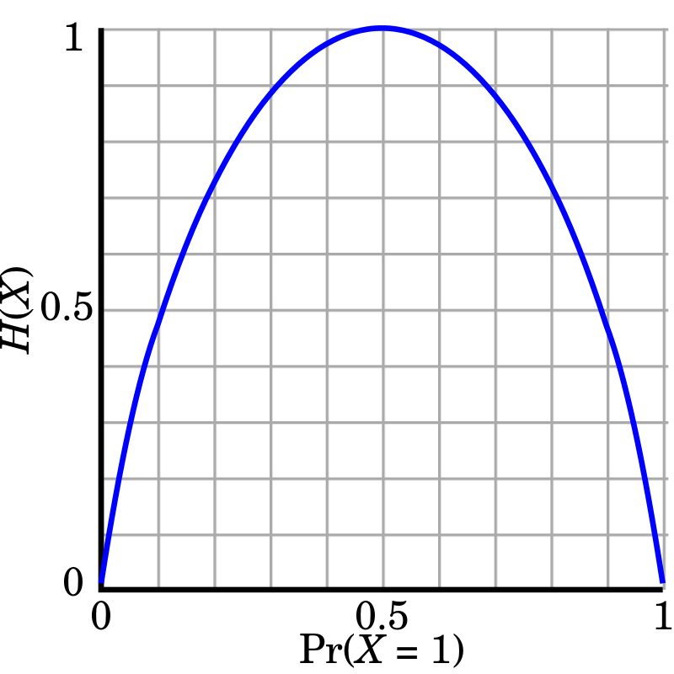
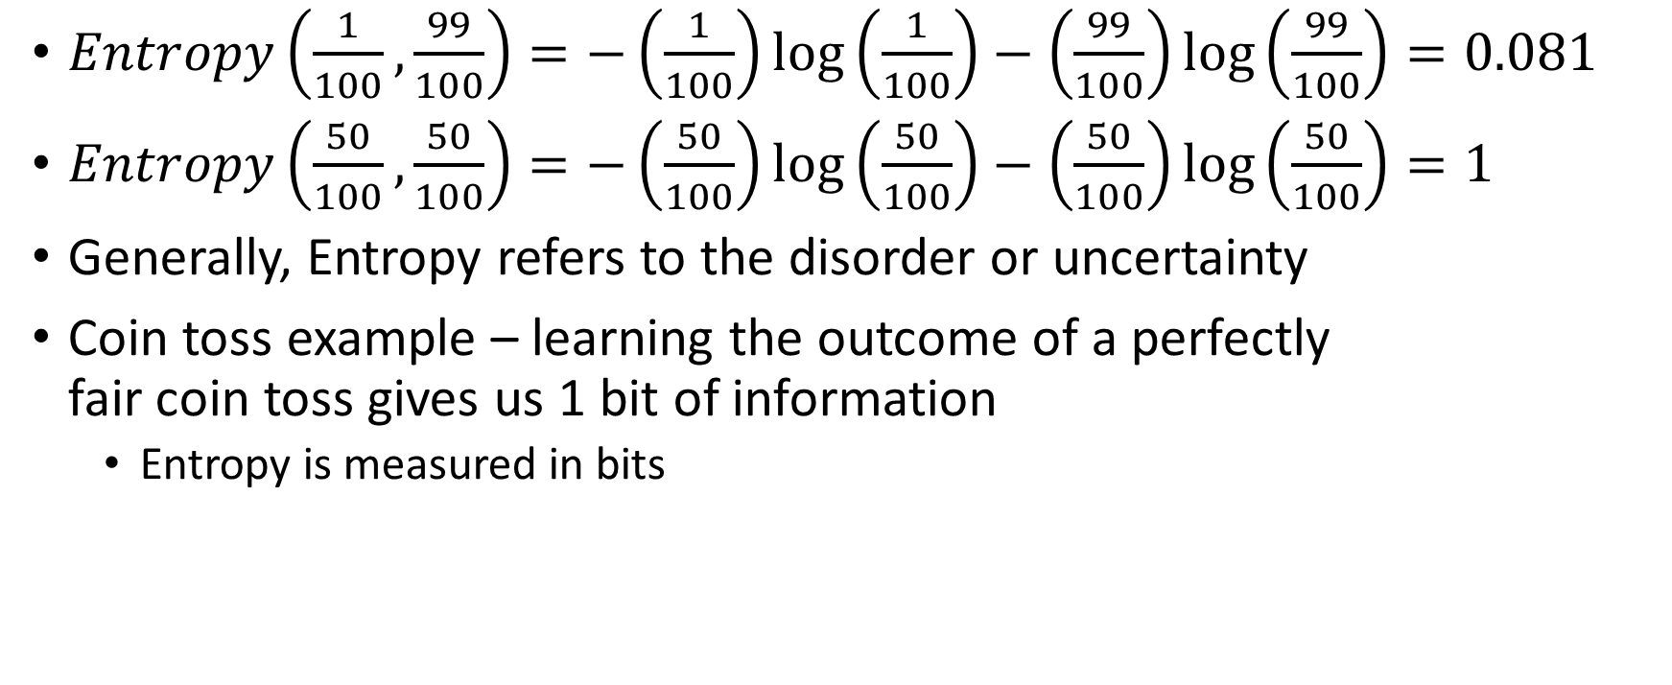
More about Entropy
$Entropy\left(\frac{1}{100},\frac{99}{100}\right)=−\left(\frac{1}{100}\right)\log\left(\frac{1}{100}\right)−\left(\frac{99}{100}\right)\log\left(\frac{99}{100}\right)=0.081$
$Entropy\left(\frac{50}{100},\frac{50}{100}\right)=−\left(\frac{50}{100}\right)\log\left(\frac{50}{100}\right)−\left(\frac{50}{100}\right)\log\left(\frac{50}{100}\right)=1$
Generally, Entropy refers to the disorder or uncertainty
Coin toss example – learning the outcome of a perfectly fair coin toss gives us 1 bit of information
Entropy is measured in bits
“A Mathematical Theory of Communication” Claude Shannon, 1948 (on Moodle) (70,000 citations)

Slide 8
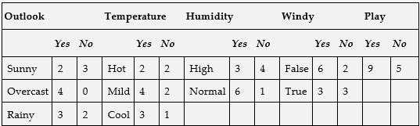

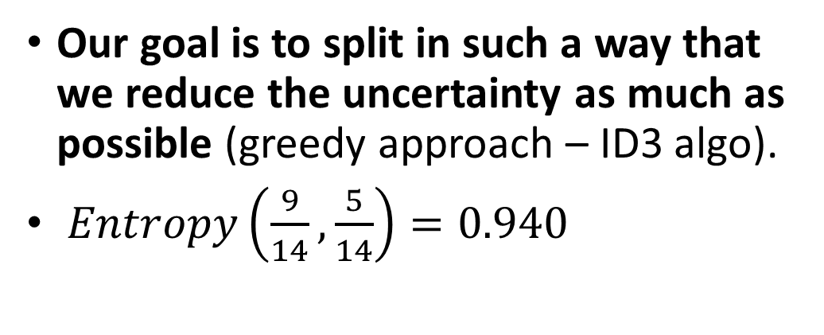
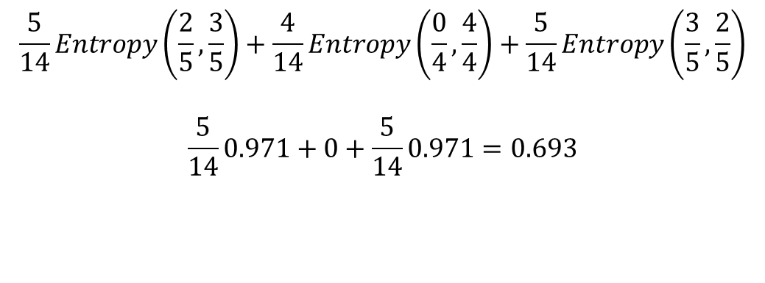
Information Gain
Our goal is to split in such a way that we reduce the uncertainty as much as possible (greedy approach – ID3 algo).
$Entropy\left(\frac{9}{14},\frac{5}{14}\right)=0.940$
Splitting on Outlook:
$$\frac{5}{14}Entropy\left(\frac{2}{5},\frac{3}{5}\right)+\frac{4}{14}Entropy\left(\frac{0}{4},\frac{4}{4}\right)+\frac{5}{14}Entropy\left(\frac{3}{5},\frac{2}{5}\right)$$
$$\frac{5}{14}0.971+0+\frac{5}{14}0.971=0.693$$
$$Gain= 0.940−0.693=0.247 bits$$

Slide 9
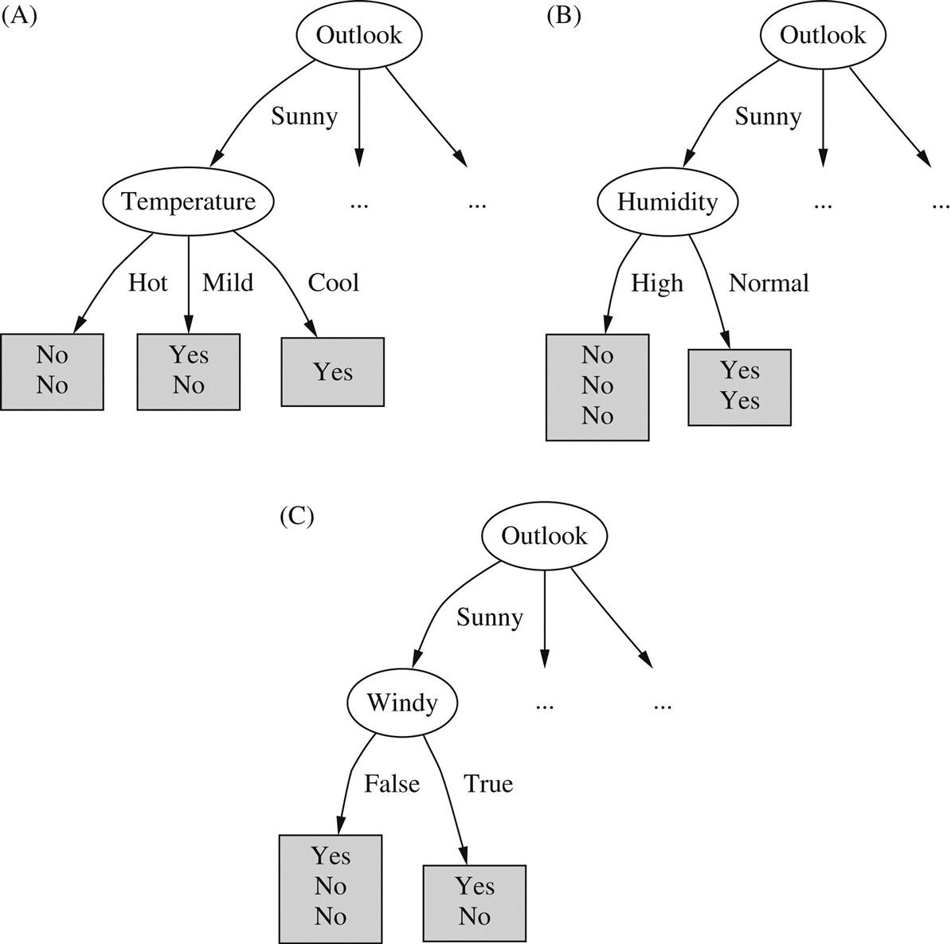
Further splits for weather data:
We can now ignore the “Outlook” attribute (we have already split on outlook)
Continue recursively from the “Sunny” branch
Gain(Temperature)=0.571 bits
Gain(Humidity)=0.971 bits
Gain(Windy)=0.020 bits
Clearly, we should split on humidity next, leading to two pure leaf nodes
(after that, we recur back to the next value of Outlook which is “Overcast”)

Slide 10
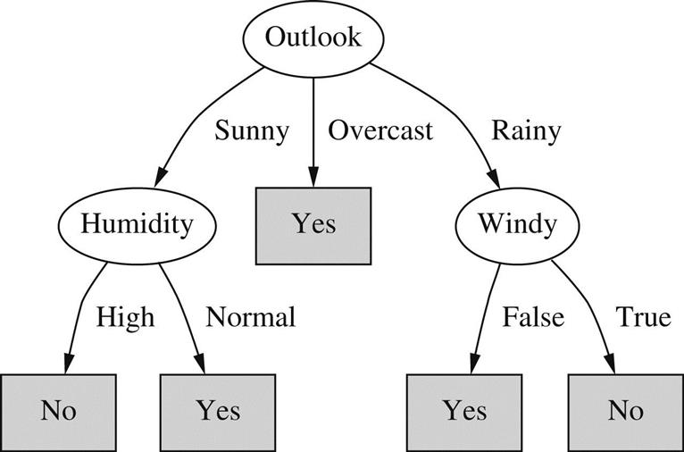
Final Decision Tree for weather data
Ideally process will terminate when all leaf nodes are pure
This may not always be the case because training data may contain instances with identical attributes but different classes
Due to noisy data or unrecorded attributes
Stop when data cannot be split any further, or the information gain is zero

Slide 11
Final Decision Tree for weather data
Outlook | Temperature | Humidity | Windy | Play
Sunny | Hot | High | False | No
Sunny | Hot | High | True | No
Overcast | Hot | High | False | Yes
Rainy | Mild | High | False | Yes
Rainy | Cool | Normal | False | Yes
Rainy | Cool | Normal | True | No
Overcast | Cool | Normal | True | Yes
Sunny | Mild | High | False | No
Sunny | Cool | Normal | False | Yes
Rainy | Mild | Normal | False | Yes
Sunny | Mild | Normal | True | Yes
Overcast | Mild | High | True | Yes
Overcast | Hot | Normal | False | Yes
Rainy | Mild | High | True | No

Slide 12
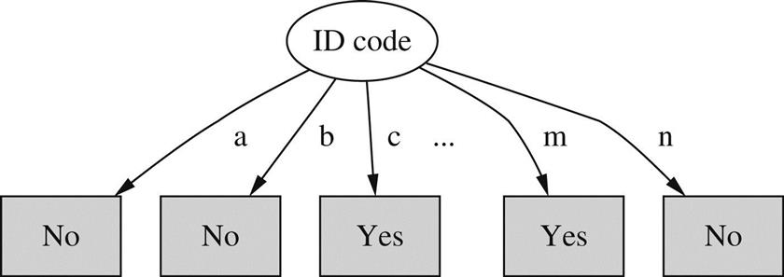
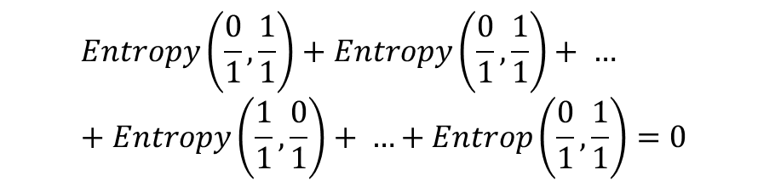
Highly branching attributes
A problem arises with the information gain calculation if some attributes have many values, giving rise to a multiway branch with many child nodes
Identification code example
ID Code | Outlook | Temperature | Humidity | Windy | Play
a | Sunny | Hot | High | False | No
b | Sunny | Hot | High | True | No
c | Overcast | Hot | High | False | Yes
d | Rainy | Mild | High | False | Yes
e | Rainy | Cool | Normal | False | Yes
f | Rainy | Cool | Normal | True | No
g | Overcast | Cool | Normal | True | Yes
h | Sunny | Mild | High | False | No
i | Sunny | Cool | Normal | False | Yes
j | Rainy | Mild | Normal | False | Yes
k | Sunny | Mild | Normal | True | Yes
l | Overcast | Mild | High | True | Yes
m | Overcast | Hot | Normal | False | Yes
n | Rainy | Mild | High | True | No
$$Entropy\left(\frac{0}{1},\frac{1}{1}\right)+Entropy\left(\frac{0}{1},\frac{1}{1}\right)+ …+Entropy\left(\frac{1}{1},\frac{0}{1}\right)+ …+Entrop\left(\frac{0}{1},\frac{1}{1}\right)=0$$
In this case, information gain will be maximal
(9.40 - 0 = 9.40), but ID code attribute is useless

Slide 13
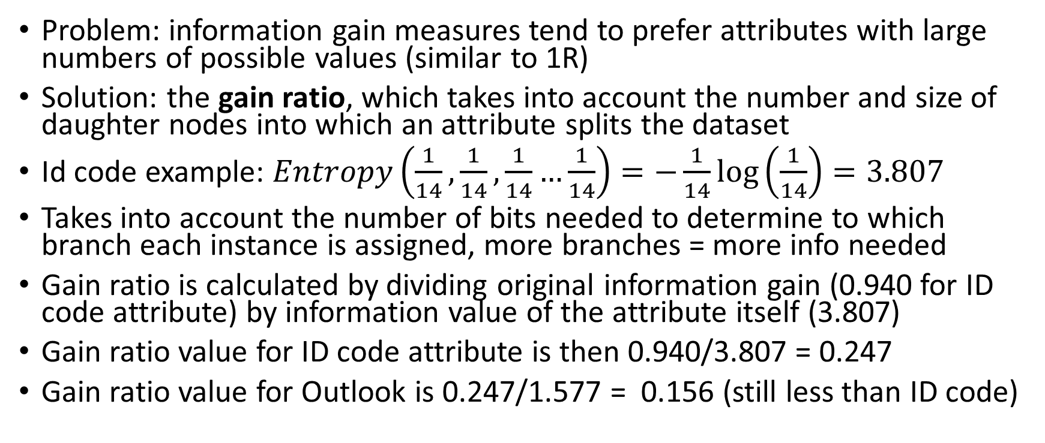
Gain ratio
Problem: information gain measures tend to prefer attributes with large numbers of possible values (similar to 1R)
Solution: the gain ratio, which takes into account the number and size of daughter nodes into which an attribute splits the dataset
Id code example: $Entropy\left(\frac{1}{14},\frac{1}{14},\frac{1}{14}…\frac{1}{14}\right)=−\frac{1}{14}\log\left(\frac{1}{14}\right)=3.807$
Takes into account the number of bits needed to determine to which branch each instance is assigned, more branches = more info needed
Gain ratio is calculated by dividing original information gain (0.940 for ID code attribute) by information value of the attribute itself (3.807)
Gain ratio value for ID code attribute is then 0.940/3.807 = 0.247
Gain ratio value for Outlook is 0.247/1.577 = 0.156 (still less than ID code)

Slide 14
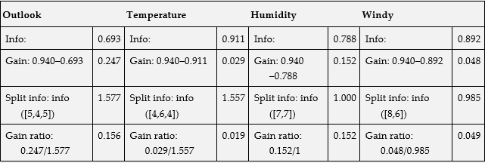
Gain ratio values for different tree stumps

Slide 15
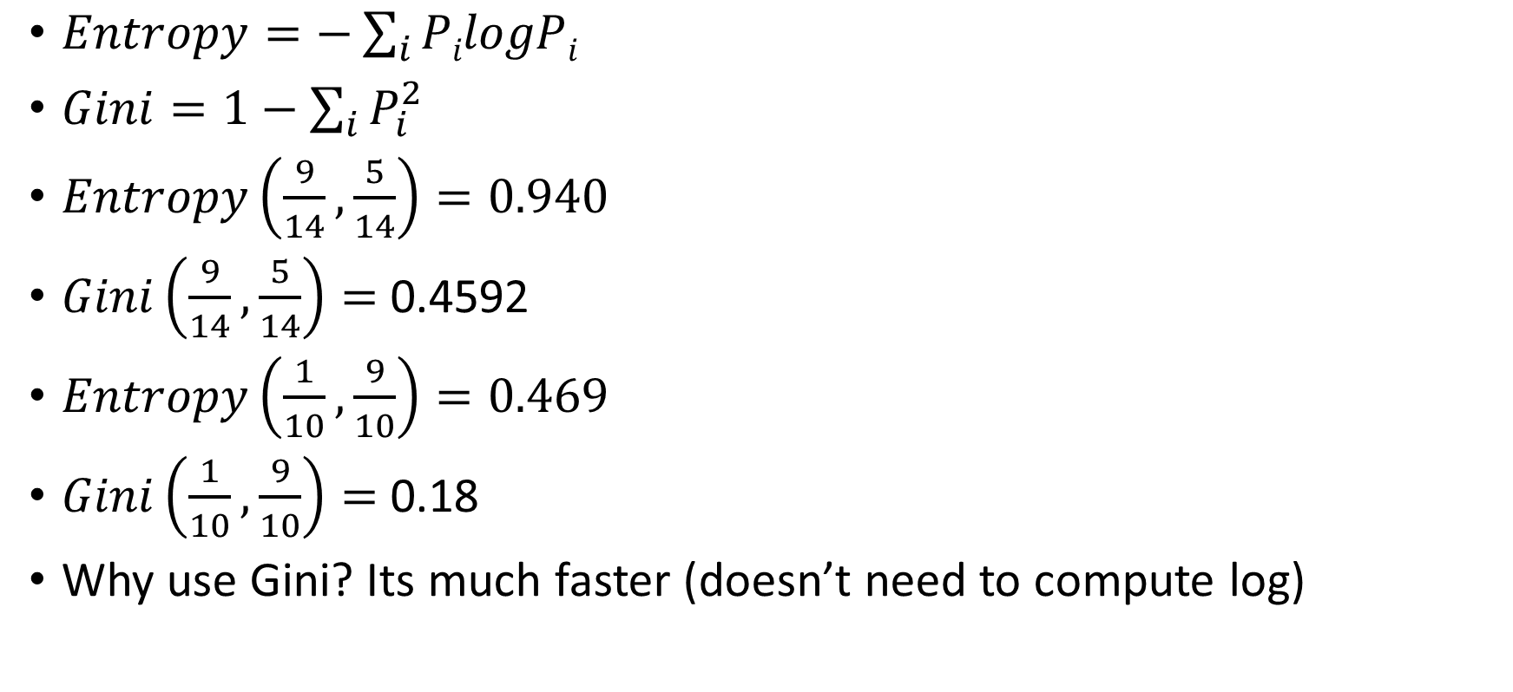
Other measures of “node purity”
$Entropy=−\sum_{i}{PilogPi}$
$Gini=1−\sum_{i}{P_{i}^{2}}$
$Entropy\left(\frac{9}{14},\frac{5}{14}\right)=0.940$
$Gini\left(\frac{9}{14},\frac{5}{14}\right)=$0.4592
$Entropy\left(\frac{1}{10},\frac{9}{10}\right)=0.469$
$Gini\left(\frac{1}{10},\frac{9}{10}\right)=$0.18
Why use Gini? Its much faster (doesn’t need to compute log)

Slide 16
Decision Tree in scikit-learn
https://scikit-learn.org/stable/modules/tree.html
Scikit-learn decision trees do not handle categorical data
Iris data
Other datasets: https://scikit-learn.org/stable/datasets/index.html
Iris, digits, wine, breast cancer (classification datasets)
Test out Decision trees on these datasets, and visualize the raw data using matplotlib (pyplot.plot)

