Slide 1
CS405/505 Data Mining
Lecture 23

Slide 2
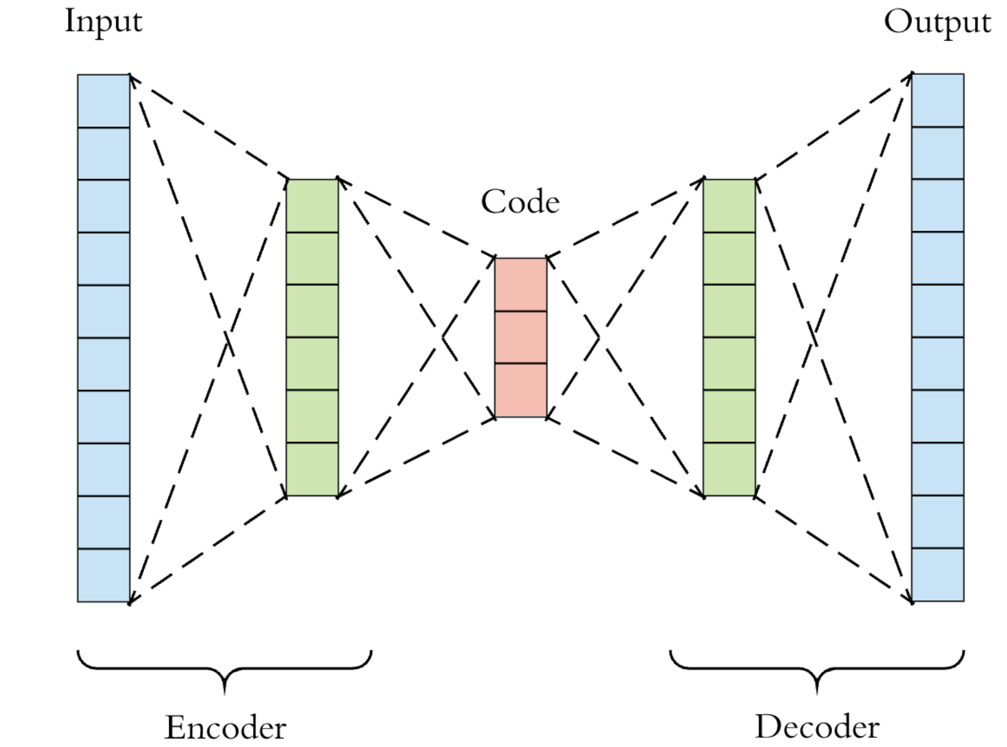
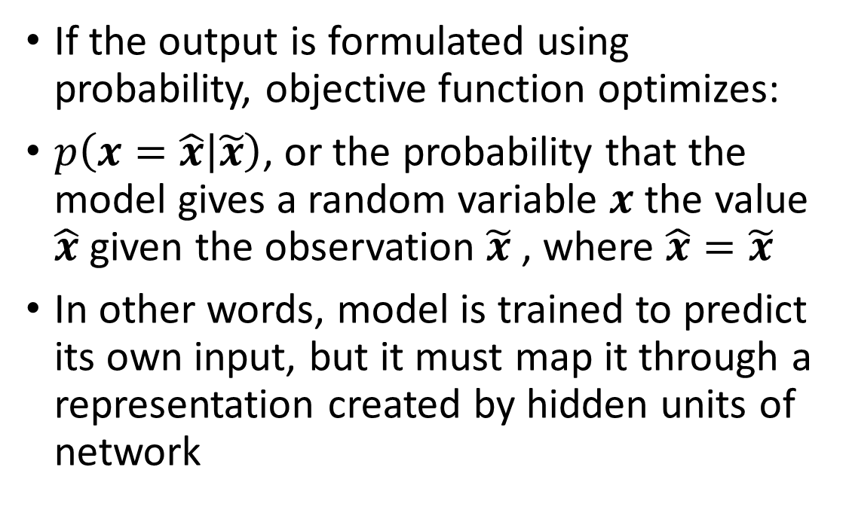
Autoencoders
Up until now, used neural networks for classification (supervised learning)
Neural networks can also be used for unsupervised learning (PCA, ICA, etc.)
An autoencoder is a network that learns an efficient coding of its input
Set input equal to output, and reduce number of hidden units
If the output is formulated using probability, objective function optimizes:
$p\left(x=\hat{x} | \tilde{x}\right)$, or the probability that the model gives a random variable $x$ the value $\hat{x}$ given the observation $\tilde{x}$ , where $\hat{x}=\tilde{x}$
In other words, model is trained to predict its own input, but it must map it through a representation created by hidden units of network

Slide 3
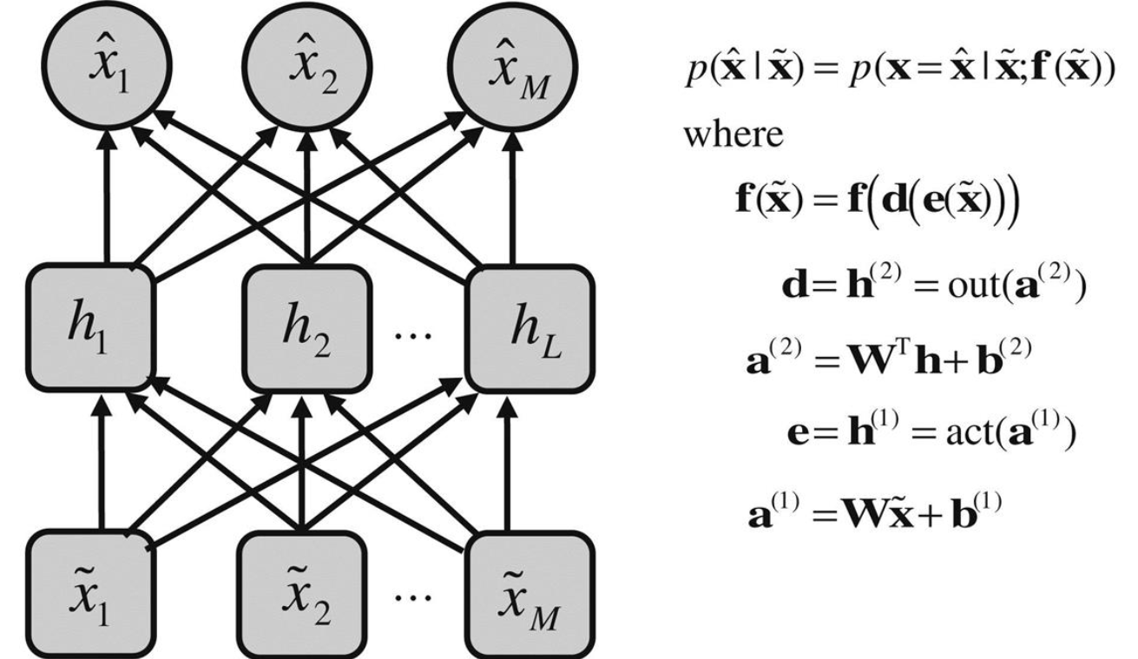
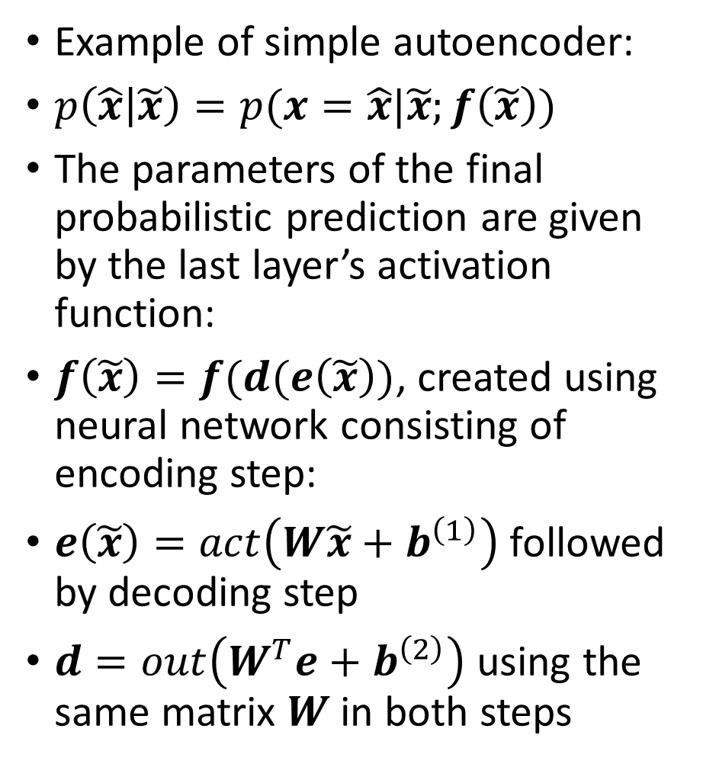
Simple autoencoder
Example of simple autoencoder:
$p\left(\hat{x} | \tilde{x}\right)=p(x=\hat{x}|\tilde{x};f\left(\tilde{x}\right))$
The parameters of the final probabilistic prediction are given by the last layer’s activation function:
$f\left(\tilde{x}\right)=f(d(e\left(\tilde{x}\right))$, created using neural network consisting of encoding step:
$e\left(\tilde{x}\right)=act\left(W\tilde{x}+b^{\left(1\right)}\right)$ followed by decoding step
$d=out\left(W^{T}e+b^{\left(2\right)}\right)$ using the same matrix $W$ in both steps

Slide 4
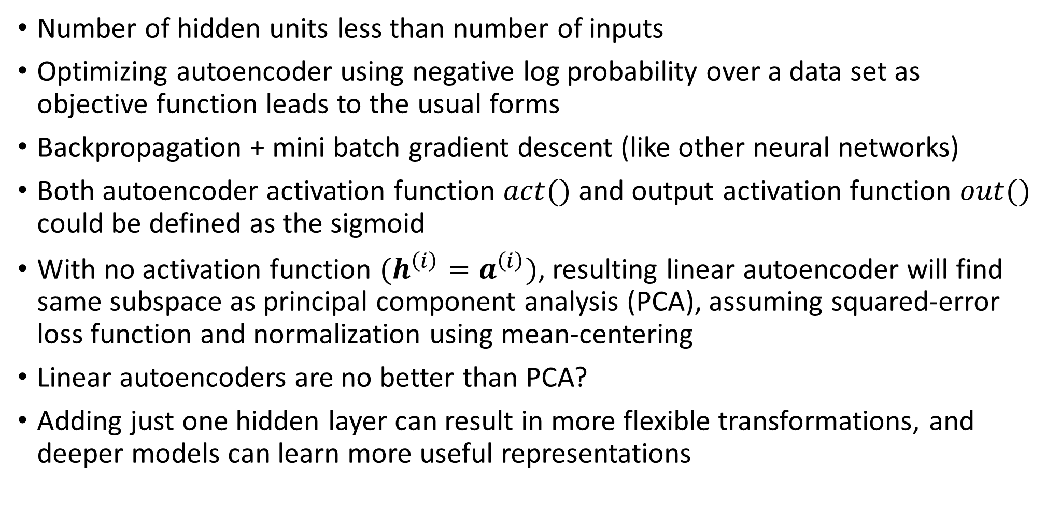
Autoencoder
Number of hidden units less than number of inputs
Optimizing autoencoder using negative log probability over a data set as objective function leads to the usual forms
Backpropagation + mini batch gradient descent (like other neural networks)
Both autoencoder activation function $act()$ and output activation function $out()$ could be defined as the sigmoid
With no activation function $(h^{\left(i\right)}=a^{\left(i\right)})$, resulting linear autoencoder will find same subspace as principal component analysis (PCA), assuming squared-error loss function and normalization using mean-centering
Linear autoencoders are no better than PCA?
Adding just one hidden layer can result in more flexible transformations, and deeper models can learn more useful representations

Slide 5
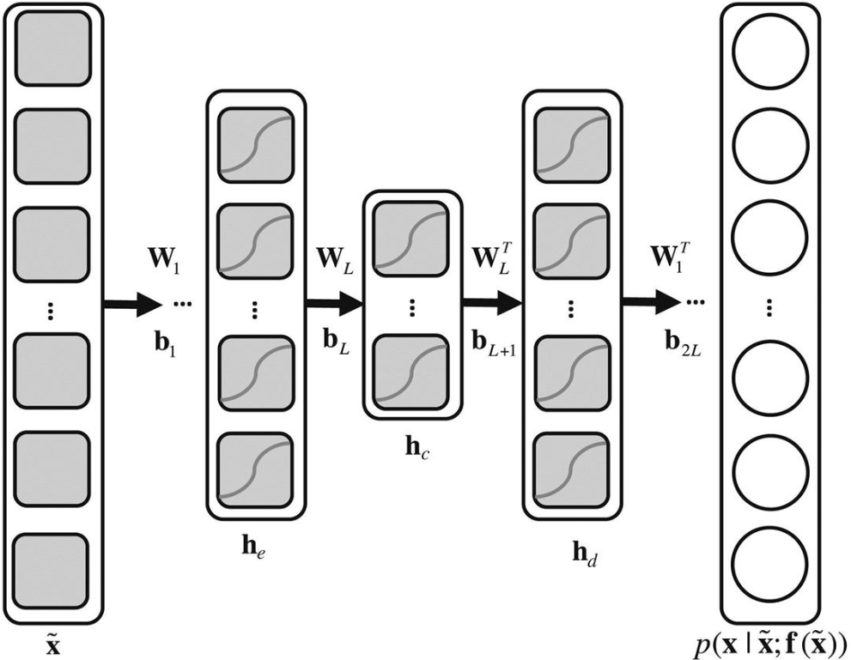
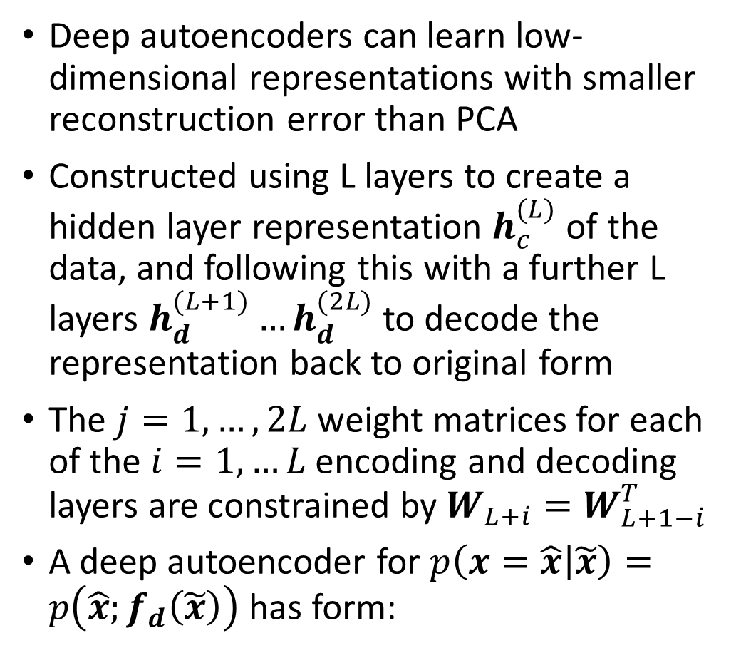
Autoencoder
Deep autoencoders can learn low-dimensional representations with smaller reconstruction error than PCA
Constructed using L layers to create a hidden layer representation $h_{c}^{(L)}$ of the data, and following this with a further L layers $h_{d}^{(L+1)}…h_{d}^{(2L)}$ to decode the representation back to original form
The $j=1,…,2L$ weight matrices for each of the $i=1,…L$ encoding and decoding layers are constrained by $W_{L+i}=W_{L+1−i}^{T}$
A deep autoencoder for $p\left(x=\hat{x} | \tilde{x}\right)=p\left(\hat{x};f_{d}\left(\tilde{x}\right)\right)$has form:
$f\left(x\right)=f_{d}(a_{d}^{\left(2L\right)}(…h_{d}^{\left(L+1\right)}(a_{d}^{\left(L+1\right)}(h_{c}^{\left(L\right)}(a_{e}^{\left(L\right)}(…(h_{e}^{\left(1\right)}(a_{e}^{\left(1\right)}(x)$))))))))

Slide 6
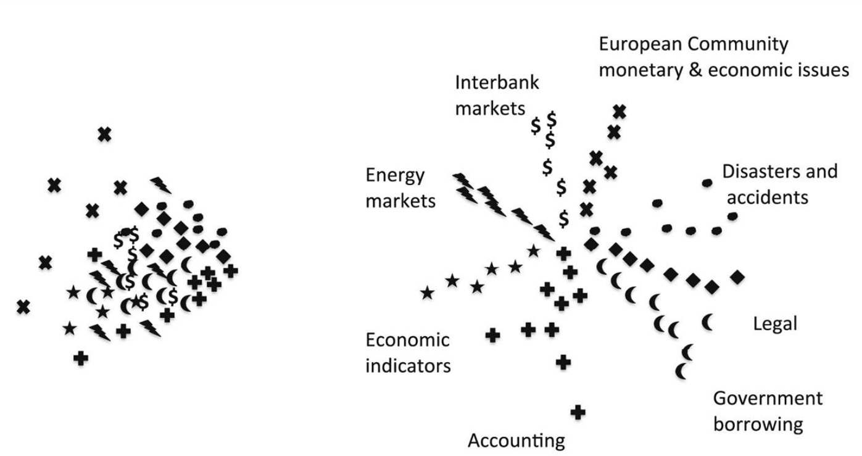
Autoencoder vs PCA example
Low dimensional PCA space (left) compared to space learned by deep autoencoder (right)
Comparison of data projected into 2D space by PCA and deep autoencoder
Autoencoder is nonlinear, so the network can arrange the learned space in such a way that it better separates natural grouping of data

Slide 7
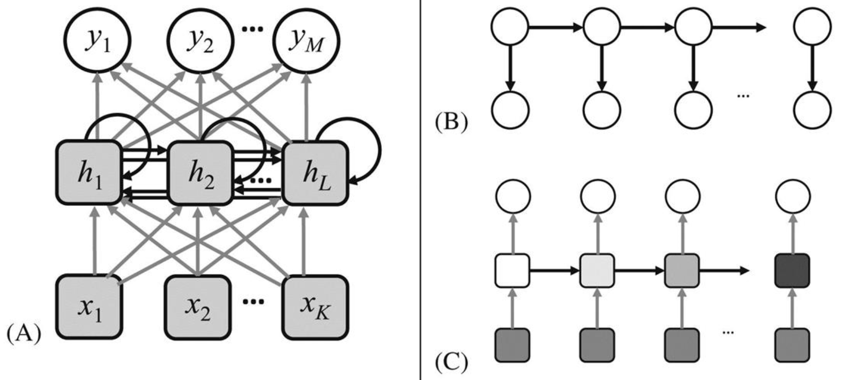
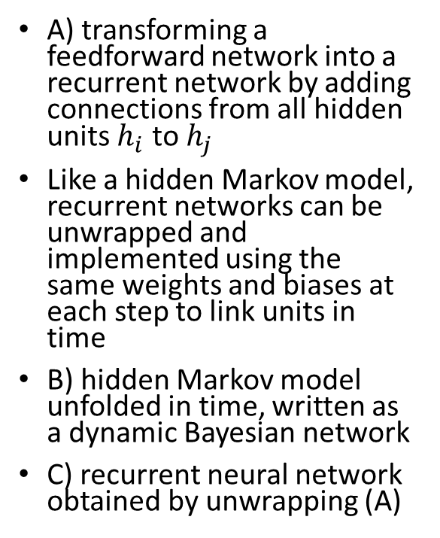
10.6 recurrent neural networks (RNNs)
Recurrent neural network = network with connections forming directed cycles
As a result, they have internal state
This makes them prime candidates for tackling learning problems involving sequences of data (handwriting/speech recognition, machine translation, etc.)
A) transforming a feedforward network into a recurrent network by adding connections from all hidden units $h_{i}$ to $h_{j}$
Like a hidden Markov model, recurrent networks can be unwrapped and implemented using the same weights and biases at each step to link units in time
B) hidden Markov model unfolded in time, written as a dynamic Bayesian network
C) recurrent neural network obtained by unwrapping (A)

Slide 8
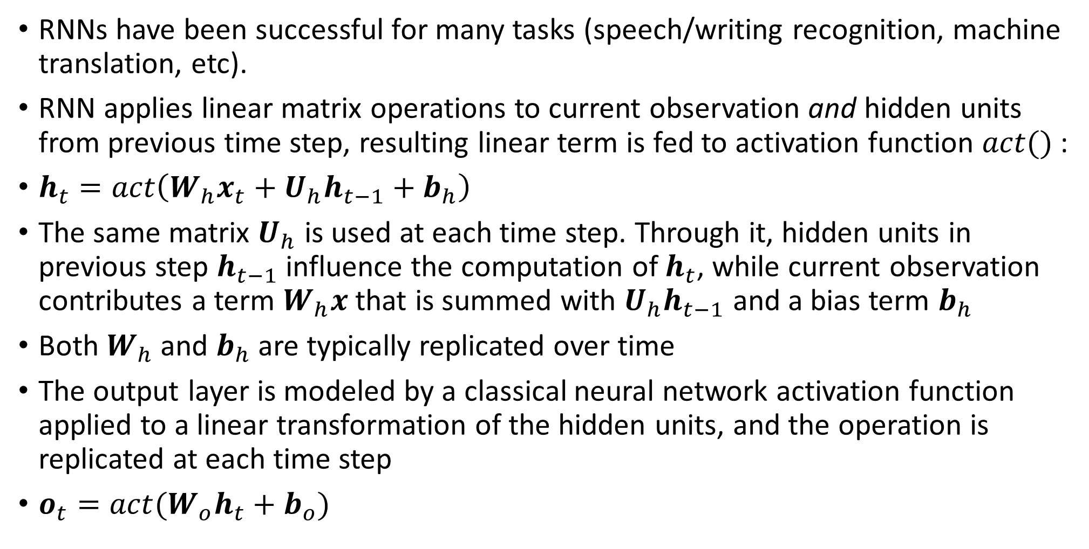
Recurrent Neural networks (RNNs)
RNNs have been successful for many tasks (speech/writing recognition, machine translation, etc).
RNN applies linear matrix operations to current observation and hidden units from previous time step, resulting linear term is fed to activation function $act()$ :
$h_{t}=act\left(W_{h}x_{t}+U_{h}h_{t−1}+b_{h}\right)$
The same matrix $U_{h}$ is used at each time step. Through it, hidden units in previous step $h_{t−1}$ influence the computation of $h_{t}$, while current observation contributes a term $W_{h}x$ that is summed with $U_{h}h_{t−1}$ and a bias term $b_{h}$
Both $W_{h}$ and $b_{h}$ are typically replicated over time
The output layer is modeled by a classical neural network activation function applied to a linear transformation of the hidden units, and the operation is replicated at each time step
$o_{t}=act(W_{o}h_{t}+b_{o})$

Slide 9
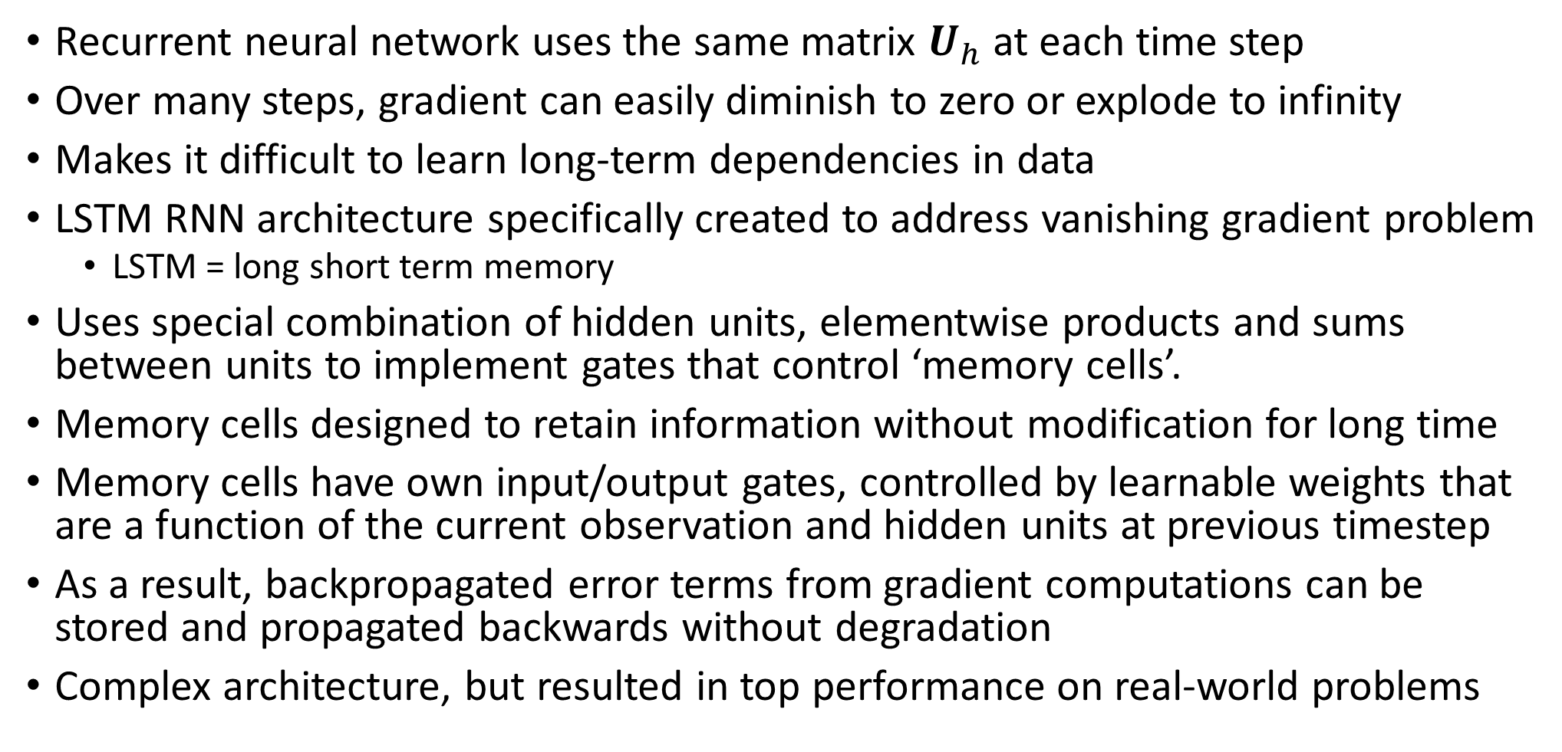
Exploding/Vanishing gradients
Recurrent neural network uses the same matrix $U_{h}$at each time step
Over many steps, gradient can easily diminish to zero or explode to infinity
Makes it difficult to learn long-term dependencies in data
LSTM RNN architecture specifically created to address vanishing gradient problem
LSTM = long short term memory
Uses special combination of hidden units, elementwise products and sums between units to implement gates that control ‘memory cells’.
Memory cells designed to retain information without modification for long time
Memory cells have own input/output gates, controlled by learnable weights that are a function of the current observation and hidden units at previous timestep
As a result, backpropagated error terms from gradient computations can be stored and propagated backwards without degradation
Complex architecture, but resulted in top performance on real-world problems

Slide 10
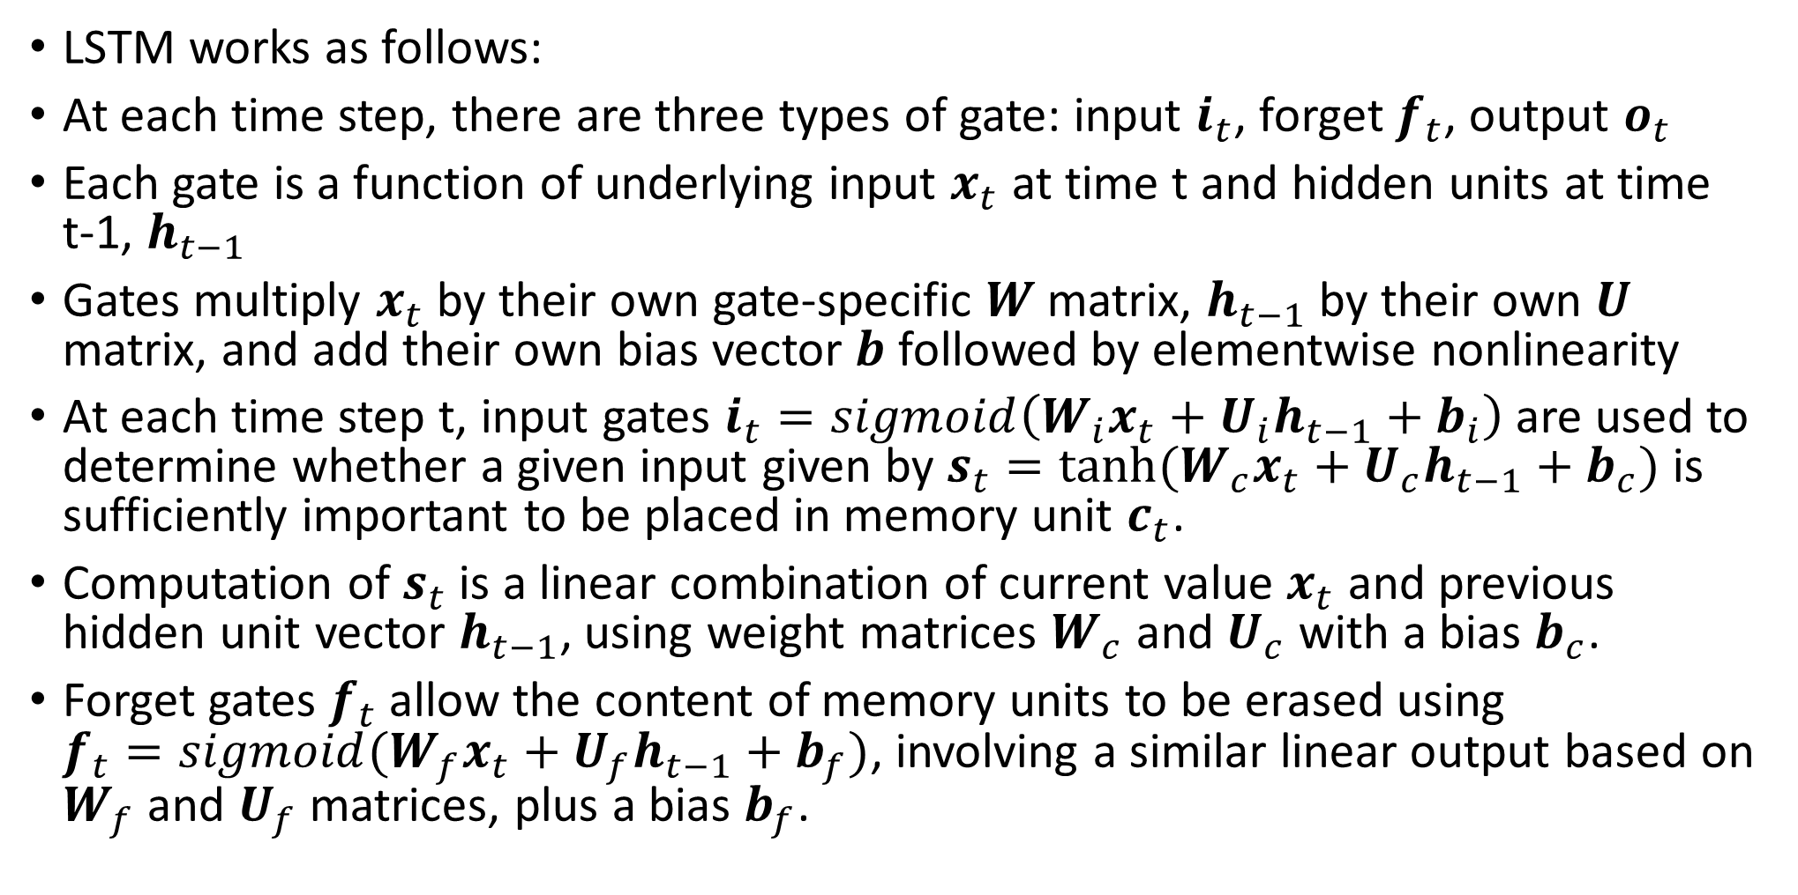
Long short-term memory (LSTM) network
LSTM works as follows:
At each time step, there are three types of gate: input $i_{t}$, forget $f_{t}$, output $o_{t}$
Each gate is a function of underlying input $x_{t}$ at time t and hidden units at time t-1, $h_{t−1}$
Gates multiply $x_{t}$ by their own gate-specific $W$ matrix, $h_{t−1}$ by their own $U$ matrix, and add their own bias vector $b$ followed by elementwise nonlinearity
At each time step t, input gates $i_{t}=sigmoid\left(W_{i}x_{t}+U_{i}h_{t−1}+b_{i}\right)$ are used to determine whether a given input given by $s_{t}=tanh⁡(W_{c}x_{t}+U_{c}h_{t−1}+b_{c})$ is sufficiently important to be placed in memory unit $c_{t}$.
Computation of $s_{t}$ is a linear combination of current value $x_{t}$ and previous hidden unit vector $h_{t−1}$, using weight matrices $W_{c}$ and $U_{c}$ with a bias $b_{c}$.
Forget gates $f_{t}$ allow the content of memory units to be erased using $f_{t}=sigmoid(W_{f}x_{t}+U_{f}h_{t−1}+b_{f})$, involving a similar linear output based on $W_{f}$ and $U_{f}$ matrices, plus a bias $b_{f}$.

Slide 11
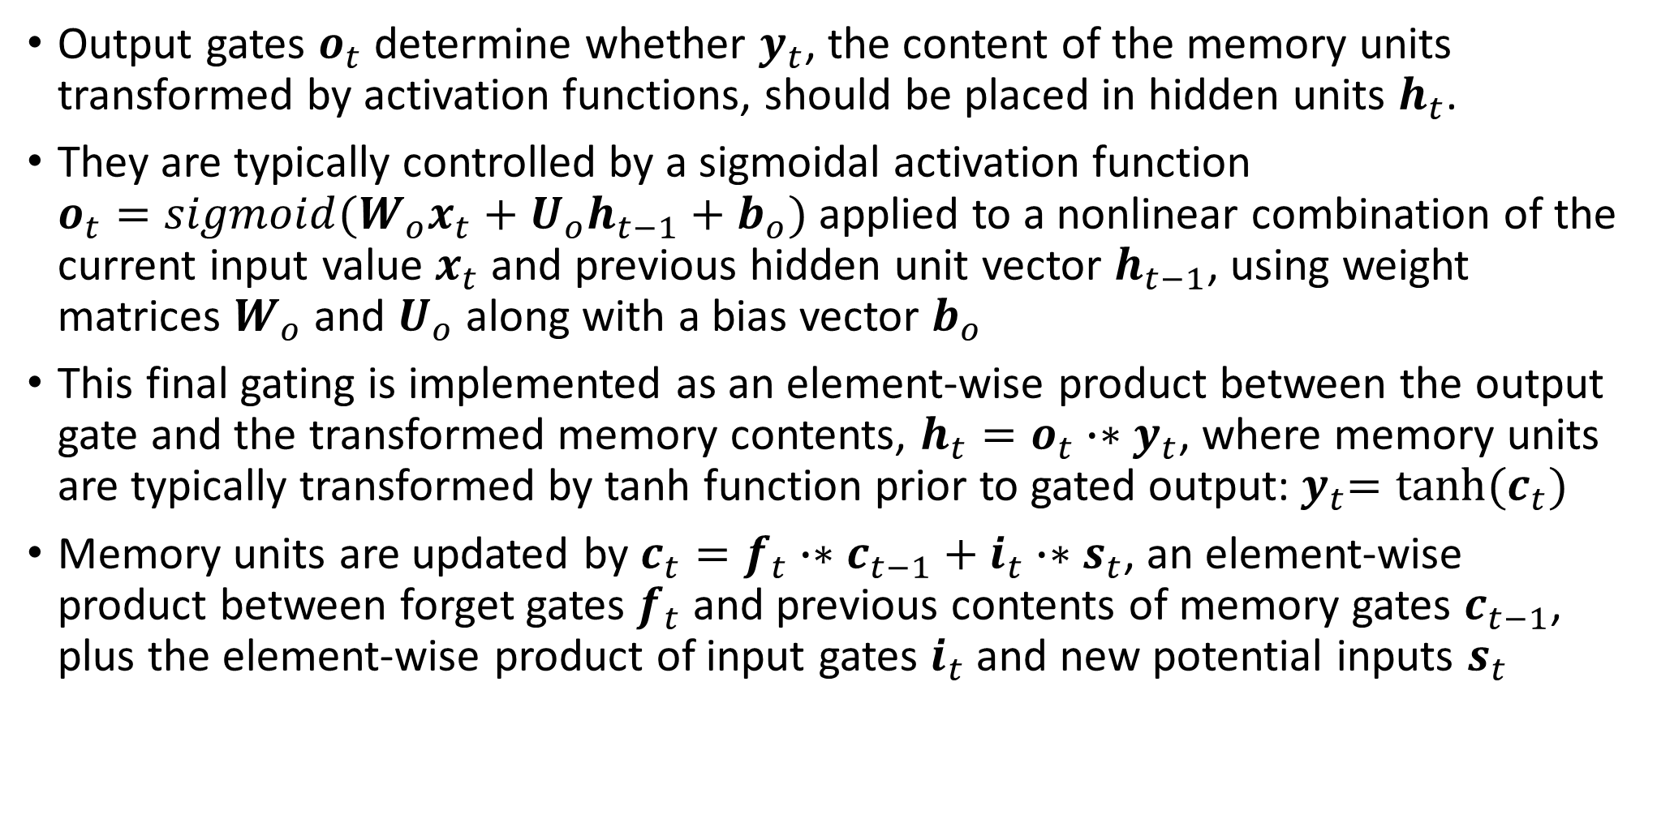
Long short-term memory (LSTM) network
Output gates $o_{t}$ determine whether $y_{t}$, the content of the memory units transformed by activation functions, should be placed in hidden units $h_{t}$.
They are typically controlled by a sigmoidal activation function $o_{t}=sigmoid(W_{o}x_{t}+U_{o}h_{t−1}+b_{o})$ applied to a nonlinear combination of the current input value $x_{t}$ and previous hidden unit vector $h_{t−1}$, using weight matrices $W_{o}$ and $U_{o}$ along with a bias vector $b_{o}$
This final gating is implemented as an element-wise product between the output gate and the transformed memory contents, $h_{t}=o_{t}∙∗y_{t}$, where memory units are typically transformed by tanh function prior to gated output:${ y}_{t}=tanh⁡(c_{t})$
Memory units are updated by $c_{t}=f_{t}∙∗c_{t−1}+i_{t}∙∗s_{t}$, an element-wise product between forget gates $f_{t}$ and previous contents of memory gates $c_{t−1}$, plus the element-wise product of input gates $i_{t}$ and new potential inputs $s_{t}$

Slide 12
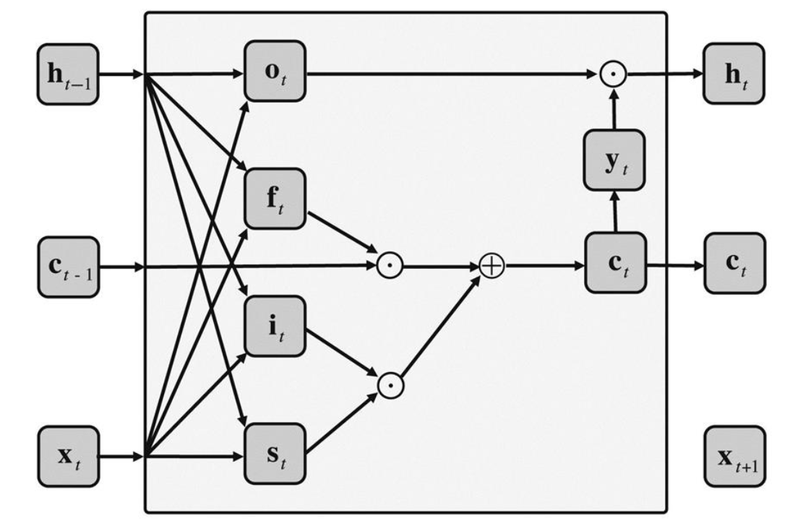
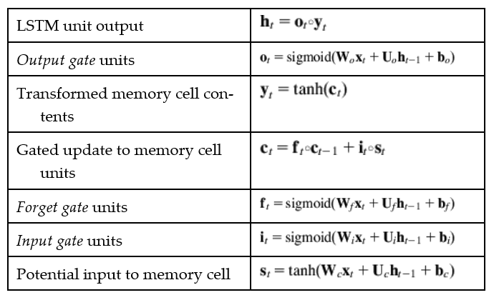
Structure of a long short-term memory unit

Slide 13
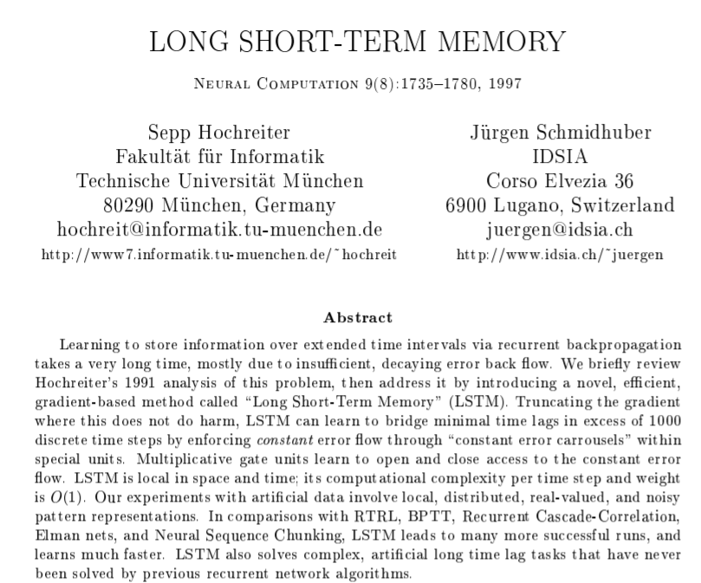
(available on moodle)
“this paper presents Long short-term memory, a novel recurrent network architecture in conjunction with an appropriate gradient-based learning algorithm. LSTM can bridge time intervals in excess of 1000 steps, even in the case of noisy, incompressible input sequences, without loss of short term time lag capabilities”
More intuitive explanation of LSTMs:
Also, check out blog post:
https://colah.github.io/posts/2015-08-Understanding-LSTMs/
http://karpathy.github.io/2015/05/21/rnn-effectiveness/

Slide 14
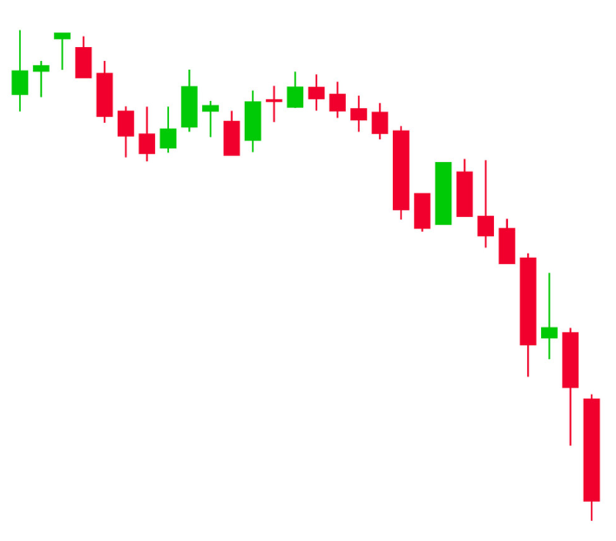
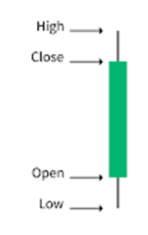
Keras example:
LSTM network for time series prediction
LSTM+CNN obsolete? check out article “attention is all you need” from Google Brain (on moodle)

