Slide 2
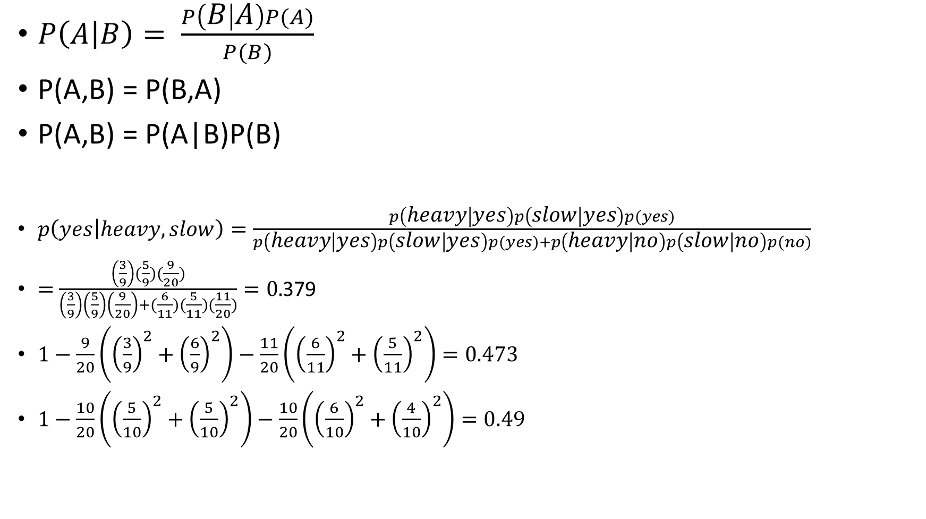
$P\left(A | B\right)= \frac{P\left(B | A\right)P(A)}{P(B)}$
P(A,B) = P(B,A)
P(A,B) = P(A|B)P(B)
$p\left(yes | heavy,slow\right)=\frac{p\left(heavy | yes\right)p\left(slow | yes\right)p(yes)}{p\left(heavy | yes\right)p\left(slow | yes\right)p(yes)+p\left(heavy | no\right)p\left(slow | no\right)p(no)}$
$=$ $\frac{\left(\frac{3}{9}\right)(\frac{5}{9})(\frac{9}{20})}{\left(\frac{3}{9}\right)\left(\frac{5}{9}\right)\left(\frac{9}{20}\right)+(\frac{6}{11})(\frac{5}{11})(\frac{11}{20})}=0.$379
$1−\frac{9}{20}\left({\left(\frac{3}{9}\right)}^{2}+{\left(\frac{6}{9}\right)}^{2}\right)−\frac{11}{20}\left({\left(\frac{6}{11}\right)}^{2}+{\left(\frac{5}{11}\right)}^{2}\right)=0.473$
$1−\frac{10}{20}\left({\left(\frac{5}{10}\right)}^{2}+{\left(\frac{5}{10}\right)}^{2}\right)−\frac{10}{20}\left({\left(\frac{6}{10}\right)}^{2}+{\left(\frac{4}{10}\right)}^{2}\right)=0.49$

Slide 3
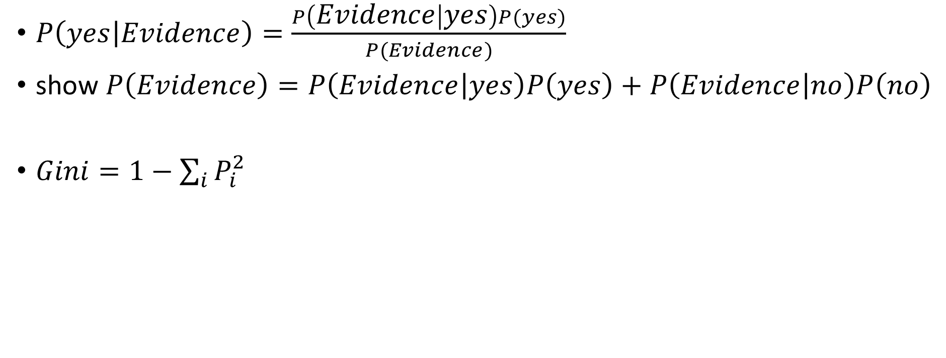
$P\left(yes | Evidence\right)=\frac{P\left(Evidence | yes\right)P(yes)}{P(Evidence)}$
show $P\left(Evidence\right)=P\left(Evidence | yes\right)P\left(yes\right)+P\left(Evidence | no\right)P\left(no\right)$
$Gini=1−\sum_{i}{P_{i}^{2}}$

