Slide 1
CS 405/505 Data Mining
Lecture 25

Slide 2
Chapter 12 - Ensemble learning
Powerful way to improve performance of machine learning is to combine predictions from multiple models
This involves constructing an ensemble of classifiers
example: a set of decision trees (forest) rather than a single tree
Overview chapter 12:
Bagging and randomization – randomly perturbing input/model
Random forests – created by combining bagging and randomization
Boosting – iteratively improving the ensemble
AdaBoost.M1
Stacking – each member of ensemble is a different type of model
Interpreting ensemble learning output

Slide 3
12.2 Bagging
Select several training datasets of the same size from problem domain
Build a decision tree for each dataset
Will the trees be identical? Probably not
Decision tree induction is an unstable process
Slight changes in training data can easily result in different attribute chosen at some node
Instability implies some trees will correctly classify a test instance, others will not
Combine the trees by having them each vote on a given test instance’s class
The more the merrier – more trees = better predictions
Combined classifier is rarely less accurate than classifier built from single dataset
Theoretical basis for this assumption?

Slide 4
Bias-Variance decomposition
Combining multiple hypotheses can be viewed through theoretical device known as the bias-variance decomposition
Bias-variance decomposition:
Bias:
Suppose we have an infinite number of independent training sets of same size
Use these training sets to create an infinite number of classifiers
Process test instance using all classifiers, single answer determined by vote
Evaluate expected error rate by getting the error of the combined classifier over infinite number of independently chosen test examples
Error rate for particular learning algorithm called its bias for the learning problem
Measures how well learning method matches the problem
Measures persistent error of learning algorithm, can’t be eliminated by infinite samples

Slide 5
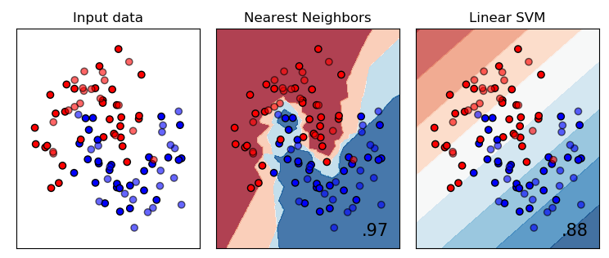
Which model has higher bias error on the input data?

Slide 6
Bias-Variance decomposition
Variance
Second source of error in a learned model stems from particular training set used
Training set is inevitably finite, not fully representative of population of instances
Expected value of this component of error, over all possible training sets of a given size, and all possible test sets, is called the variance of learning method
Total expected error of classifier = bias + variance (bias-variance decomposition)
Combining multiple classifiers reduces variance component, decreasing error
More classifiers (and training sets) = greater reduction in variance
Problem: usually only one training set exists
Bagging attempts to simulate the infinite training sets using a bootstrap method
sampling with replacement from original dataset, creating new dataset of equal size
Bagging = Bootstrap Aggregating

Slide 7
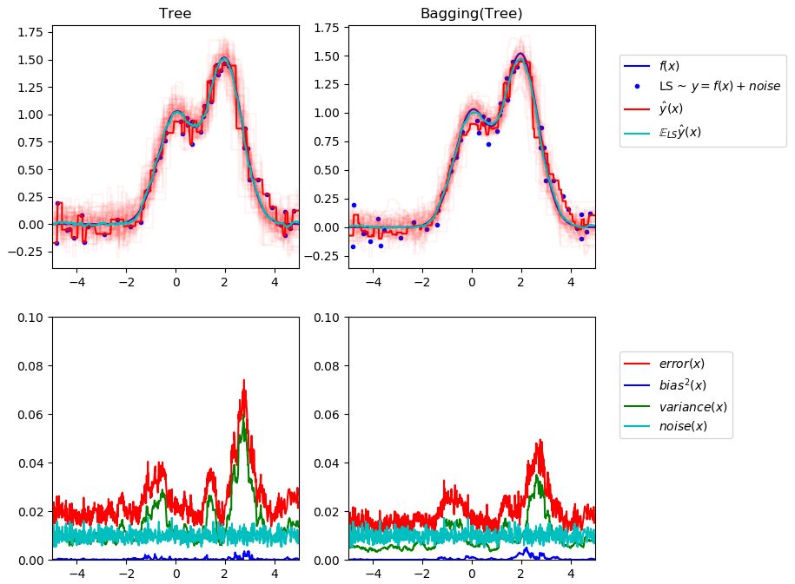
Bias-Variance decomposition
Upper left: predictions (dark red) of single decision tree trained over random dataset of a toy 1D regression problem
Also shows predictions (light red) of other single decision trees trained over other instance of the problem
Variance term here corresponds to width of beam of predictions (light red) of the individual estimators
Bias term here corresponds to difference between average prediction of estimator (cyan) and best possible model (Dark blue)
Lower left corresponds to pointwise decomposition of expected mean-squared error of a single decision tree.
Confirms bias is low (blue)
Confirms variance is large (green)
Right figures correspond to same plots but using a bagging ensemble, instead of 1 tree
Variance components (and hence, overall error) is less when using ensemble
https://scikit-learn.org/stable/auto_examples/ensemble/plot_bias_variance.html#sphx-glr-auto-examples-ensemble-plot-bias-variance-py

Slide 8
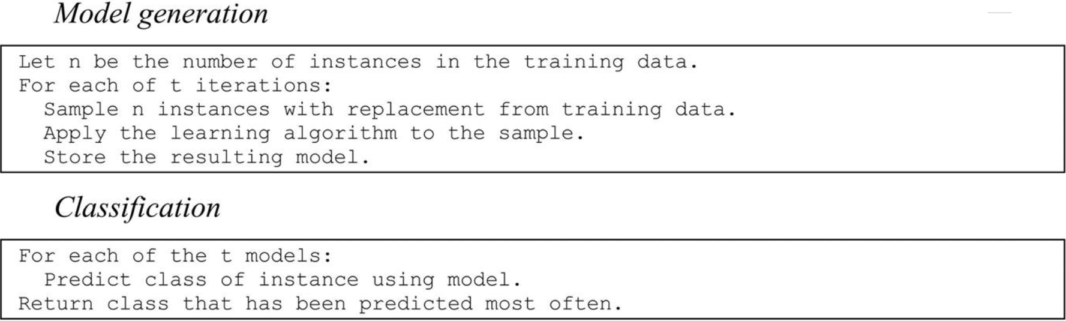
Bagging algorithm
Bagging applies learning scheme (decision tree in this case) to each artificially generated dataset, and classifiers generated from this vote on new instance
Bagging just resamples original dataset, but often outperforms a single classifier
Performance due to bagging is never worse than for single classifier
Can also be used for regression (average the predictions)

Slide 9
Randomization
Consider perceptron: weights are randomly initialized to small random values
Different weight initializations may yield different end results
One way to make classification outcome more stable is run learner several different times with different random number seeds, combine results with voting
Almost every learning algorithm can be randomized in this way
Decision tree: greedily splits at each node on lowest gini/entropy – instead, randomly pick from the top N options to split
Bagging and randomization yield similar results but it sometimes pays to combine
They introduce randomness in different, perhaps complementary ways
Popular algorithm for learning random forests builds a randomized decision tree in each iteration of bagging algorithm, often producing excellent predictors

Slide 10
Randomization vs Bagging
Randomization can be applied to a greater variety of learners
Bagging fails with stable algorithms whose output is insensitive to small changes in input
Example: nearest neighbor classifiers (output changes very little due to resampling)
Nearest-neighbor classifiers can be randomized by selecting different attributes to perform distance calculation on
Called the random subspaces method for constructing ensemble
Can combine random subspaces with bagging

Slide 11
Random Forest
Random forest is an ensemble learning method for classification and regression
Constructs a multitude of decision trees using bagging (default is 100 in sklearn)
Selects random subset of features to split on at each node (feature bagging)
Combines predictions using mode (most often occurring class across all trees) to generate classification
https://scikit-learn.org/stable/modules/generated/sklearn.ensemble.RandomForestClassifier.html
Parameters:
n_estimators (number of trees in forest)
criterion (gini or entropy)
max_depth (maximum depth of each tree in forest)
max_features (number of features to consider when looking for best split)
bootstrap (true or false) – default true
randomization
bagging

Slide 12
Example on final project
Decision tree classifier vs random forest
Class distribution
Cross validation

Slide 13
Bagging with costs
Bagging results can be improved by increasing diversity of ensemble by making learning scheme as unstable as possible while maintaining a minimum accuracy
Example: when learning ensemble of decision trees, switch off pruning, making them even more unstable
Further improvements by changing way predictions combined for classification:
Bagging uses voting
When models output probability estimates, can average these probabilities across models
This improves classification slightly, and also allows us to assign probabilities
Metacost combines predictive benefits of bagging with cost-sensitive prediction:
1) build ensemble classifier using bagging
2) Use it to relabel training data by giving every training instance a prediction minimizing expected cost, based on probability estimates from bagging
3) discard original class labels and learn single new classifier from relabeled data
Result is a cost-sensitive classifier, costs have been built into class labels

Slide 14
Rotation Forest
Rotation forests specifically try to create diverse yet accurate classifiers
Combines random subspace and bagging approaches with PCA feature generation to construct ensemble of decision trees
In each iteration, input attributes randomly divided into k disjoint subsets
PCA applied to each subset to create linear combos of attributes in subset
The k sets of PCA components are used to compute values for derived attributes
These comprise the input to tree learner at each iteration
Experiments indicate rotation forests can give similar performance to random forests, but with far fewer trees

