Slide 1
CS405/505 Data Mining
Lecture 26

Slide 2
Admin + Assignment 2
Tuesday Nov 26 is final day of class (7 lectures remaining)
Student evaluations this Wednesday (not mandatory)
Assignment 2:
Class average 86% (vs 92% for assignment 1)
-10% if you used GNB solution common to over 50 students
You can copy code I put on moodle (perceptron), but not other code
Most problems were with question 2a (GNB)
Small demo of GNB

Slide 3
12.4 Boosting
Bagging works because of decision tree instability (models are complementary)
Boosting explicitly seeks models that complement each other
Bagging vs Boosting:
Similarities
Both use voting for classification
Both combine models of the same type (e.g. decision trees)
Differences
Boosting is iterative – while in bagging each model is built separately, in boosting, each model is influenced by the performance of previously built models
Boosting encourages models to become experts for previously incorrectly handled instances
Boosting (unlike bagging) weights a model’s contribution to final vote by performance, rather than giving equal weight to all models

Slide 4
Boosting algorithm
Assume the underlying learning algorithm can handle weighted instances
Error is calculated as sum of weights of misclassified instances divided by sum of all weights
1) Begin by assigning equal weights to all instances in the training data
2) Train classifier on this data, reweigh each instance according to output:
Weight of correctly classified instances decreased, incorrectly classified instances increased
Produces set of ‘easy’ instances (low weight) and ‘hard’ instance (high weight)
3) in next (and all subsequent) iteration, classifier is built from reweighted data
Focuses on classifying hard instances correctly
Instance weights are increased/decreased according to output of new classifier
After each iteration, weights reflect how often instances have been misclassified by classifiers produced so far
By maintaining this ‘difficulty’ measure, the procedure provides an elegant way of generating a series of experts that complement each other

Slide 5
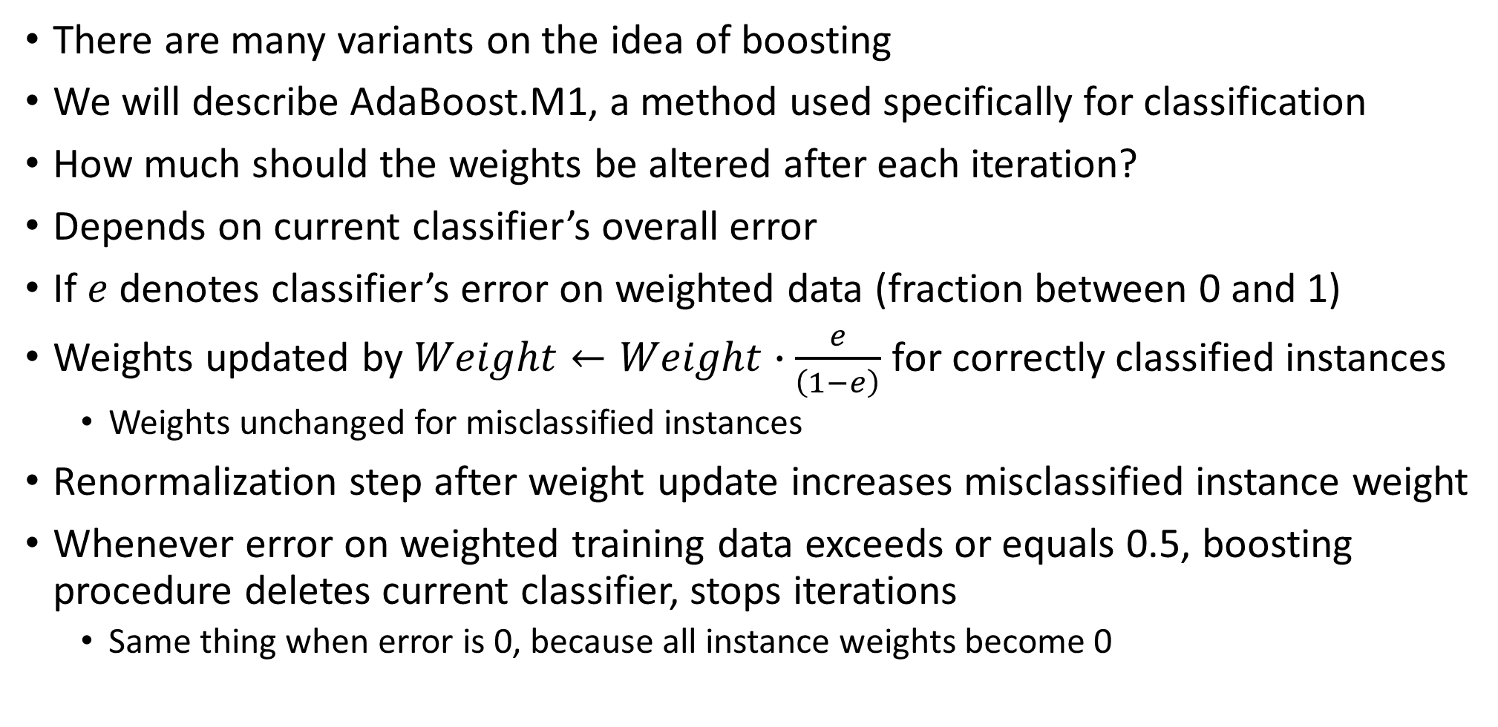
AdaBoost
There are many variants on the idea of boosting
We will describe AdaBoost.M1, a method used specifically for classification
How much should the weights be altered after each iteration?
Depends on current classifier’s overall error
If $e$ denotes classifier’s error on weighted data (fraction between 0 and 1)
Weights updated by $Weight←Weight∙\frac{e}{\left(1−e\right)}$ for correctly classified instances
Weights unchanged for misclassified instances
Renormalization step after weight update increases misclassified instance weight
Whenever error on weighted training data exceeds or equals 0.5, boosting procedure deletes current classifier, stops iterations
Same thing when error is 0, because all instance weights become 0

Slide 6
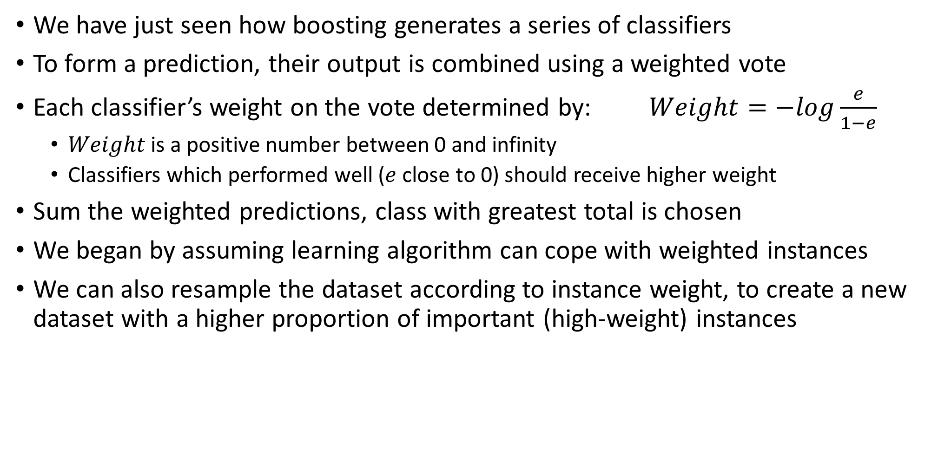
Adaboost (forming prediction)
We have just seen how boosting generates a series of classifiers
To form a prediction, their output is combined using a weighted vote
Each classifier’s weight on the vote determined by: $Weight=−log\frac{e}{1−e}$
$Weight$is a positive number between 0 and infinity
Classifiers which performed well ($e$ close to 0) should receive higher weight
Sum the weighted predictions, class with greatest total is chosen
We began by assuming learning algorithm can cope with weighted instances
We can also resample the dataset according to instance weight, to create a new dataset with a higher proportion of important (high-weight) instances

Slide 7
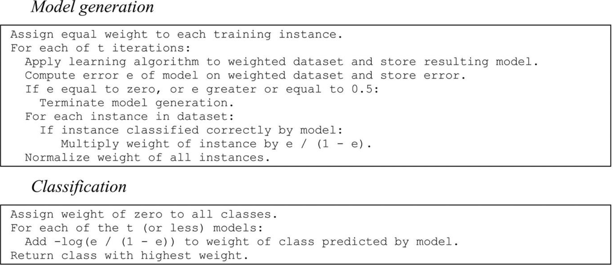
AdaBoost pseudocode

Slide 8
The power of boosting
Idea of boosting originated from computational learning theory, a branch of machine learning research
Theoretically interesting (can use boosting to derive performance guarantees)
Can be shown that error on training data approaches zero very quickly as more boosting iterations are performed (exponentially quickly in number of iterations)
Boosting only fails on test set if individual classifiers are too complex (overfit)
Need to find good balance between model complexity and fit to data
Boosting can result in spectacular decreases in error on test set
More boosting iterations reduce error on test set even after training error plateau
Seems to contradict Occam’s razor (more iterations = more complexity)
Resolved by fact that more boosting iterations improves confidence of predictions
Boosting converts weak learners into strong ones

Slide 9
Weak learner vs strong learner
Weak learner – learner with error rate < 50% (achieves better than chance)
Classic weak learner is a decision tree
Strong learner – can learn up to any accuracy we specify
Good results for 2-class problems can be obtained using decision stumps
Boosting often produces classifiers that are significantly more accurate on fresh data (test set) than algorithms generated by bagging
Boosting can at times overfit the data (using too many separate classifiers)

Slide 10
Additive regression
Boosting interesting because it gets top performance from indifferent learners
Boosting can be recast as a greedy algorithm for fitting an additive model
Additive model: generating predictions by summing contributions across models
Most learning algorithms for additive models do not build base models independently but rather ensure the individual models complement each other
Boosting implements forward stagewise additive modeling
Start with empty ensemble, incorporate new members sequentially
At each stage, model maximizing predictive performance of entire ensemble is added
Optimizing performance in this way implies next model should always focus on those training instances in which the ensemble performs poorly
This is exactly what boosting does, by giving those instances larger weights

Slide 11
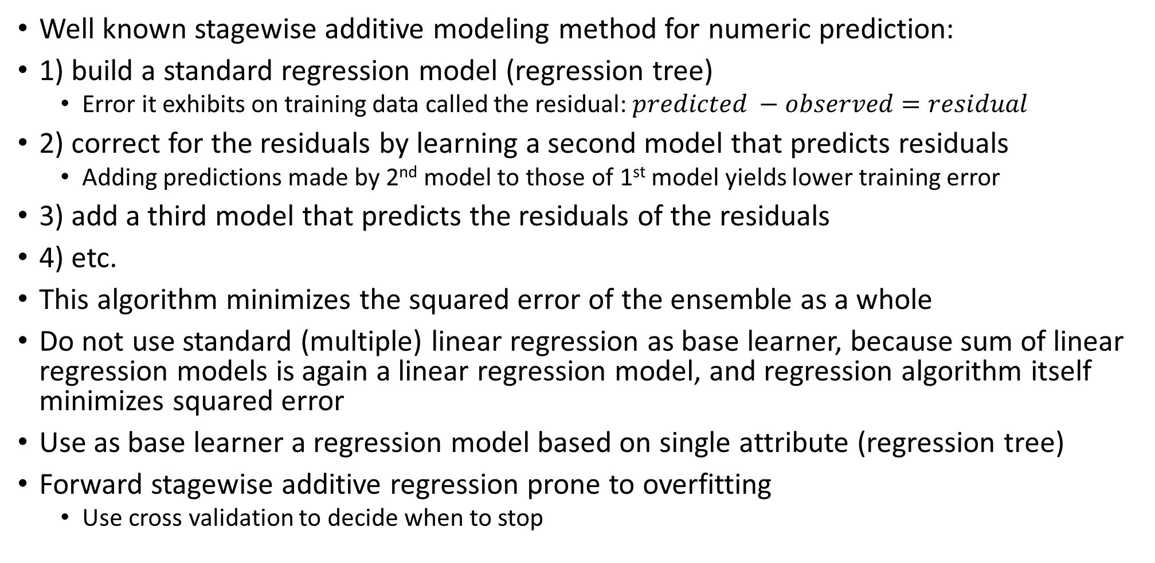
Numeric prediction
Well known stagewise additive modeling method for numeric prediction:
1) build a standard regression model (regression tree)
Error it exhibits on training data called the residual: $predicted −observed=residual$
2) correct for the residuals by learning a second model that predicts residuals
Adding predictions made by 2nd model to those of 1st model yields lower training error
3) add a third model that predicts the residuals of the residuals
4) etc.
This algorithm minimizes the squared error of the ensemble as a whole
Do not use standard (multiple) linear regression as base learner, because sum of linear regression models is again a linear regression model, and regression algorithm itself minimizes squared error
Use as base learner a regression model based on single attribute (regression tree)
Forward stagewise additive regression prone to overfitting
Use cross validation to decide when to stop

Slide 12
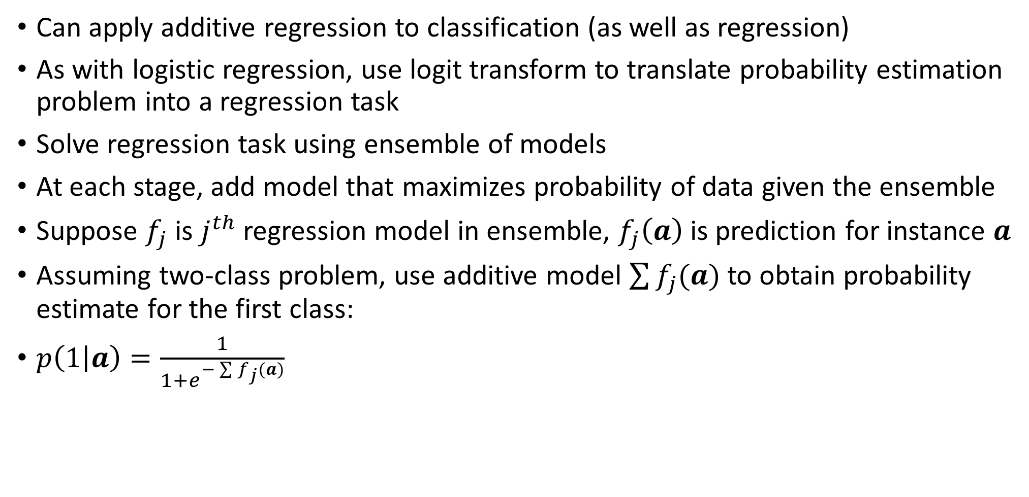
Additive Logistic Regression
Can apply additive regression to classification (as well as regression)
As with logistic regression, use logit transform to translate probability estimation problem into a regression task
Solve regression task using ensemble of models
At each stage, add model that maximizes probability of data given the ensemble
Suppose $f_{j}$ is $j^{th}$ regression model in ensemble, $f_{j}\left(a\right)$ is prediction for instance $a$
Assuming two-class problem, use additive model $\sum{f_{j}(a)}$ to obtain probability estimate for the first class:
$p\left(1 | a\right)=\frac{1}{1+e^{−\sum{f_{j}(a)}}}$

Slide 13
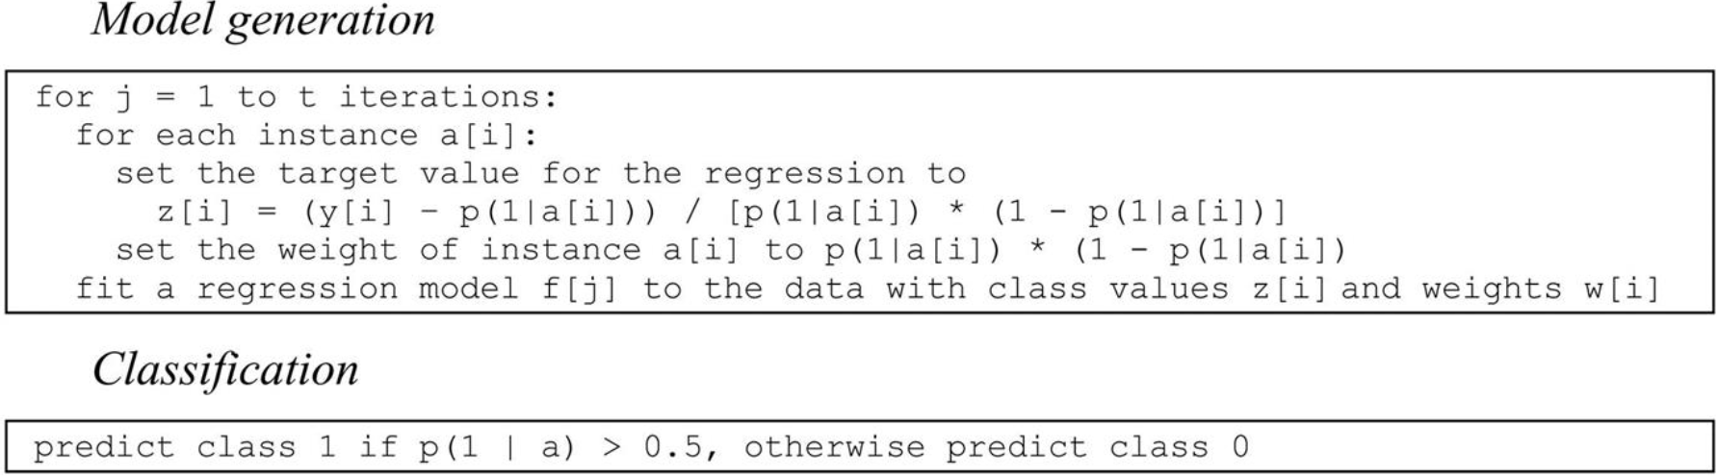

LogitBoost algorithm
LogitBoost performs additive logistic regression, generating individual models $f_{j}$
Here $y_{i}$ is 1 for an instance in class 1, 0 for instance in class 2
In each iteration, algorithm fits a regression model $f_{i}$ to a weighted version of the original dataset based on dummy class values $z_{i}$ and weights $w_{i}$
Assume $p\left(1 | a\right)$ is computed using $f_{j}$ built in previous iterations
Algorithm maximizes probability of data with respect to the ensemble

Slide 14
Interpretable ensembles
Bagging, boosting, and randomization all produce ensembles of classifiers
Ensembles make it difficult to analyze what info has been extracted from data
Would be nice to have a single model with the same predictive performance
One possibility:
1) generate artificial dataset by randomly sampling points from dataset,
2) assigning labels based on ensemble,
3) and then learn decision tree or rules on this artificial dataset
This strategy should replicate the performance of the ensemble, and provides us with a single tree to interpret

Slide 15
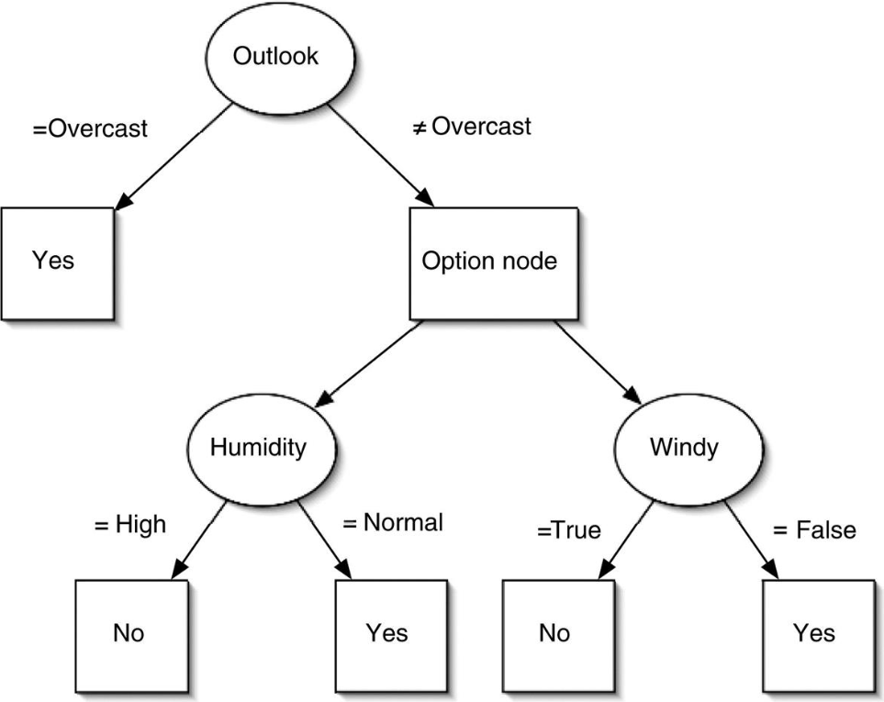
Option trees
Another approach is to derive a single structure that can represent an ensemble of classifiers compactly
If ensemble is built from decision trees, can use an option tree to do this
Option trees contain two types of node:
Decision nodes
Option nodes
At decision node, take a single branch
At option node, take ALL branches
To classify instance, filter it down through the tree, and take majority across class across all leaves

Slide 16
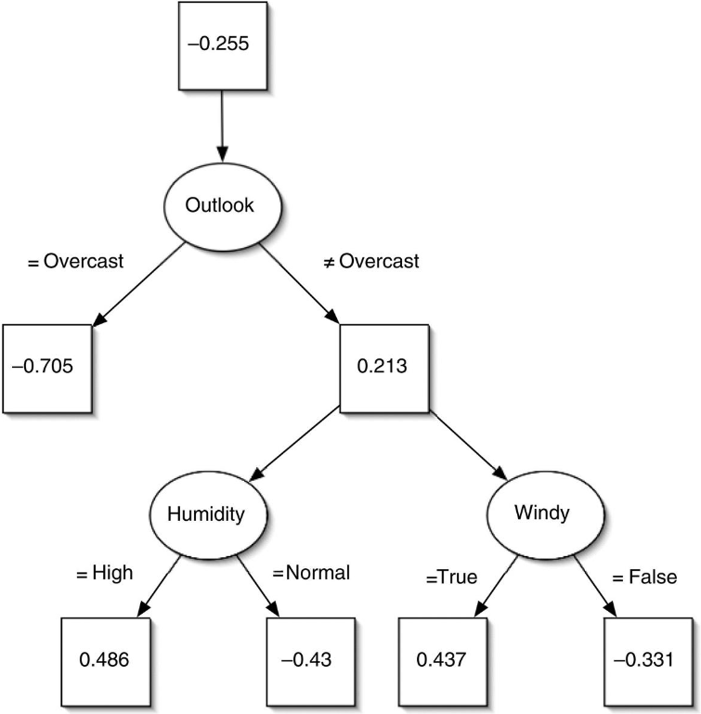
Option trees
Option trees can be generated by modifying an existing decision tree learner to create an option node if there are several splits that look similarly useful according to their information gain
Can also grow an option tree by incrementally adding nodes
This is commonly done using a boosting algorithm, resulting trees are called alternating decision trees
Decision nodes called splitter nodes
Option nodes called prediction nodes
Example: alternating decision tree for weather data
Positive value => play=no
Negative value => play=yes
To classify instance, filter it down the tree and sum all the leaves
Alternating tree grown using boosting algorithm
Assume base learner produces single conjunctive rule in each boosting iteration
Alternating decision tree can be generated by adding each rule into the tree

Slide 17
Stacking
Stacking is a different way of combining multiple models
Unlike bagging and boosting, stacking not used to combine models of same type
Stacking is applied to models built by different learning algorithms
Suppose you have the following:
Decision tree inducer
Naïve Bayes learner
Instance-based learning scheme
And you want to create a classifier for a given dataset
Usual procedure: use cross validation, find which model gives lowest error, use it
A better approach may be to combine the results of all 3 algorithms
Can use voting, but only makes sense if algorithms perform comparatively well
If 2/3 algorithms perform much worse than the third, voting hurts prediction

Slide 18
Stacking
Stacking introduces concept of metalearner, which replaces voting procedure
The problem with voting is we don’t know which classifier to trust
Stacking tries to learn which classifiers are most reliable, using the metalearner
Input to metamodel (level 1): predictions of base model (level 0)
Level 1 instance has as many attributes as there are level 0 learners
Level 1 attribute values are predictions from level 0 learners
How to train level 1 learner?
Simply learning on level 0 predictions inevitably ignores certain classifiers (bad)
Instead, use a validation set to train the level 1 learner:
Train base level 0 models on training set
Level 0 models can also output probabilities
Which model to use as level 1 learner?
Simple linear models, or trees with linear models at leaves usually work well

Slide 19
Summary
Boosting
Iteratively construct classifiers that are complementary, weigh final vote (by accuracy)
Combines weak classifiers to form strong classifier
Stacking
Learn optimal combination of different algorithms using metalearner
Regressor/classifier boosting in sklearn:
https://scikit-learn.org/stable/modules/generated/sklearn.ensemble.GradientBoostingRegressor.html
https://scikit-learn.org/stable/modules/generated/sklearn.ensemble.GradientBoostingClassifier.html
Ensemble methods overview:
https://scikit-learn.org/stable/modules/ensemble.html
Chapter 9 is next (probabilistic methods, math heavy)

